Slide 1



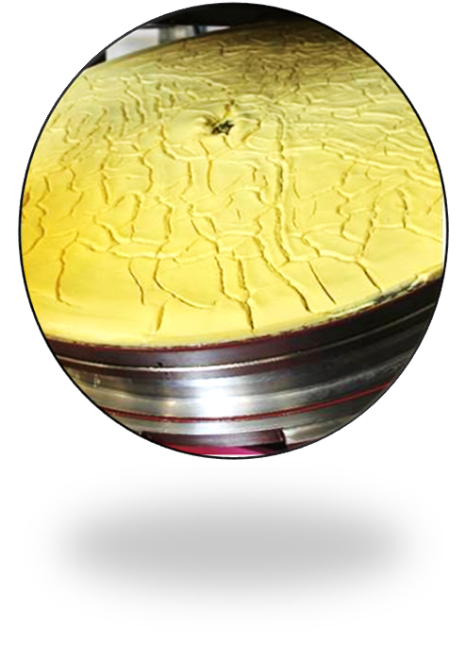
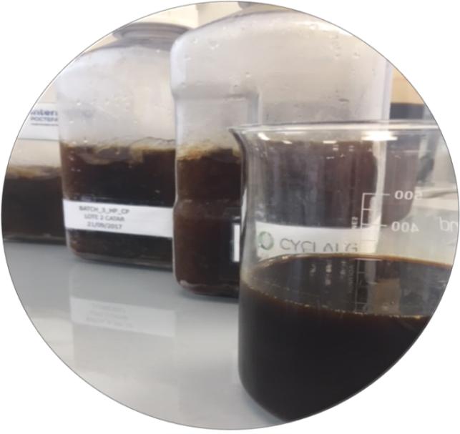
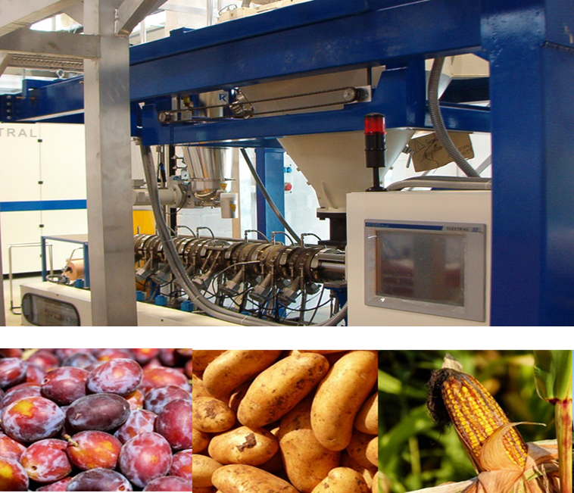
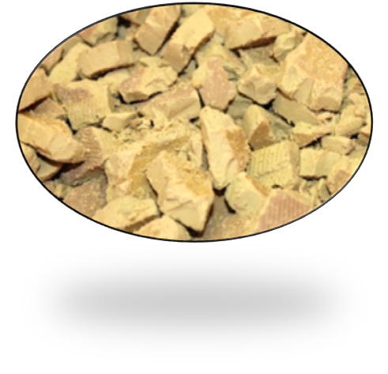
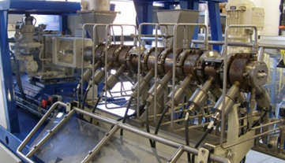
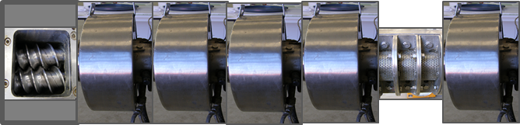
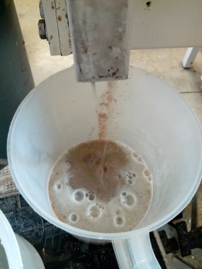
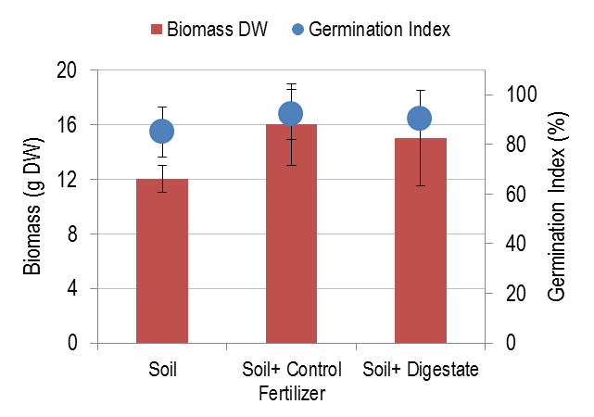
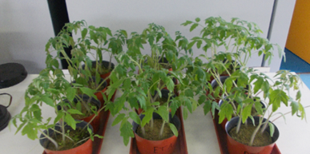
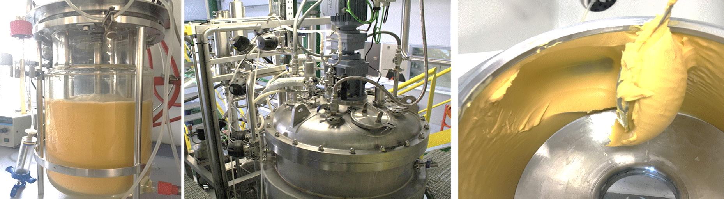
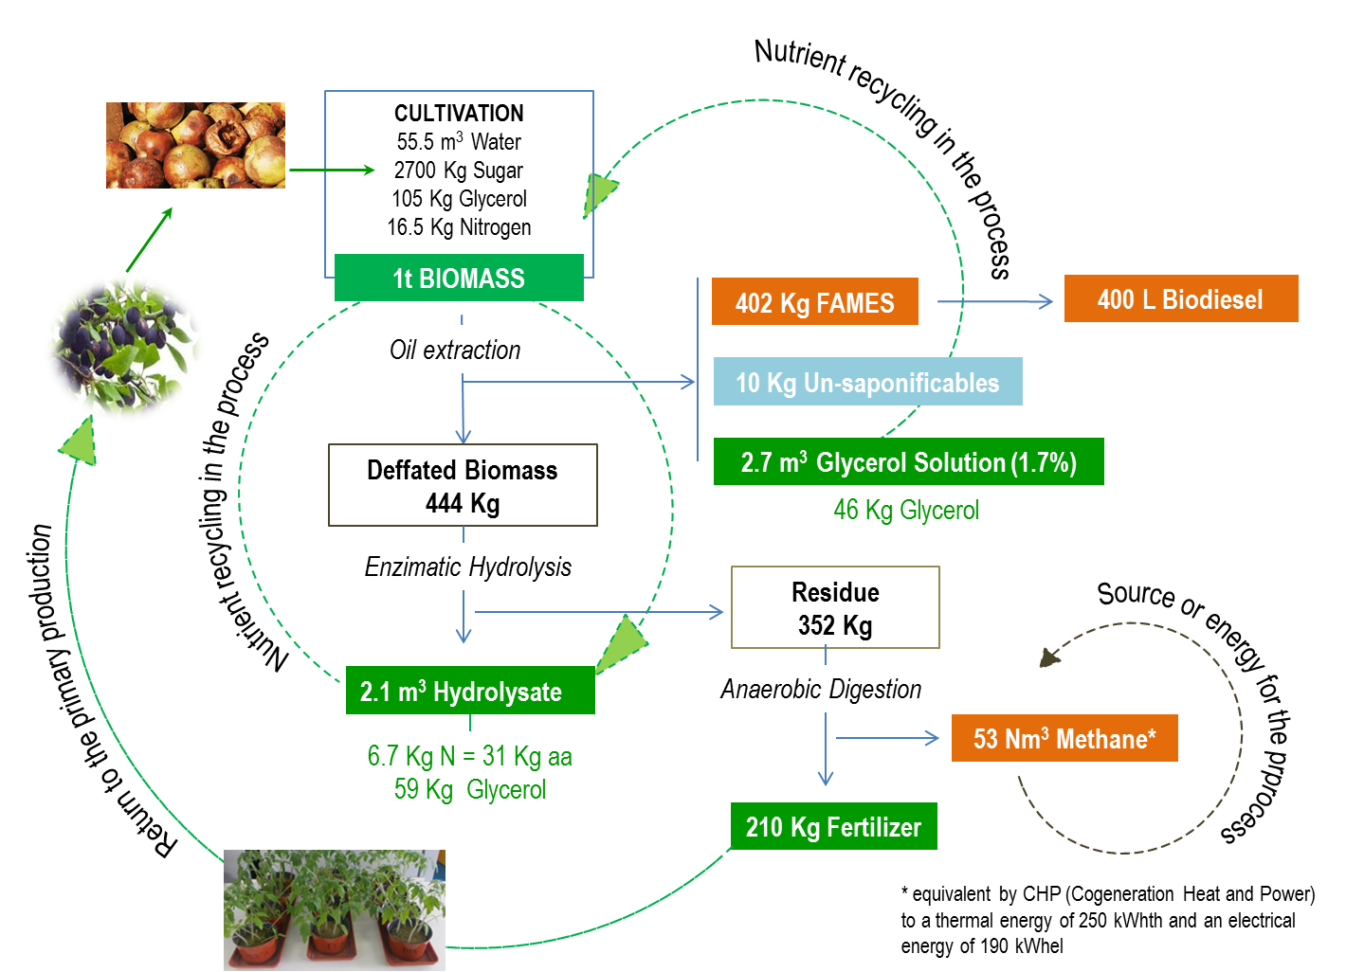
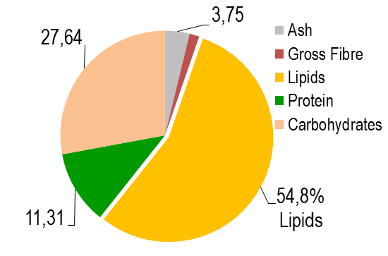
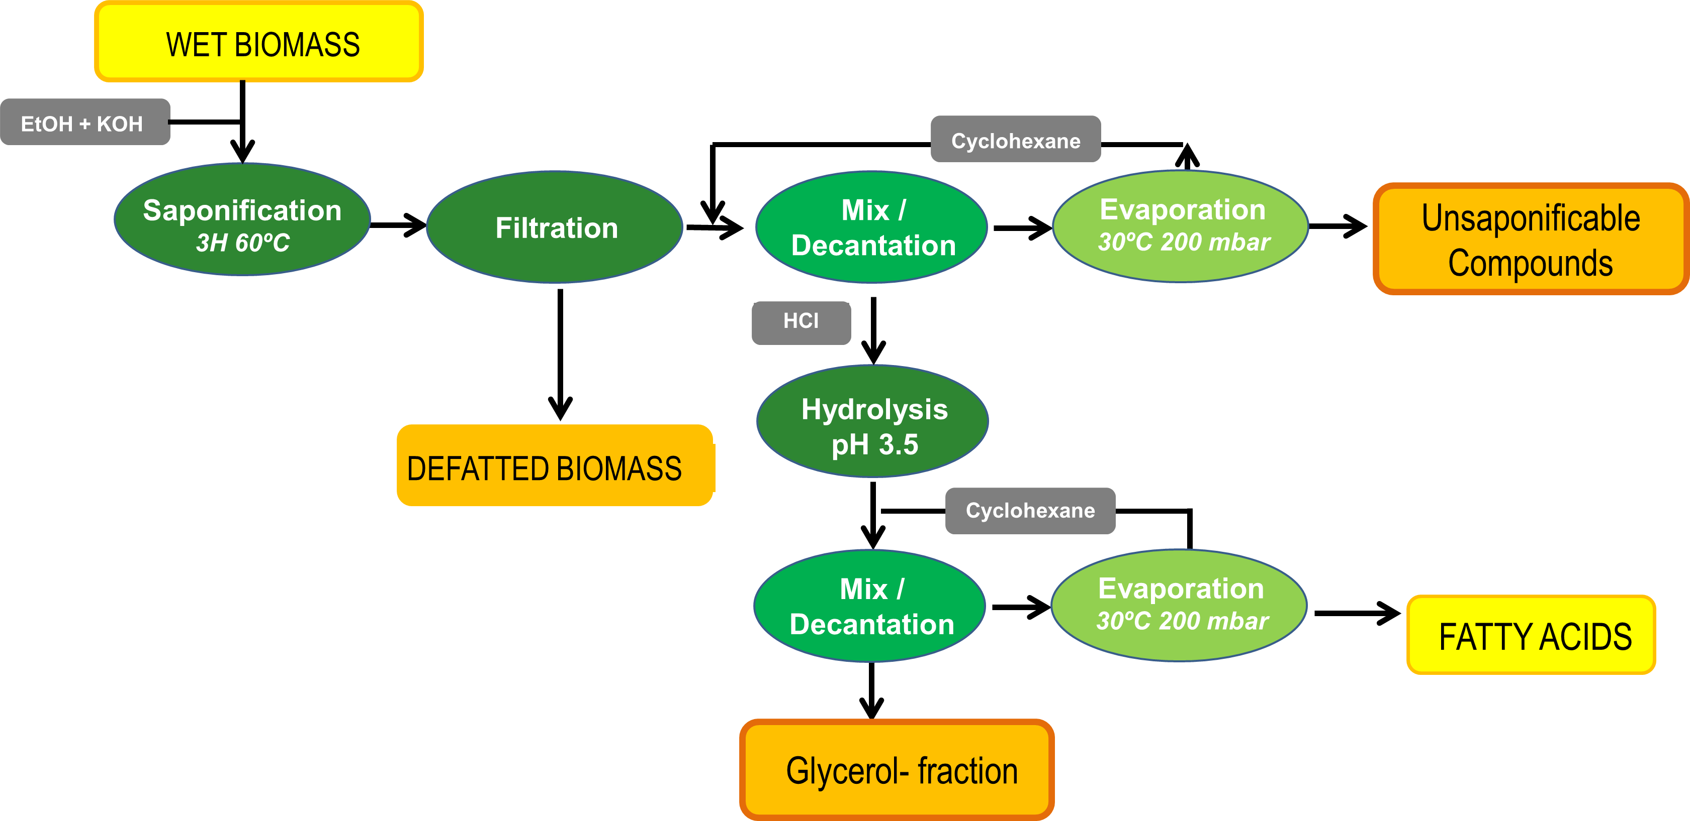
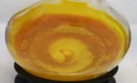
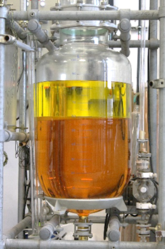
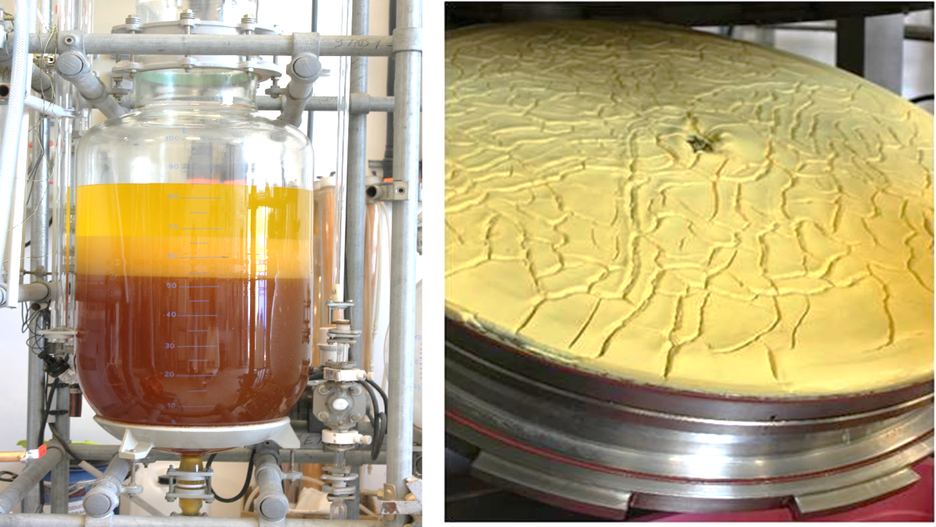

A network of technological centers to develop A microalgal-based biorefinery
INTRODUCTION
4. SEQUENTIAL VALORIZATION OF DEFATTED BIOMASS
It is presented a pilot-scale biorefinery implementation where heterotrophic production of Chlorella protothecoides is combined with the use of agri-food waste as source of nutrients. A subsequent integral processing of algal biomass results in different algae-based products for energetic, chemical and agricultural sectors which brings the process closer to the goal of "zero waste".
4.1. Amino acids recovery by enzYmatic hydrolysis
PRODUCT
RAW MATERIAL
Viscozyme + Alcalase + Flavourzyme
DEFFATED BIOMASS
PROTEIN HYDROLYSATE
COMPOSITION
1. AGRI-FOOD WASTES PROCESSING BY TWIN-SCREW STRUDER
- Total N= 3.2 g/L
- Amino acids = 10 g/L
- Glycerol = 28 g/L
- Glucose =1.5 g/L
FRUIT
WASTE
Solid/Liquid Separation
PROTEIN-EXTRACTED RESIDUAL BIOMASS
Input
Extruded
Residue
4.2. Anaerobic
digestion
HYDROLYSATE
RAW MATERIAL
BIOGAS
Solvent:
water
At Continuous Pilot Scale
196 Nm³ CH₄/T Organic Matter
Figure 1. Scheme of fruit waste hydrolysis by extrusion process. Raw material (plums) was supplied by a local French Fruit Processing Company.
COMPOSITION
Figure 4. Cascade-valorization of de-fatted biomass: 20% was turned into a nutrient-rich solution and the remaining 80% was anaerobically digested for the production of biogas.
Biogas digestate was tested as soil fertilizer in tomato seed–bed with comparable results to those of a commercial fertilizer.
- Glucose+Frutose= 230 g/L
- Amino acid = 9.7 g/L
DIGESTATE (FERTILIZER)
2. HETEROTROPHIC PRODUCTION OF C.PROTOTHECOIDES BIOMASS
Scale up: 5-L to 1000 L Fermenters
5. IMPLEMENTATION IN AN INTEGRATED BIOREFINERY APPROACH
Fruit Waste
Figure 2. Biomass chemical composition.
3. OIL EXTRACCTION: BIODIESEL AND 3 CO-PRODUCTS
②
①
Source of bioactive molecules
STEROLS, CAROTENOIDS
Figure 5. The applied biomass exploitation scheme, allows reaching four closed loop-flows for nutrients and energy. The product yields per ton of dry-weigh produced biomass (at pilot scale) are indicated
③
BIODIESEL
PROPERTIES (EN14214)
CONCLUSIONS and FUTURE PROSPECTS
Figure 3. Scheme of the used oil extraction process showing the four resulted products: fatty acids suitable for biodiesel production and 3 recoverable co-products.
The implemented biorefinery scheme offers potential to increase the sustainability and economic feasibility of microalgae-based biodiesel industries. Techno-economical analysis and Life Cycle Analysis is being conducted.
Alternative uses for de-fatted biomass (e.j. feed) and for glycerol fraction (e.j. building blocks production) will be evaluated.
The project CYCLALG: A network of tecnologycal centres to developed a microalgae biorefinery. (EFA037/15) has been 65% cofinanced by the European Regional Development Fund (ERDF) through the Interreg V-A Spain-France-Andorra programme (POCTEFA 2014-2020).

