Slide 1

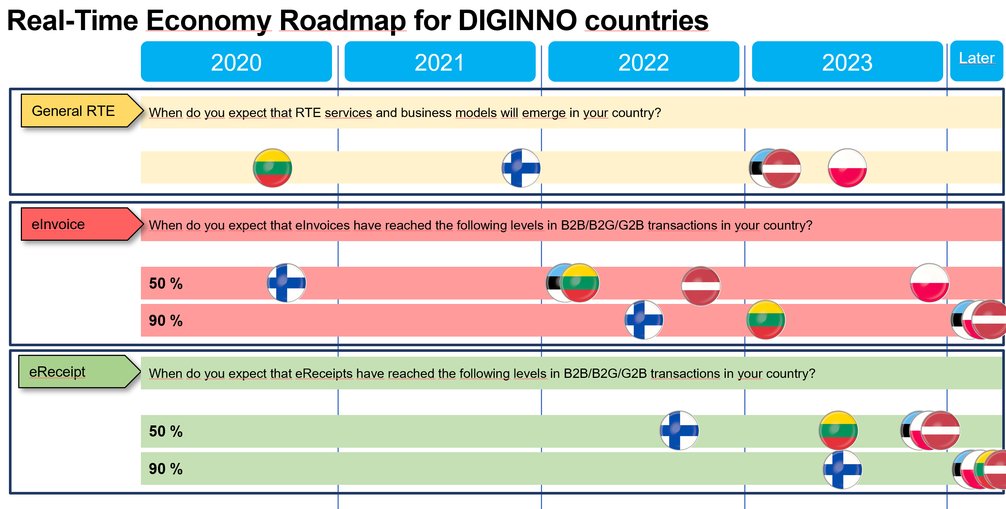
Showcase D: Borderless Real-Time Economy (RTE)
How to continue?
Notes:
Overall targets:
make life simpler for SMEs
Integrated Nordic region

