Slide 1


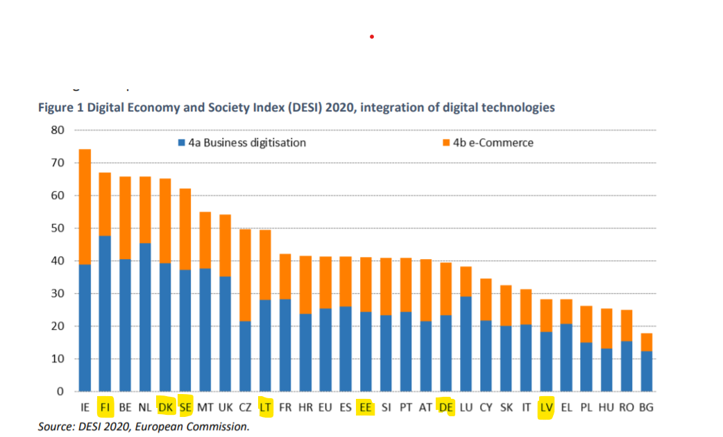
DIGINNO conference 15 Dec 2020, Torben Aaberg, AAU

Slide 2
EXAMPLES OF CHALLENGES Obstacles for increased ICT uptake in SME’s Less attention to advanced technologies Inadequate ICT infrastructure Barriers created by regulation Lack of financial instruments Lack of qualified labour force Obstacles for SME cross-border operations Insufficient cross-border interoperability between national e-government infrastructures For industry: Difficult to access new markets High costs of cross-border operations For governments: Difficult to share data across borders High transaction costs across borders
DIGINNO conference 15 Dec 2020, Torben Aaberg, AAU

Slide 3
EU policies
Industry digitalisation
Digitising Europe Initiative
Digital Innovation Hubs, PPP platforms etc.
Cross border connectivity
European Interoperability Framework
Digital Single Gateway, Once Only Principle etc.
National policies
Industry digitalisation
Digitalisation strategies
Industry 4.0 platforms, SME funding schemes, IT education upgrade etc.
Cross border connectivity
National G2B services
DIGINNO conference 15 Dec 2020, Torben Aaberg, AAU

Slide 4
ARE POLICIES EFFICIENT?
Industry digitalisation
Instruments offered may not address the needs of SME’s
Not sufficient cooperation between national Industry 4.0 platforms
Policies inadequate to solve cross-border challenges
“Today activities exist mostly still in silos: cross-border collaboration is scarce and the understanding of industrial strategy diverges across EU countries...” (DIGITAL EUROPE)
Cross-border e-services for business
EU regulations interpreted and implemented differently.
Each country “pick and choose” e-services based on national approach and thematic priorities
“Technology is there but difficult to agree on which services to prioritise …”
Tendency of prioritising national-centric services that do not address cross-border connectivity
“Why waste taxpayer’s money to change our national system unless there are obvious advantages?”
DIGINNO conference 15 Dec 2020, Torben Aaberg, AAU

Slide 5
IDEAS FOR TRANSNATIONAL SOLUTIONS (EXAMPLES)
Industry digitalisation
Harmonise legislation or administrative practices
Connect existing meeting places (networks, platforms)
Upgrade collaboration SME’s and knowledge institutions
Joint actions to promote labour mobility in BSR
Approaches that work in one country may also work in another country: Explore!
Cross-border G2B services
Concrete business cases as examples of how solutions can be collectively developed
Ministries and industry from different countries together develop pragmatic solutions
Process for increasing interoperability; legal, organisational and technical aspects
How to balance national priorities with transnational priorities..?
DIGINNO conference 15 Dec 2020, Torben Aaberg, AAU

