Slide 1




Digitalization of cross-border G2B public services (WP3)
Outcomes of 4 show-cases
DIGINNO Final conference 2020 December 15th

Slide 2
PRESENTATIONS:
Outcome 1: Cross-border E-CMR outcome & DIGINNO-Proto spin-off - Rūta Šatrovaitė-Bulbovienė, WP3 Lead, INFOBALT (Lithuania) & Inna Nosach, Project Manager, Ministry of Economic Affairs and Communications (Estonia)
Outcome 2: Cross-border KYC - Rainer Osanik, R.O.S Law Office OÜ (Estonia)
Outcome 3: Cross-border business registration - Idongesit Williams, AAU (Denmark)
Outcome 4: Cross-border eReceipt - Risto Lehtinen DIMECC Oy (Finland)
QUESTIONS ADDRESSED
1. Motivation to develop the selected e-services
2. Results achieved during the project
3. Road ahead (next activities planned)

Slide 3
Cross-border eCMR - towards paperless logistics with BSR and across its borders by Rūta Šatrovaitė-Bulbovienė

Slide 4

Why we decided to develop the eCMR?
Because we wanted to help:
1. our region and countries to gain competitive advantage in logistics sector
2. our businesses to become more efficient
3. our employees (drivers) to get their job quick
Notes:
Transport and logistics creates a significant value of BSR GDP (e.g. Lithuania 13 percent)
Not paper is a problem, but the process shaped by the paper documents. The same document is printed and handed to different authorities at least 6 times during on logistics operation. 99 percent of cross-border logistics operation involve paper documents.
To avoid personal contact relevant during COVID-19, consentrate on their main work, avoiding additional work.

Slide 5

Results of our 3 years work
Feasibility study on eCMR progress in BSR region and recommendations for the implementation
Architecture model of eCMR data exchange platform
eCMR prototype development and testing between Estonia, Latvia, Lithuania and Poland (spin-off project DIGINNO-Proto)
Political engagement
Transnational community of stakeholders
Follow up projects, e.g. DINNOCAP next steps of eCMR testing, national initiatives (Recovery and Resilience Fund allocation to eCMR national access point development in Lithuania)

Slide 6
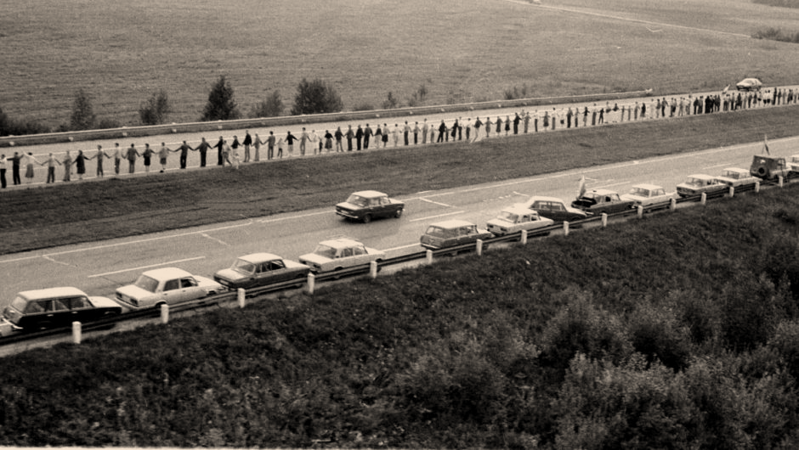
2021
2nd phase eCMR testing in BSR and expansion of the prototype to other regions
Implementation of eCMR solution between at least 2 BSR countries
2021- 2022
2024
2023
Expansion of solution to EaP and other EaP countries
Align eCMR prototype with eFTI regulation

Slide 7
Cross-border KYC service
By Rainer Osanik

Slide 8
Why KYC is a problem?
KYC process is currently suffocating the economy
The obliged entities are spending billions of euros to collect KYC data
The same data is asked again and again and again...
It is not exchanged in between the obliged entities
It does not flow cross border
There is no unified/standardized KYC process
The States have most of the data needed for KYC, but it is not accessible

Slide 9

From vision to solution
With International workgroup we agreed principles for future ideal cross-border KYC service
We made feasibility study and policy recommendation
Latvia and Estonia have started to adopt policy recommendations and to develop KYC utilities which follow main principles from DIGINNO ideal cross-border KYC service
Local prototypes have been already made and tested
Nation wide KYC utility production has been started

Slide 10


Slide 11
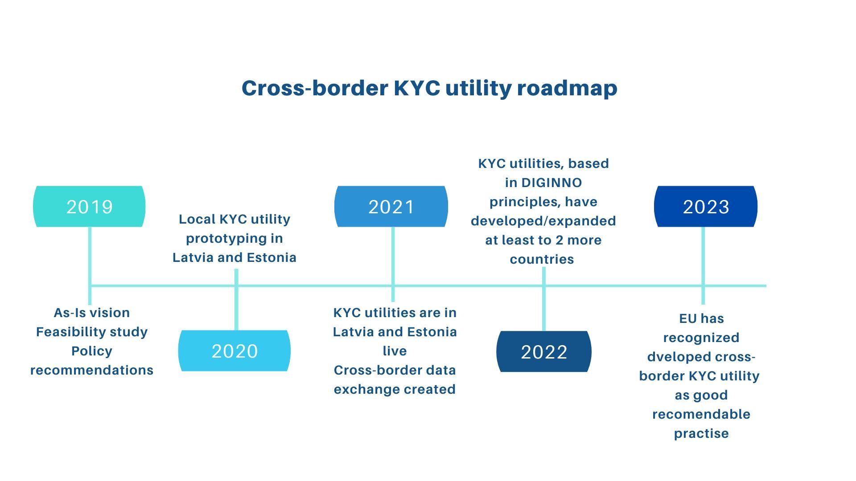
A way ahead

Slide 12
Cross-Border Business Registration with Integrated eIDAS Framework by Idongesit Williams

Slide 13



Cross-Border Business Registration with Integrated eIDAS Framework
Targets of the solution:
Business registrars in the BSR and EU.
BSR/EU SMEs.
Tasks:
Develop a cross-border network that will enable:
The technical link between the national systems.
Cross-border identification, access/transactions and language translation possibilities.
Recommend harmonization policies that will enable the system to operate.
Problems encountered by the Business registrars :
The technical inability to ascertain Cross-border identity of foreign SMEs.
The technical inability to provide access for foreign SMEs to perform transactions.
Language barrier.
Problems encountered by SMEs
Most SMEs reps face market entry barriers related to:
  Differences in national Residence requirements and technical systems.
  Differences in national Identity requirements and technical systems.
  Differences in national taxation requirements and technical systems.
  Minor differences in national business registration process.
  Language barrier.

Slide 14

Cross-Border Business Registration with Integrated eIDAS Framework
Solution developed: An Intelligent multi-lingual cross-border business registration Infrastructure.
Nature of the solution
The solution is equipped with a context broker, Message Broker and eIDAS to facilitate aggregated search, cross-border transaction, identity and access management functions respectively.
Functionality and value of the solution :
Reduce some of the barriers to Cross-border mobility of SMEs.
Enable SMEs within the EU register their business in other jurisdiction without having to travel there.
Facilitate some form of legal, technical, operational and semantic interoperability between the business registration infrastructures in the BSR and EU.
Notes:
Airi – staus quo of the progress reports.
Idongesit –on eIDAS, September – a deadline for countries to notify EU about eiDAS nodes?
Cooperation with NCM. Proposal for extra funding. No final decision. The proposal for our side was send;
High level e-Government conference in Vienna. Who is going? Maybe they can ask if other PP could receive the invitation?
WP4 –Torben de facto joint Aalbourg unviversity. Will it cause any changes for WP4 activities?

Slide 15
Proposed Business Registration Showcase Roadmap
Integration of infrastructure with that of the Single Digital Gateway
Development of DIGINNO policy recommendations for the showcase
Development of governance framework for the infrastructure.
2020
2022
2019
2021
2023
Establishment of agreement by EU member states to implement the infrastructure.
Development of infrastructure
integration of infrastructure with business registrars

Slide 16
Borderless Real-Time Economy (RTE) eReceipt show case by Risto Lehtinen

Slide 17

Borderless Real-Time Economy (RTE)
Motivation
The states, companies, and citizens spend too much time and money on activities that would work better in real time and if performed in a secure and automatic manner.
In an RTE ecosystem data moves in real time in a digital, structured and standardized format.
In RTE, data exchange processes are fully automated (i.e. machine-to-machine communication).
Benefits of RTE:
  Simplifies business processes
  Saves resources on maintenance and support activities
  Helps companies focus on their main business activities
Challenges to wide adoption:
  No nationally or internationally agreed standard for eReceipts.
  No standardized addressing logic or identification tools nationally or internationally.
  No commonly used infrastructure for exchanging eReceipts nationally or across borders.
  Lack of service providers, so e-receipts are typically exchanged using the 3-corner model or through point-to-point roaming channels.

Slide 18
Showcase D: Borderless Real-Time Economy (RTE)
eInvoice
eReceipt
Real-time payment eProcurement eSalary
eAddress
eID
eSignature
eAccounting
eReporting
eForecasting
…
What was done?
Selected focus: eReceipt (a structured, digital proof of a paid purchase that allows businesses to automatically exchange financial transactions and data in public and private sectors both within and across borders)
Activities:
Document the current situation and on-going RTE activities in the BSR (“As-is”).
Identify how to improve and harmonize the overall situation (“To-be”).
Use technological, legal, and financial viewpoints.
Identified implementation challenges:
Lack of/low political will and unsupportive regulations/legislation.
Lack of critical mass of users (countries, companies, people).
Lack of cooperation between service partners (both public and private).
Low number of integrations and system updates from the service providers.
Complex and resource-intensive integration to retailer’s databases.
Lack of cost-effective business models for service providers.

Slide 19
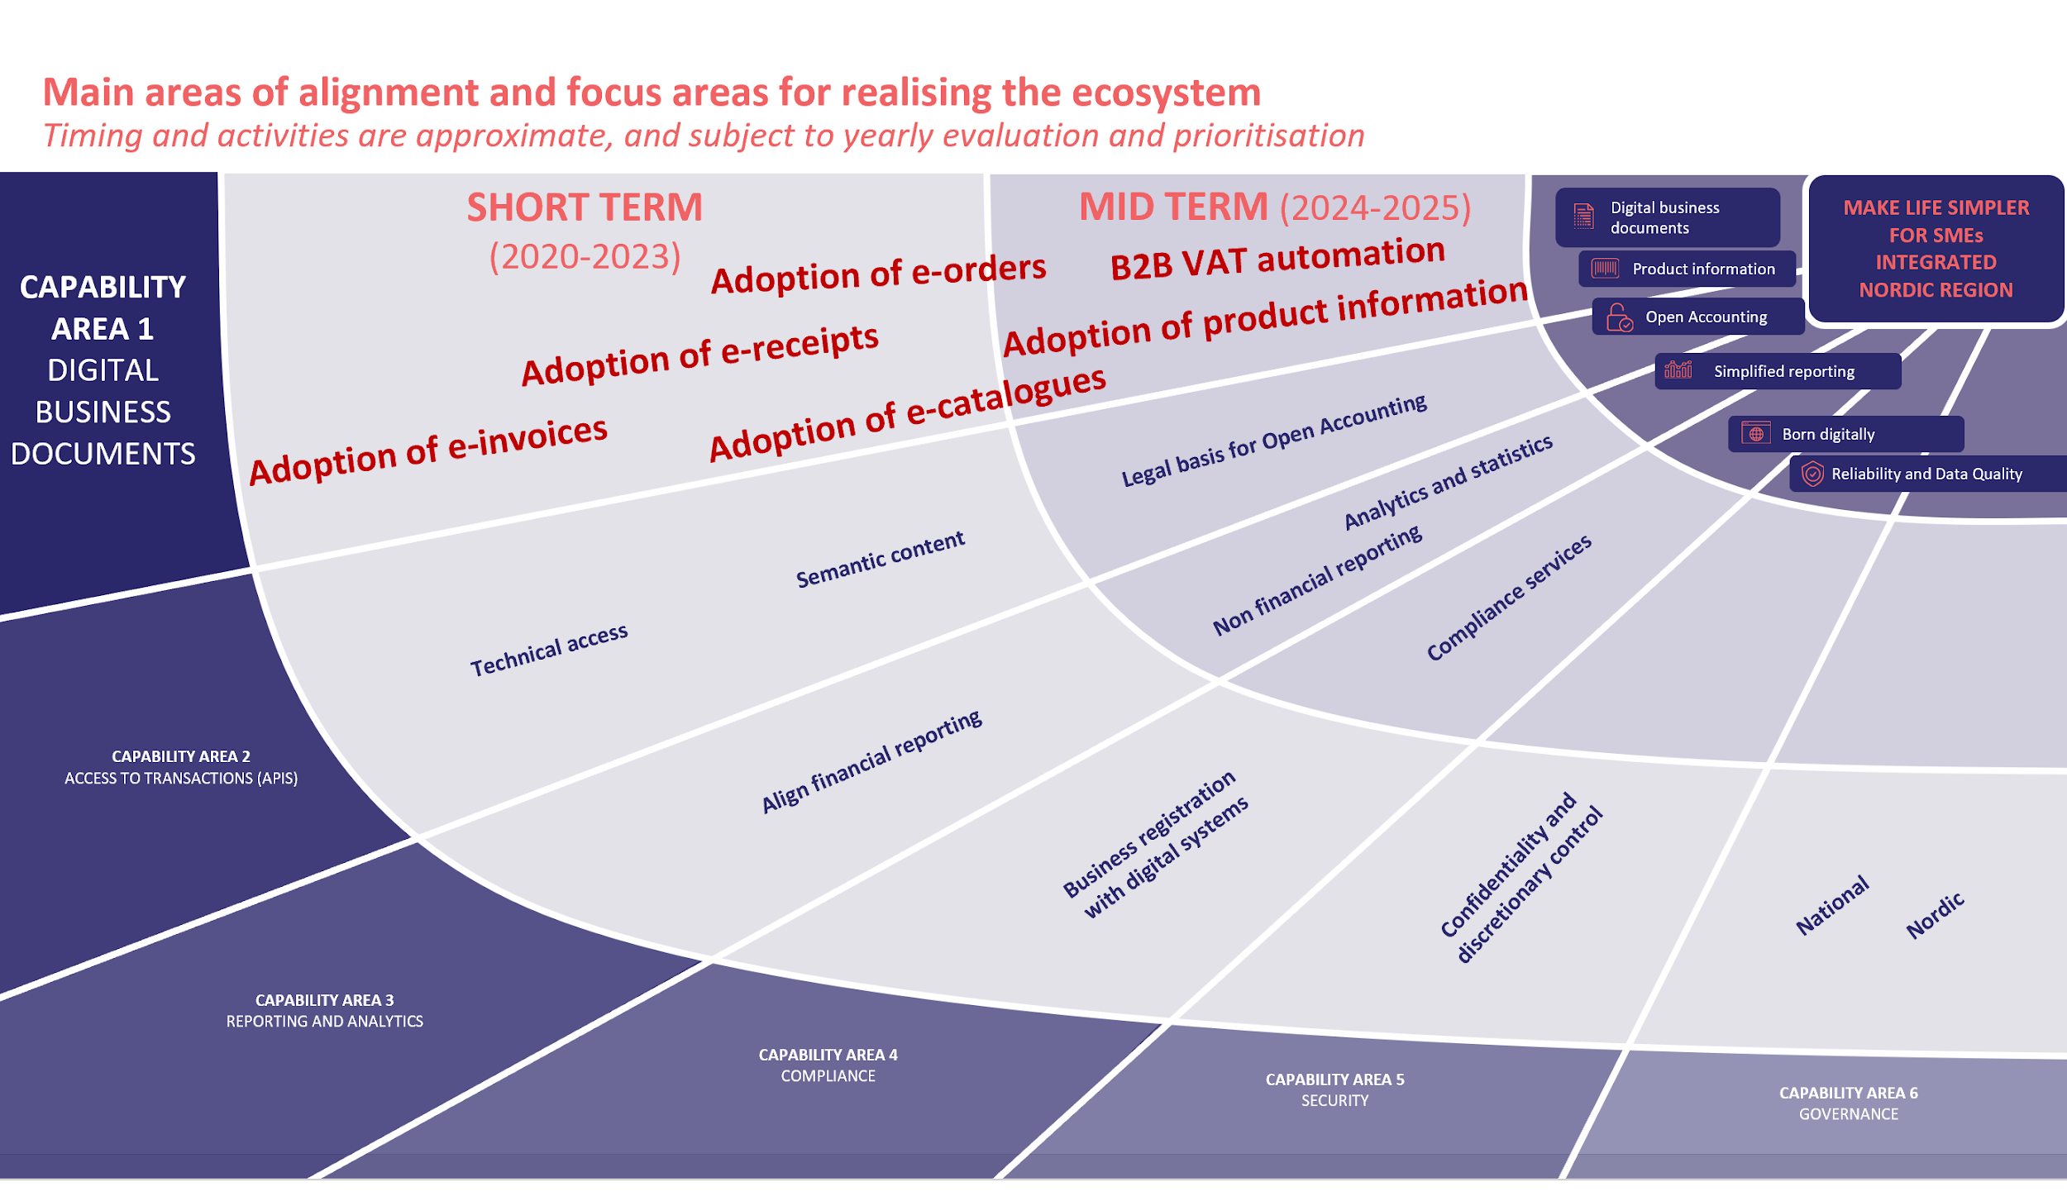
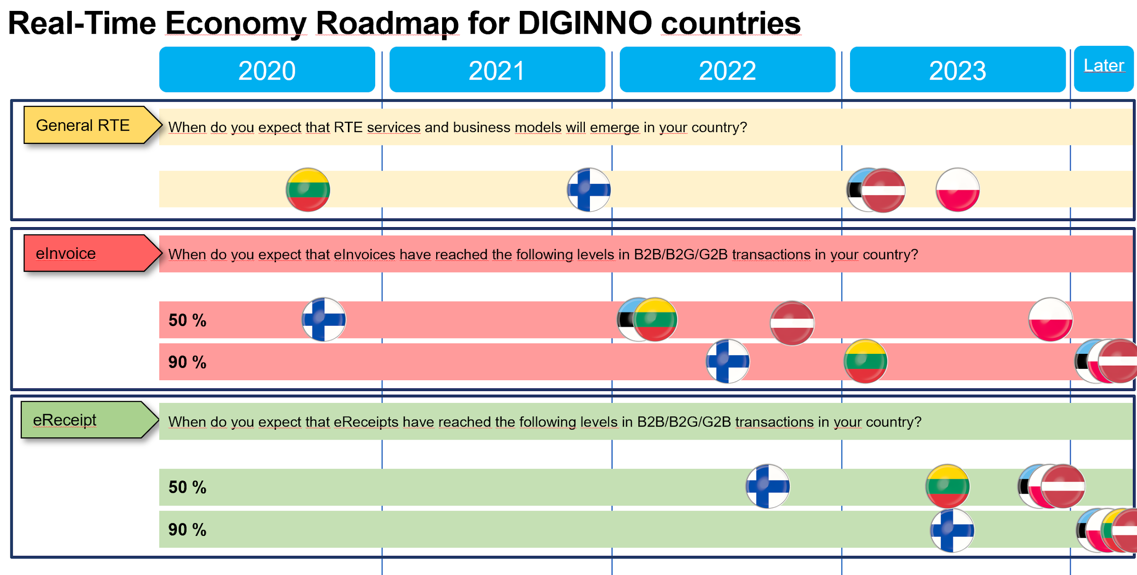
Showcase D: Borderless Real-Time Economy (RTE)
How to continue?
Notes:
Overall targets:
make life simpler for SMEs
Integrated Nordic region

Slide 20
If you have any questions or need further information, please feel free to contact:
Rūta Šatrovaitė-Bulbovienė (ruta@infobalt.lt) & Inna Nosach (Inna.Nosach@mkm.ee)
Rainer Osanik (rainer.osanik@roslaw.ee)
Idongesit Williams (idong@es.aau.dk )
Risto Lehtinen (risto.lehtinen@dimecc.com)

