Slide 1


Building cross-border digital self-assessment tool for industries - values and lessons learned
Dr. Māra Jākobsone, Vice President LIKTA

Slide 2

DIGINNO ONLINE SME DIGITAL
MATURITY RECOMMENDER TOOL
Awareness raising for SMEs
Starts a movement (discussion) inside the company towards digitalization
Gives a kick - help to do the first steps
Understanding where your enterprise stands compared with others (the sector, region, turnover, employees)
Concrete links to other tools, sources, online materials etc.
Primarily aimed for the SME’s management level

Slide 3
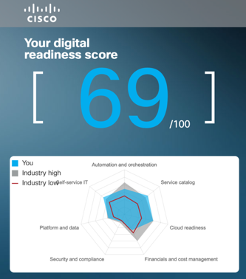
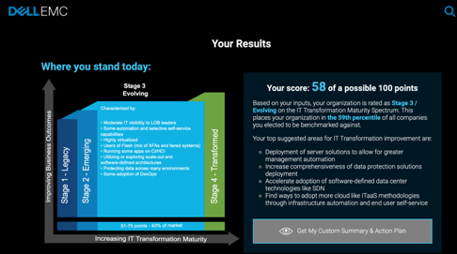
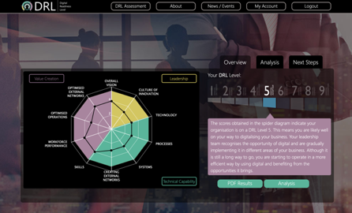
DESK RESEARCH FINDINGS ON EXISTING DIGITAL MATURITY RECOMMENDER TOOLS
Over 20 tools identified and screened
All reviewed tools analyzed together with project partners
Lesson to learn from the Desk research analysis:
Structure of the tool
Methodology of the tool
Result presentation

Slide 4
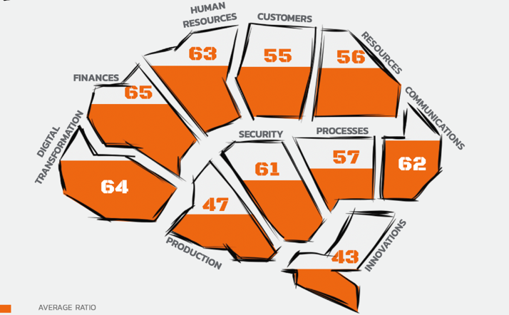
AWARENESS RAISING FOR SMEs
1. Digital transformation and competition
2. Financial data management
3. Human resources environment
4. Customer relationship management
5. Resource management
6. Communication and customer relations
7. Digitalization of processes
8. Security policy and practices
9. Digitalization in production
10. Innovation and growth perspectives
ACROSS 10 BUSINESS DIMENSIONS

Slide 5
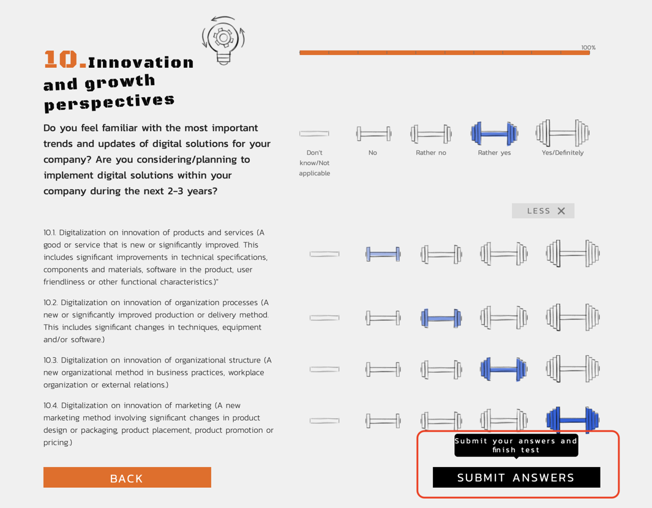

Slide 6
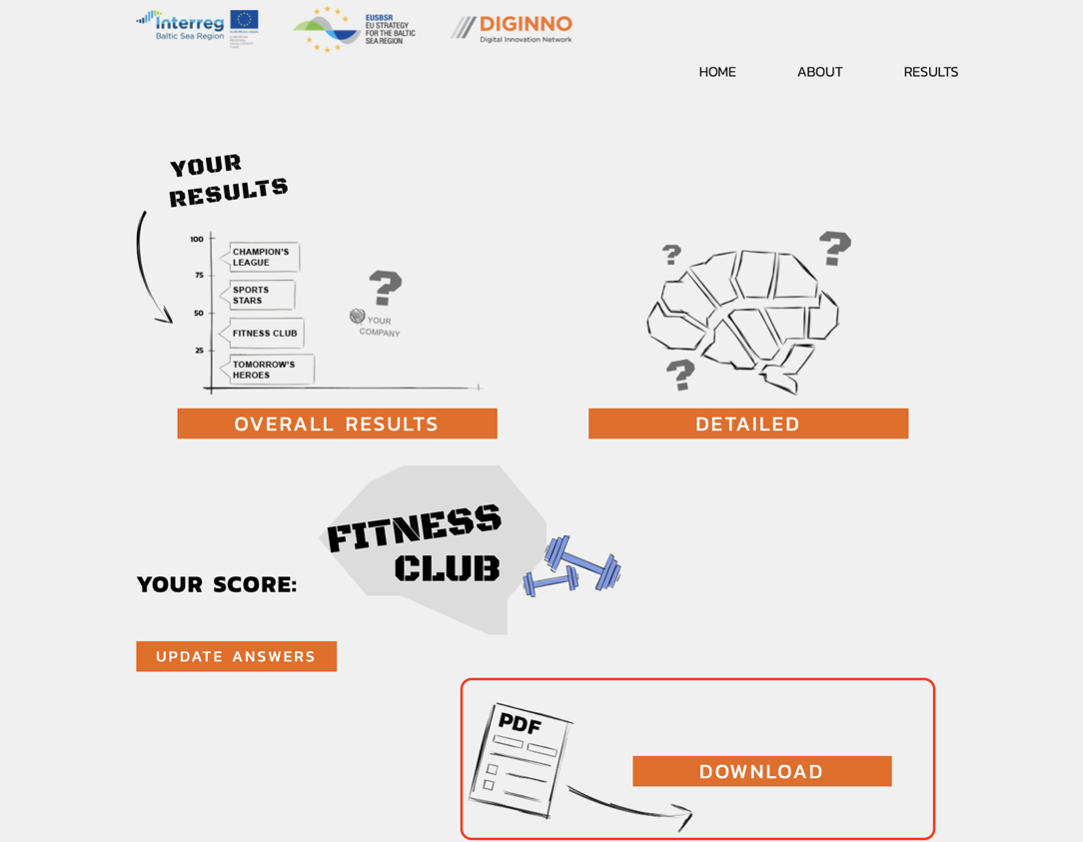

Slide 7
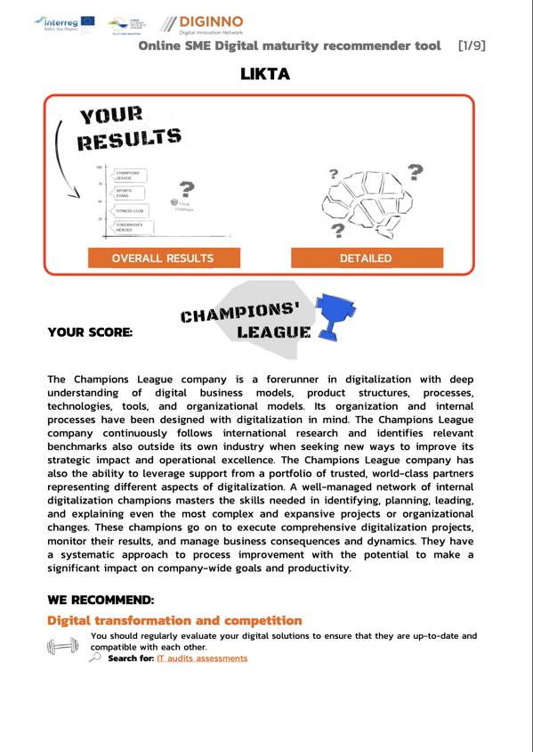
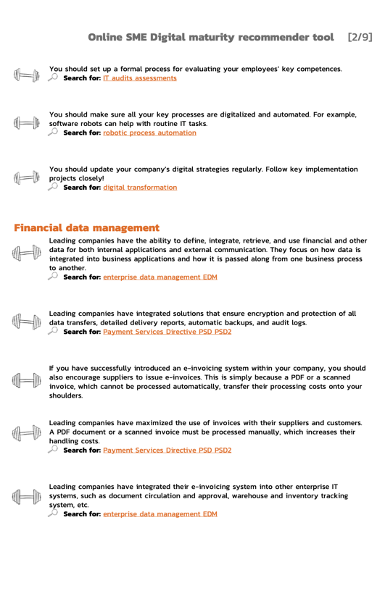
Descriptions of all result categories are available HERE

Slide 8

DIGINNO TOOL COMPARES DIGITAL TRANSFORMATION IN BALTIC SEA REGION COUNTRIES
ENG language version combining all regions
Baltic Sea region versions:
Latvia
Denmark
Estonia
Lithuania
Poland
Sweden

Slide 9

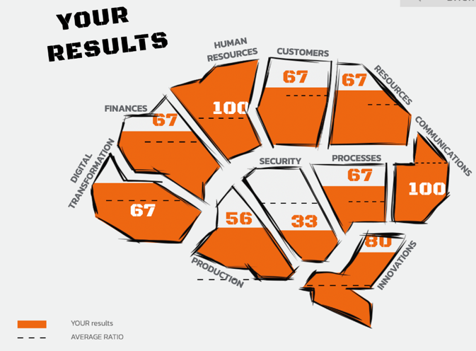
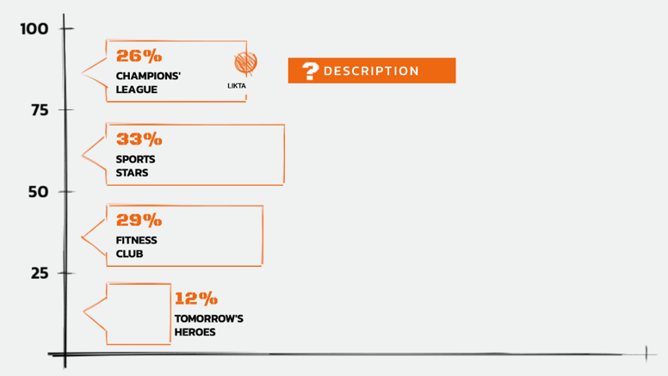
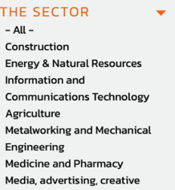
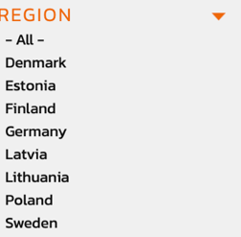
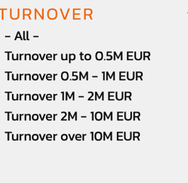
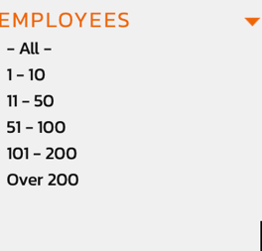
4 RESULT CATEGORIES
Each result category has a detailed description

Slide 10









Over 800
COMPANIES HAVE EVALUATED THEIR DIGITAL MATURITY in LATVIA
8%
Full digital transformation
20%
ONLY A FEW SECTORS HAVE PERFORMED DIGITAL TRANSFORMATION
50%
Basic solutions have been implemented, slowly embracing the latest IT solutions
10%
Basic IT solutions have been implemented
Thinking about the introduction of IT solutions
SECTOR ASSOCIATION SURVEY: LATVIAN COMPANIES IN THE EARLY DIGITAL PATH
THE SURVEY WAS CONDUCTED IN 2019. IN MARCH OF THE YEAR, POLLING 51 INDUSTRY ASSOCIATION EXECUTIVES

Slide 11







THANK YOU!
www.likta.lv
@LIKTA.LV
mara@likta.lv; andra@likta.lv
@LIKTA_LV
+371 67311821, +371 67291896
@The Latvian Information and Communications Technology Association - LIKTA
Notes:
Calibri

