Slide 1

DINNOCAP partners
10 Partners from 8 countries of Baltic Sea Region:
Ministry of Economic Affairs and Communications of Estonia (LP)
Aalborg University (WP 2 lead)
Association Infobalt (WP 3 lead)
Estonian Association of Information Technology and Telecommunications
Latvian Information and Communication Technology Association
Polish Chamber of Commerce of Electronics and Telecommunications
The Bronnoysund Register Centre
Engineering Industries Association of Lithuania
RISE Research Institute of Sweden
Association of SMEs Support Centres in Kaliningrad region

Slide 2
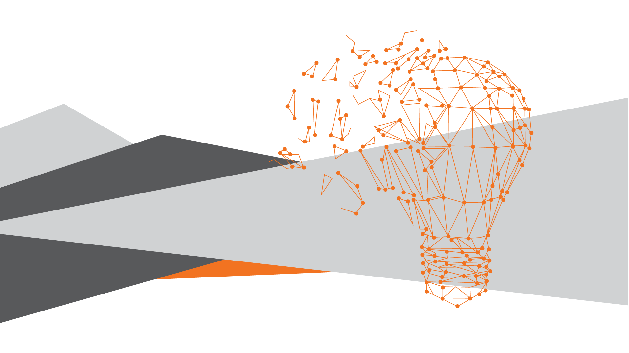
Main goals of DINNOCAP project
Build on the outcomes of DIGINNO
Non-technological innovation based on increased capacity of innovation actors (SME’s, Industry associations, Public Sector)
Extending the outputs and sharing the practices to Russia
Activities divided to 3 work packages:
WP1 administrative management
WP2 Digital Transformation through stronger BSR community
WP3 Digital Transformation of public services delivered by SME’s

Slide 3
WP2 - Digital Transformation through stronger BSR community
DINNOCAP will utilise main outputs of DIGINNO for supporting the implementation of concrete tools to facilitate digitalisation, evaluate the processes and helping to reach across borders.
Outputs:
Action plan: transnational Industry dialogue, action and policy support
Practical learning points and recommendations helping to uptake digitalisation
Online Maturity Tool evaluation report
Digital transformation instruments

Slide 4
WP3 - Digital Transformation of public services delivered by SME’s
DINNOCAP will build on data exchange platform, eCMR platform and test data exchange between service providers and governmental institutions
Outputs:
Practical method of data exchange G2B
A methodology for transnational governance framework
Consolidated stakeholder community, i.e signed letters of intent

Slide 5

How you can help?
Stakeholders and partners will be engaged via workshops and seminars
Give your input and feedback, initiate discussions, spread the word!
Together we can build stronger community!

