Slide 1
Cross-border co-operation for industry digitalization, and new ways of working
– experiences from Fit-for-Baltics Innovation Study
15.12.2020
Doris Pryjma, System manager
DIMECC Ltd. (Finland)

Slide 2
Why ?
DIMECC’s Demobooster concept generated a lot of interest in DIGINNO members
  Some DIGINNO members attended a Demobooster event as spectators in Finland in 2018.
Could DIMECC Demobooster concept be used in other BSR countries to boost innovation & digitalisation agenda and at the same time connecting larger companies with smaller start-up / scaleup companies?
Could DIMECC Demobooster concept work as copy / paste or are there local limitations in BSR countries, which need to be considered?
Need to find out Demobooster’s fit in Baltic countries
  Understanding local business environment and private & public operators (e.g. mindset)
  Understanding cross-border operation possibilities, requirements and possible limitations
In digital age, it’s best to take ideation to the digital generation, to get their views & ideas to this already established concept

Slide 3
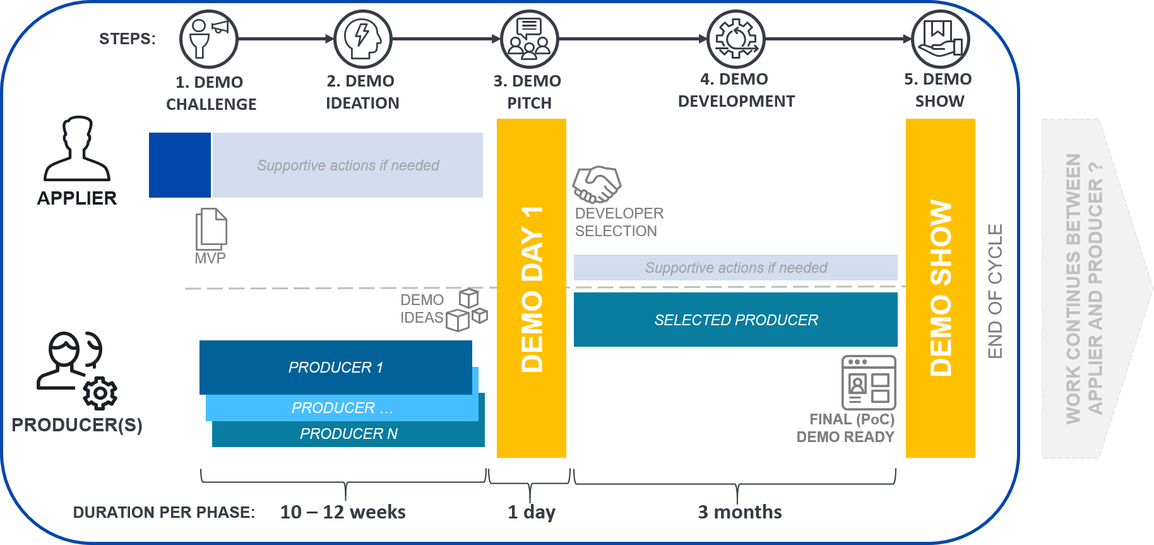
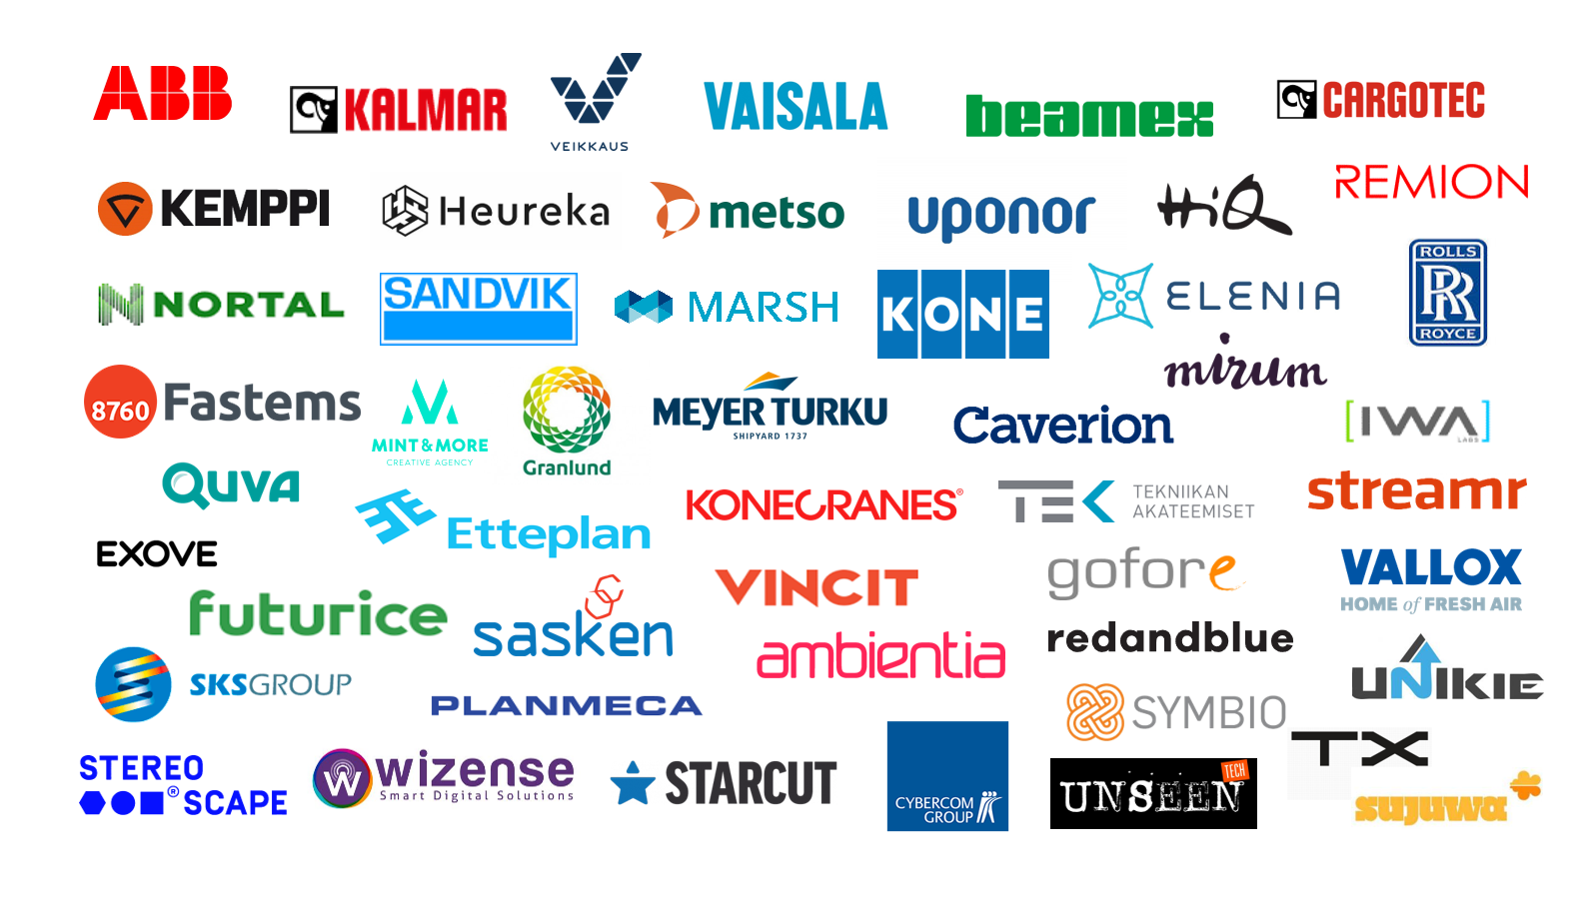
What Demobooster?
DIMECC Demobooster is an innovation platform for manufacturing companies and software businesses, which targets to speed up digital product development activities.
Companies that have participated in Demobooster events either as Appliers or Producers:
*
**
Process cycle of Demobooster
*Applier = Company with challenge
** Producers = ICT companies with solution ideas

Slide 4
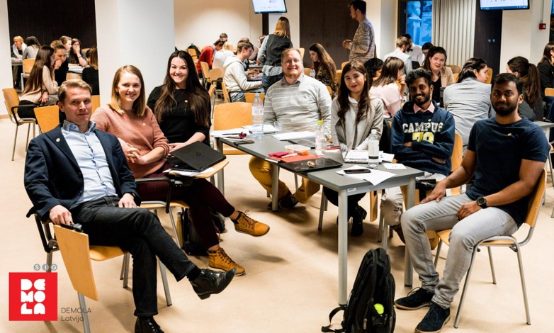
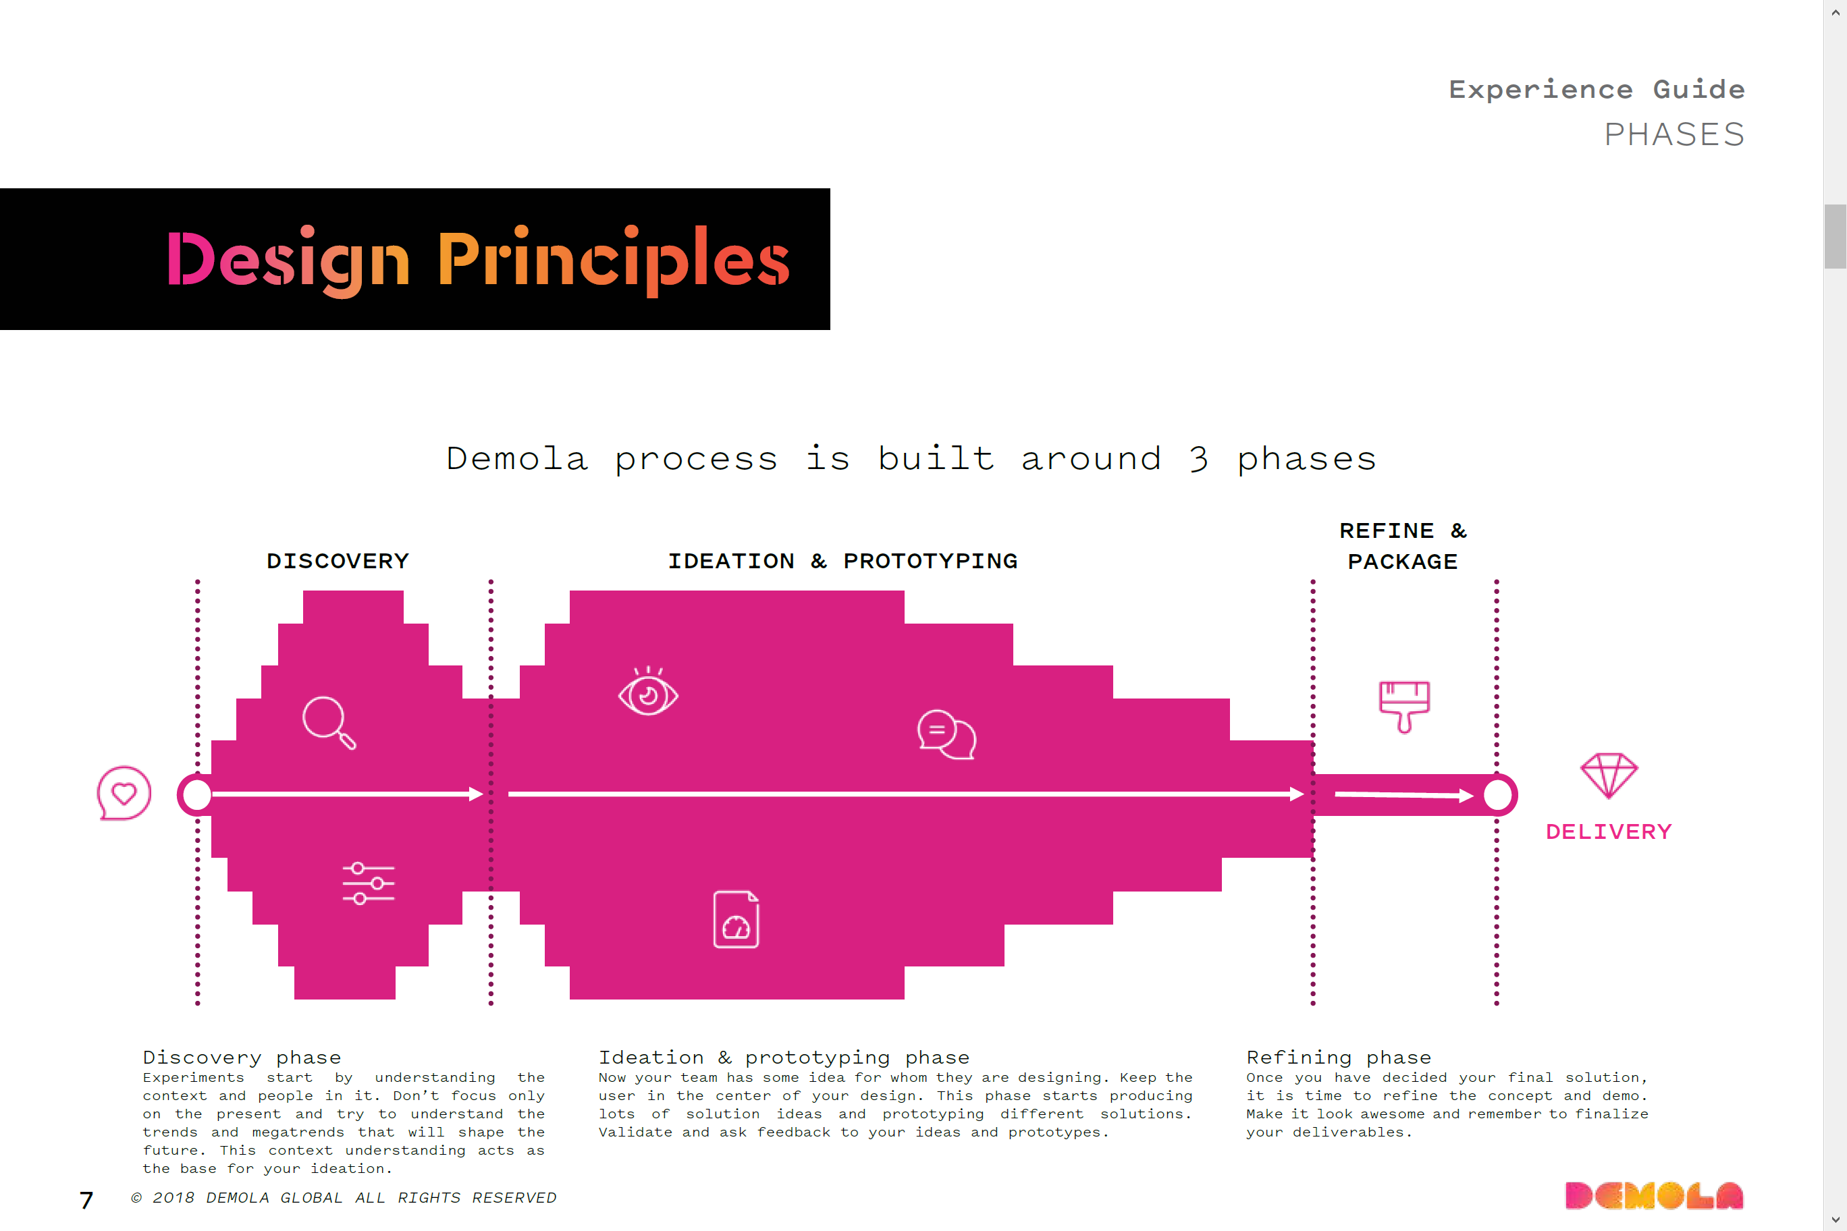

Who & How?
With Demola co-operation we were able to establish centralised facilitation & connection point to digital age student teams in Estonia, Latvia and Lithuania universities.
Executing similar project at same time in 3 countries with 3 separate teams, with co-creation between DIMECC & the local teams + facilitation by Demola.
Raise the challenge to teams, work planned & executed by teams (with Demola co-creation process) and results linked to one joint document to get overall understanding.
Due to COVID-19, local working session had to be replaced with online & remote working → boosting digitalisation in that sense as well
Team Latvia had a chance to meet once in real life before COVID-19, with Demola & DIMECC

Slide 5
Results & insights
Doable, some similar concepts exist
A fully digital, highly-scalable Demobooster platform should be implemented as a core to enable efficient and consistent service experience
Operation through local, established partner with intrinsic motivation, such as Chamber of Commerce, would smoothen the launch phase
Conferences and similar events should be exploited via hackathon-type part of the process to reach customers where they naturally are
Crossborder co-operation was enhanced throughout the project via weekly meetings with DIMECC, Demola facilitator, and students from BSR countries. DIGINNO partners from ITL, LIKTA and LINPRA also provided valuable insight by participating in some of the meetings.

Slide 6
For more information:
Demobooster – DIGINNO Fit-for-Baltics Innovation final report:
https://www.dimecc.com/wp-content/uploads/2020/06/Demola-Final-Report-DIMECC.pdf
DIGINNO best practice post:
https://www.diginnobsr.eu/post/2020/09/01/diginnobest-learning-together-to-enhance-digital-innovation-in-the-baltic-sea-region
DIMECC Demobooster concept:
www.demobooster.com
DIMECC blog about DIGINNO project:
https://www.dimecc.com/keep-on-going-because-the-solution-is-near-even-if-you-dont-see-it-yet/

Slide 7
Thank you!

