Slide 1
Inland Navigation in the Baltic Sea Region Competitiveness Improvement Plan (CIP)
2019-02-15

Slide 2
Content
EMMA in a Nutshell
Competitive Improvement Plans
Baltic Sea Region and International
Conclusions and Recommendations

Slide 3
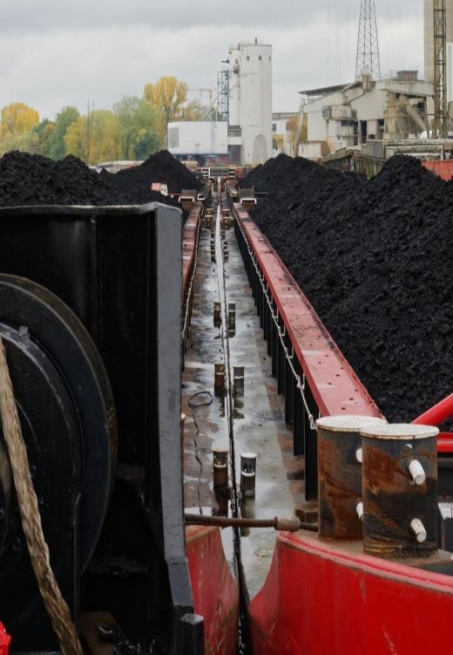
The Interreg Baltic Sea Region Programme Project EMMA
…AIMS TO ENHANCE INLAND NAVIGATION IN THE BALTIC SEA REGION
Enhancing freight Mobility and logistics in the BSR by strengthening inland waterway and river sea transport and proMoting new internAtional shipping services
Lead Partner: Port of Hamburg Marketing
Project Partners: 20 (from DE, FI, LT, PL, SE)
Associated Partners: 45+
Funding Programme: Interreg Baltic Sea Region Programme
Project Budget: 4.42 million € Thereof ERDF co-financed: 3,45 million €
Project duration: 3/2016 – 2/2019
Notes:
How to achive aims?
Pilot actions
to analyse and akquire data
To proof concepts and to demonstrate potentioals
Stakeholder plattform which acts neutral in regar of competition
Exhibitions
Events
Public information
Lobby work and lobby strategies
Together with existing organisations and associations

Slide 4
The EMMA project
PILOT ACTIONS AND DEMONSTRATIONS
Sweden – Gothenburg area (Lake Värnen)
Transport shift from road to inland waterways in Lake Värnen area
Finland – North Karelia (Saimaa Canal & Lake Area)
Enhancing IWT in Saimaa canal and lake area
Germany (North German river basin)
Digital map with status information on inland waterways (RIS)
Poland – Gdańsk (the river Vistula)
Feasibility study for a multimodal inland terminal
Lithuania – Klaipėda (the river Neman)
Heavy goods transportation from the Port of Klaipėda to the hinterland | Concept to retrofit diesel propulsion system
Notes:
Lake Malären (SE) and Saimaa canal (FI) are heavily affected by ice in winter times
Same Standards and Harmonisation in Europe needed

Slide 5
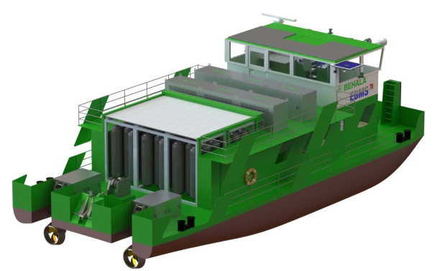
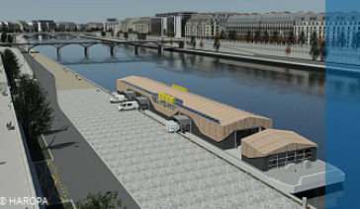
The EMMA Vision for the Baltic Sea Region
IWT is a green, smart transport mode, well integrated in multi-modal supply chains with remarkable share in the modal split
IWT is well considered in strategic transport network planning and legislation
A clear ITS strategy (RIS/VTS) is in place and enables smart shipping solutions
An alternative fuel network is in operation serving a modern, smart and green IWT fleet
Transition points between different waterway classes and there interlinks are established
Sectors’ voice is strengthened
© BEHALA/ TUB-EBMS
© Watertruck+
Notes:
IWT stakeholders from BSR countries are well represented in national associations and organisations which themselves support European and international associations and institutions (CESNI, UNECE)
Knowledge sharing and exchange between the stakeholders is practiced on BSR/EU level (IWT-platform)

Slide 6
Content
EMMA in a Nutshell
Competitive Improvement Plans
Baltic Sea Region and International
Conclusions and Recommendations

Slide 7
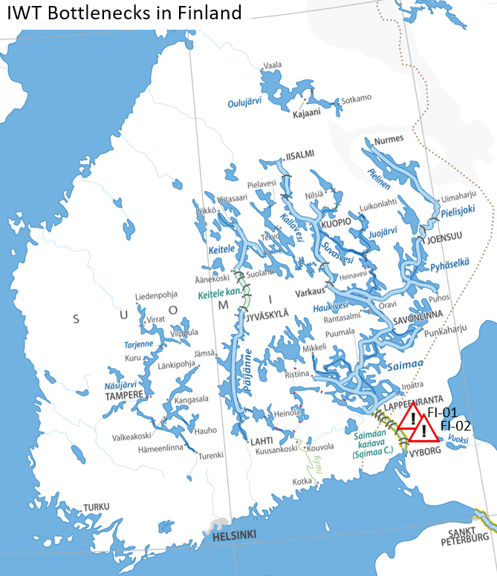
Finland
Infrastructural Bottlenecks and Potentials
Lake Saimaa (several lakes and waterways) are connected by natural and artificial canals and lock to the BSR.
The locks used today were renewed in 1968 when vessels in general were smaller than today.
By enlarging all eight locks by 12 meters in length would benefit traffic in Saimaa inland waterway
A political issue is raising water level in the Canal by 10 cm. This measure together with a solution to stabilise the dams is technically possible but requires a permission of The Water Court.
Realisation of measures above would result in a new vessel size able to carry about 20% more cargo resulting in enhanced competitiveness of IWT against other transport modes.
Notes:
FI-01 Renewing Locks in Saimaa Canal
Dimensions of the 8 lock in Saimaa Canal does not meet the requirements of commercial shipping now and in the future
The maximum dimensions allowed for a ship transiting the canal are: Length: 82.0 m (269.0 ft), Beam (width): 12.2 m (40 ft), Draft: 4.35 m (14.3 ft), Height of mast: 24.5 m (80 ft)
Lengthening all 8 locks in Saimaa Canal by 8-10 meters would benefit the commercial traffic in Saimaa inland waterway by increasing the vessel fleet from approximately 30 to 90. Extension of fleet would give Saimaa inland waterway vessels that have better ice class and give them better maneuverability in ice conditions resulting shorter closing period in winter. Shorter closing period would benefit supply chains, because could they would not have to diverse supply chains to sea ports because waterway is closed for 2,5 months in winter time when this type of traffic is needed. Bigger vessels capacity to take cargo would also be better.
Construction of new locks should be made without closing the vessel and road traffic. Mainly constructions would be made during winter break which is about 2,5 months. If it is necessary this closure can be extended with 2 months more. It is estimated that all the constructions cannot be made in previous mentioned time. Construction is implemented to 2-3 years, which means 2-4 locks construction at the same time.
Cost estimation: 50 million Euros
Saimaa Canal is not part of TEN-T corridor but only way to reach lake Saimaa inland waterway which is part of TEN-T network
FI-02 Draught in Saimaa Canal
Draught for vessel in Saimaa Canal is limited to 4,35m. It is possible to increase the water level in Saimaa Canal with 10cm if necessary. This measure is possible by permission of water court. Things that have to be solved that the water levels in sea and in lake Saimaa enables increasing water level in Saimaa Canal. Also it have to be solved that the dams in Canal will bear.
By increasing the draught in Saimaa Canal with 10cm increases vessels loading capacity by 50 – 100 tons
Saimaa Canal is not part of TEN-T corridor but only way to reach lake Saimaa inland waterway which is part of TEN-T network

Slide 8
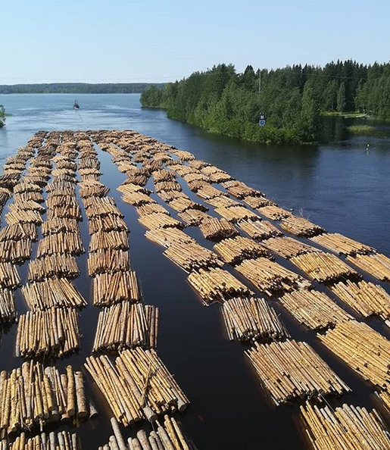
Finland
Recommendations and Conclusions
Planned investments should be implemented without delay to offer reliable infrastructure to IWT stakeholders.
Digitalisation should be pushed forward to ensure to keep track of VTS service developments and to align it to central European RIS accordingly.
Enhanced co-operation between politics and administrations to support resources, financing and involvement of the industry in order to conduct the needed improvements and enable more efficient use of IWT should be aimed.
© kareliacottagesfinland

Slide 9
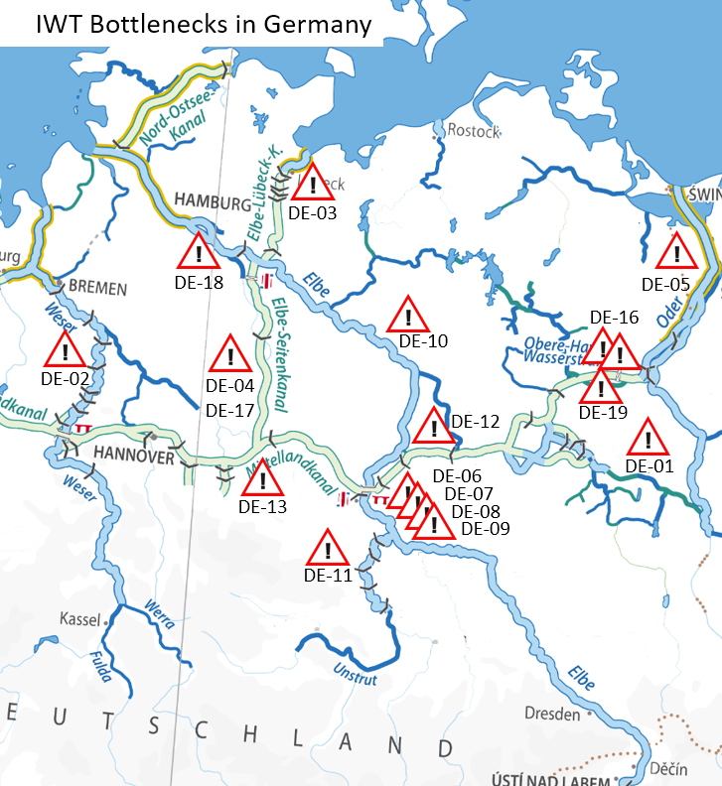
North-North-East Germany
Infrastructural Bottlenecks and Potentials
19 different obstacles were investigated and include lock restrictions, length and width restrictions, clearance height and draught restrictions.
Three general obstacles are observed: from an IWT shipper’s and associations’ point of view, missing mooring areas for inland waterway vessels in ports, limited availability of River Information Services (RIS) in some parts and limited operating hours at a ship lift.
Especially private investments are particularly hindered by lack of maintenance and rehabilitation as well as regeneration measures in river basins and infrastructure, which result in unstable navigational conditions.
Another key aspect is information sharing and digitalisation to achieve competitive IWT services (RIS, 5G network)
Notes:
DE-01 Spree-Oder-Waterway → Lock restriction
The double lock Fürstenwalde is the last bottleneck on the whole relation of the SOW. An upgraded / replaced lock would enable the waterway class to be upgrade from III to IV. The result would then also be to fulfil the minimum requirements of the internattional waterway E-17 according to AGN. Only allows vessels of max. 67 m length to pass through. Vessels of class III can only be used on entire SOW due to this.
How to overcome: There is a concrete suggestion in the framework of a PPP that is still under investigation.
NOT part of TEN-T
DE-02 River Weser → Length and width restrictions
At multiple locations the river is not suitable for certain vessel classes (largest allowed vessel length 110m, breadth 11.45m, reduced loading draft 2.50m instead of 2.80m) to pass each other in opposite directions. Masters of vessels have to get in contact via radio and arrange sequence and where to pass each other in order not to block the waterway. Support is given by the mandatory use of AIS allowing masters to get into direct contact.
A breakdown of a single vessel or convoy at these locations might completely block the waterway and disable vessel traffic completely.
Not all mooring areas are suitable for largest allowed vessels.
Conditions should be established for fully exploiting the economies of scale of inland navigation (upgrade of the waterway from Class IV to Va) and allow the passage of vessels with a length of 110 m and a width of 11.45 m on the Middle Weser.
North-Sea Baltic Corridor
DE-03 Elbe-Lübeck Canal → Draught restrictions
The whole canal is suitable for class IV vessels and convois but with restrictions: maximum allowed draught is 2.00m, minimum height under bridges is 4.40m. In order to fully accomodate class IV draught and air draft must be enhanced. Also the 6 locks need to be modernized
Renewal of locks and extending the draught is planned and manifested in the Federal Infrastrucutre Plan 2030 (838 mil. EUR investments for all measures)
North-Sea Baltic Corridor
DE-04 Elbe Lateral Canal → lock restrictions
Twin ship lift Lüneburg in Scharnebeck has a maximum usable length of 100m and by that limit the entire IWW system to this ship size. Further the ship lift is going to reach its constructed lifetime in 2025 and needs to be replaced.
In order to use bigger vessels from beginning to end of the channel, the ship lilt will be replaced by a new lock, which was manifested in the Federal Infrastructure Plan 2030 (CBR 0,9) In future ships of class IVb can pass the canal
NOT part of TEN-T
DE-017 Elbe Lateral Canal → usability restrictions (soft measure)
If just one of the two troughs of the twin ship lift is usable (the other is closed e.g. for refurbishment) additional pushing equipment for convoys is required. The lift operates 24hrs a day but pusher tug operate 8 hours a day. Thus the convoy shipper has to wait up to 16 hrs to use the lift.
This bottleneck could be overcome by enlarging operating hours of the pusher tug service, e.g. from 5am to 11pm. This might be realised by one additional working shift using the same equipment and quays.
DE-05 River Oder → Insufficient Maintainance of Groynes (River Regulation Structures)
groynes are not up to scratch anymore, resulting in sedimentary deposition in the fairway. These sections are bottlenecks due to the reduced draught. Additionally the missing regulatory function can lead to ice ice shifting and ice congestion.
Restauration works on the Oder for the re-establishment of groynes
NOT part of TEN-T
DE-06 River Elbe Mühlberg to Mouth of Saale → Insufficient Maintainance of Groynes (River Regulation Structures)
Wrosion of riverbed lead to malfunction of existing regulation system (groins etc.), aggravated by absent groins;
Maintenance by dumping of bed load; planning of adjustment of regulation system is needed (in scope of "Master Plan Elbe“ which was decided in 2017)
No information on cost-benefit available but a pilot project in Klöden (km 170 - 198,5) was executed.
Orient-East-Med Corridor
DE-07 River Elbe Bridge Roßlau → Clearance high restriction
Height restriction for container transports in 3 layers - only in case of high water (5,45 m over HSW - highest navigable water level)
lifting in case of bridge replacement (not planned in the moment) to increase IWT efficiency
Orient-East-Med Corridor
DE-08 River Elbe Bridge Schönebeck → Clearance high restriction
Height restriction for container transports in 3 layers - only in case of high water (5,04 m over HSW - highest navigable water level)
lifting in case of bridge replacement (not planned in the moment) to increase IWT efficiency
Orient-East-Med Corridor
DE-09 River Elbe Bridge Magdeburg → Clearance high restriction
Height restriction for container transports in 3 layers - only in case of high water (5,05 m over HSW - highest navigable water level)
lifting in case of bridge replacement (not planned in the moment) to increase IWT efficiency
Orient-East-Med Corridor
DE-10 River Elbe Dömitz to Hitzacker → Draught restriction
Missing groins along the so called "Reststrecke"; non-completion of river regulation as from mouth of river Havel up to Lauenburg
The adjustment of the regulation system is in scope of "Master Plan Elbe”
Orient-East-Med Corridor
DE-11 River Saale → Draught restriction
A missing lock at Klein Rosenburg (km 9.6) to realize a continuous draught between Calbe (mouth into Elbe) up to Halle/Trotha
The project was included in the Federal Transport Infrastructure Plan 2030 within the category "additional need", no. 3. However, due to the category and low CBR a potential realization is not obvious
Cost estimation: 134 mil. EUR, CBR 0,2
NOT part of TEN-T
DE-12 Elbe-Havel-Canal → Lock restriction
The existing lock “Wusterwitz” had to be replaced. The new replacement lock showed building damage, that results in a delay for the finalization of bottleneck.
Further procedure is unclear as well as re-opening.
NOT part of TEN-T
DE-14 missing AIS at certain waterways
This bottleneck is fixed already by waterway administration
DE-13 Mittelland-Canal → clearance high restrictions
Currently a 2-layor container transportis only limited possible on the stretches Magdeburg-Hannover-Minden.
Lifting of several bridget and further measures have been decided to increase efficiency of IWW transport. This will allow IWW vessels up to 180m length and up to 2,000ts (motor barge) respectively 3,500ts loading capacity (push barge convoy) to ship on the canal stretch.
Planned costs 1,2 billion EUR and Cost-Benefit-Ratio of 0,08. The project is included in the Federal transport Infrastructure plan.
North-Sea-Baltic Corridor
DE-15 River Peene → Draught restrictions
Several parts have a draught restriction between 1,30m and 1,90m which are mainly caused by unsificcient maintenance (dragging and bushing)
How to overcome: dredging or flushing of several short parts.
Costs are estimated at 200,000 EUR
NOT part of TEN-T
DE-16 Oder-Havel Canal at the Port of Eberswalde
The OHK is part of the Havel-Oder-Waterway and following bottleneck occur :
At the port of Eberswalte there is not enough space for vessels Class 5a (vessels >80m length ) to turn around in order to navigate into the opposite direction after loading or unloading. Vessels have to navigate to a place to turn upstream for about 10 km to the next boat lift (Niederfinow) to turn around.
Responsible authorities like to enlarge the place to turn at the boat lift when refurbishing the lift whereas the shipping industry likes to have a place to turn at the port.
Orient-East-med Corridor
DE-18 missing mooring areas in the Port of Hamburg
Orient-East-med Corridor
DE-019 Havel-Oder-Waterway → Length and Width Restrictions
To extend the canal for classed IV vessel it has to be widen up and deepened (4 m bright and 3,5 depth on the whole canal profile needed)
Costs are estimated to 500 mil EUR
Orient-East-med Corridor

Slide 10
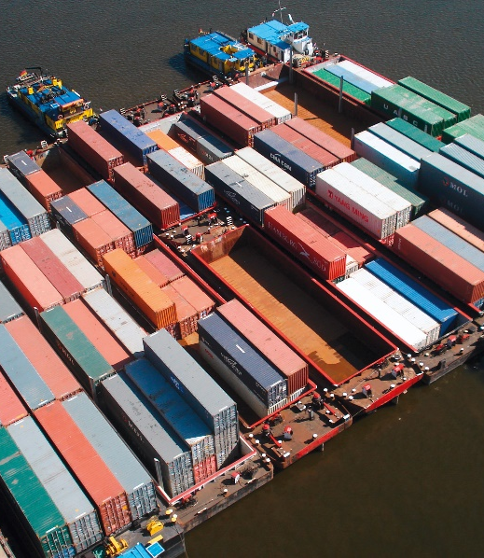
North-North-East Germany
Infrastructural Bottlenecks and Potentials
Inland Waterway | Potential | Source
Elbe Lateral Canal | 15-19 m tons (Base year data 2014) | Ergänzungsgutachten zum Ausbau des Elbe-Seitenkanals (ESK), Hanseatic Transport Consultancy (HTC), 8th June 2015.
River Saale | LUB Consulting: 2 m tons (Base year data 2012) vs. PLANCO: 0.23 – 0.56 m tons (Base year data 2011) | Argumentationspapier zum Saale-Seitenkanal auf Basis der aktualisierten gesamtwirtschaftlichen Bewertung 2012, LUB Consulting GmbH, August 2012. Aktualisierung des Gutachtens zur Gesamtwirtschaftlichen Bewertung des Ausbaus der unteren Saale, PLANCO Consulting, 2012.
River Elbe | 0.27 m TEU linked to hinterland transport of the port of Hamburg (Base year data 2011) | Analyse des Ladungspotenzials der Binnenschifffahrt im Hinterlandverkehr des Hafens Hamburg (2011/2012), Hamburg Port Authority and Port of Hamburg Marketing, 2011/2012.
Berlin Region, Spree-Oder-Wasserstrasse | 3.3 – 4.5 m tons | Tischvorlage, Treffen mit PSts Enak Ferlemann, WEITBLICK e.V. 26.04.2016
Elbe-Lübeck-Canal | 2 – 3 m tons | Hanseatic Transport Consultancy (HTC), 2013.
© DBR

Slide 11
North-North-East Germany
Recommendations and Conclusions
The waterway administration should:
Set up adequate infrastructure to enhance further digitalisation and to develop ITS systems further.
Support data exchange and set-up of easy to use information platforms as well as one-stop-shop platform to provide navigational, operative and administrative information on inland waterways.
© DBR

Slide 12
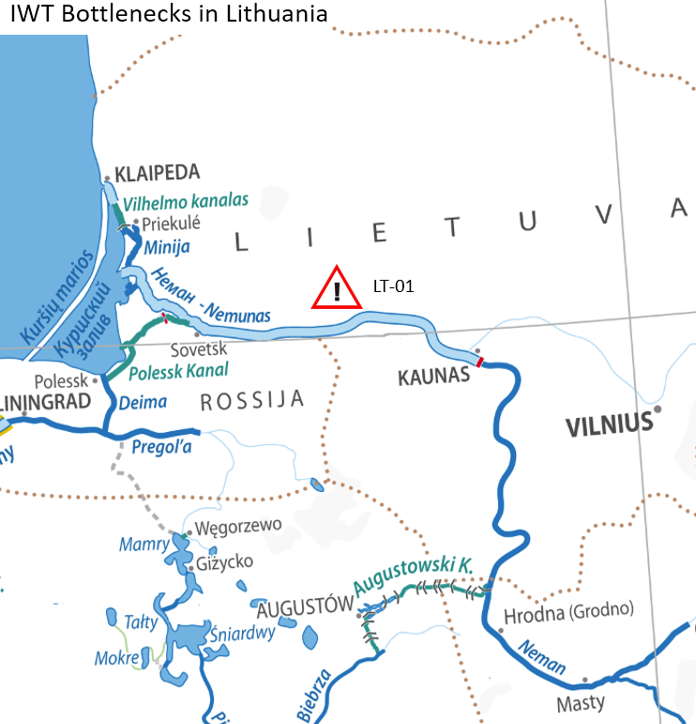
Lithuania
Infrastructural Bottlenecks and Potentials
River Nemunas offers challenging navigations due to length, draft and width restrictions and weather conditions along the whole river.
The draft between Jurbarkas and Kaunas may fall down to 1.1 meters only.
Closer because of ice from end-November until end-March
A good number of industry (e.g. chemical plants, construction companies, energy plans) are located about 30 - 50 km to the inland port of Kaunas.
The need to transport oversized cargo to the port of Klaipeda has a tendency to grow (export).
Notes:
LT-01 Buy Kursiu river Nenunas
Nenunas river in general is not well maintained for IWW services: Ships draft limit (max 1,1 m in the section Jurbarkas - Kaunas), maintenance dredging, not available damp construction according Lithuania Environmental low.
Effects: Increased efficiency and reliability of IWT
NOT part of TEN-T corridor
Pilot:
Analysis of river Neman‘s IWW potential connecting the hinterland to the Port of Klaipeda
Special barge design for oversize cargo transportation
Light ship tonnage to cope with difficult navigable conditions
Testing container transportation by IWW between Klaipeda and Kaunas (planning coming summer)

Slide 13
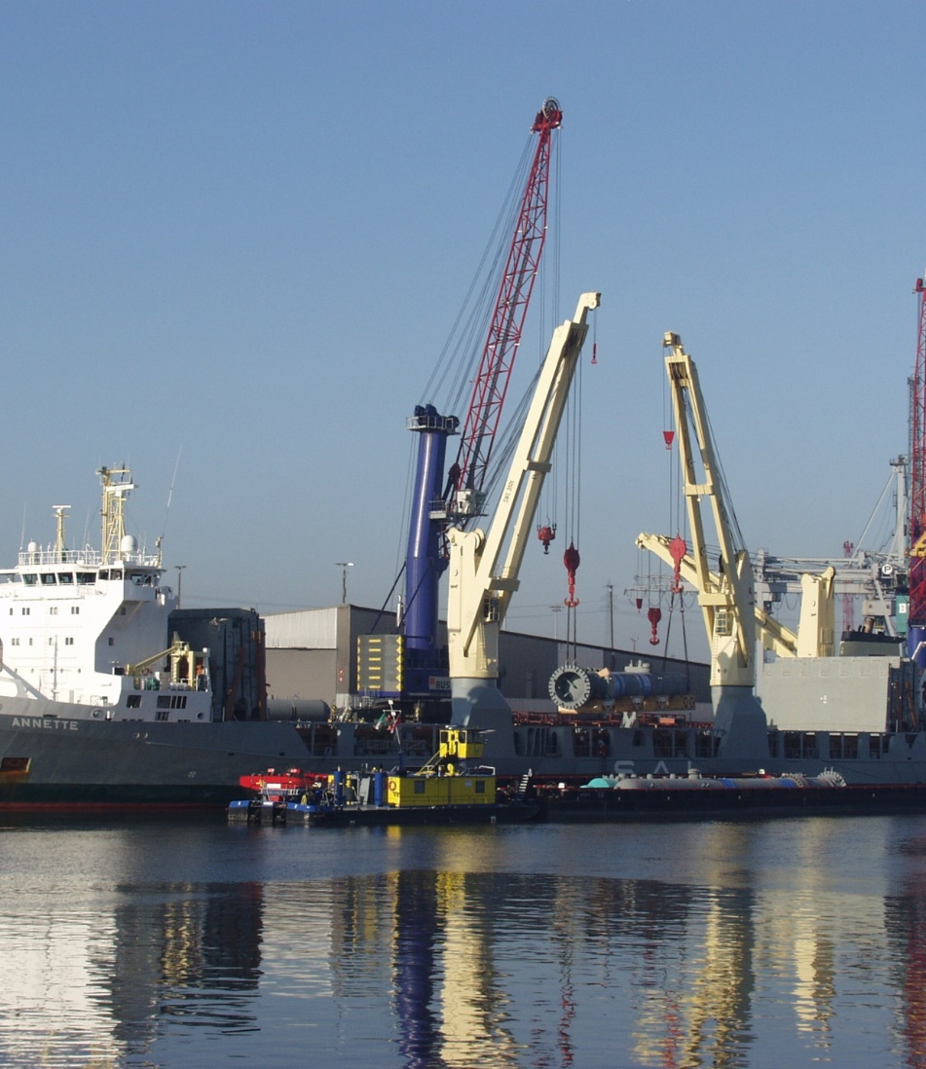
Lithuania
Recommendations and Conclusions
Low-draft vessels are existing on BSR markets and their potentials for IWT transports in LT should be analysed in more detail (especially for the heavy lift transports).
Lithuania Inland Waterway Administration is not comparable with those in other EMMA countries. From an outside view the responsibilities scheme is quite complex and detailed. A simplification should be aimed.
Green IWT solutions have big potentials in LT due to the LNG import terminal located at the mouth of the river and should be pushed forward.
© Port of Hamburg Marketing

Slide 14
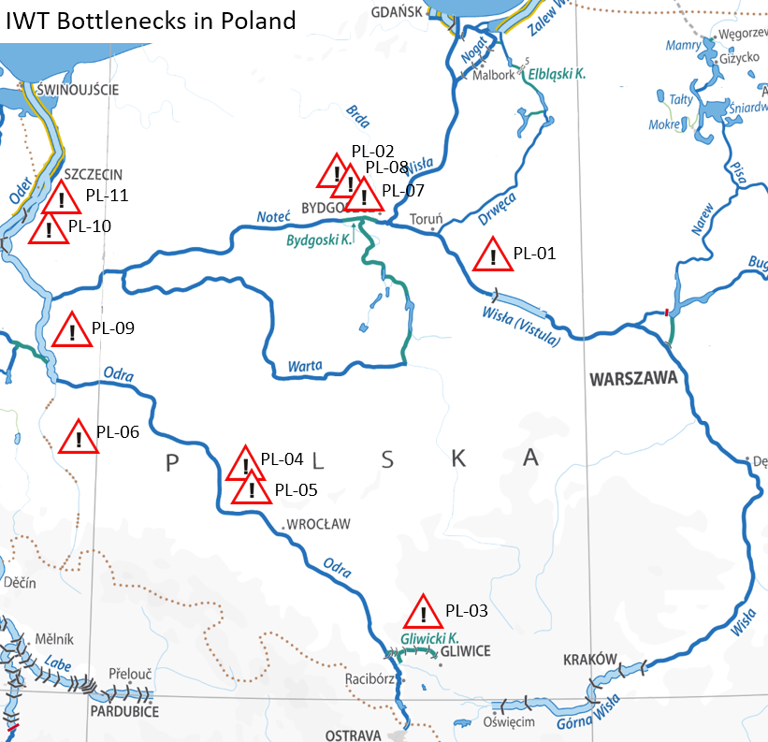
Poland
Infrastructural Bottlenecks and Potentials
The Polish stratey for the Development of Inland Waterways in Poland includes:
at least class IV of navigability on rivers E-30 (Oder) and E-40 (Vistula)
Modernization of the E-70 waterway (including the Oder-Vistula connection)
Construction of the Silesian Channel
International cooperation and training of the new professional staff.
The range of bottlenecks identified on free floating rivers are length and width restrictions of vessels, draught and clearance height. Whereas lock restriction and insufficient maintenance was named at canals.
Notes:
PL-01 Vistula River – low water levels on river canal’s section 684-772 km
The whole stretch described suffers from problems related to the restricted transit depth of 1.4 m and lower. The transit depth is only guaranteed for about 10 per cent of the navigation period on the Vistula. There is no stream engineering, which meanders from its one side to the other. Sandbanks are additional difficulty, moving down the river, depending on the hydrological situation, from 150 to 900 m in a year. The persisting negative level of river is caused by the fact there is only one operating barrage on the lower Vistula (1 out of 9 barrages planned), with the idea to build the others being abandoned. Nowadays the central government is aiming at solving the problem with a comprehensive programme of waterways development. Please note: there are procedures under way concerning the ratification by the Polish State of the European Agreement on Main Inland Waterways of International Importance (AGN Convention)
A project called The Lower Vistula Cascade should be implemented, which provides for constructing 9 barrages on the stretch Warsaw - Gdańsk. Only the construction of subsequent barrages will retain water and ensure appropriate sailing conditions.
The estimated benefits of the project amount to about PLN 100 bln. The sum predominantly consists of transport benefits (PLN 43.7 bln), limiting the risk of flooding (PLN 21.8 bln), income from tourism (PLN 17 bln), hydroenergetics (PLN 9.7 bln), as well as agriculture and forestry (PLN 7.9 bln). The added value will include immeasurable benefits such as the increase of employment in the widely understood water management, mainly the management of waterways transport.
NOT part of TEN-T yet but PL government would like to include Vistula river
PL-02 River Brda – birdge clearance
Most Portowy (the Harbour Bridge) is the lowest bridge on the channelized Brda river. The height of the clearance on the high navigable water is about 3.2 m. The width of the navigable span is 12.
The potential elimitation of the "bottleneck" will result in the navigation lane being blocked for the period of the repair works. The estimated time of the works is one year.
Part of Baltic-Adriatic Corridor TEN-T Corridor
PL-03 Gliwice Channel – lack of maintainance
Lack of maintenance has led to the siltation of the channel and reduced the depth to 180. The length of Gliwice Canal locks allows the operation of a single barge or a set consisting of one barge and towboat. Currently operated pushed sets need to be undone while passing through the locks, which is a serious obstacle to shipping
Part of Baltic Adriatic TEN-T Corridor
PL-04 Brzeg Dolny (km 281.6) to the mouth of the Lusatian Neisse (km 542.4)
Banks regulated with groynes
The Oder here has the lowest depth, but the most difficult stretch for navigation is directly below the barrage in Brzeg Dolny, where as a result of the progressive erosion of the riverbed, a significant part of the depth of the navigation season fall below 1.0 m.
Within the section, all river bends with a radius of less than 400.0 m have been rebuilt, but there is still 43 curves awaiting repair with a radius of less than 600 m.
Out of the 14 bridges crossing the Oder River within the stretch 5 bridges has a vertical clearance of less than 4.0 m with one particularly limiting navigation road bridge in Krosno Odrzańskie(Km 514.1), with its navigable span of 3.28 meters in height.
How to overcome: Build 15 water barrages, conduct adjustment works in order to adapt to new hydraulic condition,rebuild the river bends with a radius of 650m or perform bypass through lock channels
Part of Baltic Adriatic TEN-T Corridor
PL-05 Malczyce barrage – draught restriciton
Buliding the construction of the new barrage at Malczyce would improve the conditions of navigation.
Currently there is sometimes so shallow that even small boat hook in stones and tree trunks lying on the bottom of the Odra river.
Construction Malczyce barrage is a key investment for the improvement of navigation conditions on the Odra waterway. The location of the extent to 300 km of the river decided, among others, best engineering-geological conditions, reducing flooding adjacent areas with minimal stacking, possibility of building a degree beyond the river bed which facilitates manufacturing and reduces construction costs and low interference with the natural environment.
Part of Baltic Adriatic TEN-T Corridor
PL-06 Lusatian Neisse (km 617.6) –Warta (km 542.2)
The entire section is characterised by a bad influence of the regulation structures (groyne) on the morphology of the river, forming numerous tedious grinds lowering the depth of the transit.The bottom of the regulatory river bed ranges there from 64.0 to 80.0 m.There are 4 meander bends of of radius R = 600 m
There are 5 bridges located on this stretch with one railway bridge limiting the navigation (Kostrzyn on Oder 615,1km) the vertical clearance is 3.67m at the state of high navigable water
Part of Baltic-Adriatic Corridor TEN-T Corridor
PL-07 Bydgoszcz Canal – insufficient maintenance
Okole lock – technical state decreases from year to year. The lock was put into operation in 1914. Due to the lack of means for renovation (last preservative renovation was done in 1995) the condition of the lock from year to year deteriorates, that at the same time threatens safety in exploitation.
Lock requires total renovation (overhaul). Currently a contractor is selected for investment: Modernization/improving of engineering structures of Bydgoszcz Canal. Okole lock with buildings.
Government plans to include the canal in the Baltic-Adriatic Corridor
PL-08 Bydgoszcz Canal and Lower Notec – insufficient maintenance
Transit depth is not guaranteed in some places (eg. river mouth of Łobzonka - km 57,300 and Stara Notec Rynarzewska - km 39,200). In summer growth of water plants is observed, that limits flow of river. Dredging works and cutting works (of water plants) are performed every year however due to limited financial means the range of works is not sufficient to ensure full capacity of waterway.
Goal is to restore waterway parameters of class II. The scope of works: e.g. development of revitalization project, restoration of correct shoreline, elimination of not proper curvature, rebuilding of technical infrastructure, restoration of correct transverse parameters of river bed through dredging works and arrangement/organizing vegetation, strengthening revetments with natural materials, development of technical infrastructure in awanports (outports).Timetable of works should ensure protection periods for e.g. hatching birds.
Government plans to include the canal in the Baltic-Adriatic Corridor
PL-09 Kostrzyn on Oder-Hohensaten (section from the mouth of the Warta to Oder Havel Channel)
The geometric shape of the riverbed is characterized by large widths what leads to the variability of the river current. Additional difficulties are caused by outwashes located at the mouth of the Warta river.On this stretch there are two bridges including 4,14m railway bridge at 653,9 km (Siekierki) limiting the vertical clearance.
How to overcome: Unification of regulatory width for individual sections, rebuild of low bridges
Total estimated for the stretch (617,6km-683km): 353,6m,however the final cost depends on mutual agreements with Germany
Part of Baltic-Adriatic Corridor TEN-T Corridor
PL-10 Hohensaten (Oder Havel Channel) to Widuchowa
The stretch from 667,2km to 683km regulated by groynes on both sides. After 683km there is a sudden collapse of the land slope to as low as 3cm/km. The change of the hydraulic flow conditions causes sedimentation of rubble being dragged downstream. Problem with the transit depths occurs within the first 16 km of the stretch, however, limits the whole route to Szczecin.
How to overcome: The change of the parameter of the groyne systems. The use of a mixed system of regulation(lateral and longitudinal groynes). Construction and repair of seawalls of the river banks below 683km.
Part of Baltic-Adriatic Corridor TEN-T Corridor
PL-11 Widuchowa –Szczecin (Oder mouth to Dąbie Lake)
Within this stretch in the Szczecin Floodway System there are 3 bridges:
(1) The railway drawbridge over Oder Regalica in Szczecin (734km) on the line between Szczecin Central Port and Gryfino, close to the station of Szczecin Podjuchy. This is the only one in Europe viaduct with mechanically lifted span for barges. It is it is a historic bridge built in the nineteenth century. It undergoes continuous breakdowns and when the wind blows in excess of 15 per second bridge could not be raised. Despite a number of repairs it still causes major difficulties in the Oder inland navigation.
(2) The railway drawbridge located near the Szczecin main train station with clearance of 3,49m
(3) The road drawbridge called "Long bridge" with clearance of 3,10m.
Apart from Oder Regalica the other two bridges and after further repairs are operated as fixed bridges.
The Oder Regalica bridge needs to be rebuilt and the cost estimation is around 200 million PLN
Part of Baltic-Adriatic Corridor TEN-T Corridor

Slide 15
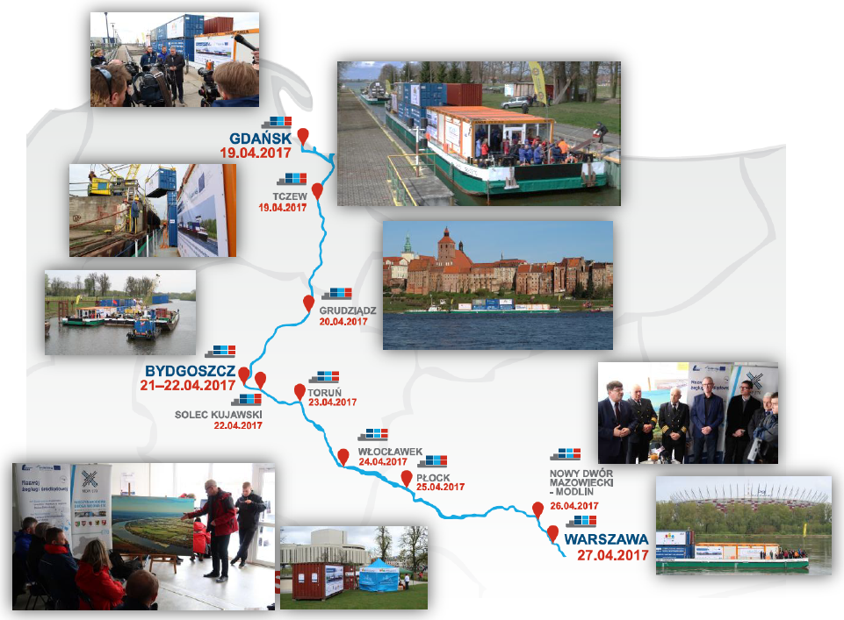
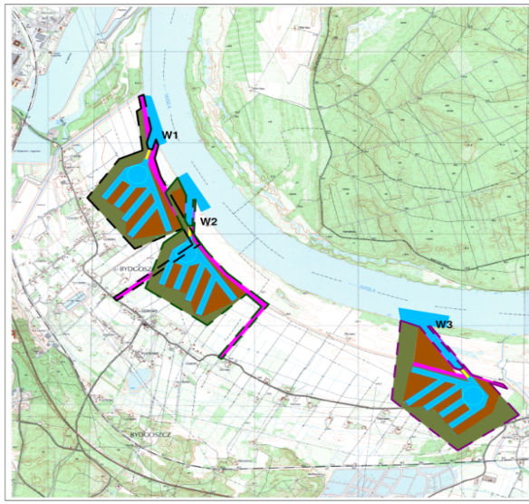
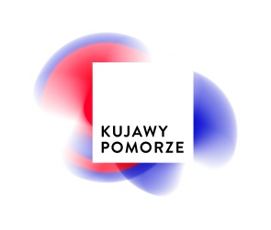
Polish Vistula River – Promotion and Research Cruise
From Gdańsk to Warsaw
Multimodal port Bydgoszcz - Solec Kujawski
The cruise in a nutshell
70 m push convoy loaded with 20 containers
Daily distance tavelled: 20-80 km (in total 440 km)
Simultaneous research on river and infrastructure
Demonstrative handlings: 2
Events in cities: 7
Workshops on board: 7
Press conferences: 5
Planning of a multimodal port near Bydgoszcz
Notes:
Organization of meetings and conferences on economic use of rivers
National contest of inland navigation and waterways for high school students
Cooperation with local, regional and national bodies responsible for IWT and water management
Cooperation with other regional authorities situated along E40 and E70 waterways
Active participation in ministerial working group on IW investments and national board of development
Multimodal platform based on road-, railway- and inland waterway transport
Location study of the port is being executed within EMMA project
Scope: analysis of market environment, sector analysis, financial and risk analysis, planning concept, functional programme, location variants
Extensive expert group involvement
Inspirations by best practice examples from EMMA countries

Slide 16
Poland
Infrastructural Bottlenecks and Potentials
Inland Waterway | Potential | Source
Dolna Wisła | Uniwersytet Gdański 7-12 mln ton (Dane roku bazowego 2017) Projekt InWapo (Interreg Central Europe) 7-10 mln ton (Dane roku bazowego 2014) | K. Wojewódzka-Król, R. Rolbiecki, Społeczno-ekonomiczne skutki zagospodarowania dolnej Wisły, Gdańsk 2017. Studium Techniczno-Ekonomiczno-Środowiskowe rewitalizacji i przywrócenia żeglowności Dolnej Wisły na odcinku Warszawa-Gdańsk, Gdynia 2014.
Połączenie Odra-Wisła (Warta, Noteć, Kanał Bydgoski, Brda) | Porozumienie MDW E70 (województwa lubuskie, wielkopolskie, kujawsko-pomorskie, pomorskie i warmińsko-mazurskie) ok. 4 mln ton (Dane roku bazowego 2011) | Analiza popytu na przewozy ładunków i pasażerów Drogą Wodną E70 (dla przedsięwzięcia: Rewitalizacja śródlądowej drogi wodnej relacji wschód-zachód obejmującej drogi wodne: Odra, Warta, Noteć, Kanał Bydgoski, Wisła, Nogat, Szkarpawa oraz Zalew Wiślany (planowana droga wodna E-70 na terenie Polski), Sopot 2011.
Oder | 1970-1980: trasport from the Gliwice channel to Świnoujście at a level of up to 10 ml tonnes. In the long-term perspective, an increase in transport is estimated E-30 waterway to 25 million tons. | III International Maritime Congress –debate „Odra szlakiem rozwoju” Krzysztof Woś, Założenia do programu rozwoju polskich śródlądowych dróg wodnych. Warszawa 9.02.2016
Oder | The team under the guidance of prof. Michał Pluciński 20 million tons (Data base year 2016) | Resolution No. 79 of the Council of Ministers of June 14, 2016 regarding the adoption of "Assumptions for plans for the development of inland waterways in Poland for 2016-2020 with a view to 2030

Slide 17
Poland
Recommendations and Conclusions
Promising waterways are the River Oder (Odra, E-30), River Vistula (E-40) between Warsaw and Gdańsk and the International Waterway E-70.
Many companies with good prospects to use IWT (e.g. petro- chemical, paper, steel industry) for oversized and bulk cargo incl. liquid transports are located along the waterways.
The water management reform carried out in the last two years creates great chances for the development of inland navigation and the return of water transport in Poland.
The key issue will be finding sources of financing for planned projects, including European funds.
To develop the existent lobby network, might be a good starting point to strengthen sectors’ voice and support the government in their strategic visions for the IWT network.
Multimodal port Bydgoszcz - Solec Kujawski

Slide 18
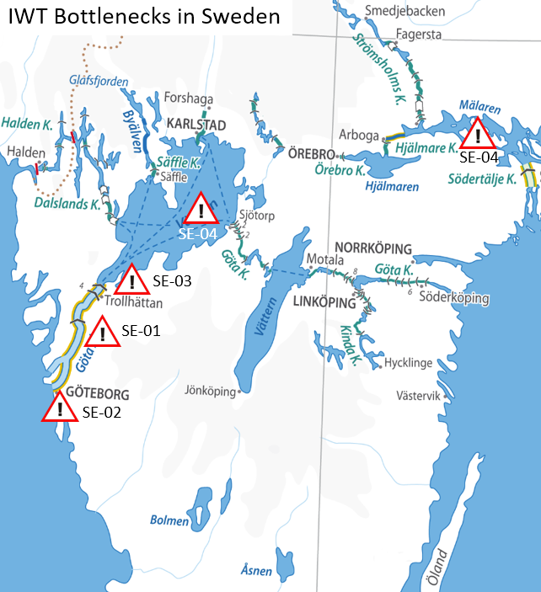
Sweden
Infrastructural Bottlenecks and Potentials
Sweden is in the phase of an emerging IWT market. The status comes along with all the needs and challenges in setting up new regulations and creating a business environment for inland navigation for the first time.
Due to the late introduction of IW regulations, the administration and responsibility is widespread.
Rules and regulations are based on IMO/SOLAS. An harmonising approach of IWT regulations according to EU standards is needed. → E.g. limited coverage of the area classified as IWW, Pilot on board regulation, fairway dues, etc.
Six locks (120 years old) between Göteborg and Lake Vänern need to be renewed. Budget was recently included in the national transport plan
Notes:
All SE bottlenecks are not part of any TEN-T Core Corridor.
SE-01 Göta River from Göteborg (Göta River Bridge) to Vänersborg → Insufficient River Information System applications
Since there are conflicts between river traffic and passing train and roadways, earlier RIS-pilot (GOTRIS) showed a need for traffic synchronization between different modes of traffic. New bridge over Göta River in the center of Göteborg have legal prerequisites to be followed by some sort of traffic management system addressing issues above.
The GOTRIS concept was developed and piloted in 2014 showing how the identified issued could be resolved. Decision for implementing a similar system is pending the decision of reinvestments of locks. Initiative for a pre-implementation through CEF instrument is being discussed.
Positive effects: Better usage of the river infrastructure, less waiting time for vessels at bridges (openings), lower CO2 emissions, better energy efficiency, less waiting time for public transport
Task force instigated (SMA, STA, City of Göteborg) to address the issue. Initiative through CEF instrument to do a pre-implementation (SMA,STA)
SE-02 New Göta Älv bridge → Clearance height restrictions (e.g. low bridge higts)
New bridge in central of Göteborg over the river will have clearance height of 12 m, compared to existing bridge of 18m
Restrictions Mon-Fri, 06-09, 15-18) for vessels with height clearance over 12 m. (Compared to todays 18 m)
SE-03 Trollhättan-locks
The locks are approaching end of economic and technical lifetime. Should WIT still be possible in future six locks need to be replaced before 2030.
Costs: Preliminary estimated to be about Euro300 million. Ongoing study by Trafikverket in cooperation with SMA.
Effects: Larger capacity, shorter time to pass, lower number of locks, higher reliability
SE-04 Inaccessible areas for IWW traffic – legal obstacles
The limited coverage of the area classified as IWW is a bottleneck. In Sweden only the two lakes of Mälaren and Vänern, including Göta river from the high bridge at the entree of Göteborg to Lake Vänern.
More areas outside of the mentioned needs to be classified, even if as Category 1, but to be able to connect industries and ports that are to be found in the region outside of the mentioned lakes.
Effects: Extended area of operation for a future IWW fleet, leading to an extended reach and access to more cargo as well as opportunities.

Slide 19
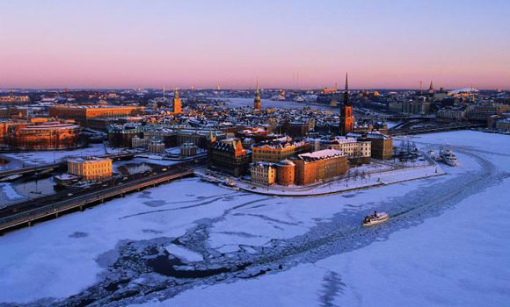
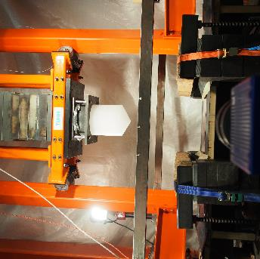
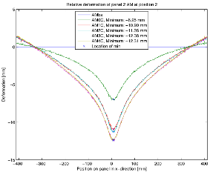
Swedish: Ice impact modelling
In cooperation with the research institutions KTH (SE) and TUHH (DE)
One of the most commonly referred obstacles for IWW is uncertainties on winter navigation.
The project aims to answer; What is IWW winter conditions? Which ice loads shall vessels be designed to cope?
The project will contribute to the knowledge in ice loads and suitable hull design in terms of hull shape hull material, material concepts & structure arrangements.
Model for calculation ice impact force and energies established
Test methodology developed
First test series carried out

Slide 20
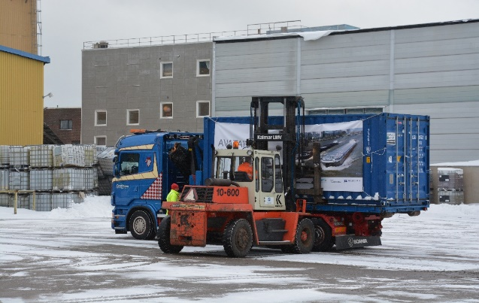
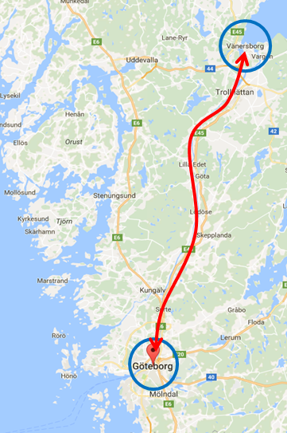
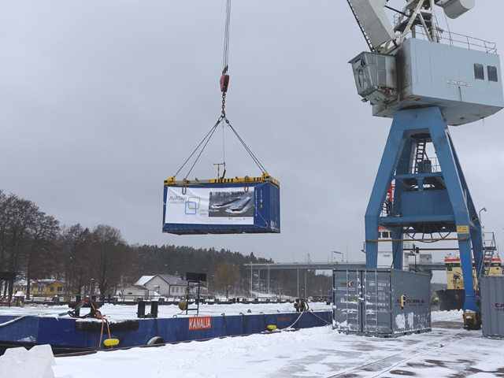
Swedish Pilot: Lake Vänern
FIRST TIME DEVELOPMENT OF IWT IN SWEDEN
Container Shuttle Gothenburg – Vänersborg
Regular sailings envisaged
Modern push-barge concept might be feasible
Length limitation 89 m (lock chamber)
A pilot voyage was successfully proven, 7th March 2017
There is no problem with the existing fairways and it is a lot of free capacity not used today.
Lock limitation is challenging, especially as the locks are old (build in 1916)
Notes:
Sweden implemented the EU Directive 2006/87/EC (a set of rules and regulations dictating technical and operational requirements for ships engaged in inland waterway traffic) in December 2014 but no commercial traffic has started.
The test sailing was on Avatar Logistics initiative and why they did it is because Sweden needs to “kick off” the inland navigation.
According to the plan the pilot project managed to test the full logistics chain in reality, loading in Göteborg, transport by barge, discharging in Vänersborg, reloading to truck and delivery to the customer.
The container pilot in Göta älv was executed with vessel and barge equipment that are available in Sweden. Meaning that this not is an efficient equipment, technical & financial for a permanent liner service.
The idea with the pilot is to attract the market the possibilities with inland navigation, since this is new in Sweden and to push the politicians to finalize the regulations for inland vessels/traffic.
Simultaneously AVATAR Logistics will develop a vessel type for Scandinavian weather conditions’.

Slide 21
Sweden
Recommendations and Conclusions
All stakeholders involved in transport need to work together to get a common idea on the Swedish future of inland waterway transport (Vision and Strtegy).
To build up a lobby structure focusing on IWT and representing Sweden in European and International matters is needed.
IWT regulations should remain as streamlined as possible to the European regulations.
UNECE has discussing extending its resolution 61 with rules for river-sea shipping, where inland navigation vessels may sail outside the traditional IWT zones. This - from a Baltic perspective - could close gaps between areas classified as zone 3 to 1 (like in Sweden) and facilitate growth of transport volumes between hubs.
© AVATAR Logistics Ab

Slide 22
Content
EMMA in a Nutshell
Competitive Improvement Plans
Baltic Sea Region and International
Conclusions and Recommendations

Slide 23
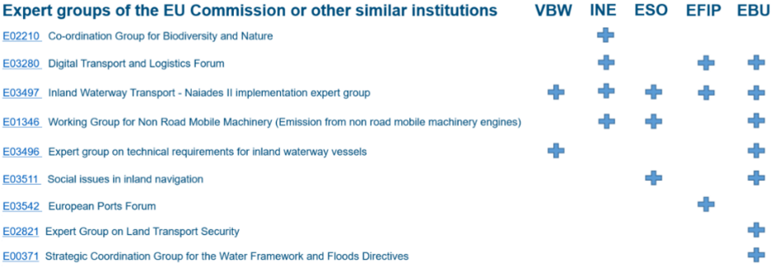
Make Use of Existing Responsibility Structures
Expert Groups by the European Commission
Registered European branch organisations can be heard in EU COMs Expert Groups.
Representatives from BSR countries in these European branch organisation are crucial to be heard and to strengthen entire sectors’ voice, thus:
National branch organisations should be strengthened in all BSR countries by regional stakeholders.
National branch organisations themselves should be part of European- respectively international branch organisations.
Member states should be part of institutionalised policy working groups etc. as well.
Notes:
On European level several IWW associations represent the sector towards EU institutions like the EU Parliament, the EU Commission and the EU Council. On European level several lobby organisations exist focusing on inland navigation, namely European Barge Union (EBU), European Federation of Inland Ports (EFIP), European River-Sea-Transport Union (ERSTU), European Skippers’ Organisation (ESO), Inland Navigation Europe (INE) and the Association for inland navigation and navigable waterways in Europe (VBW).
Analyses in the project showed the lack of members from the Baltic Sea Region (besides Germany and Poland to some extend) represented by IWW associations in Brussels. This is due to the fact of missing national branch associations. However, especially the acquisition of single private organisations from one country should not come along with the privilege representing this country officially on European levels. The danger is to represent single interests of one/some financially strong members and not the entire sector of the country. Thus, it can be stated, that the national drawback is also influencing sectors representation on the European level.
However, it has to be clearly stated, that cooperation between the associations exist and increases. Besides others joint statements, policy-/recommendation papers and events are organised to bundle forces. Strengths of the individual associations are getting used by all, even though not in any kind of business yet.

Slide 24


Make Use of Existing Responsibility Structures
CESNI Committee and UNECE
A special role plays the “Central Commission for Navigation on the Rhine” (CCNR). CCNR and the EU COM created a European committee for drawing up common standards in the field of inland navigation: CESNI, www.cesni.eu
The CESNI Committee directly influences European legislation (e.g. RIS) and as such all member states should be present (which is not the case in respect of all BSR countries).
The UNECE Working Party on Inland Water Transport is called “SC.3”. Representatives from Member states, their waterway administration or River Commissions are appointed to represent national interests in the different working parties and committees.

Slide 25
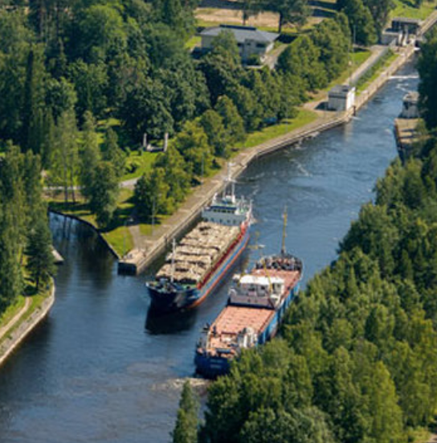
European information systems for inland waterway transport
Different Systems in the Baltic Sea Region
In Central Europe implementation of interoperable RIS will provide information for navigation and operations.
In some BSR countries, e.g. the Nordics, inland waterways are connected to sea rather than other inland waterways.
Short Sea-, River-Sea- and Lake-Sea ships are using the same infrastructure.
A separate RIS system is not existing and is probably not being installed.
Similar Vessel Traffic Services (VTS) systems, Automatic Ship Identification (AIS) and single window data sharing systems are in operation.
Therefore, regulations and operational practices should take interoperability of both systems (RIS/VTS) into account.
© City of Lappeenranta

Slide 26
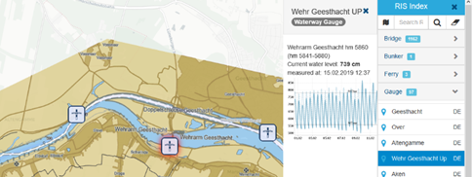
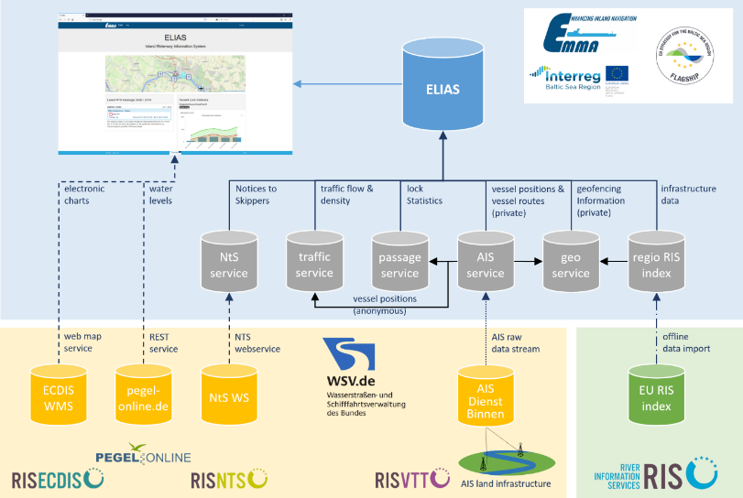
Making Use of Existing River Information Services
A prototype to support vessel masters, fleet and cargo managers was created to demonstrate modern information technology potentials - ”ELIAS”:
Open source and public accessible map based web application: https://elias.isl.org/index.xhtml
Information on waterway infrastructure is gathered from the European RIS index
The anonymised vessel positions (based on real-time AIS) allow a calculation of traffic density and traffic flows
Passage statistics service
Notices to Skippers Service
Geofencing service

Slide 27
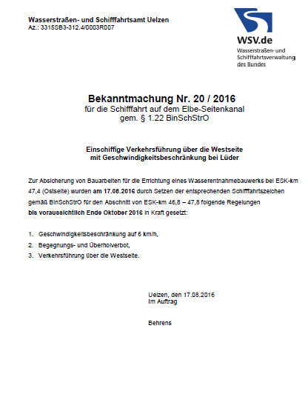
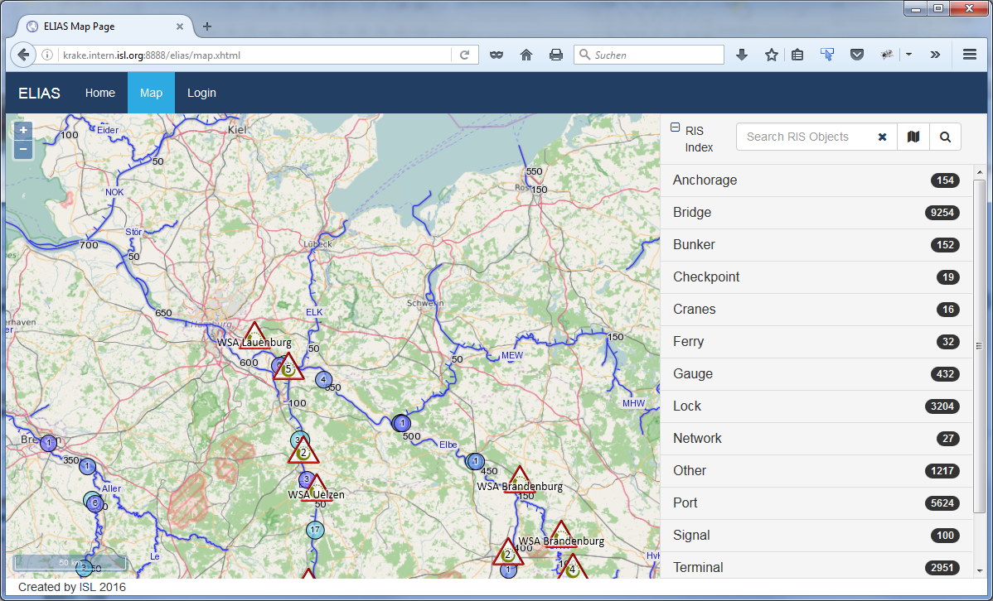
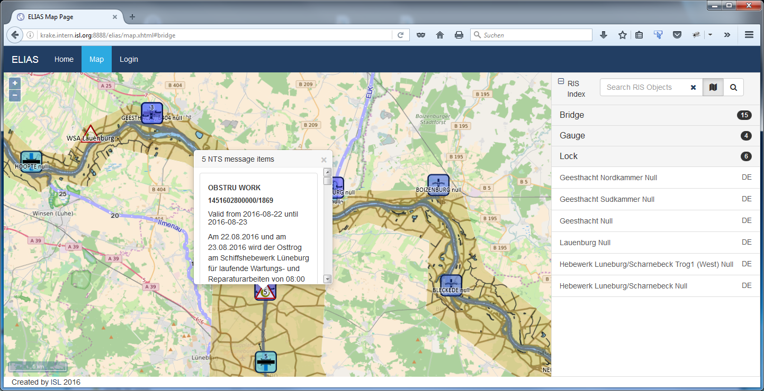



Making Use of Existing River Information Services
“ELIAS” FUNCTIONALITIES (Developed in EMMA)
Browsable map pan & zoom
Info on RIS objects
Geocoded NtS message display
Link to external details
Notes:
Technique and public section:
Electronic Chart Display and Information System (ECDIS)
Electronic navigational chart overlay (iENC): Position of locks, bridges, gauges, bunker stations, etc.: European RIS Index Publicly available contents is rather heterogeneous.
Notices to Skippers (NtS), German service integrated. Other countries to follow. Fallback via proprietary subscriptions (email) possible
Display of water levels (WRM messages based on NtS)
Possible value added information: trends, hotspots, vertical clearance under bridges
General traffic information based on anonymised AIS data
traffic density
lock waiting times
AIS land infrastructure is available in parts of Germany. Discussions with ministry are ongoing.
Inclusion of detailed ports & terminal data
Map-based web application providing static and basic status information on IWW
Electronic navigational chart overlay (iENC)
Position of locks, bridges, gauges, bunker stations, etc.: update of European RIS Index
Notices to Skippers (NtS): Only NtS-WebService from Germany currently integrated.
Real time water levels - provided by German waterway authorities (WSV)
Dynamic traffic situation: traffic density (no of vessels per section) & traffic flow (vessel speed per section)
Lock passage statistics (lock passage time = waiting time + lockage time)

Slide 28
Content
EMMA in a Nutshell
Competitive Improvement Plans
Baltic Sea Region and International
Conclusions and Recommendations

Slide 29
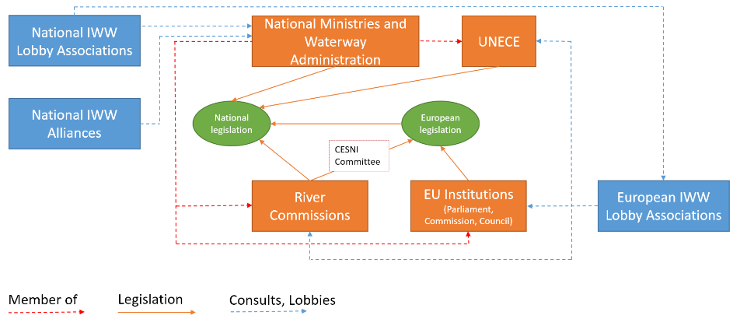
Enhance Administrative and Branch Associations’ Structures

Slide 30
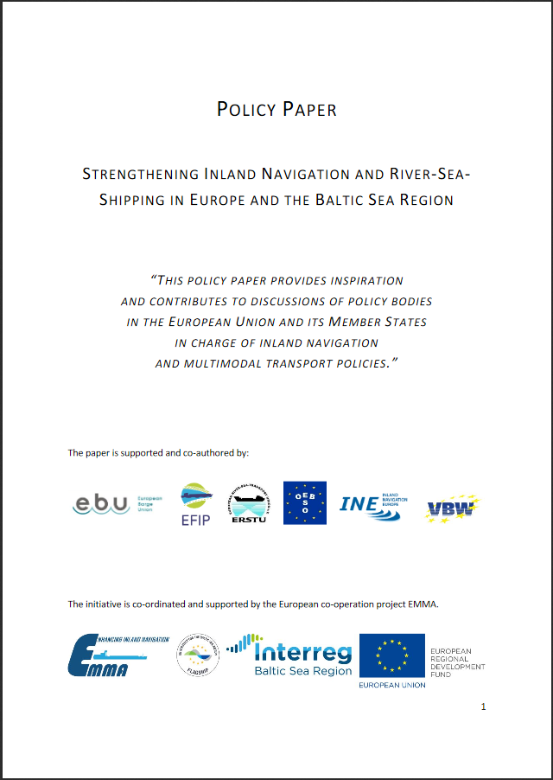
A Clear BSR Strategy to Lift IWT Potentials is Needed
EMMA Position Paper to Enhance IWT
IWT integrated in multimodal logistic solutions
Respect the different characteristics of waterways
Transition points between different waterway classes and there interlink
Inclusion of a clear strategy for the uptake of alternative fuel technology
Inclusion of a clear ITS strategy (RIS & VTS Services)
Harmonised national rules and regulations
Investments to strengthen and modernise infrastructure is needed (shore site and on-board)
European Inland Waterway Transport Knowledge Platform
Smart & Innovative Strategic IWW Transport Projects
www.project-emma.eu/sites/default/files/EMMA_Policy%20Paper%20to%20strengthen%20IWT%20in%20BSR.pdf
Notes:
Identified challenges:
Investment and innovation backlog, ashore & on board
Inhomogeneous national regulations and markets
Weather conditions can be challenging (e.g. ice)
Lack of attention for inland navigation and available infrastructure
Stronger cooperation of stakeholder needed (→lobby structures)
Smart projects needed to lift potentials, to bring innovation to the sector and to keep started procedd alive!
Inland waterways should play a more important role in the Baltic Sea Region in future!
VTS = Vessel Traffic Service
RIS = River Information Service

Slide 31
Thank you for your attention.
2019-02-15

