Slide 1

Arctic Investment Platform
Project overview and road map for launching the

Slide 2


Background
Pre-feasibility study 2018​
Fully-fledged feasibility study and road map project 2019-2020 (ends 30.09.2020)
Regions, willing to participate in AIP cooperation after project, sign a Cooperation Agreement

Slide 3
Fully-fledged feasibility study and roadmap project objectives
Analyse the demand and feasibility of a structured funding co-operation of the NSPA regions to boost the investment capacity of the regions SMEs
Propose a framework for such a support system
Provide a tangible roadmap for the set-up of such a support system
Ensure credible resources to engage in a dialogue with the institutions relevant to the set-up of such a system (incl. regional stakeholders, national funding agencies, financial institutions, the European Investment Bank (EIB), the European Commission and national ministries in each of the three countries)

Slide 4
Findings and achievements
The findings of the study are in line with reports and studies by organizations such as the OECD and the European Commission
The study supported the establishment of the AIP, while providing a framework and road map for the launching of it
The framework and road map has since then been updated based on stakeholder consultations
Project has answered all the set objectives

Slide 5
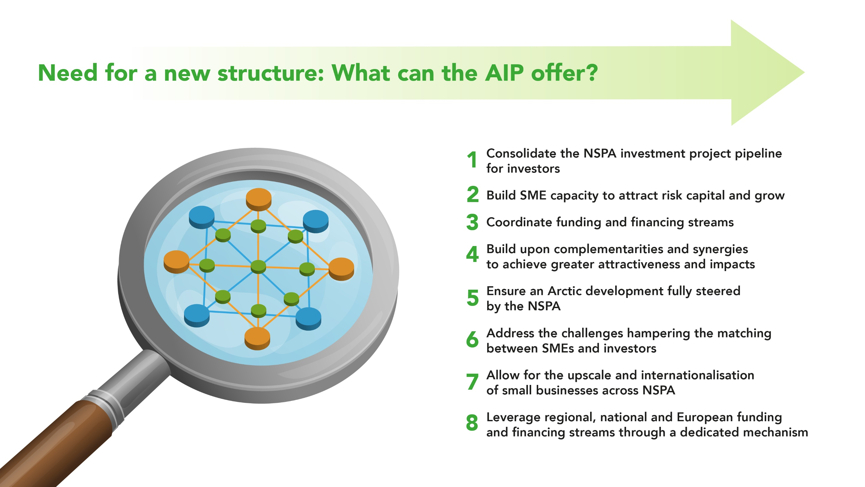

Slide 6
Road map for launching the AIP

Slide 7
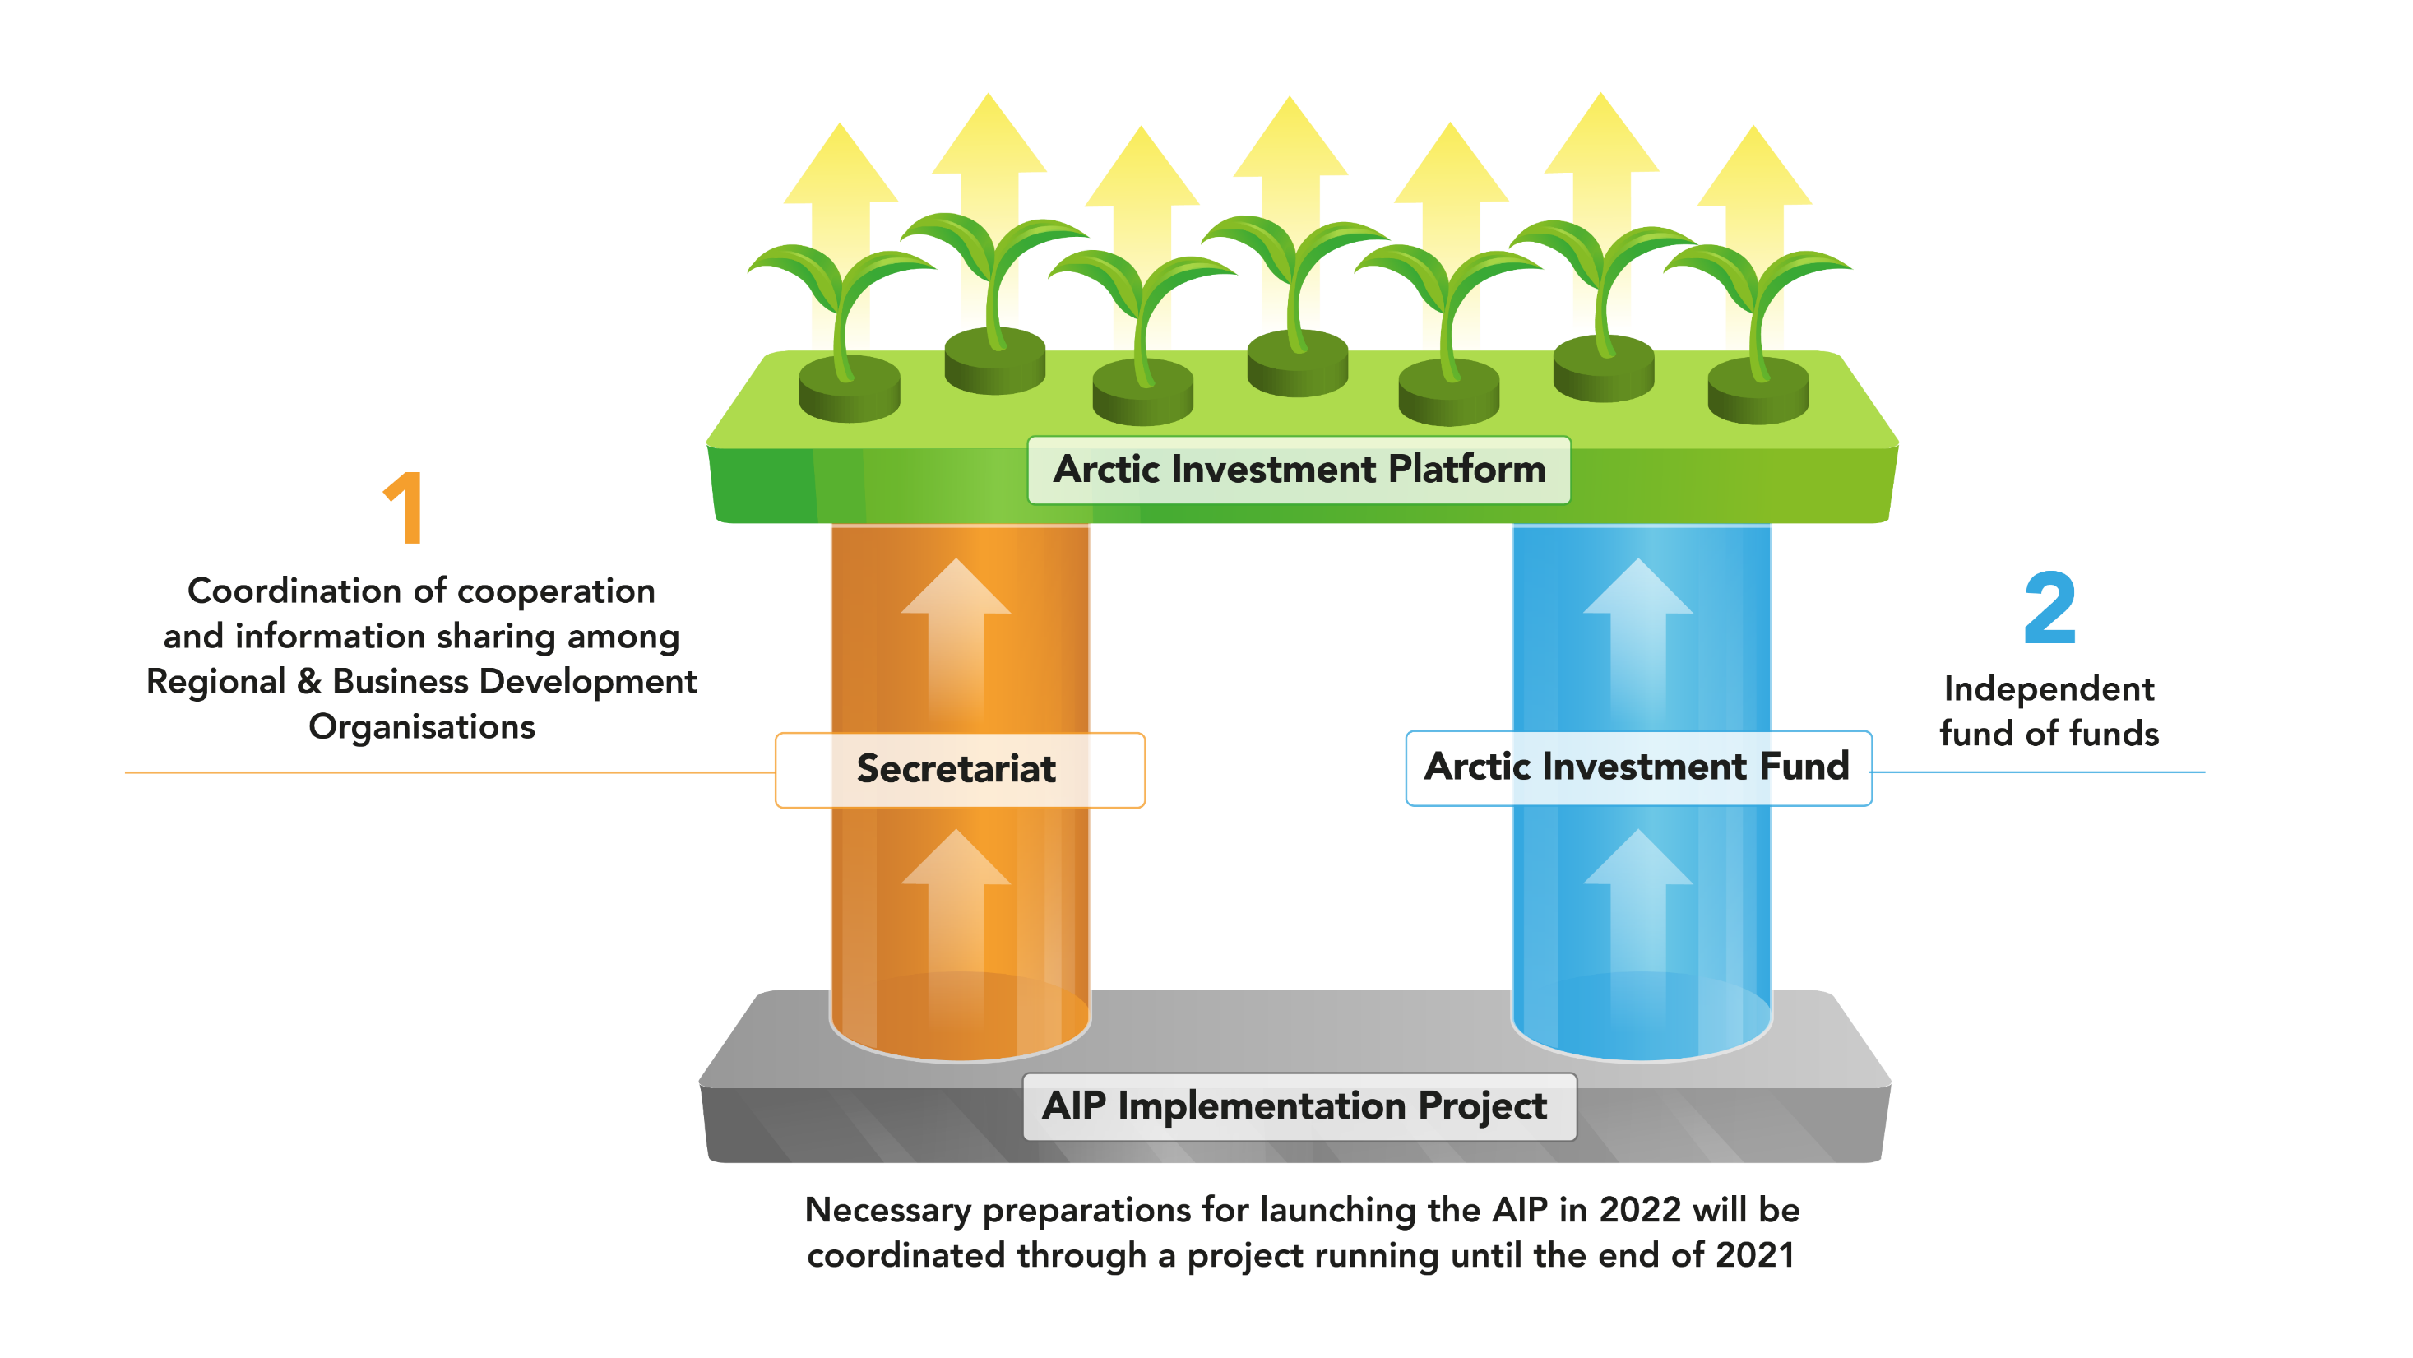

Slide 8
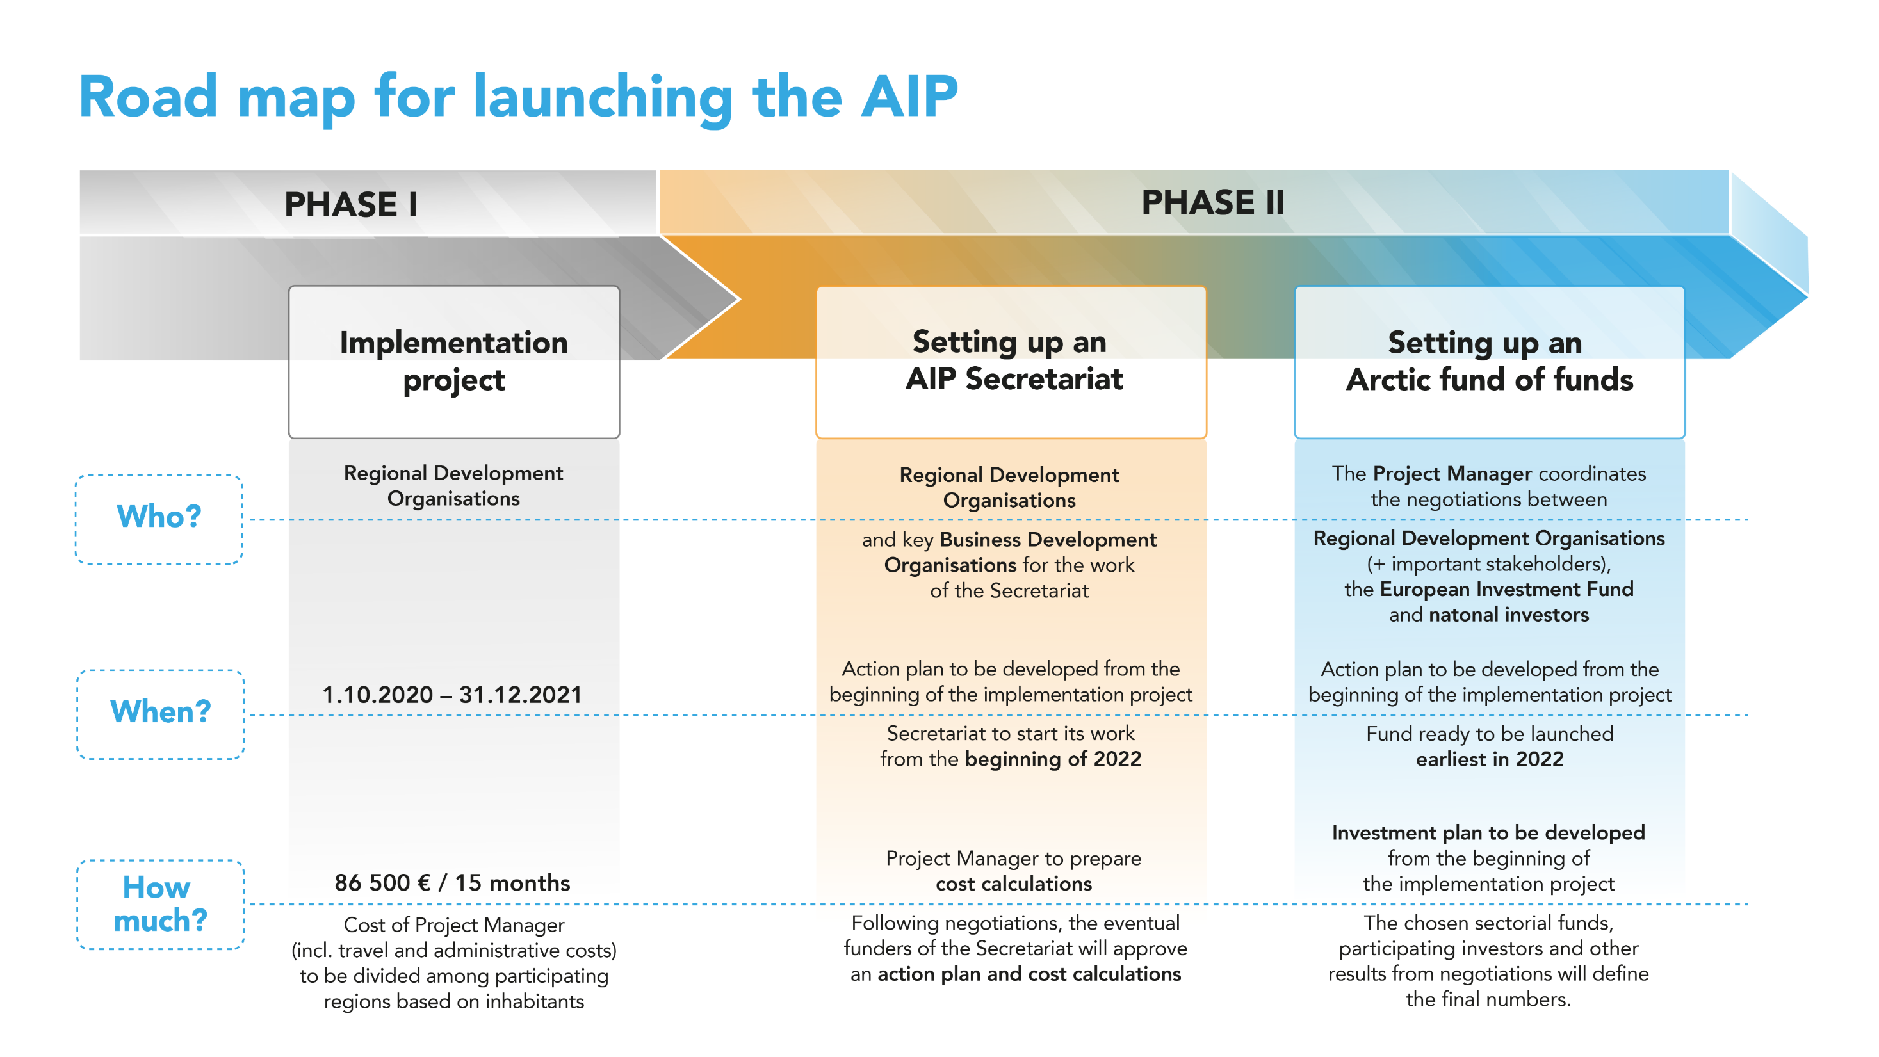

Slide 9
Project for setting up the AIP
Project Manager to coordinate
  Setting up a tangible work plan and budget for the Secretariat, to be put in action after the term of the Cooperation Agreement ends, if deemed useful by the participating regions
  The process of setting up an Arctic fund of funds until terms and conditions for the fund management team have been agreed upon
Reports to
  Signatories of the Cooperation Agreement, forming the Project Steering Committee
All Regional Development Organisations signing the Cooperation Agreement will share the cost – Regional Council of Lapland takes the administrative responsibility of hiring the Project Manager
The coordinated cooperation ensures
  Continuous added value for the participating regions
  Leverage in external communication
  The creation of a financial instrument suitable for the participating regions, while utilizing the EU level momentum

Slide 10
Secretariat
Coordinates at least
  Setting up of information-sharing across the participating regions to optimize the information available
    leading to better coordination of technical and financial advisory services for SMEs, while minimizing duplication of regional actors’ work
  Participation in match-making events and partnerships, further strengthening the common deal flow of the participating regions
Reports to
  Signatories of the future longer term Cooperation Agreement, forming the AIP Steering Committee
All Regional (& Business) Development Organisations signing the Cooperation Agreement will share the cost – one takes the administrative responsibility of hiring the staff
The coordinated cooperation ensures
  Continuous added value for the participating regions
  Leverage in external communication
  More visibility for participating regions’ investment opportunities in a moment when reviving the economy is crucial

Slide 11
Arctic Investment Fund
The Arctic as a growth catalyst for Europe
Management team to launch a call for fund managers, based in the participating regions, to set up sectorial funds
Active investing period
Target areas: Scale-up SMEs in Finland, Sweden & Norway with Arctic know-how
NSPA companies on growth track:
Negotiations with EIF to take on the role of management team for the fund
Vast variety of high tech companies in start up and growth phase
Need for (VC) funding
Regions to agree on the terms of participation in the fund of funds
Regions to give mandate to the management team
Structures in place for a fund that complies with the EU Green Deal and Taxonomy on Sustainable Finance
Investments
Employment
R&D
    Action plan to propose terms for investing in the fund
    Before committing to the fund’s action plan, regions do not commit to financing the fund

