Slide 1

Improved access to finance for Arctic SMEs
Taking the cross-border regional cooperation in the Northern Sparsely Populated Areas to a new level

Slide 2
Why more structured funding cooperation?​
Common challenges and shared goals​ but also complementarities
European Commission Arctic Communication 2016: Lack of investments in the European Arctic​
OECD report 2017: A more structured collaboration could be established to bring together investors and improve SME access to finance​
Tradition of cross-border cooperation in the NSPA but still room for improvement (leverage through common strategy → transforming local challenges into European opportunities)
Feasibility study to confirm needs and opportunities

Slide 3
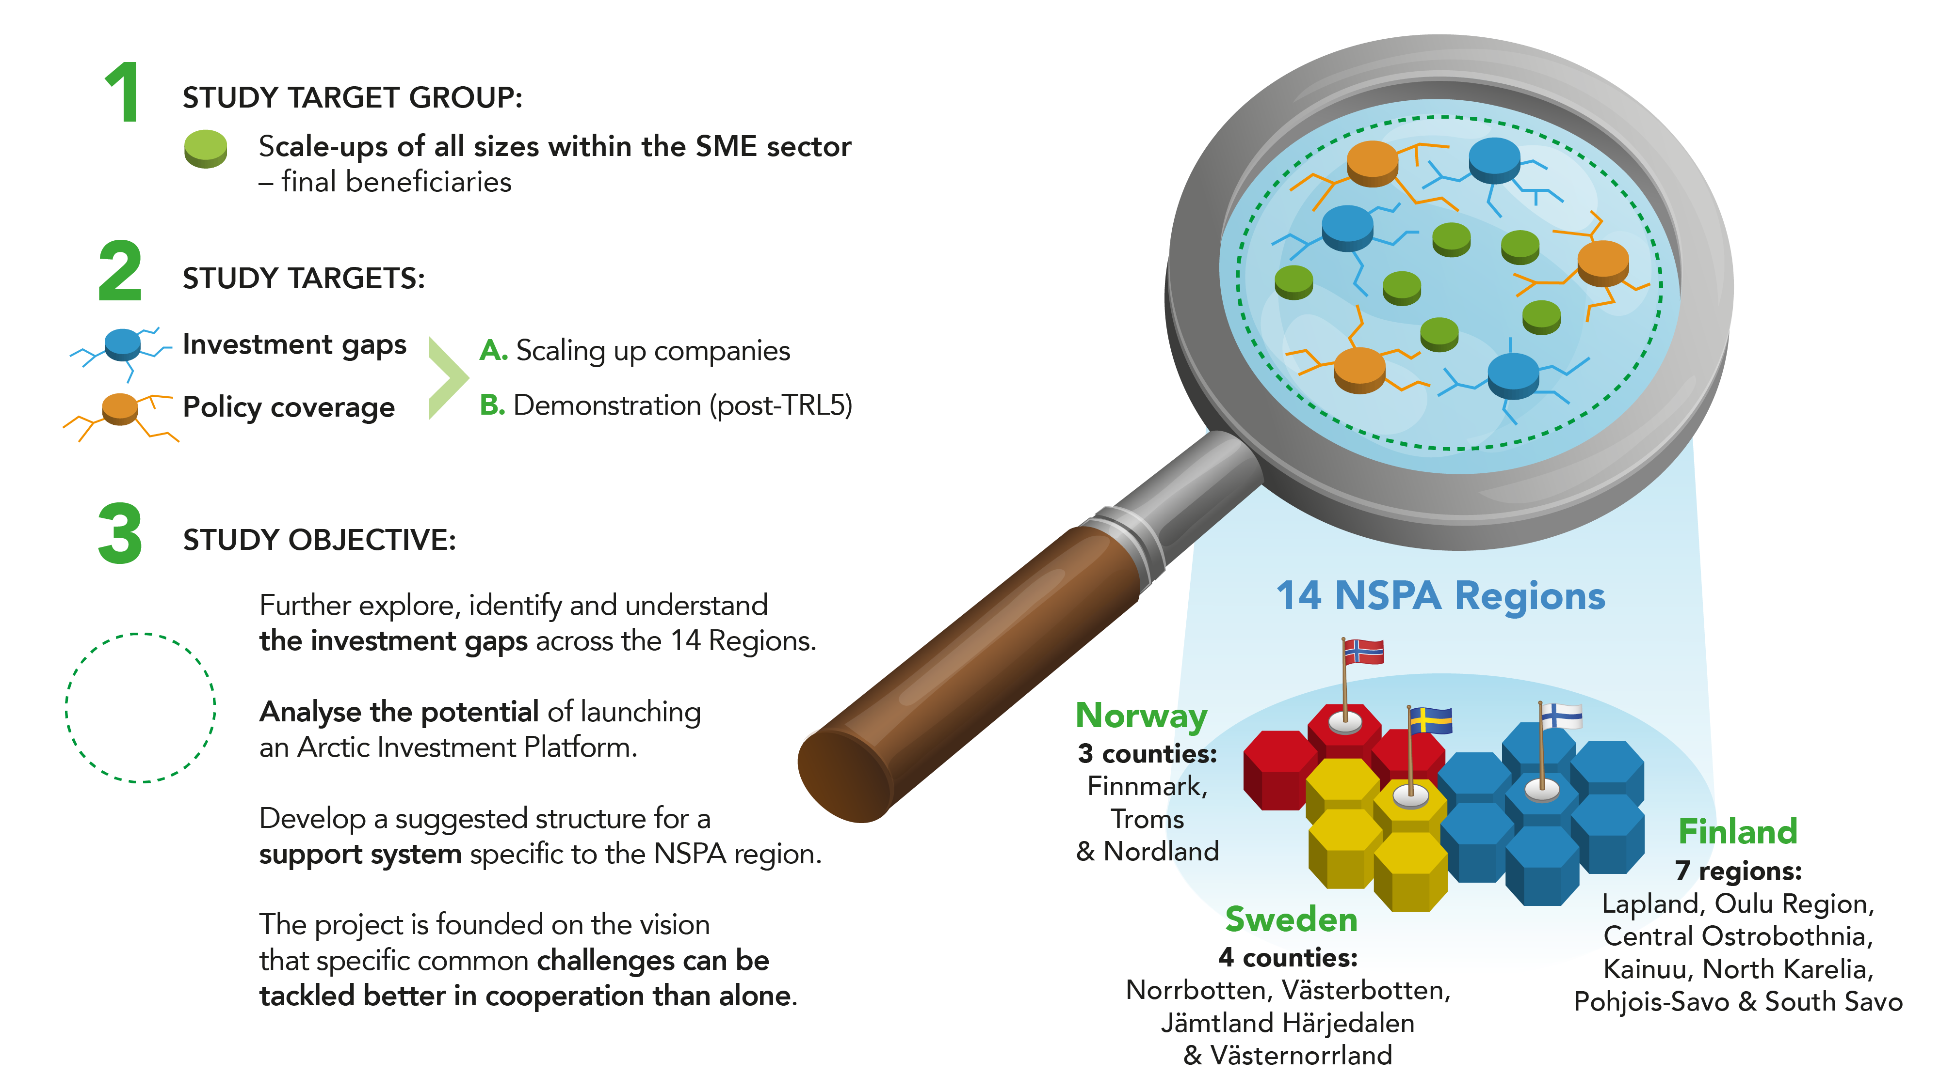

Slide 4
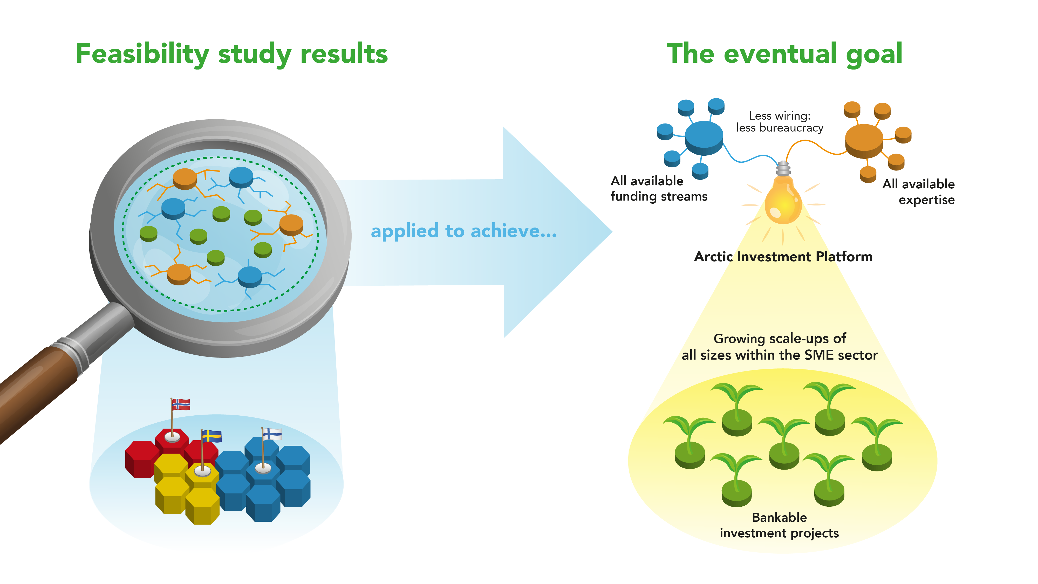

Slide 5
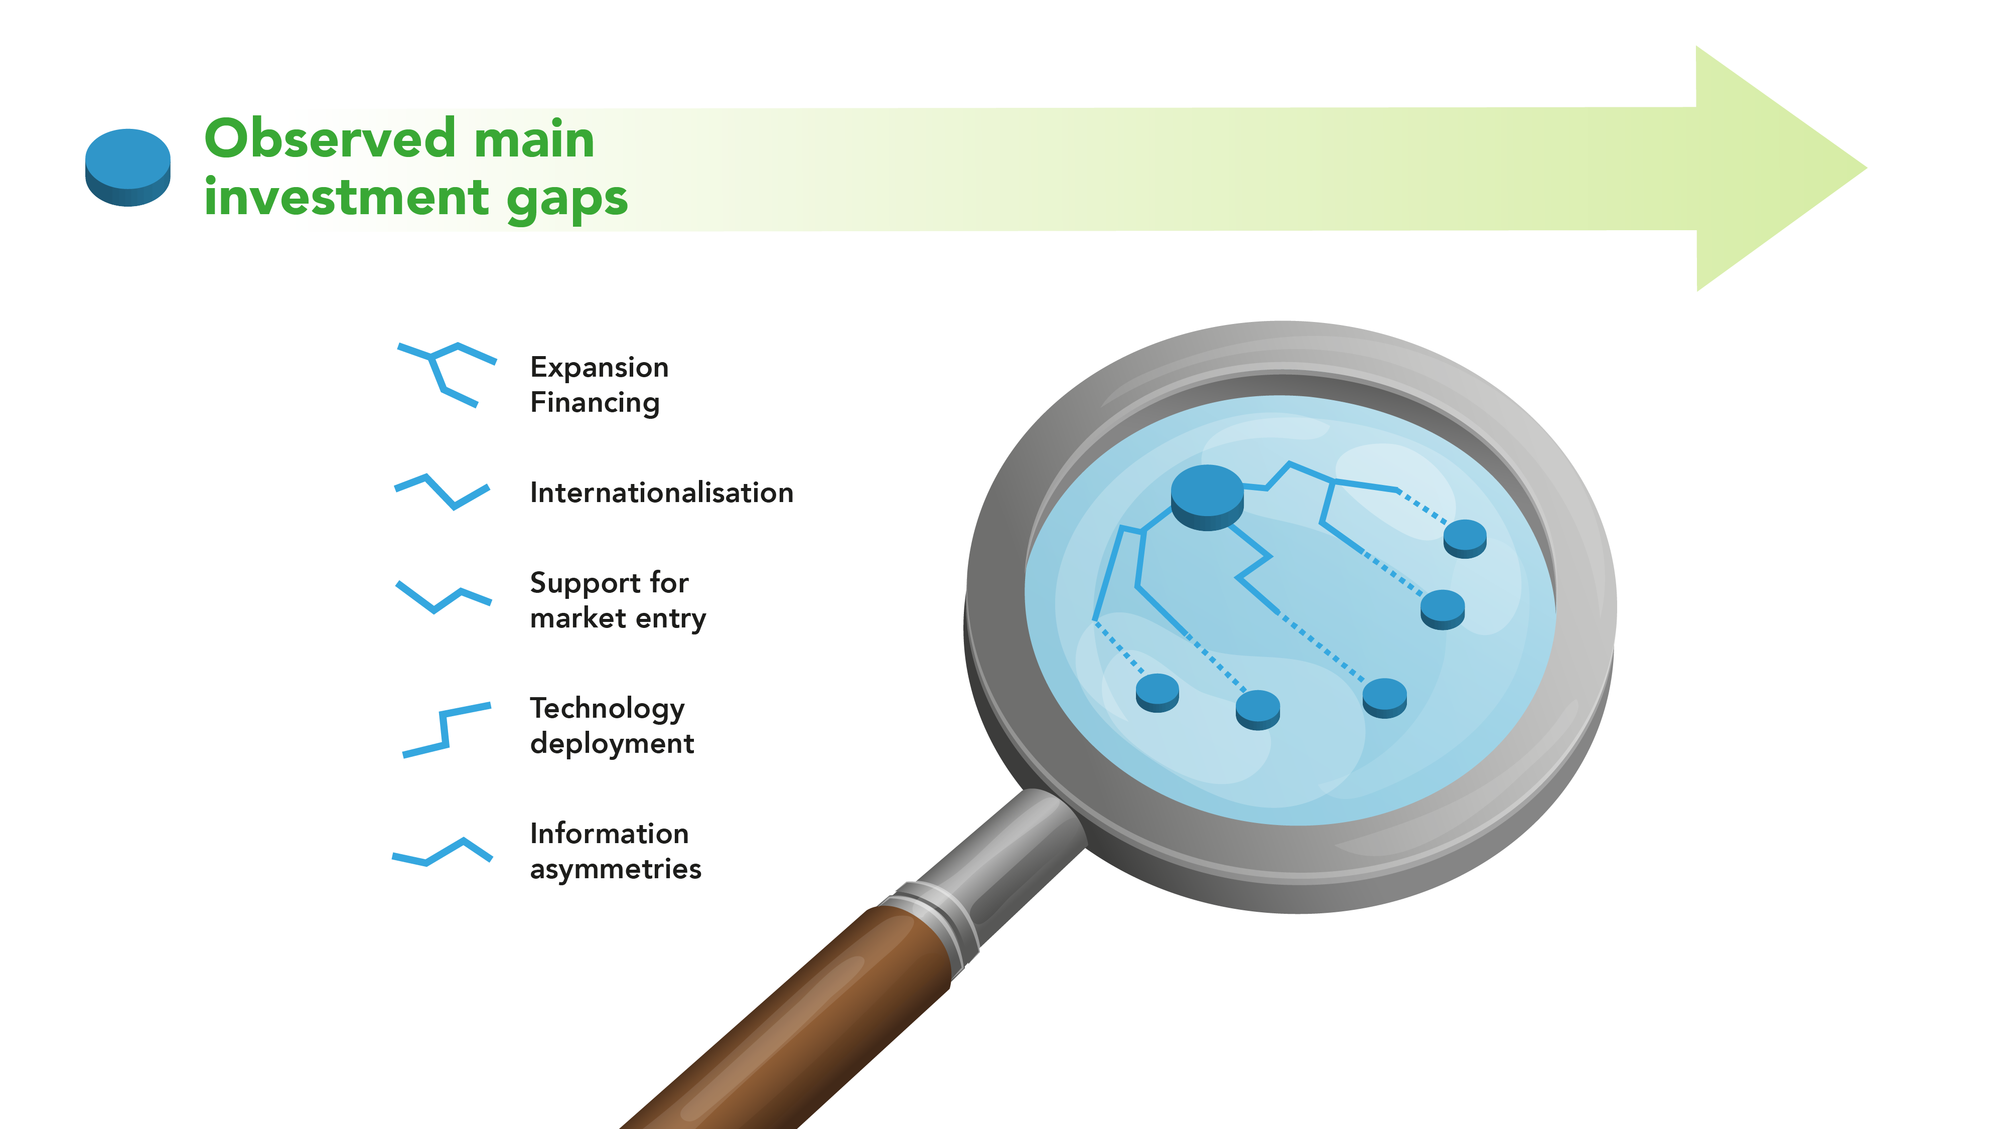

Slide 6
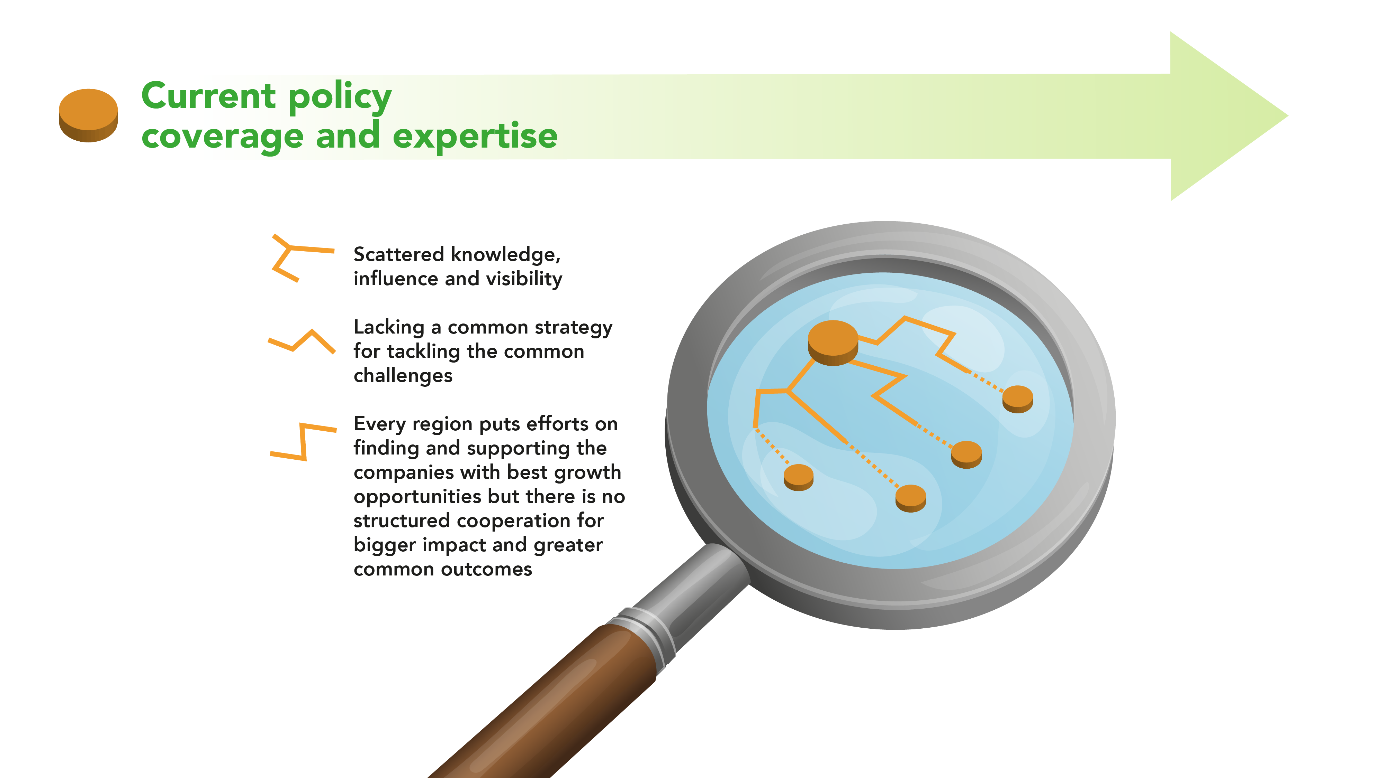

Slide 7
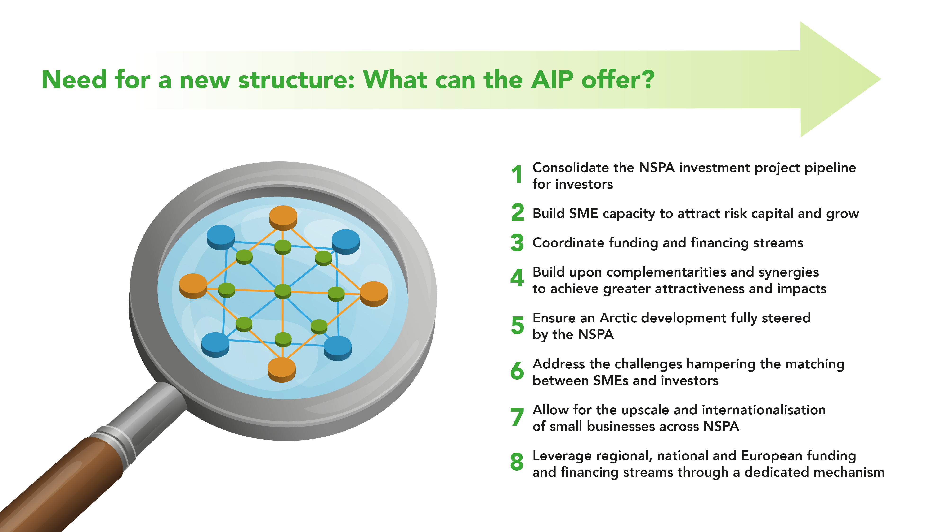

Slide 8
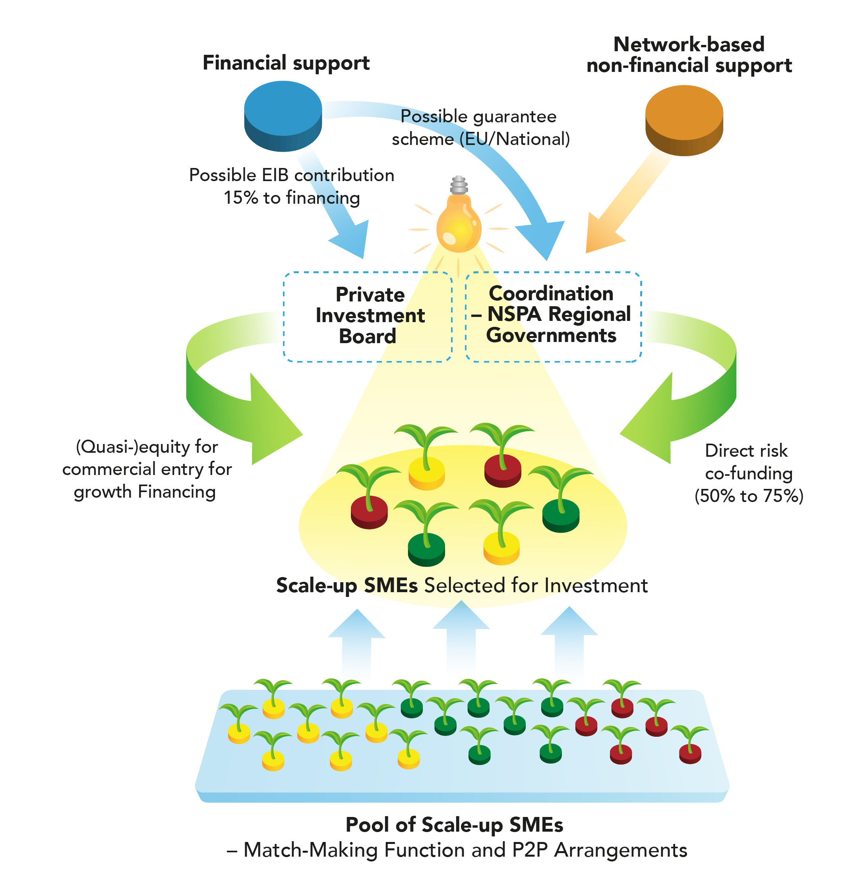
Example of a possible organization of AIP building blocks

Slide 9
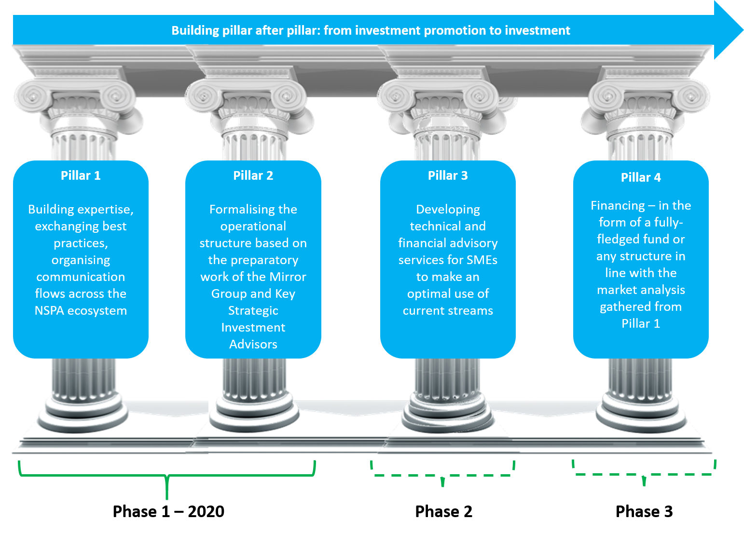

Slide 10
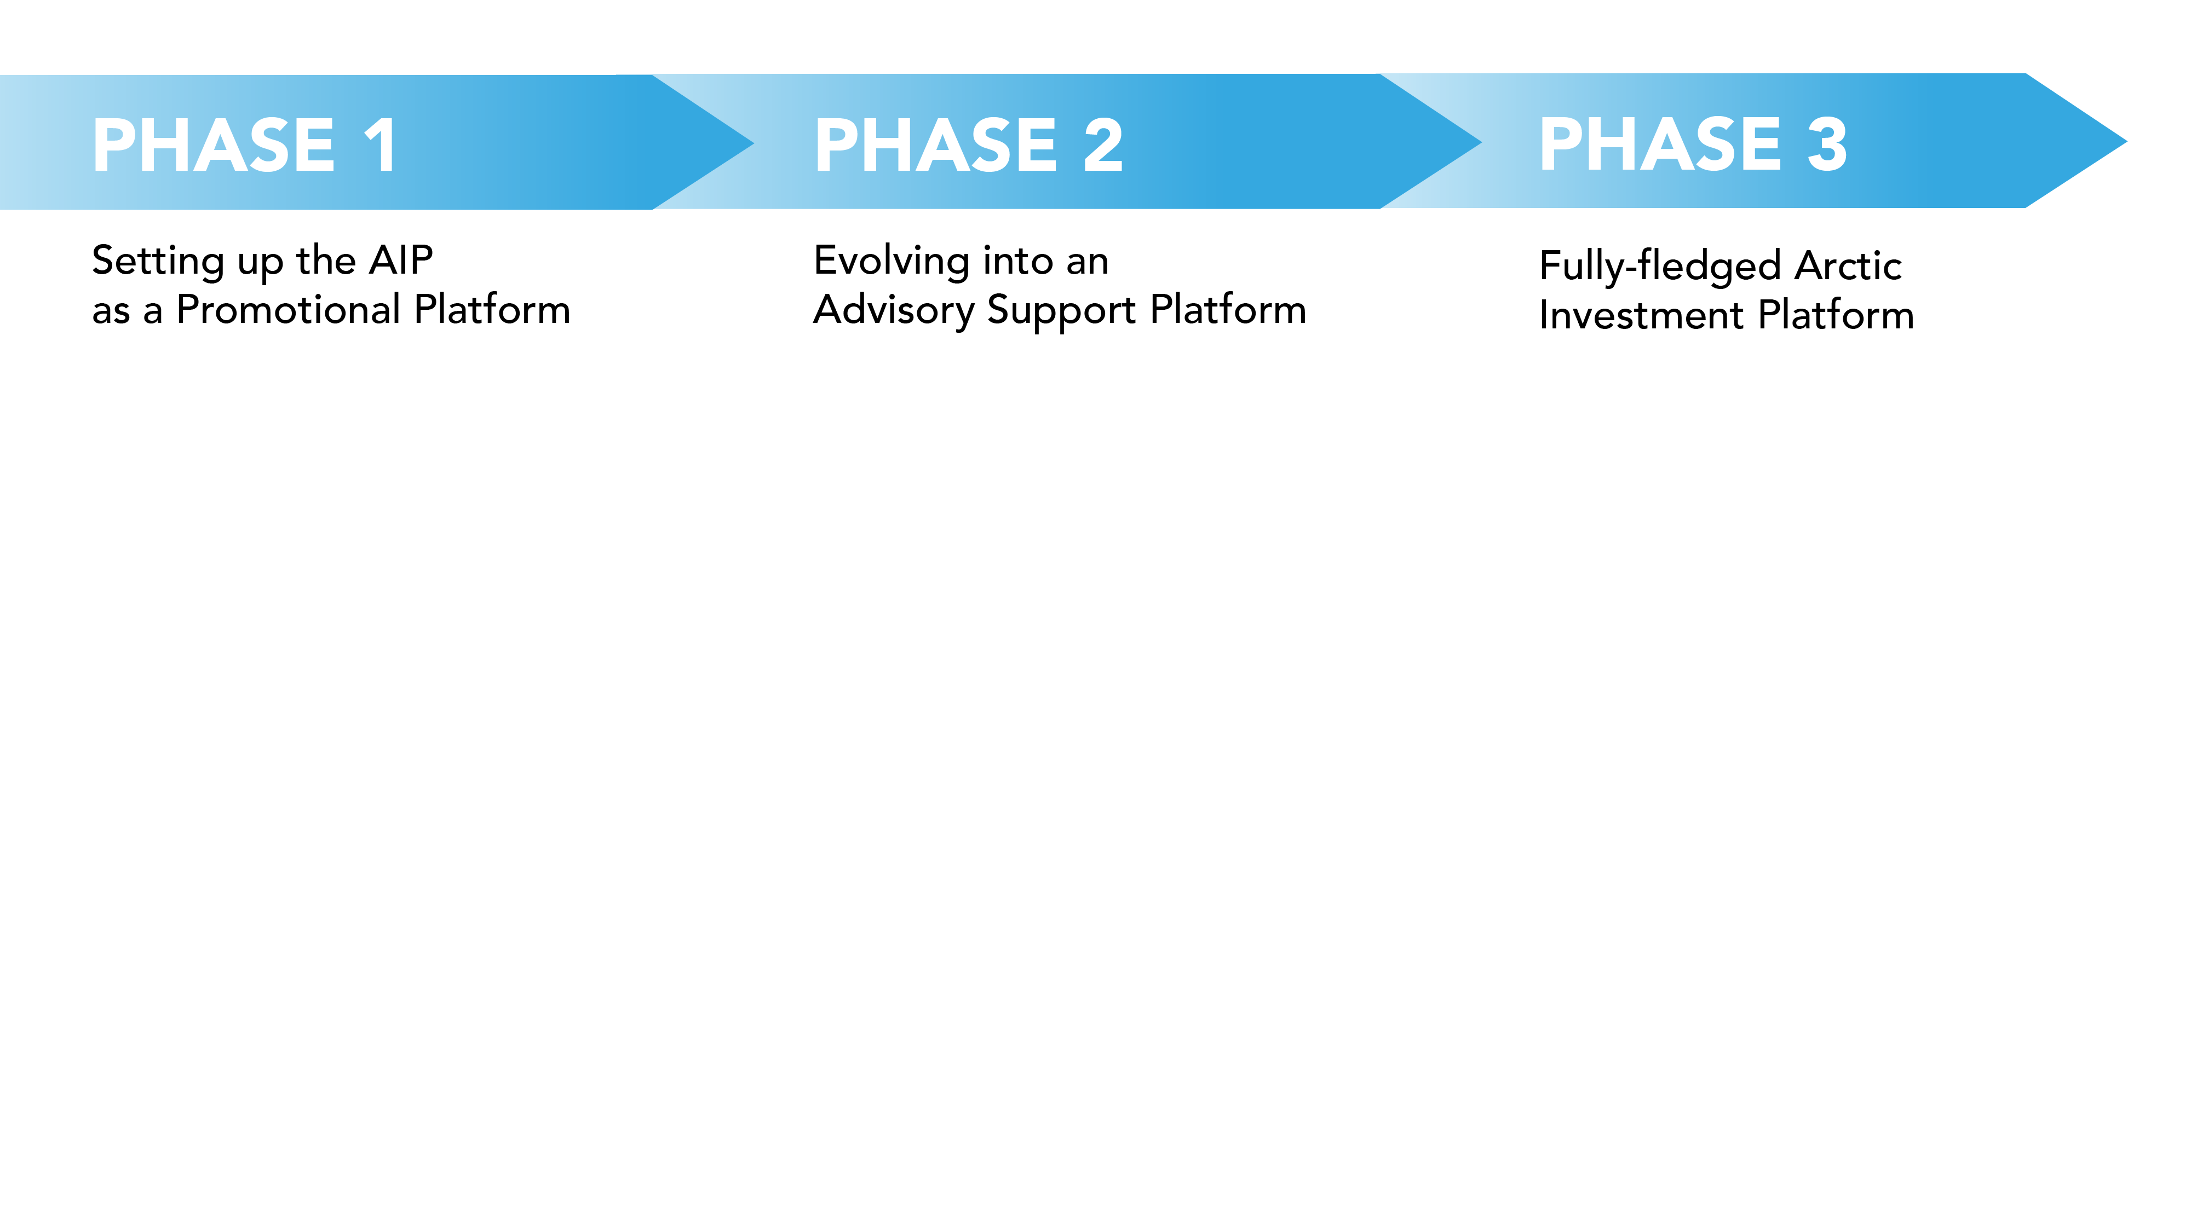

Slide 11
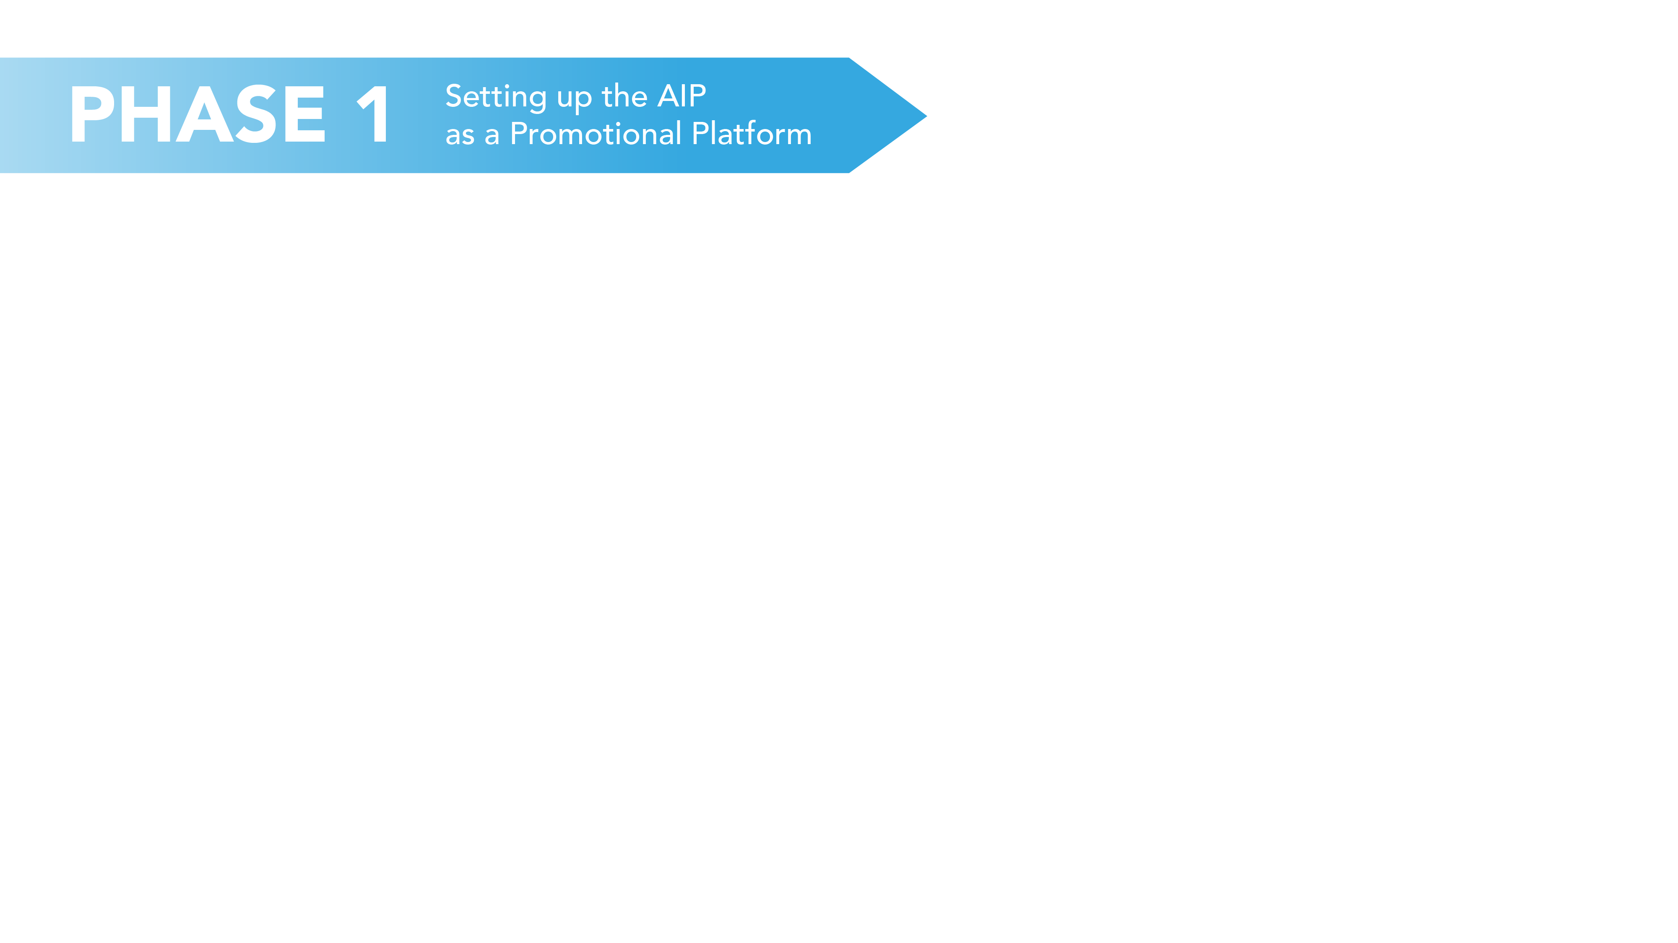


1. Results of feasibility study and road map validated by NSPA regions
2. Draft Memorandum of Understanding (MoU) between NSPA regions for setting up the AIP
3. The MoU discussed internally and pre-validated by regions
4. The MoU will be finalised in view of an official launch during the Polar Bear Pitching in March in Oulu.
5. Validation of the design and key activities to be implemented by the AIP including its first Board Meeting and a structure (most likely set around two key groups: the Board and the Stakeholders Group)
6. Relevant steps will be taken to build up the administrative structure of the platform and the formal kick-off of the platform activities for Pillars 1 and 2. These activities would be mainly oriented toward the promotion of Arctic investment, raising awareness and creating visibility for business investment opportunities in the NSPA. Relevant investment projects could for instance be scanned and operations could be undertaken to match the supply and demand sides (identifying valorisation and communication opportunities, etc.) while organising the community.
7. A first progress report submitted by the coordinator of the AIP by the end of 2020, marking a key milestone in the process.

Slide 12
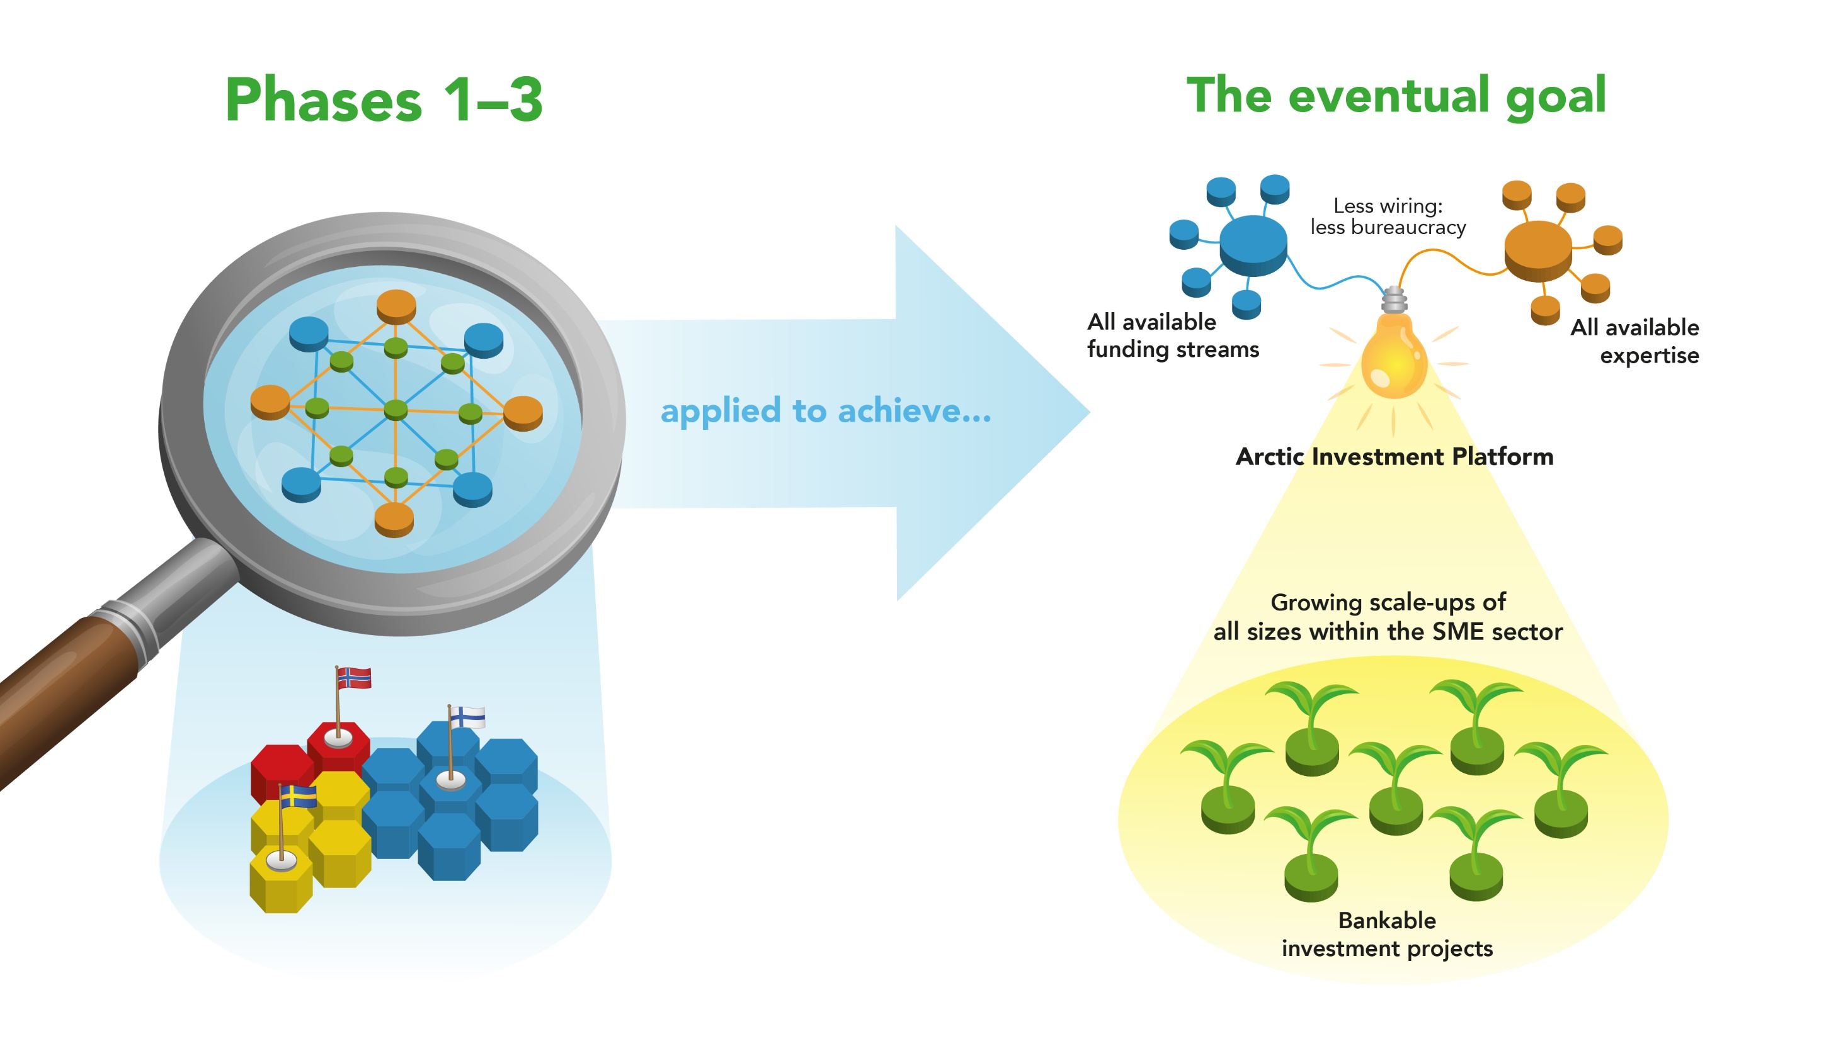

Slide 13
