Slide 1
Introduction to the process and ambitions of the Arctic Investment Platform
Umeå 3 October 2019
#arcticinvestmentplatform

Slide 2
Why more structured funding cooperation?
Common challenges and shared goals
European Commission Arctic Communication 2016: Lack of investments in the European Arctic
OECD report 2017: A more structured collaboration could be established to bring together investors and improve SME access to finance
History of cross-border cooperation in the NSPA but still room for improvement (leverage through common strategy -> transforming local challenges into European opportunities)

Slide 3
Why an Arctic Investment Platform?
Knowledge and information sharing for the common good of the NSPA
Bridge existing investment gaps
Provide financial & network-based non-financial support
Increase awareness of investment opportunities in the NSPA

Slide 4
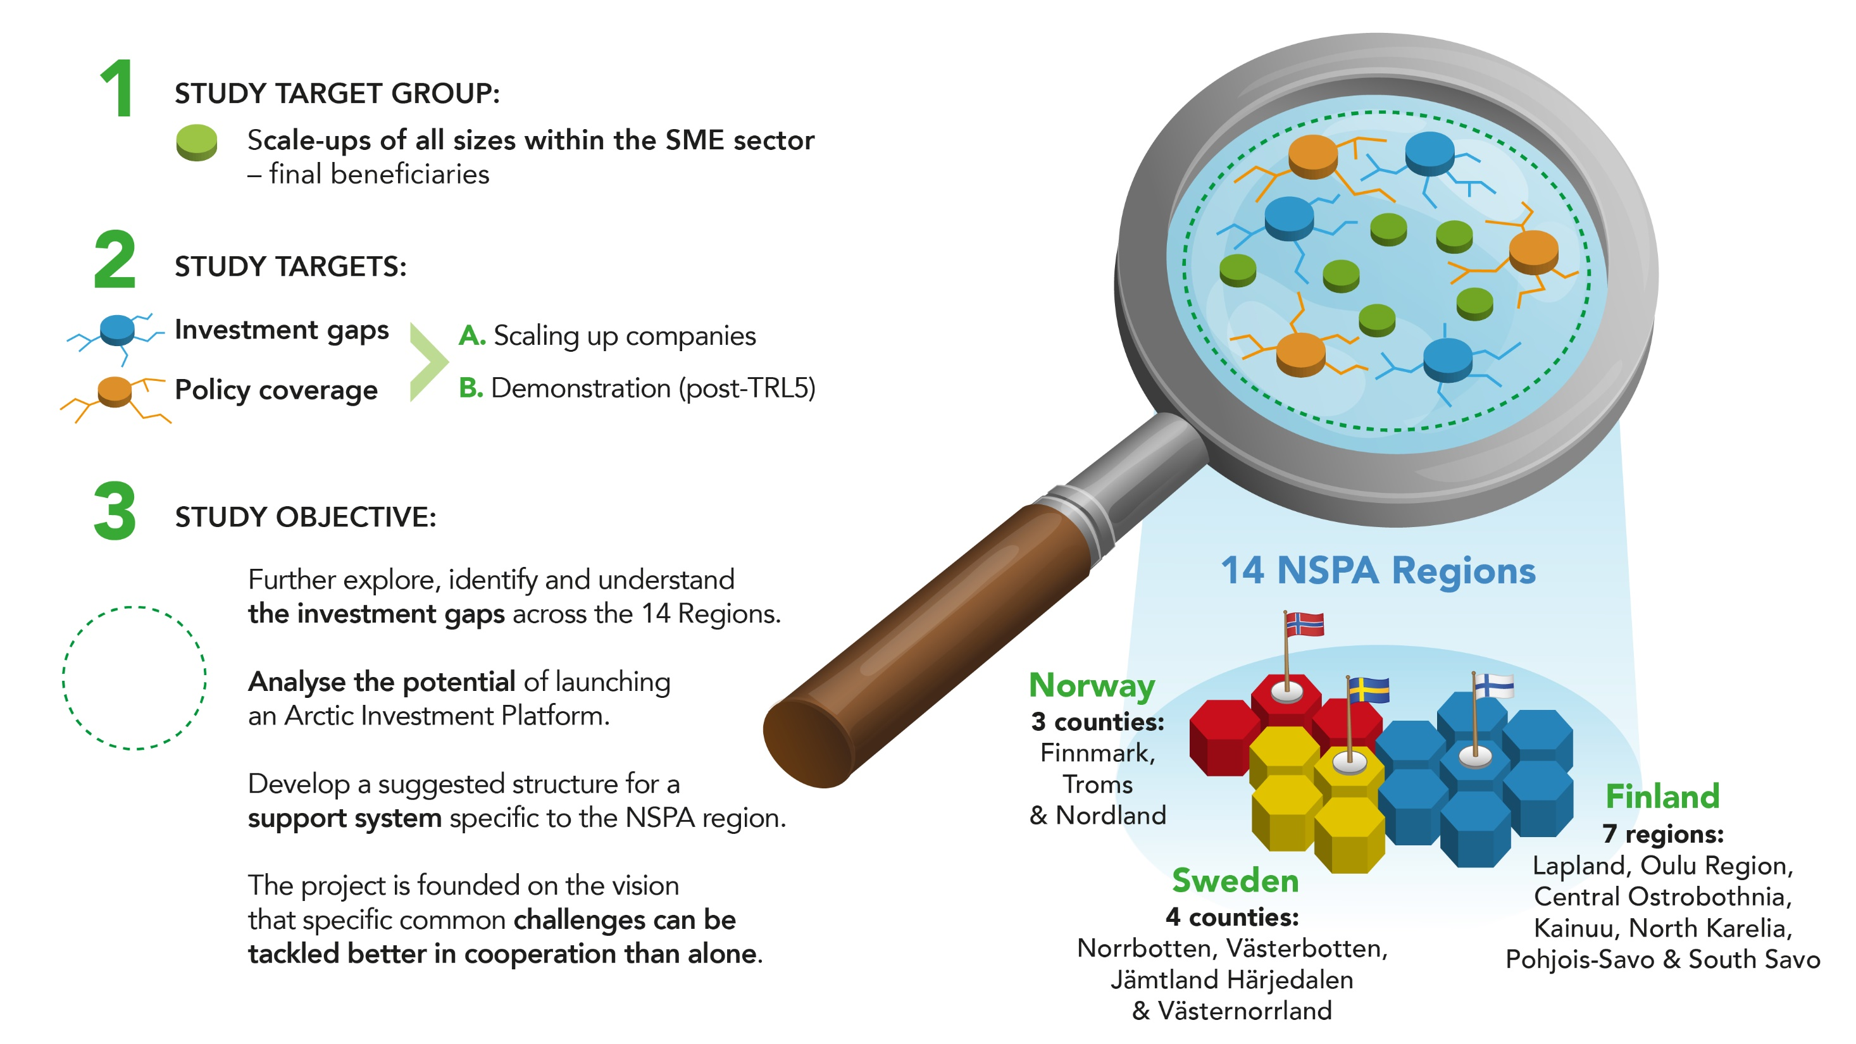

Slide 5
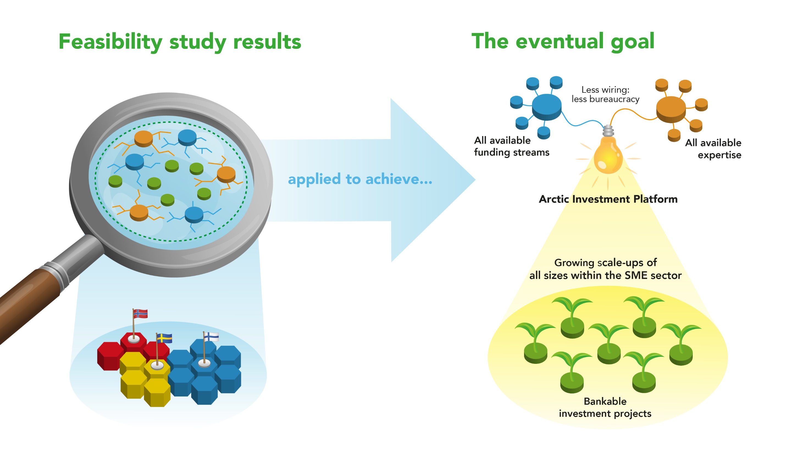

Slide 6
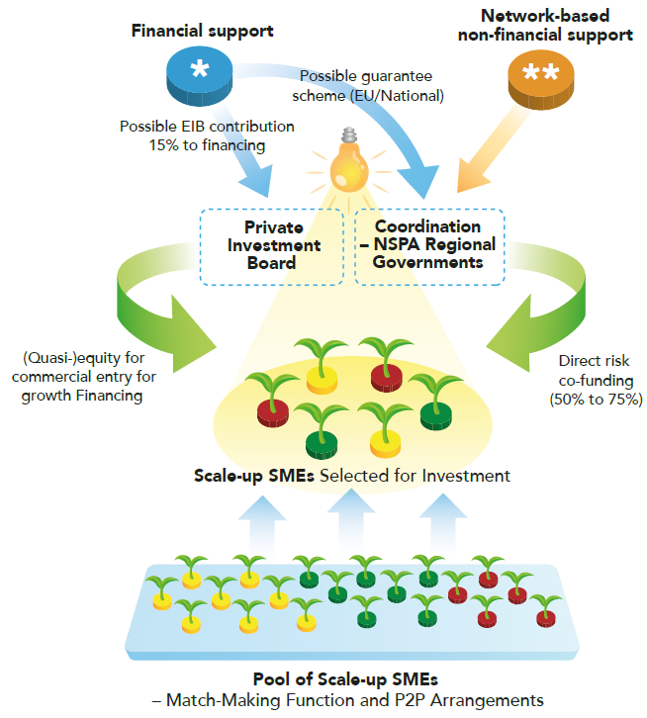
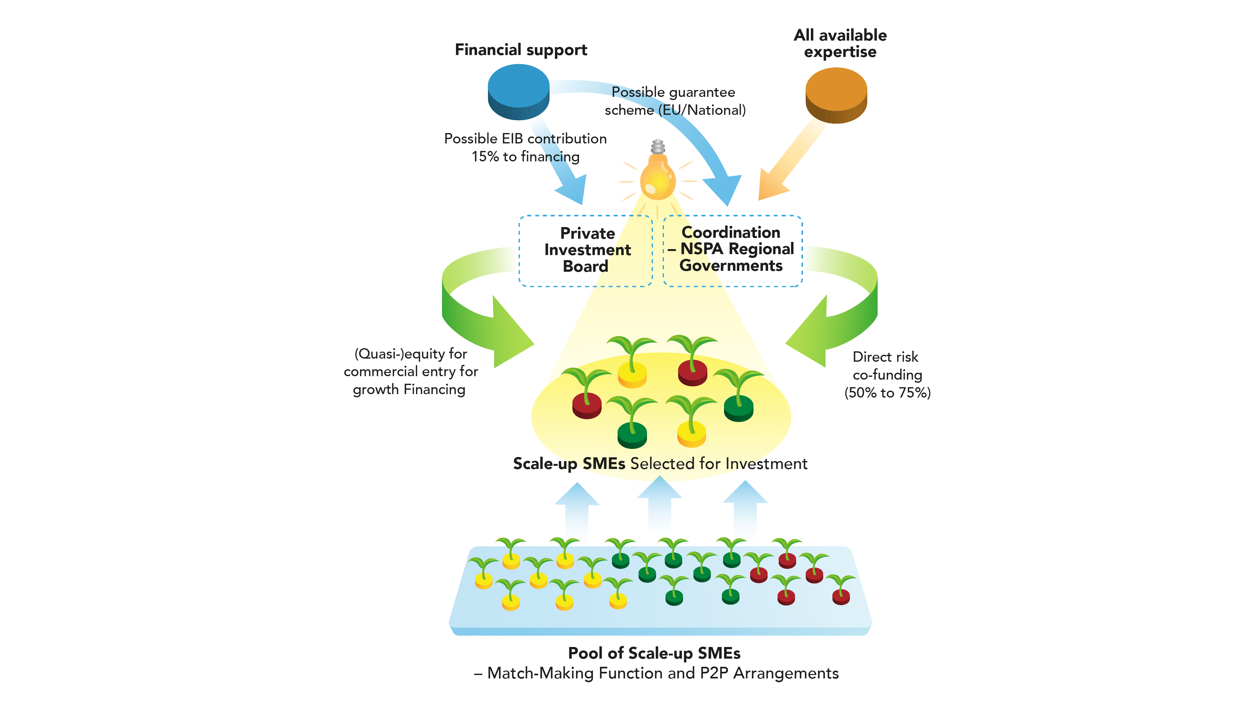

Slide 7
Key results of pre-feasibility study
Cross-regional investment opportunities confirmed
Arctic Added Value identified
Additional layer needed
Early suggestion on roles of public/private stakeholders
A stronger focus needed, without risking critical mass

Slide 8
Further specifying the focus through a fully-fledged feasibility study
  The Arctic Investment Platform should focus on:
  the potential of investing in value chains derived from Digitisation and a sustainable use of Arctic Natural Resources instead of specific sector(s)
  Project maturity rather than company maturity
  Surveys to SMEs with investment plans, potential financiers & cluster organisations clarify the supply and demand side of investments.

Slide 9
Next steps in the work towards an AIP
September-November: Reactions on early results of surveys (financial experts & regional representatives) and analysis on demand and feasibility
October-November: Additional secondary data – recommendations of financial experts to be discussed with project partners and regional representatives within a week from now
By the end of the year: Ready feasibility study with road map
2020: Preparing the implementation phase

Slide 10
