Slide 1
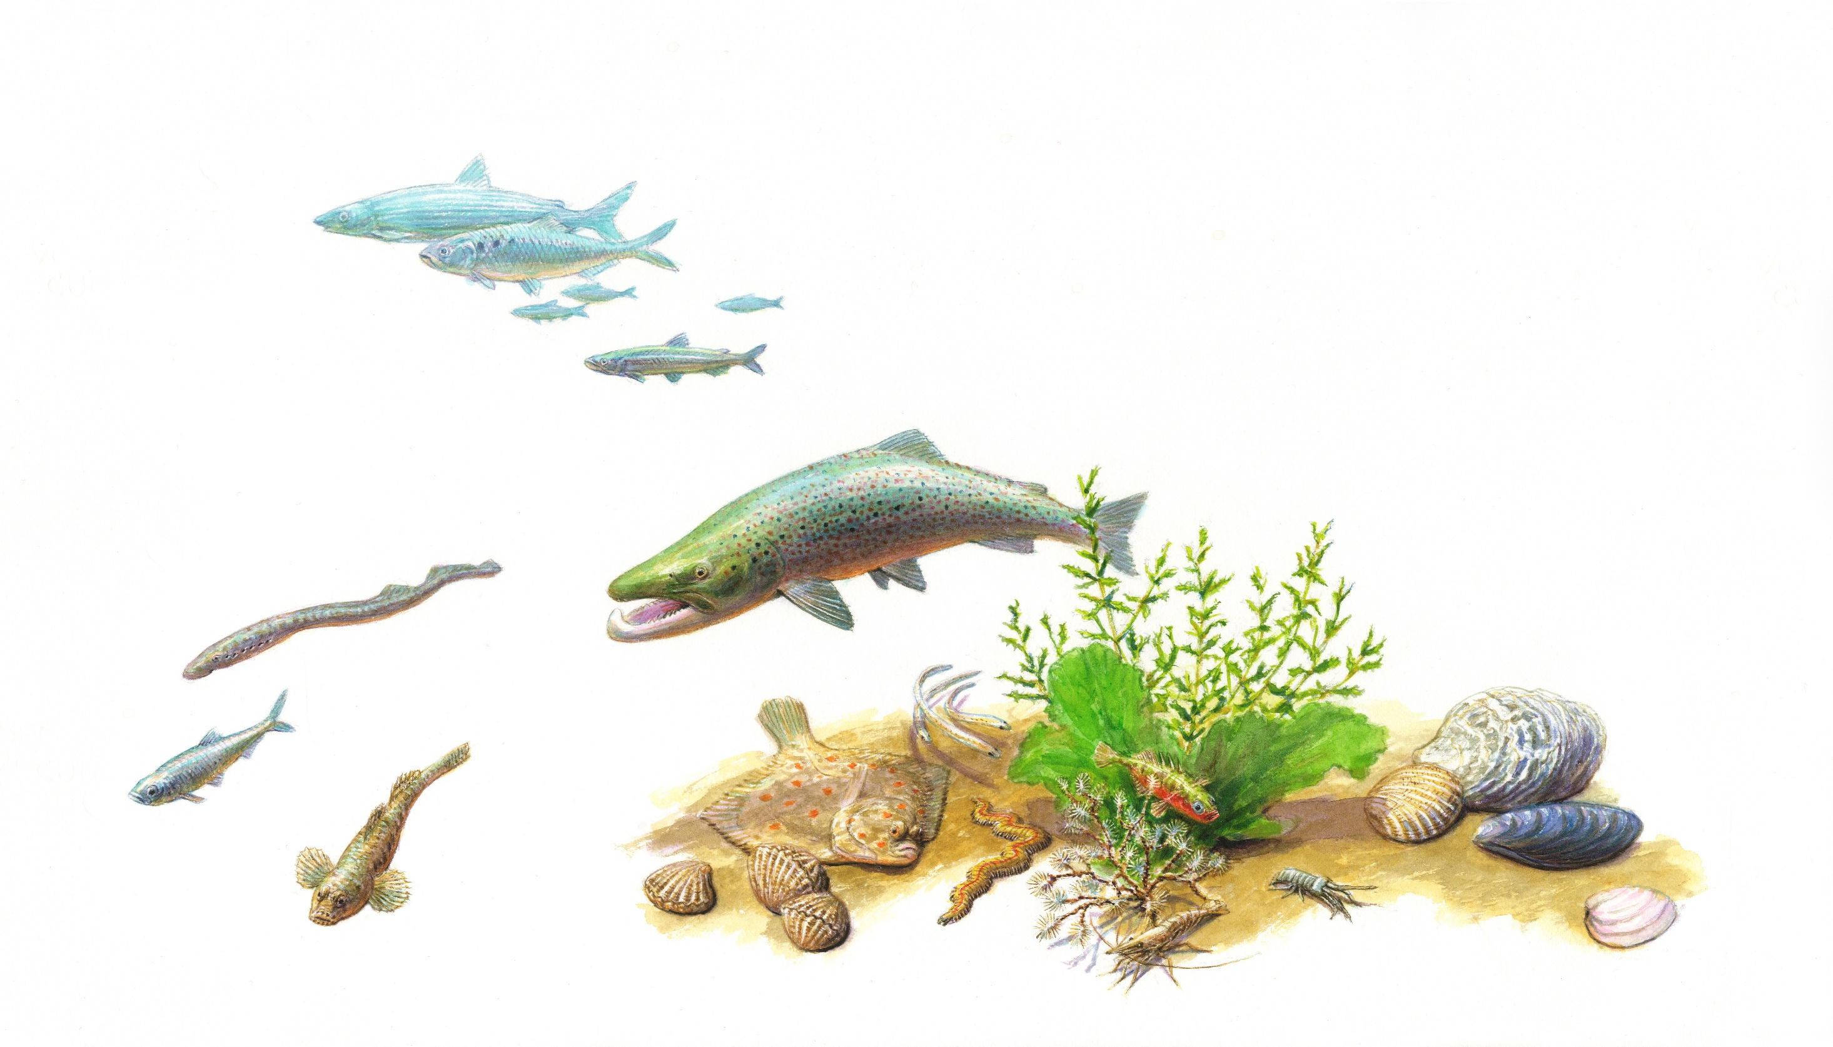

Workshop Fish Migration
March 4, 2021
Tekening: Jeroen Helmer, ARK natuurontwikkeling
Notes:
Welcome everybody!
Today’s workshop is all about a well studied subject: migratory fish in the river Rhine.

Slide 2
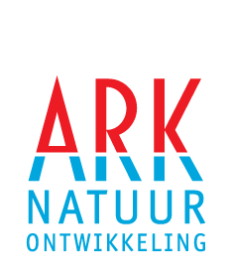



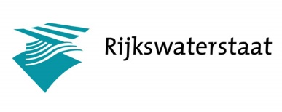









Project partners
Financing parties
Notes:
The program is offered to you by the project partners from the Green Blue Rhine Alliance
A cross-border cooperation between Germany and the Netherlands
Financed by Europe and German and Dutch Ministries and Provinces, and nature NGO’s
Together, within this quite large project we work on several themes:
. flood plain restoration
. connectivity for otters
. and restoration of migratory fish

Slide 3
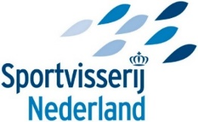
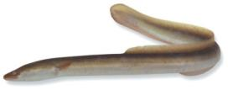

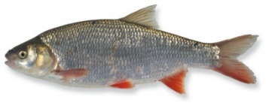

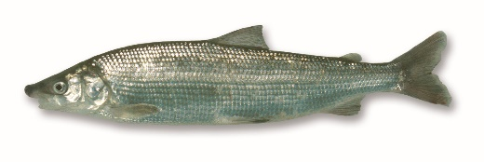
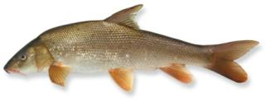
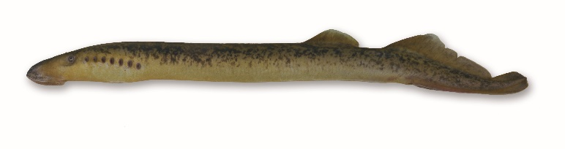
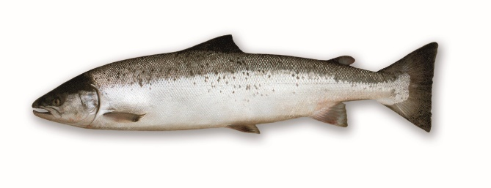

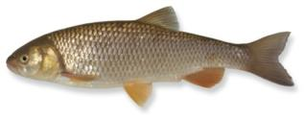
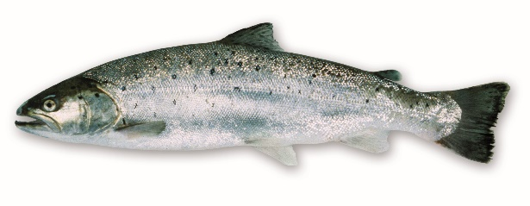

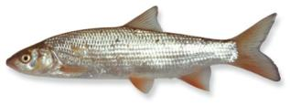
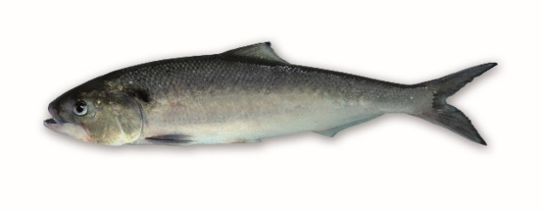
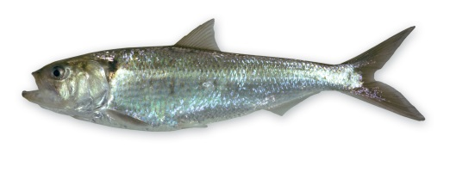
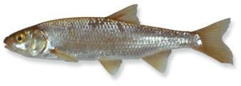
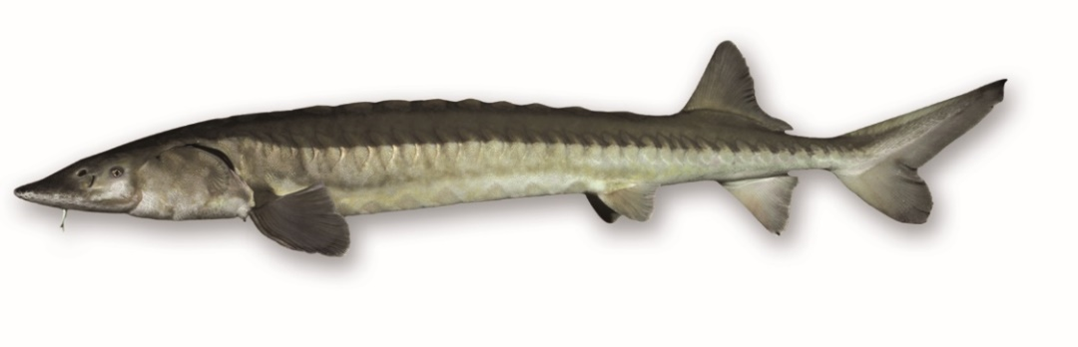
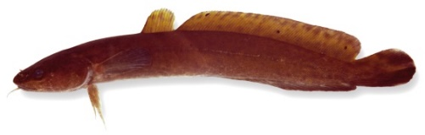
River Rhine Migratory Fish
Diadromous
Potamodromous
II
European eel (Anguilla anguilla)
Three spined stickle back
(Gasterosteus aculeatus aculeatus)
Smelt
(Osmerus eperlanus)
Ide (Leuciscus idus)
II + IV
Houting (Coregonus oxyrinchus)
II
Sea lampreay (Petromyzon marinus)
V
Barbel (Barbus barbus)
II + V
Atlantic salmon (Salmo salar )
II + V
River lamprey (Lampetra fluviatilis)
Chub (Squalius cephalus)
II
Brook lamprey (Lampetra planeri )
Sea trout (Salmo trutta)
Nase (Chrondostroma nasus)
II + V
Twait shad (Alosa fallax)
II + V
Allis shad (Alosa alosa)
Dace (Leuciscus leuciscus)
CITES
Habitats Directive
I
II + IV
European sturgeon (Acipenser sturio)
Burbot (Lota lota)
Red List
Notes:
What you see here, is an overview of the Rhine’s migratory fish
To the left of this blue vertical line fish that migrate between fresh water and the sea
To the right of the blue line, there are fish that migrate within fresh water
These fish have issues, as you can deduce from their protected status
Such issues can be migration barriers, like dams, sluices, weirs, hydropower plants
And there some other issues which will be addressed within this workshop
But we will also look forward towards solutions and possibilities

Slide 4
Workshop Fish Migration
Time | Subject | Organisation | Speaker
13:00-14:15 | Opening | SVNL | Niels Brevé
 | Conjoint fish sampling DE–NL | BRG Düsseldorf/RWS | Nicole Scheifhacken & Margriet Schoor
 | Stow net fisheries Lower Rhine | RhFV/SVNL | Andreas Scharbert & Roland van Aalderen
 | Plastic sampling | RWS/RU | Margriet Schoor
 | Fish migration between River and Flood Plain | RWS | Luc Jans
14:15– 14:30 | BREAK
14:30-15:45 | Sturgeon habitat River Rhine | ARK | Bram Houben
 | Shipping and eel mortality in the Rhine | ATKB | Max van de Ven
 | Mechanical damaged eels | RAVON | Jeroen Tummers
 | Look ahead to follow-up cooperation GBRA | Project manager GBRA | Bernadette Botman
Notes:
So, this is todays program
There are 2 sessions with 4 speakers each, and a short break in between of 15 minutes
We will finish at approximately a quater to four.
Each speaker has 15 minutes in total.
At the end of this work shop, the last speaker is project manager Bernadette Botman, project manager of the GBRA program
--- --- ----
Ok, then this is the moment that I would like to hand over the word to our first speaker of today
Nicole Scheifacken from the Bundes Regierung Dusseldorf
Your talk will be on conjoint fish sampling in Germany and the Netherlands
We look very much forward to that
So, when you are ready, Nicole, the stage is yours

