Slide 1
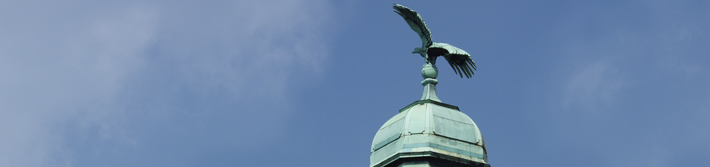

Conjoint fish sampling GBRA Interreg DE-NL Dr. Nicole Scheifhacken, BR D Margriet Schoor, RWS Düsseldorf, 4. März 2021

Slide 2
Examples of fish monitorings during GBRA
Conjoint monitoring RWS - BRD Lower Rhine – Waal 2020 (Report Van de Ven et al. in prep. 2021)
Sea and River Lamprey monitoring Summer 2019
Lower Rhine and related tributaries (Scharbert et al. 2020)
Fish monitoring – Seine net, eDNA, autumn 2018
French, Dutch teams: Juveniles Allis shad, Lampreys, others, Clavé et al. 2019, Dorenbusch et al. 2019
Fish monitoring – Drift net main channel, spring 2018
Allis shad, Sea lamprey upstream migration, potamodromous species, Clavé et al. 2019
Fish damages during water abstractions Rhine (2011-2020)
Evaluation and statistics of reports and data:

Slide 3

Conjoint monitoring RWS - BRD Lower Rhine – Waal 2020
Main focus:
Comparison of riverine habitats using Dutch and the NRW sampling standards
Focus on juvenile rheophilic species
Comparison of protocols and results of different sampling methods
Identification of differences and similarities
Determination of general rules and conversion rates data collected

Slide 4
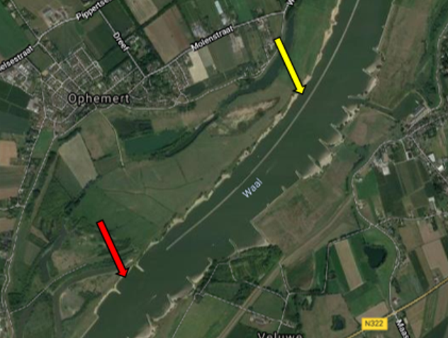
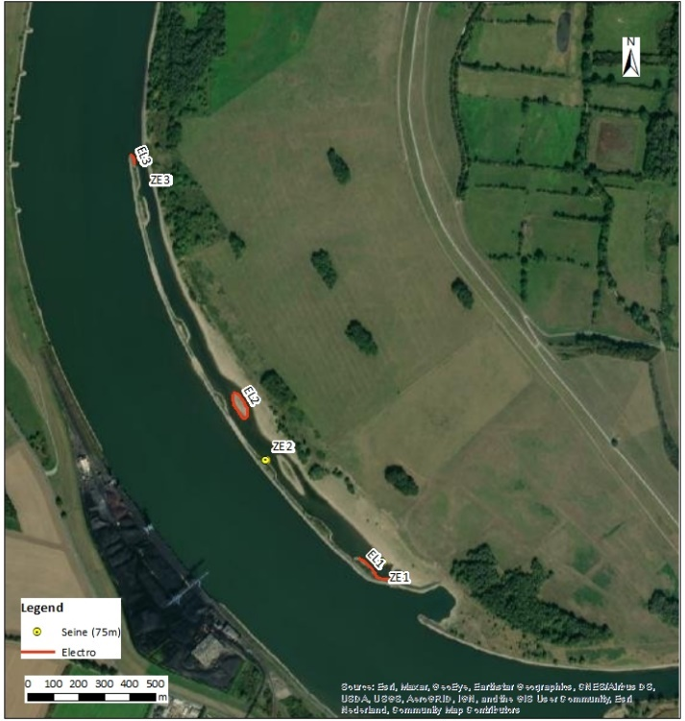
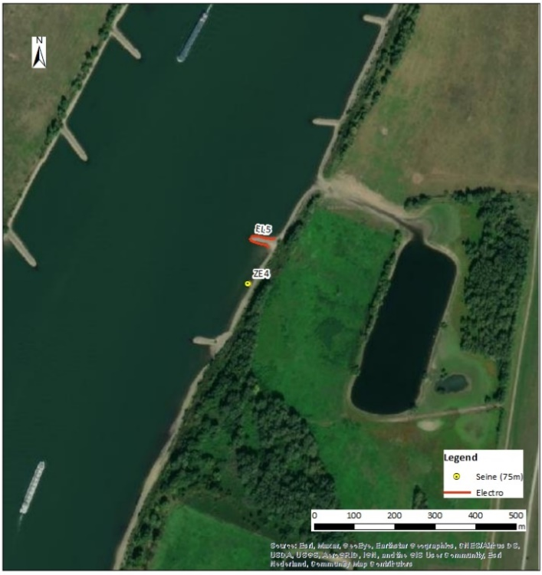
4 Sites
Ophemert Langsdam, Waal, NL
Groyne field, secondary channel
Walsum, groyne field and side channel, Duisburg NRW
Van de Ven et al. report in prep. 2021
Notes:
Research area "Langsdam Ophemert" in the Waal near Ophemert in the Netherlands. Yellow arrow indicates the side channel, the red arrow indicates the groyne field.

Slide 5
Methods used: per site groyne, secondary channel
Electrofishing, point abundance, stretch
Seine net
eDNA – 2 protocols
Venturi dredger (lamprey larvae sediment)
Van de Ven et al. report in prep. 2021
Notes:
BUWAwith a venturi sediment dredger: 46 sediments samples; 23 (Waal near Ophemert (Figure 7) and 23 in the Rhine near Walsum (Figure 8). At each site 18 samples were taken in the secondary channel and 5 samples were taken in the groyne field.

Slide 6
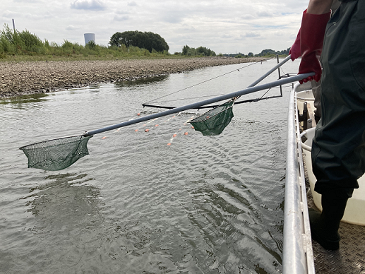
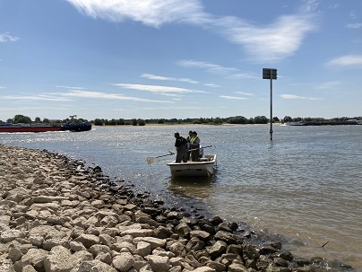
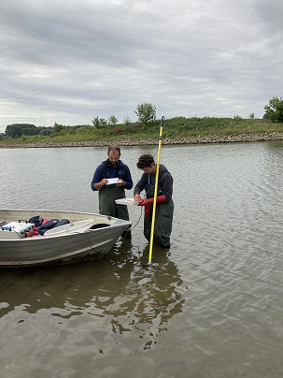
Electrofishing – Boat Dutch
Stretch NRW
Point abundance, NRW
Fotos SN 2020
Notes:
BUWAwith a venturi sediment dredger: 46 sediments samples; 23 (Waal near Ophemert (Figure 7) and 23 in the Rhine near Walsum (Figure 8). At each site 18 samples were taken in the secondary channel and 5 samples were taken in the groyne field.

Slide 7
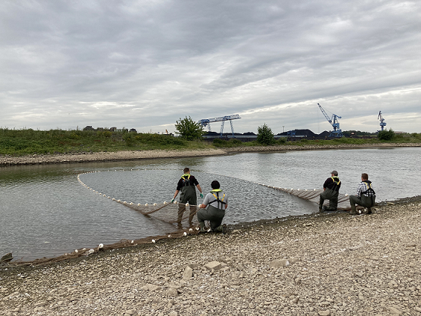
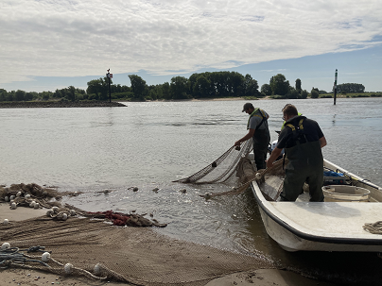
Methods used: per site groyne, secondary channel
Seine net Walsum Ophemert
Van de Ven et al. report in prep. 2021
Notes:
BUWAwith a venturi sediment dredger: 46 sediments samples; 23 (Waal near Ophemert (Figure 7) and 23 in the Rhine near Walsum (Figure 8). At each site 18 samples were taken in the secondary channel and 5 samples were taken in the groyne field.

Slide 8
Ecological guilds
diadromous-katadromous
Anguilla anguilla
Chelon sp.
Platichthys flesus
potamal rheophilic (A)
Barbus barbus
Chondrostoma nasus
Leuciscus leuciscus
Romanogobio belingi
semi rheophilic (B)
Leuciscus aspius
Leuciscus idus
Squalius cephalus
Vimba vimba
eurytopic - lotic
Alburnus alburnus
eurytopic-lotic - allochthonous gobies
Neogobius fluviatilis
Neogobius melanostomus
Ponticola kessleri
eurytopic
Perca fluviatilis
Rutilus rutilus
eurytopic-related to floodplain habitats
Abramis brama
Blicca bjoerkna
Sander lucioperca
floodplain species -autochthonous
Gasterosteus aculeatus
Van de Ven et al. report in prep. 2021

Slide 9
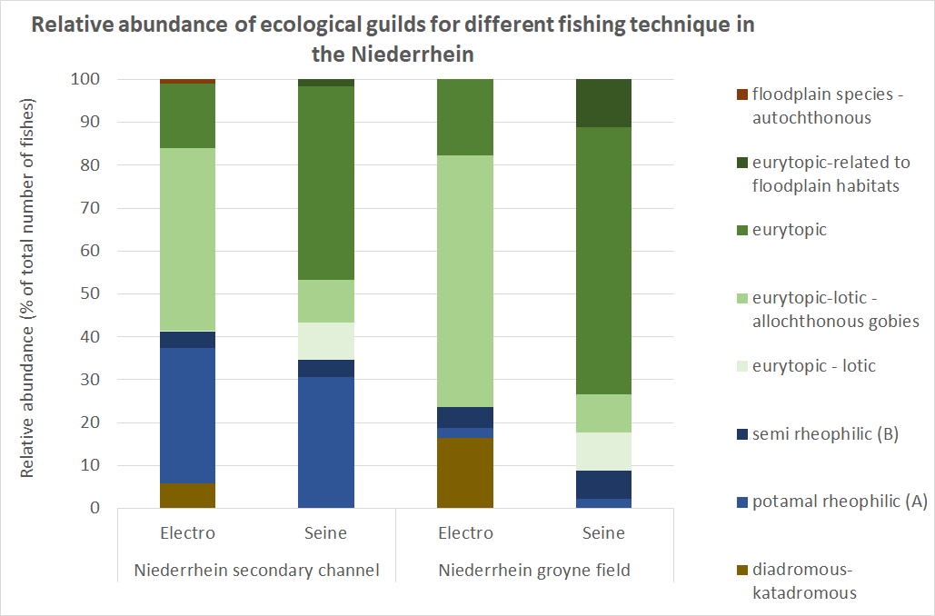
First result
Dutch data only
Van de Ven et al. report in prep. 2021

Slide 10
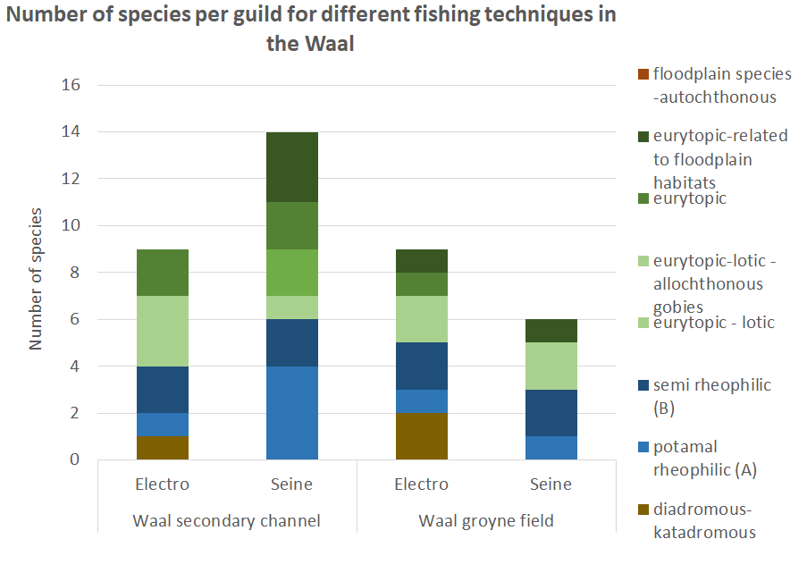
Dutch data only
Van de Ven et al. report in prep. 2021

Slide 11
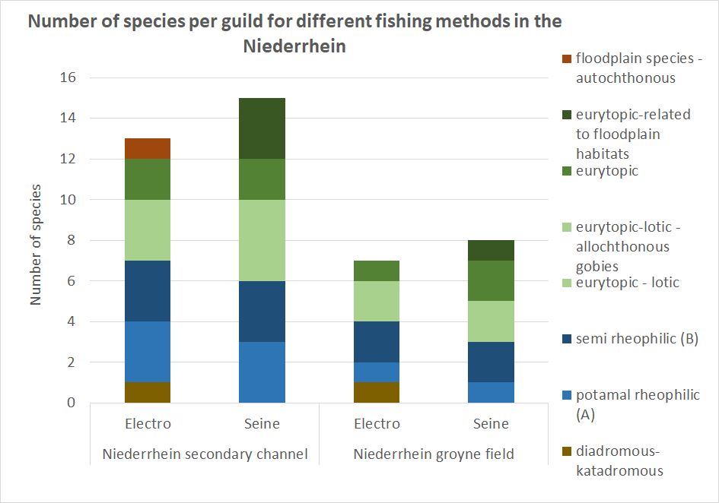
Dutch data only
Van de Ven et al. report in prep. 2021

Slide 12
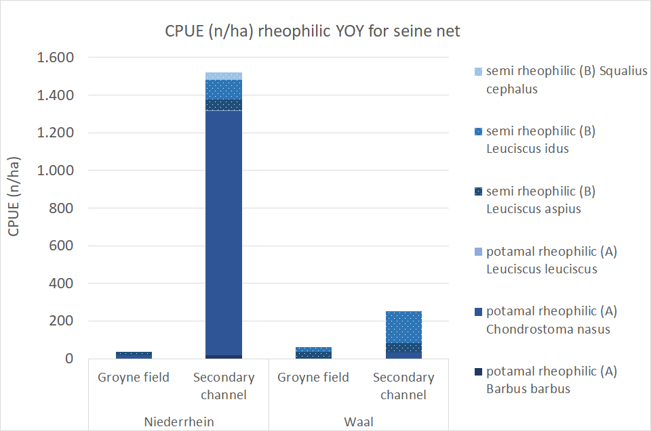
Seine net – rheophilic species YOY
Dutch data only
Van de Ven et al. report in prep. 2021

Slide 13
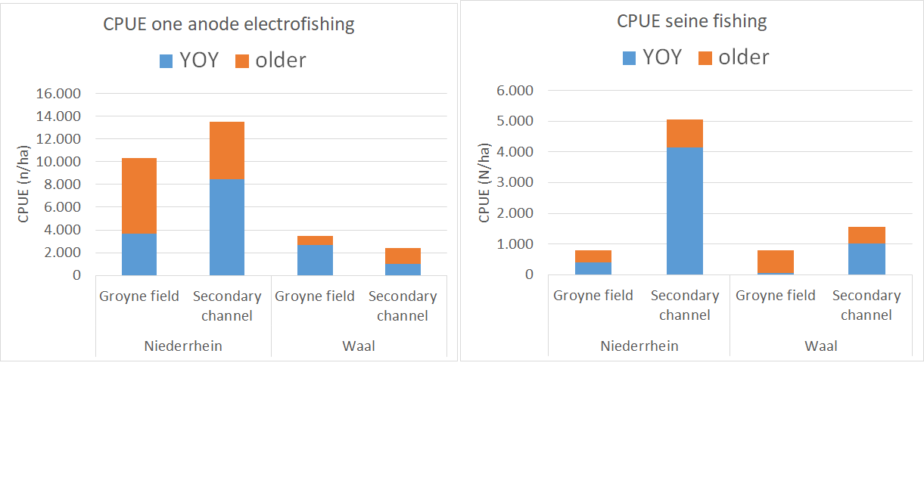
YOY or older – Electrofishing – Seine net
Dutch data only
Van de Ven et al. report in prep. 2021

Slide 14
Comparison of data
Report soon

Slide 15
Thank you for your attention!
Thanks to everyone in the project for their contribution in field sampling and data evaluations !!!

Slide 16
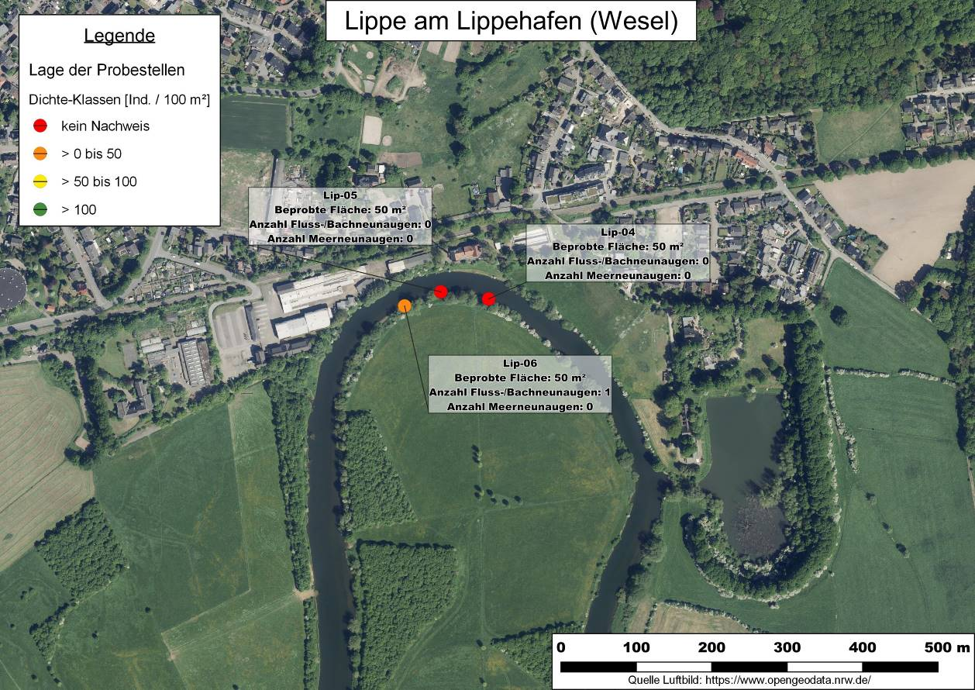
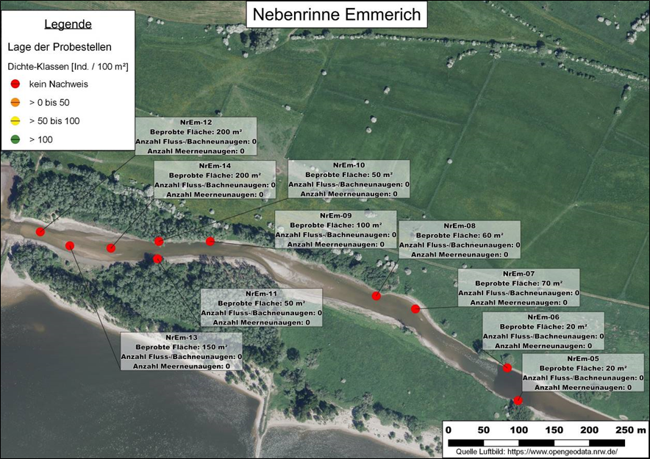
Lamprey (Querder/Transformer) monitoring
Sampled habitats: 184, ∑ area: 48.783 m²
Rhein main channel: 79
including several floodplain habitats
e.g. Emmericher Ward 14
Some tributaries
Lippe13
Wupper 19
Sieg 20
Report Scharbert et al. 2020

Slide 17
Results Sea and River lampreys 2019
Report Scharbert et al. 2020

Slide 18
Results
Lampetra
Petromyzon
Report Scharbert et al. 2020

Slide 19
2018
2019
gauge level during sampling in Aug., Sept. 2019
Report Scharbert et al. 2020

Slide 20
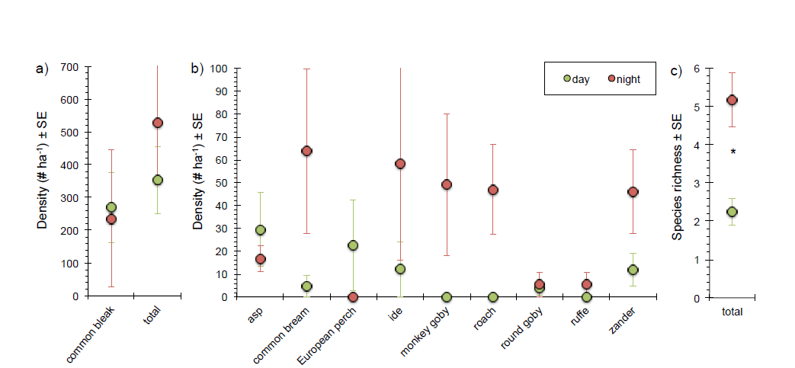
Seine net 2018 differences: day - night
p < 0,001
Report: Dorenbusch et al. 2019

Slide 21
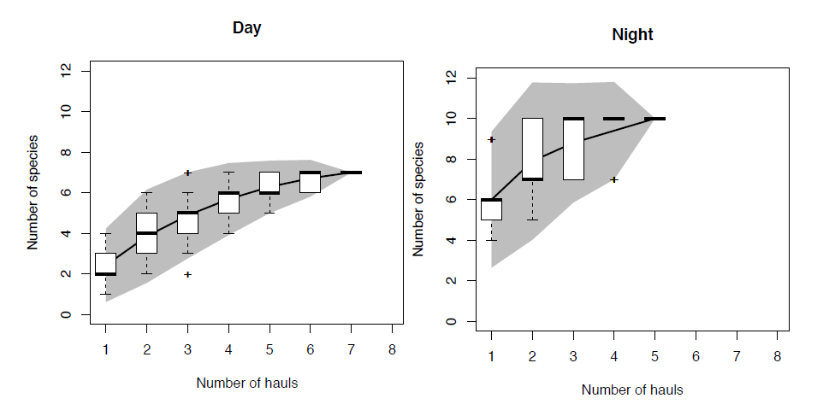
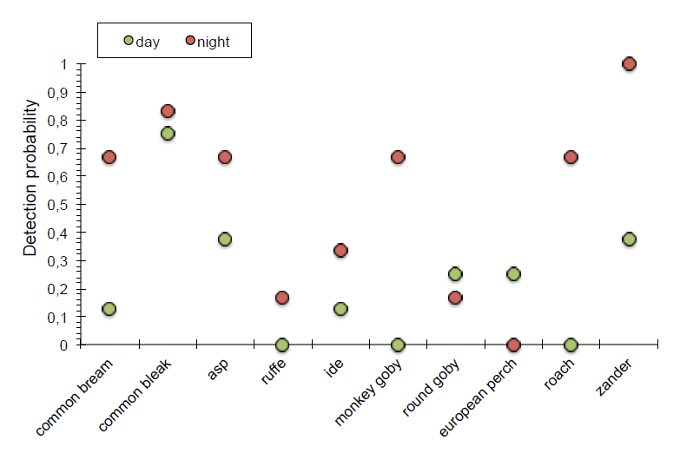
Differences day - night
Report: Dorenbusch et al. 2019

Slide 22
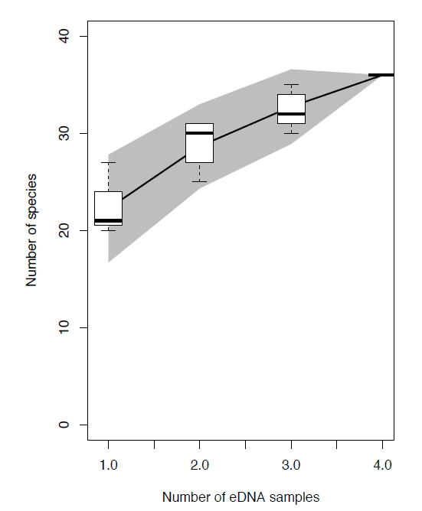
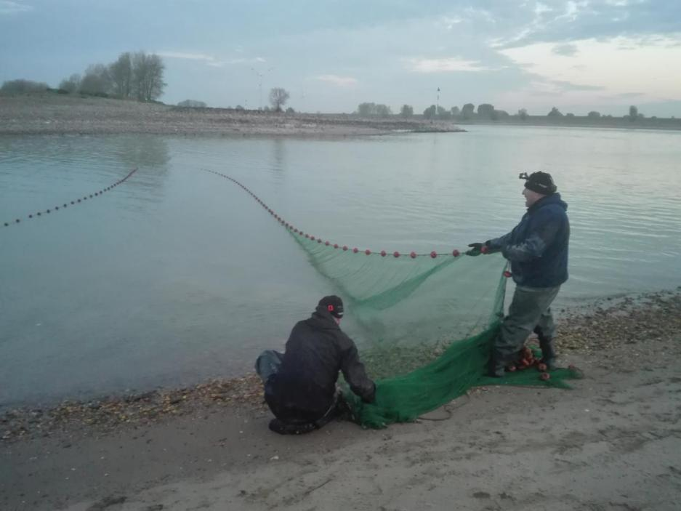
Dutch: eDNA sampling
protocol
French – Seine net sampling protocol all approaches
night samples only
documentation of sampling protocol
Report: Dorenbusch et al. 2019
Report: Clavé et al. 2019
Notes:
In total, 36 species have been detected in the four eDNA samples from the study area
(table 3.2). eDNA of allis shad was not observed in the samples. Twelve species were
observed in all four samples and had a detection chance of 1, whereas six species
were observed in three samples (detection chance of 0,75) and five species in two
samples (detection chance of 0,5). There was also a large group of species (n=13)
that was only observed in one sample (detection chance of 0,25). Subsequently, for
three of these 13 species only very low number of DNA barcodes were detected
(<0,05 % in relation to the total amount of detected fish DNA barcodes in the sample).
Two sets of species, i.e. Lampetra fluviatilis/L. planeri and Platichthys
flesus/Pleuronectus platessa cannot be distinguished from eachother based on the
primers used.

Slide 23
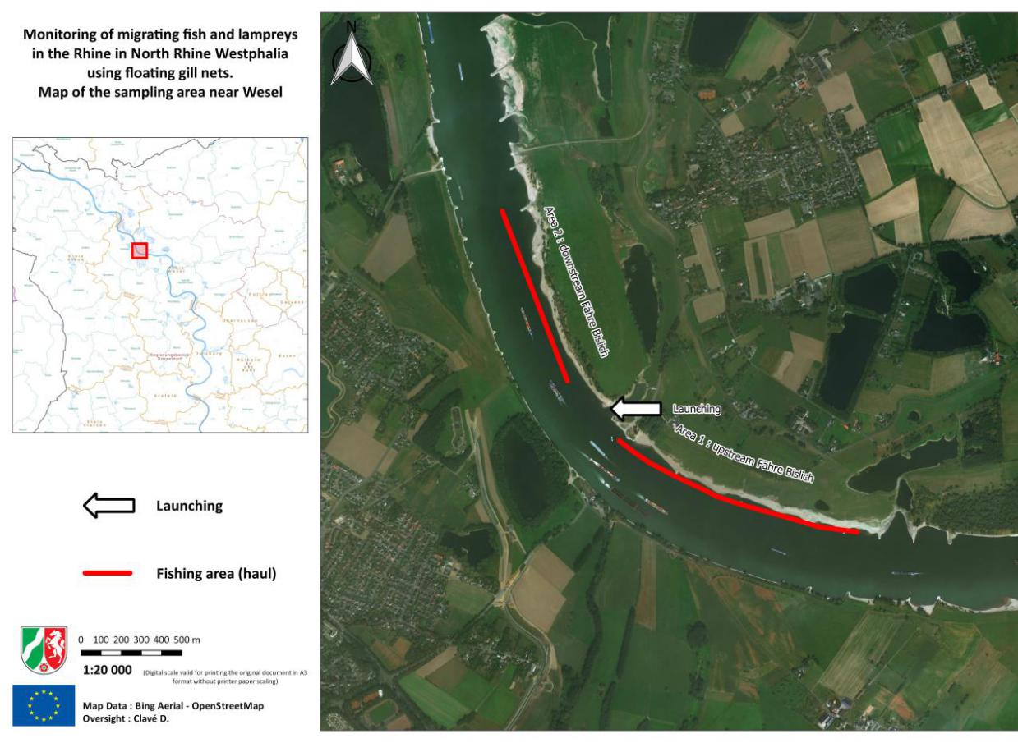
Allis shad, Lamprey upstream migration
Drift net monitoring, spring 2018 - professional fishermen
Average length of haul 1220 m
Report: Clavé et al. 2019

Slide 24
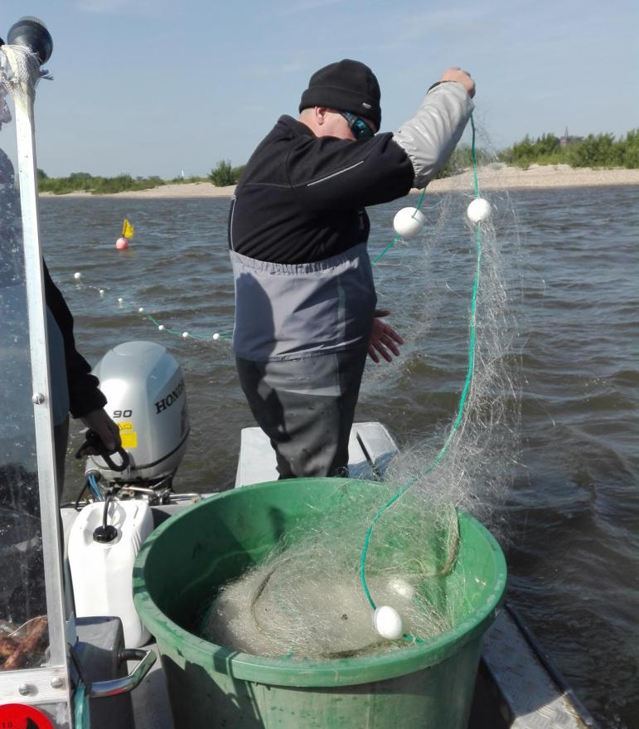
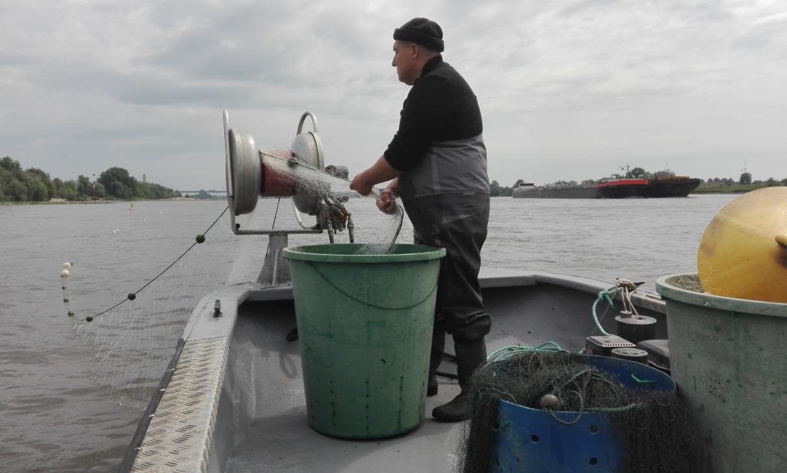
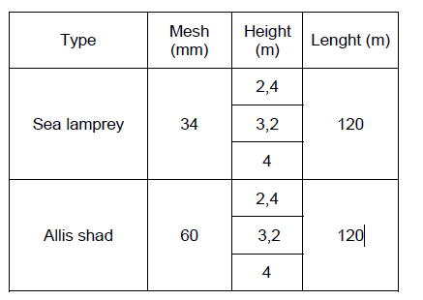
Drift net monitoring - Allis shad, Sea lampreys upstream
Report: Clavé et al. 2019
Net protocols

