Slide 1
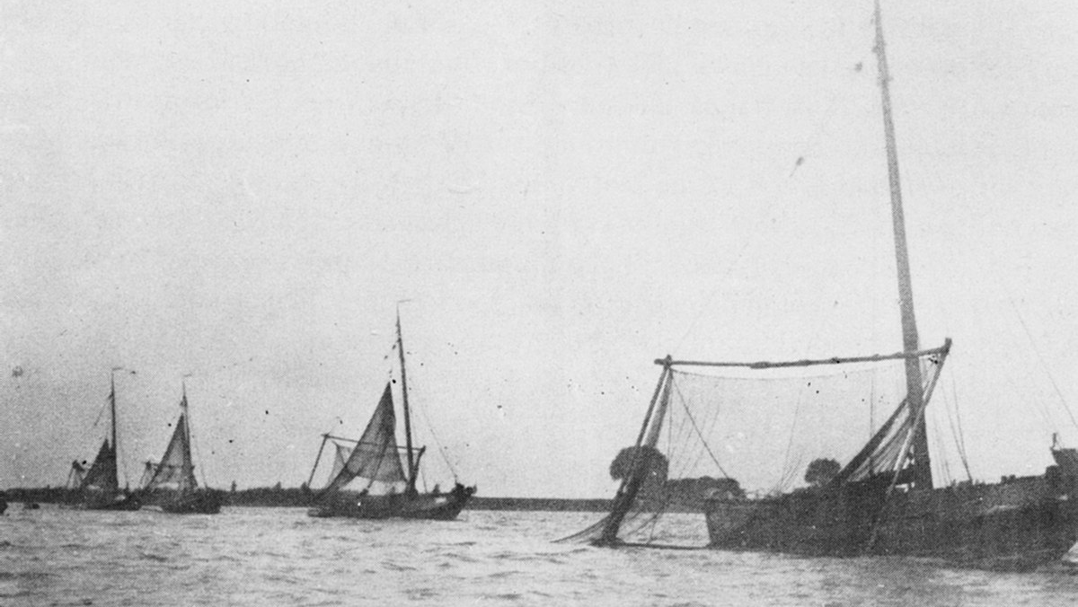



Monitoring migratory fish – with an eelschokker
Roland van Aalderen, Andreas Scharbert, Frank Collas 4-3-2021
Notes:
A picture of aalschokkers fishing at Haringvliet around 1885 in the Rhine estuary.

Slide 2
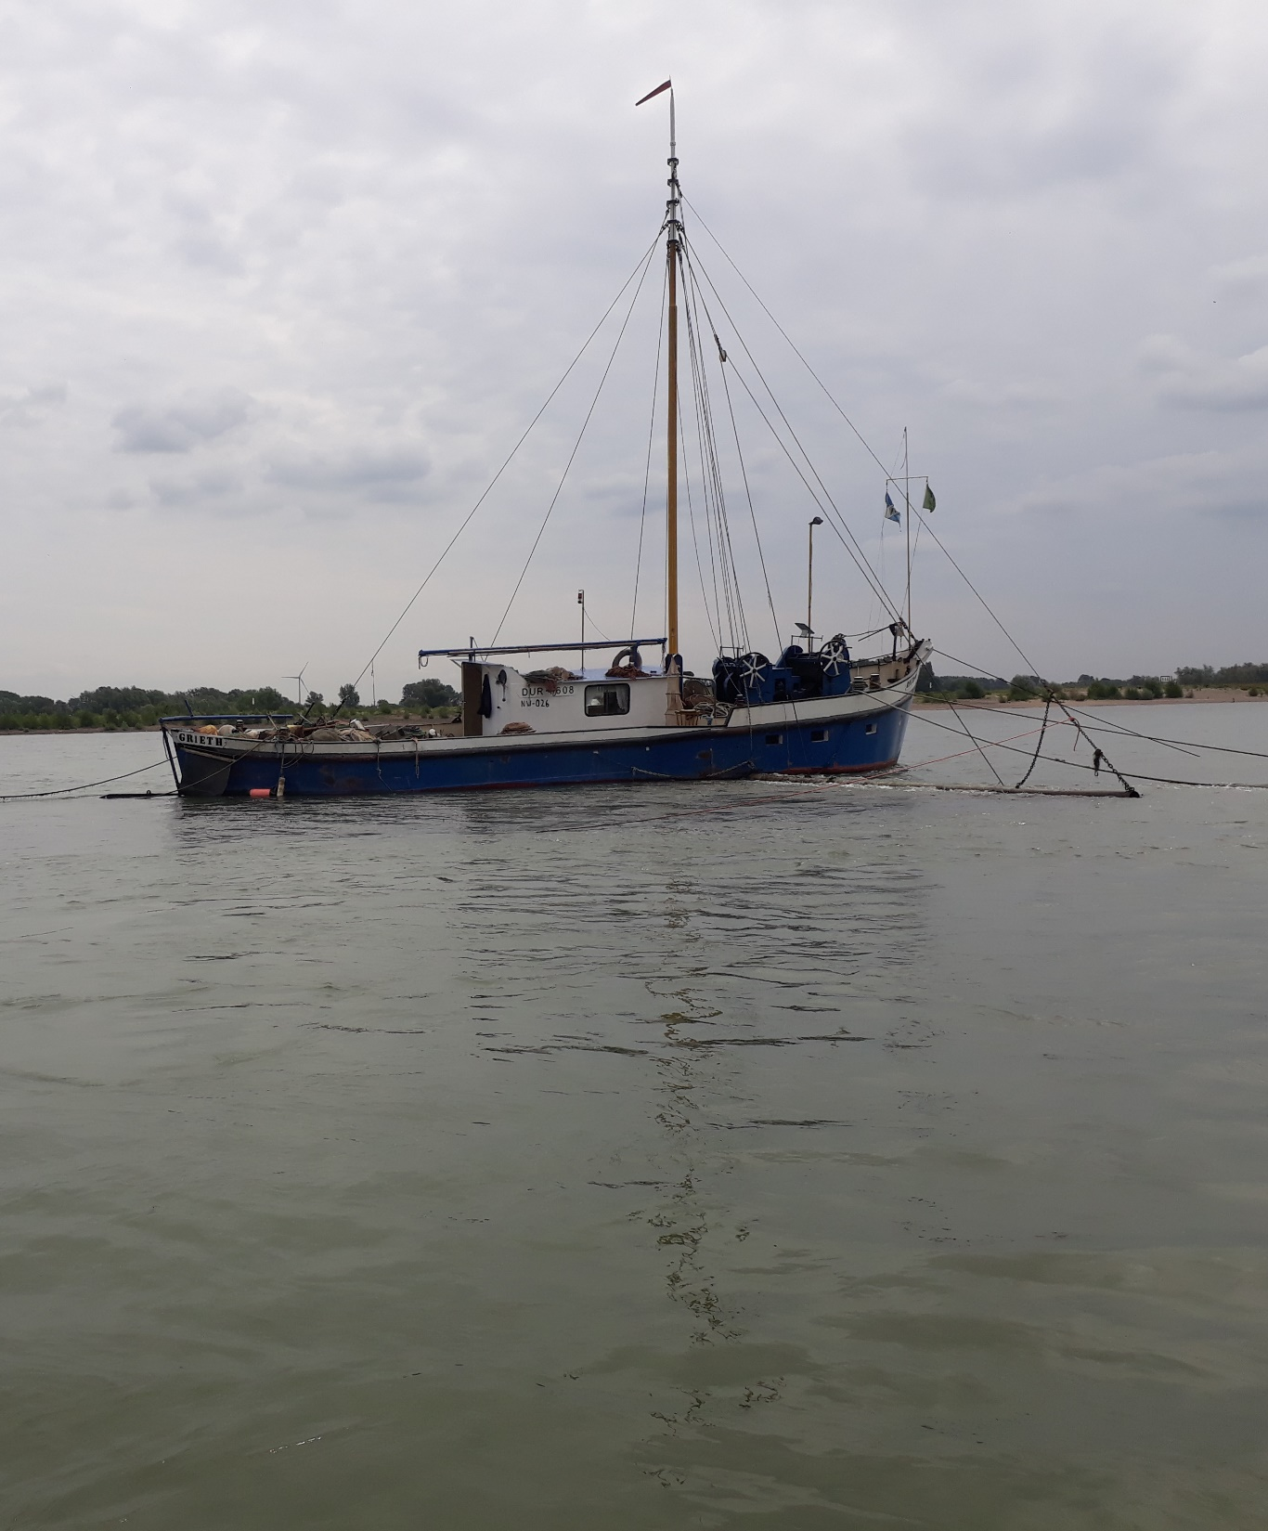
background information
Long history of fishing for eel with stow nets on the Rhine
2 projects with stow net (“aalschokker"):
  Germany (EMFF), 2019-2021
  Netherlands (GBRA), 2018-2021
  Combining data within GBRA for knowledge development on migratory fish
Partners: Rheinischer FischereiVerband, Sportvisserij Nederland, Rijkswaterstaat, Radboud Universiteit, Bezirksregierung Dusseldorf
Nice documentary: https://www.omroepgelderland.nl/nieuws/2473701/Nederland-en-Duitsland-zetten-zich-samen-in-voor-de-vissen-in-de-Rijn
Notes:
> 150 aalschokkers, 1950 op de Rijn: 75 NL, 140 DL

Slide 3
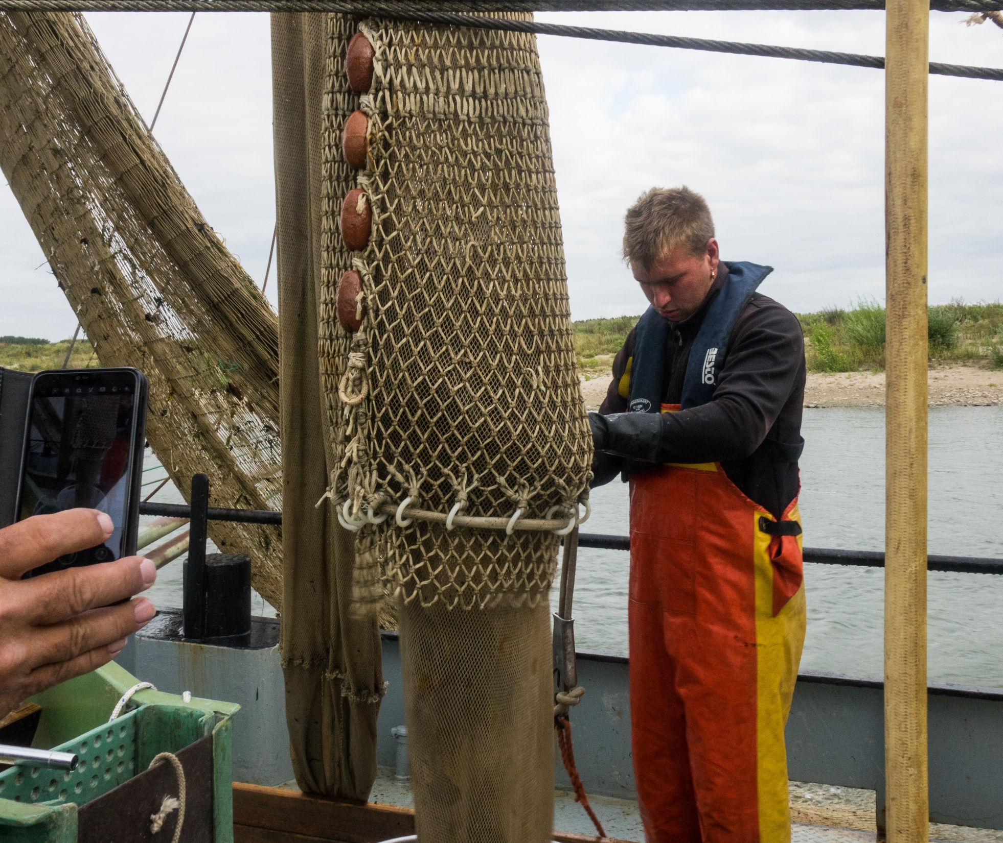
Objective of the project
      Testing stow net fishing as sampling technique
      Downstream migration of salmon, seatrout, allis shad, lamprey, houting and eel
      Inventory of the amount of “Knakaal” (injured or dead eel caused by hydropower or ship)
      Plastic transport

Slide 4
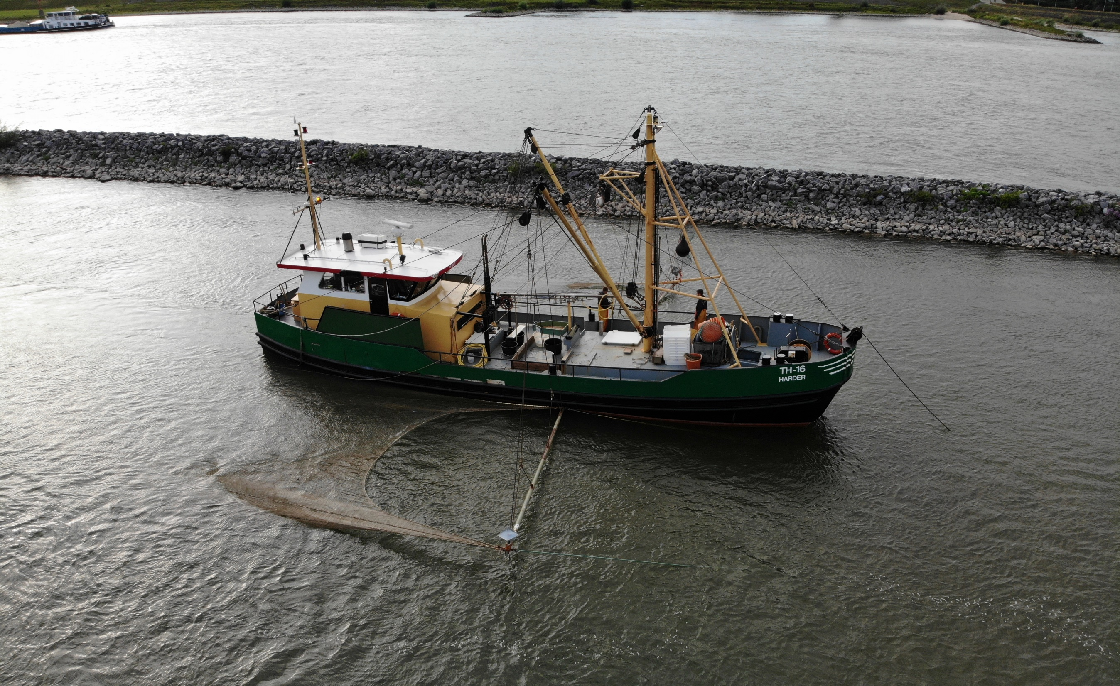

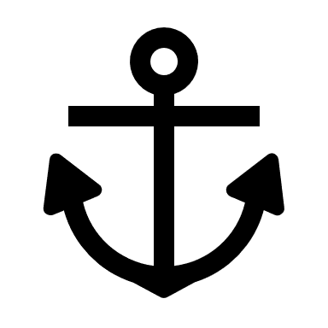
NL: 3,3 – 6,7% of river 240 m
DL: 3,1 % of river 320 m
Method
flow direction
50 meter
8 meter
4 m (bottom)

Slide 5
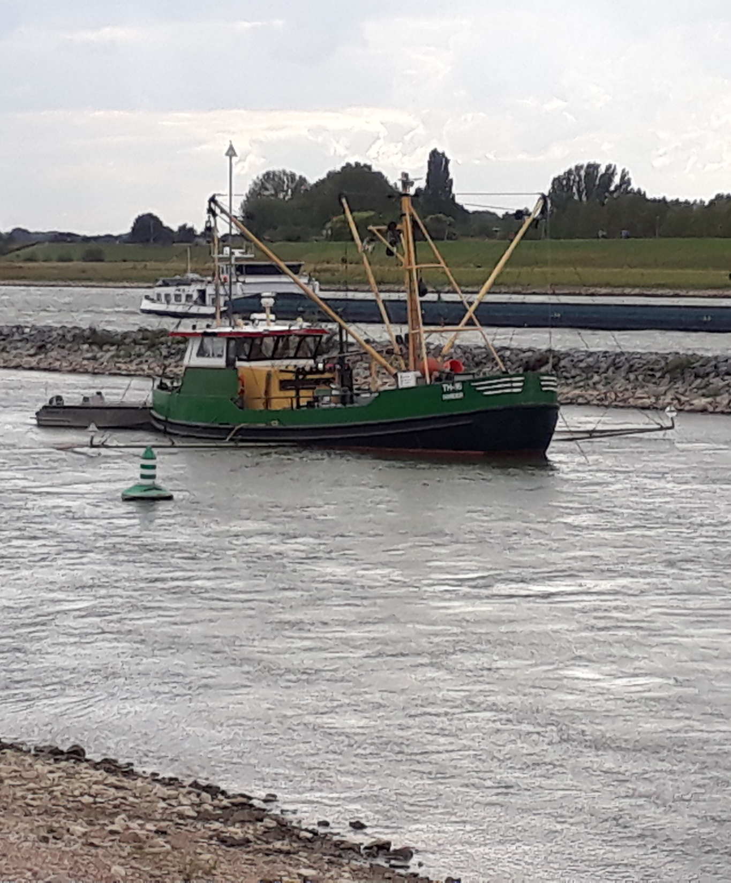
Method
Stow net fishing
      Stow net: funnel-shaped net, passive gear
      Different moments: (day-night, spring and autumn)
      Different locations: Rees (DE) vs Tiel (NL)
      Fish determination and measurement on board
Germany (Grieth) | Netherlands (Tiel)
2 vessels | 1 vessel
1 net per vessel | 1 or 2 nets/vessel
10 hours/sample (1/day) | 2 hours/sample (5-10/day)
10 m width | 8 m width
1,2 cm mesh size | 1,5 cm mesh size
at nigth | at day & nigth

Slide 6
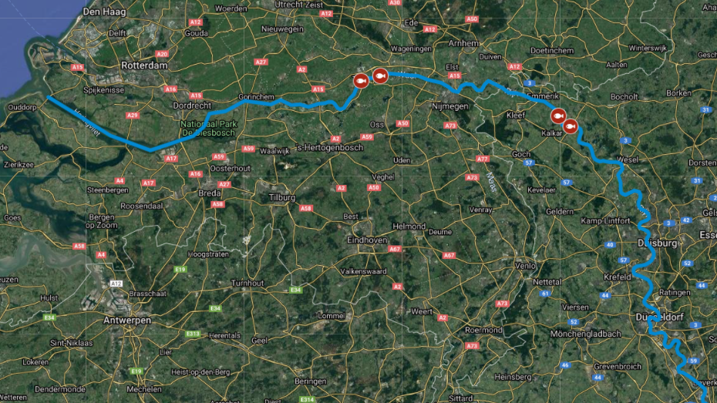
Tiel, km 910
79% Rhine discharge
240 m width
Grieth, km 840
100% Rhine discharge 320 m width

Slide 7
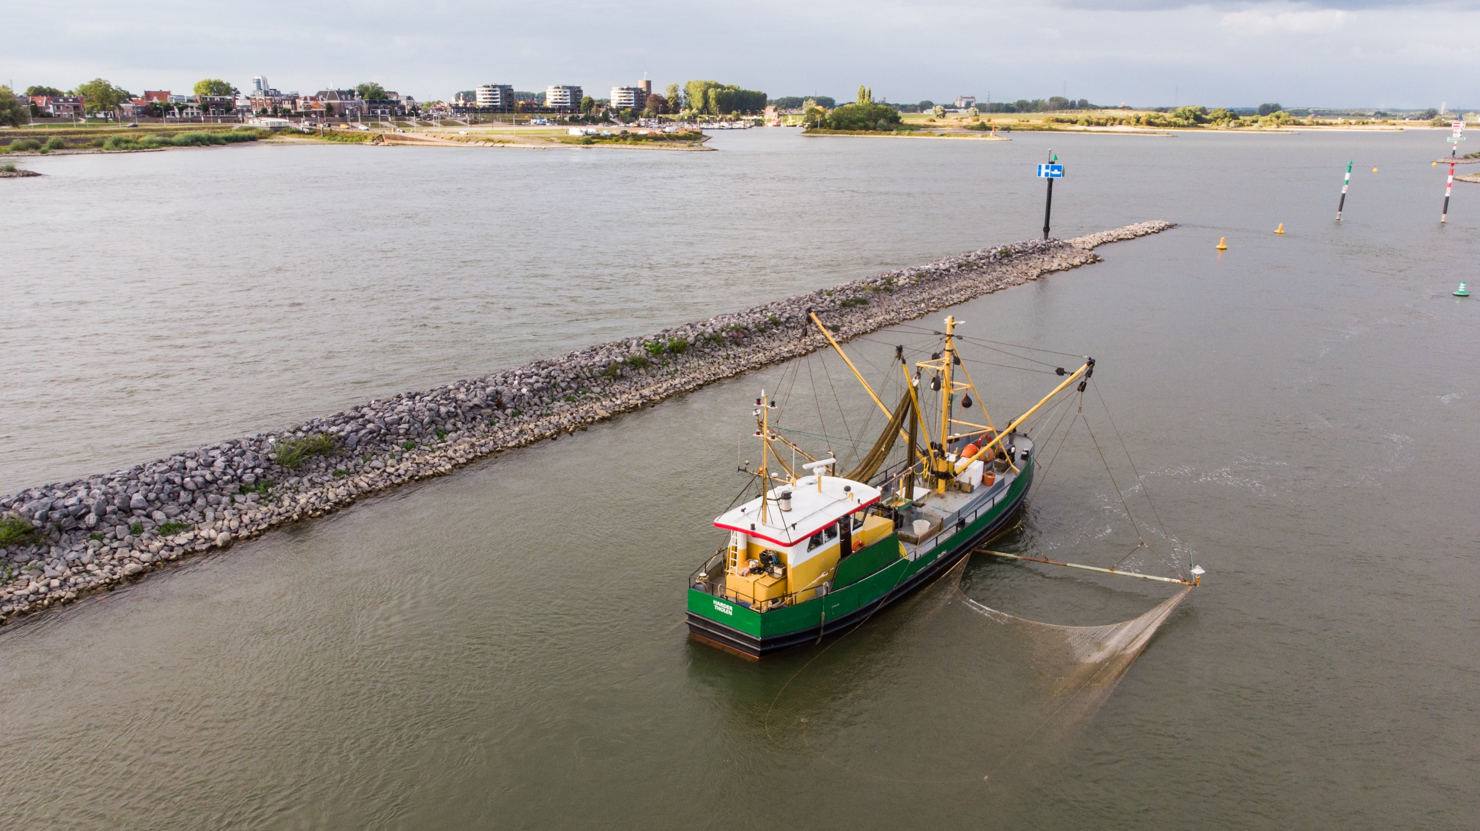
Tiel

Slide 8
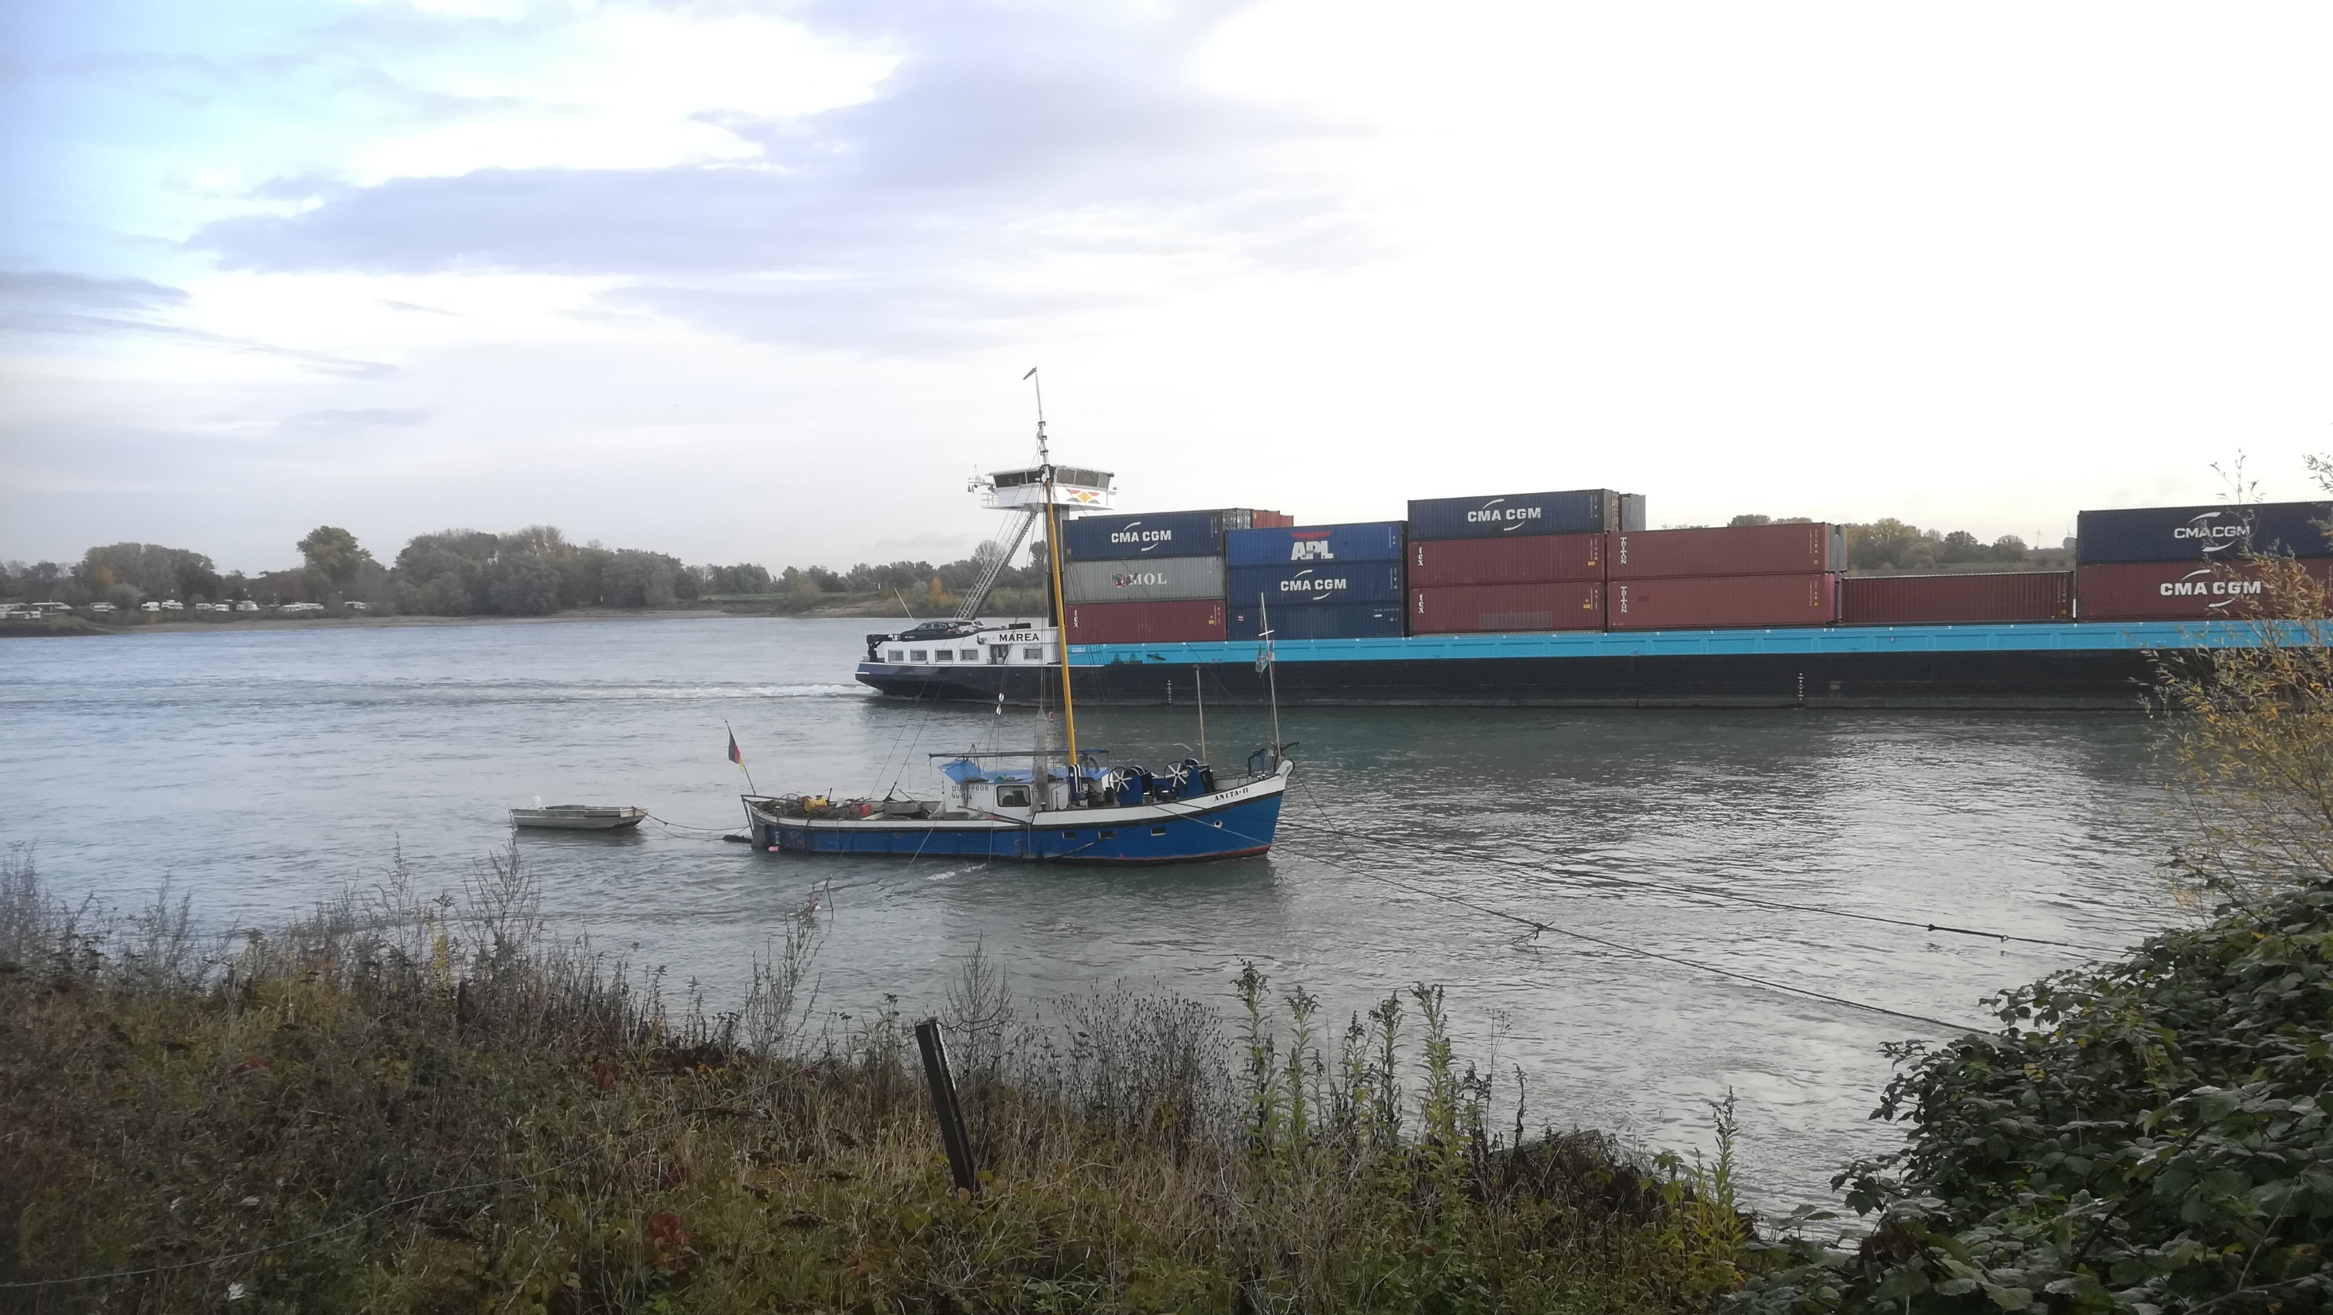
Grieth

Slide 9
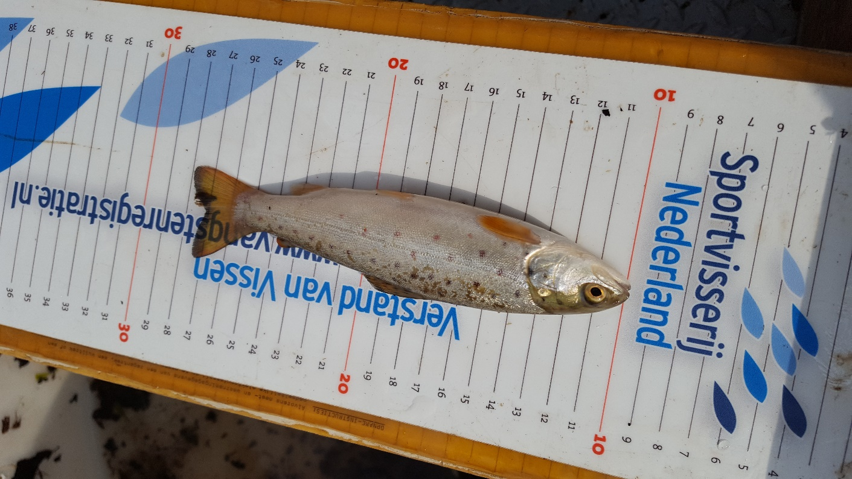
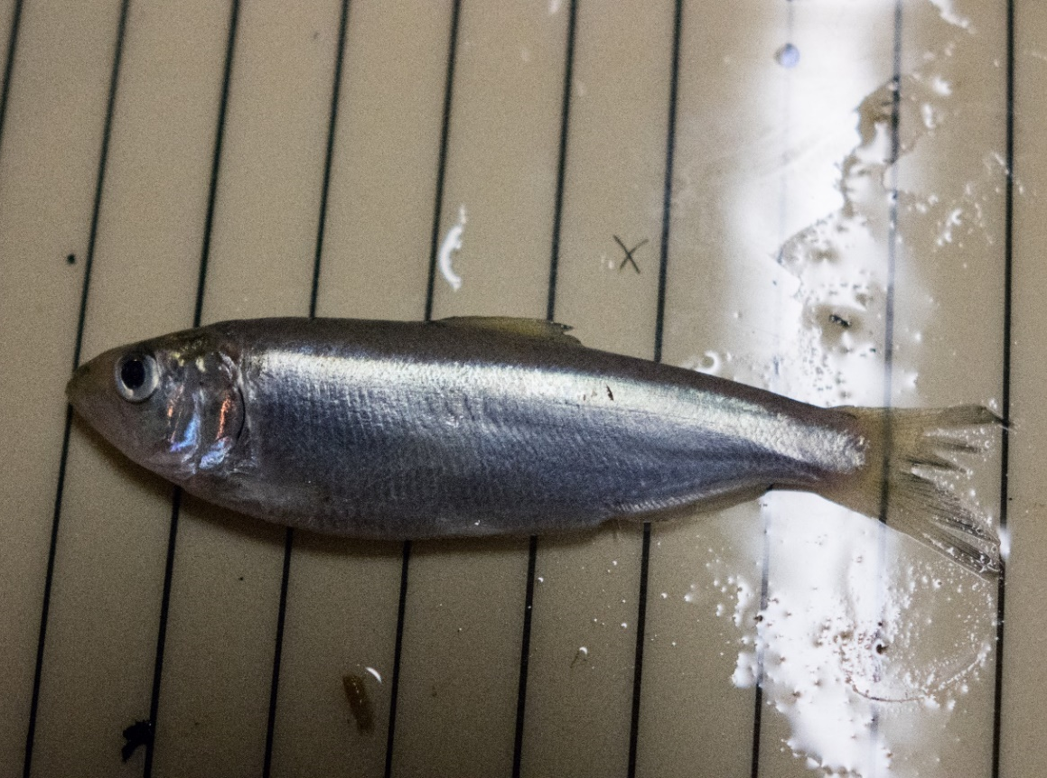
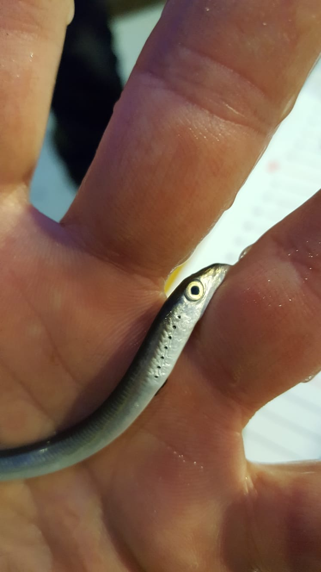
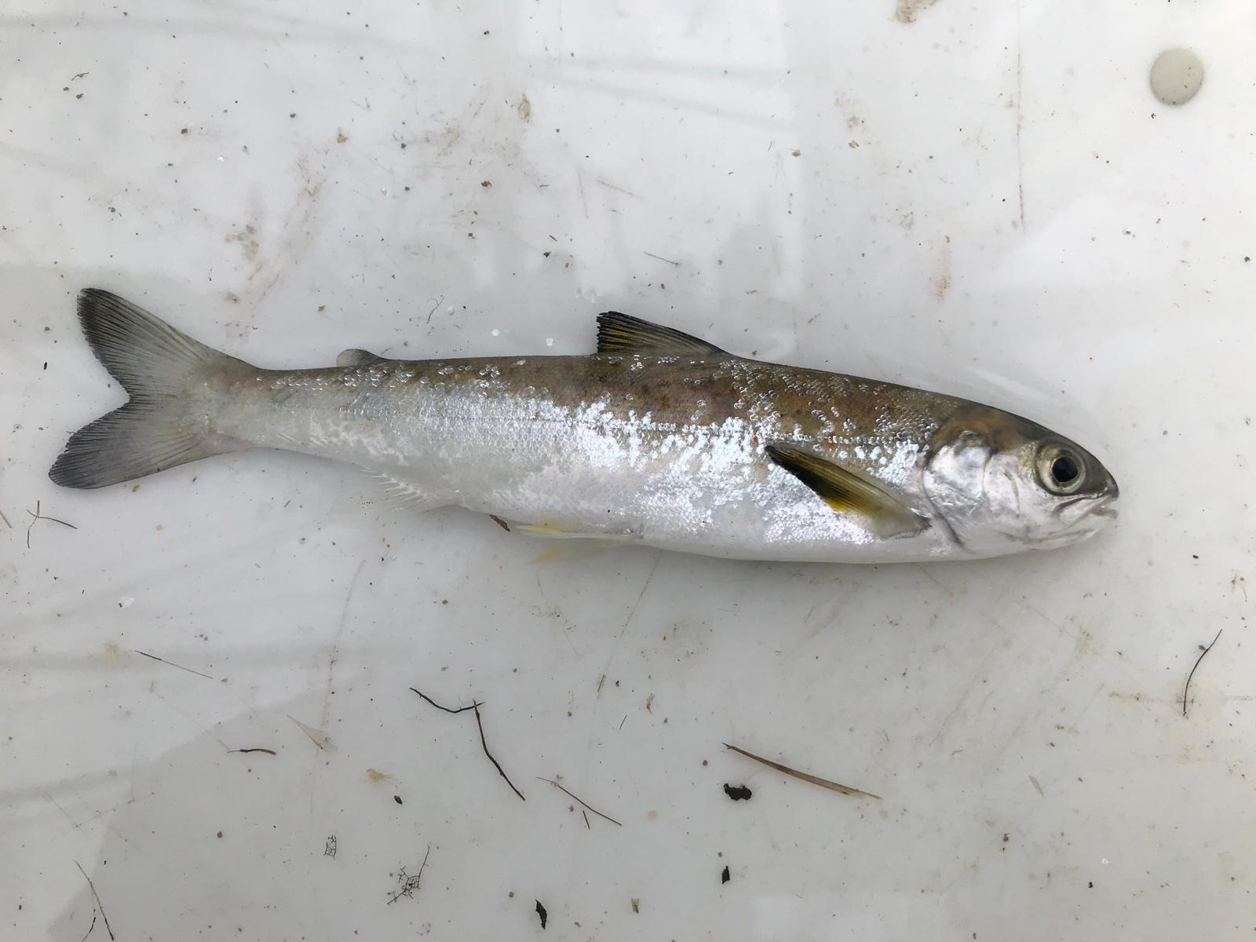
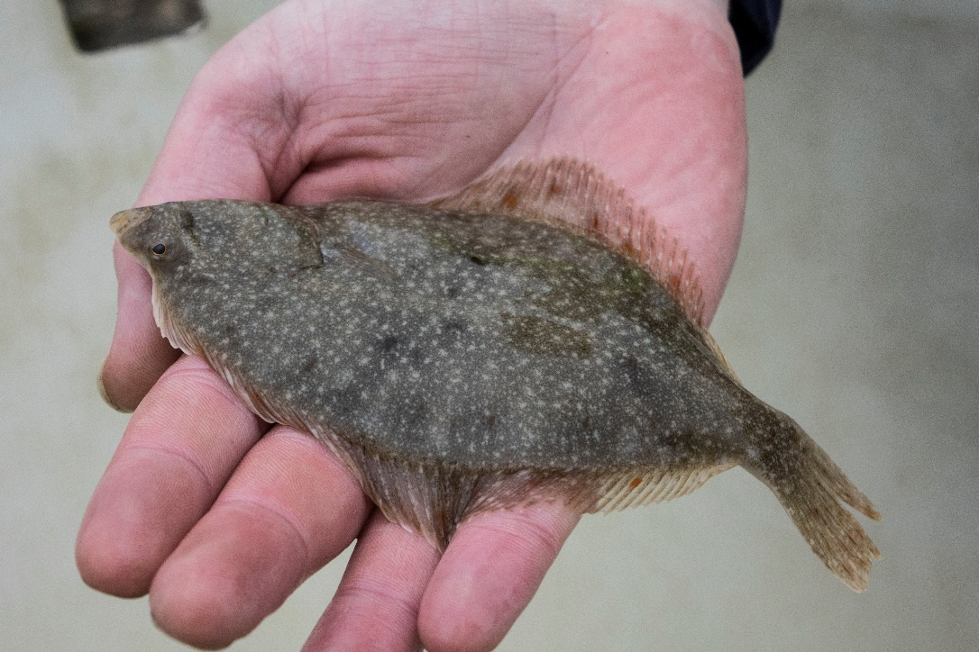
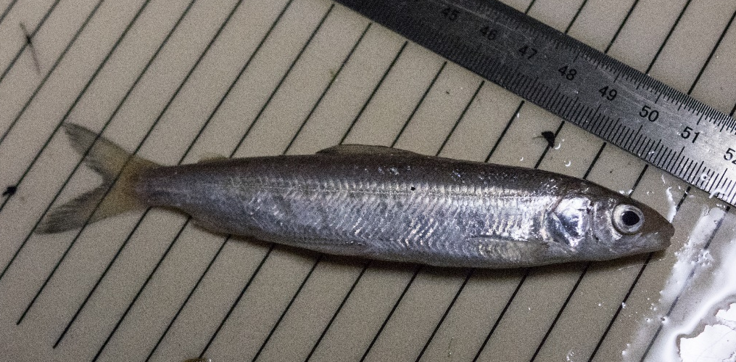
Stow net fishing as a sampling technique for down stream migrating fish?

Slide 10
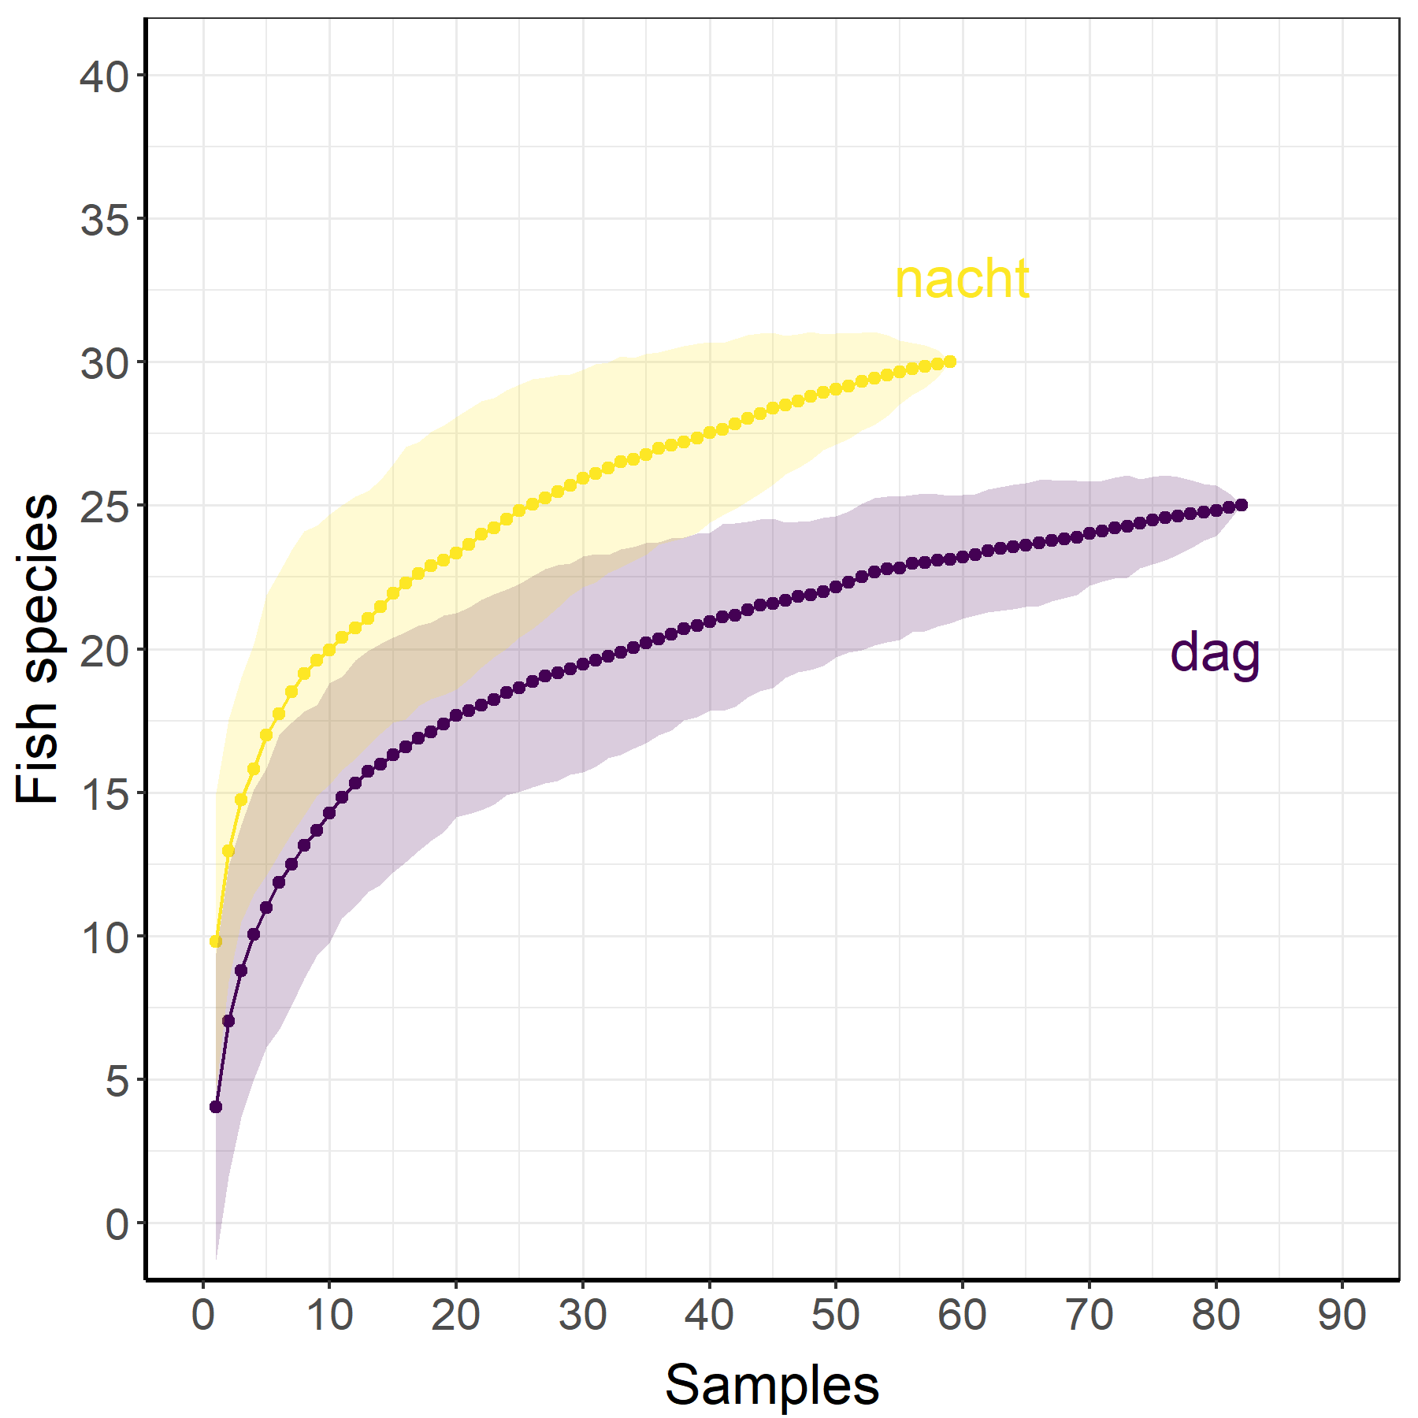
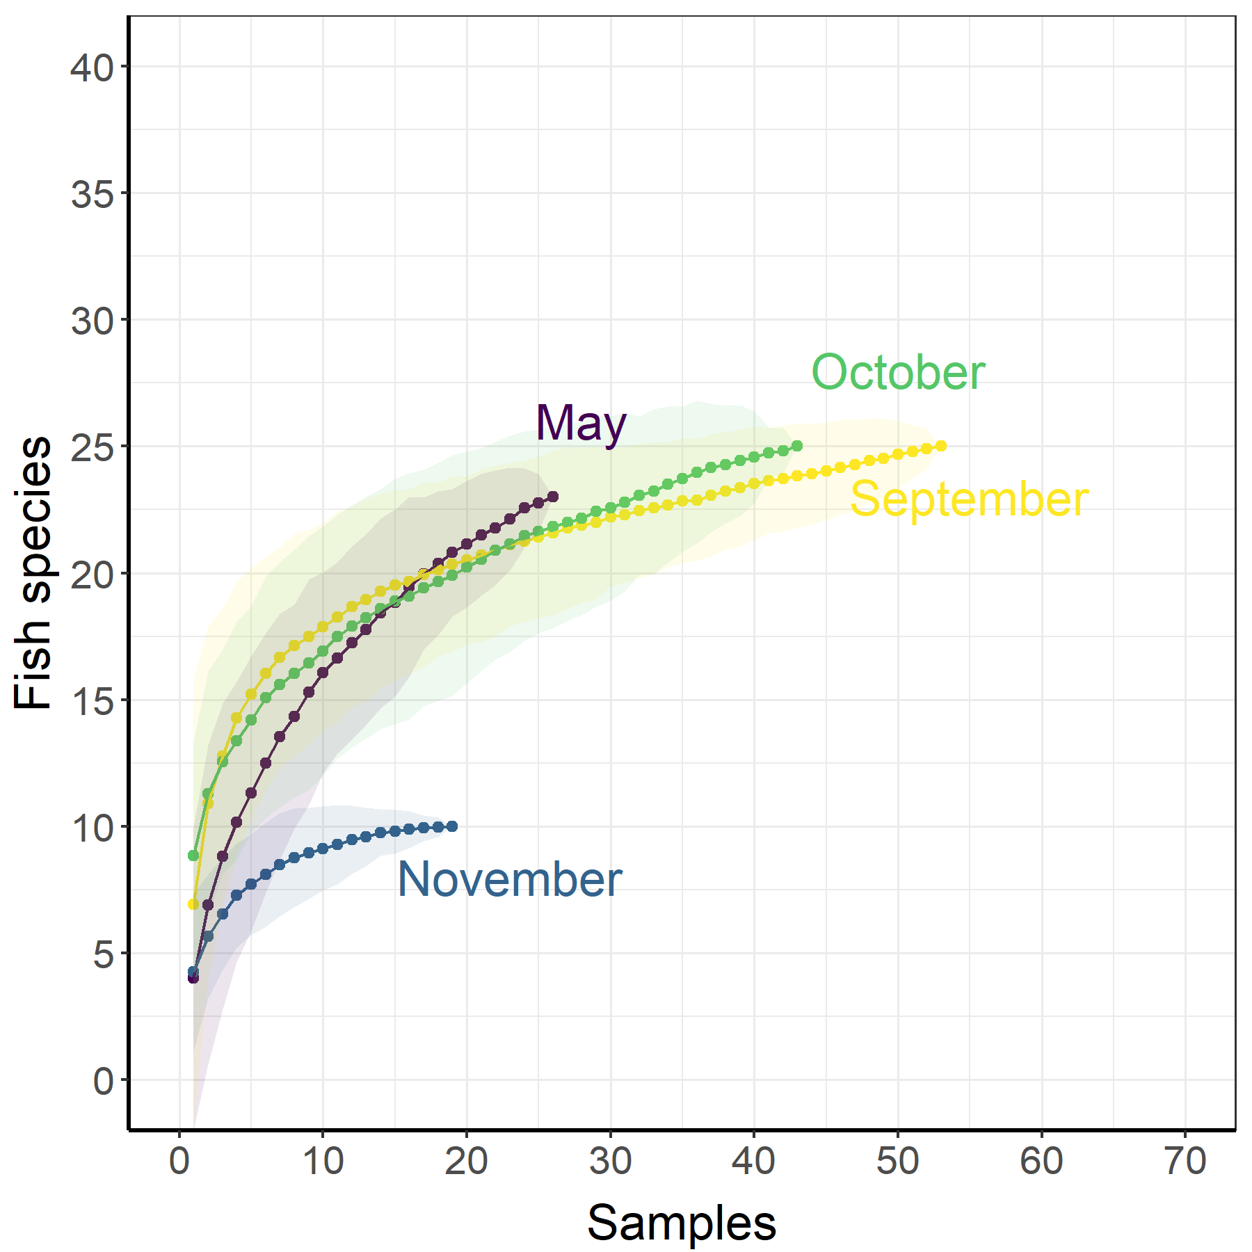
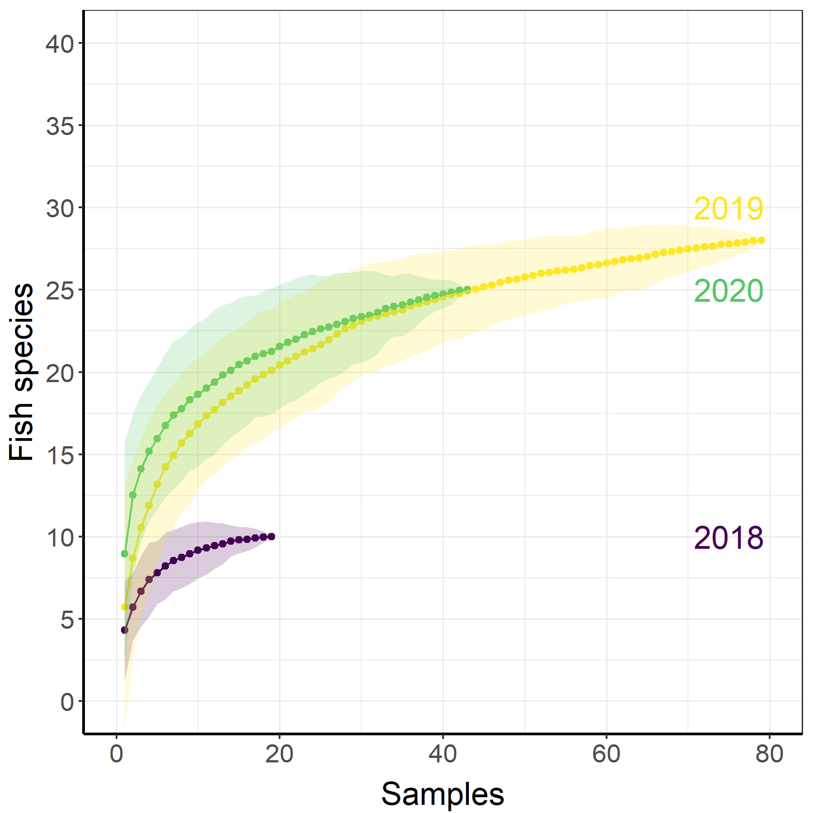
Prelimanary results Netherlands
Species richness
35 fish species (NL)
Higher diversity at nigth
Highest diversity in October
Species Accumulation Curve

Slide 11
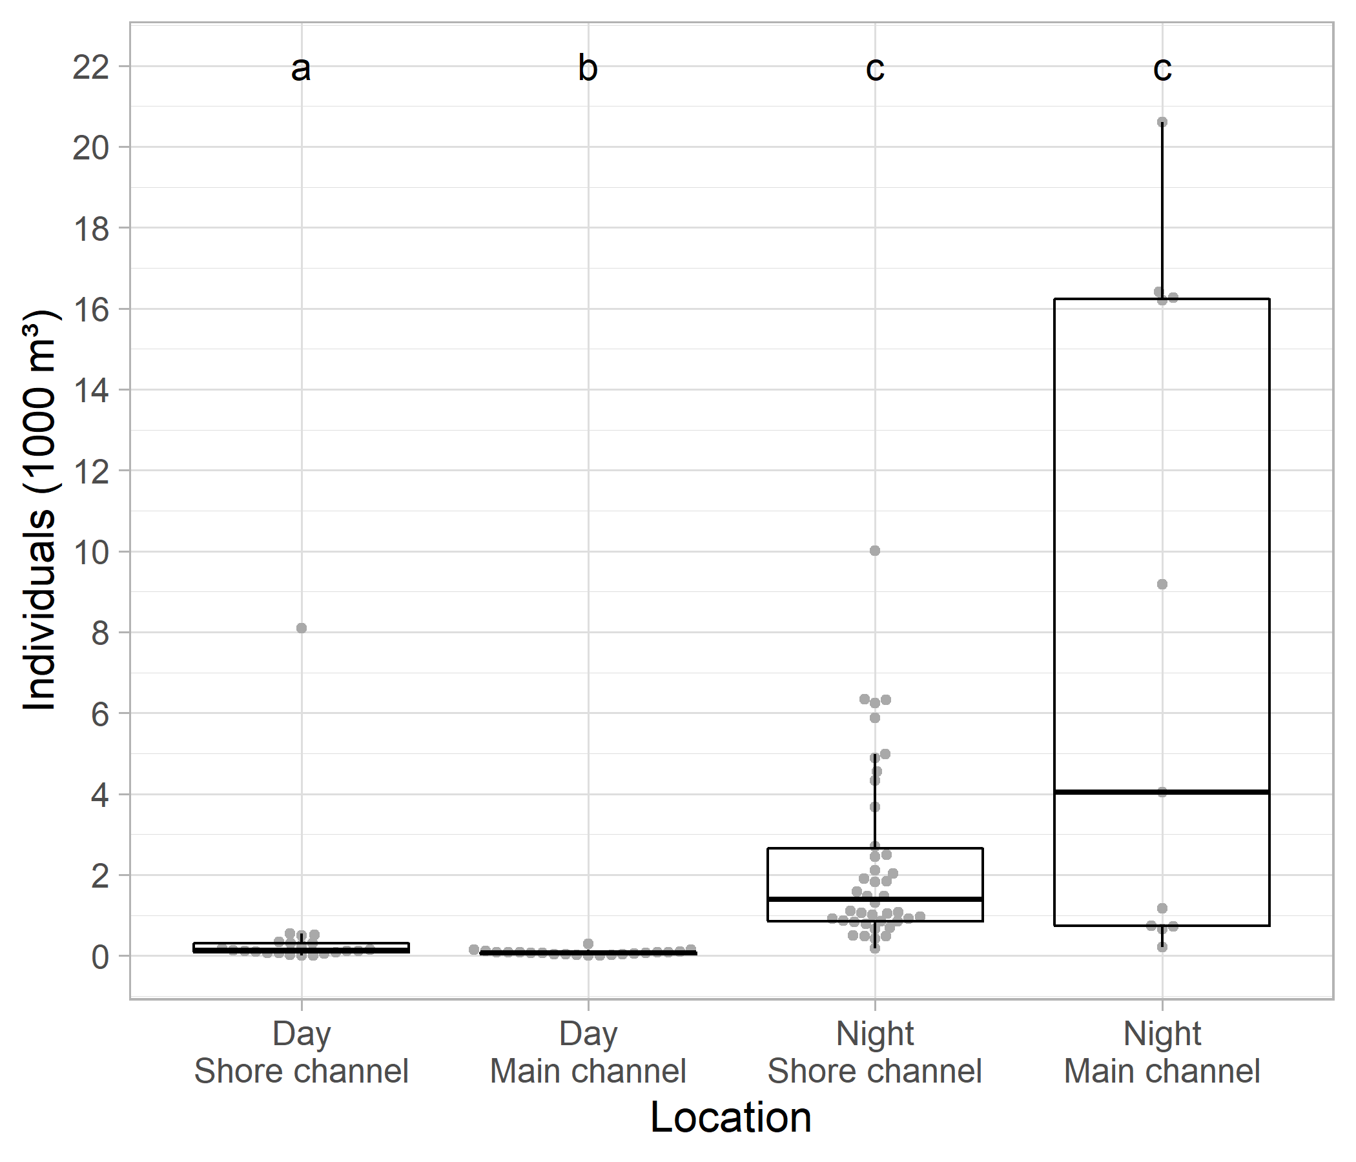
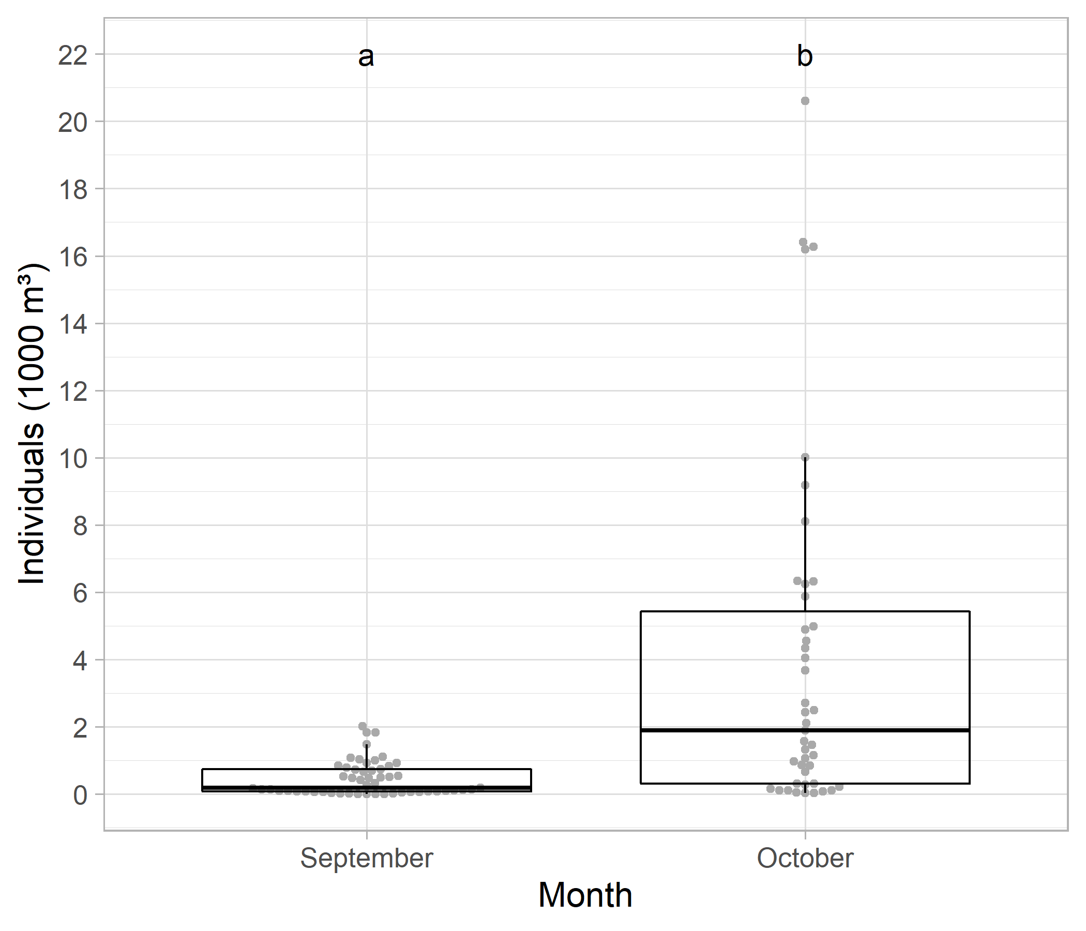
Prelimanary results Netherlands
Fish density
Highest abundance at nigth and October
(appr. 30 sec fishing)

Slide 12
Prelimanary results
Comparison Germany – Netherlands
Different approach:
Germany: existing fishery, very flexible, continuously, fishing mainly at night, one sample per day
Netherlands: hiring a fishermen with personel, fixed schedule, 5 to 10 samples per fishing day.
More German data available
 | Germany | Netherlands
#fishing days | 36 | 24
#samples | 36 | 142
#species | 31 | 35
#fish caugth | 6.400 | 14.800

Slide 13
Prelimanary results
Comparison Germany – Netherlands
Species composition (most common)-all data pooled:
Name DL | name NL | gilde | #DE | #NL
Brasse | brasem | eurytopic | 4099 | 1989
Rotauge | blankvoorn | eurytopic | 1060 | 7019
Barsch | baars | eurytopic | 478 | 949
Nase | sneep | rheofilic | 353 | 1613
Karpfen | karper | eurytopic | 78 | 33
Gründling | riviergrondel | rheofilic | 54 | --
Zander | snoekbaars | eurytopic | 51 | 112
Aal | aal | diadromous | 49 | 30
Ukelei | alver | rheofilic | 41 | 1555
Rapfen | roofblei | rheofilic | 41 | 302
Döbel | kopvoorn | rheofilic | 31 | 2
Güster | kolblei | eurytopic | 15 | 219
Grundel | zwartbekgrondel | exotic | 15 | 113
Aland | winde | rheofilic | 14 | 512
Stichling | driedoornige stekelbaars | diadromous | 6 | 173
Schwarzmaulgrundel | zwartbekgrondel | exotic | 4 | 113
Weissflossengründling | witvinriviergrondel | exotic | -- | 118

Slide 14
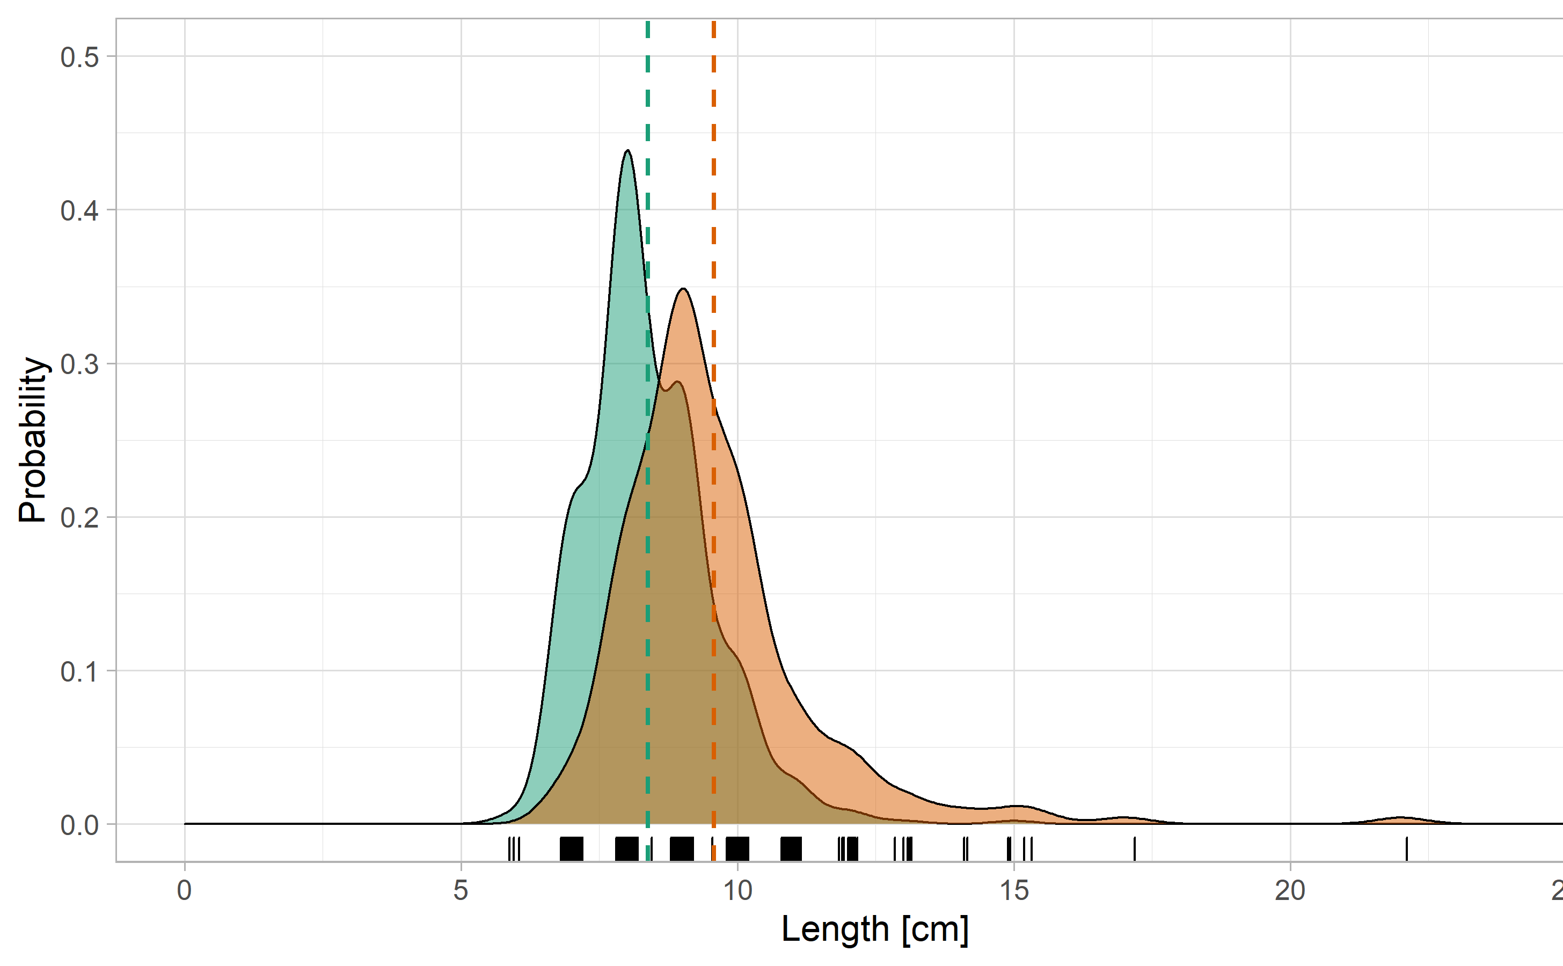
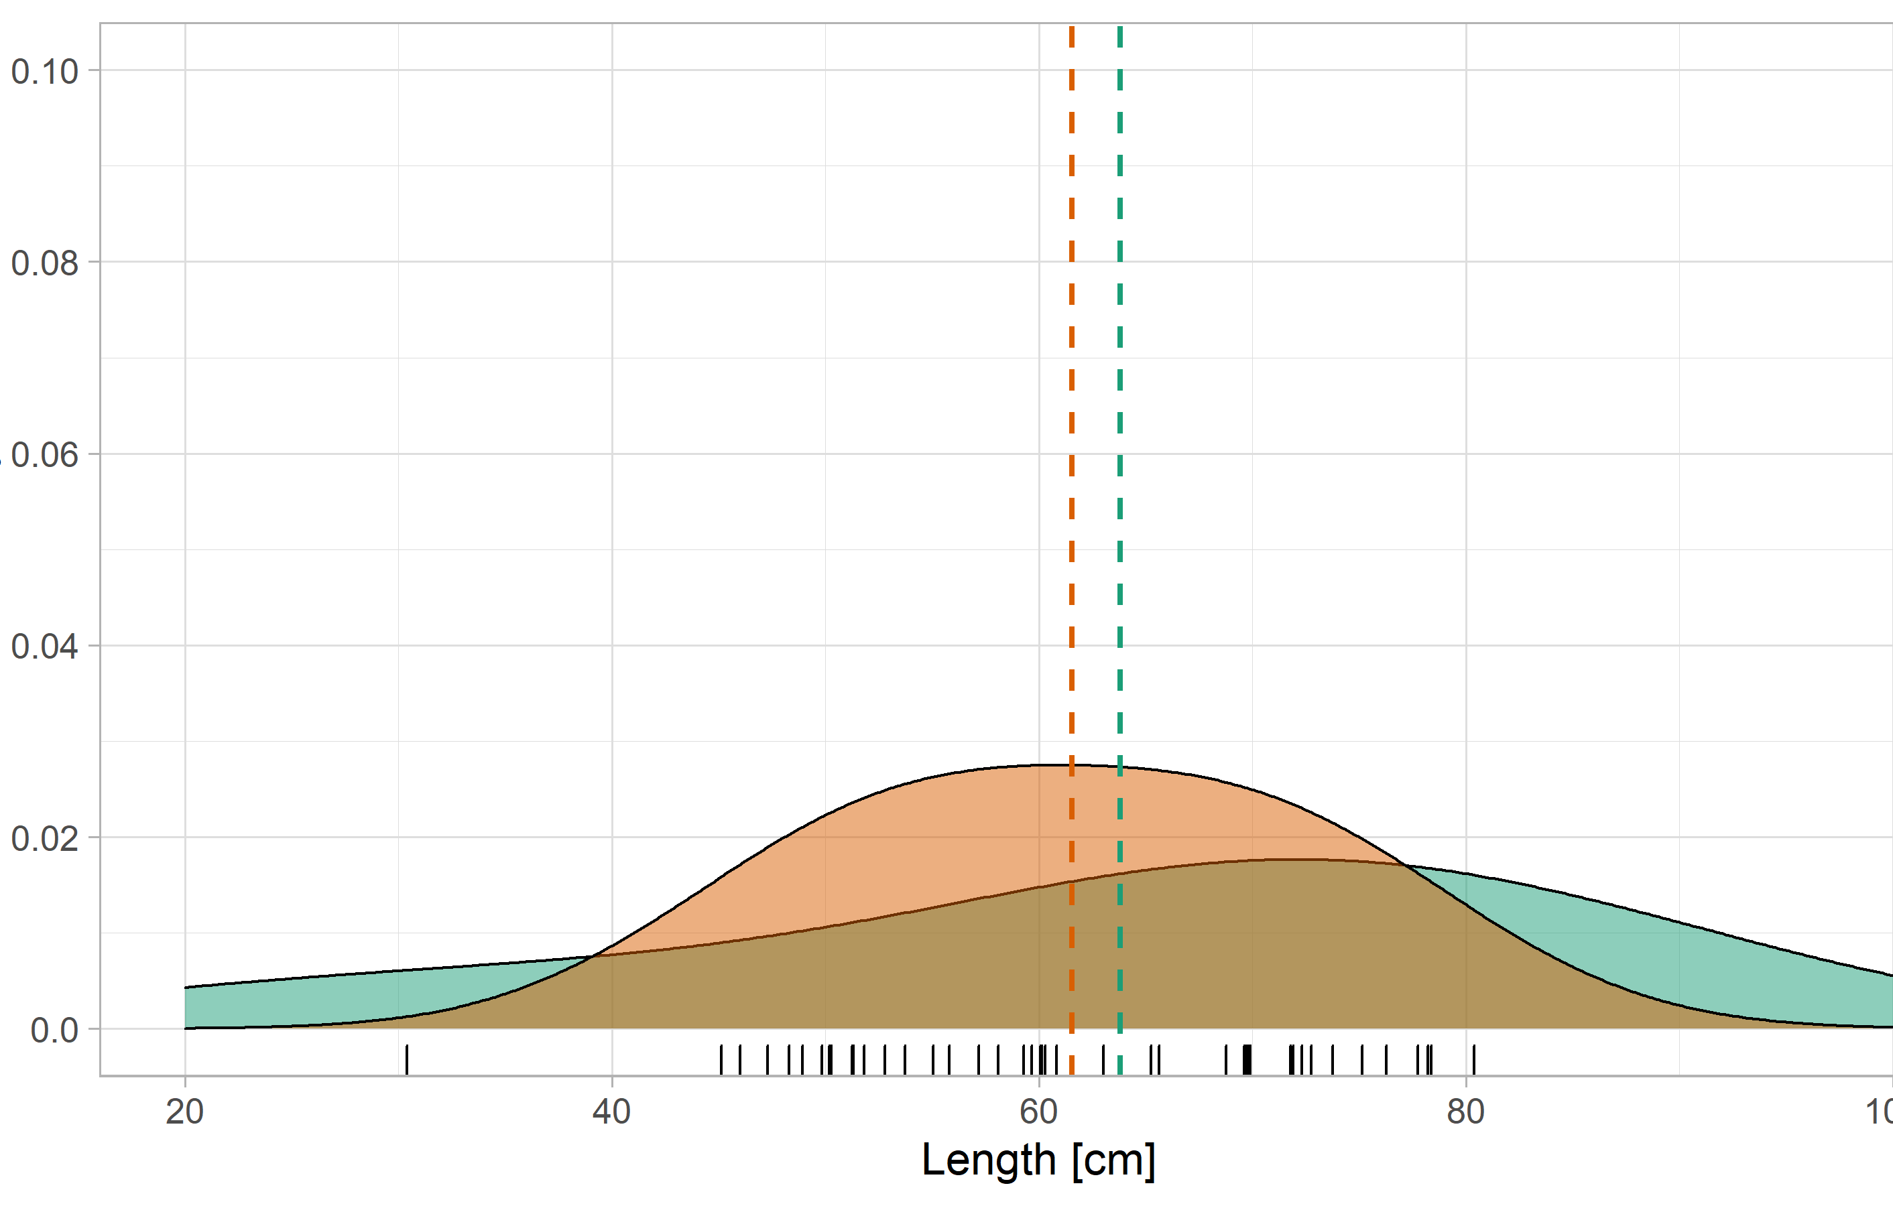
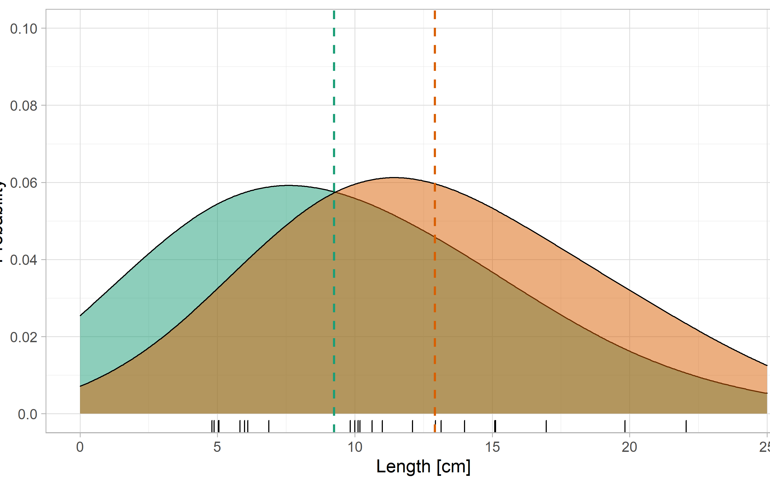
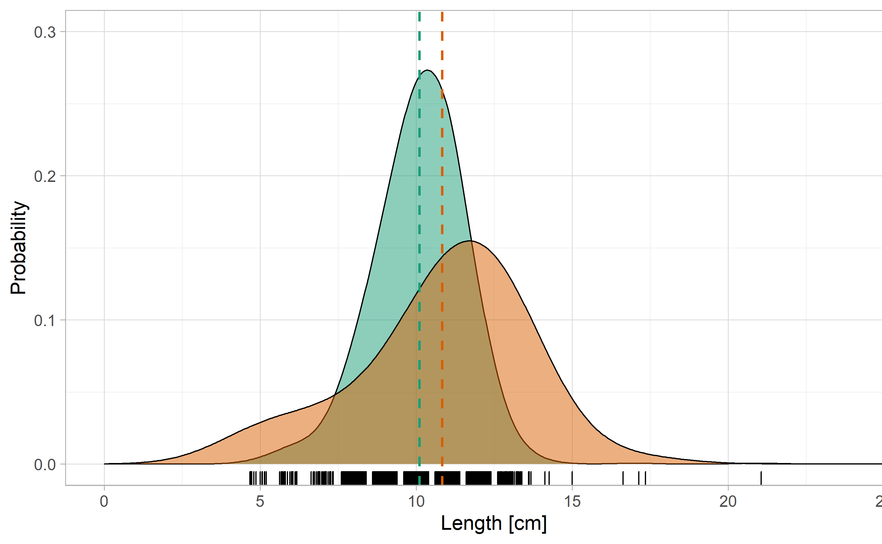
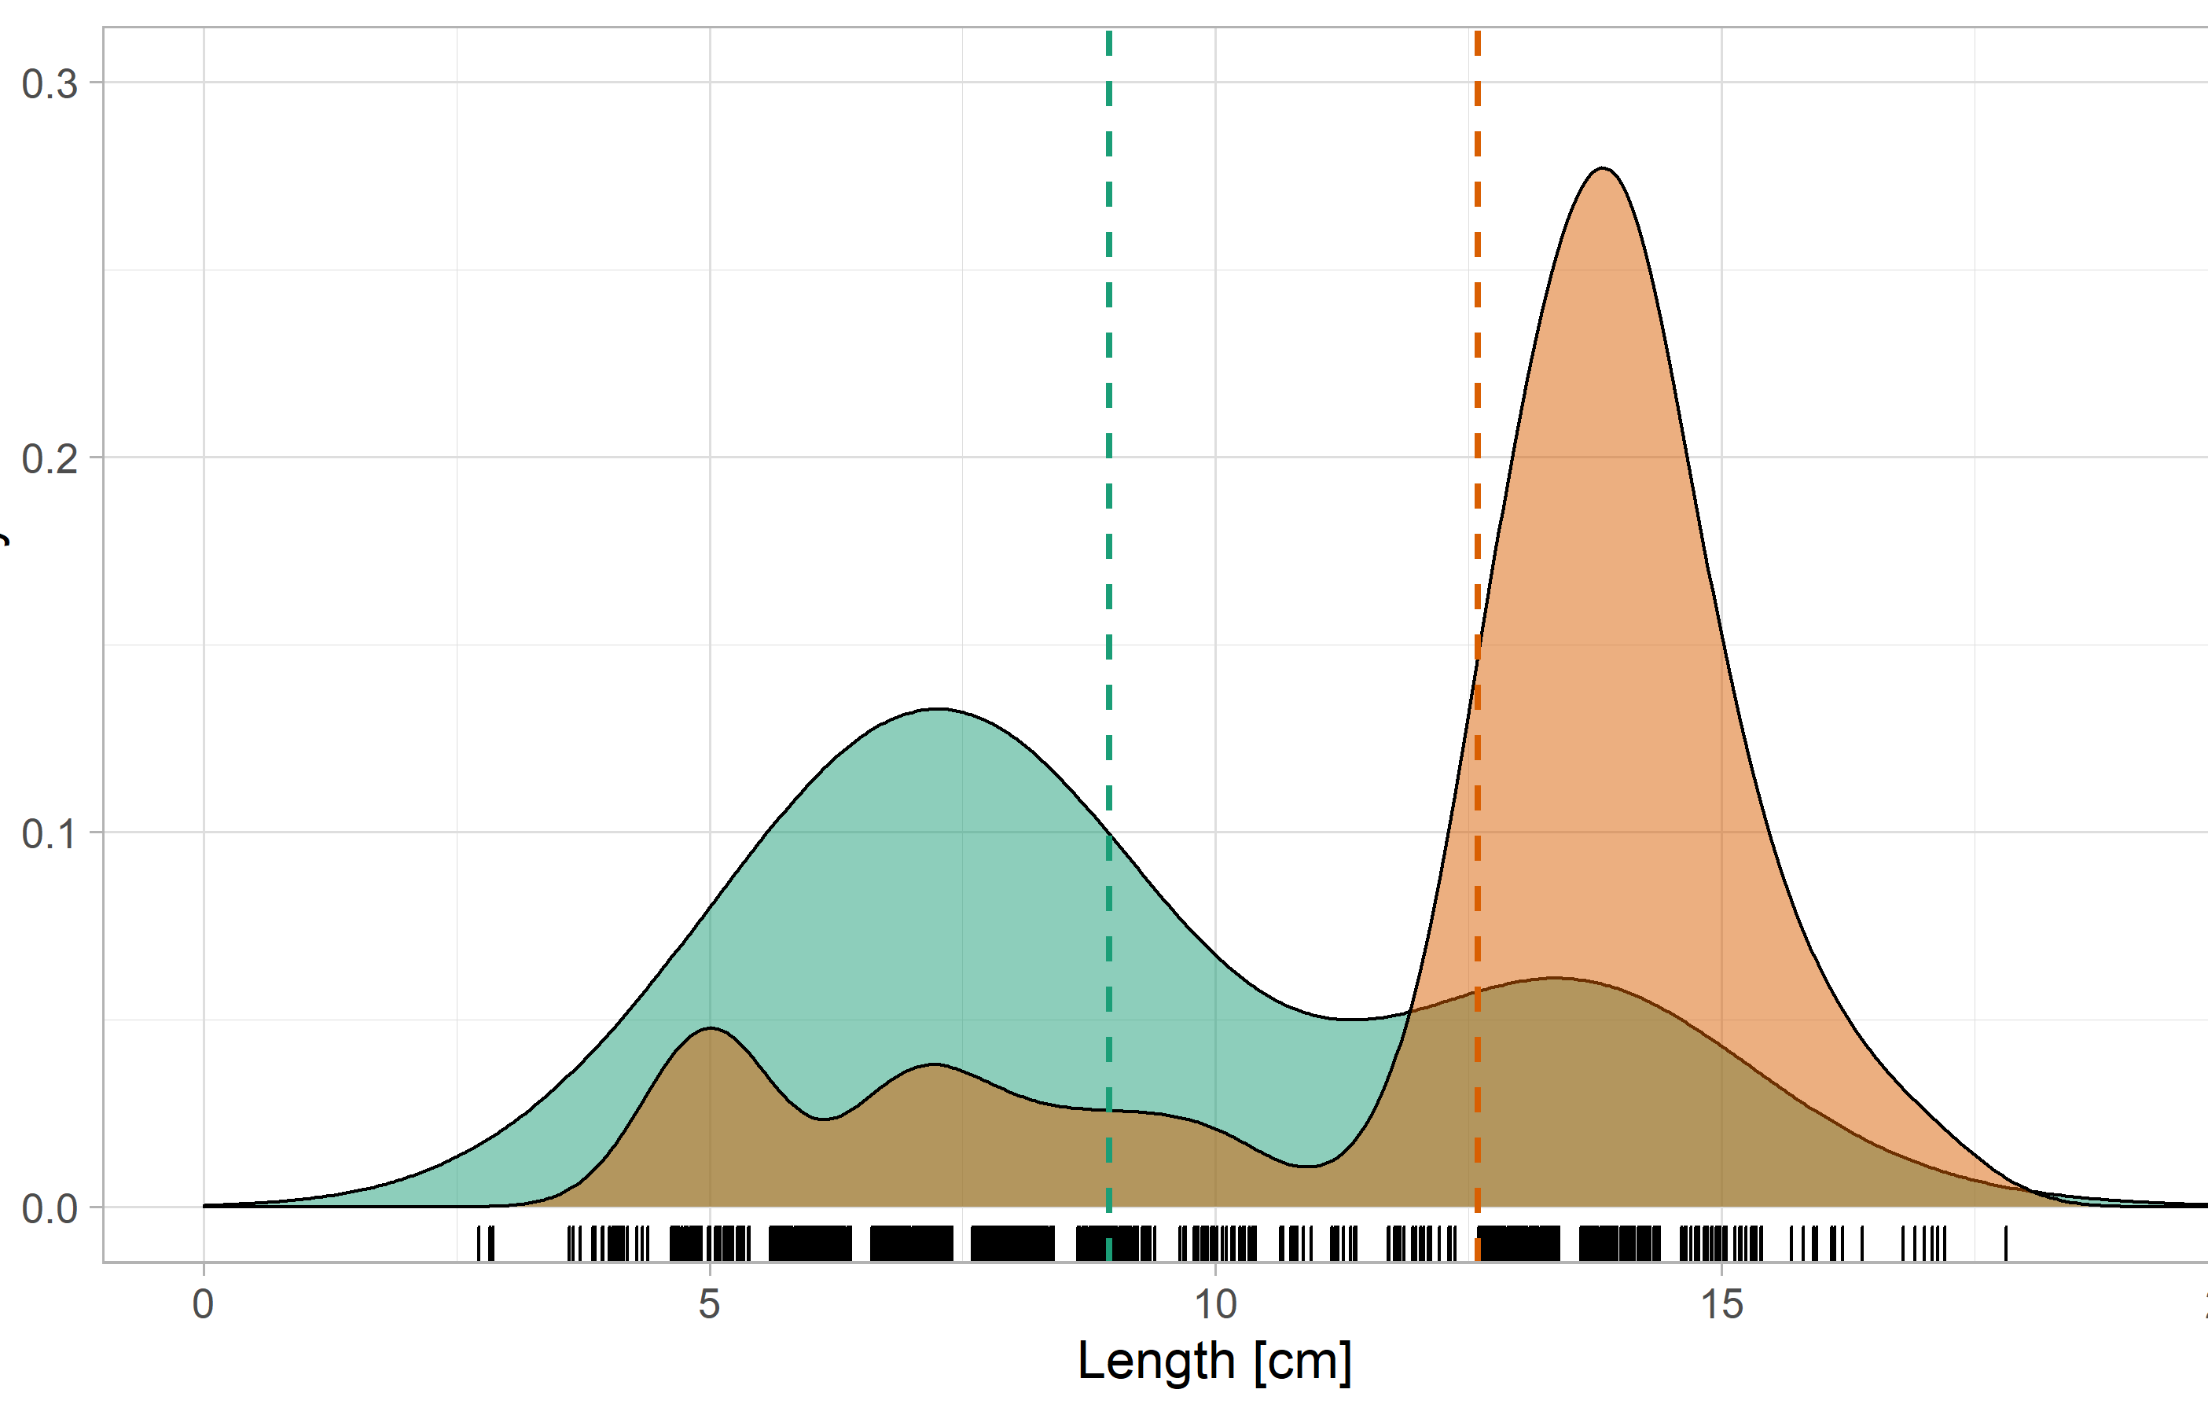
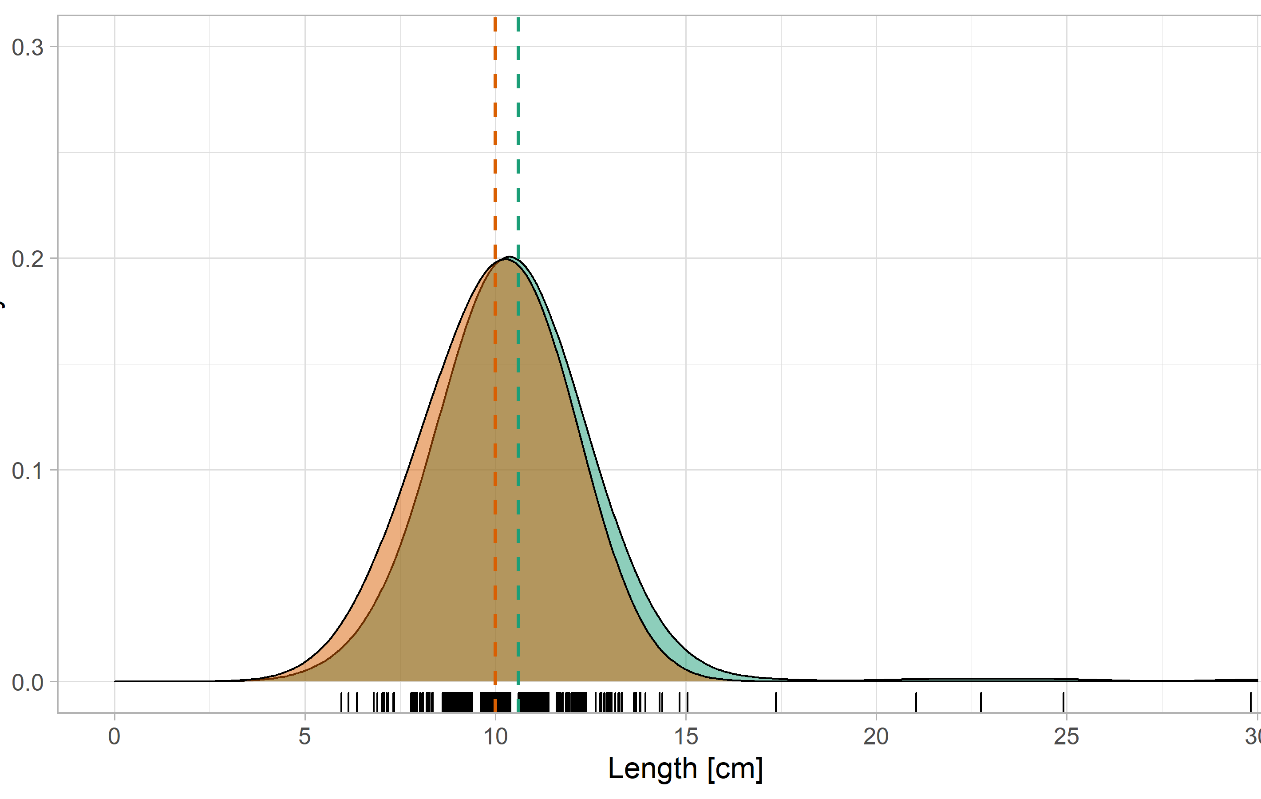
Prelimanary results
 | Germany
 | Netherlands
Comparison Germany – Netherlands
Length composition in October
Perch
Eel
Barbel
25
100
25
Nase
Bleak
Ide
25
20
30

Slide 15
Prelimanary conlusions
Stow net fisheries are suitable for monitoring diadromous fish (all species):
  Quantative monitoring
  Behavioural monitoring
Differences in species en length composition DE - NL
Comparing DE and NL results: insigth in losses of downstream migration.
Stow net fisheries could be an instrument for monitoring knakaal.
River dynamics (discharge, temperatures) ask for year-round monitoring (or flexible based on early warnings). A fixed and limited schedule is not suitable.

Slide 16
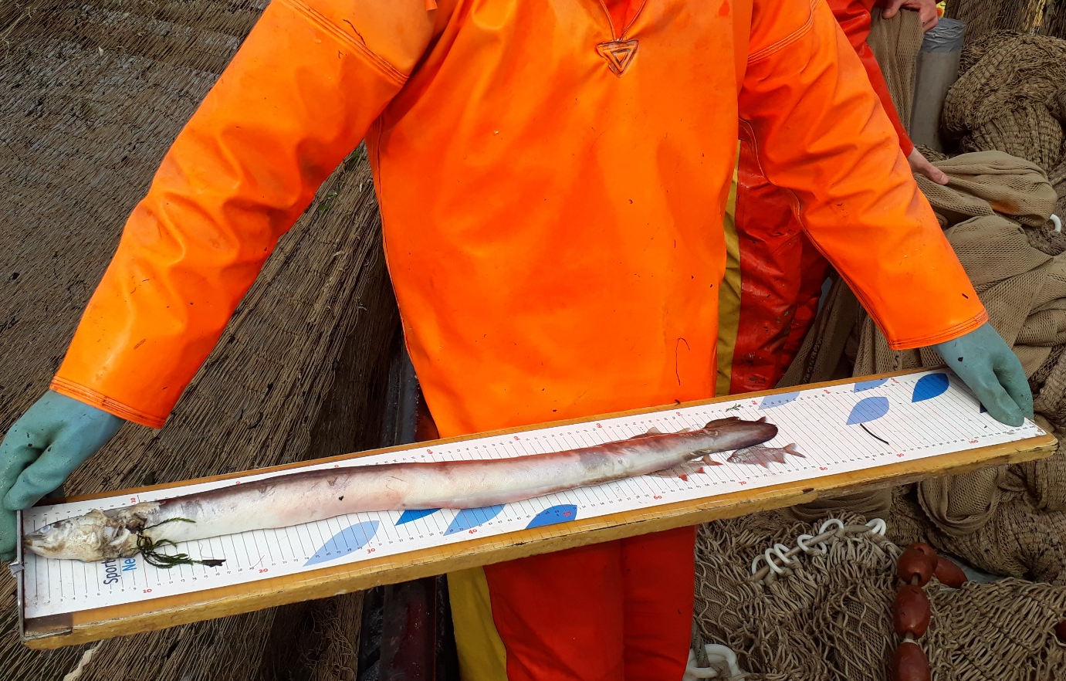
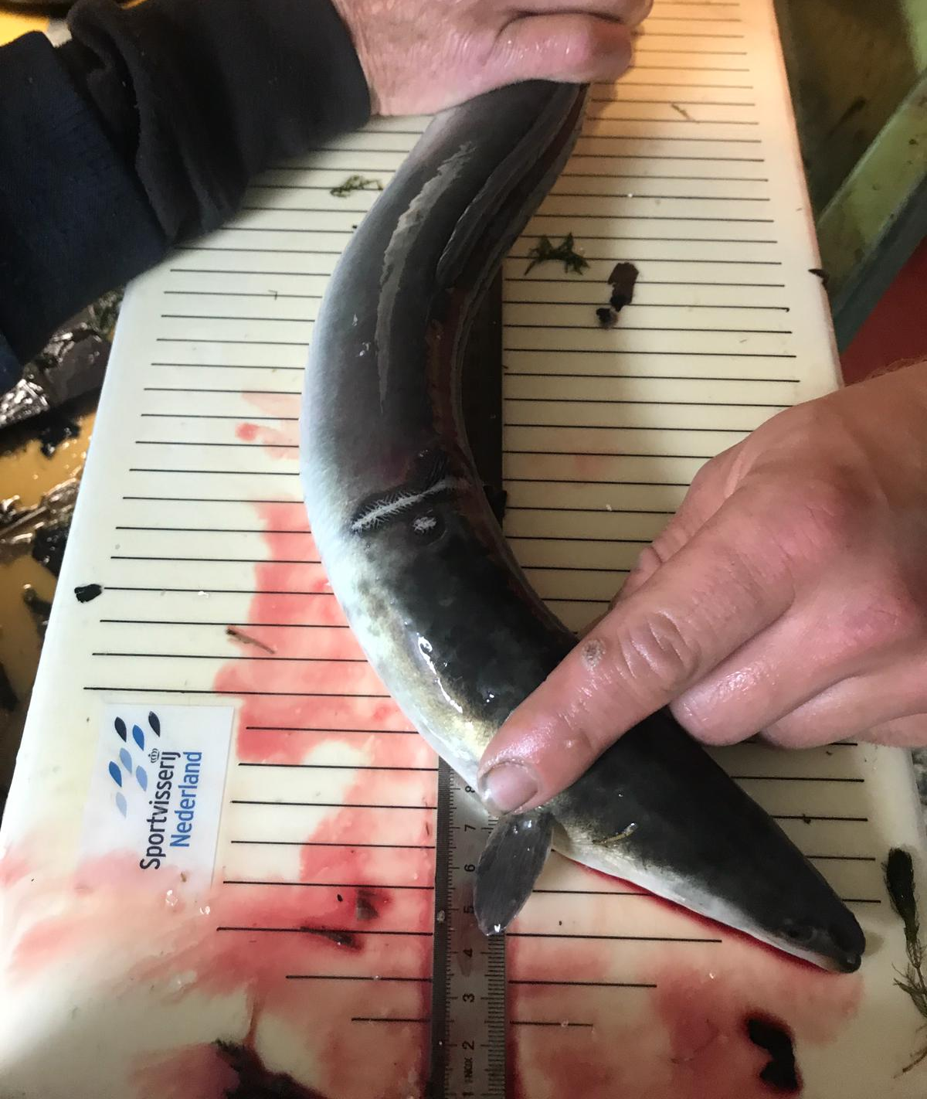
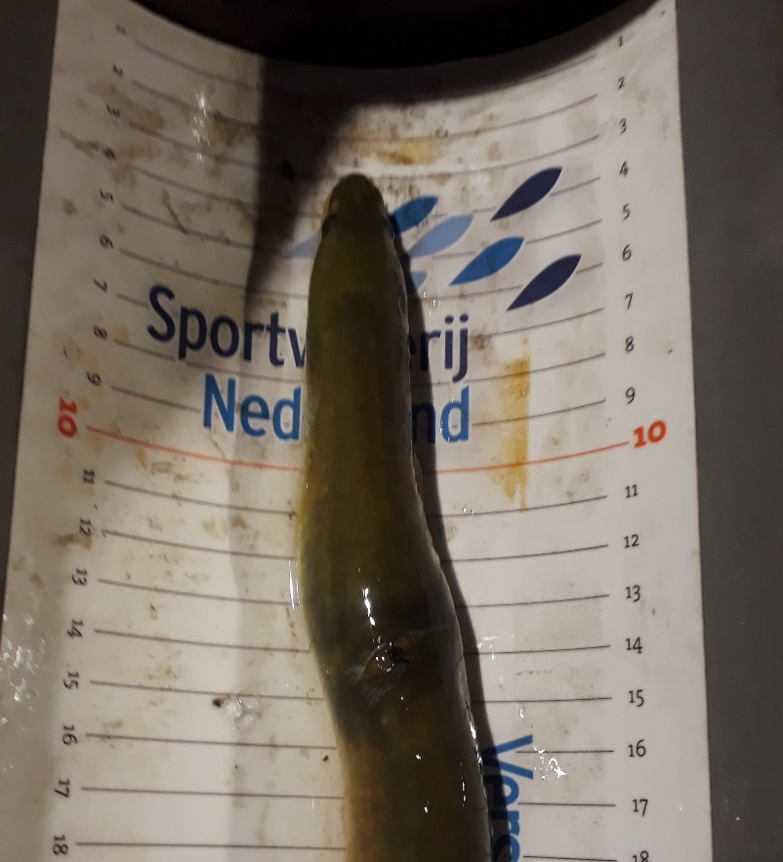
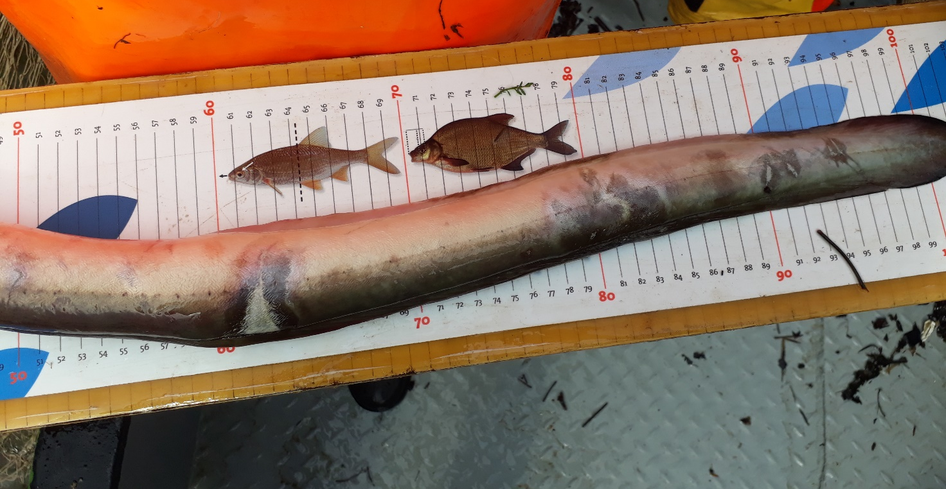
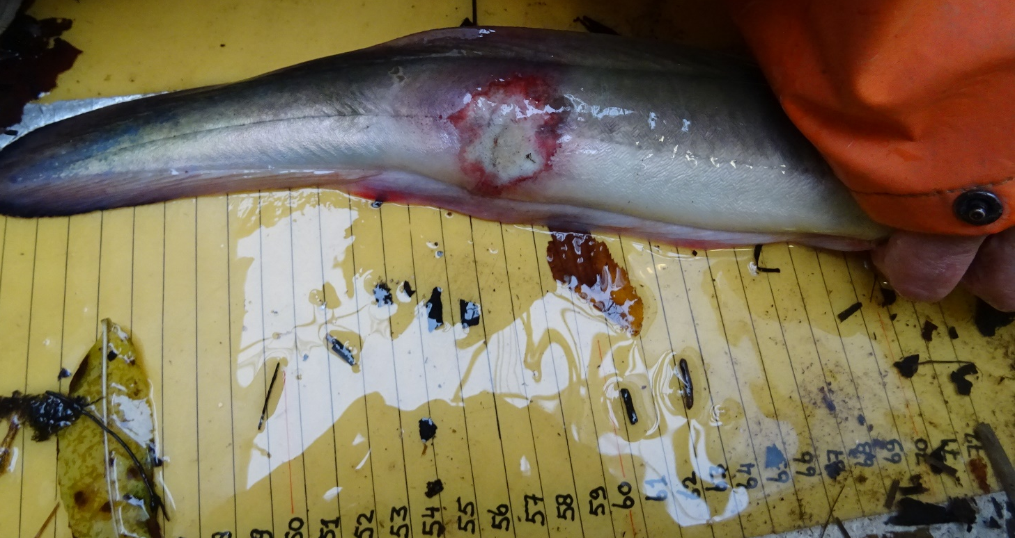
Stow net fishing as a sampling technique for “knakaal”?

Slide 17
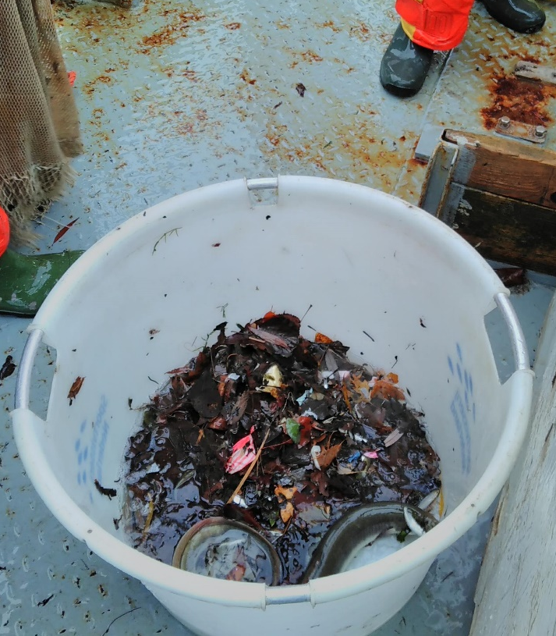
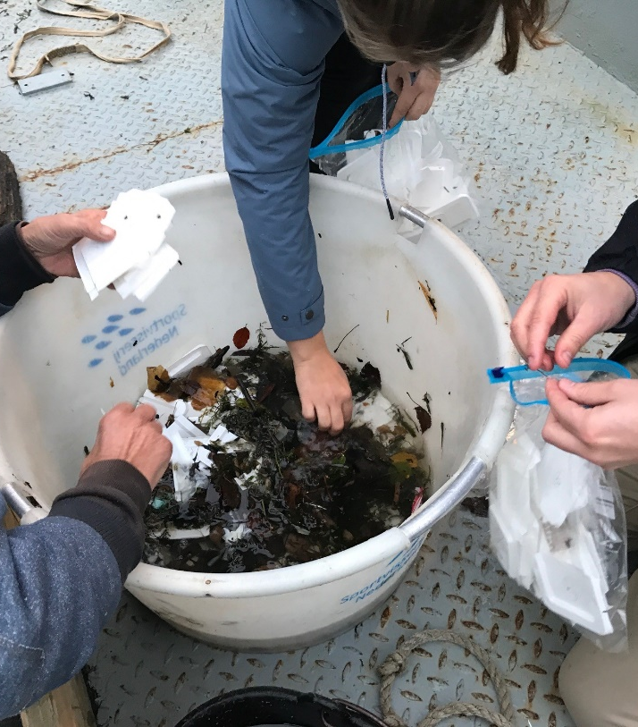
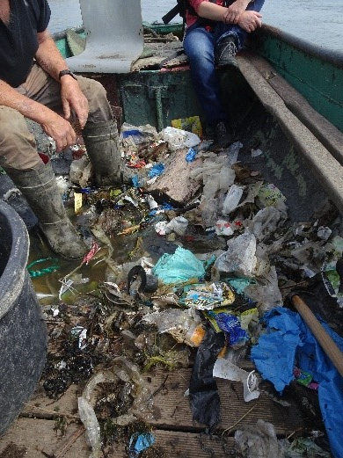
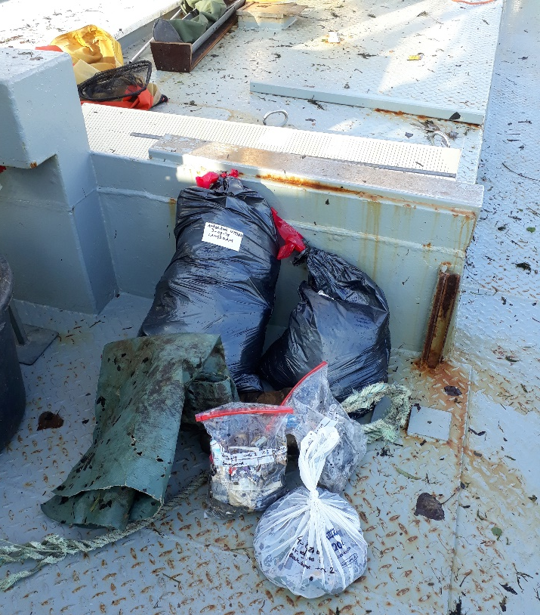
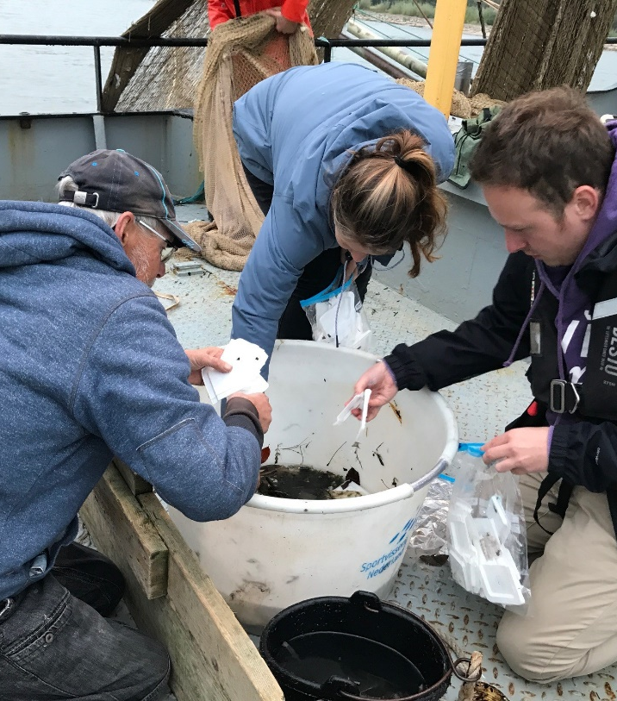
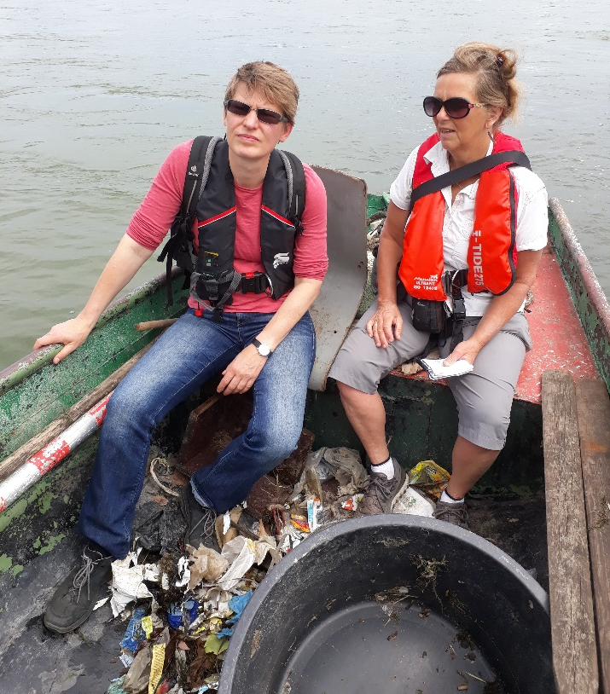
Stow net fishing as sampling technique for plastic?

Slide 18
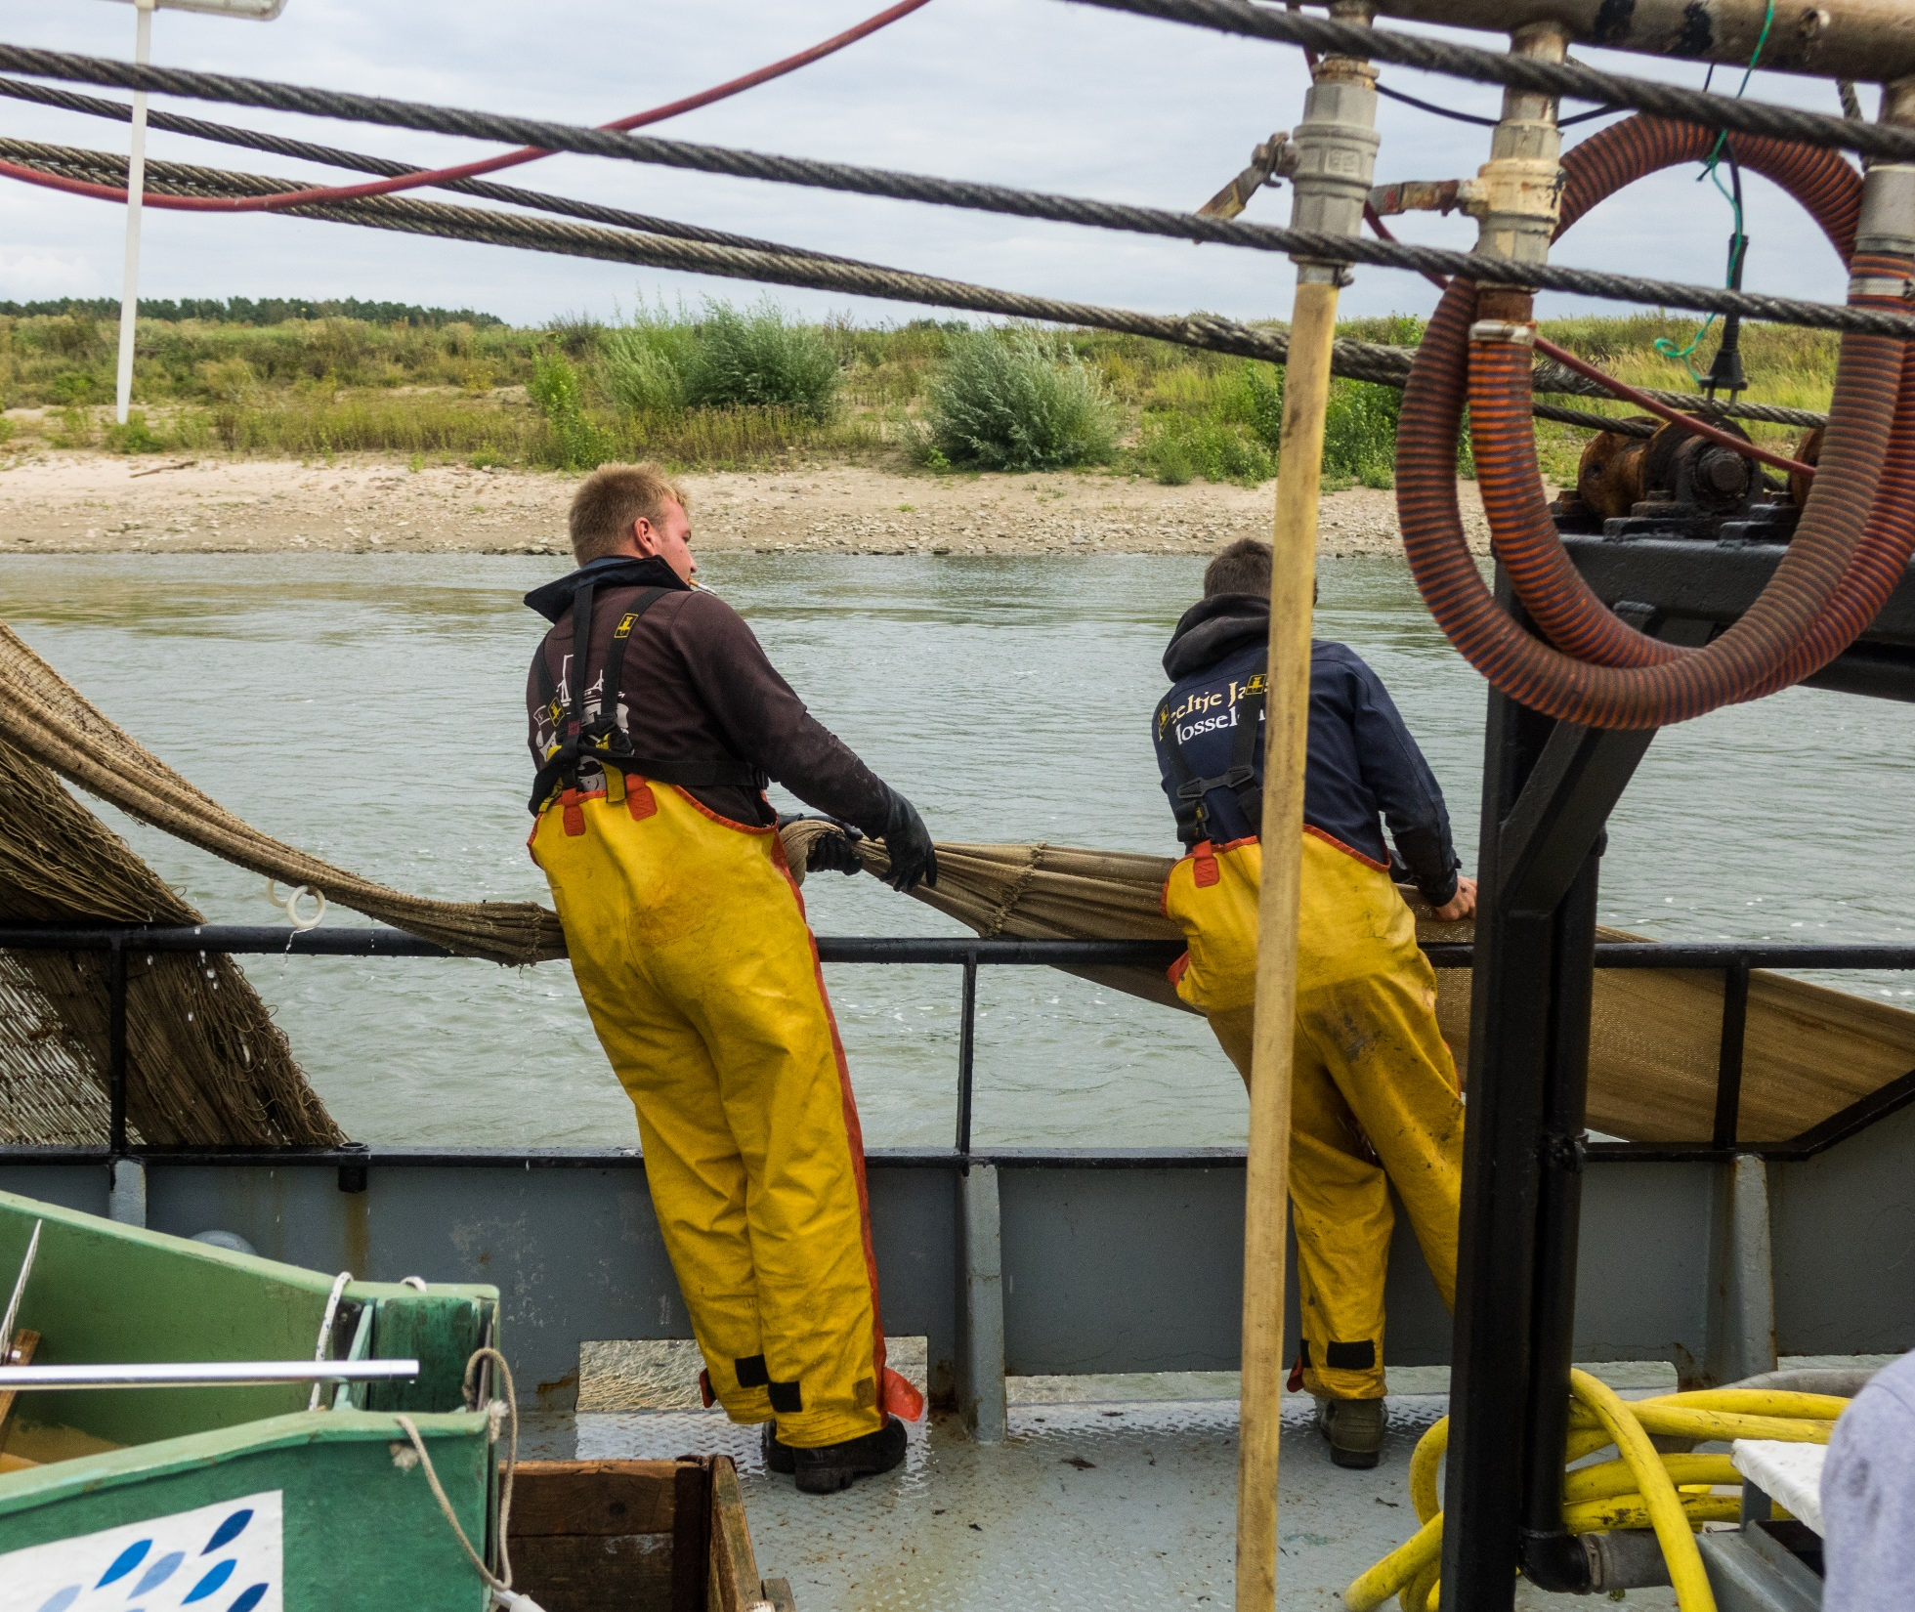
Remaining challenges
      Optimizing conjoint sampling Tiel - Grieth
      Theme’s to adress:
            Knakaal
            Migratory fish
            Riverine fish
      Long term goal: year-round sampling to understand the ecosystem of the lower Rhine

Slide 19
