Slide 1

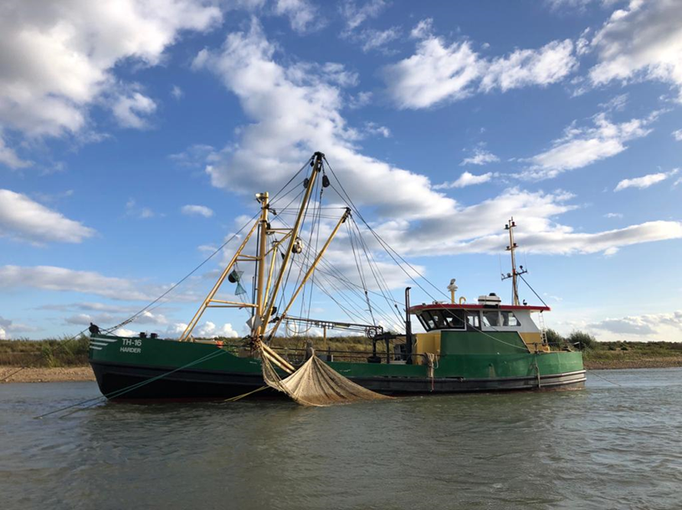
Plastic sampling
How bycatch became a hot topic
Margriet Schoor (Rijkswaterstaat),
Frank Collas, Stephanie Oswald (Radboud University)
March 4, 2021
Rws informatie

Slide 2

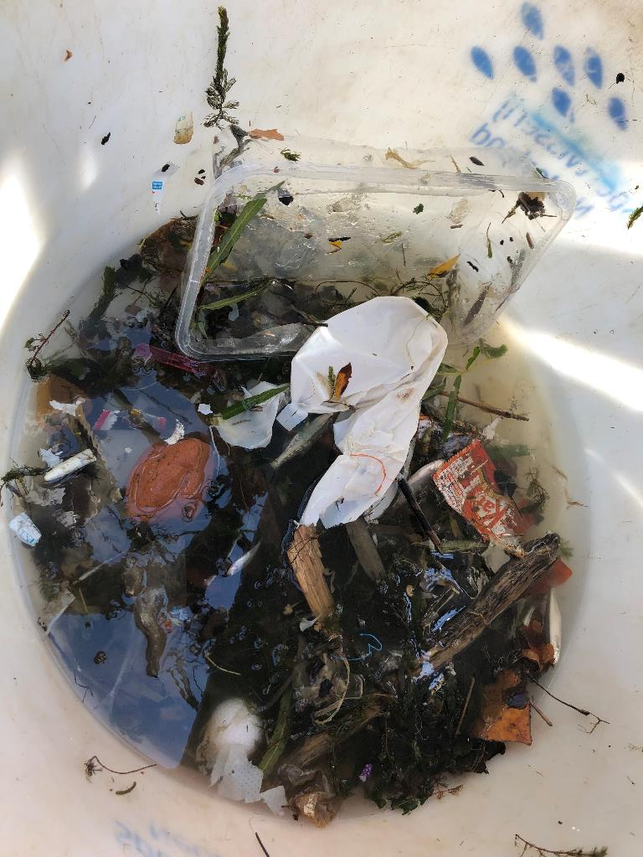
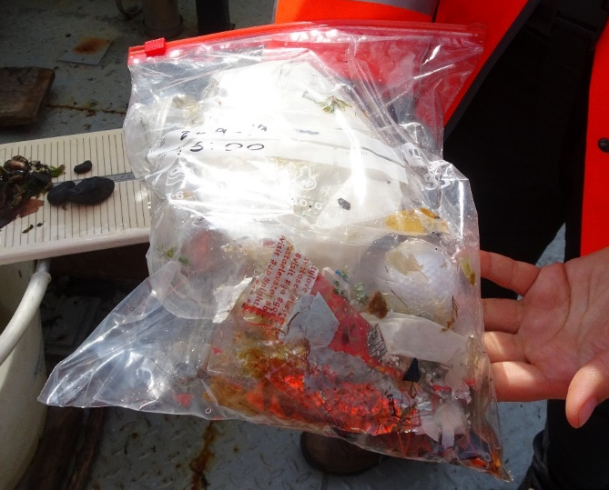
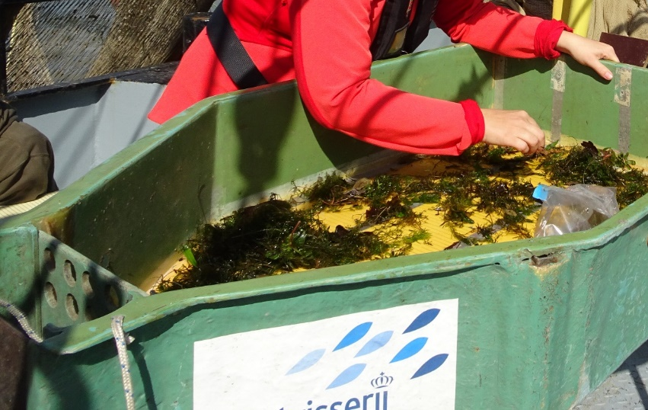
The Waal stow net fishery
More plastic than fish!
A lot of plant material
Collecting the plastic every 1 to 2 hours
Rws informatie

Slide 3
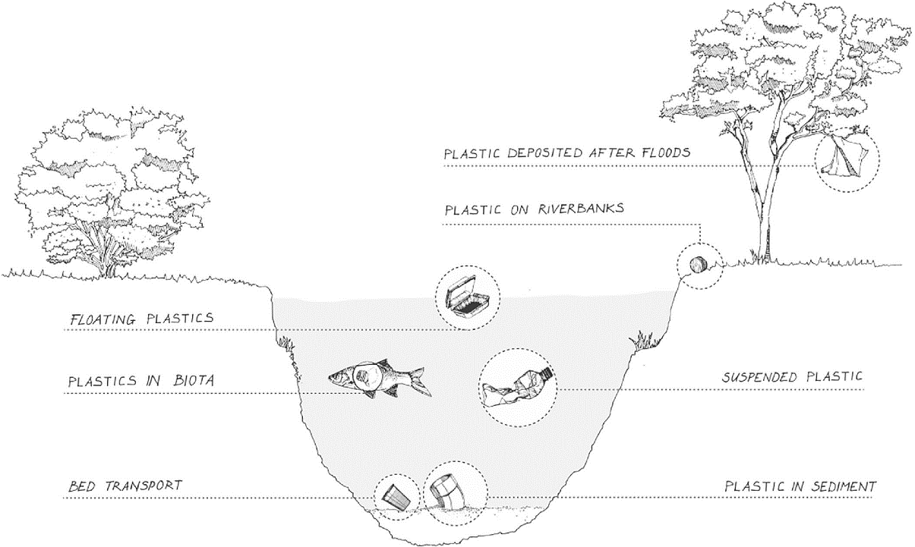
Plastic pollution in rivers
Rivers transport plastic to the sea
Multiple sources and sinks
Research mainly focussed on:
  River banks (Schone Rivieren)
  Top of water column
Stow net fishing? (Eelschokker/Ankerkuil)
Assesment of plastics in the entire water column
Van Emmerik & Schwarz 2019
Rws informatie

Slide 4
Research questions
What plastic materials are present in the water column?
What is the origin of the plastic?
How much plastic is potentially transported yearly?
Goal of this pilot
to learn about the main sources of plastic
to come to a monitoring strategy (method, variation in density, costs)
Rws informatie

Slide 5
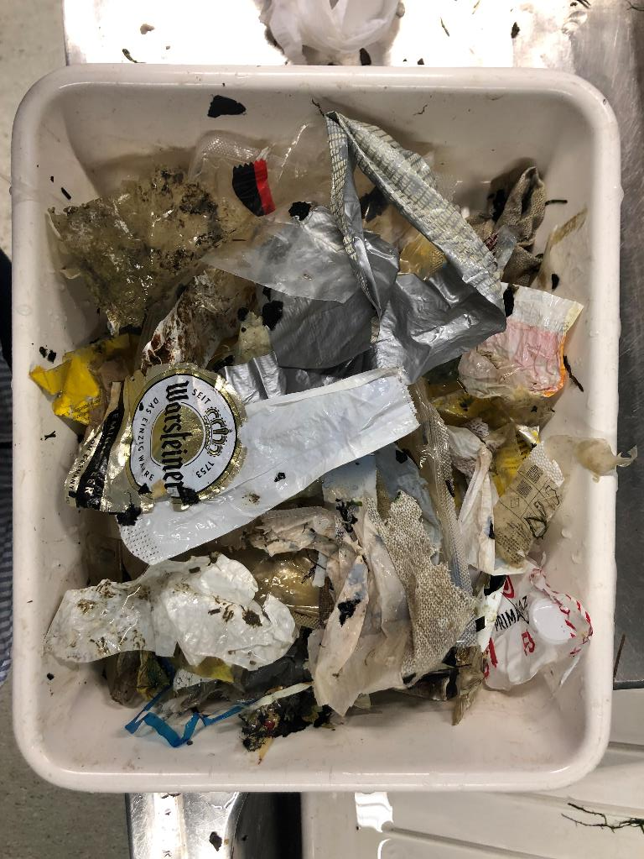
Method
Cleaned and sieved
Meso plastics (0,5 – 2,5 cm) and Macro plastics (>2,5 cm)
Identification according to river OSPAR categories
Counted
Partly weighed
Statistics: Bootstrapping to derive yearly numbers of plastics
Rws informatie

Slide 6
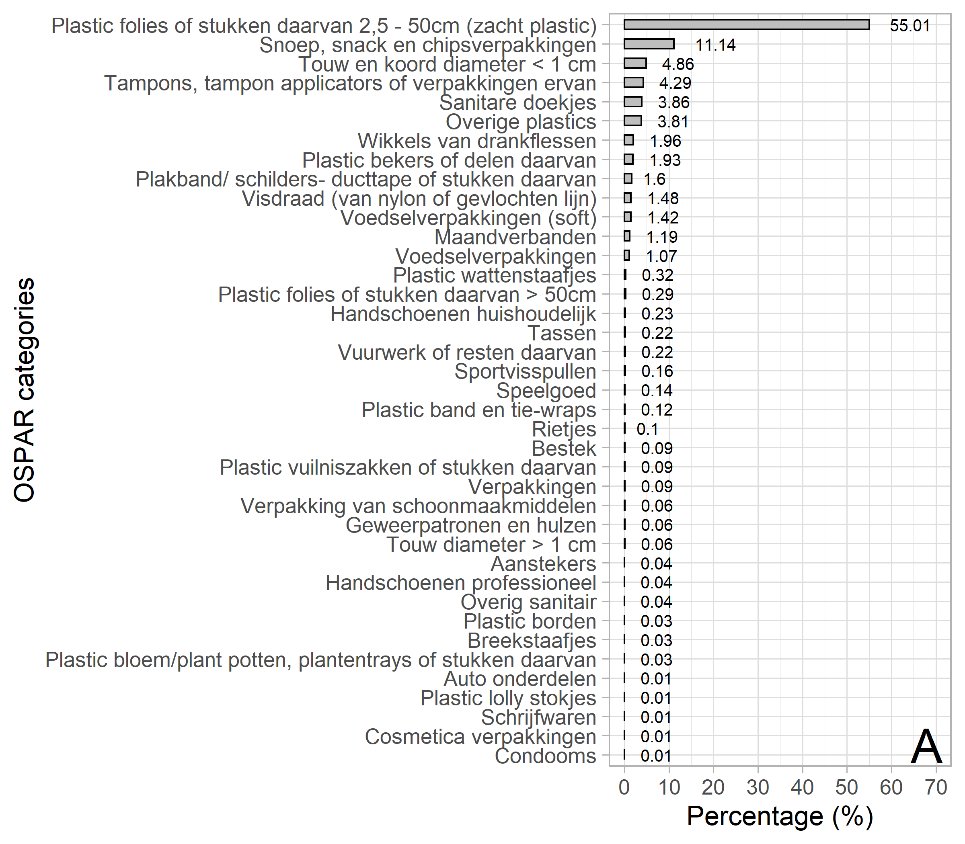
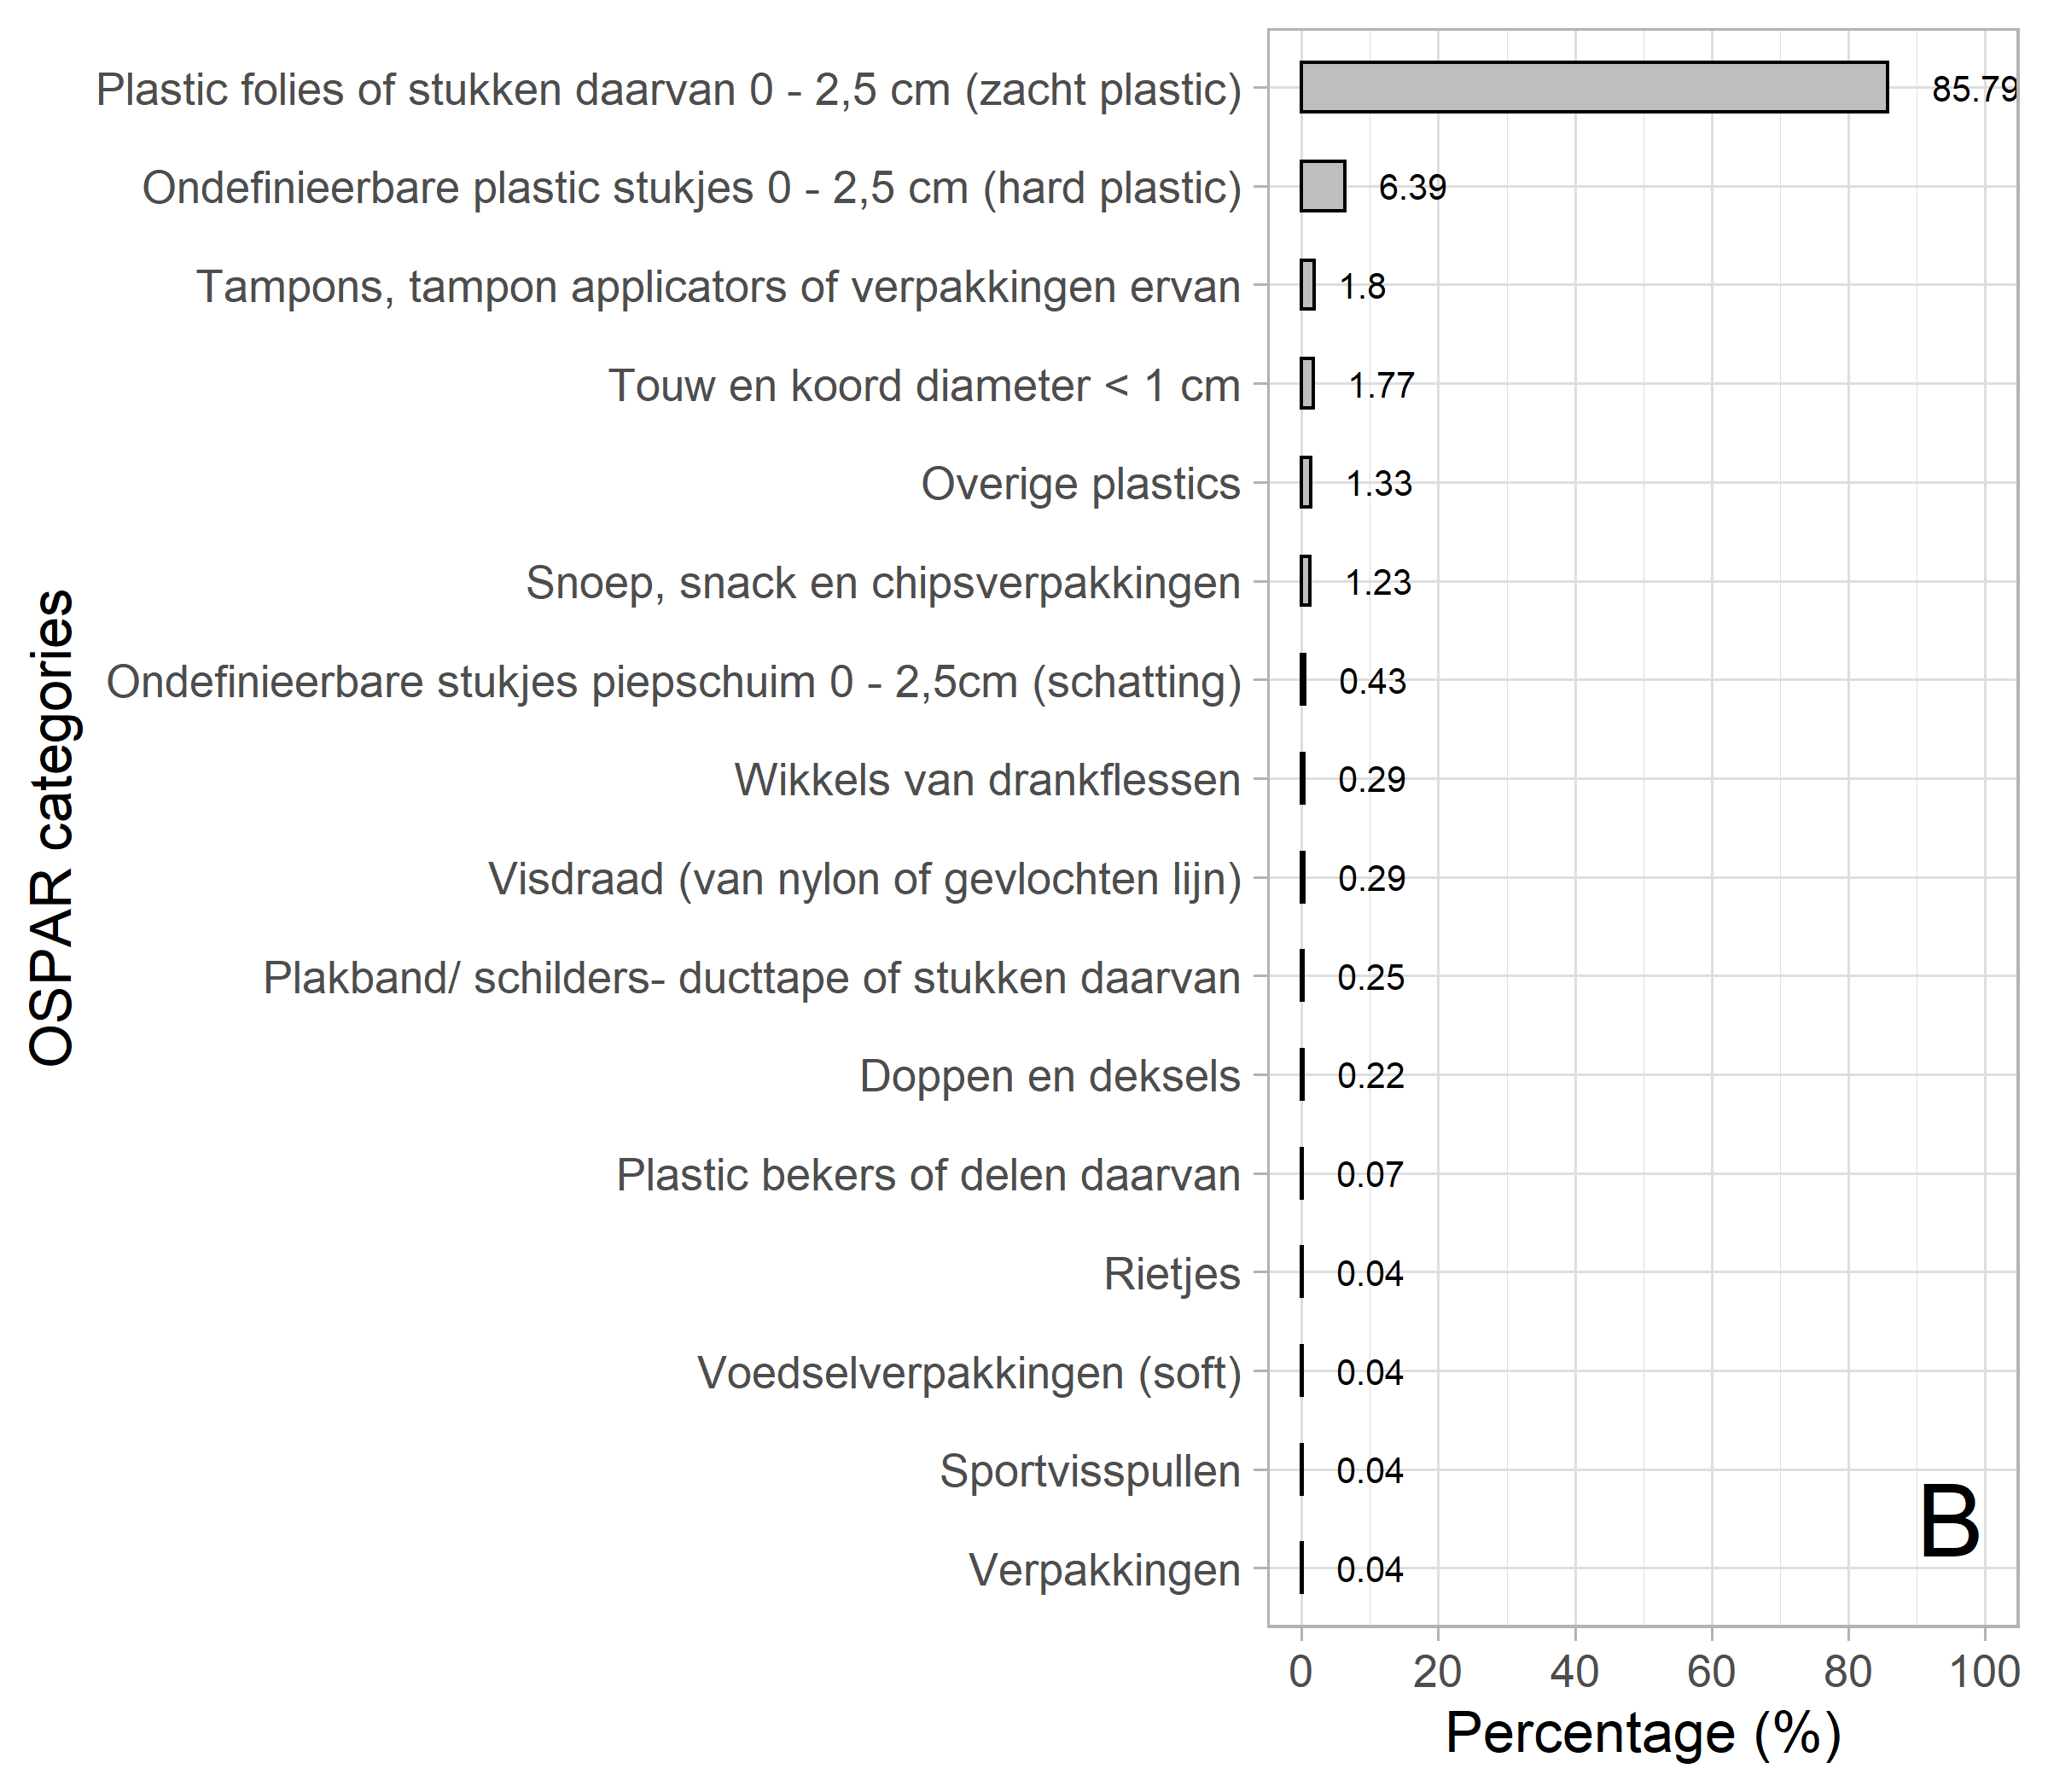
Collected plastic categories
Plastic foil
Candy packages
Cord & string <1cm diameter
Tampon packages
Sanitary wipes
marco
meso
Rws informatie

Slide 7
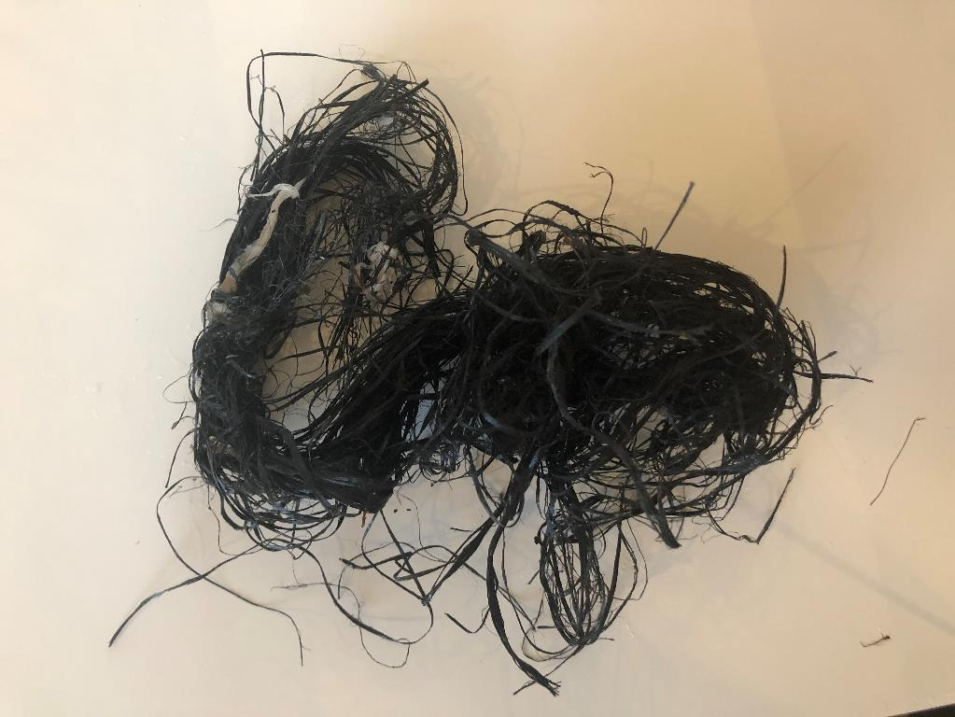
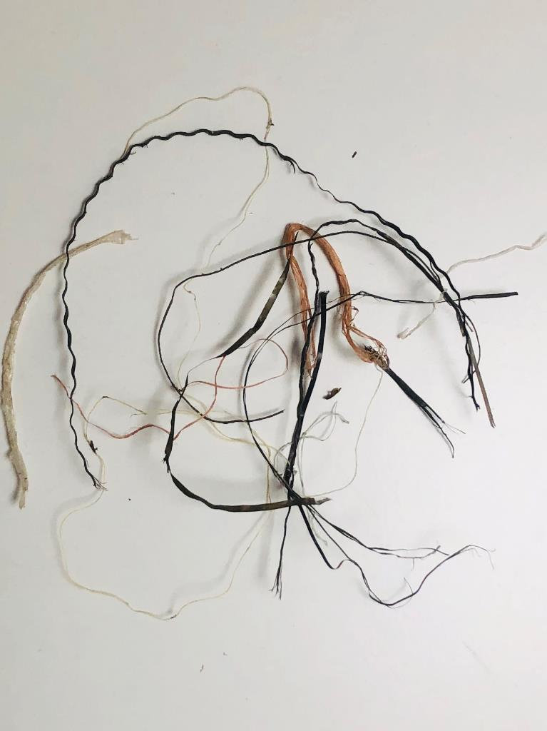
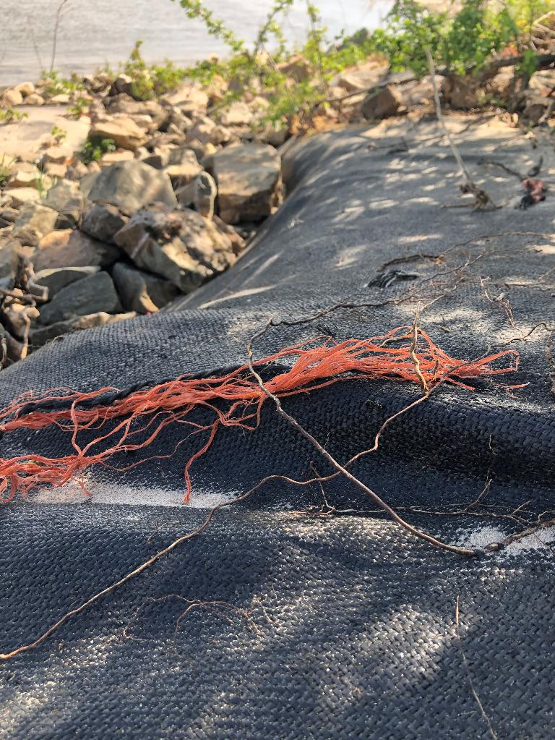
Collected cord & string
Rws informatie

Slide 8
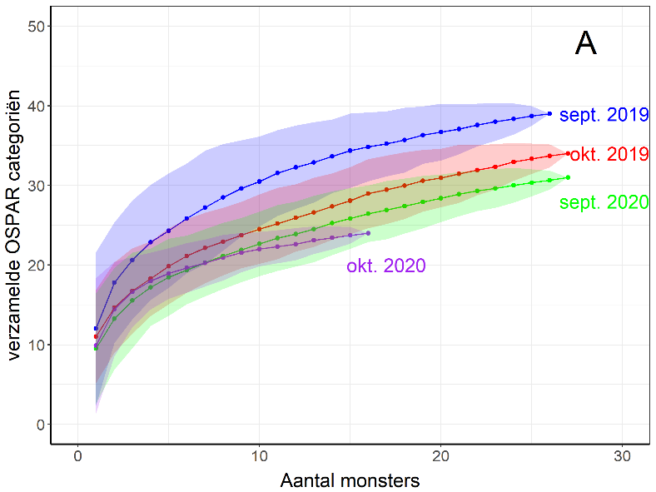
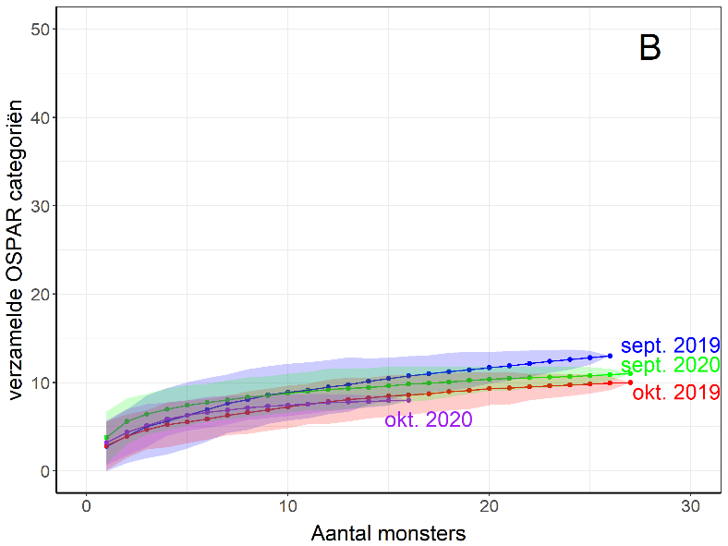
Variation amount of collected plastic categories
Sept > Okt
2019 > 2020 → Corona effect?
Macro
Meso
Rws informatie
Collas et al in prep.

Slide 9
Country of origin
18 countries
Majority from:
  Drainage area Rhine
  Eastern European countries
Shipping?
USA - Toerism?
→ river cruises
Rws informatie

Slide 10
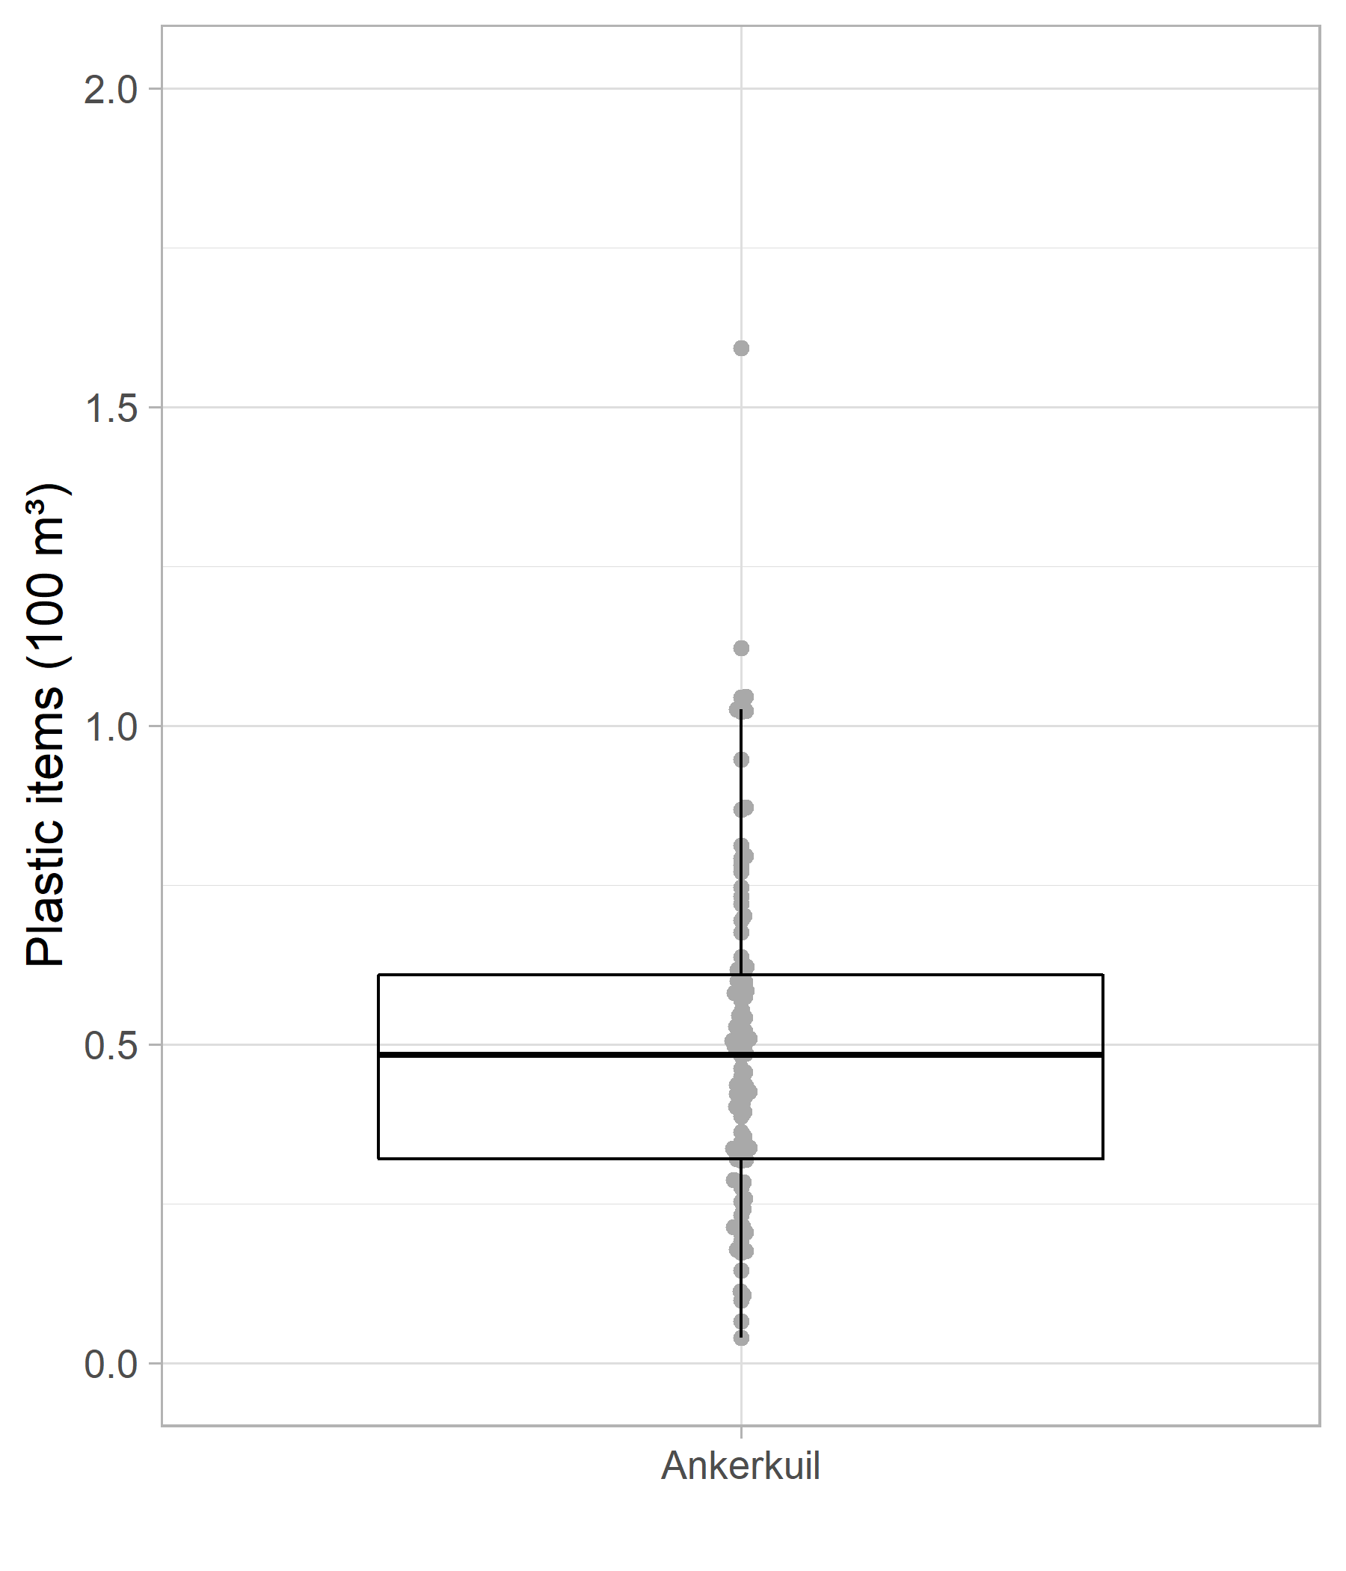
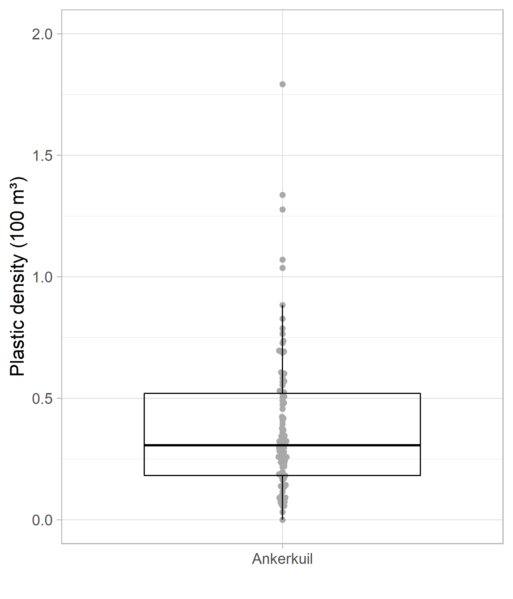
Density of plastic
Macro
Meso
Macro plastics:
0 à 18 items / 1000 m³
average: 5 items/1000 m³
Meso plastics:
about the same
But: underestimation
due to the stow net
Concentration higher than other Western European rivers
(Ems, Weser, Elbe; Schöneich-Argent et al. 2020)
  ~0.02 items/1000m³ versus
  ~10 items/1000 m³ (Waal)
Rws informatie
Collas et al in prep.

Slide 11
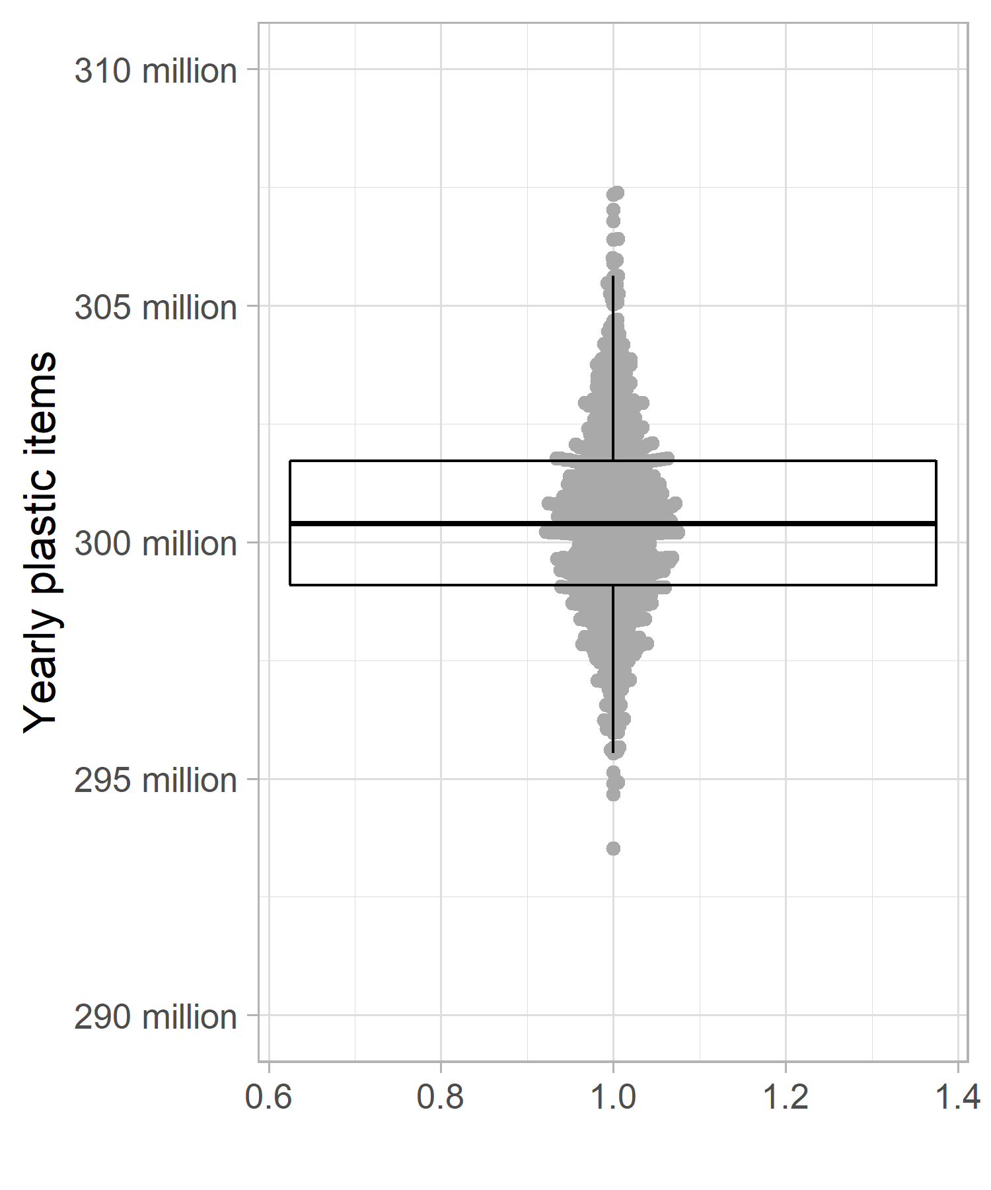
Yearly numbers of plastic in Rhine water
Based on low discharges! (<1800 m³/s)
And tested net efficiency
Waal
Waal: 300 million pieces/year (=79% Q_{Lobith} during sampling)
Boven Rijn: 380 million pieces/year
Rws informatie
Collas et al in prep.

Slide 12
Mass of plastic
data 2019
data 2019
no clear relation between the number of pieces and the mass of a sample
Large variation, low density of large/heavy pieces pieces
Rws informatie

Slide 13
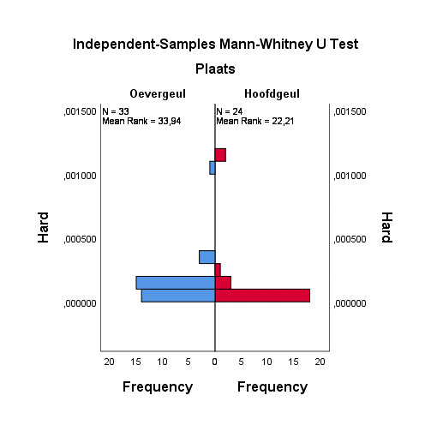
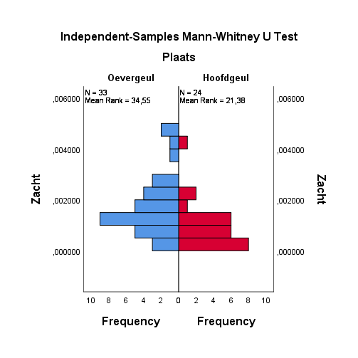
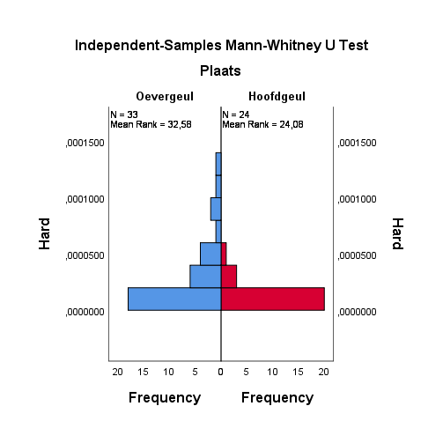
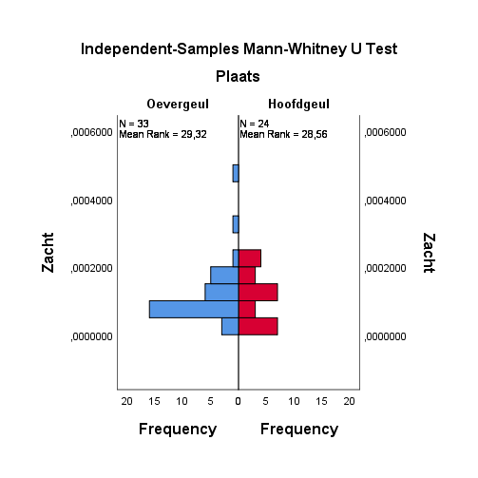
Mass plastic in main channel and side channel
data 2019
Macro (>2,5 cm)
Meso (5-25 mm)
→ Mass →
Significant (1%)
significant (1%)
Niet significant
significant (5%)
compared with main channel: → more plastic in side channel
Rws informatie

Slide 14
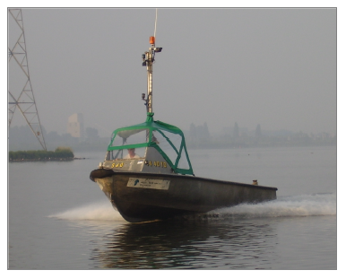
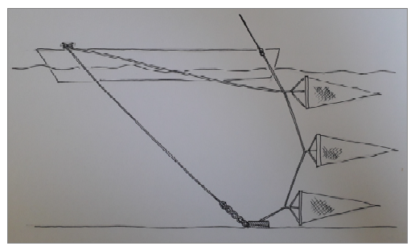
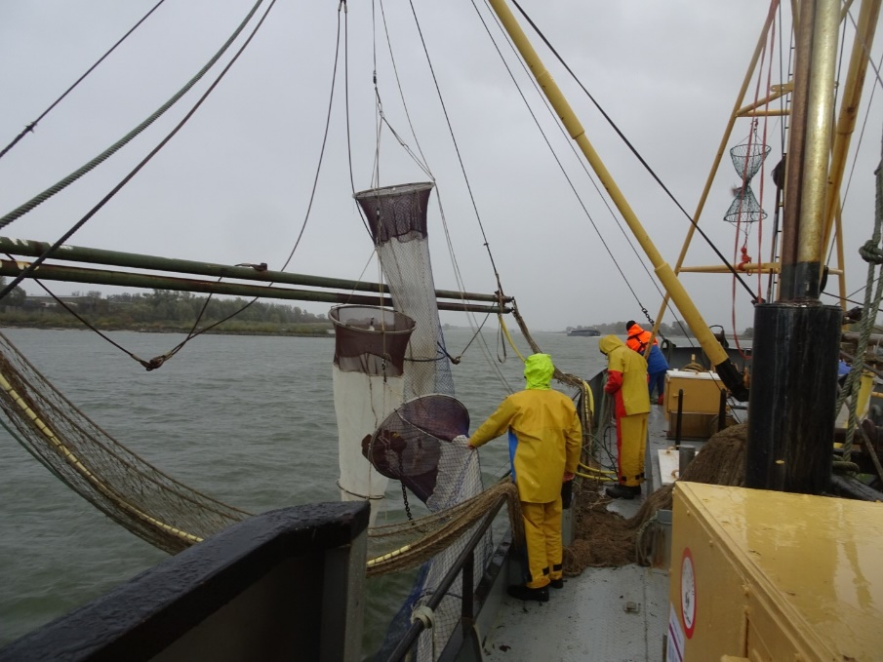
What is going on ?
1 m
Plastic sampling met 3 (larvae) nets above each other (ATKB):
  Test with net 0,5 cm
  Plastic sampled during flood
  Plastic sampled in Tolkamer and IJssel
Analysis by Radboud University:
  Samples ankerkuil 2020
  Samples larvae nets
GPS trackers to follow plastic 2 weeks
Larvae nets catch 2,5 times more meso plastic
Macro plastic density comparable, but low numbers
Rws informatie

Slide 15
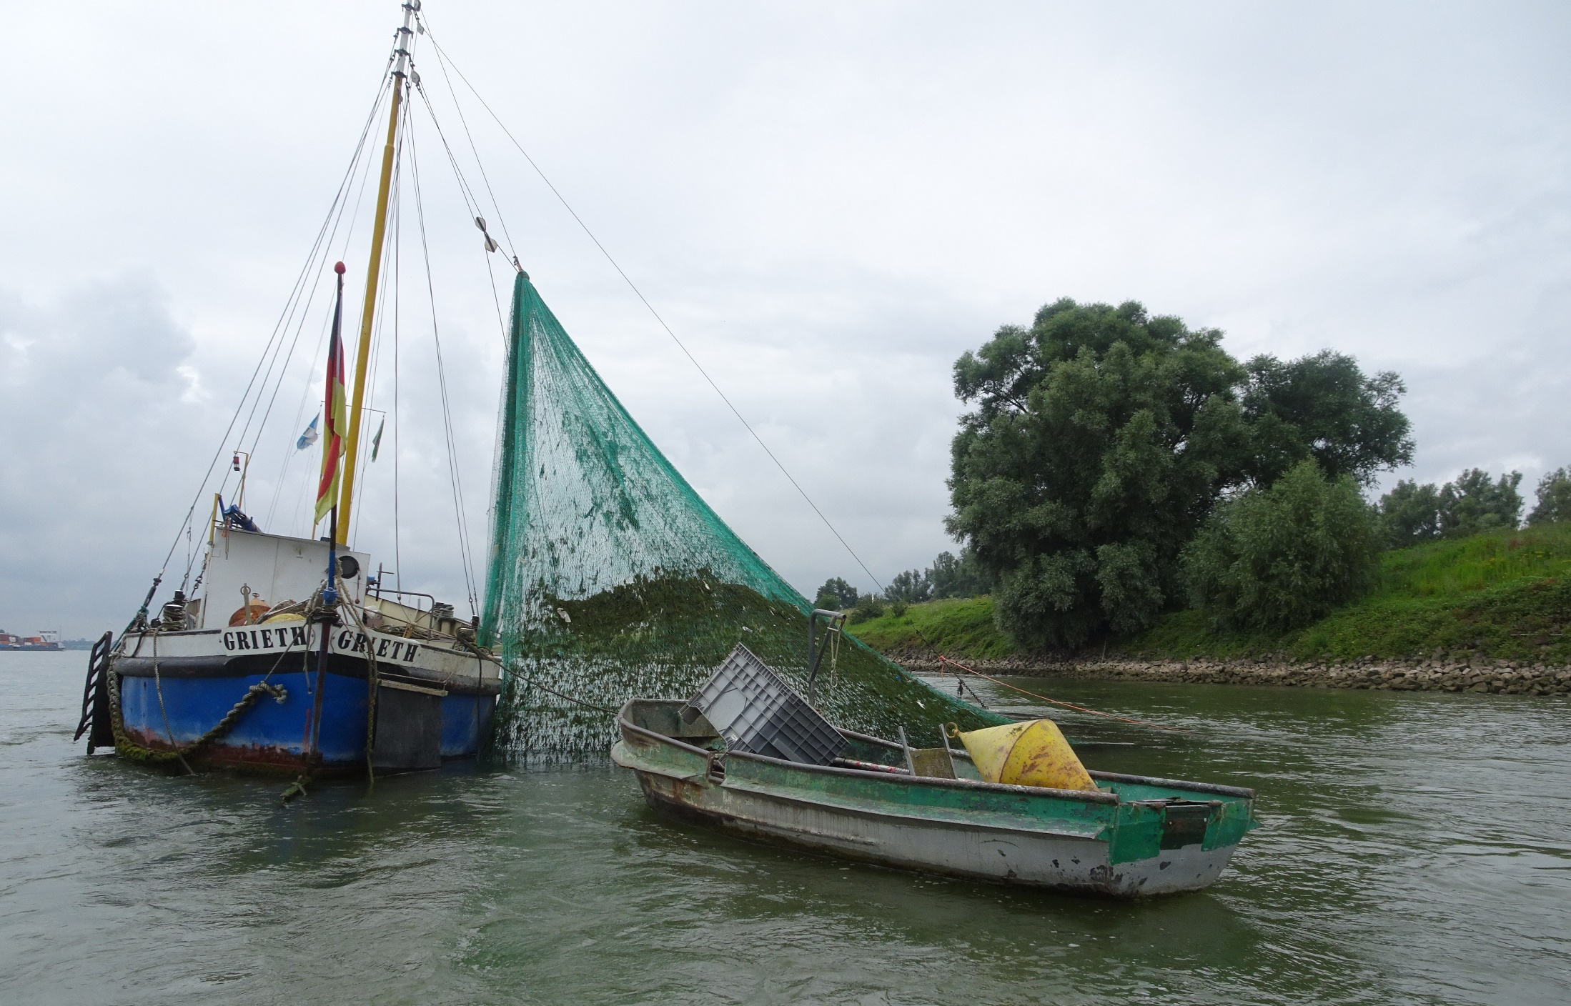
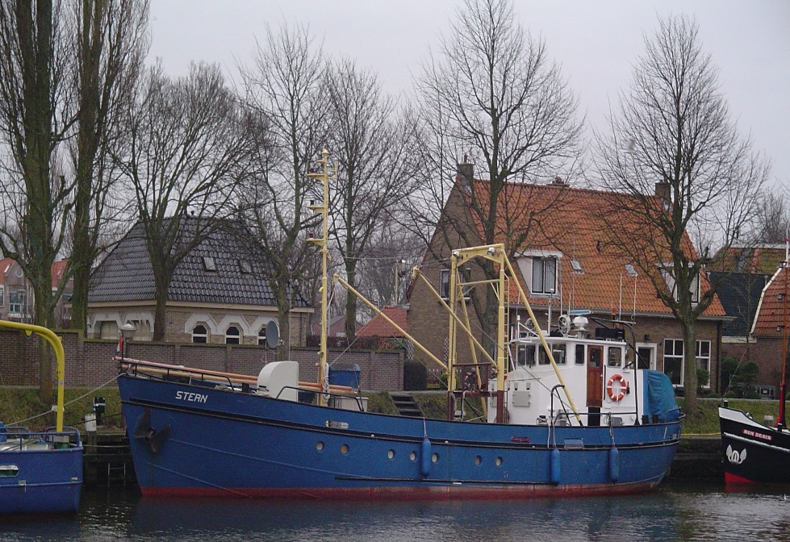
Next april plastic campaign:
Different methods & different places:
2 weeks ankerkuil Waal (GBRA)
  Collecting plastics from stow net
  Collecting plastics from larvae nets
  Collecting plastics from a new fine net (3m x 1 m, 3 mm mash)
  ADCP measurement of flow velocity
  Test of DIDSON sonar camera
Collecting plastic with larvae net on Niederrhein (GBRA)
6 days Boven Rijn (RWS - not sure yet)
  Collecting plastics from larvae net
  Collecting plastics from a new fine net
River banks plastic collecting (WUR - not sure yet)
Rws informatie

Slide 16
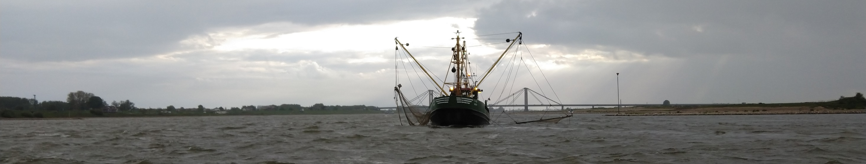
Future wishes plastic research GBRA
More plastic sampling (depth, width, longitudinal, seasonal variability)
  to come to a monitoring strategy
  focus on in/output at borders
Collaboration with RU and WUR and Germany
Identify main sources (e.g. tributaries, shipping) and put on the agenda
Rws informatie

