Slide 1
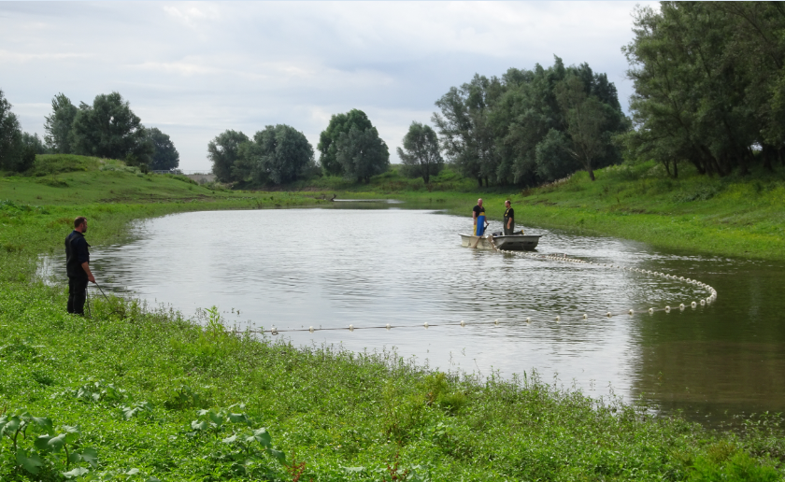
Fish Migration between River and Floodplain
Some provisional results
Luc Jans; Rijkswaterstaat Oost-Nederland
March 4th 2021
RWS Informatie

Slide 2
Comprehensive research on fish along the river Rhine
Habitat use juvenile fish; PhD Twan Stoffers; 2017-2020; 2200 hauls (catches) on 60 locations (river banks and secondary channels/backwaters) along Waal, IJssel and Nederrijn; on three locations very detailed studies
Fish communities in flooded grasslands; RAVON 2018-2020
Standard monitoring of fish stock main channel; each year in March
Telemetry; migratory fish; Sea trout, Salmon
RWS Informatie

Slide 3
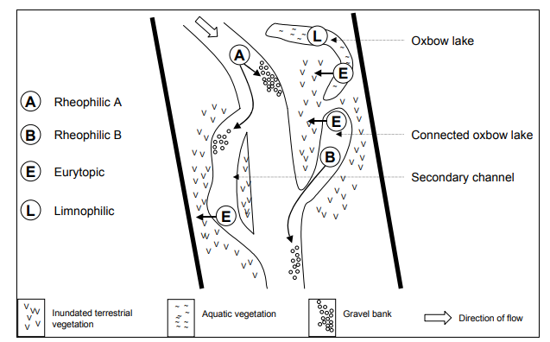
Wide range of riverine fish species; all using different habitats
From: Grift, R.E. 2001. How fish benefit from floodplain restoration along the lower River Rhine. PhD Thesis, Wageningen University.
RWS Informatie

Slide 4
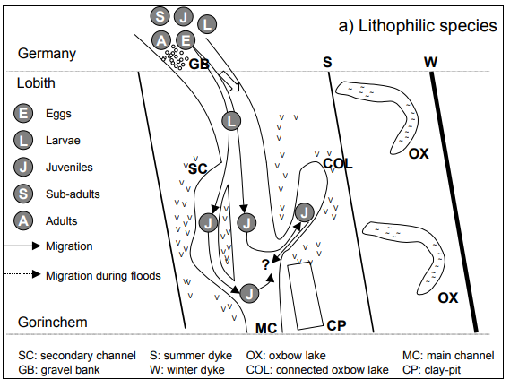
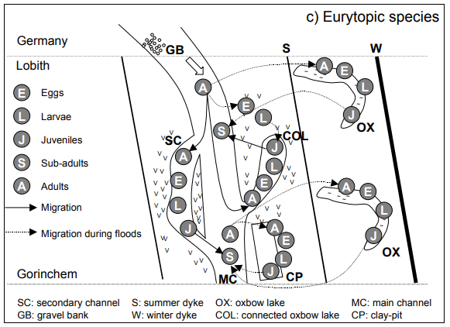
Wide range of riverine fish species; all using different habitats
From: Grift, R.E. 2001. How fish benefit from floodplain restoration along the lower River Rhine. PhD Thesis, Wageningen University.
RWS Informatie

Slide 5
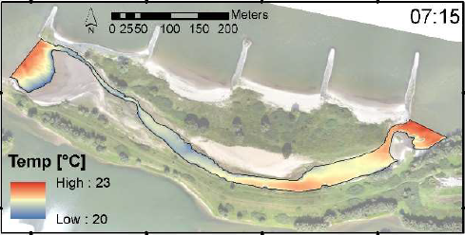
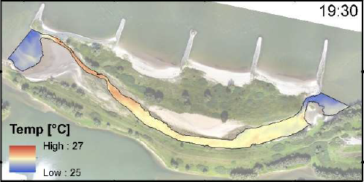
Even daily migration of fish!
Gamerense Waard (Waal); Hot summer day; Water temperature
From: Collas et al. 2019. Sub-Daily Temperature Heterogeneity in a Side Channel and the Influence on Habitat Suitability of Freshwater Fish. Remote Sens. 2019, 11, 2367; doi:10.3390/rs11202367
RWS Informatie

Slide 6
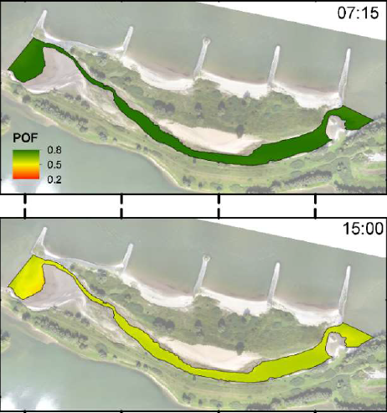
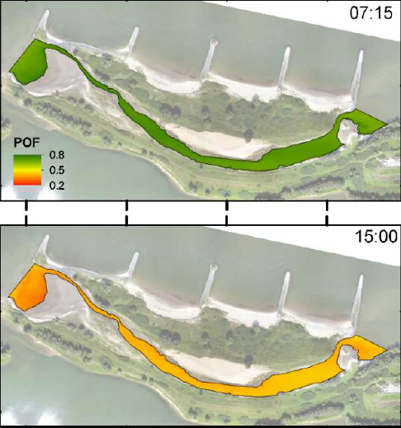
Ecological suitability
Alien species
Native species
RWS Informatie

Slide 7
Fish density day and night
Average fish density (no/100 m2)
RWS Informatie

Slide 8
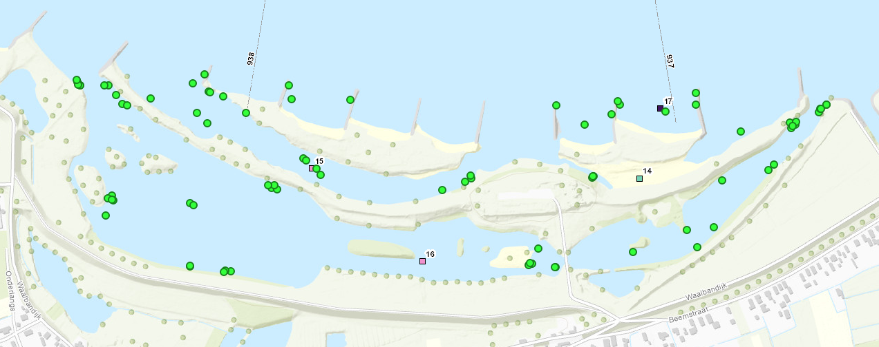
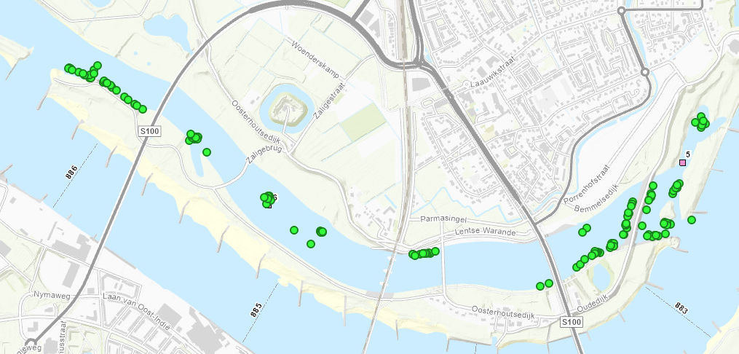
Very comprehensive research on juvenile fish
Gamerense Waard
Spiegelwaal; Nijmegen)
RWS Informatie

Slide 9
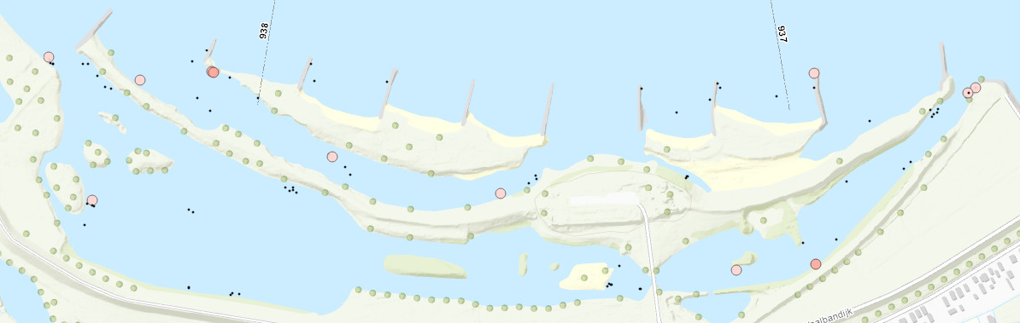
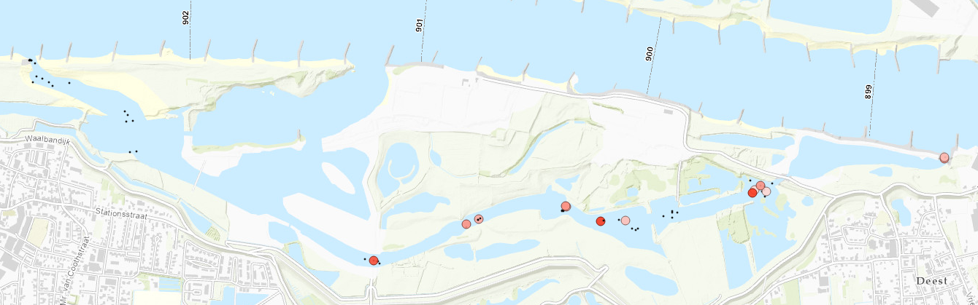
Barb Gamerense Waard
Chub (Kopvoorn) Afferdense en Deestse Waarden
RWS informatie

Slide 10
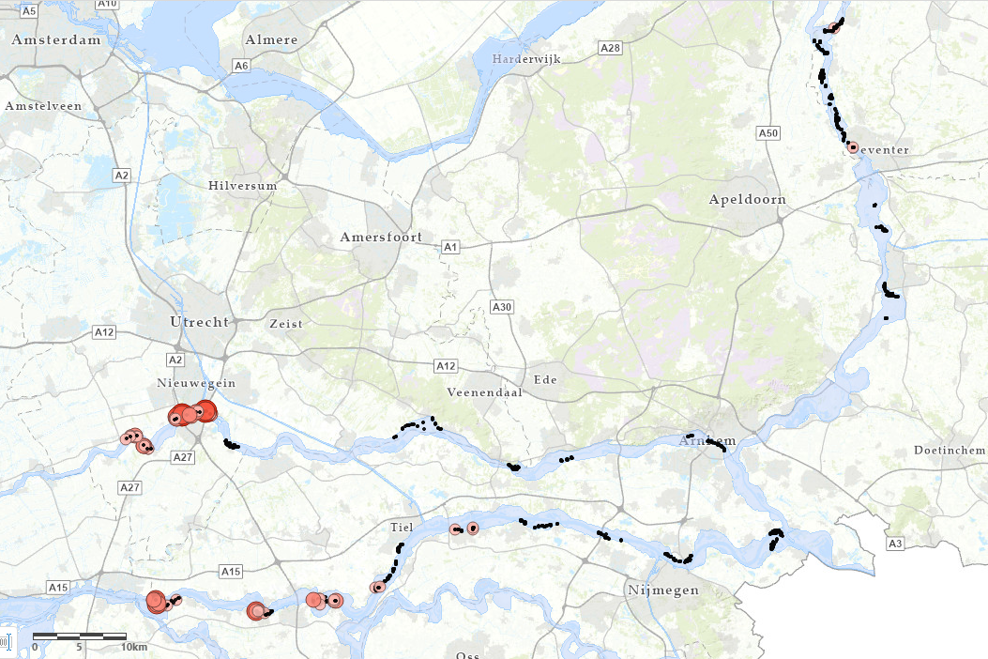
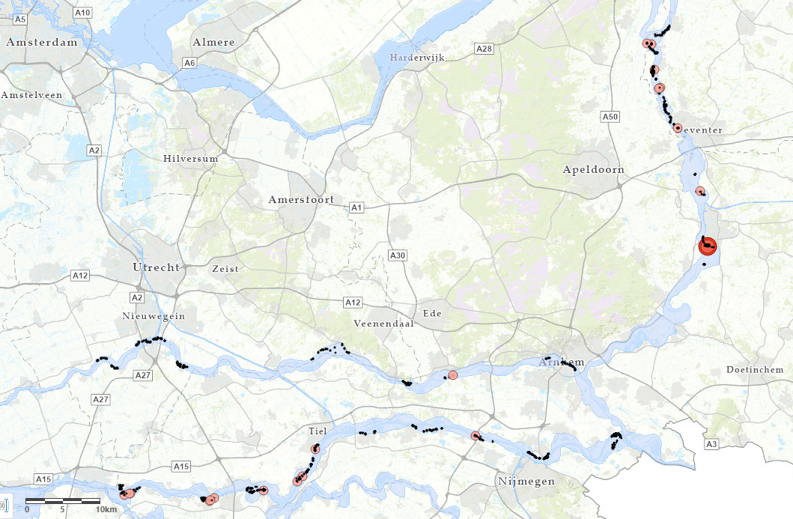
Catfish (Europese meerval)
Flounder (Bot)
RWS informatie

Slide 11
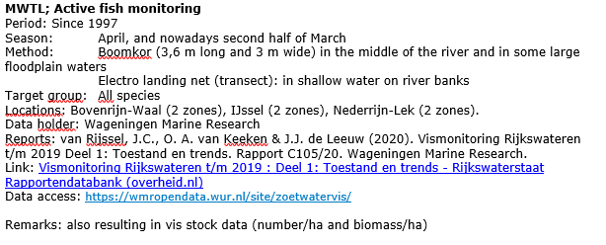
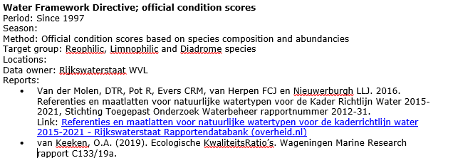
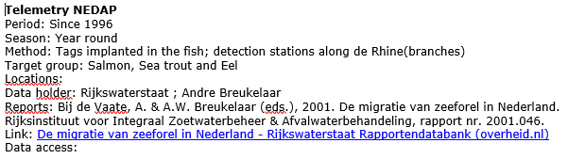
Preparing an overview of available fish data Rhine
Germany & The Netherlands
RWS Informatie

