Slide 1

Shipping and eel mortality in the Rhine
Thursday March 4th – Green-Blue Rhine Alliance
Notes:
My name is Max van de Ven, project manager at ATKB environmental consultancy. Today I will be presenting a study I conducted for the Green Blue Rhine Alliance on shipping and eel mortality in the lower Rhine (in the Netherlands).

Slide 2
Shipping and eel mortality in the Rhine
In this presentation…
Introduction and problem definition
Research objective
Method and data
Results & discussion
  Temporal patterns & collision probability
  Spatial patterns & collision probability
  River discharge & collision probability
Conclusions
Questions & Discussion
Notes:
A short summary of the content of this presentation.

Slide 3
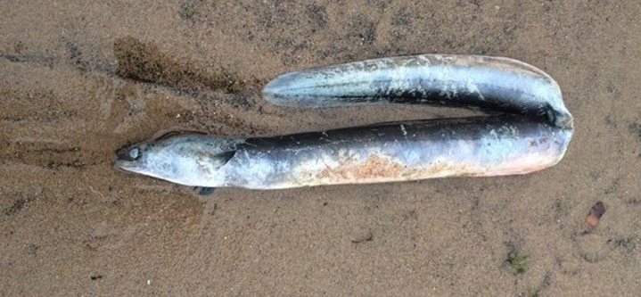
Introduction & problem definition
European eel is of mayor ecological and of socio-economical importance in the Rhine catchment.
Nowadays the stock remains outside the safe biological limits (ICES, 2014).
EC Regulation (1100/2007) requires that member states take measures to assure a 40% pristine escapement to the sea.
In addition to fisheries, pumping and hydropower stations also remain important anthropogenic mortality factors.
→ “knakaal” (nicked eel)
Notes:
Primarily directed at European eel, although the problems caused by shipping probably apply for other diadromous fish species as well. Eel is a proxy.

Slide 4
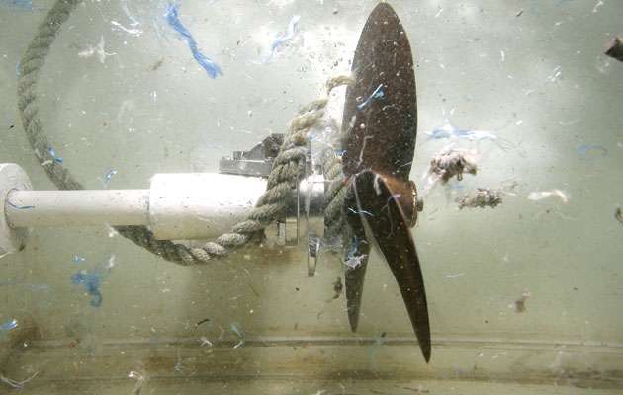
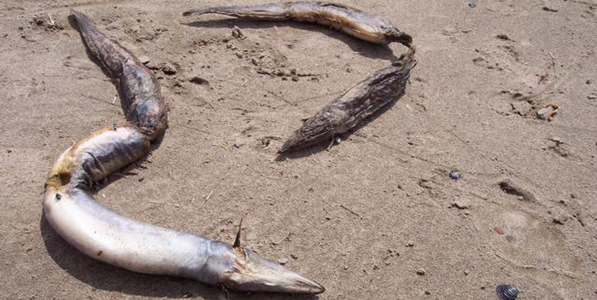
Introduction & problem definition
Mechanically damaged eels and other fishes with typical cuts are also found at moments and locations that make pumping or hydropower stations as the cause of death improbable.
Collisions with ship propellers are suspected to be a potential mortality factor. Especially in rivers with high shipping traffic.
Notes:
Research focus until now especially in sea mammels and in sturgeons in United States Mississippi

Slide 5
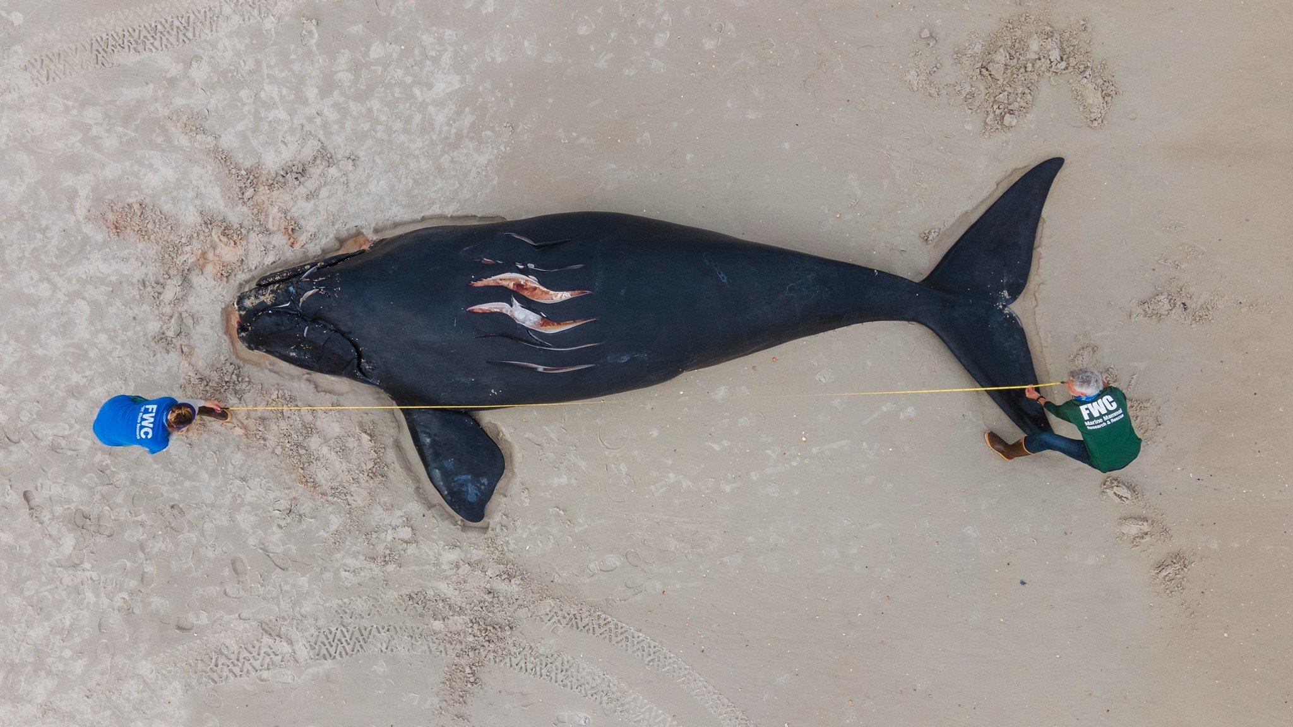
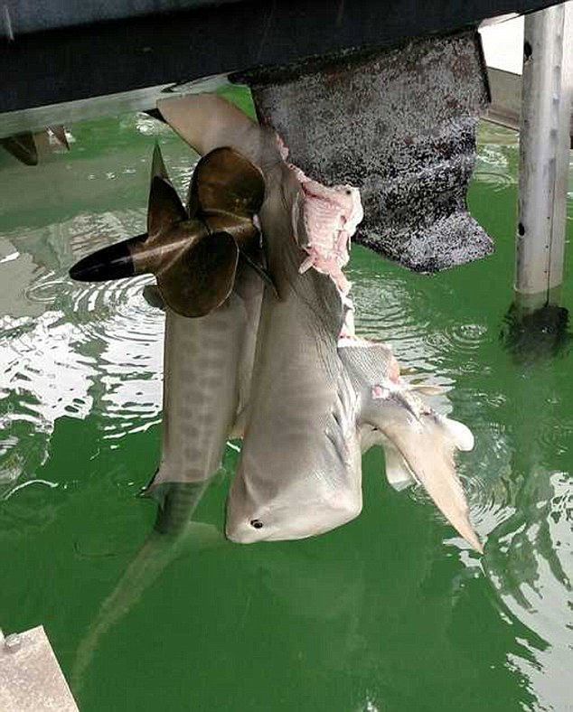
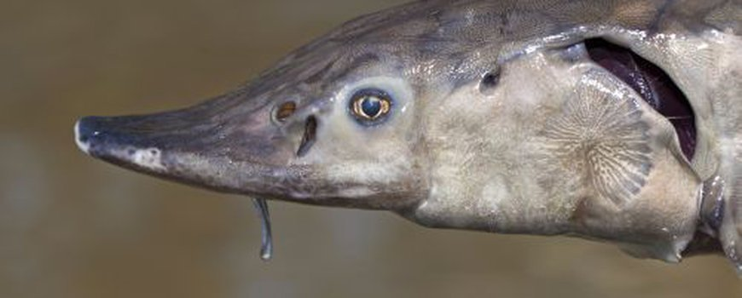
Notes:
Shipping is mentioned as one of the factors that should be investigated in the light of re-introduction of species extinct

Slide 6
Research objective
In this study the potential role of shipping as a cause of eel mortality in the Rhine is investigated by characterizing relevant aspects of ships and shipping in the Lower Rhine and to relate these characteristics to the behavior of eels.

Slide 7
Method & Data
Which characteristics of ships potentially influence the risk of collision?
Which characteristics of eels potentially influence the risk of collision?
Expert judgement
List of relevant aspects of ships / shipping
List of relevant aspects of eels
Literature:
Reports CCR & IVR
Shipping data:
RWS and AIS
Literature
Characterization / description of relevant aspects of ships / shipping
Characterization / description of relevant aspects of eels
How do they relate?

Slide 8
Method & Data
Ships/shipping | Eels
Ship type/size Propellor Type and size Propulsion Shipping intensity Shipping speed Spatial use of the river Shipping depth Shipping direction Position in the river | Periodic activity Day and night activity Seasonal activity Life stage activity Reaction time and swimming speed Spatial use of the river Habitat use Migration routes

Slide 9
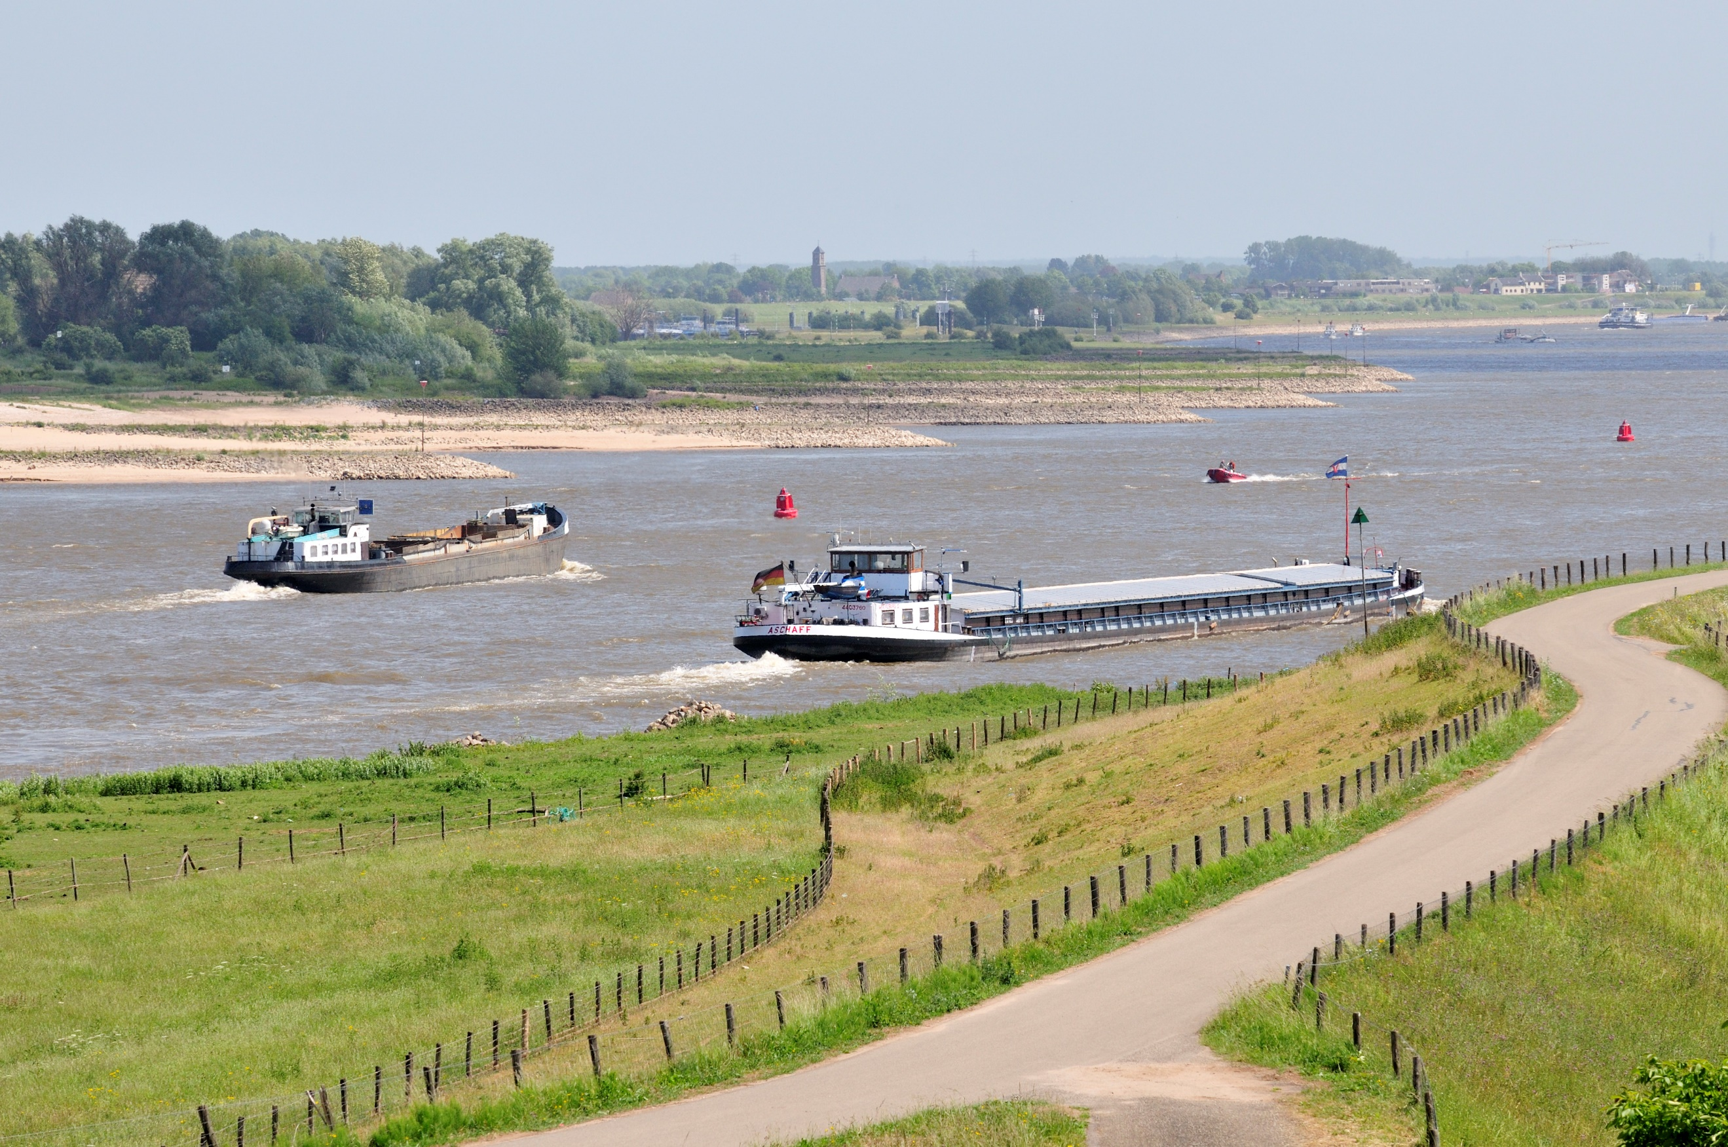
THE RHINE FLEET

Slide 10
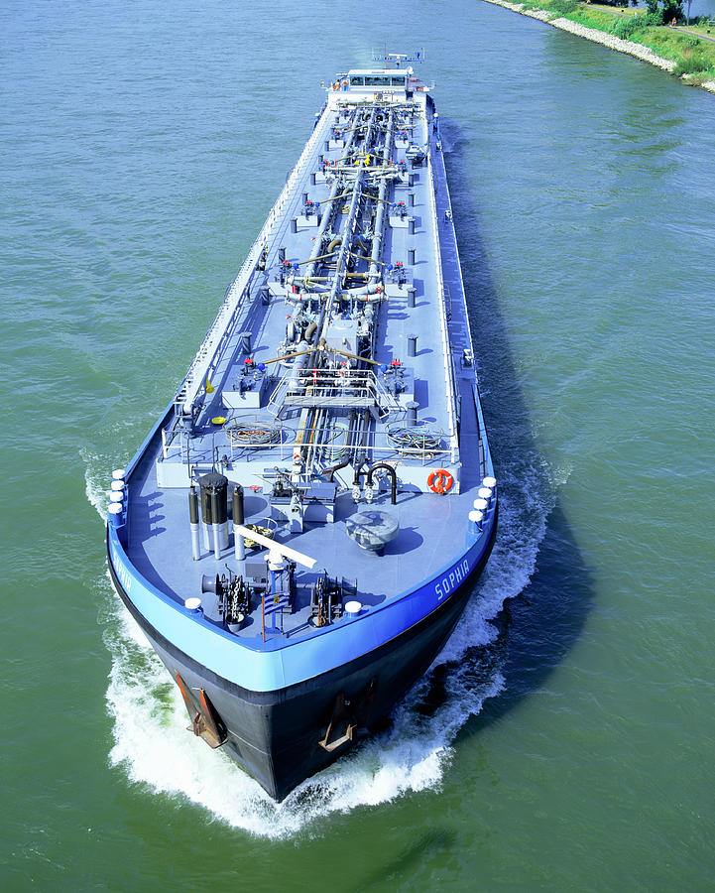
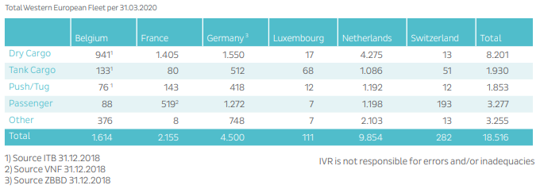
Ship types based on function
The Rhine fleet comprises ca. 10.000 ships:
7,033 dry cargo vessels
1,433 tankers
1,319 pushers and tugs
(CCR 2020)
tanker

Slide 11
Ship types
Based on
size

Slide 12
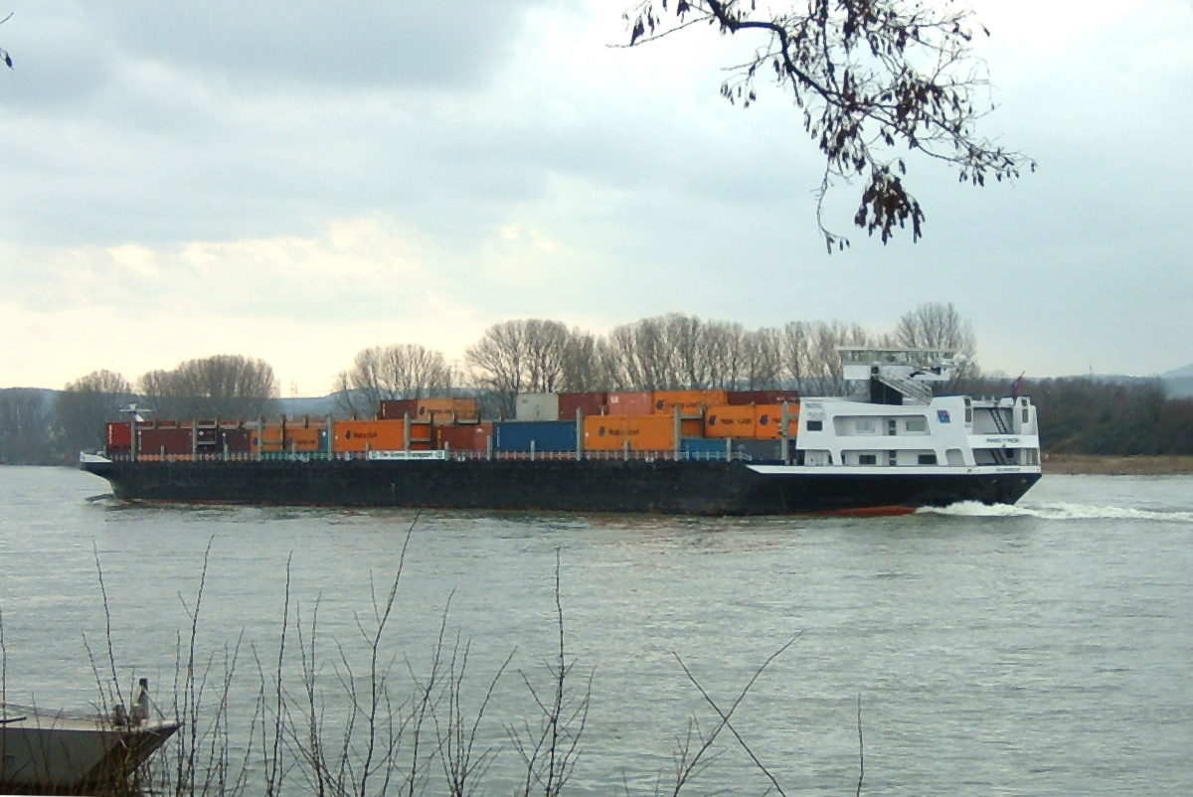
Ship types on the Rhine
M8: Groot Rijnschip / Large Rhine ship (CEMT V)
Notes:
350.000 shipping movements in 10 year period equals average of 35.000 per year and 100 per day. A thirth of all ship movvements on the Waal.

Slide 13
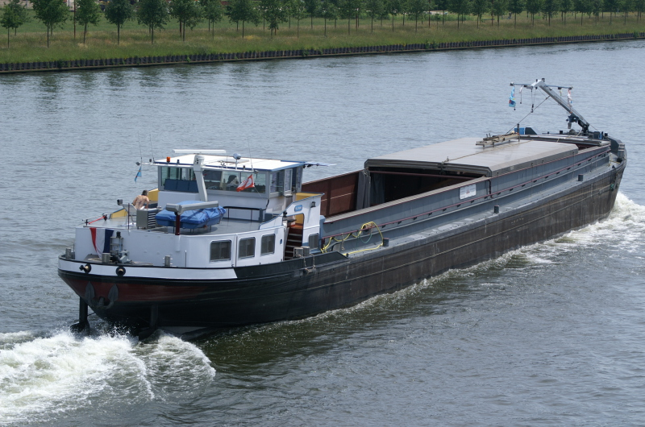
Ship types on the Rhine
M6: Rijn-Herne(kanaal)schip (CEMT IVa)
Notes:
150.000 in 10 years / 15.000 per year / 40 per day

Slide 14
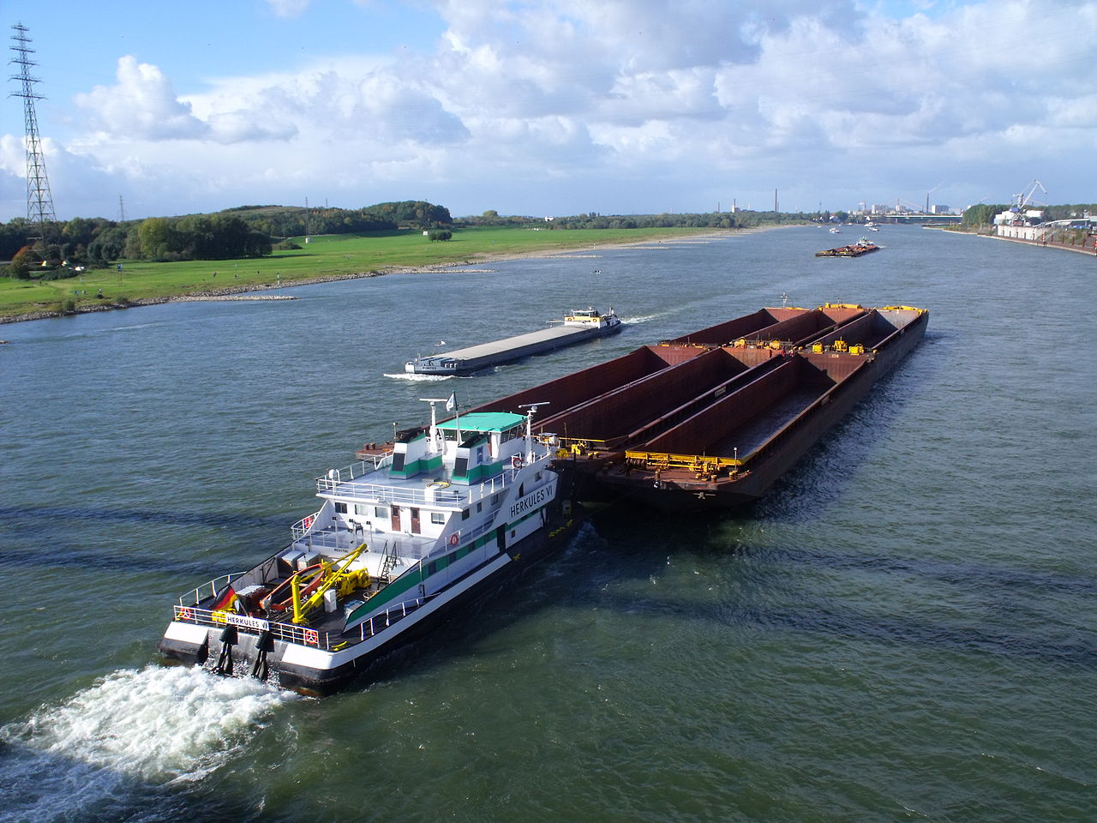
Ship types on the Rhine
BII: zesbaks duwstel(CEMT VII)
Notes:
Largest ships…. Pusher crafts designed for pushing barges.
50.000 in 10 year / 5.000 per year / 14 per day

Slide 15
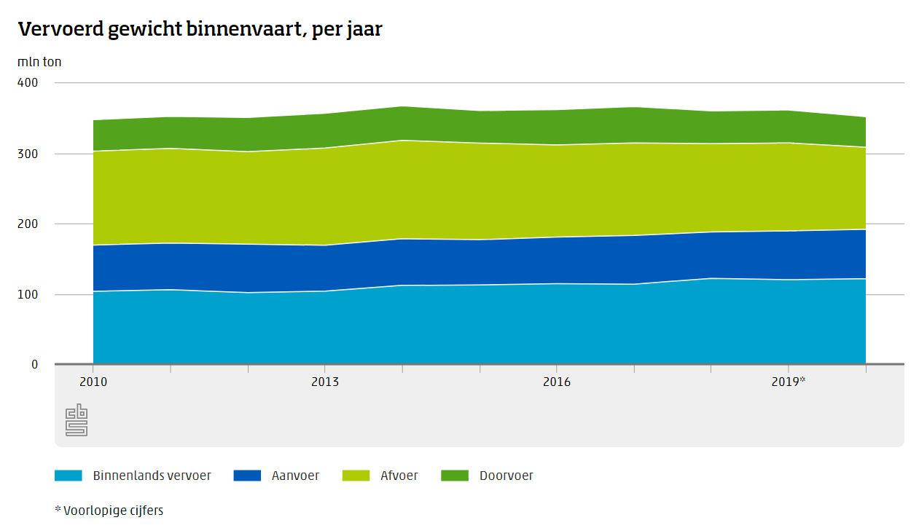
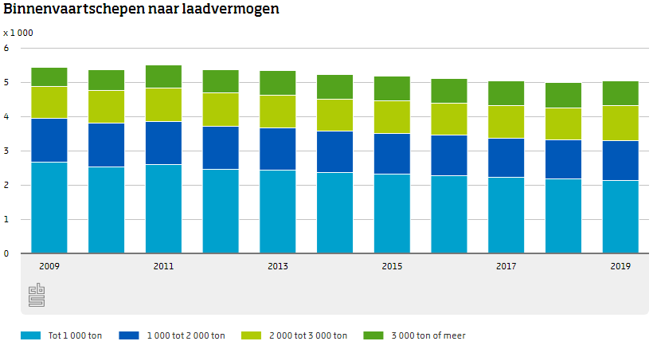
Increasing ship size
Notes:
More push barges, less smaller ships (M2-M6)

Slide 16
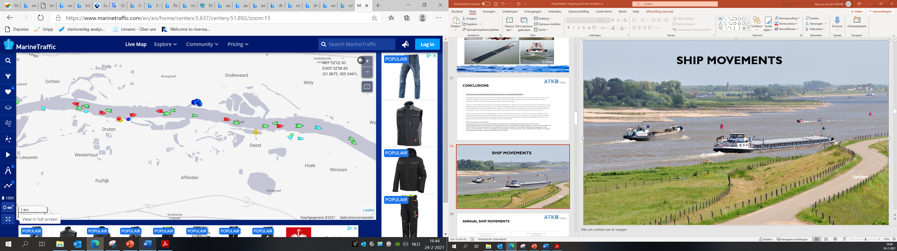
SHIP MOVEMENTS
tanker

Slide 17
ANNUAL Ship movements
Notes:
Anual movements pretty stable around 100.000 movements per year, more in 2011 and 2018. In Merwede about 85% of the Waal.

Slide 18
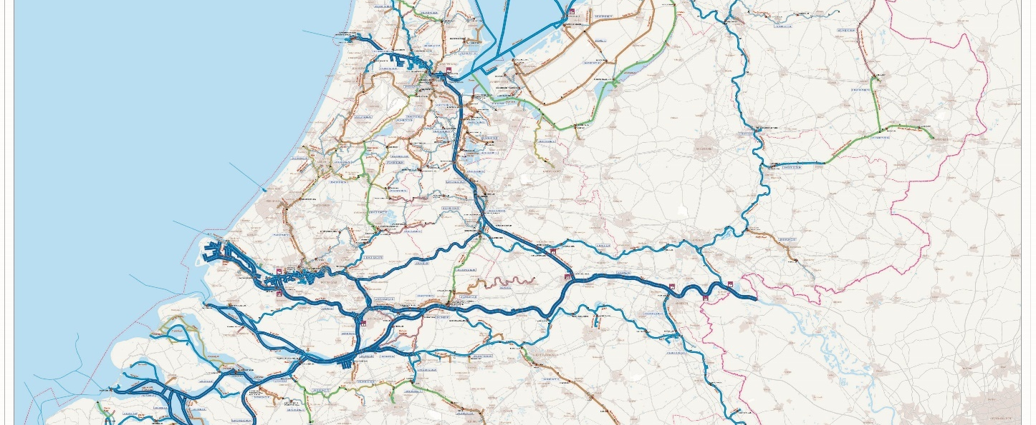
Waal
Boven Merwede
Notes:
Anual movements pretty stable around 100.000 movements per year, more in 2011 and 2018. In Merwede about 85% of the Waal.

Slide 19
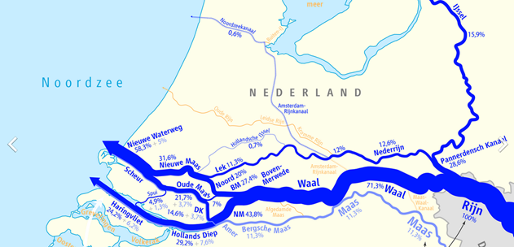
Silver eels “follow” river discharge.
The Waal and Boven Merwede are the main traffic routes for eel as well as for (cargo)shipping.
Notes:
Anual movements pretty stable around 100.000 movements per year, more in 2011 and 2018. In Merwede about 85% of the Waal.

Slide 20
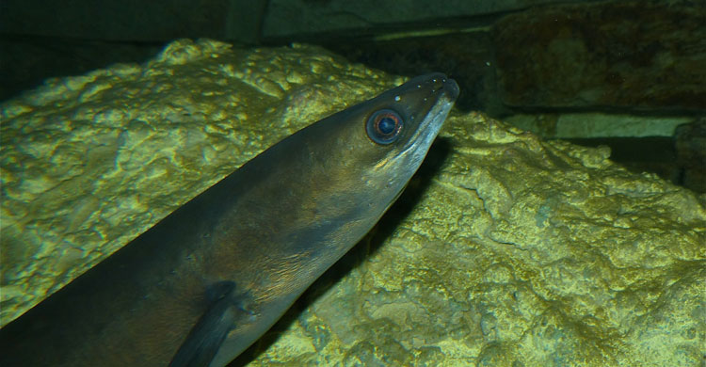
Temporal variations in ship movements
Notes:
Although shipping intensity decreases after 18:00 hours, in the Waal it tends to be more 24/7 activity. In times of shortages also during nightly hours.

Slide 21
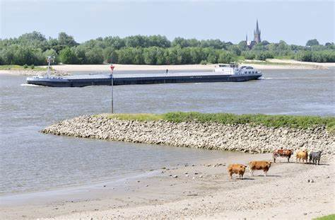
SHIP movements and river discharge

Slide 22
SHIP movements and river discharge

Slide 23
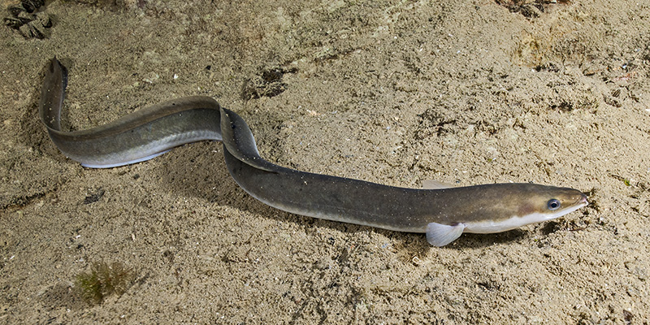
DEPTH POSITION and river discharge

Slide 24
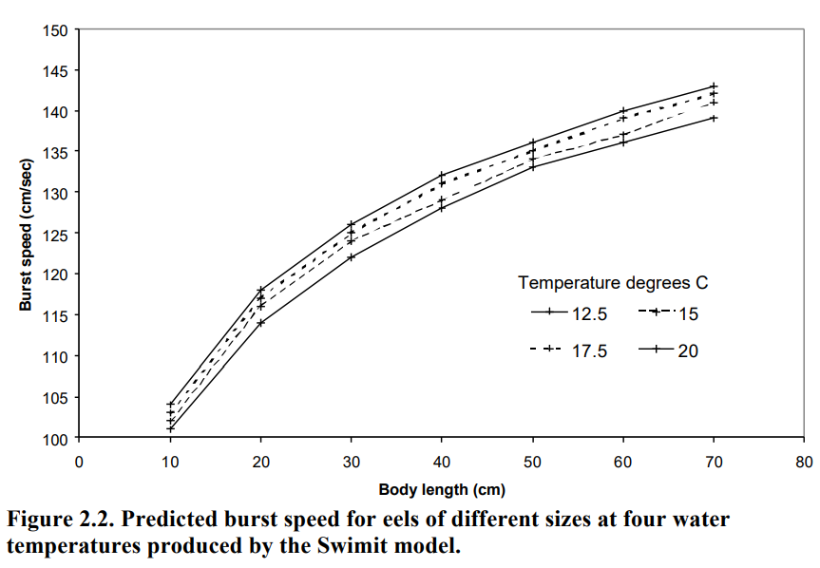
Ship velocity and burst speed of eel

Slide 25
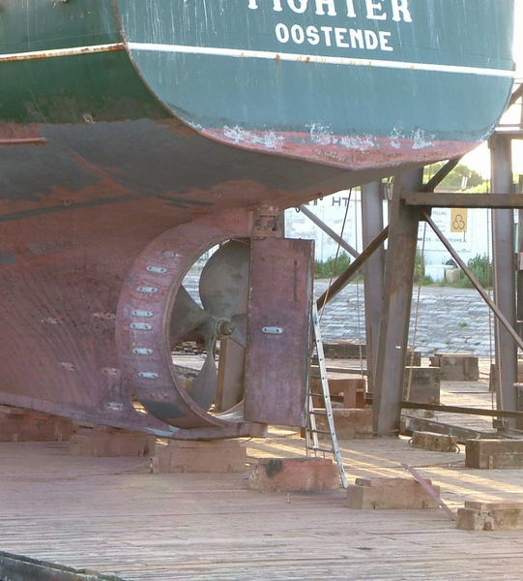
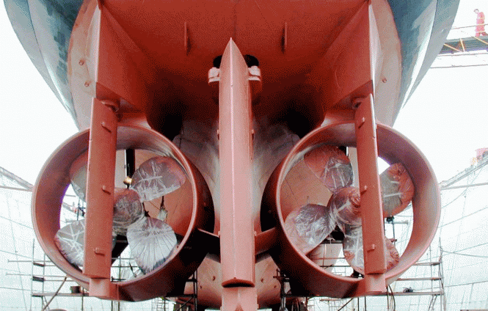
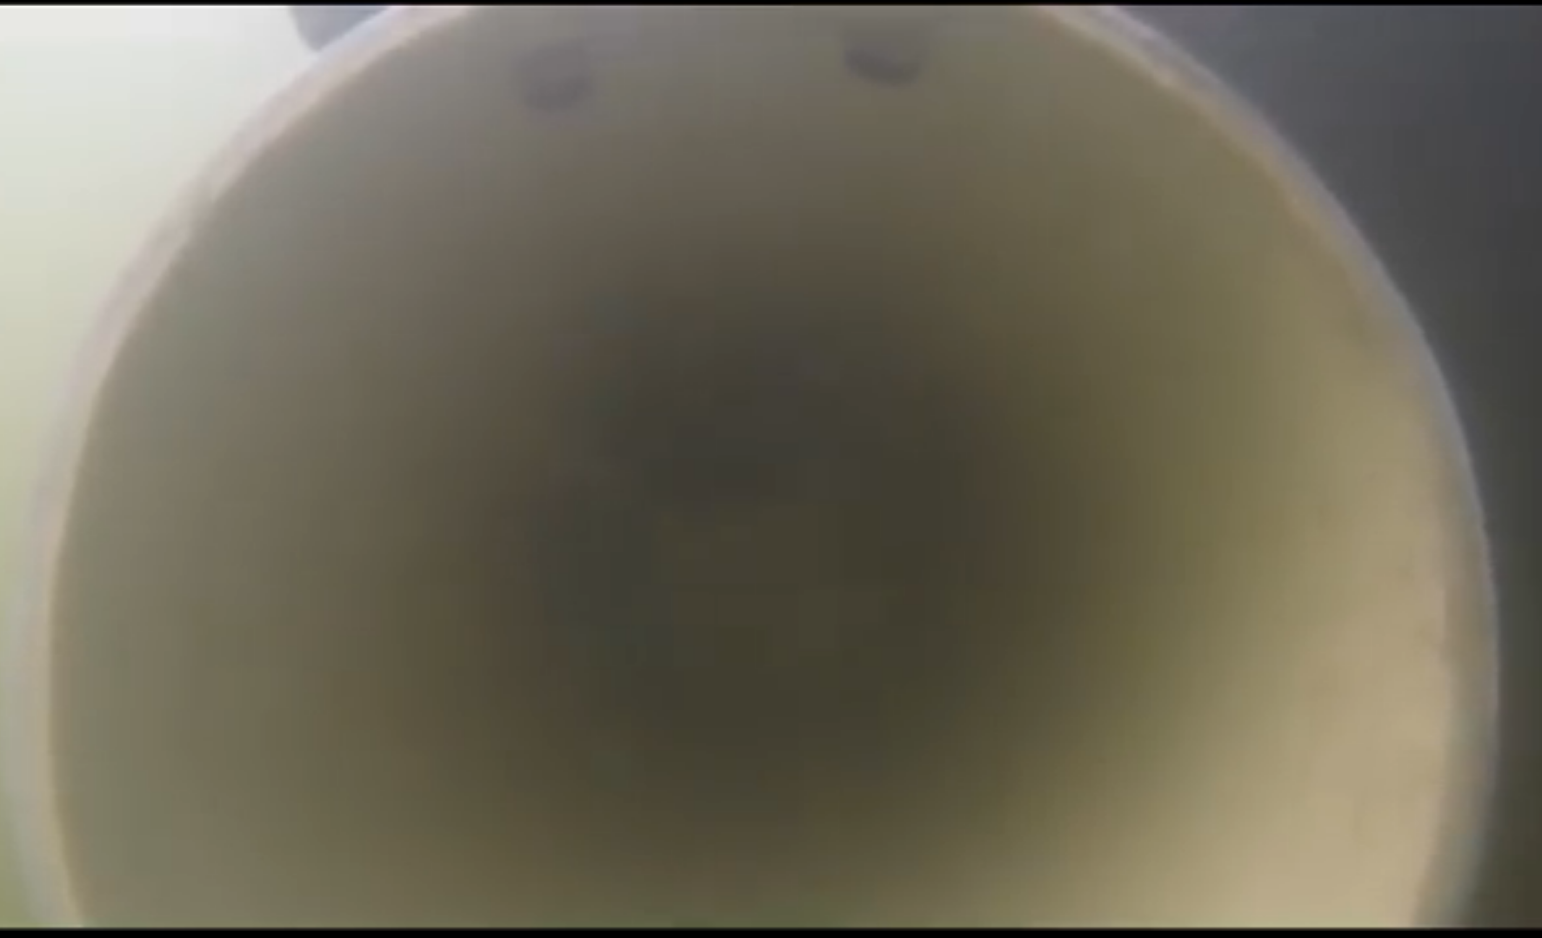

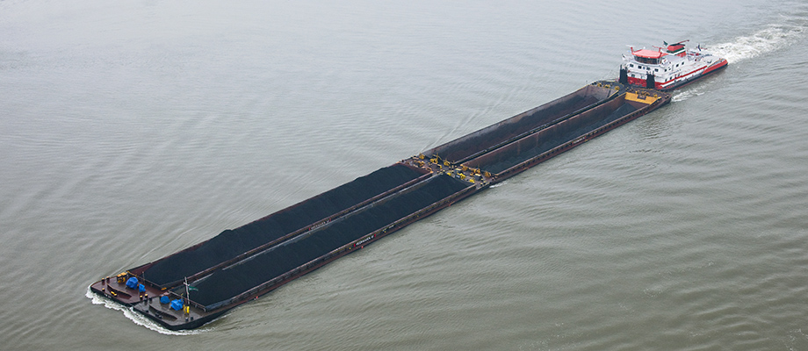
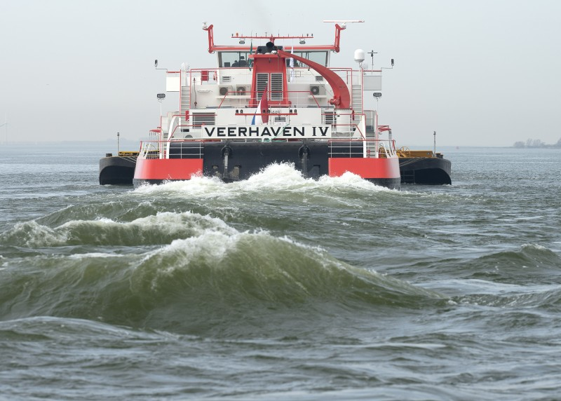
propulsion
3 x 2000 hp
Notes:
A large diversity of propellers. Open and closed. Even fish friendly propellers. Propeller size and propulsion power are important aspects. Calculations on forces not included in this study.

Slide 26
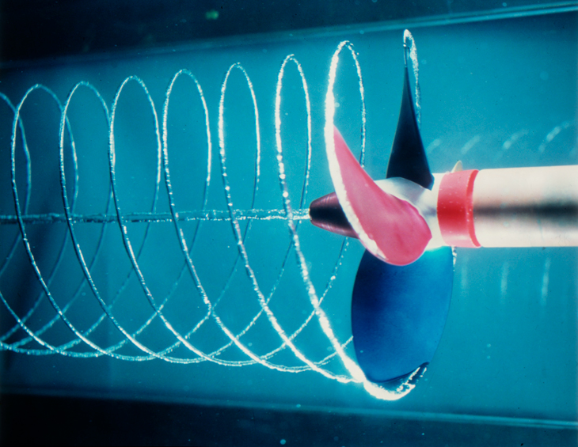
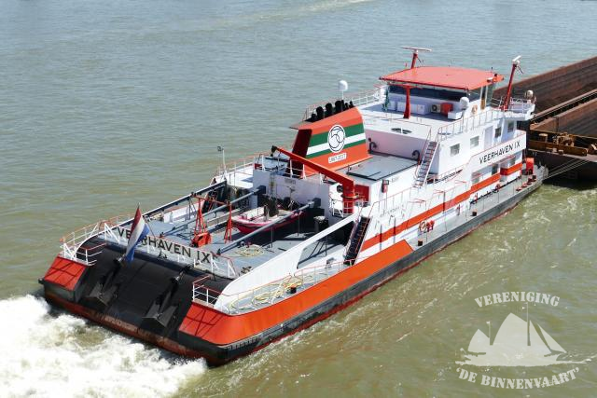
Propeller volumes / river discharge
Notes:
Calculations based on size and number of propellers, speed and activity. In relation to river discharge. Depending shipping intensity and discharge, between 12and more than 300% of total river discharge through propellers.

Slide 27
Important Conclusions
The probability for (silver) eels to fall victim to a ship's propeller is highest on the river Waal, from sunset to midnight, especially at low river discharges in the months of October and September (and after heavy rains?).
Under conditions of low river discharge, the water volume that passes the ship propellers probably exceeds total river discharge.
The velocity of most vessels is higher than the maximum swimming speed of eel.
Fast-moving, heavily loaded and deep-lying vessels with a powerful multiple propulsion system form the greatest risk. In order to limit the risk for silver eels, the number of movements of these ships at critical moments should be kept to a minimum.

Slide 28
Recommendations
for future investigation
Comparison of results with observations of damaged/broken eels in the field (SVN/RAVON)
Comparison of results with results from telemetric studies
Calculations on critical depth based on propeller/prolusion characteristics
Direct proof through field research (towing a net behind a ship at critaical moments)
Determine characteristic damage profiles?

Slide 29
Thank you for your attention!
QUESTIONS?
Max van de Ven (MSc) / m.vandeven@at-kb.nl / (+31)0617116485

