Slide 1
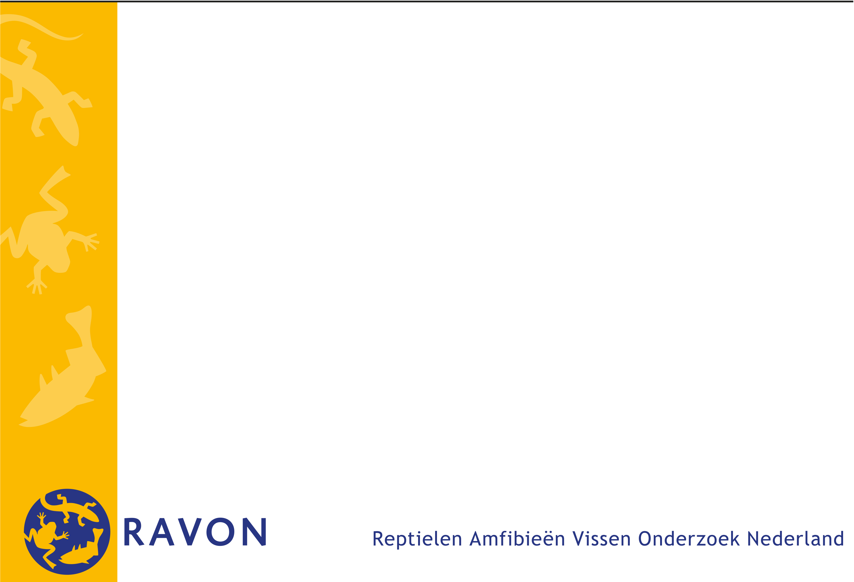
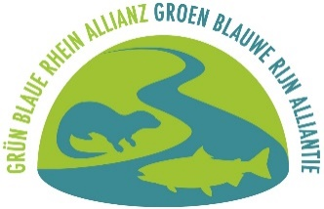



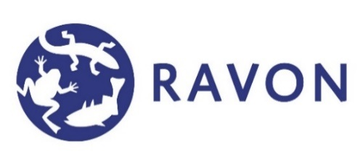


Stranded and snapped eels
Insights into factors causing mechanically damaged eels along the Waal
Jeroen Tummers
RAVON - Reptile, Amphibian and Fish Conservation Netherlands
March 4th, 2021

Slide 2
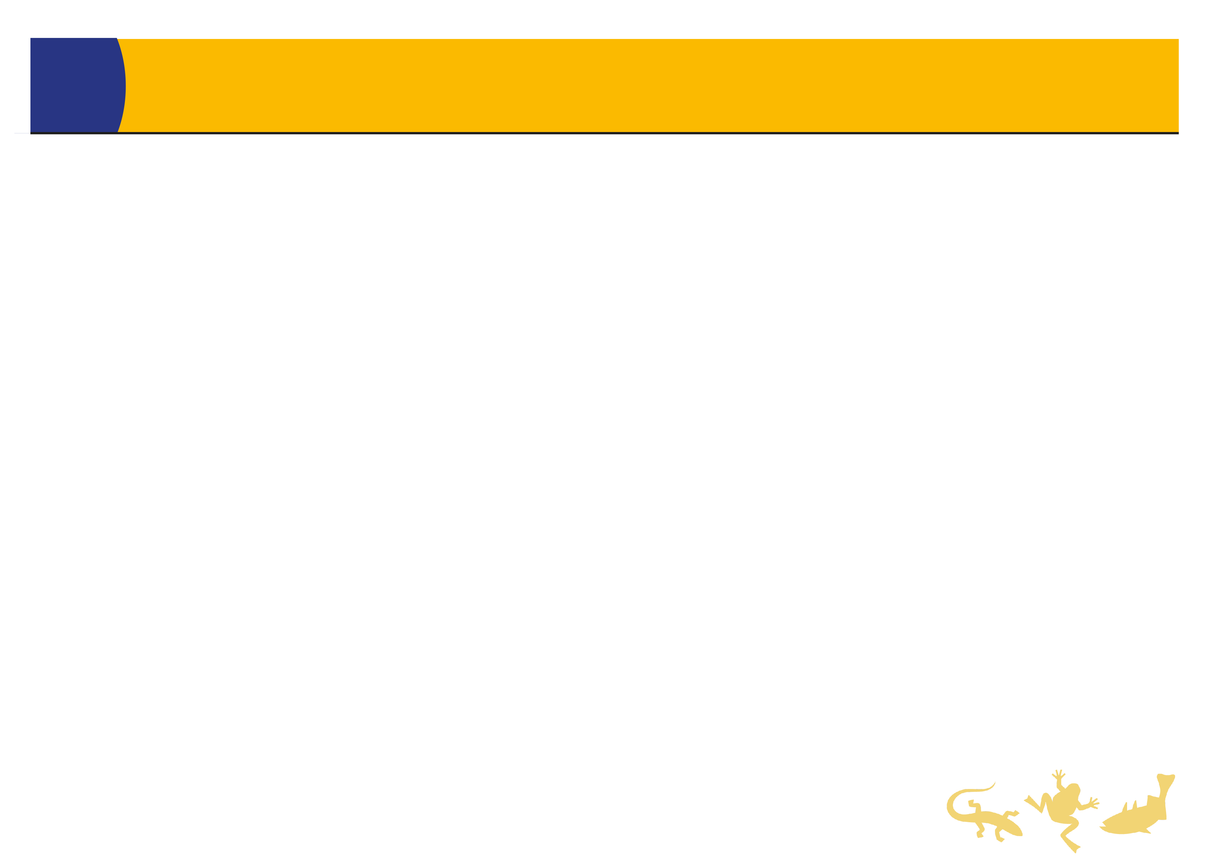
Content
Rationale
Study approach
Study area
Results of 2020
Looking ahead
Participation

Slide 3
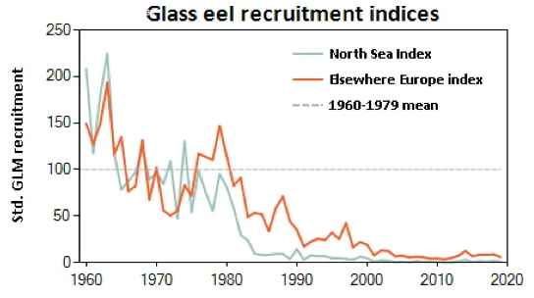
Stranded and snapped eels project
Rationale
  Since years, batches of eels found along the big rivers in the Netherlands, of which a proportion mechanically damaged.
  Eel critically endangered (IUCN, 2020). Since 1960 98% less recruitment of glass eel from North Sea (ICES, 2019).
  National eel management plan (EU Aalbeheerplan). 40% effectiveness/survival of out-migration of silver eel to sea.
  EU Water Framework Directive, requires good potential for (longitudinal) connectivity in surface waters.
Aims
  To evaluate the magnitude of the problem: how many stranded, mechanically damaged eels, and where.
  To gain insights into the potential causality (ship traffic, water infrastructure (pumping stations, hydropower turbines).
  ICES (2019). Advice on Fishing opportunities, catch, and effort for European eel. Joint EIFAAC/ICES/GFCM Working Group on Eels (WGEEL). ICES Scientific Reports. 1:50. 177 pp. http://doi.org/10.17895/ices.pub.5545

Slide 4
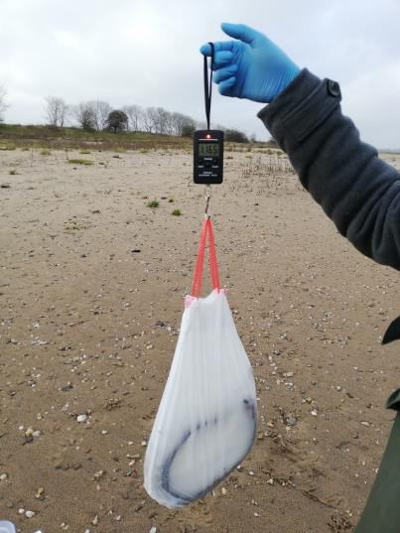
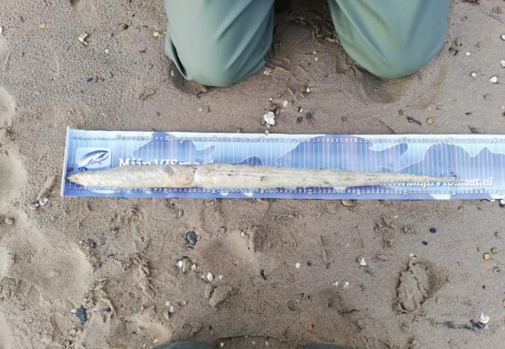
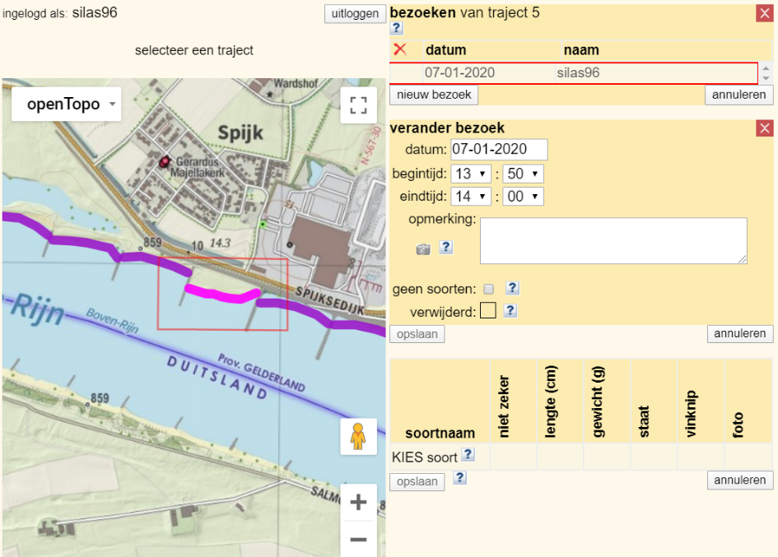
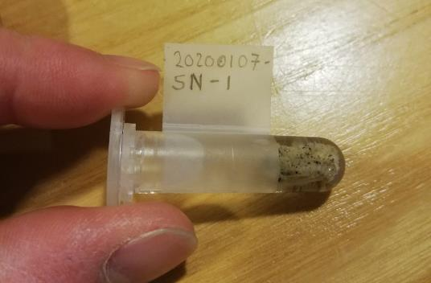
Study approach
Volunteers
  Standardized walkover surveys (protocol),
  fieldkit
Data includes:
  Fish observation (all species)
    Location
    Length/weight
    Fin clip
    Photographs (fish, injury, section)
    Null observation (important for analyses)
Data portal (knakaalportaal, Telmee.nl, Waarneming.nl)
  Upload of data during survey, or at home

Slide 5
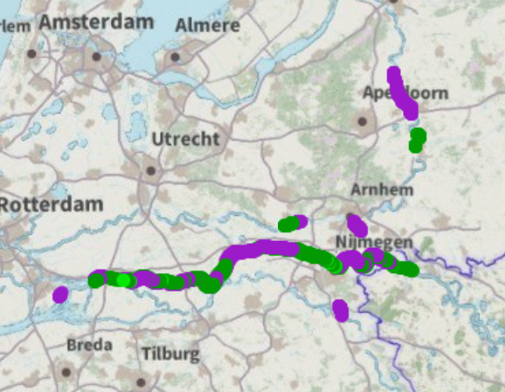
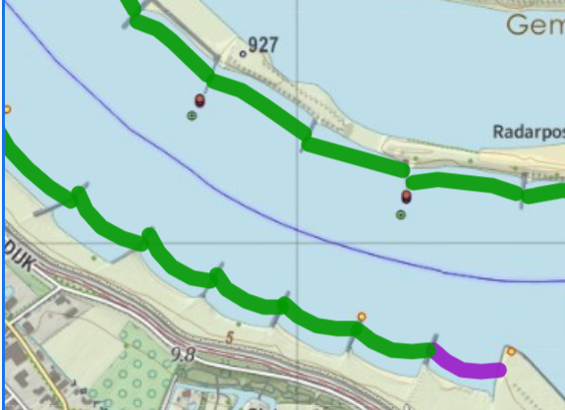
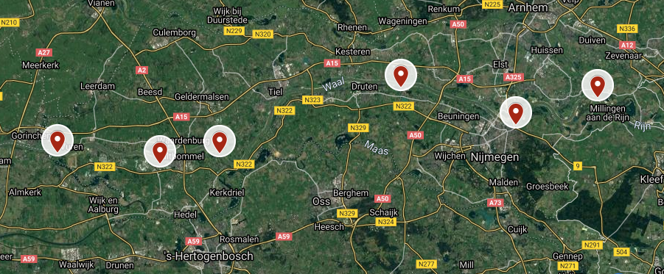
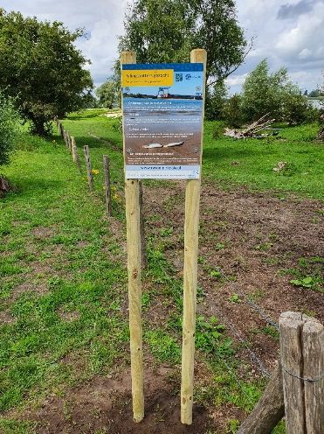
Study area
Focus: Waal catchment (Boven-Rijn, Waal en Boven-Merwede)
  Intense shipping traffic. One of the busiest waterways.
  Hydropower/pumping stations in tributaries (closest hydropower station in Rhine is in DE)
Other rivers (IJssel, Nederrijn) taken into account as well.
  Beaches/groynes plentiful along Waal.

Slide 6
Results 2020 – surveying intensity
Total number of sections surveyed, sections surveyed > 1x and total number of surveys per river (as of 9-2-2021).
Number of volunteers as of 12-1-2021.

Slide 7
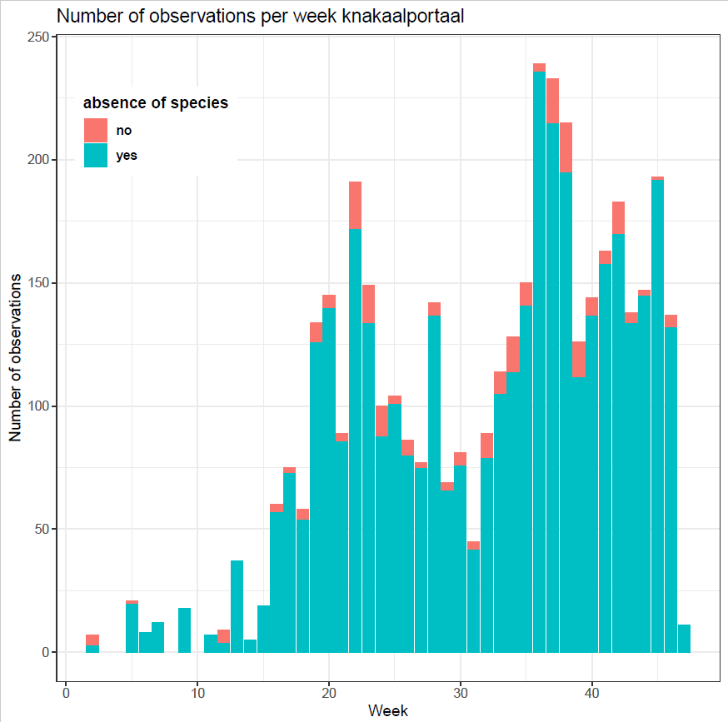
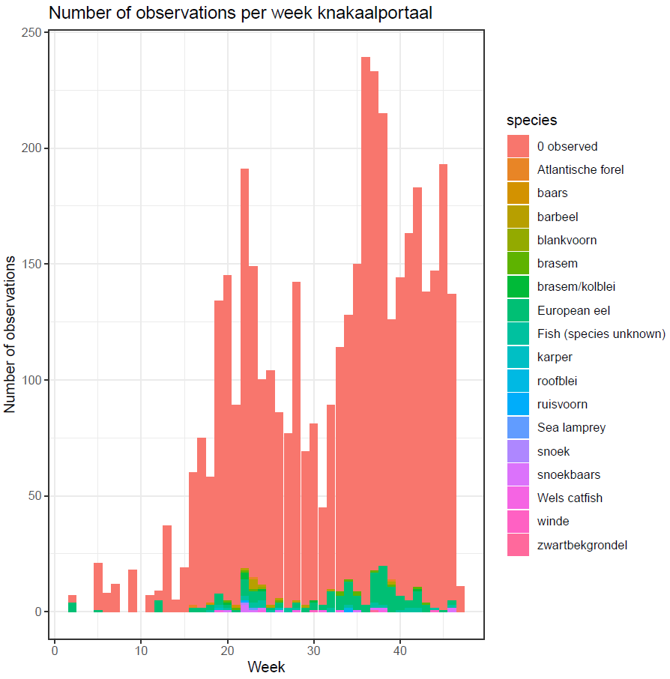
Results 2020
Source: Peters, B. (2020). Broken eels in the Dutch part of the river Rhine. RAVON internship report.

Slide 8
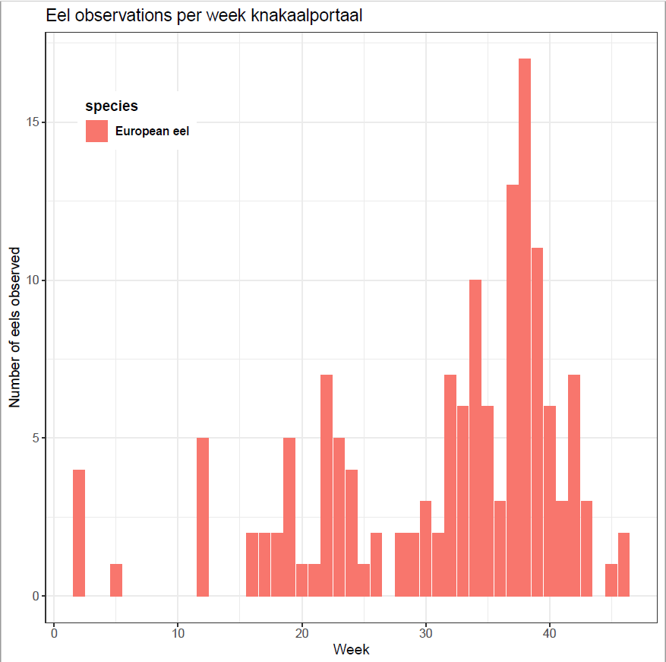
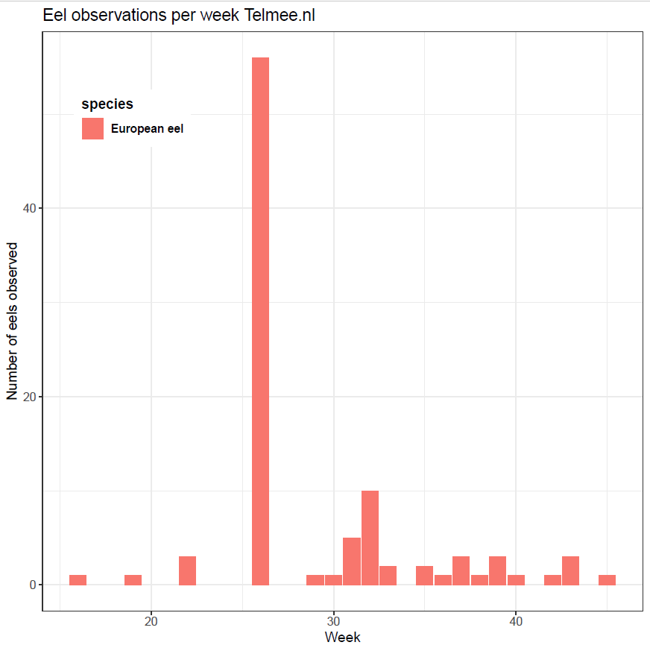
Results 2020
Source: Peters, B. (2020). Broken eels in the Dutch part of the river Rhine. RAVON internship report.

Slide 9
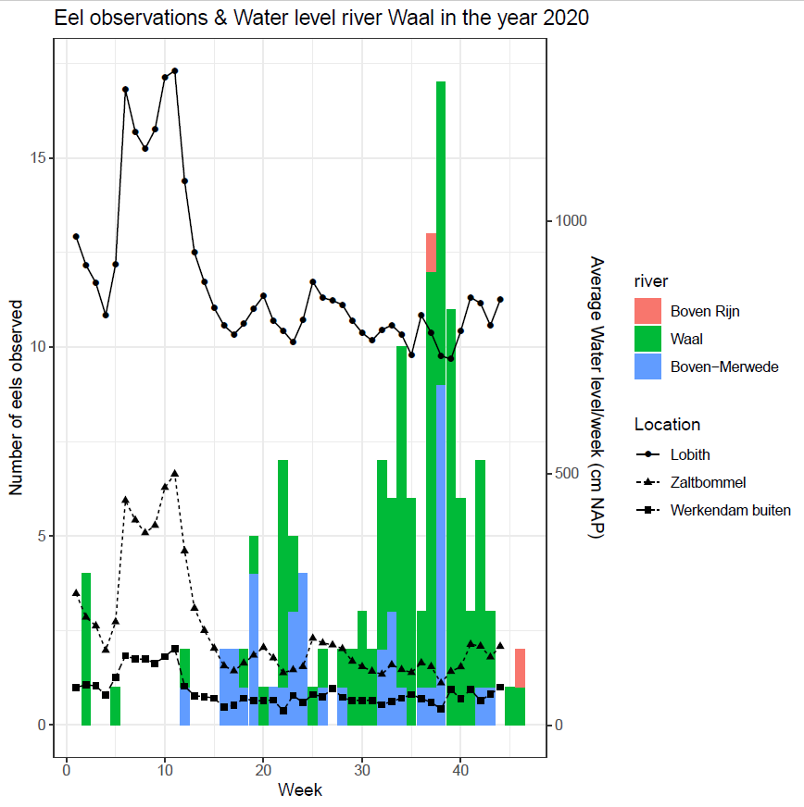
Results 2020

Slide 10
Results 2020 – No. of observations
Data knakaalportaal (as of 9-2-2021)
No. of fish (knakaal portaal (9-2-2021), Telmee (24-2-2021))

Slide 11
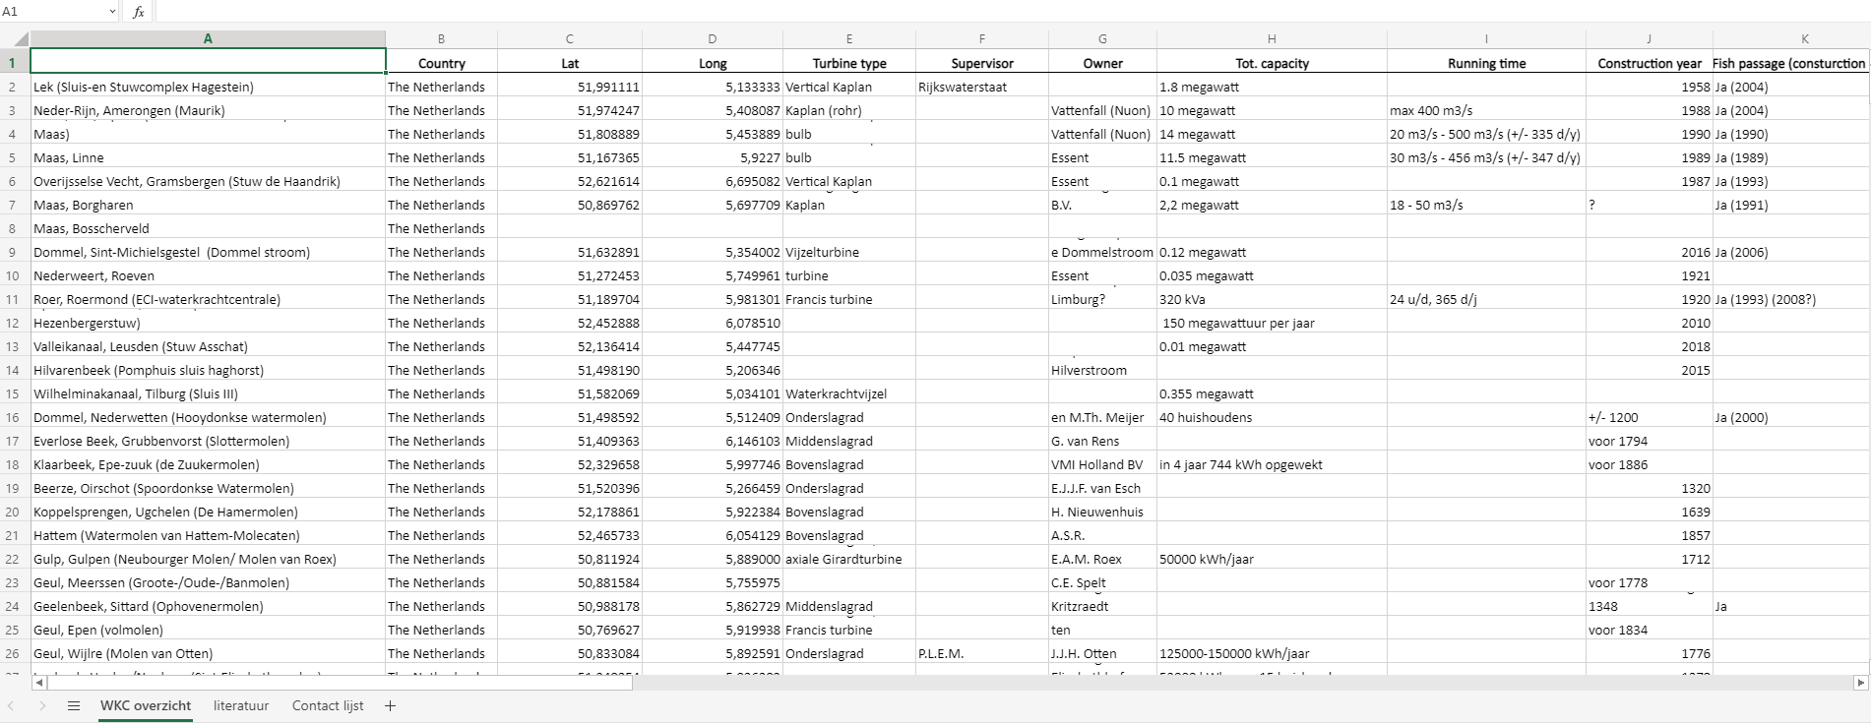
Locations hydropower turbines

Slide 12
Looking ahead
Analyses: state of fish, type of injury
  Anthropogenic factors. Relating observations to:
  In-river structures (distance/periods of operation)
  Shipping traffic
Abiotic factors. Relating observations to:
  Water level, discharge
  Water temperature, moon cycle
Null observations (and interval) as a metric for survey intensity, probability of fish observation.

Slide 13
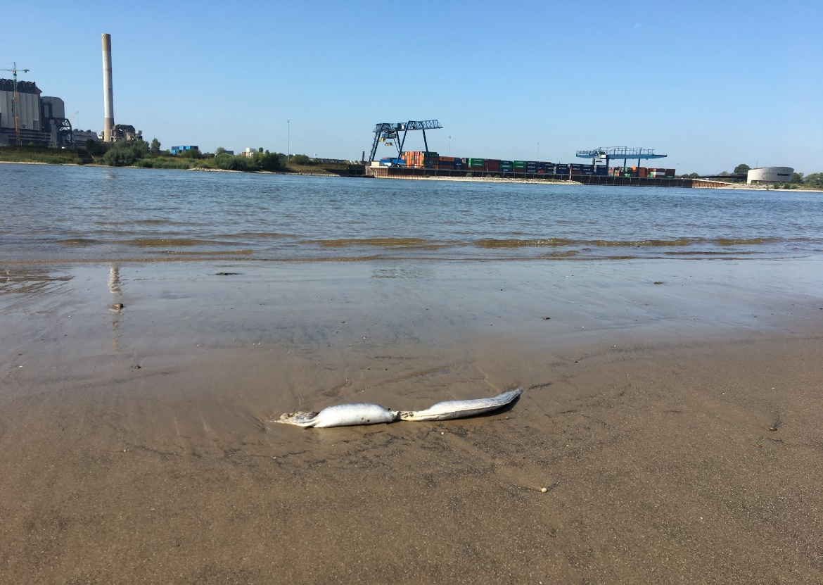
Participation
For own observations, or if you know potential volunteers:
Knakaal@ravon.nl
Waarneming.nl
Telmee.nl
Photo: Geert Stoltenberg

