Slide 1




GREEN BLUE RHINE ALLIANCE
Results workshop floodplain development
22nd March 2018

Slide 2
Conclusions working groups
Constraints mentioned by participants:
1) Governance
governmental fragmentation and little interaction between gov. bodies (DE)
understaffing (DE)
Lack of integral, long-term planning (DE)
2) Land use
- intensive agricultural use of floodplains (both): little biodiversity on the land and strong demands on water level management
- Fragmented private ownership (DE) in NL 60% owned by nature organisations (SBB)
3) Nature conservation and restoration
Polluted sediments in floodplains. In DE obligation to remove these sediments, thus strongly increasing project costs
river bed erosion due to channelization and fixation and sediment entrapment upstream – affects many users (not only nature)
Intense ship trafficking: restrictions on movement of water and sediment
Flood protection: restrictions for natural developments, i.e. softwood forests

Slide 3
Conclusions presentation
Solutions for ecological constraints:
Long-term, ‘utopian’:
- Restore sediment load from Oberrhein (now blocked by dams)
Adapt vessels to the river instead of the reverse. As a consequence less restictions for nature restoration
Remeandering of the Rhine
Short-term, practical:
Sediment fixation with e.g. gravel
Restoration of side streams
➔ Learning opportunity! :
Sediment fixation only in DE, side streams mainly in Nl
-
-

Slide 4
Conclusions presentation
Opportunities for short-term, practical solutions:
Near Salmorth:
Landesregierung NRW purchased land for nature development
Deichvorland neay Grieth
Opportunities for a side channel (presently under study)
Bienener Altrhein
Old riverbranch, at one side connected to Niederrhein and nowadays accessible for fish. Much land purchased by Landesregierung NRW

Slide 5
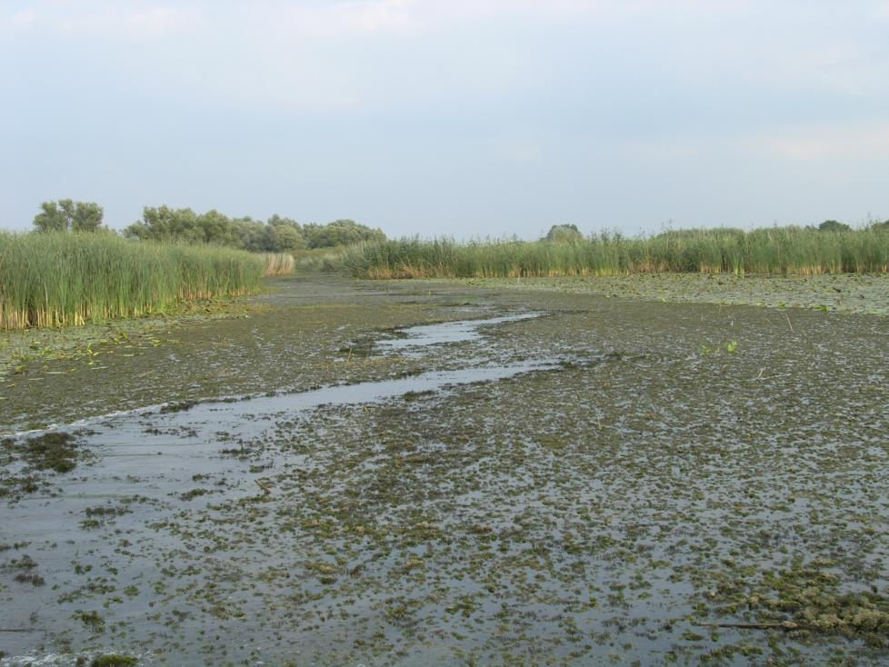
Case Rijnstrangen
Silt and Sulphate; cause and consequences

Slide 6
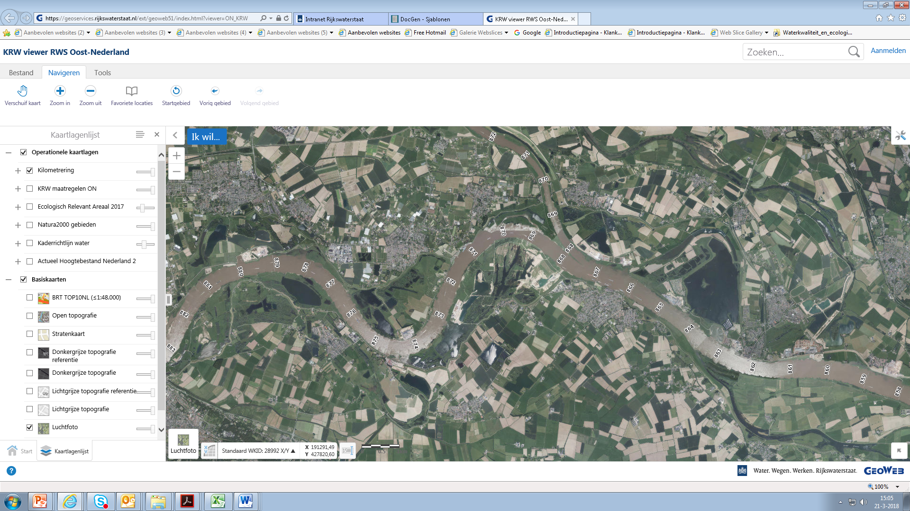
Case Side channel Boven Rijn
Location and consequences

Slide 7
Case Emmericher Ward – Rindernsche Kolke
Improvement water management floodplains

Slide 8










The partners

Slide 9





The supporting partners

Slide 10



Financially supported by:

Slide 11

Silt and sulphate in the Rijnstrangen cause and consequence

Slide 12
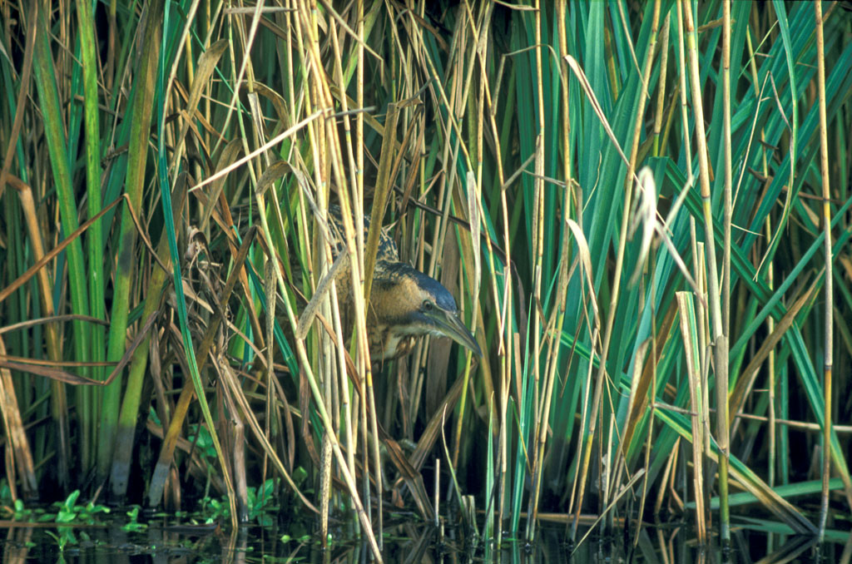

Slide 13
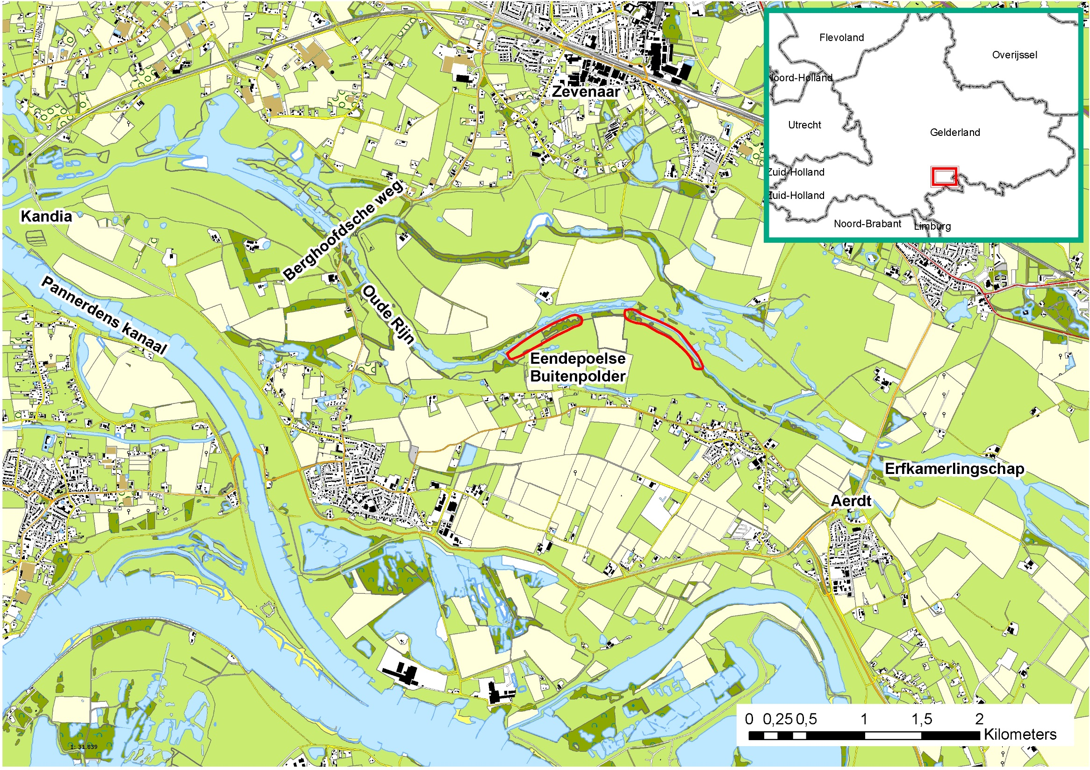
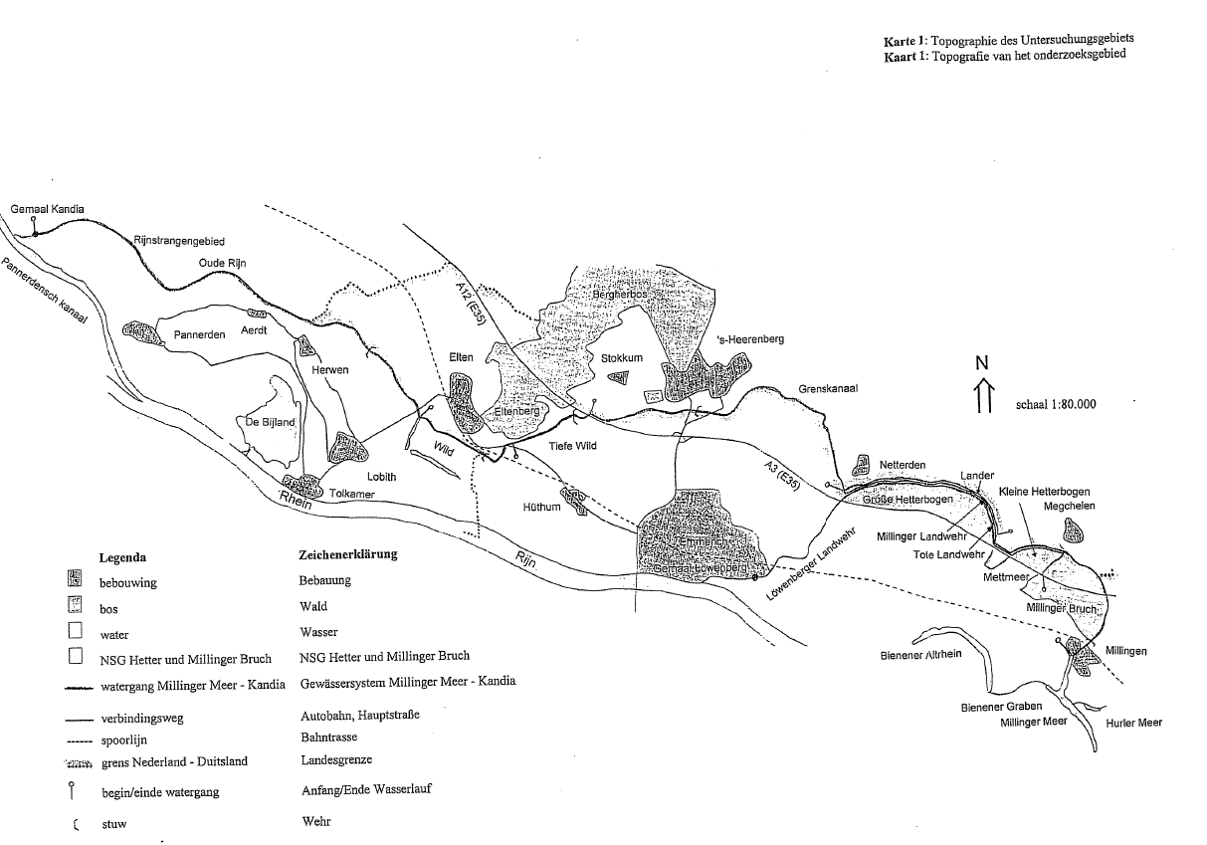
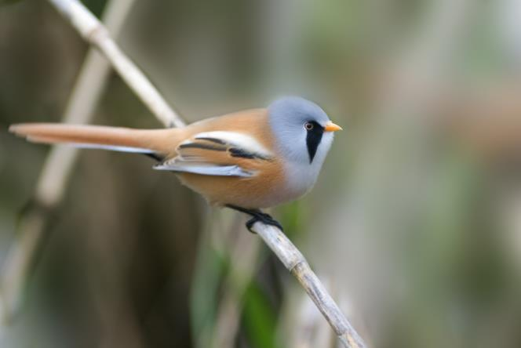
Monitoring in de Rijnstrangen
polderen en peilen
John Lenssen

Slide 14
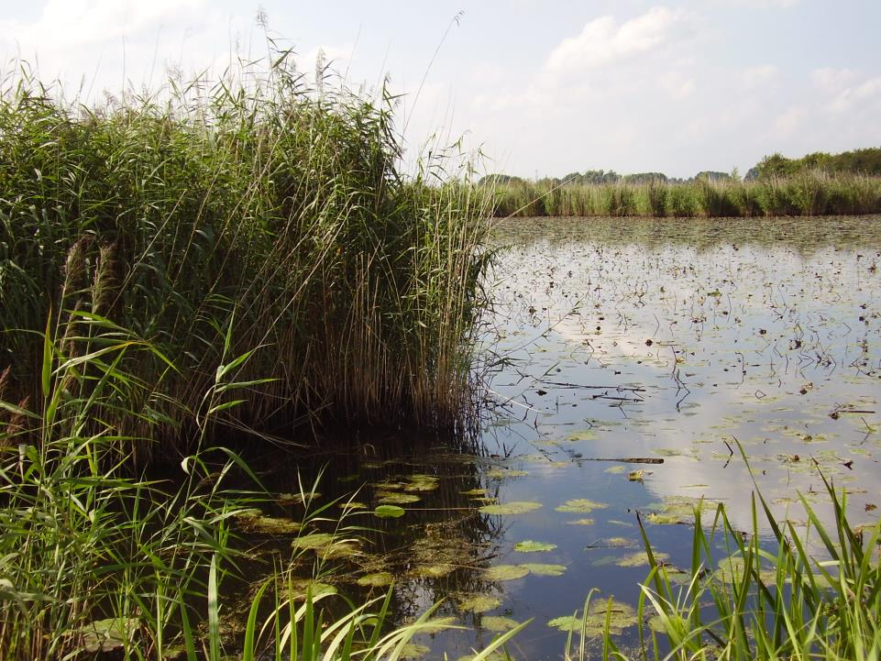
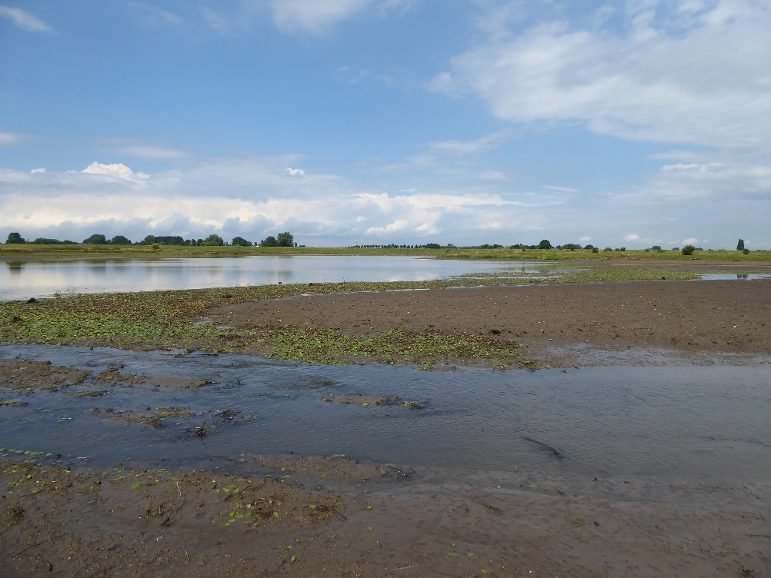
Since 2016 more natural water level regime
Higher water levels on average,
and
once every four year drop during summer

Slide 15
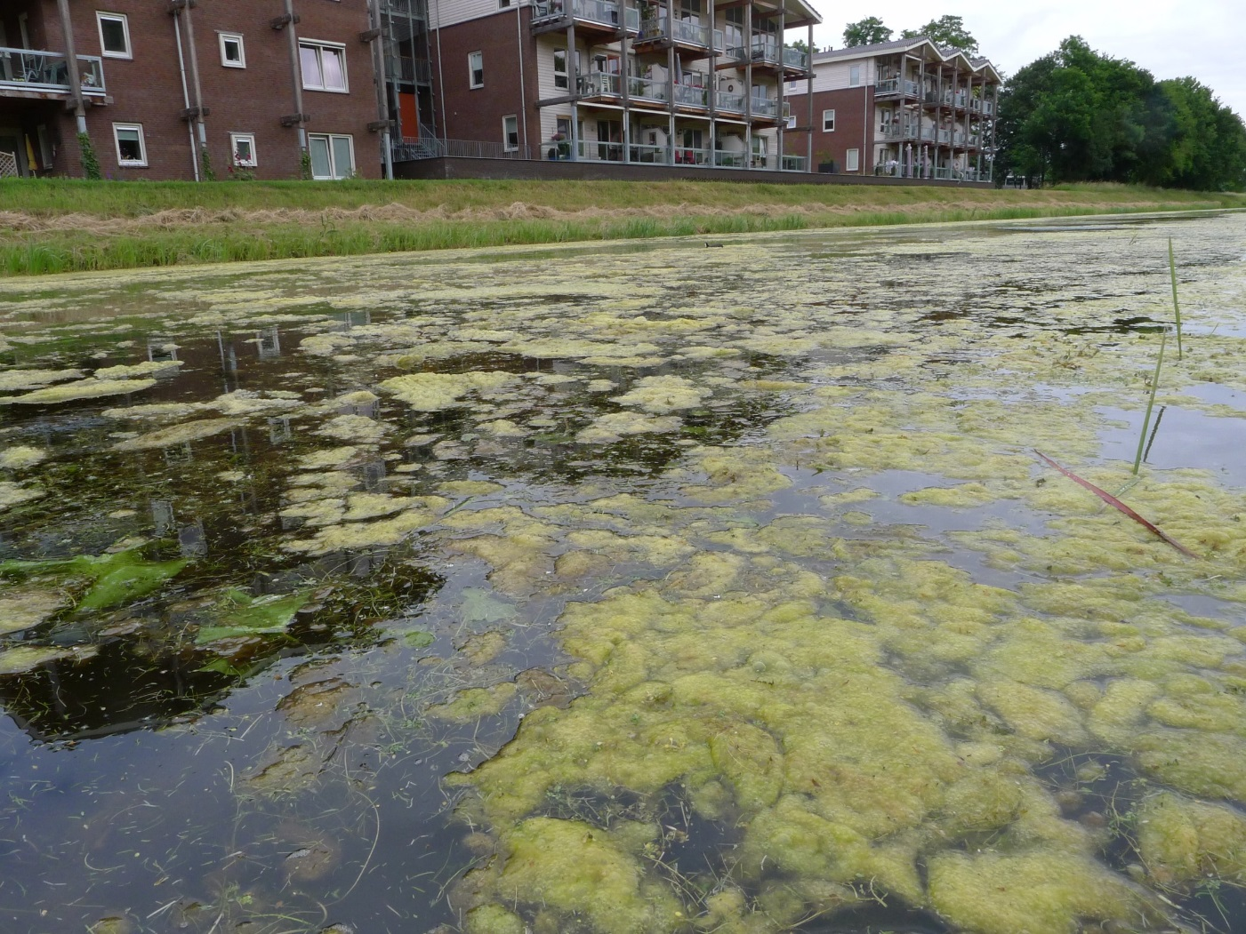
Still unresolved water quality issues:
Hypertrophic sediment due to silt deposition,
and
long residence time in summer

Slide 16
Research questions
A- Possible solution for hypertrophic sediment:
dredging /bagger(e)n
only deposition from past or still going on?
if still going on: where does silt come from?
B- Possible solution for long residence time:
establish connections with upstream water courses (Millinger & Toter Landwehr)
But this water is higher in sulphate concentration
are these concentrations harmful and if so, what can be done to lower them?

Slide 17
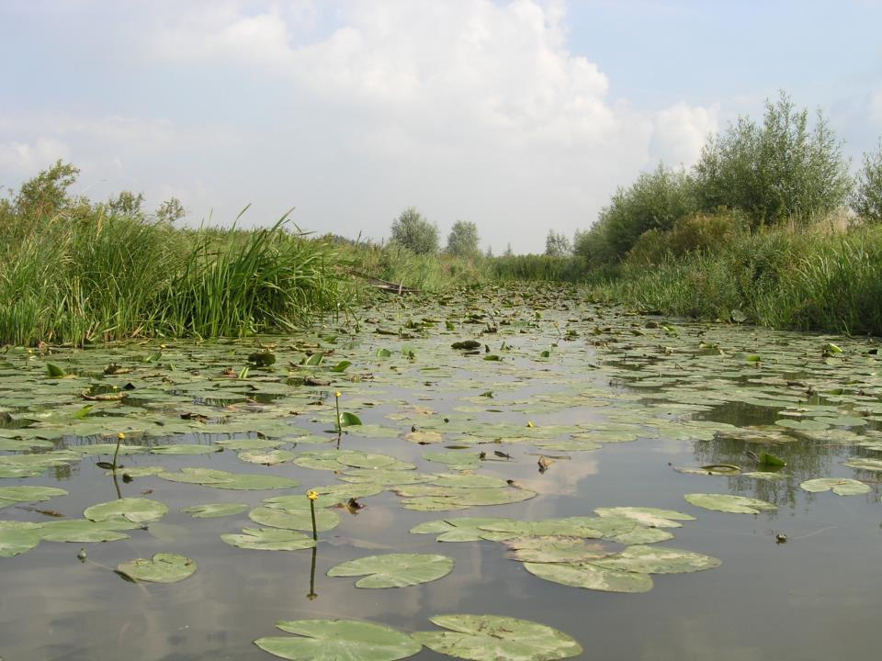

Slide 19
Side channel Boven Rijn
Workshop floodplain development
GBRA, 22 maart 2018

Slide 20
Study side-channels with gravel-bed
Physical conditions: gravel and coarse sand,
In floodplain or behind longitudinal dam
1 á 2 km
Study
Geographical opportunities: property, underground infrastructure, geomorphology, flow rate
(morphological) effects on the main channel: expert judgement or calculations
Stakeholders (i.e. other floodplain development)

Slide 21
Optional side-channels Boven-Rijn

Slide 23
Internationales Feuchtgebiet - Ramsar und EU-Vogelschutzgebiet
„Unterer Niederrhein“
Hydrologische Studie Emmericher Ward und Rindernsche Kolke

Slide 24
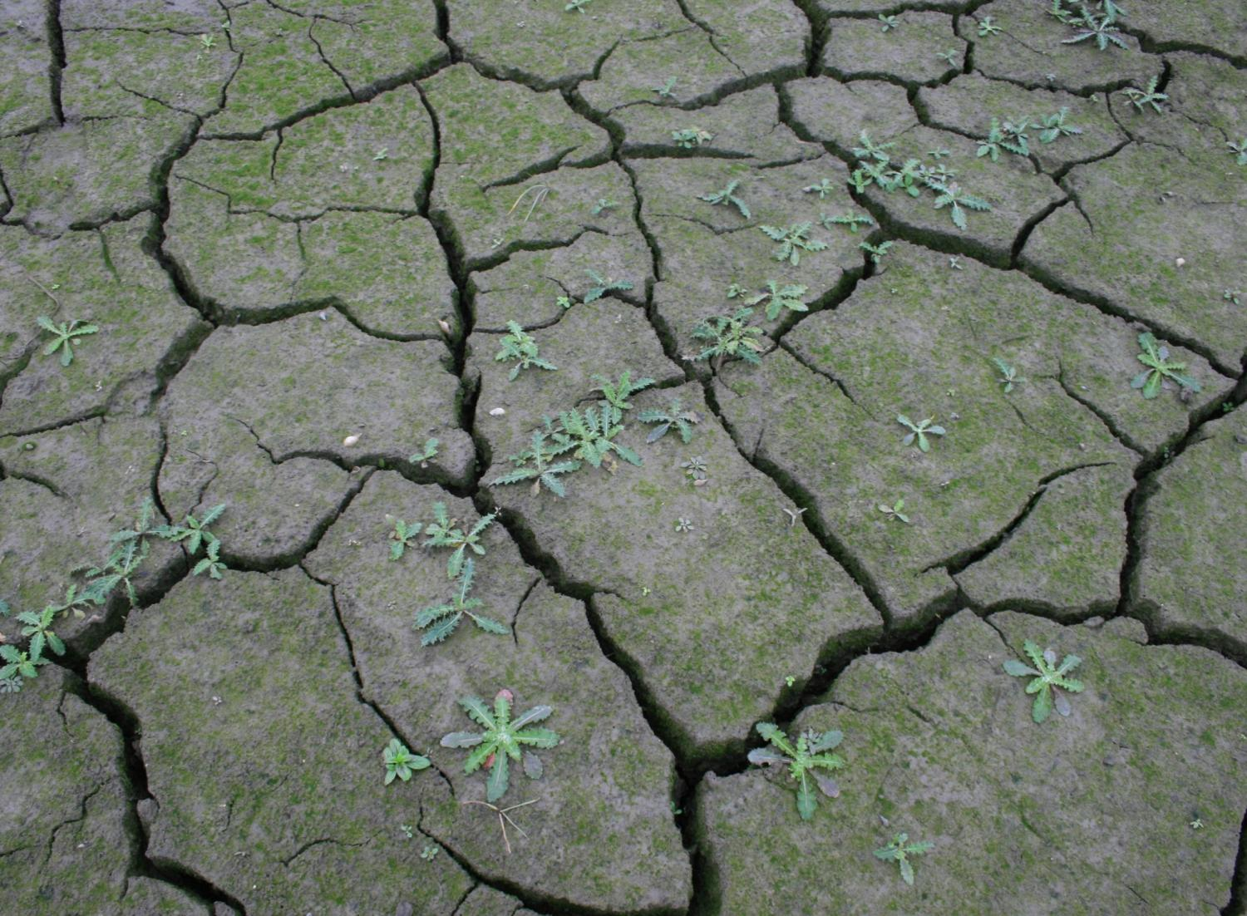
Fortschreitende Austrocknung der Auen

Slide 25
Vegetationseinheiten | Kürzel | Flächengrößen (ha) |  | Ten-denz | Hauptgründe
 |  | 2008 | 2013
Überflutungsrasen
Waldsumpfkresse-Flechtstraußgrasrasen, Knickfuchsschwanzrasen | K4o, K41w, K5o, K51w, K6 | 5,53 | 2,00 | - | Austrocknung, Intensivierung
Kriechhahnenfuß-Quecken-Flutrasen | K33w, K33w/43w, K43w, K43w/C4, K43w/A5A, K53w | 46,56 | 5,28 | - - | Austrocknung, Intensivierung
Rohrglanzgras-Flutrasen | K58w, K58w/(C4), K78w | 2,74 | 1,66 | - | Austrocknung
Rohrschwingel-Gesellschaft | K32w, K42w | 0,41 | 0,37 | - | Austrocknung, Intensivierung
Elymus repens-Dominanzbestände | K40w, K40w/(C4), K50w, K50w/K58w | 0,27 | 4,21 |  | Verbrachung
Arrhenatheretalia-Gesellschaften
Fuchsschwanz-Frischwiesen | A5A, (A5A) | 34,88 | 50,38 | + + | Intensivierung
Arrhenatheretalia-Fragment | (A), (A)4, (C)4o, (C)4, (C)3 | 18,59 | 24,27 | + | Austrocknung
Glatthaferwiesen
Tal-Glatthaferwiese | A2, A23t, A23t/W1, A23d, A2/4t, A4t, A3, A4, A4/A3 A41, A51, A51o | 29,12 | 36,55 | + | Austrocknung
Mischform Glatthaferwiese - Fettweide | (A)/C4, A/C4, A/C4t | 4,11 | 12,50 | +
Fettweiden
Weidelgras-Weißkleeweiden | C2, C23, C23t, C23d, C2/4t, C4t, C3, C4, C4o, C4/K, C4/K51w | 41,81 | 43,52 | +

Slide 26
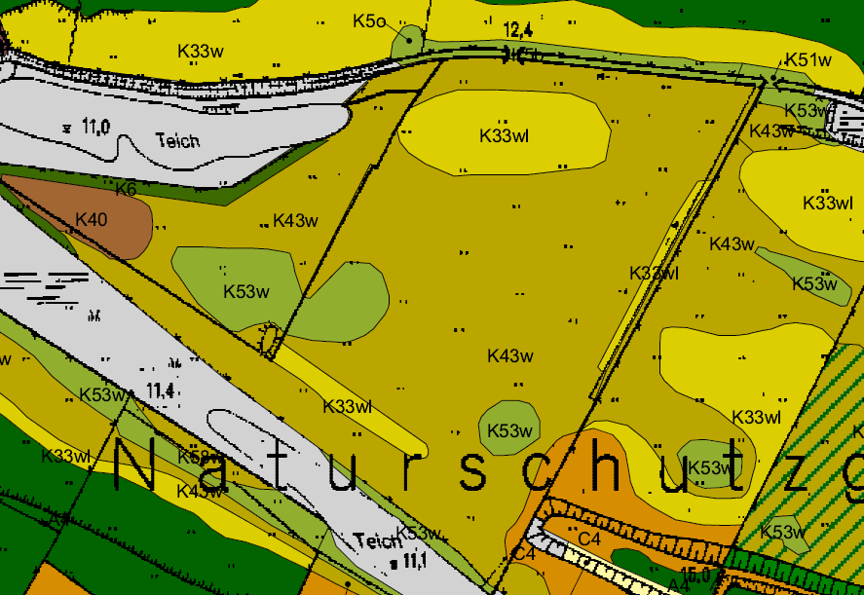
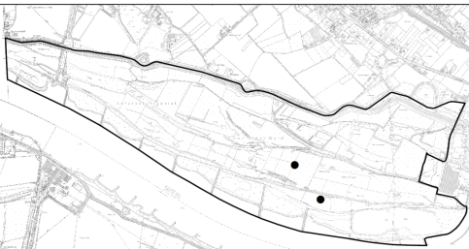
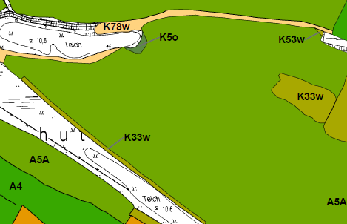
Vegetation Grünland
2008
Vielfältiges Flutrasenmosaik weicht monotoner Fuchsschwanzwiese
2013

Slide 27
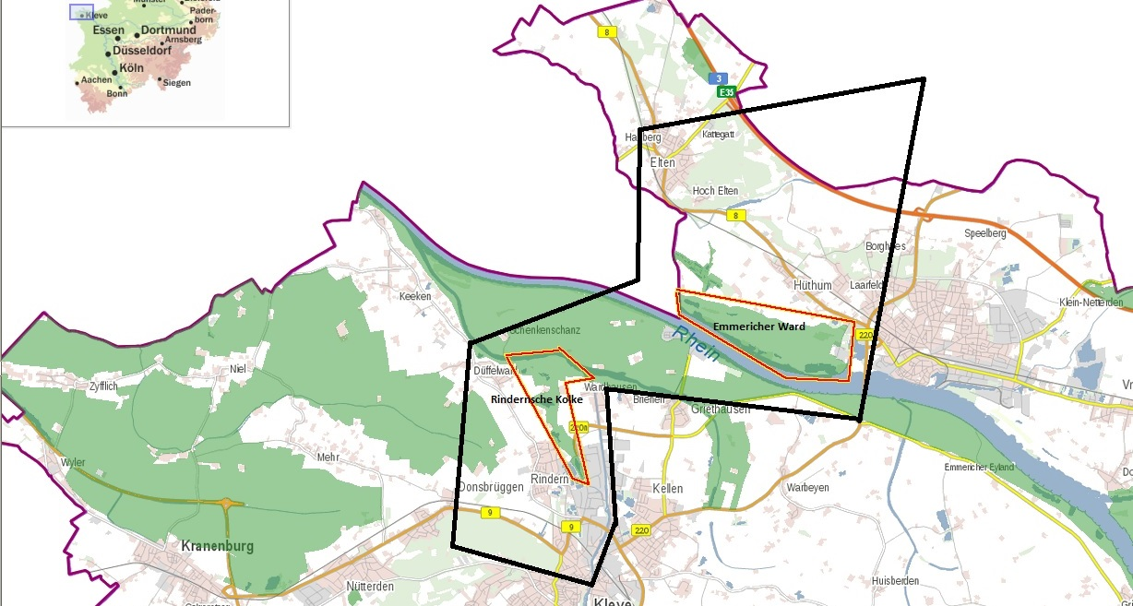
Emmericher Ward und Rind. Kolke
Green Blue Rhine
Hydrologische Studien zur Verbesserung des Wasserhaushaltes in fossilen und rezenten Auen

Slide 28
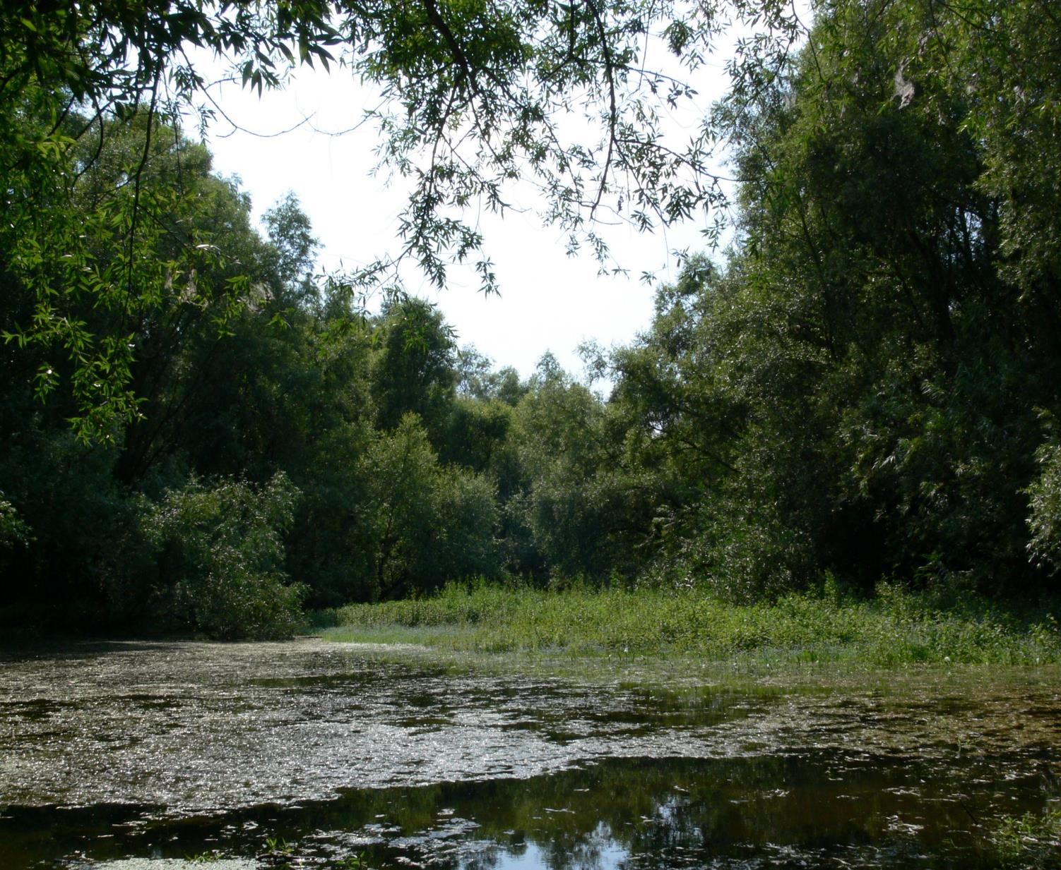
Vielen Dank !

