Slide 1
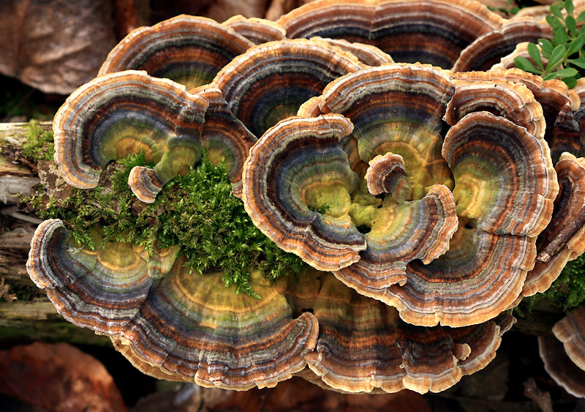
PRETREATING BIOMASS WITH WHITE-ROT FUNGI FOR ENHANCED ANAEROBIC DIGESTION
Groene Kaskade Meeting
12th September 2019
Matthijs de Koning, MSc

Slide 2
Biomass pretreatment
Lignocellulose is recalcitrant to degradation:
Complex, cross-linked structure
Lignin
Current pretreatment physical/chemical methods
Energy consumption
Waste streams
~25%
10-35%
→ Alternative: biological pretreatment
25-60%
U.S Department of Energy Genome Programs image gallery, http://genomics.energy.gov

Slide 3
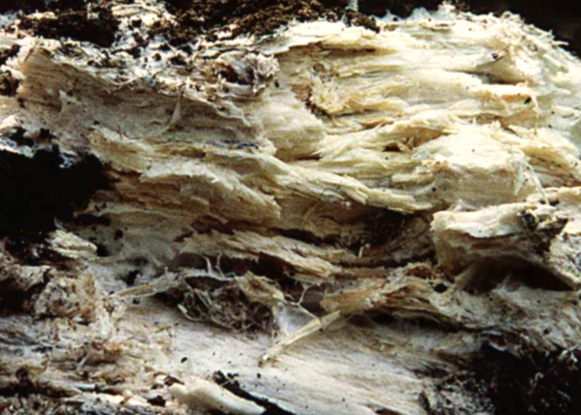
White-rot fungi
Nature’s most efficient wood-degraders: fungi
Soft-rot, brown-rot, white-rot fungi
White-rotters (Basidiomycetes) selective in lignin degradation
Array of extracellular redox enzymes:
Laccases, Heme-peroxidases, H₂O₂-generating enzymes
→ Lignin → CO₂ + H₂O
Biomass pretreatment with white-rot fungi (WRF)

Slide 4
Biological pretreatment with WRF
Food
Millati R, et al. 2011. Biological pretreatment of lignocelluloses with white-rot fungi and its applications: A review. BioResources 6:5224–5259.
Notes:
idea is not new.
applications.

Slide 5
Biological pre-treatment with WRF: Our goal
Promising process (efficacy on lab- or pilot-scale)
Factors delaying commercialization:
slow process
carbohydrate loss
scale-up issues (e.g. sterilization)
Can we design a technically- & economically-feasible decentralized process?
(E.g. anaerobic digestion facility, biomass hub, farm)
Notes:
10-100 kT/yr e.g. anaerobic dig. facility, MSW, biomass hub, farm scale (as alternative to ensile)

Slide 6
Biological pre-treatment with WRF: Our goal
Hemps
(flax, hemp)
Food
Feed
Materials (Fibre)
Bulk chemicals
Energy & Fuel
Paper, Cardboard, Textiles
Sugars → EtOH, LA/PLA, VFAs
CH₄, CH₃OH
Mushrooms
(+ improved digestibility)
Wood
(willow, alder)
Reeds
(cat's-tail, miscanthus, reed, straw)
Grasses
(from road verge & nature)

Slide 7
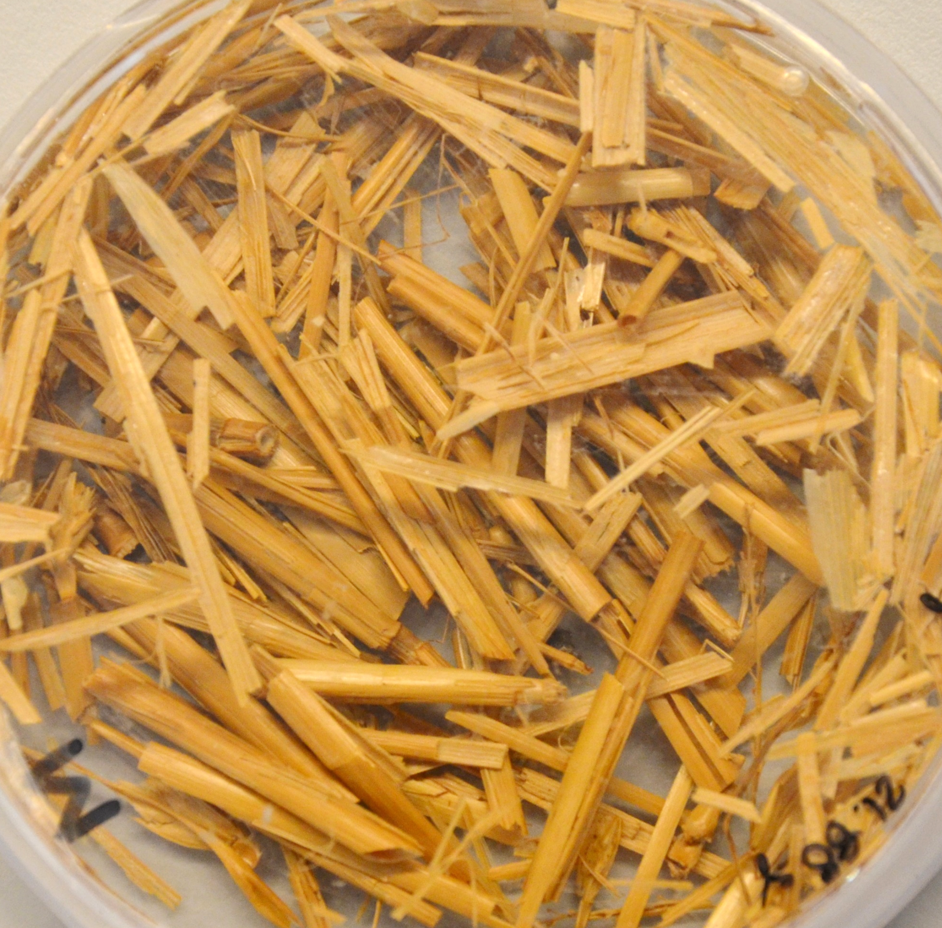
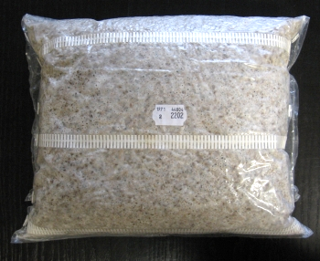
Prospective value-chain
Strain preservation
Spawn production
Fungal pre-growth
Biomass pre-treatment
Inoculation
Bioreactor
Off-site technology
On-site technology
Mushroom company (TBD)

Slide 8
Previous research goals:
Select ideal white-rot fungal strain
Based on literature and experimental screening
Optimize lab-scale liquid growth of white-rot fungi
Medium, pH, T, aeration, etc.
Aim: abundant growth & robustness against contamination
Pending steps:
Scale-up liquid culturing
Airlift reactor is desirable for mixing with minimal mechanical sheer and distribution of oxygen through the reactor
Optimize biomass pretreatment
Inoculum amount and incubation time
Selected fungi C for wheat straw and fungi D for grass
Liquid growth medium with cheap nutrient sources and microbial robust using a cocktail of organic acids, low pH and pasteurization

Slide 9
Future research goals:
Scale-up and optimize liquid culturing
Successfully grow liquid spawn to inoculate biomass
Scale-up biomass pre-treatment
Handling new mechanical parameters
Gain experience in successfully pre-treatment of large volume
Verifying pre-treatment effects on large scale
Producing usable fibrous materials and bio energy

Slide 10
Thank you for your attention!

Slide 11
Strain preservation
Spawn production
Fungal pre-growth
Biomass pre-treatment
Inoculation
Bioreactor
Off-site technology
On-site technology
Mushroom company (TBD)

