Slide 1


CIRCLE-IN
Web Academy
A Training Program for
the Entrepreneurial Development
in the Circular Economy

Slide 2
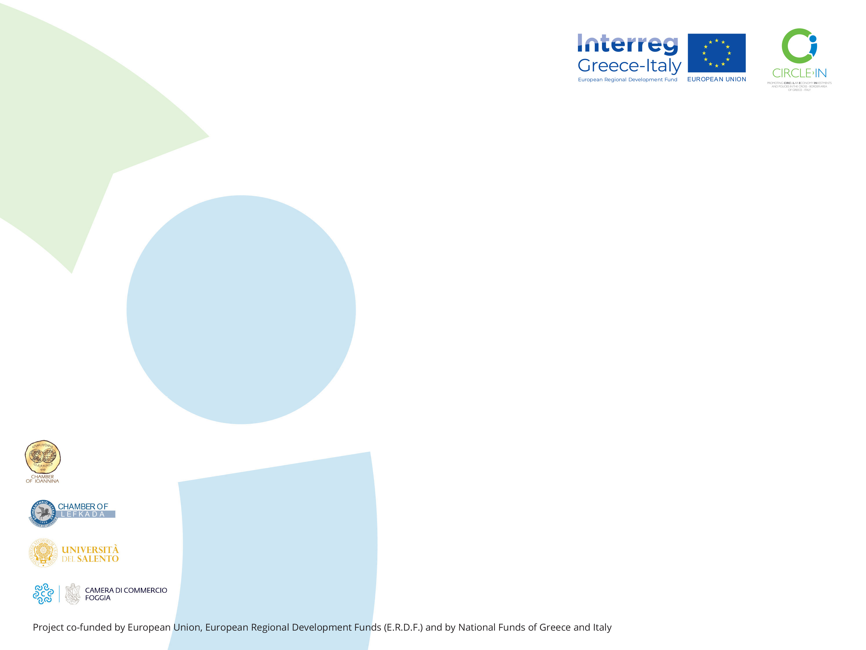
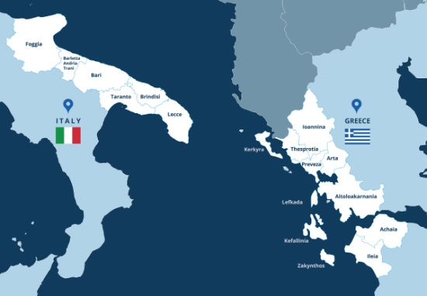
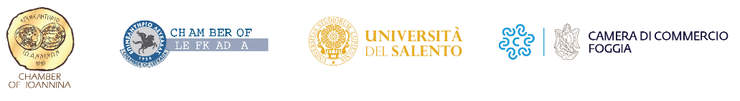
About CIRCLE-IN
CIRCLE-IN is a cross-border cooperation project aimed at foster the sustainable economic growth of the Ionian-Adriatic area through the promotion of Circular Economy and the implementation of pilot actions in terms of technology-driven entrepreneurship.
MAKE
USE
RETURN
Entrepreneurship
The project is funded under the first call of the announcement Interreg V-A Greece-Italy 2014-2020.
CIRCULAR ECONOMY
Partners

Slide 3
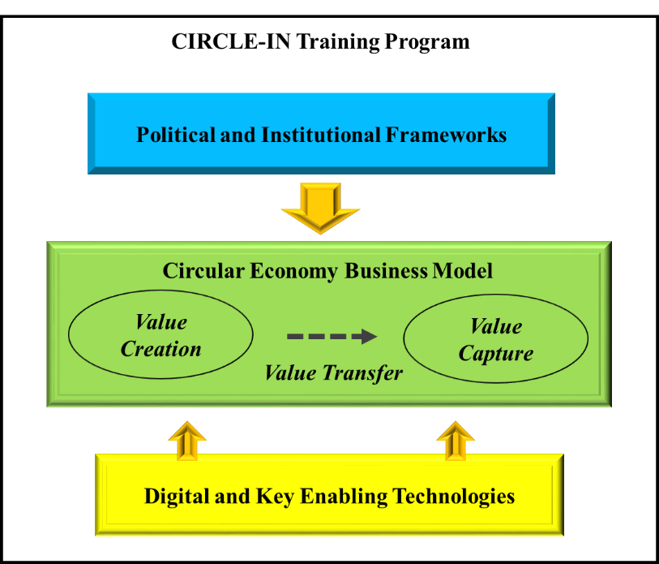
About CIRCLE-IN
Web Academy
Circle-In Web Academy is a training initiative aimed to promote the development of entrepreneurial competencies in the field of circular economy.
In coherence with the goals of the CIRCLE-IN project, the web academy aims to foster the creation of innovative mindsets and competencies in human capital and to support the exploitation of technological know-how into sustainable entrepreneurial ventures.
The initiative has been coordinated by the Laboratory of Management Engineering of the University of Salento with the collaboration of all project’s partners.
The program of the web academy is structured around three main thematic areas:

Slide 4
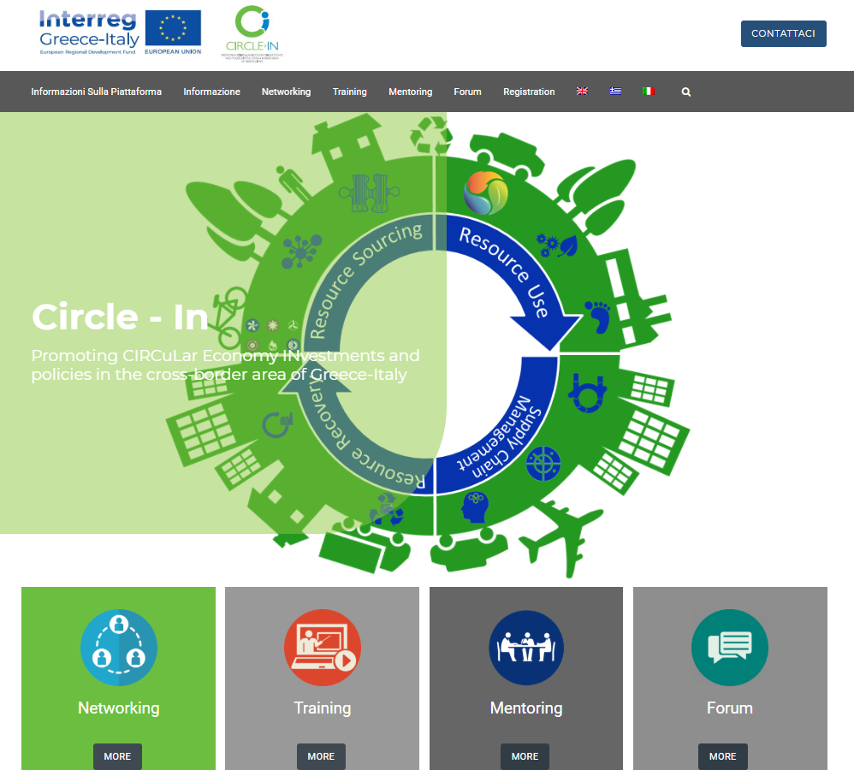
CIRCLE-IN
Training Program
Circle-In Web Academy is conceived as an experiential learning laboratory including seminars of academics and researchers, professionals and entrepreneurs.
All the seminars will be available online after login on the project platform, starting from October 21, 2020, at the following link:
http://platform.circle-in.eu/it/
A certificate of attendance will be provided to all participants who after the seminars will make the assessment.

Slide 5
CIRCLE-IN
Web Academy: the program
Welcome Speech
Fabio POLLICE, Rector University of Salento
Intro and learning objectives
Giuseppina PASSIANTE and Pasquale DEL VECCHIO, UNIVERSITY of SALENTO
Political and Institutional Frameworks
1.1. Strategies for promoting the transition towards Circular Economy in Europe
Roberta DE CAROLIS & Carolina INNELLA, ENEA
1.2. ICESP Platform – The Italian Way to the Circular Economy
Grazia BARBERIO - ENEA
1.3. Legal Issue for Circular Economy
Matteo AVELLO, ECOCERVED Scarl
1.4. Sustainable Entrepreneurship Development in the EU strategy
Giusy SECUNDO, University of SALENTO
1.5. Theory in Practice: Standards and Innovative Business Models for Tourism
Valentina NDOU & Gioconda MELE, UNIVERSITY of SALENTO

Slide 6
CIRCLE-IN
Web Academy: the program
2. Circular Economy Business Model (1/2)
2.1. Technological Entrepreneurship for Circular Economy
Pasquale Del Vecchio, UNIVERSITY of SALENTO
2.2. Introduction of Circular Economy in enterprises
Francesca CAPPELLARO, ENEA
2.3. Circular Business Models
Andrea URBINATI, LIUC UNIVERSITY
2.4. Circular Economy Business Model in the production and consumption system
Paola SPOSATO, ENEA
2.5. Industrial Symbiosis: which business opportunities to support the circular economy?
Luca FRACCASCIA, SAPIENZA UNIVERSITY of ROME and DELFT UNIVERSITY

Slide 7
CIRCLE-IN
Web Academy: the program
2. Circular Economy Business Model (2/2)
2.6. Addressing Circular Economy through Design for X approaches
Claudio SASSANELLI, POLYTECHNIC of MILAN
2.7. Theory in Practice: FIUSIS, European Best Practice for the Business Model
Marcello PICCINNI, FIUSIS srl
2.8 Why Growth Hacking is important in Circular Economy
Lara D’ARGENTO, Growth Mentor
2.9 Smart Tourism Destination in the Circular Economy: a business analytics perspective
Caterina MALANDUGNO, LINKS Management & Technology Spa

Slide 8
CIRCLE-IN
Web Academy: the program
3. Digital and Key Enabling Technologies
3.1. Blockchain for Circular Economy
Roberto CERCHIONE, PARTHENOPE UNIVERSITY of NAPLES
3.2. Exponential Technologies: Sustainability Opportunities from Disruptive Innovation
Alessandro MARGHERITA, UNIVERSITY of SALENTO
3.3. A Multi-Sided Platform supporting Circular Economy
Gianluca ELIA, UNIVERSITY of SALENTO
3.4. Theory in practice: Eggplant, transforming wastewater into bioplastic
Vito Emanuele CAROFIGLIO, EGGPLANT srl
3.5 Theory in practice: Eceplast a sustainable packaging innovators
Nicola ALTOBELLI, ECEPLAST srl
3.6 Theory in practice: ECOMET, innovative solutions for recovering metal plaf
Viola MARGIOTTA, ECOMET srl

Slide 9
Thank you for the attention!
For more info and updating,
please follow us at:
https://www.facebook.com/InterregCIRCLE.IN
http://platform.circle-in.eu/it/
https://greece-italy.eu/

