Slide 1
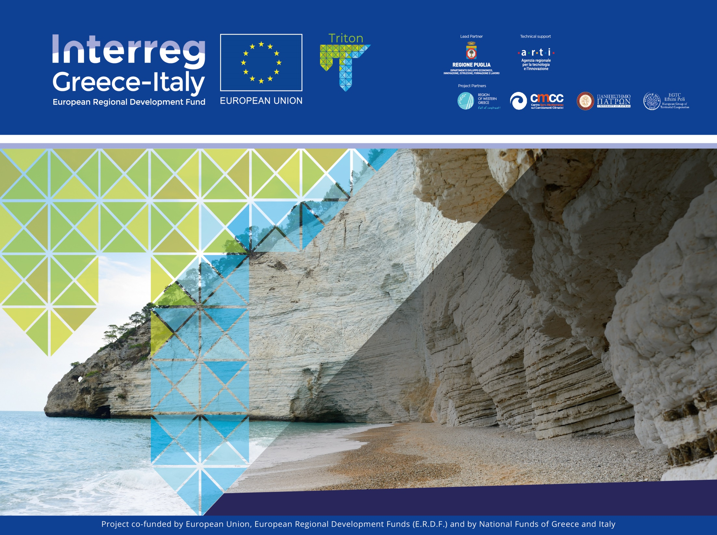
Summer School
Coastal Erosion and Effects
State of Art of Legislation
Patras, 24.09.2019
Michela Cariglia-ARTI

Slide 2
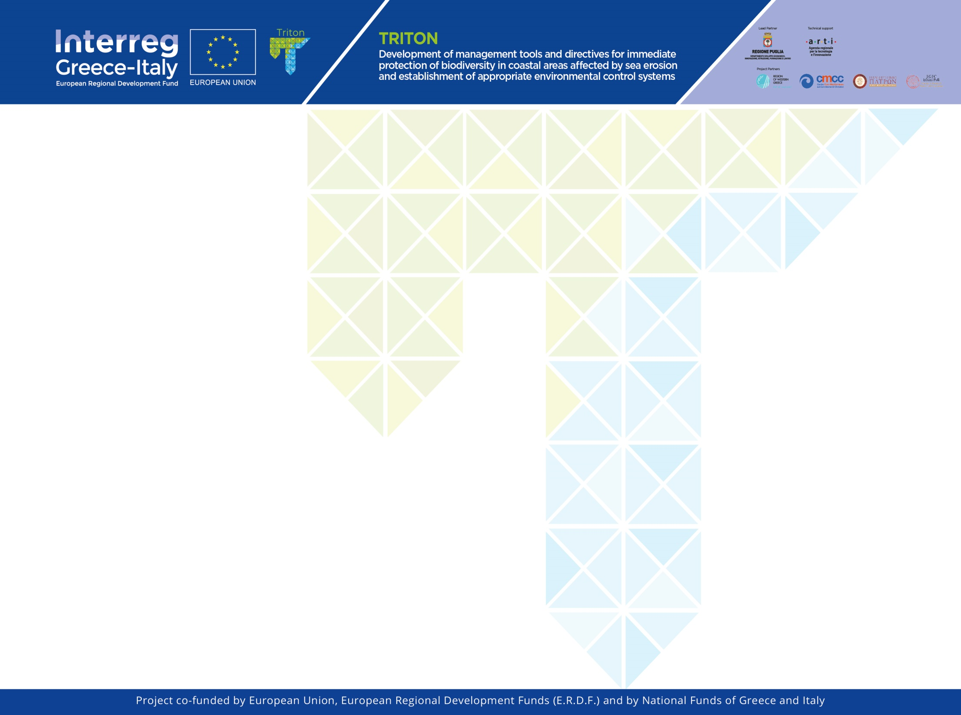
Outline:
1)Triton at a glance
2)Triton as sustainable development tool for Adriatic – Ionian area
3)Technicalities, challenges and opportunities
4) Mapping and Planning of tools and Framework
5) Pilot cases
6) Summer School and Training Days

Slide 3
Triton @ a glance/1
Triton is an innovative approach to the coastal erosion phaenomenon in Adriatic – Ioanin area based on the following assumption:
Learning – Testing- Training
It aims at enhance the awareness on coastal erosion risks and prevention trough the capitalization of existing results from different experiences, testing the effect of shared KPI in different situation and training the operators and technicians on the tools toward an integrated model of DSS.

Slide 4
Triton @a glance/2
Triton project is composed by 5 work-packages and 30 actions which develop the objectives of the project and Programme as well.
Among the envisaged activities, the main outputs are listed as follows: a Toolkit of Alternative Policy Instruments for policy makers, developed on the basis of assessment of the local impediments for implementation and structured in a phased mutual learning approach; a set of shared indicators and decision support tools for the operational mapping and monitoring of coastal erosion risk at local and regional scale; a web-based Participatory GIS/SIT tool empowering inhabitants and visitors to communicate effectively with the local and regional authorities and to achieve transparent Coastal Zone Management governance and collaboration of all stakeholders. This tool will be based on layers of local environmental and legal-institutional data (including legislative plans) accessible to the broad public and suited to the particulars of the involved partners; a preliminary draft of Greece and Italy cross-border cooperation legislation for the related matters of Coastal Zone Management; - a model (pilot) Observatory in the area of intervention for use by the local and regional actors including the Municipal Authorities, to help create a feasibly shared mode of data collection and monitoring beyond the circle of the Project; International Training Course for staff of stakeholders and professional associations to raise the awareness for Coastal Zone Management and land uses, in order to contribute to the elimination of the erosion effects; position paper toward the common Operative Plan Adoption for Coastal Zone Management at EUSAIR level; a framework for local authorities and regional stakeholders to access to EIB funds for ICZM’s intervention. The produced tools will be available for use by involved stakeholders such as Regional, Local and Port Authorities and firms.

Slide 5
Triton as suistainable development tool: what we do for ICZM and Legislation Framework
Triton PP’s coordinated by Apulia Region is working together on the following main aspects:
Census on State of Art on Integrated Coastal Management Zone scouting the best practices, the projects results and the bottom up challenges/difficulties
Analysis on the indicators effectiveness at Adriatic-Ionian level
Development of a Platform as repository of data between Greece and Italy as tool to support the DSS
Test the tools and the KPI in specific areas in Greece and Italy
Spread out the knowlegde on coastal erosion risks and prevention trough the Training Days and Summer School
Enhance the awareness on coastal erosion risks and prevention trough a Paper Position for EUSAIR

Slide 6
Triton as suistainable development tool/2
Development of a Platform as repository of data between Greece and Italy as tool to support the DSS
The lack of coordination of information is going to be overcome torugh the development of an open platform on project website
https://greece-italy.eu/rlb-funded-projects/triton/
able to give a framework for each stakeholders involved in the coastal management.
The main utilities from platform are finalized to give accessible data to support the decision on coastal management and risks prevention at different level.
It supports the paradigma of decision makers because it support the scenario analysis for stakeholders at local, regional and inernational level.

Slide 7
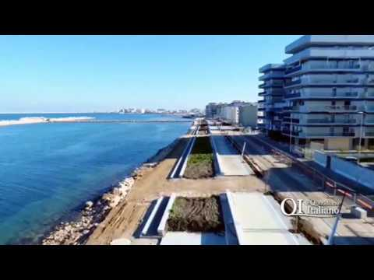
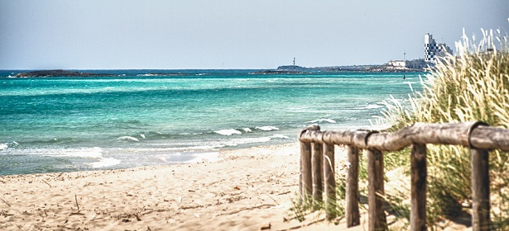
Triton as suistainable development tool/3 – The pilot test
:
Network, WEB GIS and DSS three pillars
The network is finalized to work on pilot areas on both Countries
On Greek side a pilot test is foreseen in Missolonghi area
On Apulian side a set of pilot test based on the meseauremnt of effectiveness of coastal mangement and risks prevention are under process in Bari-Fesca San Girolamo and Ugento.

Slide 8
Triton as suistainable development tool/4 – The pilot test
2) The WEB GIS is finalized empowering inhabitants and visitors to communicate effectively with the local and regional authorities and to achieve transparent Coastal Zone Management governance and collaboration of all stakeholders. This tool will be based on layers of local environmental and legal-institutional data (including legislative plans) accessible to the broad public and suited to the particulars of the involved partners; a preliminary draft of Greece and Italy cross-border cooperation legislation for the related matters of Coastal Zone Management

Slide 9
Triton as suistainable development tool/Training Days and Summer School
Triton approach is based on the importance of knowledge spread out trough the learning for staff of stakeholders and professional associations to raise the awareness for Coastal Zone management and land uses, in order to contribute to the reduction of the erosion effects.
The plan of of training activities is divided into two main patterns (or training modules):
• Theoretical / practical training course for experts of local public bodies and the technicians involved in the preparation of municipal plans of the coasts, in n. 5 days to be held in Puglia;
• International Training Course (Summer School) / - on the theme of sustainable management of coastal heritage and on actions to combat erosion, including the use of performance and assessment indicators to be held in Puglia and in the Region of Greece West.

Slide 10
Coastal erosion processes: main terminologies and theories
The “coast”, also known as the “coastline” or “seashore”, is the area where land meets the sea or ocean, or a line that forms the boundary between the land and the ocean or a lake.
A precise line named a “coastline” cannot be determined due to the continuous variation of sea level according to waves and winds and to the continuous displacement of materials.

Slide 11
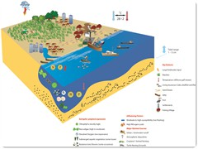
Coastal erosion processes: main terminologies and theories

Slide 12
Coastal erosion processes: main terminologies and theories
The “coast”, also known as the “coastline” or “seashore”, is the area where land meets the sea or ocean, or a line that forms the boundary between the land and the ocean or a lake. A precise line named a “coastline” cannot be determined due to the continuous variation of sea level according to waves and winds and to the continuous displacement of materials.
The term “coastal zone” refers to a region where interaction of the sea and land processes occurs. The coast and its adjacent areas on and off shore are an important part of a local ecosystem, social and economic chain.
The high level of biodiversity creates a high level of biological activity, which has attracted human activities for thousands of years. Most part of the world's people live in coastal regions. Many major cities are on or near good harbours and have port facilities. Some landlocked places have achieved port status by building canals.
The coast is a frontier that nations have typically defended against military invaders, smugglers and illegal migrants. Fixed coastal defences have long been erected in many nations, coastal countries typically have a navy and some form of coast guard, in Italy Marina Militare Italiana, Guardia Costiera, Capitaneria di Porto, respectively.

Slide 13
Coastal Erosion Effects
Climate change is causing serious threats on natural and human systems worldwide (IPCC, 2018).
In particular, climate-related impacts will be especially relevant in coastal areas, where a dense interaction between terrestrial and marine systems occurs (IPCC, 2013).
According to the IPCC scenarios, coastal areas, and related ecosystems, will be increasingly exposed to erosion, as a direct consequence of rising sea levels and changing patterns of extreme events (MATTM, 2017).
The expected physical impacts (e.g. sea-level rise, storms, floods), already affecting low-lying coastal areas, are projected to increase in the future leading to more severe environmental effects (IPCC, 2013).
Examples are biodiversity loss, reduced species survival and species shift which, in turn, will affect ecosystems services flow and generate socio-economic damages, including disruption of urban areas and infrastructures (UNDP, 2011; IPCC, 2014a).

Slide 14
Located at the land-sea interface, coastal areas are dynamic environments in which natural and anthropogenic processes interact at diverse temporal and spatial scales, modifying their geomorphological, physical and biological characteristics (Mills et al., 2005).
https://www.youtube.com/watch?v=wDVSZefJqXU
Natural effects include shoreline interactions with incident waves, tides, storms, tectonic movements, as well s physical processes linked to the sediment transport by rivers (Dolan et al., 1981).
The processes of coastal erosion and accretion have always existed and have contributed, over time, to shape the coastal landscape by creating a wide variety of types of coastline (e.g. cliff, sandy and rocky coast, etc.). Coastal erosion can be a slow (years, decades or centuries) or rapid onset (days or weeks) process: it normally has a long term trend, due to the continuous wave motion, but it can be as well rapid, as a consequence of an extreme flood event (Mentaschi et al., 2018).
https://youtu.be/ialqVcLhrMc

Slide 15
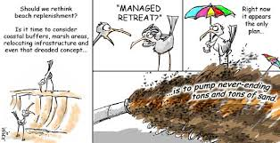
Located at the land-sea interface, coastal areas are dynamic environments in which natural and anthropogenic processes interact at diverse temporal and spatial scales, modifying their geomorphological, physical and biological characteristics (Mills et al., 2005).

Slide 16
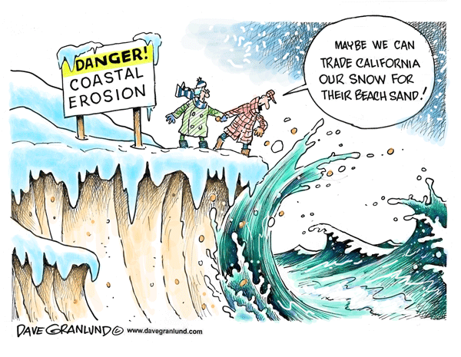
Natural effects include shoreline interactions with incident waves, tides, storms, tectonic movements, as well s physical processes linked to the sediment transport by rivers (Dolan et al., 1981).
The processes of coastal erosion and accretion have always existed and have contributed, over time, to shape the coastal landscape by creating a wide variety of types of coastline (e.g. cliff, sandy and rocky coast, etc.). Coastal erosion can be a slow (years, decades or centuries) or rapid onset (days or weeks) process: it normally has a long term trend, due to the continuous wave motion, but it can be as well rapid, as a consequence of an extreme flood event (Mentaschi et al., 2018). https://
www.youtube.com/watch?v=H6Q6PSFi6Vo

Slide 17
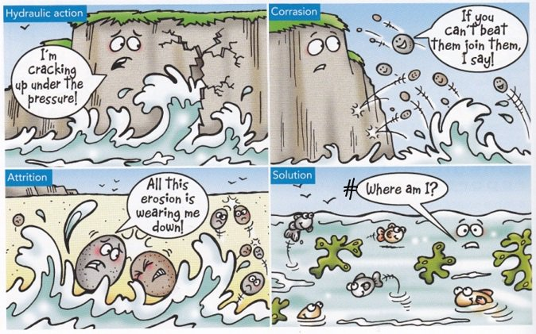
This process can also be accelerated by anthropogenic pressures: as example, the damming of streams can led to a decrease of sediments transport since they would result trapped behind dams; the extraction of natural resources from the seabed (sand and gas) and water abstraction from groundwater may cause ground subsidence.
In this context, due to the this complex interplay between natural and human-made pressures, the
Mediterranean region
is already experiencing
a number of environmental
impacts, including
erosion and degradation
of coastal ecosystems,
triggering efforts
to improve short-term
coastal management
(Nicholls and Hoozemans, 1996).

Slide 18
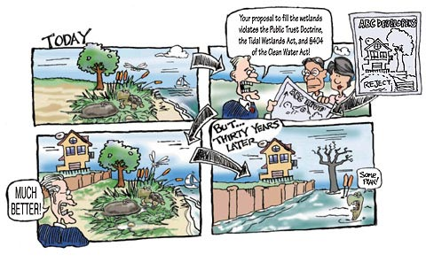
Even though the Mediterranean Sea is not expected to be subjected to sea level rise as the oceans, the region is considered to be a climate change hot-spot due to its specific physical, environmental and socio-economic features. In fact, the Mediterranean region is characterized by low lying coastal areas particularly prone to storm surge flooding events and rising sea level, as sea water can’t be stopped by steep slope or dunes providing natural defense to water intrusion (ETC/ACC, 2010; Anzidei et al., 2014, 2017).

Slide 19
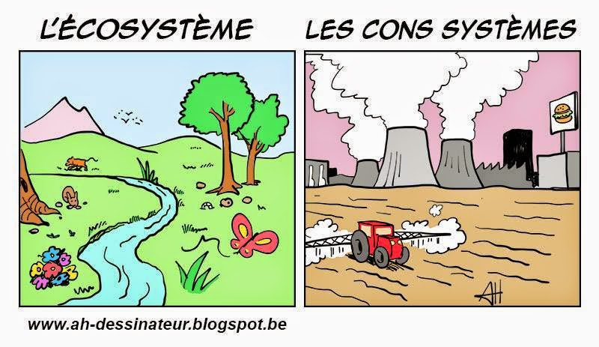
Against this background, coastal authorities are faced with the challenging task of balancing coastal development with risk management.
An integrated approach to coastal management is needed to face coastal erosion processes, merging both technical and scientific studies to identify, on one side, the main causes contributing to coastal imbalance and to design,
on the other,
the most appropriate
monitoring actions
for understanding
the trends and the
required
structural measures,
following the order
of priority resulting
from the level of risk.

Slide 20
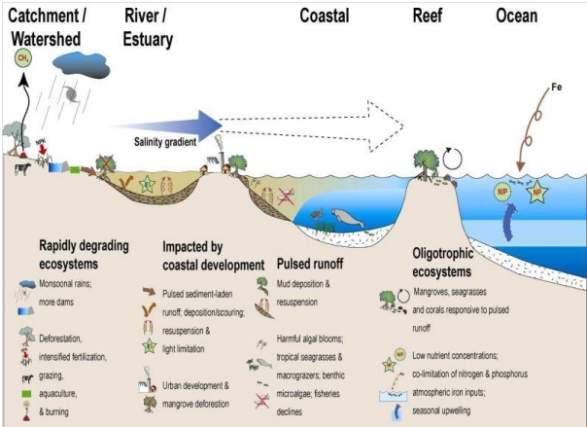
The Integrated Coastal Zone Management (ICZM) approach represents a valuable tool to face these kinds of environmental issues, providing a structured framework and principles to mitigate impacts due to short- and long-term uses, and
support strategies
for sustainable
and integrated
shoreline management.
However, even though
the ICZM Protocol
has been signed in 2008
(UNEP/MAP/PAP, 2008),
its implementation
is still fragmented across
the Mediterranean region.

Slide 21
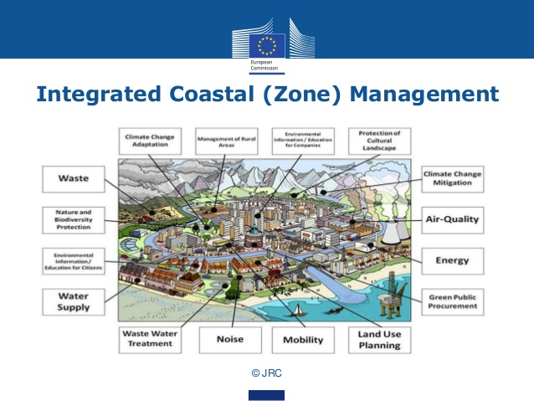

Slide 22
TRITON CONTRIBUTE’S TO LEGISLATION IMPLEMENTATION
Drawing on this need, the overall objective of the Triton project is to reduce the consequences of coastal erosion by bridging the policy-implementation gap in the ICZM in the area of intervention (IT-GR) and improving the integration of coastal zone policies within broader spatial planning and socio-economic policies.
The Apulian and Western Greece shorelines, in the area of intervention of the project, are facing significant erosion impacts due to natural and man-induced causes, calling for targeted interventions and adaptation strategies based on risk analysis and management.
.

Slide 23
Coastal erosion processes: main terminologies and theories
The high level of biodiversity creates a high level of biological activity, which has attracted human activities for thousands of years. Most part of the world's people live in coastal regions. Many major cities are on or near good harbours and have port facilities. Some landlocked places have achieved port status by building canals.
The coast is a frontier that nations have typically defended against military invaders, smugglers and illegal migrants. Fixed coastal defences have long been erected in many nations, coastal countries typically have a navy and some form of coast guard, in Italy Marina Militare Italiana, Guardia Costiera, Capitaneria di Porto, respectively.

Slide 24
Coasts, especially those with beaches and warm water, attract tourists. In many island nations such as those of the Mediterranean, Indian Ocean, South Pacific and Caribbean, tourism is central to the economy. Coasts offer recreational activities such as swimming, fishing, surfing, boating, and sunbathing. Growth management can be a challenge for coastal local authorities who often struggle to provide the infrastructure required by new residents. The coastal evolution is the product of morphodynamic process that occurs in response to change in external conditions (Wright and Thom, 1977).
The structure of the coasts is very heterogeneous and its shape depends on several factors such as the soil material, the exposure to the atmospheric agents, the anthropic pressing and the human activities. A main difference can be remarked between rocky shore and sedimentary shore.

Slide 25
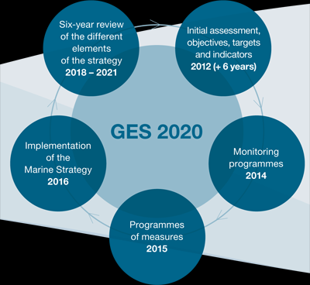
Directive 2008/56/EC
The aim of the European Union's ambitious Marine Strategy Framework Directive is to protect more effectively the marine environment across Europe.
The Commission also produced a set of detailed criteria and methodological standards to help Member States implement the Marine Strategy Framework Directive. These were revised in 2017 leading to the new Commission Decision on Good Environmental Status.
Annex III of the Directive was also
amended in 2017 to better link
ecosystem components, anthropogenic
pressures and impacts on the marine
environment with the MSFD's 11 descriptors
and with the new Decision on
Good Environmental Status.

Slide 26
Directive 2008/56/EC
The Marine Strategy Framework Directive aims to achieve Good Environmental Status (GES) of the EU's marine waters by 2020 and to protect the resource base upon which marine-related economic and social activities depend. It is the first EU legislative instrument related to the protection of marine biodiversity, as it contains the explicit regulatory objective that "biodiversity is maintained by 2020", as the cornerstone for achieving GES.
The Directive enshrines in a legislative framework the ecosystem approach to the management of human activities having an impact on the marine environment, integrating the concepts of environmental protection and sustainable use.
In order to achieve its goal, the Directive establishes European marine regions and sub-regions on the basis of geographical and environmental criteria. The Directive lists four European marine regions – the Baltic Sea, the North-east Atlantic Ocean, the Mediterranean Sea and the Black Sea – located within the geographical boundaries of the existing Regional Sea Conventions. Cooperation between the Member States of one marine region and with neighbouring countries which share the same marine waters, is already taking place through these Regional Sea Conventions.
In order to achieve GES by 2020, each Member State is required to develop a strategy for its marine waters (or Marine Strategy). In addition, because the Directive follows an adaptive management approach, the Marine Strategies must be kept up-to-date and reviewed every 6 years.

Slide 27
Directive 2008/56/EC
In order to achieve its goal, the Directive establishes European marine regions and sub-regions on the basis of geographical and environmental criteria. The Directive lists four European marine regions – the Baltic Sea, the North-east Atlantic Ocean, the Mediterranean Sea and the Black Sea – located within the geographical boundaries of the existing Regional Sea Conventions. Cooperation between the Member States of one marine region and with neighbouring countries which share the same marine waters, is already taking place through these Regional Sea Conventions.
In order to achieve GES by 2020, each Member State is required to develop a strategy for its marine waters (or Marine Strategy). In addition, because the Directive follows an adaptive management approach, the Marine Strategies must be kept up-to-date and reviewed every 6 years.

Slide 28
The amendment toward the Good Enviroment Status Dir. 845/2017
The review of Annex III to Directive 2008/56/EC is needed to complement the review of Decision 2010/477/EU. Furthermore, the relationship between Annex III to Directive 2008/56/EC and the qualitative descriptors for
determining good environmental status listed in Annex I to that Directive is only implicit in that Directive and, therefore, not sufficiently clear. The Commission, in a staff working paper from 2011 , explained relationships
between the qualitative descriptors listed in Annex I to Directive 2008/56/EC, the elements set out in Annex III to that Directive, and the criteria and indicators set out in Decision 2010/477/EU, but could provide only a partial answer due to their inherent content. A revision of Annex III to Directive 2008/56/EC is needed in order to further clarify those relationships and facilitate implementation, better linking ecosystem elements, and anthropogenic pressures and impacts on the marine environment with the descriptors in Annex I to Directive 2008/56/EC and the outcome of the review of Decision 2010/477/EU.
https://eur-lex.europa.eu/legal-content/EN/TXT/PDF/?uri=CELEX:32017L0845&from=EN
.

Slide 29
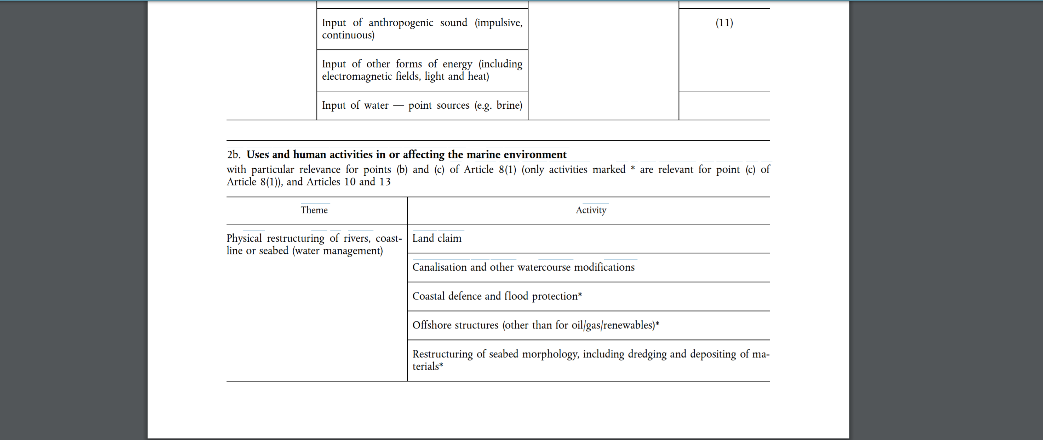
The ANNEX III of Dir. 2017/845

Slide 30
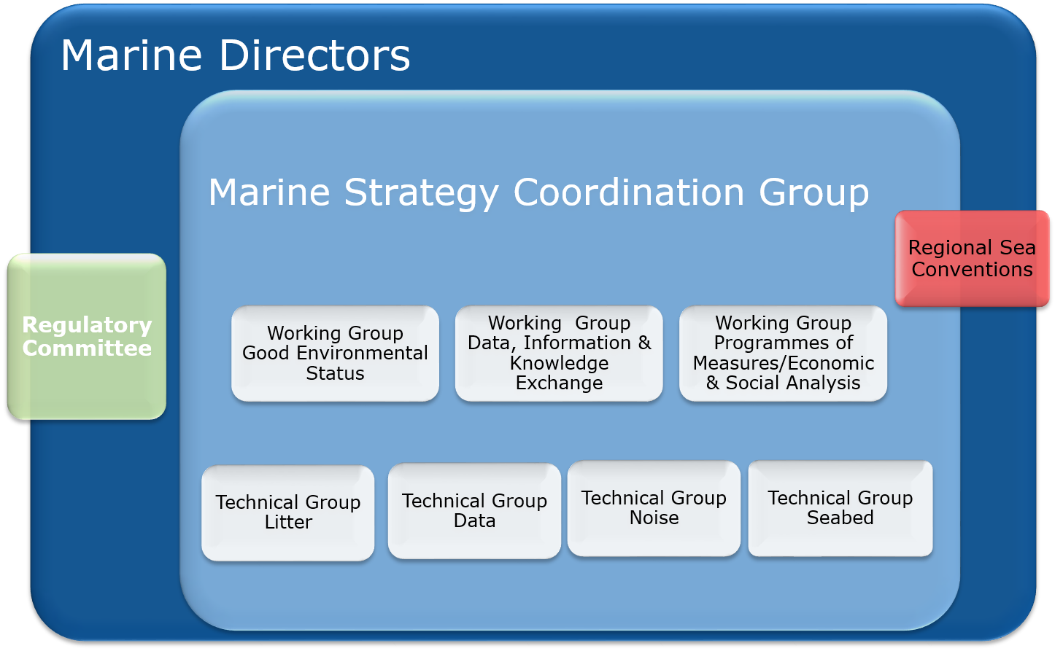
The Marine Framework Strategies

Slide 31
The Marine Framework Strategies/ Regional Cooperation
The Marine Directive sets out a regional approach to the management of our seas, requiring Member States to cooperate with their neighbours when developing their marine strategies.
Sharing our marine waters does not mean only sharing the benefits from the seas, but also addressing together the numerous challenges to be faced in acieving GES.
The frameworks developed by Member States to implement the Directive should be coherent within the different marine regions or sub-regions and across the European Union. For instance, the determination of what GES means for a Member State’s marine waters, let’s say in terms of the levels of marine litter in the waters, should be coherent with what neighbouring Member States, sharing the same waters, have determined (which does not necessarily mean that it should be similar as each national situation should be taken into account).

Slide 32
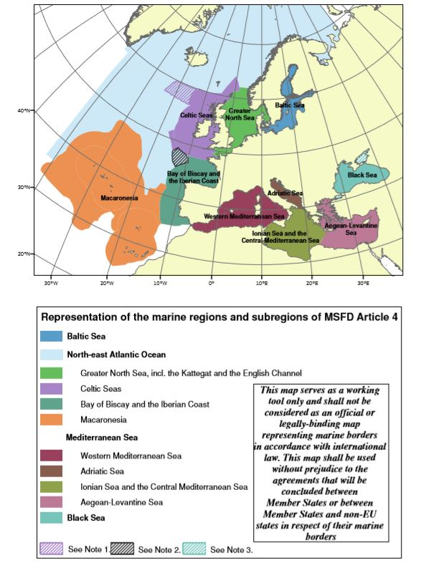
The Marine Framework Strategies/ Regional Cooperation

Slide 33
The Marine Framework Strategies/ What we can do with TRITON project to implement GES?
We can:
deepen and improve the skills of public servants and technicians involved in Integrated Management of the Coastal Zone toward a planning through the WEB GIS and SIT information systems;
Provide the state of art of legislation in Greece and Italy for ICMZ
Provide the results of pilot case in Italy and Greece
Support the decision maker torugh a pattern composed by:
- a Toolkit of Alternative Policy Instruments for policy makers, developed on the basis of assessment of the local impediments for implementation and structured in a phased mutual learning approach;
- a set of shared indicators and decision support tools for the operational mapping and monitoring of coastal erosion risk at local and regional scale; a web-based Participatory GIS/SIT tool empowering inhabitants and visitors to communicate effectively with the local and regional authorities and to achieve transparent Coastal Zone Management governance and collaboration of all stakeholders.

Slide 34
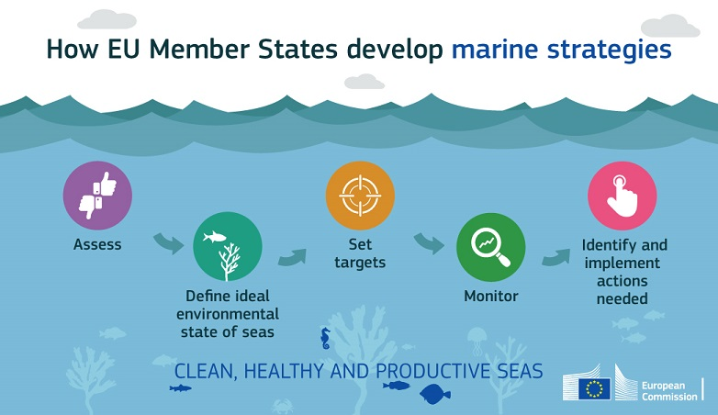

Slide 35
The Marine Directive aims to achieve Good Environmental Status of the EU's marine waters by 2020 and to protect the resource base upon which marine-related economic and social activities depend. Seas in Good Environmental Status are clean, healthy and productive. The Directive enshrines in a legislative framework the ecosystem approach to the management of human activities having an impact on the marine environment, integrating the concepts of environmental protection and sustainable use.
According to the Directive, each Member State must implement a marine strategy for its marine waters, in cooperation with other Member States sharing the same marine region, reviewed every 6 years.
Those strategies include 5 steps:
- an initial assessment of their marine waters,
- the determination of the good environmental status of their marine waters,
- the setting of environmental targets,
- the establishment and implementation of coordinated monitoring programmes, and
- the identification of measures or actions that need to be taken in order to achieve or maintain good environmental status..

Slide 36
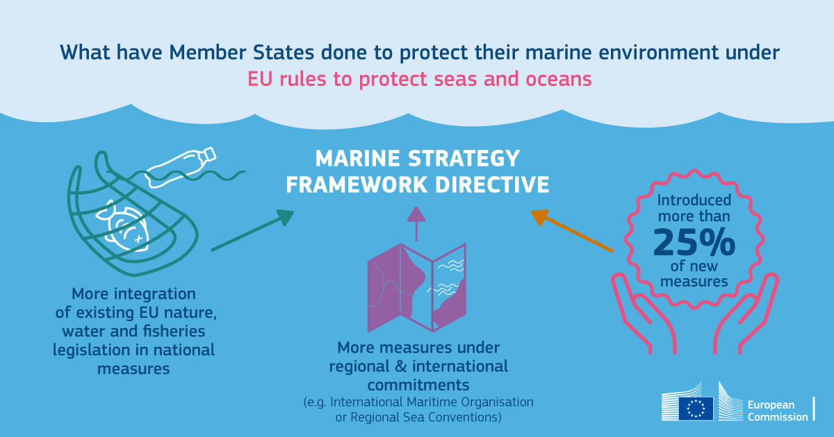

Slide 37
Increase in marine protected areas reduces pressure on marine habitats and species
A new Commission report shows significant progress in establishing protected areas in Europe's seas, with benefits for the economy and the environment. Under the UN Convention on Biological Diversity, the EU has committed to ensure the conservation of 10% of its coastal and marine areas by 2020. In 2012, 5.9 % of Europe's seas had already been designated as marine protected areas, and work is continuing with a view to achieve 10 % coverage by 2020. This objective is also reflected in Sustainable Development Goal 14 to conserve and sustainably use the oceans, seas and marine resources for sustainable development.
Many marine species across Europe´s seas are experiencing a decrease in population size and loss of habitat. Protected areas seek to reverse this trend by safeguarding ecosystems and species and rebuilding fish stocks, as well as ensuring the delivery of important ecosystem services such as coastal protection, flood management and tourism. The Commission will continue supporting Member States to designate, manage and control marine protected areas through financing mechanisms such as the LIFE Programme and the European Maritime and Fisheries Fund, while promoting inclusive governance structures for and research on marine protected areas.

Slide 38
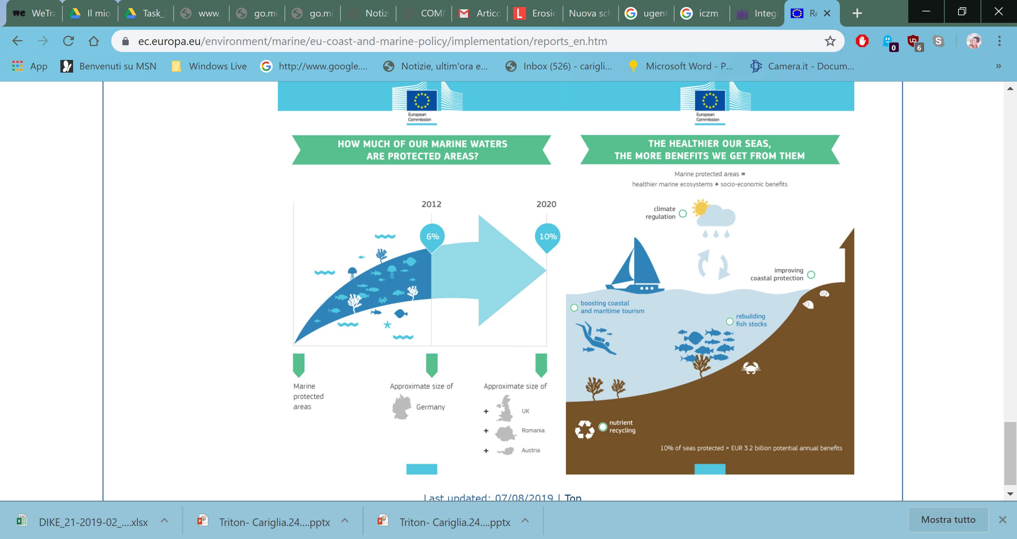

Slide 39
    Available data at the case study level: Triton approach toward a common legislation
The implementation of risk-based methodologies requires the collection and processing of a huge amount of heterogeneous information, including data from climate and hydrodynamic models to characterize hazard scenarios, as well as land-use dataset supporting the identification and characterization of potentially exposed targets and their vulnerabilities.
Accordingly, with the main aim of evaluating coastal erosion risks in the Apulia and Greek shoreline case study, an in-depth research and collection of GIS-based dataset was performed, paying specific attention on their spatial resolution and homogeneous coverage for the area of concern.
A variety of physical and environmental data, as well as data on main natural (e.g. currents, storms, winds) and anthropogenic drivers (e.g. localization of settlements and infrastructures, agricultural activities) were retrieved, in order to spatially characterize the main stressors contributing to coastal erosion processes in the case study
and identify potentially exposed targets.

Slide 40
State of Coasts in the context of the global climate change
In Europe, multiple pressures - including habitat loss and degradation, pollution, overexploitation of fish stocks climate change and natural hazards- affect the coastal ecosystems.
The effects of climate change could be devastating to vulnerable coastal and marine areas as well as to the function and structure of their ecosystems. Increasing sea level (1,7 mm/year) changes the shape of coastlines, contributes to coastal erosion and leads to flooding and more underground salt-water intrusion. Climate change also causes changes in European seas surface temperature, which has been up to six times greater than in the global oceans in the past 25 years. One of the most visible impacts of the rising sea temperature is the reduced area of sea ice coverage in the Arctic polar. The ice cover in 2007 was only half the size of the minimum ice cover in the 1950s. The diminishing Arctic ice is already impacting indigenous people and the habitats in the region, but according to pessimistic estimates in a few centuries it may constitute threat to major coastal cities in Europe, including London and Amsterdam. Increasing sea-level affects a significant number of Europeans. One third of the EU population lives within 50 km of the coast. The GDP generated by this population amounts over 30% of the total EU GPD. The coastal areas are important sources of GDP per se. The economic value of coastal areas within 500 metre from the European seas totals between €500-1,000 billion. The costs of doing nothing against the effects of climate change in coastal areas are estimated to be higher than the annual costs of taking actions, which is estimated at around €6 billion by 2020. On the other hand, the net-benefits of adaptation are put at up to €4.2 billion.

Slide 41
State of Coasts in the context of the global climate change
The challenge of climate change needs to be addressed inter alia through integrated and ecosystem-based approaches and instruments, such as integrated coastal management. These are crucial to build the foundations for sustainable coastal management and development, supporting socio-economic development, biodiversity and ecosystem services.
Integrated coastal management is an acknowledged tool to deal with current and long-term coastal challenges, including climate change and its impacts (for instance sea-level rise, changes in storm frequency, strength and patterns and increased coastal erosion and flooding). In 2002, the EU’s Recommendation on Integrated Coastal zone Management referred to the threat to coastal zones posed by climate change as the basis for a strategic approach on coastal management.

Slide 42
State of Coasts in the context of the global climate change
The challenges posed by climate change to coastal areas have been also addressed by national integrated coastal management strategies, which have implemented different principles and tools to respond to these challenges:
long-term perspective and precautionary principle, adaptive management, accounting for diversity of local conditions, working with natural processes and coherence between planning and management.
Relevant cases on implementation of integrated coastal management can be found on the OURCOAST database.
Specific cases that deal with adaptation to climate change can also be found on the European Climate Adaptation Platform.

Slide 43
Land Sea Interactions
Understanding and accommodating land-sea interactions (LSI) are critical to the successful delivery of maritime spatial planning and integrated management at the coast. The Maritime Spatial Planning Directive (2014/89/EU) explicitly requires Member States to take into account LSI in its Articles 4, 6 and 7. Specifically, Member States may use formal or informal processes, such as integrated coastal management, and reflect them in their maritime spatial plans. The MSP Directive highlights the interrelationship of marine and coastal activities and the benefits that planning can bring to coastal economies and ecosystems. The Directive requires that Member States establish their ecosystem-based maritime spatial plans by 31 March 2021.
The inclusion of LSI in the MSP Directive recognises that effective maritime spatial planning cannot take place unless consideration is given to the interface between terrestrial and marine environments. Interactions between land and sea areas can encompass the run-off of nutrients from an agricultural area into a freshwater body that ends up in coastal waters and contributes to eutrophication further offshore, as well as the laying of a cable across an intertidal area to connect an offshore wind farm to a national energy grid.

Slide 44
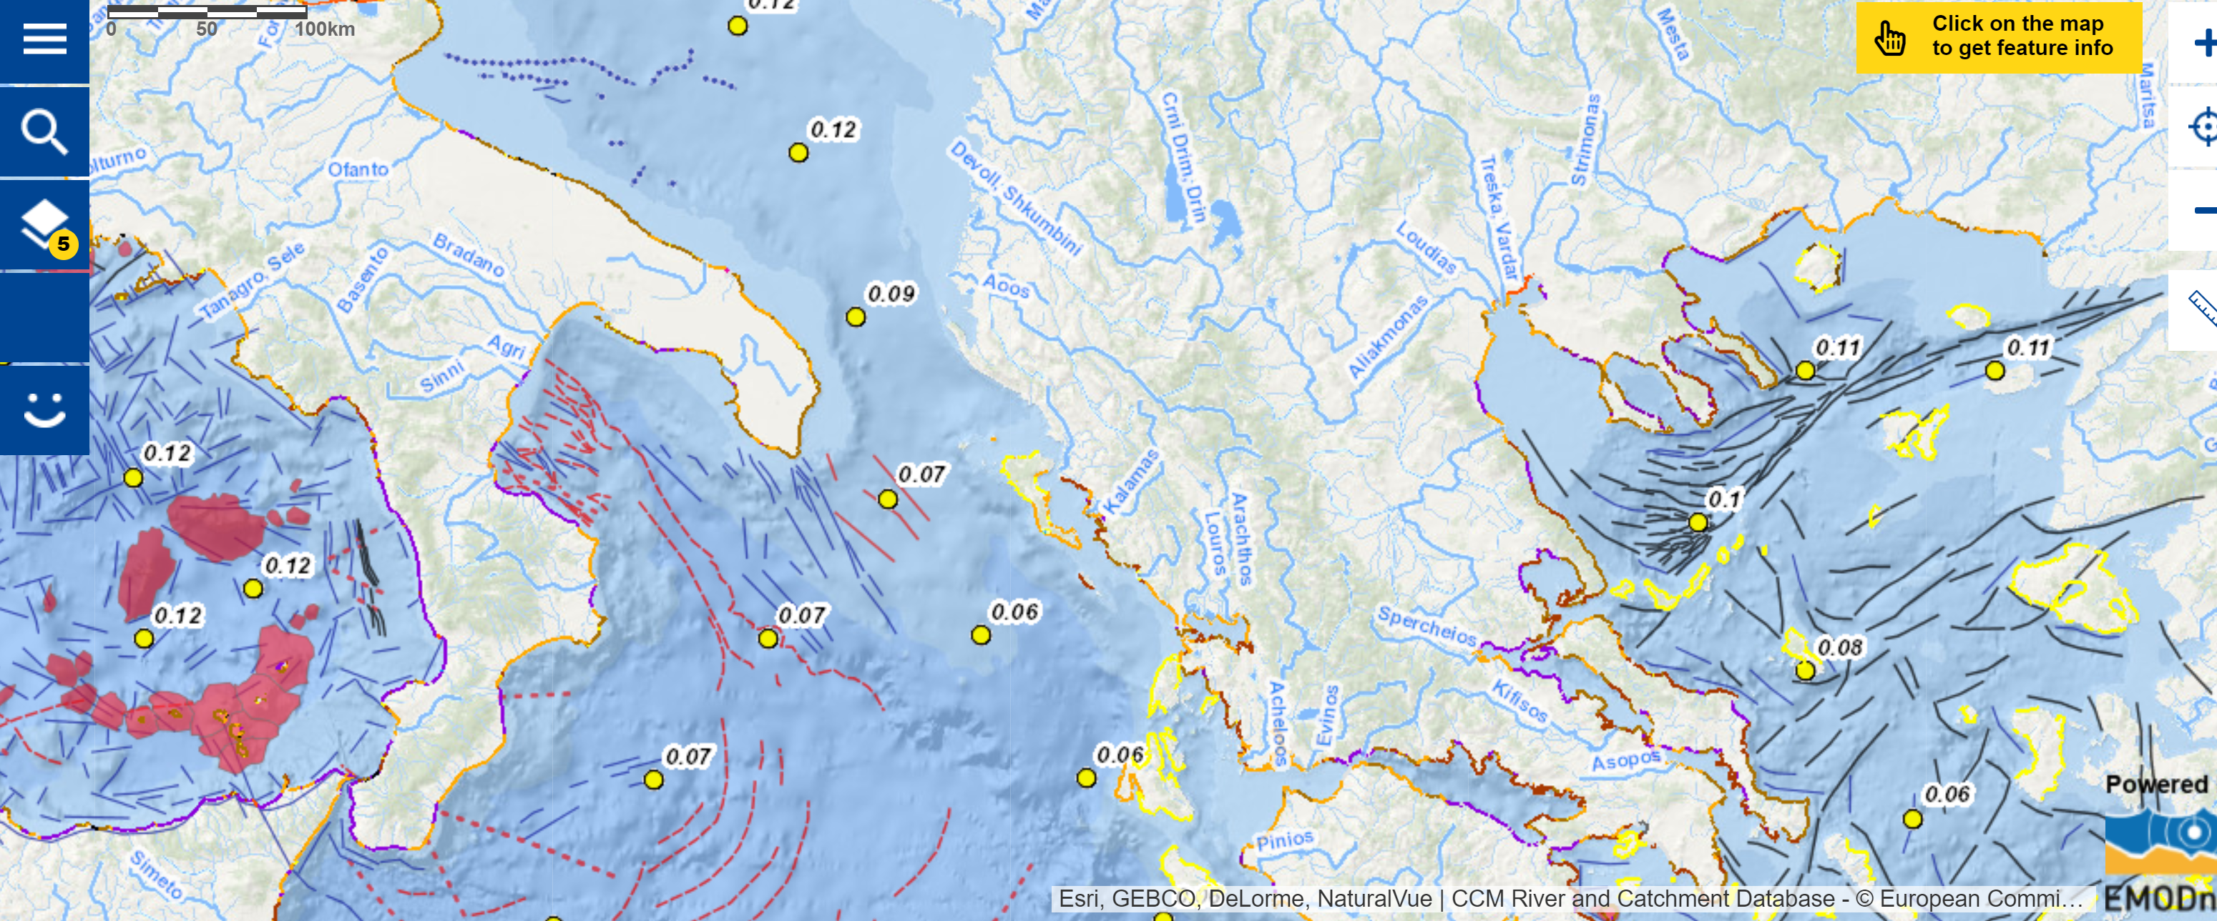
Land Sea Interactions
https://ec.europa.eu/maritimeaffairs/atlas/maritime_atlas/#lang=EN;p=w;bkgd=5;theme=450:0.75,529:0.75,12:1,18:1,10:0.75;c=2738579.054998362,5025158.611139398;z=6

Slide 45
Overwiev on Integrated Coastal Management Zone
The policy responses that recognize the need for ICZM in Europe are abundant[1]. During the last decade, the EU has begun to specifically address problems related to the state of the coasts, their sustainable development, and the coast as a regional entity. This includes the issuing of two major policy documents, namely:
The Commission communication on Integrated Coastal Zone Management: The Strategy for Europe (ICZM Strategy, COM (2000)547 final); and
The European Parliament and the Council recommendation concerning the implementation of Integrated Coastal Zone Management in Europe (EU ICZM Recommendation, 2002/413/EC).
The coastal zones are also addressed in other integrated and horizontal policies and directives that are not directly aimed at coastal zones but are nevertheless very relevant to the sustainable development of the coasts and should play a critical role in the planning and implementation of ICZM (see figure below).
.

Slide 46
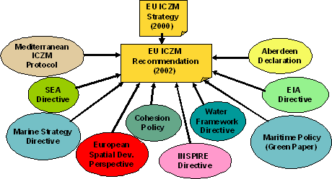
Overwiev on Integrated Coastal Management Zone

Slide 47
Overwiev on Integrated Coastal Management Zone

Slide 48
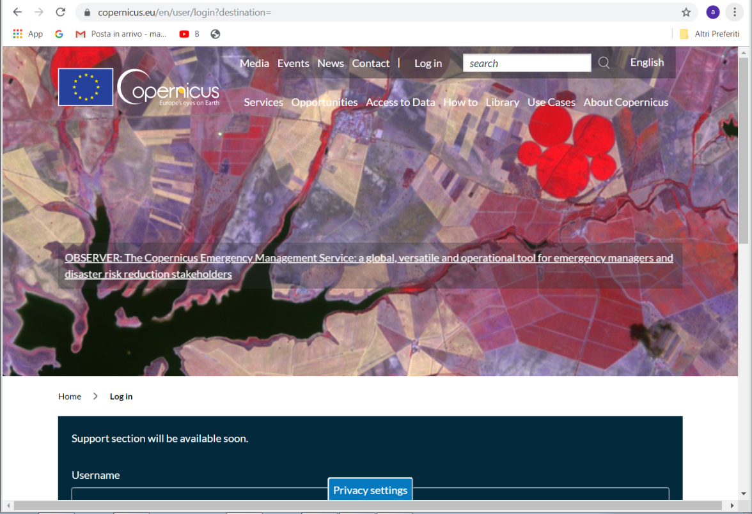
As a first-pass screening of available data for the case study, European open-source web data portals were explored. Specifically, topographic data (i.e. Digital Elevation Model EU-DEM), as well as socio-economic information concerning the land use pattern (e.g. Corine Land Cover map, localization of main infrastructures) were retrieved from the Copernicus services (e.g. Land Monitoring, Urban Atlas; www.copernicus.eu).

Slide 49
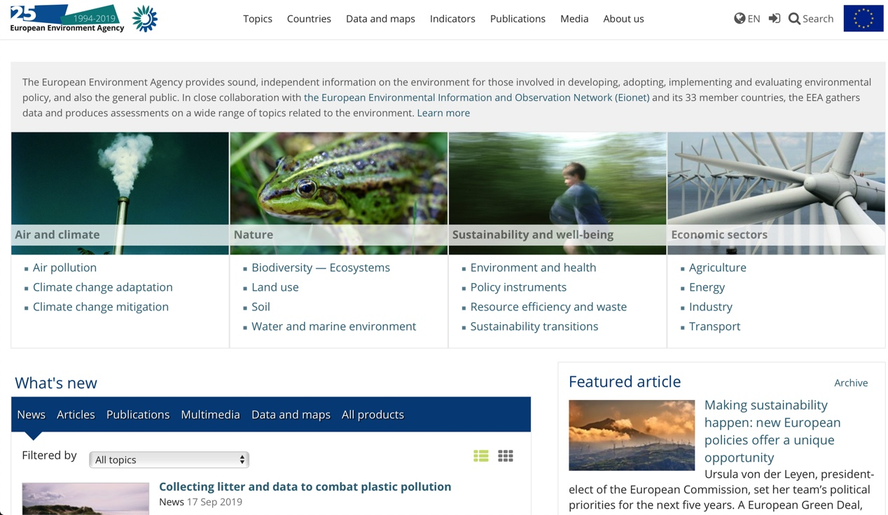
Moreover, other relevant geological (e.g. soil types), environmental (e.g. protected areas under the Natura 2000 directive) and base map data (i.e. coastline and administrative boundaries) were collected from the data catalogue of the European Environmental Agency (EEA; www.eea.europa.eu), making available a wide array of data for environmental assessment and management.

Slide 50
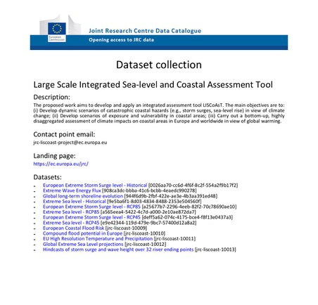
As far as climate forcing contributing to coastal erosion processes is concerned, EU-scale data were collected from the Joint Research Centre Data Catalogue, providing extreme storm surge level and extreme sea level scenarios for the historical period (1969-2004) and future timeframe (2009-2099), according to the RCP4.5 and 8.5 emission scenarios, developed in the frame of the LISCoAsT project (Large Scale Integrated Sea-level and Coastal Assessment Tool; https://data.jrc.ec.europa.eu/collection/LISCOAST).

Slide 51
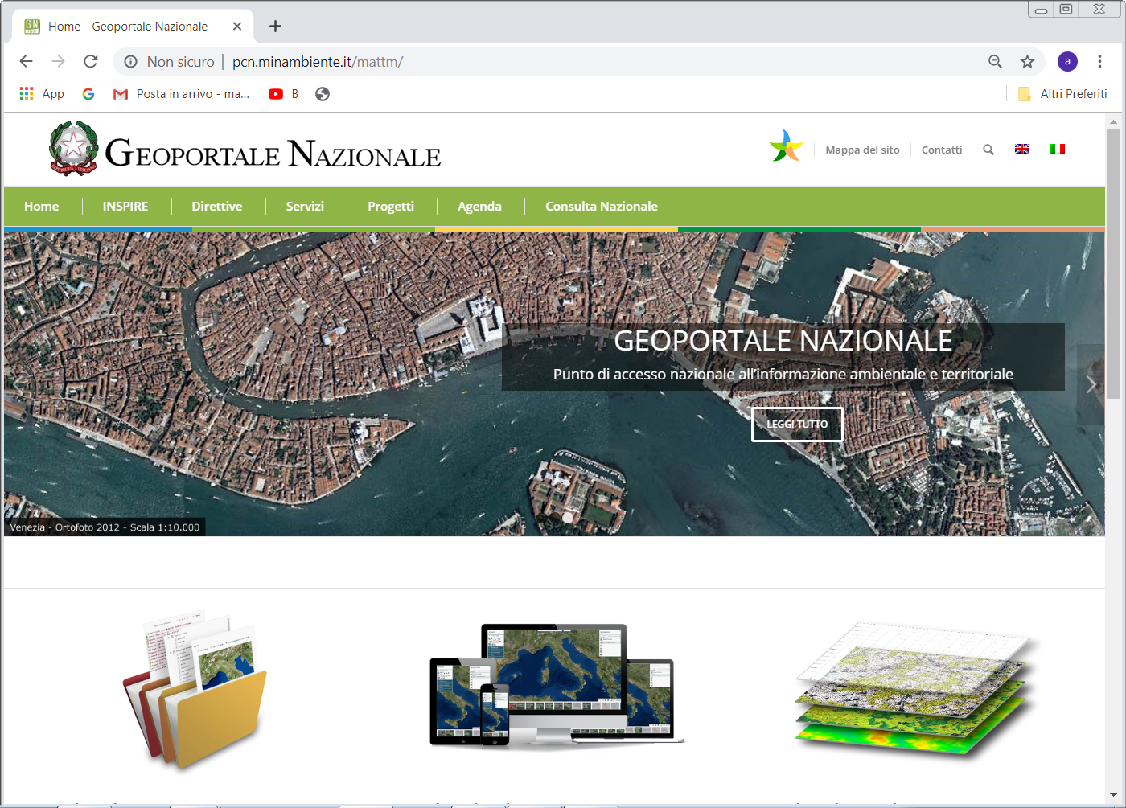
The main source of data concerning the population distribution and age has been the data portal of the Italian National Institute of Statistics (ISTAT; http://dati.istat.it), providing GIS and tabular-based data updated at the 2018 (ISTAT, 2018). More detailed geological and geomorphological information (e.g. coastal types), as well as local scale topographic data for the Apulian shoreline (i.e. Laser Imaging Detection and Ranging – LIDAR data) were instead retrieved from the National Geoportal (www.pcn.minambiente.it) of the Italian Minister of the Environment.

Slide 52
Data type | Spatial domain | Year | Spatial resolution | Time-frame | GIS Data Format | Reference/Link
 |  |  |  | Reference period
Basemap data
Administrative Boundaries | World | 2015 | / | / | Shape | http://gadm.org
Coastline | Europe | 2015 | / | / | Shape | https://www.eea.europa.eu/data-and-maps/data/eea-coastline-for-analysis-1
European Reference Grid | Europe | 2011 | 1 km, 10 km, 100 km (plus 15 km buffer) | / | Shape | https://www.eea.europa.eu/data-and-maps/data/eea-reference-grids-2
Bathymetry | Adriatic Sea | 2018 | 200 m | / | Raster | http://www.emodnet-bathymetry.eu/metadata-amp-data/composite-dtms-catalogue-service#/metadata/SDN_CPRD_145_DTM_CNR-ISMAR-22

Slide 53
Topographic data
Digital Elevation Model (EU-DEM v1.1) | Europe | 2016 | 25 m | / | GeoTIFF | http://land.copernicus.eu/pan-european/satellite-derived-products/eu-dem/eu-dem-v1.1
LIDAR | Italy | 2016 | 15 cm | / | Shape | http://www.pcn.minambiente.it/mattm/en/online-the-new-procedure-for-the-request-of-lidar-data-and_or-interferometric-ps/
Geomorphological data
Erosion of the coast | Apulia region |  |  | 5/10/15 years |  | https://start.linksmt.it/web/guest/coste
Shoreline trend | Europe |  |  |  |  | https://www.eea.europa.eu/data-and-maps/data/geomorphology-geology-erosion-trends-and-coastal-defence-works
 | Italy | 2010 | 1:2000 | / | Shape | http://www.pcn.minambiente.it/geoportal/catalog/search/resource/details.page?uuid=%7BC49FEE18-000C-4B37-B062-E76BCAD5104F%7D

Slide 54
Climate forcing
Sea level | Apulia region |  |  |  | Raster | https://start.linksmt.it/web/guest/coste
Sea temperature | Apulia region |  |  |  | Raster | https://start.linksmt.it/web/guest/coste
Sea salinity | Apulia region |  |  |  | Raster | https://start.linksmt.it/web/guest/costeS
Sea surface currents | Apulia region |  |  |  | Raster | https://start.linksmt.it/web/guest/costeS
Wave height and direction | Apulia region |  |  |  | Raster | https://start.linksmt.it/web/guest/coste
Marine circulation along main ports | Apulia region |  |  |  | Raster | https://start.linksmt.it/web/guest/coste
Extreme Sea Level and Extreme Storm Surge Level | Europe | 2017 | ~ 11 km | Historical: 1969-2004 | NetCDF | http://data.jrc.ec.europa.eu/dataset/jrc-liscoast-10012
 |  |  |  | Future: 2009-2099 under RCP8.5, 4.5

Slide 55
Environmental data
Protected areas | Europe | 2017 | / | / | GeoTIFF | https://www.eea.europa.eu/data-and-maps/data/nationally-designated-areas-national-cdda-13
Transportation of sediments | Apulia region |  |  |  |  | https://start.linksmt.it/web/guest/coste
Soil type | Europe | 2006 | 1 km x 1 km | / | Raster | https://esdac.jrc.ec.europa.eu/content/european-soil-database-v2-raster-library-1kmx1km
Biodiversity/ Natura 2000 | Europe | 2018 |  | / | Raster | https://www.eea.europa.eu/data-and-maps/data/natura-10
Nationally Designed Areas | Europe | 2017 | / | / | Shape | https://www.eea.europa.eu/data-and-maps/data/nationally-designated-areas-national-cdda-12#tab-gis-data

Slide 56
Socio-economic data
Land cover | Europe | 2018 | 500 m | CLC2018 | GeoTIFF | https://land.copernicus.eu/local/urban-atlas
Urban Atlas | Europe | 2012 |  | / | Raster | https://land.copernicus.eu/local/urban-atlas/urban-atlas-2012/view
Settlement | Europe | 2012 (released in 2017) | 2.5 m pixel | 2006-2012 | Raster | https://land.copernicus.eu/pan-european/GHSL/european-settlement-map/esm-2012-release-2017-urban-green
Population and building census | Italy | 2018 | / | 2018 | Shape | https://www.istat.it/it/archivio/104317#accordions
Population projections | Italy | 2018 | / | 2017-2065 | Shape | http://dati.istat.it/Index.aspx?DataSetCode=DCIS_PREVDEM1

Slide 57
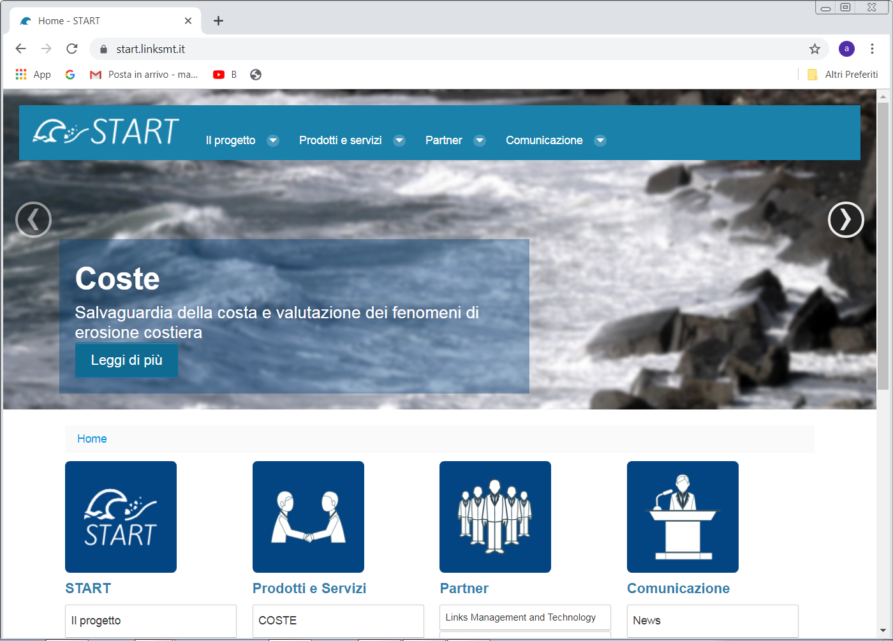
Other useful data were retrieved by exploring European and national projects dealing with the analysis of coastal erosion processes and ICZM (e.g. EUROSION, PEGASO, etc.). Among these, the largest amount of data concerning climate related forcing were retrieved from the web-data portal of the START project (SisTemi di rApid mapping e contRollo del Territorio costiero e marino; https://start.linksmt.it/), a national project aimed at providing a decision support system for coastal and port monitoring and planning activities along the Apulian coasts as well as an early warning system for climate extreme events.

Slide 58
Specifically, the web-GIS of the project makes available a wide array of information including sea and morphological observational data, sea forecast (i.e. height, period and direction of waves, sea temperature, surface currents, wave height and direction, marine circulation along the ports, sea level, sea surface salinity) and atmospheric data (i.e. air temperature, winds to 10 meters, surface pressure, cloud cover, precipitation).

Slide 59
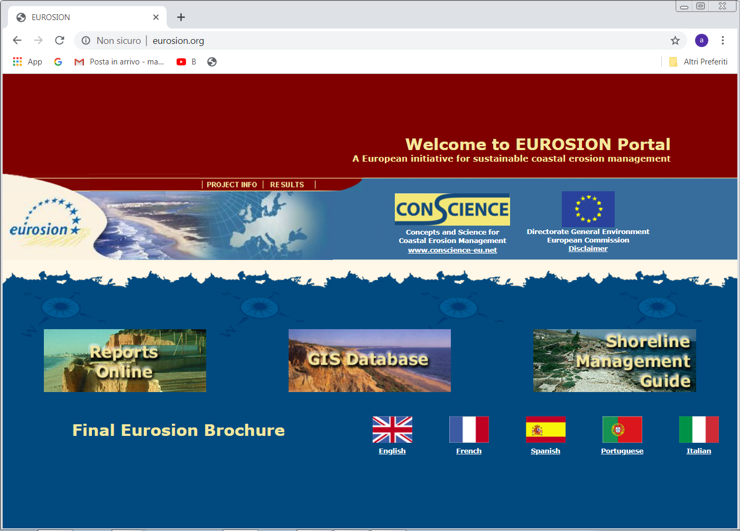
Another relevant source of data has been the web-data portal of the EUROSION project (www.eurosion.org), providing EU-scale environmental data (e.g. sediment flows, shoreline erosion trend, areas of high ecological value), socio-economic information (e.g. localization of main infrastructures and coastal artificial protections, land cover and land cover changes since 1975) and base-map layers (i.e. maritime and shoreline boundaries).

Slide 60
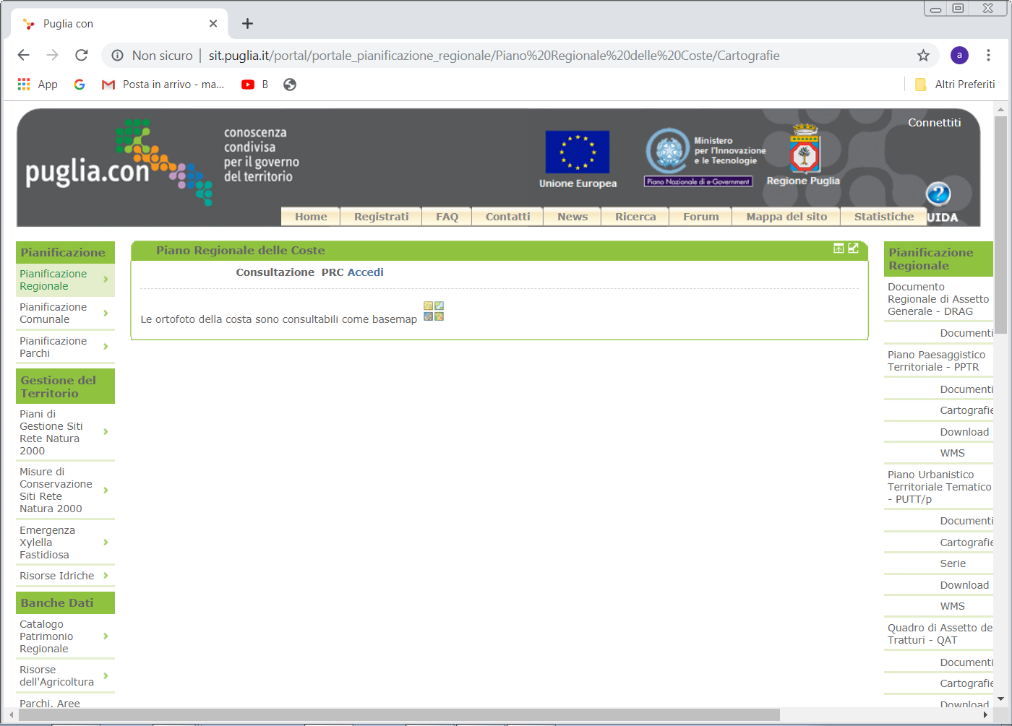
Finally, other local-scale data were acquired from the Regional Coastal Plan (PRC) of the Apulia region, making available in the web-data portal of the region (http://www.sit.puglia.it/portal/portale_pianificazione_regionale/Piano%20Regionale%20delle%20Coste) the GIS-based maps used for the analysis of shoreline evolution in the 2005-2017 timeframe (e.g. shoreline boundaries, hydrological network, land-use).

Slide 61
Thank you for your kind attention!
Michela Cariglia – PM Assistant
ARTI- Regional Development Agency for Technologies and Innovation
lptriton@regione.puglia.it

