Slide 1



USE OF MEMBRANES FOR WATER TREATMENT – PERFORMANCE AND PERSPECTIVES
F.K. Katrivesis¹, V. Sygouni², C.A. Paraskeva², V.G. Papadakis¹
¹ Department of Environmental Engineering, University of Patras
² Department of Chemical Engineering, University of Patras

Slide 2
Introduction
Removal of contaminants in water is required to prevent human health and to protect the environment.
Climate change brings frequent and prolonged droughts.
Engineers are focused on safeguarding water supply.
Use of membranes has become popular in water and wastewater treatment. Membrane separation depends mainly on three basic principles; adsorption, sieving and electrostatic phenomenon

Slide 3
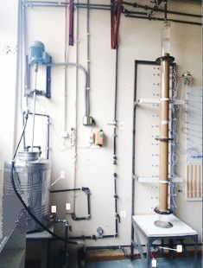
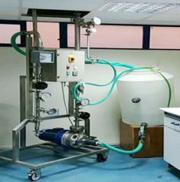
Laboratory Evaluation Study
Aqueous solution was used to simulate the turbidity of the Glafkos River surface water.
Sand column device: diameter: 90mm, filter height: 1500mm; granulometries: 0.6~1 & 1~1.4mm
UF: ceramic, length: 1020mm, pore size: 100nm, surface area: 0.24m².

Slide 4
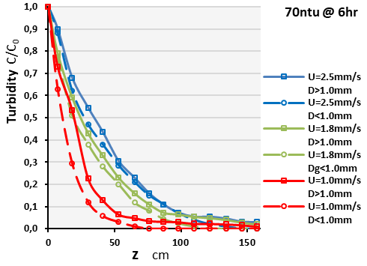
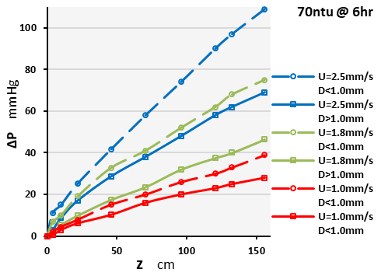
Results

Slide 5
Results

Slide 6
In deep sand filtration experiments, the surface loading of the filter greatly affects the process and the filtration capacity is a decreasing function of the flow rate.
UF unit gave excellent separation capabilities, yielding permeate stream with characteristics of higher quality.

Slide 7
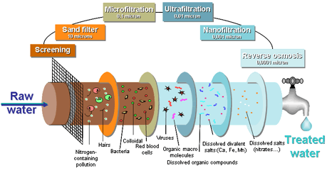
Field Performance Study
Ultrafiltration (UF) with membrane technology:
ensures excellent removal of suspended materials (colloids, solids, bacteria, Cryptosporidium and Giardia etc.).
as a post-treatment stage in the effluent of the activated sludge process, the filtrate is suitable for irrigation without restrictions according to Greek legislation (Quality Requirements according to KYA.145116/2011).
can achieve complete retention of solids and the BOD contained in the activated sludge process effluent.
has small footprint, easy upgrade and upgrading of old sewage treatment plants.

Slide 8
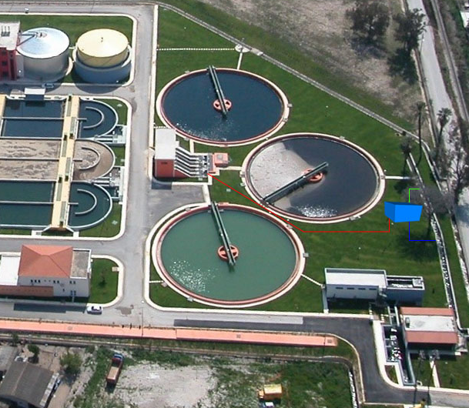
Pilot Installation Site
The membranes used in this process should have pore size suitable for the application and total filtration area capable of producing the required amount of permeate per day.
To reduce fouling phenomena, the membranes must operate in cross-flow mode, and have a built-in back-wash cleaning process. The unit must be fully automated, with pre-programmed cleaning procedures after each filtration cycle, defined by the supplier.
The unit must also have the appropriate piping and pumping systems for its operation and be enclosed in a metal casing for easier transportation and protection of the equipment.
Finally, the membrane unit should have a small footprint making its installation flexible.

Slide 9
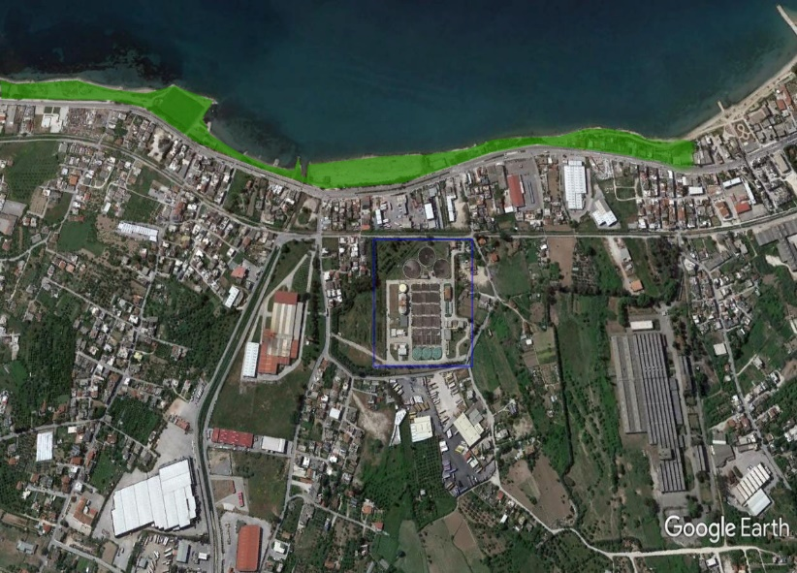
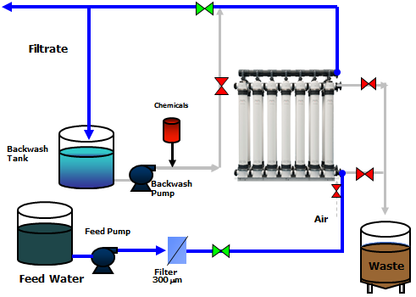
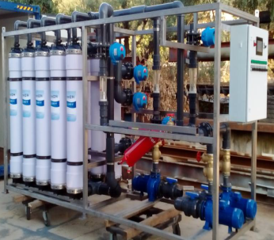
The South Municipal Park near Patras sewage treatment facility with a total surface of 50,000 m² will be irrigated using the treated water with UF membranes.

Slide 10
Acknowledgements
This work was financially supported by the project “Re-Water, Eco-technologies for the wastewater management” which is implemented under the “Interreg Greece-Italy 2014-2020”, co-financed by European Regional Development Fund and Greece.
Thank you for your attention!

