Slide 1



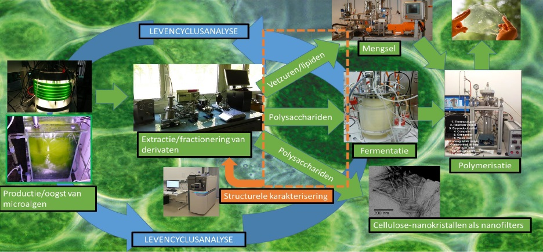
Exploitation of Biomass from Microalgae
for Polymer Materials
Hatice Turgut, Andrea Hufendiek, Laetitia Vlaminck and Filip Du Prez
Department of Organic and Macromolecular Chemistry, Centre of Macromolecular Chemistry, Polymer Chemistry Research Group, Ghent University, Krijgslaan 281 (S4), 9000 Ghent, Belgium
hatice.turgut@ugent.be
Introduction
Triazolinedione (TAD) chemistry was previously used for straightforward functionalization and crosslinking of numerous plant oils as an additive-free strategy.¹ In the context of an interregional project, namely ALPO,
on new polymeric materials from microalgal biomass, we will now extend this concept to lipids extracted from algae. Crosslinking of algae extracts and investigation of their antioxidant properties are targeted.
General Strategy
TAD chemistry
Model Crosslinking Experiments
Reaction of TAD with typical motifs of fatty acid derivatives and linseed oil (equimolar)
Fast, High Yielding
Additive-Free
Visual Feedback
Atom Efficient
 | 1ª | 2ª | 3ª | 4ª | 5^{b}
t [min] | 10 | 35 | 120 | 480 | 1
conversion [%] | ≈100 | ≈100 | ≈100 | incomplete | ≈100
Biomass from Chlorella Vulgaris (CV) has enormous biodiversity.²
The contents of microalgae and linseed oil are similar
crosslinked with ªPhenyl-TAD, ^{b}MDI-TAD
Model Antioxidance Tests
Gallic acid and ß-Carotene are examples of well-known antioxidants
Mixtures of Linseed oil and Gallic acid (LG) were found to exhibit antioxidant properties via inhibiting DPPH radical (left)
Absorbance decrease of DPPH radical upon mixing with algae extracts proves antioxidant properties (right)
As algae absorbs at 515 nm, it presumably contains ß-Carotene
ALPO project
Interreg project: New polymeric materials from microalgal biomass
Uni. de Lille & Uni. de Reims Champagne-Ardenne, Gent University, , AgroParisTech, KU Leuven KULAK, UMONS
Conclusion and Outlook
TAD molecules readily undergo fast and additive-free Alder-Ene reactions with unsaturations in oils, lipids, and fatty acids. This reaction has been used to crosslink linseed oil. As algae extracts have similar content as linseed oil, this method will be used to obtain polymeric materials from fatty acid derivatives from microalgae biomass in the next step. Using model antioxidants such as gallic acid, antioxidant properties of linseed oil and algae were also investigated and will be studied on crosslinked materials in detail.
References
Türünc, O. et al. European Polymer Journal 2015; 65,286-297.
C. Safi, B. Zebib, O. Merah, P.-Y. Pontalier, C. Vaca-Garcia, Renewable and Sustainable Energy Reviews 2014, 35, 265-278.
Acknowledgements
The authors thank the European Union for funding the ALPO project in the context of its Interreg V program.

