Slide 1

What can cities do to grow jobs through the digital transformation of existing industry?
Gävle meeting, TechTown - Transnational Meeting
13 and 14 June 2017
Notes:
Hello, I am Dominique Lestant. I represents the association Auvergne Efficience Industrielle. We bring together companies, research laboratories of higher education and institutional.
I’m going to present the cluster's answer to this question through cluster experience and more widely.
I’ll try my best to speak English, I’m not fluent. Be
Few words about Auvergne Efficience Industrielle : the 3 words of its name perfectly define the association.
Auvergne : middle of France region
Efficiency : Effectiveness at fair costs
Industrial : Any economic activity practiced on a large scale uses industrial means., not only production of manufactured goods. It’s a point of interest, we admit trade, services, leasures … also.
E-cluster : the e of efficiency and electronics.
Association created in November 2013 on the initiative of 3 companies active in data processing for industrial efficiency.

Slide 2
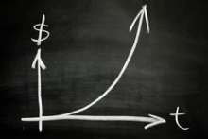

Digital : the third industrial revolution
Nothing will ever be as before
exponential
Transverse
societal
Notes:
Digital revolution ? What does it mean ?
French philosopher and historian of science Michel Serres tells digital looks like advent of language, writing, or printing for humankind.
Luc Ferry (French philosopher) and Jeremy Rifkin (American economic, social theorist, writer) talk about the 3rd industrial revolution (steam, electricity, digital).
An industrial revolution has three common characteristics (1 energy, 2 communication of goods and people, 3 organization of the economy)
1st : steam engine, printing presses, train, textbooks newspapers, working class proletariat.
2nd : electricity, explosion engine, telegraph, radio, TV, worldwide companies.
3rd : green energies, Web, collaborative economics, circular economics, functionality economics.
The peculiarities of digital revolution:
Exponential : transistor 1947, integrated circuit 1958, PC 1980, Internet 1999, smartphone 2007. Storage capacities and information treatments follow Moore’s law.
Transverse : Digital affects all human activities, the economy (industry, finance, commerce, services), education, training, health, mobility, citizenship, energy ...
Societal : Book “Petite Poucette" Generation Y Z, millennials, digital native, net generation, demographic challenges, food, environmental, ...
Exponential increasing symbiosis between each of us and our digital ecosystem. We are Men augmented by digital tools (ubiquity by Webcam, positioning by GPS, action towards our physical environment by smartphones, smartcity, smarthome … and so on.

Slide 3
Knowledge-based economy
Notes:
Evolution of economy over time, after WWII.
3 different period of times. Same features : different keys to success, according to time. First, thirty glorious
Other feature : Reversal of the innovation paradigm. Use towards the technology instead of technology towards use.

Slide 4






Disruptive companies
Substitute for an existing offer
Matching supply and demand
Growth
Notes:
Examples of disruptive companies : GAFAMA Google, Amazon, Facebook, Apple, Microsoft, Airbnb ... Uber, Netflix, Twitter, Blablacar, ...
Appearing in most of economics activities, common features :
1 Substitute to expensive and capitalistic means of production, distribution. Disintermediation, direct customer relationship.
2 Address a global demand using digital tools. Platforms for matching supply and demand. They have an innovative offer, new solution, personalized offer.
3 Reverse the classical business model : study-> production-> distribution-> user in an innovative business model : data provider-> data exploitation-> knowledge of demand-> value. The customer buys products and services, but he also produce data, and data is value. So, customer becomes “prosumer” (contraction between producter and Consumer) according to Joel de Rosnay.
4 Digital transforms relationships in the company, and from the company to its ecosystem. From the balance of power (hierarchy, power) to the relationship of flow, exchange, collaborative (Blue Ocean Strategy 2005, Chan Kim and Renée Mauborgne, researchers at INSEAD, creation of a new demand in a strategic space Challenged), in exacerbated competition, in a knowledge-based economy.
5 Produce at marginal cost 0 or at least decreasing. The marginal cost is the cost induced by an additional unit produced. Economist Jeremy Rifkin in his book 2014 "The New Society of Marginal Cost Zero" demonstrates that the low cost of disseminating information changes the economy (books, music video)
6 Unparalleled growth and a kind of monopoly.
Example Jean Dominique Senard, Michelin president “We are more afraid of a startup which could revolutionize the mobility than our 200 competitors, who are known to us as tire manufacturers”.
So digital revolution concerns each enterprise, the baker at street corner to the mobility world leader.

Slide 5

What has be done to grow jobs ?
Answer :
Why it works :
  The idea must come from entrepreneurs,
  Institutional provides infrastructure, funding,
  Institutional sets goals,
  Instead of structuring a sector, the collective federates different skills,
Troubles :
  Collaborative
  Time
  Cultural problem
Results :
  From 3 to 28 members,
  33 innovative collaborative projects,
  Technical days,
  Relationship between companies and companies with higher education laboratories,
Notes:
Conclusion :
Members companies improve 5 to 15% annual growth, result or reason ?
Laboratories develop news research programs, get more funding and produce more scientific publication.
Institutions play their role to make entrepreneurs want to digitalize. To clarify : providing infrastructure (fiber, roads, airports and anything else to ease economy), communicating, and boosting economy.

Slide 6
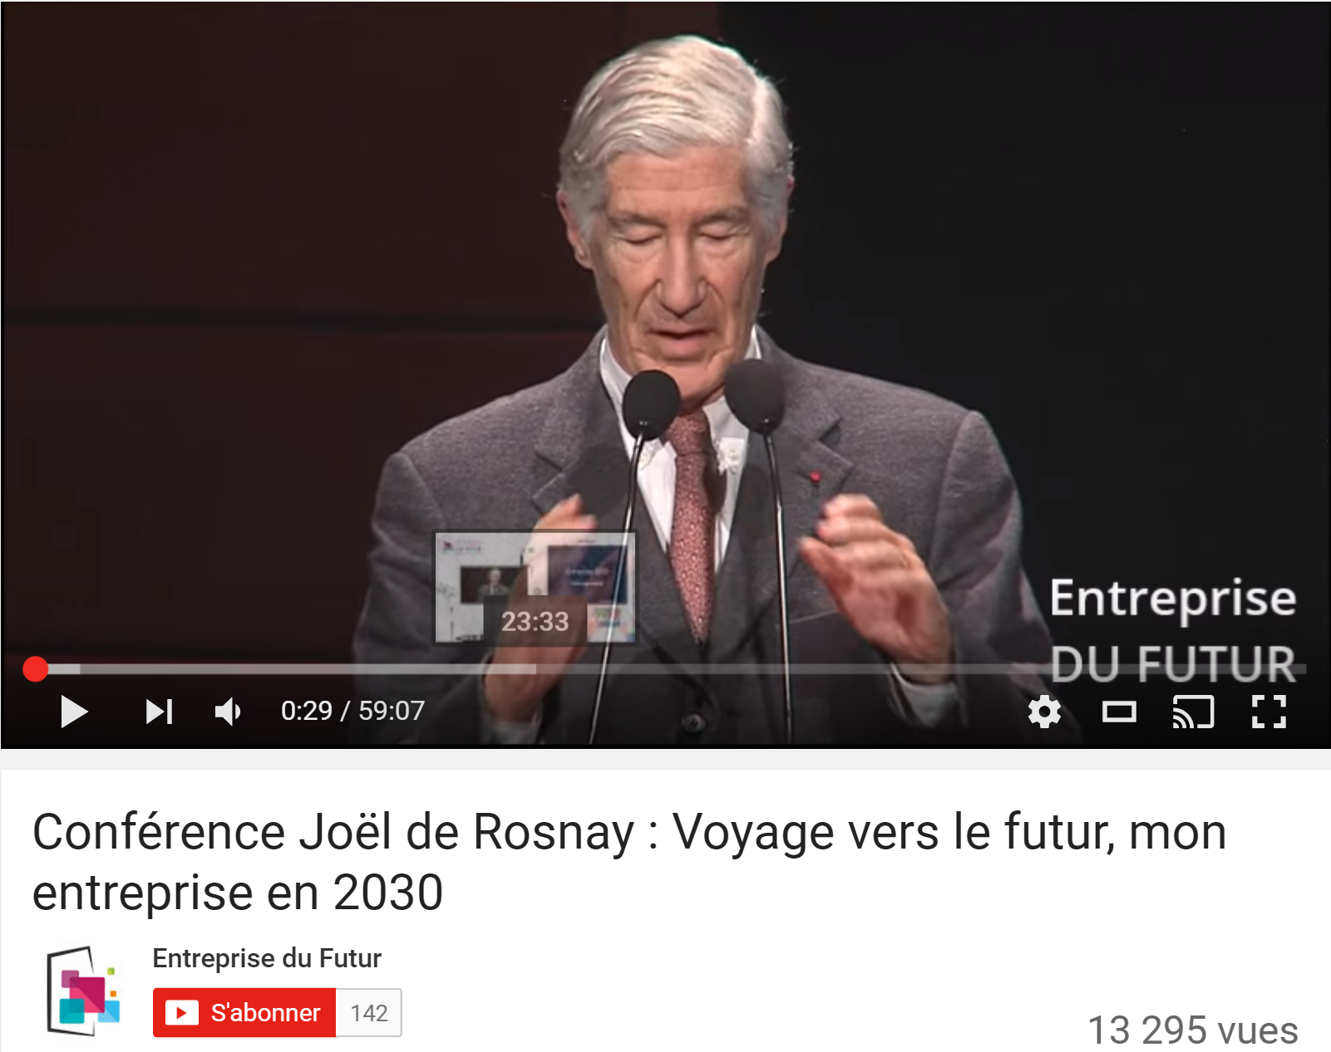
Inspiring talks
https://www.youtube.com/watch?v=xxOh4ATAREg Joel de Rosnay
https://www.youtube.com/watch?v=2TzmbJdk14Q Michel Serres
http://www.hauteloiredeveloppement.com/ Luc Ferry
Notes:
More details, I invite you to have a look about these inspiring talks.

Slide 7




  Tel +33 4 73 19 62 63 mob +33 6 509 505 18
Dominique.lestant@e-cluster.fr
www.e-cluster.fr
Notes:
Thanks for your attention.
Supported by FEDER, French government, Auvergne-Rhône-Alpes Region.

