Slide 1

DIGITAL TRANSFORMATION
OF TRADITIONAL INDUSTRY
Tech Town, Gävle June 14th 2017
Peter Nordqvist

Slide 2

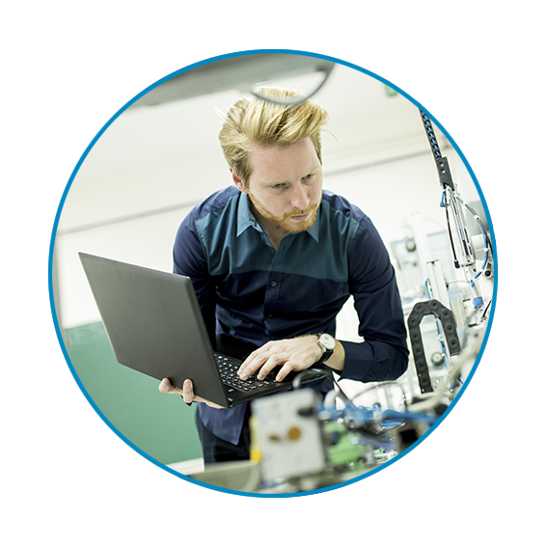
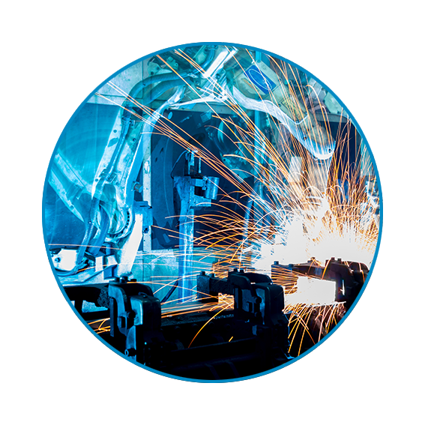

FINDIT IN A NUTSHELL
IT-cluster financed by community-,
regional-, and national authorities
Active mainly in the regions Gävleborg and
Dalarna
4 employees
The ”HQ” is in the science park Sandbacka Park, in Sandviken. 2 small offices in Borlänge and Hudiksvall too
Founded by Sandvik and Sandviken 11 years ago

Slide 3

FINDIT´S GOAL
By (usually) working as a “coupling device”, i.e. connecting problem owners with problem solvers, we support the creation of sustainable competitive SMEs and value chains through industrial IT!

Slide 4
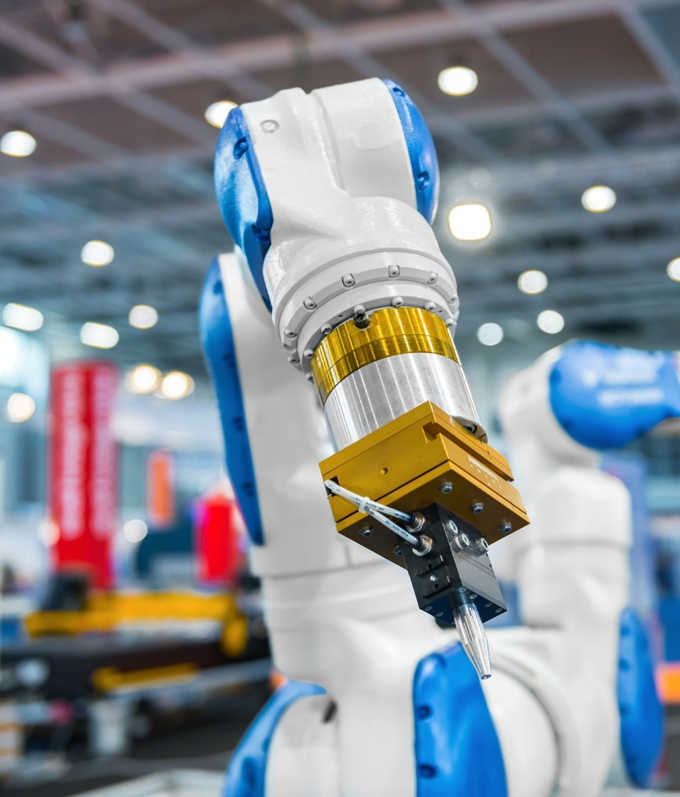
INDUSTRIAL IT (as we define it)
VAD ÄR INDUSTRIELL IT?
IT used industrially to collect and manage data at different levels
IT used to control administrative and physical flows, both internally and externally (e.g. in the value chains)
IT for streamlining and optimizing processes (e.g. production and logistics)
IT support for exchanging information to enable resource optimization in the entire value chains

Slide 5
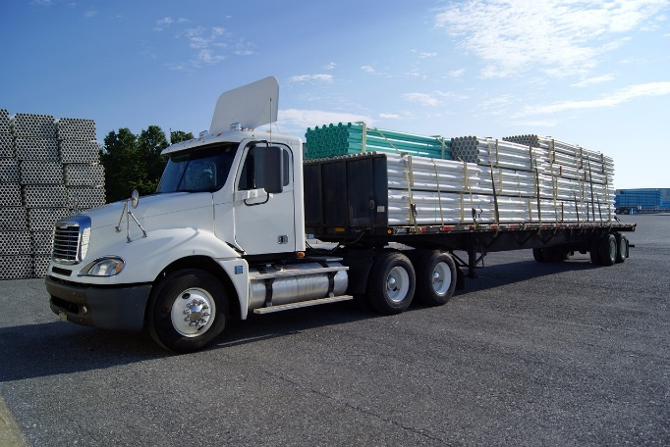

VALUE CHAIN
(as we define it)
The series of activities that create and build value at every step in an entire production chain
All nodes are independent with own agendas, goals etc
Goods and information flow in the chain
Industrial IT supports this networking
Raw Materials
SME / Subcontractor
Process Industry
End Customer

Slide 6
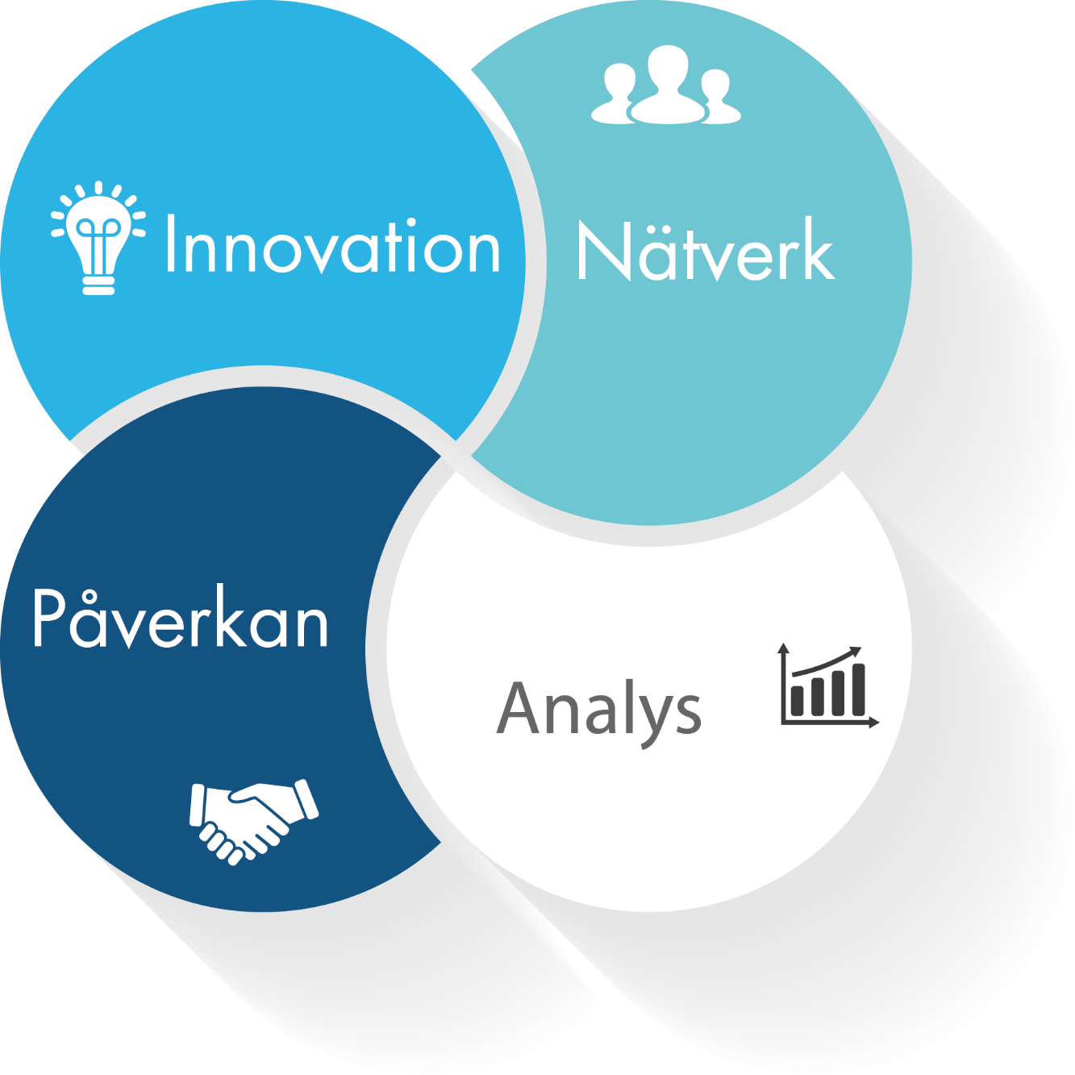
FINDIT´S FOUR MAIN
ACTIVITIES/TOOLS
Innovation – Applications, projects
Networking –
IT-manager/Gamification/SME/Female
Influence –
Referral body, policy making
Analysis –
Inventories (SME, IT-suppliers)
Innovation
Networking
Influence
Analysis

Slide 7
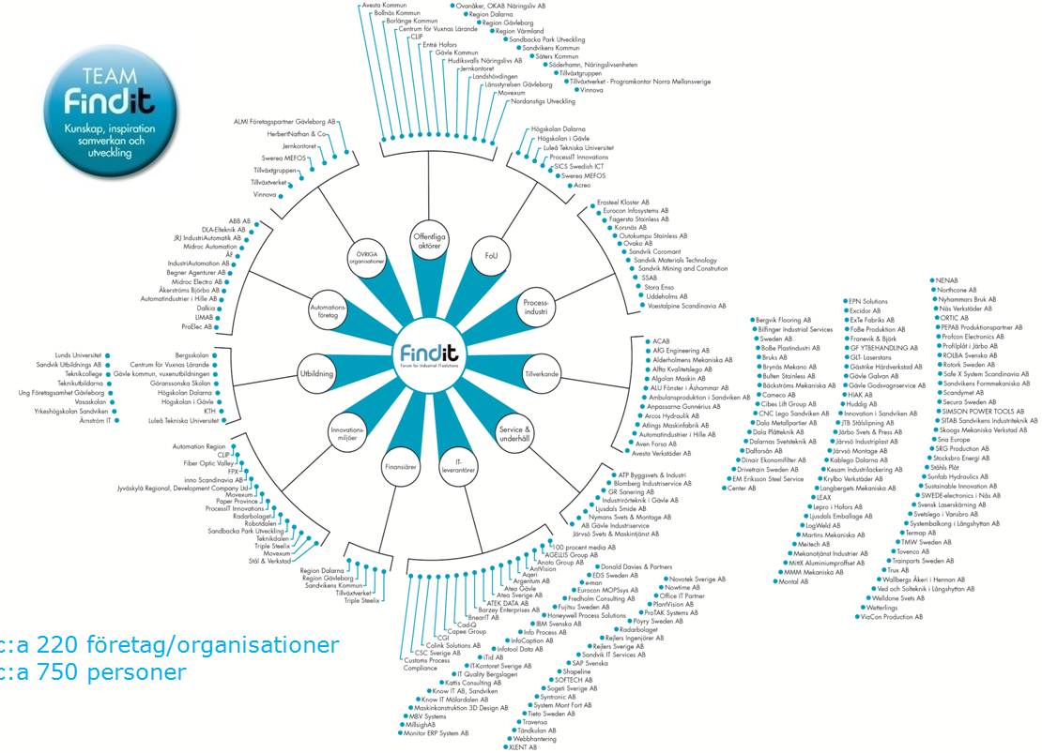

FINDIT´S NETWORK
400 Team FindIT member organizations including 950 contacts in our CRM-system!
(170612)
Monthly letters, invitations….
Targeted searches/mailings/
requests…

Slide 8

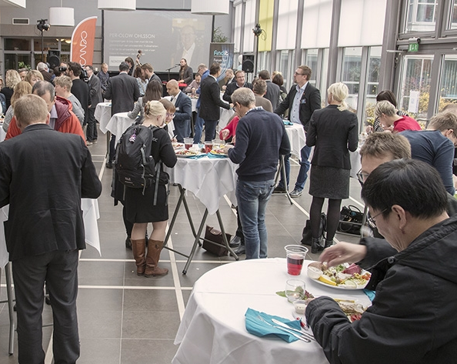
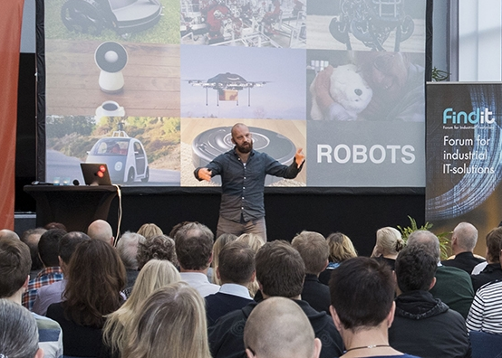
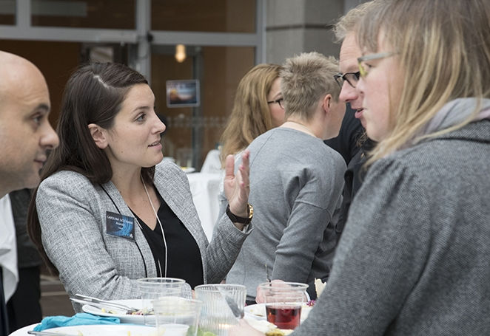
October
25th
2017
Sandbacka
Park
findit-solutions.se/it-forum
IT-FORUM - FINDIT´S ANNUAL BUSINESS DAY
Last year around 180 visitors
Around 20 seminars and lectures
Around 20 stands in an exibition area
Networking

Slide 9

DIGITAL TRANSFORMATION OF TRADITIONAL INDUSTRY
Lasse Aspelin - Stora Enso, presents a gamification project – before/during/after the implementation. The first project is now followed up by a second….
Roland Andersson - Sandvik, Arnfinn Fredriksson - Movexum, Johan Soläng - Invotech will describe how a multinational corporation, a startup incubator arena and an IT supplier (plus a few more) together found a solution to a tricky logistics problem, plus how this led to other new innovations/business ideas….
Ola Wallberg - Fiber Optic Valley, presents a national program for supporting the digital transformation of SMEs. The goal is set high in terms of number of participating companies….

Slide 10






NÄR NI VILL NÅ OSS
THANK YOU!
info@findit-solutions.se
www.findit-solutions.se
026-24 17 57
Finansiärer

