Slide 1

Notes:
Welcome back to some of you and Welcome to TechTown to some of you who meet up with the project for the first time!
Thank´s again for yesterday and last night – impresseing performances at the Pre-Midsummer Games and a win for ”The Latin Lovers”!
I promised you yesterday to give you an introduction to Gävle and here it is, I´ve also been asked to reflect on our previous Urbact project – ESIMeC and will do so before I hand over to Ulf to present on the TechTown project in Gävle - before we arrive to the focus of today – with presentations on todays theme: Job creation throught the digitalisatioin of existing businesses – with examples from both Gävle and other TechTown partners.

Slide 2
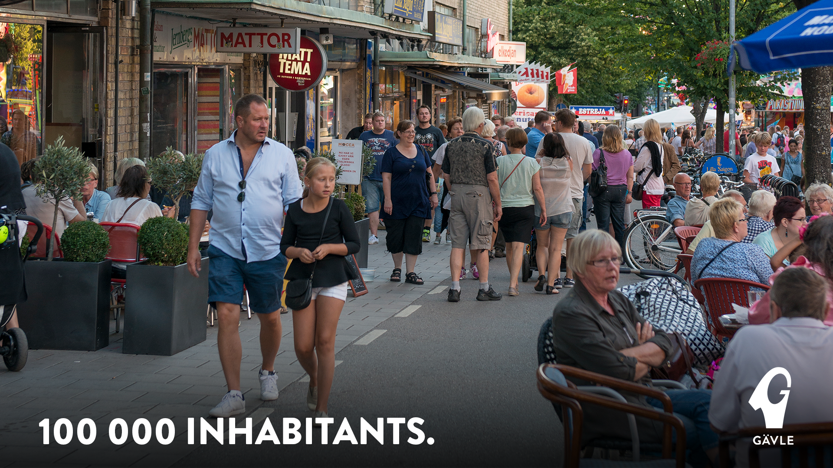
Notes:
Growing city – 100 000 inhabitants since April! Appr 1000 new inhabitants/year – planning for 120 000 in 2030. Growth due to: positive birth numbers, people moving into Gävle from surrounding areas/the region (smaller towns), new arrivals - refugees
Growth puts even stronger emphasise on:
JOB CREATION
HOUSING – 10 000 units 2030…
EDUCATION – not a strong tradition in education, strong industrial region – we used to be able to go directly into work withouth too much education, that has changed but it takes time to change the attitudes towards education – I will talk more about that when I get to ESIMeC
INTEGRATION – need to get it right, get our new Swedes into work/education and the society as soon as possible

Slide 3
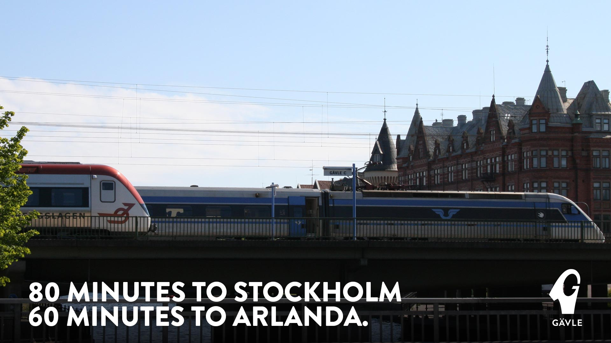
Notes:
Good, strategic location – reason why people settled here in the first place and we became a city in 1446 – junction of the sea/river, main railways, motoirways and the national airport only 60 min away

Slide 4


Slide 5
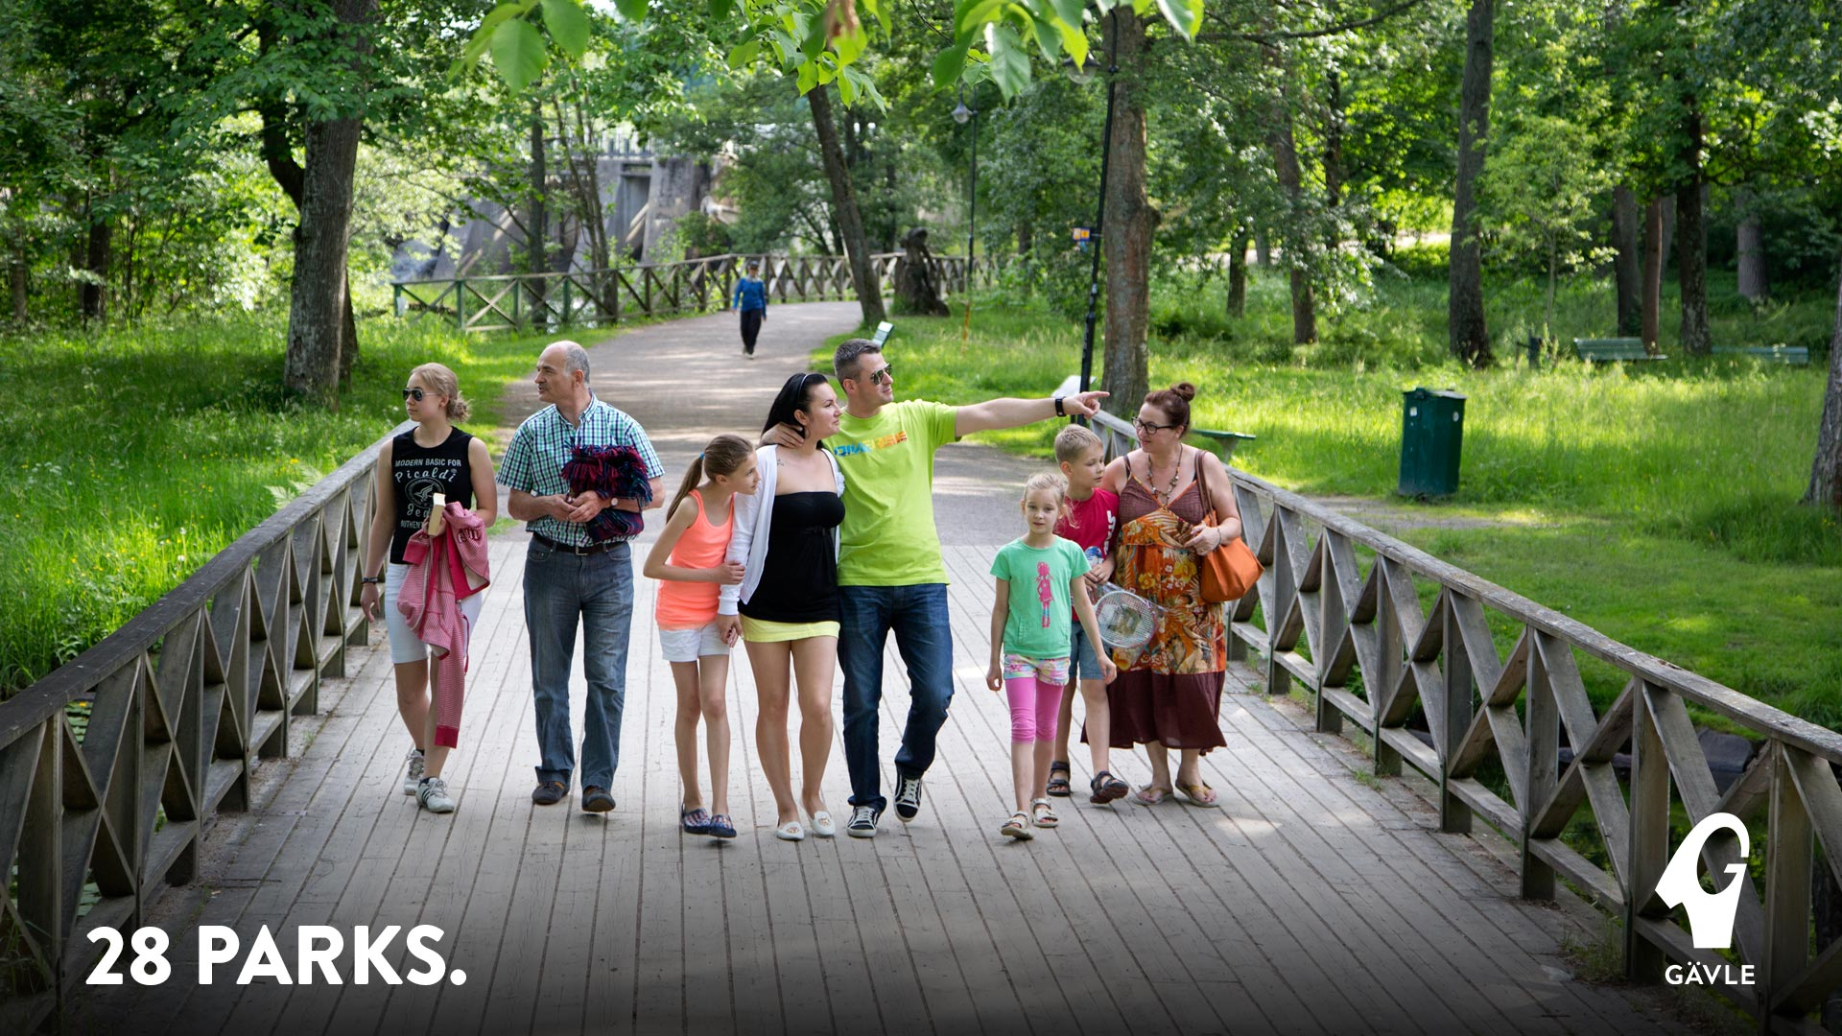
Notes:
Green & Sustainable Smart City - Award winning: Super municipality, Good Living, Best Accessibility, European Mobility Award, GIS Capital of Europé…

Slide 6
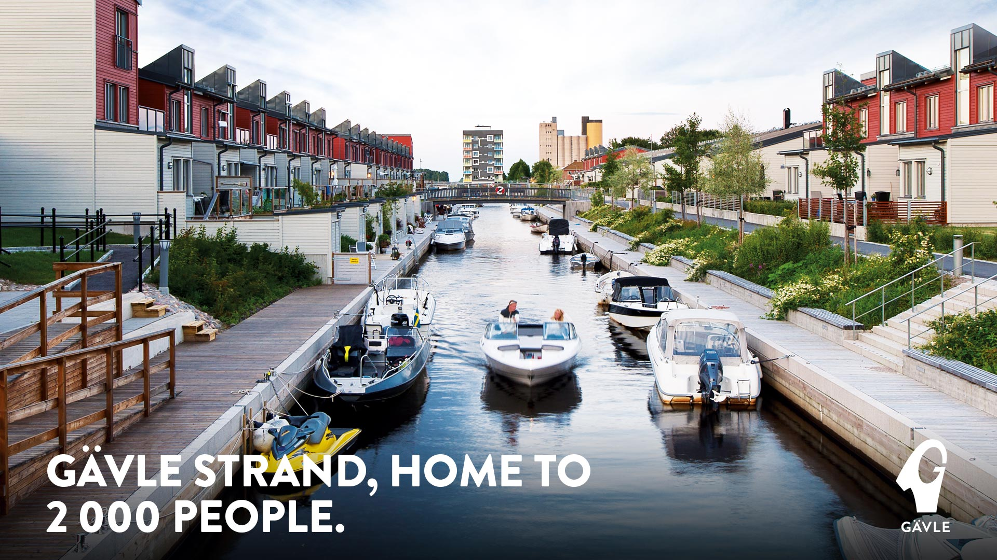

Slide 7
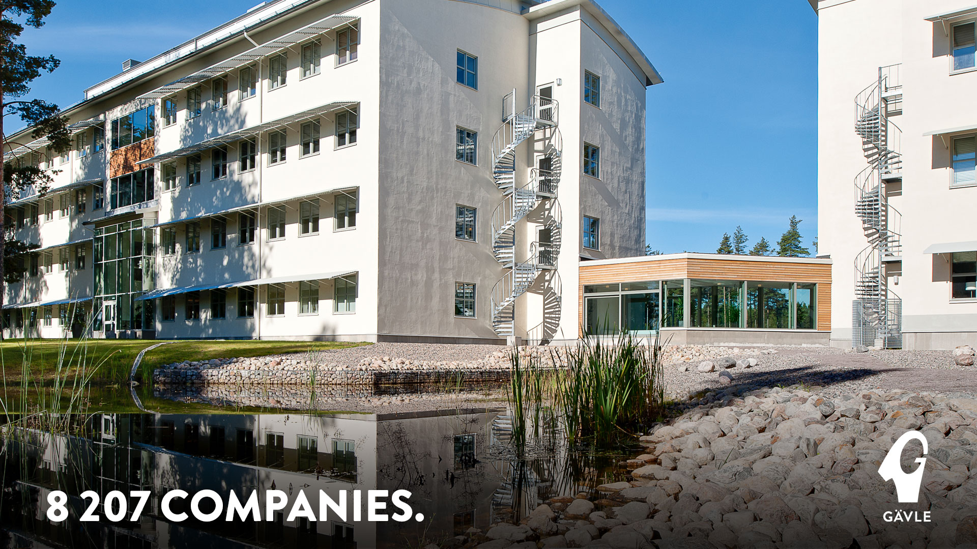

Slide 8
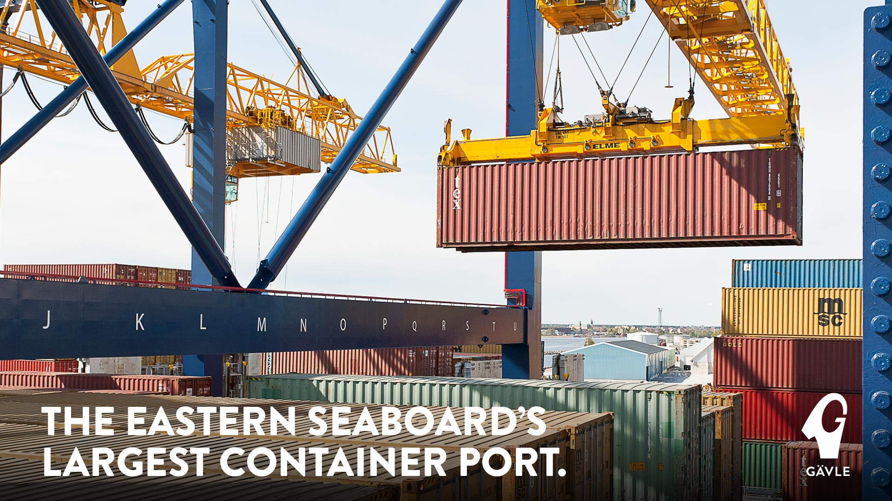

Slide 9


Slide 10


Slide 11






Cluster initiatives
Notes:
Infrastruktur – bostäder, mark och lokaler, att bo på platsen man verkar – samhällsservice av hög kvalitet, kommunikationer
Kompetens – rätt kompetens och rätt utbildning, Företagarservice
Ledarskap och attraktion – stolthet, varumärke, storytelling
Hur gör andra? – Vi behöver träffas och samarbeta i Gävle, vad görs på annat håll i Sverige och andra länder

Slide 12

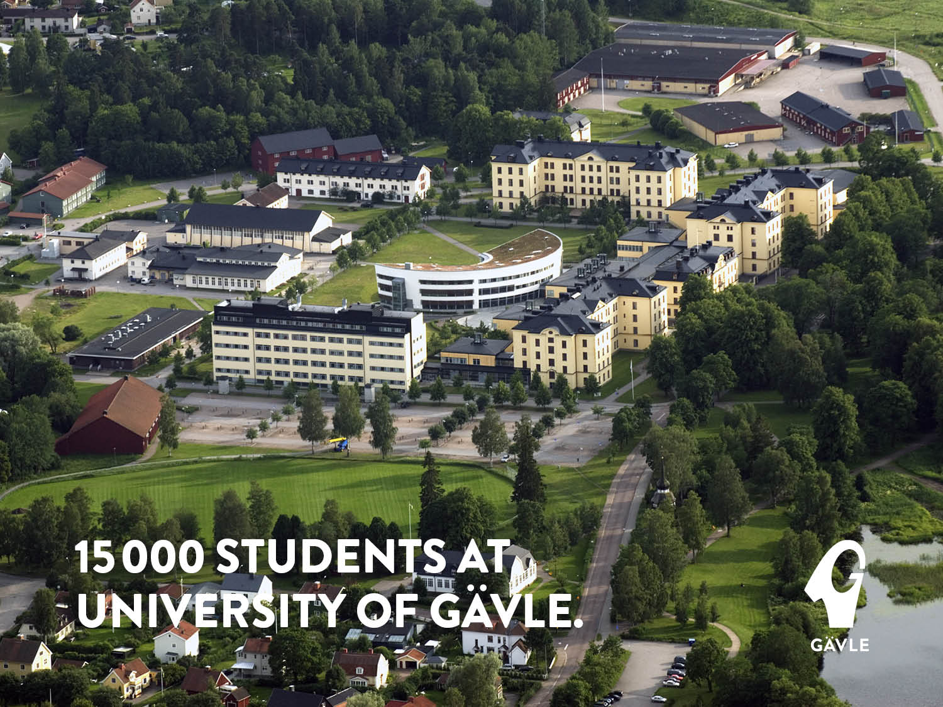
Notes:
Three faculties:
Engineering and Sustainable studies
Education and Business studies
Health and Occupational studies

Slide 13


Slide 14


Slide 15
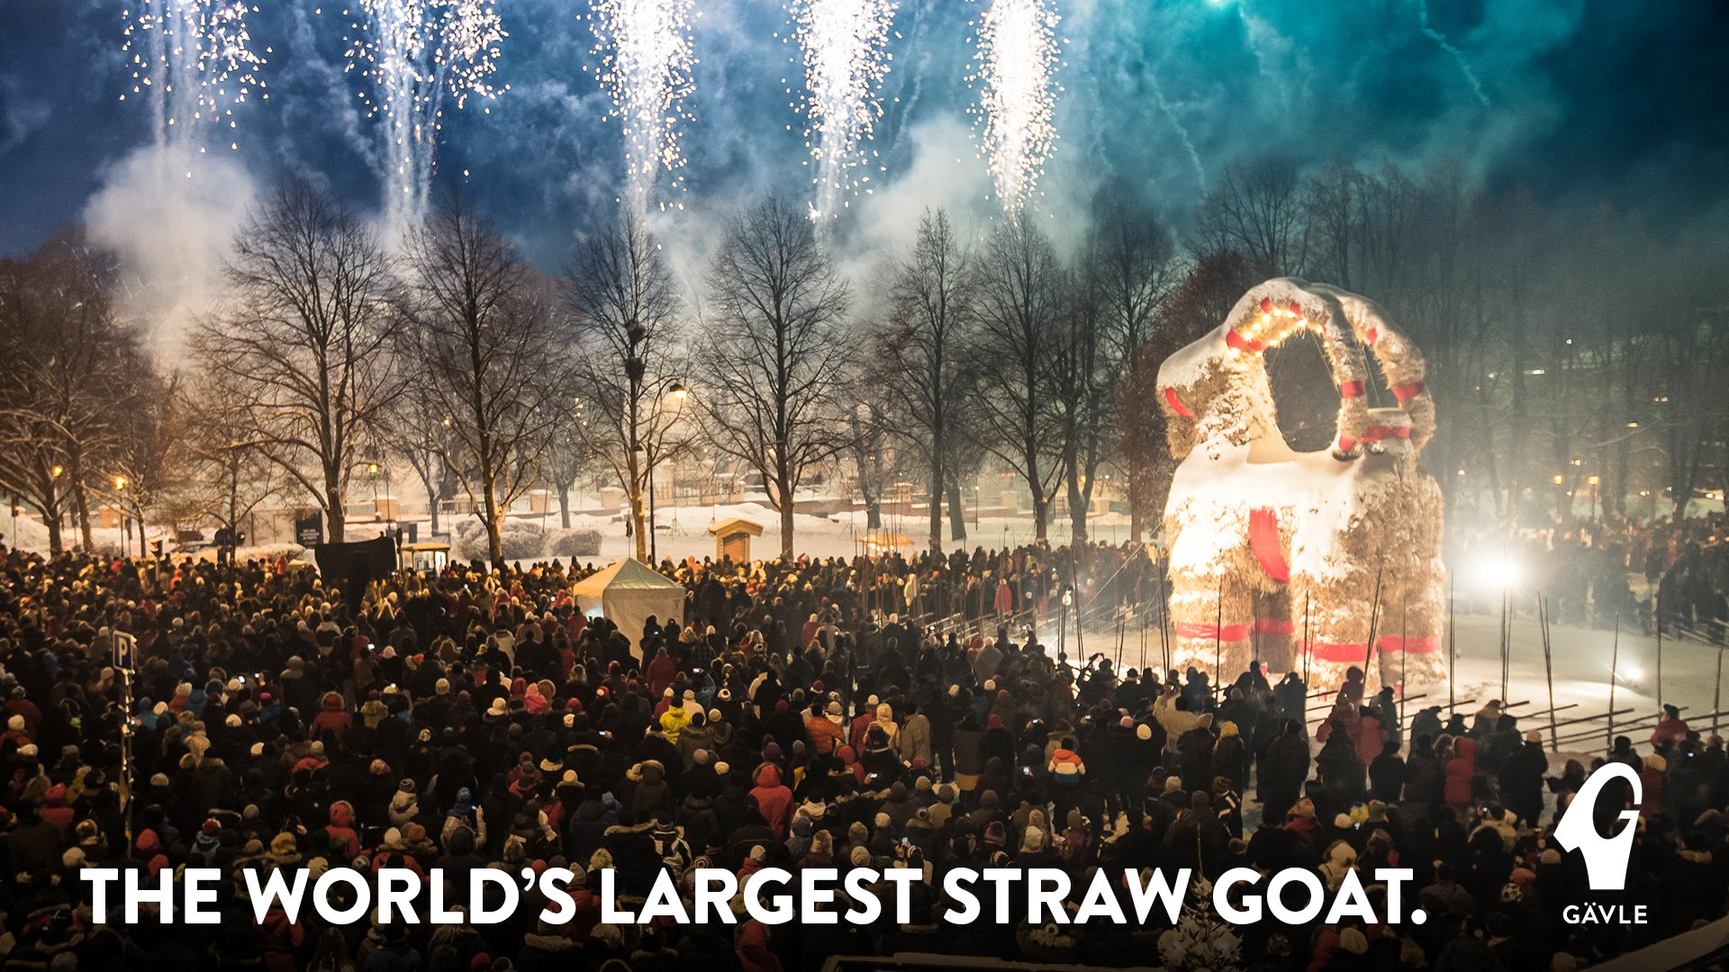

Slide 16

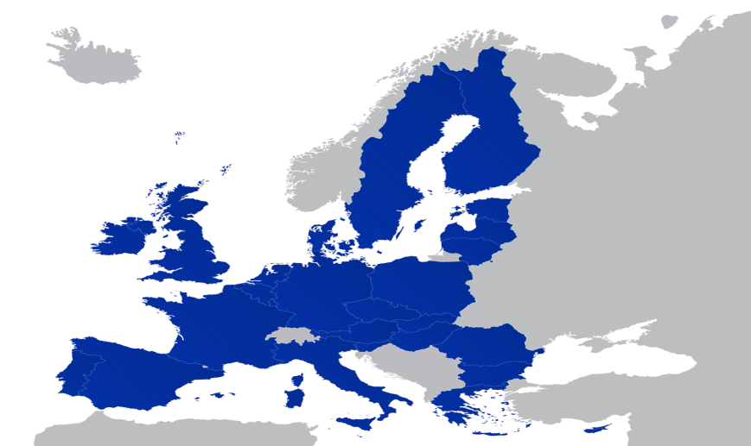



Gävle – ESIMeC, some reflections
”Preparing young people for the world of work”
Notes:
Changing attitudes towards education in order to make it more relevant to the labour market and reach a higher level of education in the population
Changing attitudes towards education in order to make it more relevant to the labour market and reach a higher level of education in the population
Målet med denna plan är att genom samordnade insatser påverka och stärka unga och vuxnas attityder och intresse för ökad utbildning
Det konkreta målet för den lokala handlingsplanen (LAP) är att öka kunskap och insikt hos Gävles skolor, personal, och elever och föräldrar om arbetsmarknadens utseende och villkor, om vikten av utbildning för att skapa framtida livsval, och om den viktiga kopplingen mellan utbildningsval och framtida yrkesmöjligheter. Detta är en viktig pusselbit för att på sikt både öka utbildningsnivån och för att skapa en bättre matchning av kompetens mot arbetsmarknadens framtida behov.

Slide 17

Process
Follow up
Learnings
Notes:
Create an arena and a systematic process where Labour market and public sector stakeholders develop together a clear picture of future competence needs at local and regional level
Education, key to work and posisbilities of choice in life
Goal of LAP – through coordinated actions influence and strenghten youth and adults attitudes towards and interest for education
Process: problem definition, stakeholder mapping… build on existing initiatives, slow process – intense final step when producing the LAP, Celebration and signing of MOU – good idea! Municipality in charge of follow up, inviting all stakeholders to update meetings every 6 months during the implementation period 2013-2015
Follow up – two years after end of implementation of LAP: all actions but one implemented – and that one will hopefully be put into action this year – sometimes it takes time! New actions have been developed/born out of ESIMeC actions – cooperation between stakeholders increased and become more structured over time.
Long term ongoing work & priority!
Learnings:
- Coordinated strategic development work,
- Development of structures and processes
- New knowledge and experiences
- Coordination of resources
- Faster development – pressure to deliver
- Increased internationalisation, new networks
- Contact managing authorities (Tillväxtverket, ESF…)
17

Slide 18
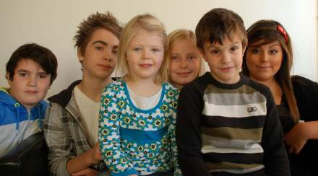
ACTION 1 – Competence Centre Gävle
ACTION 2 – Skills index
ACTION 3 – Labour market and education knowledge
ACTION 4 – Information from the Employment Office on the labour market in Gävle and its region
ACTION 5 – PRAO – work experience scheme
ACTION 6 – Model for study visits in local businesses and workplaces for students, teachers and school principals
Notes:
Create an arena and a systematic process where Labour market and public sector stakeholders develop together a clear picture of future competence needs at local and regional level
18

Slide 19
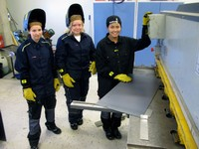
ACTION 7 – “The Rope” companies in schools
ACTION 8 – “The Rope” Ambassadors
ACTION 9 – Young Entrepreneurs scheme in all upper secondary programmes
ACTION 10 – Future plan for pupils in pre- and elementary schools
ACTION 11 – Youth In, youth establishment in the labour market
ACTION 12 – Feasibility study on a “Future Fair”
Notes:
Create an arena and a systematic process where Labour market and public sector stakeholders develop together a clear picture of future competence needs at local and regional level
19

