Slide 1


Fifth Transnational Event
Gävle – March 2017
Notes:
Tracey to introduce

Slide 2
Our Key Question
What does your city do – or plan to do – to grow jobs through the digital transformation of existing businesses?

Slide 3

Linked questions….
What can cities do to support digital transformation of traditional industry and existing businesses?
How can they ensure that 'digital' is an opportunity (and improves productivity) and not a threat to existing industry?
What is the role of cluster policy?
How can cities help / motivate traditional small businesses to digitalise?
When can we say a company has gone through digital transformation?

Slide 4






Question time
Czas na zapytania
Klausimų valanda
Jautājumu laiks
Kérdések órája
H ώρα των ερωτήσεων
Frågestund
Turno de preguntas
L'heure des questions
Doba vyhrazená pro otázky
Vprašanje časa
Kyselytunti
Spørgetid
vragenuurtje
Hodina otázok
Questão de tempo
Infotund
Ora interpelărilor

Slide 5

Time for a cuppa…

Slide 6
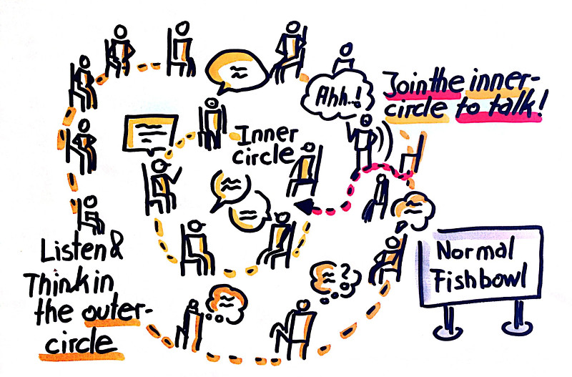

Slide 7
Capturing the learning
Work with people from your city
What have you learnt?
How is it relevant to your own challenges and Integrated Action Plan?
How will you use the learning? What will you do differently between now and the next meeting? & longer term?

Slide 8
Question time
Czas na zapytania
Klausimų valanda
Jautājumu laiks
Kérdések órája
H ώρα των ερωτήσεων
Frågestund
Turno de preguntas
L'heure des questions
Doba vyhrazená pro otázky
Vprašanje časa
Kyselytunti
Spørgetid
vragenuurtje
Hodina otázok
Questão de tempo
Infotund
Ora interpelărilor

