Slide 1


Fifth Transnational Event
Gävle – June 2017
Notes:
Tracey to introduce

Slide 2
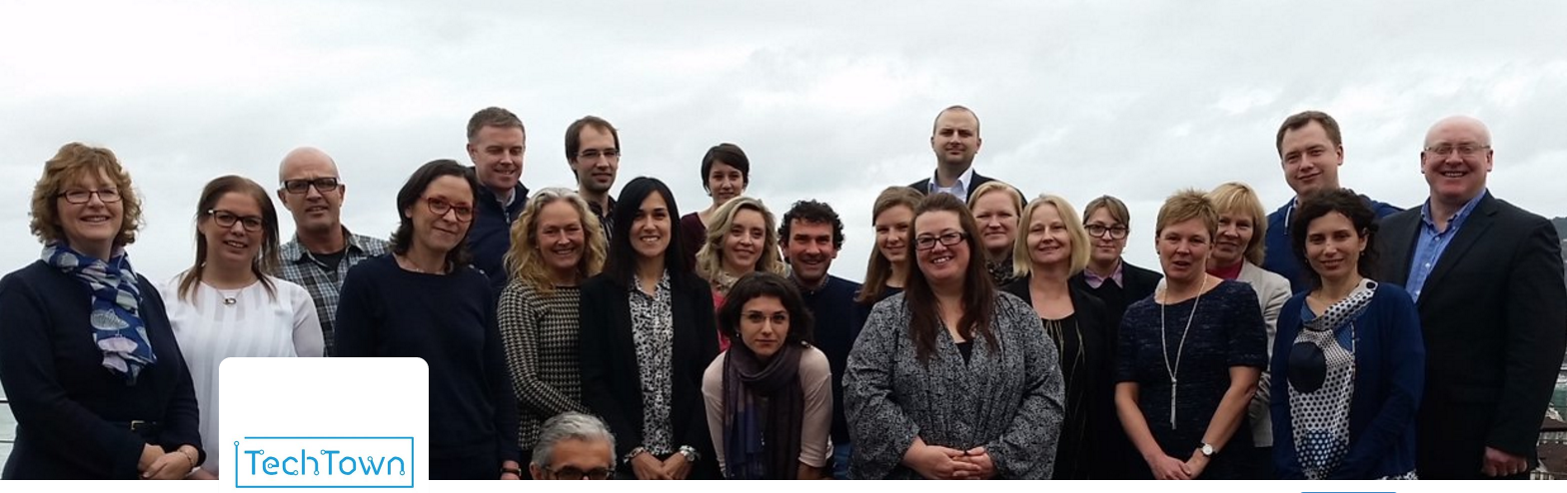
Introductions
#TeamTechTown

Slide 3
13 June 2017
09:15 | Welcome & introductions
09:30 | Setting the scene
09:45 | Getting back in the room - Review of city actions and progress since Barnsley
11:00 | Break
11:30 | Mid Term Review Workshop
12:30 | Lunch
Notes:
Run through programme
Reminder that TN meetings will be a mixture of thematic content, work towards IAPs, TN exchange
Reminder re. Podcast – please be prepared for AP & Ceri to accost you with microphone

Slide 4
13 June 2017
14:00 | Mid Term Review – conclusions & Action Planning
15:00 | TechTown Space Update
15:30 | Break
16:00 | Partnership meeting – ULG Coordinators only Discussion of Dubrovnik meeting (26 & 27 September) (Growing digital jobs through the Smart City Agenda) Dates for Loop City meeting (23 & 24 November) (The role of the City and Action Plan Peer Reviews) Finance and Claims Initial discussion of TechTown & local dissemination events Any other business
17:00 | Close
18:30 | Meet for dinner
Notes:
Run through programme
Reminder that TN meetings will be a mixture of thematic content, work towards IAPs, TN exchange
Reminder re. Podcasts and Prezis’ – please be prepared for AP to accost you with microphone

Slide 5

Back in the room…..
TechTown
Thematic Focus & Conclusions so far
Notes:
Back to the serious stuff – short reminder of where we got to

Slide 6

Thematic Focus
Understanding
Digital
Digital Jobs
Governance – the role of cities
Digital
Talent

Slide 7
Thematic Focus
Better understanding the digital economy
Growing digital jobs
Growing new digital jobs through start ups and existing businesses
Growing jobs through the digital transformation of traditional industry
Growing digital jobs through the smart city agenda
Providing spaces and places for connections
Finding, growing, retaining and returning talent
Notes:
Theme
Better understanding the digital economy
How can cities identify their digital community?
How to others define 'digital jobs' and is it helpful to pin down a precise definition?
What tools already exist which can help to measure existing and future growth potential?
What new metrics will be needed to measure city interventions?
Is there scope to develop a tool for TechTown cities to help with this?
Growing new digital jobs through start ups
What can cities do to support digital start ups?
How can cities better position themselves to optimise the conditions for competitiveness?
What sort of business support do digital start ups want and need?
How can cities help start ups to survive and to grow?
Growing jobs through the digital transformation of traditional industry
What can cities do to support digital transformation of traditional industry and existing businesses?
What is the role of cluster policy?
(How can cities help small family (retail) businesses?)
Growing digital jobs through the smart city agenda
How can cities ensure that they maximise the local jobs creation potential linked to delivering smart city agendas?
How can they avoid larger multinationals reaping all the rewards?
What role could local city challenges, hackathons play?
What role could public procurement play?
Providing spaces and places for connections
How important is it to have a physical space for the digital community? What does this space look like? What is the accompanying 'offer' in terms of business support, incubator or accelerator support? What is the unique position of medium sized cities?
Finding, growing, retaining and returning talent
How can medium sized cities attract and retain (young) skilled people?
How can they position themselves so that people want to live and work there?
What can cities do to better match education and training provision with the needs of the digital economy (now and in the future)?
How can they avoid losing out to larger regional and national 'hubs'?

Slide 8
Transnational workplan
Date | Host | Thematic Focus
June 2016 | Basingstoke | Better understanding the digital economy
September 2016 | Limerick | Growing new digital jobs through start ups & SMEs
November 2016 | Cēsis | Finding, growing, retaining and returning talent
March 2017 | Barnsley | Providing spaces and places for connections
June 2017 | Gävle | Growing jobs through the digital transformation of traditional industry
September 2017 | Dubrovnik | Growing digital jobs through the smart city agenda
November 2017 | Loop City Copenhagen | Action Planning for the digital economy
Spring 2018 | To be confirmed | Final Dissemination Event A Digital City Future: Adapt or Die Lessons from TechTown
Notes:
Can we set a date for Cesis now?

Slide 9
What does a TechTown
look like?
What assets does it have?

Slide 10
What does a TechTown
look like?
WorkSpace

Slide 11
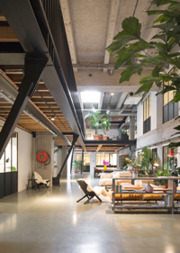
A TechTown has...1) WorkSpace
....of & for the digital community
  Incubators, accelerators, co working spaces
  Design
  Community
  Co location of other services / attractions
  Differences not similarities – places have meaning; spaces don’t – there are lots of ‘anywhere’ towns
  Coffee, pizza & beer!

Slide 12


Slide 13
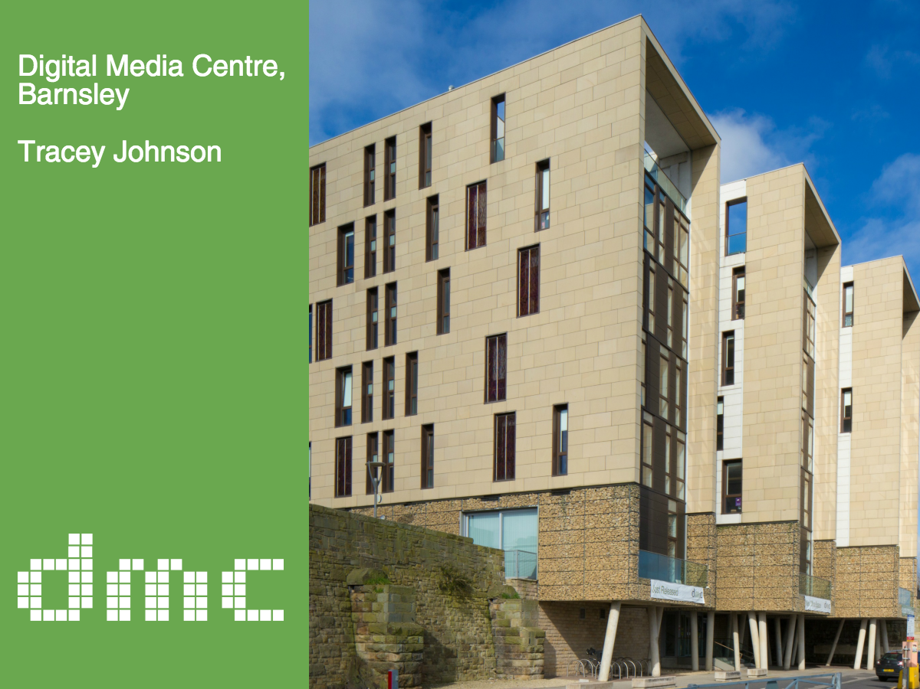

Slide 14
What does a TechTown
look like?
Talent

Slide 15
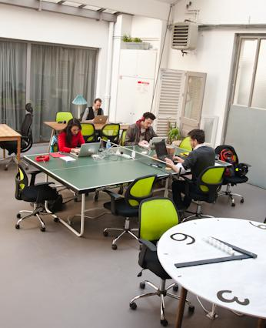
A TechTown has...2) Talent
  Lifestyle choice
  Career progression opportunities
  Networks & meet ups
  Spaces and places for connections
  Role models – alumni programme
  Programmes which ‘hack’ into the educational curriculum to offer wider tech skills training e.g. coding clubs, TeenTech – type events
  ‘Soft’ stuff – fruit, ping pong, good tea & coffee

Slide 16

Growing Tech-Talent
Elina Ingelande | Learn IT co-founder

Slide 17
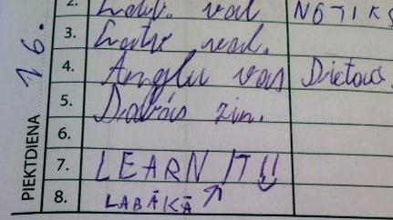

Slide 18
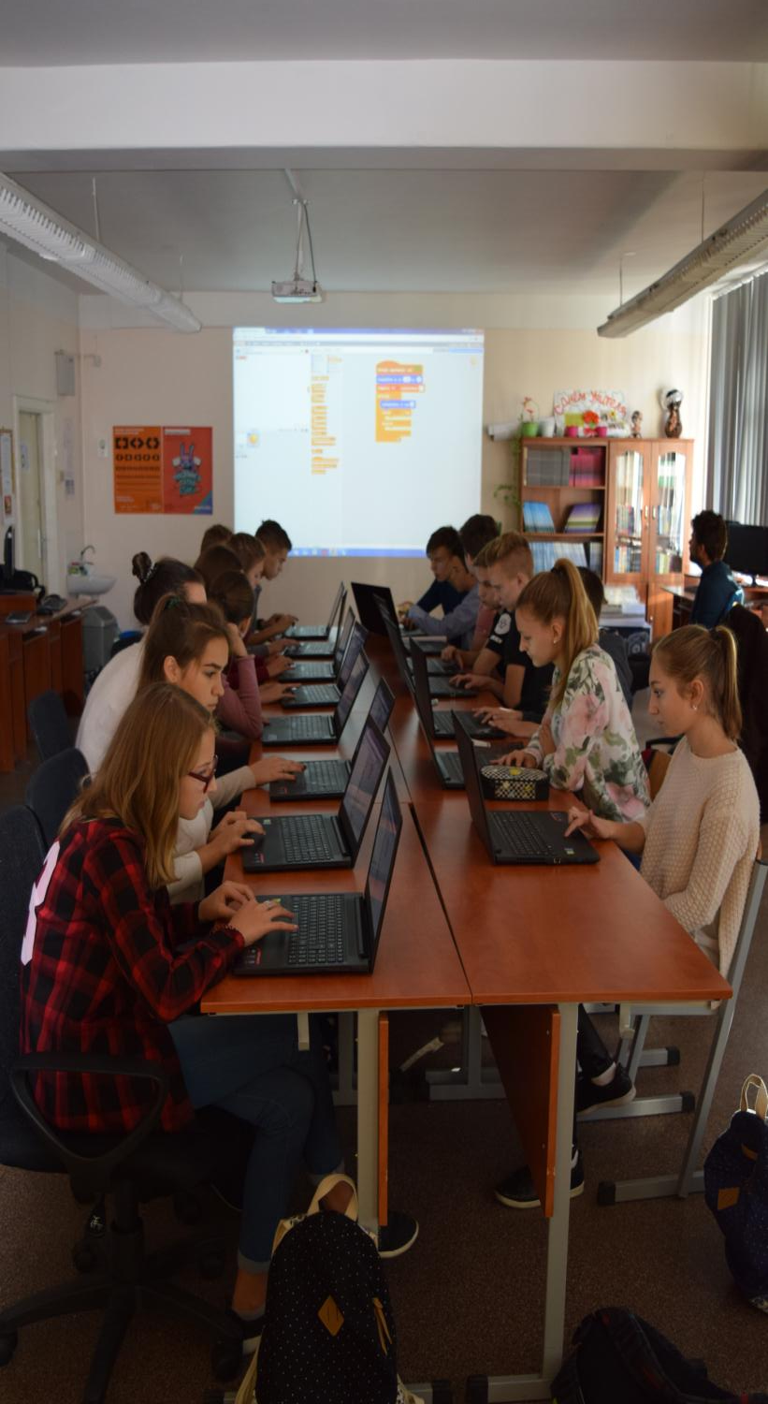

Even short workshops
can do miracles
After 2 hours long class, girls who consider their interest
to study coding as high or very high switched
from 2% to 13%

Slide 19
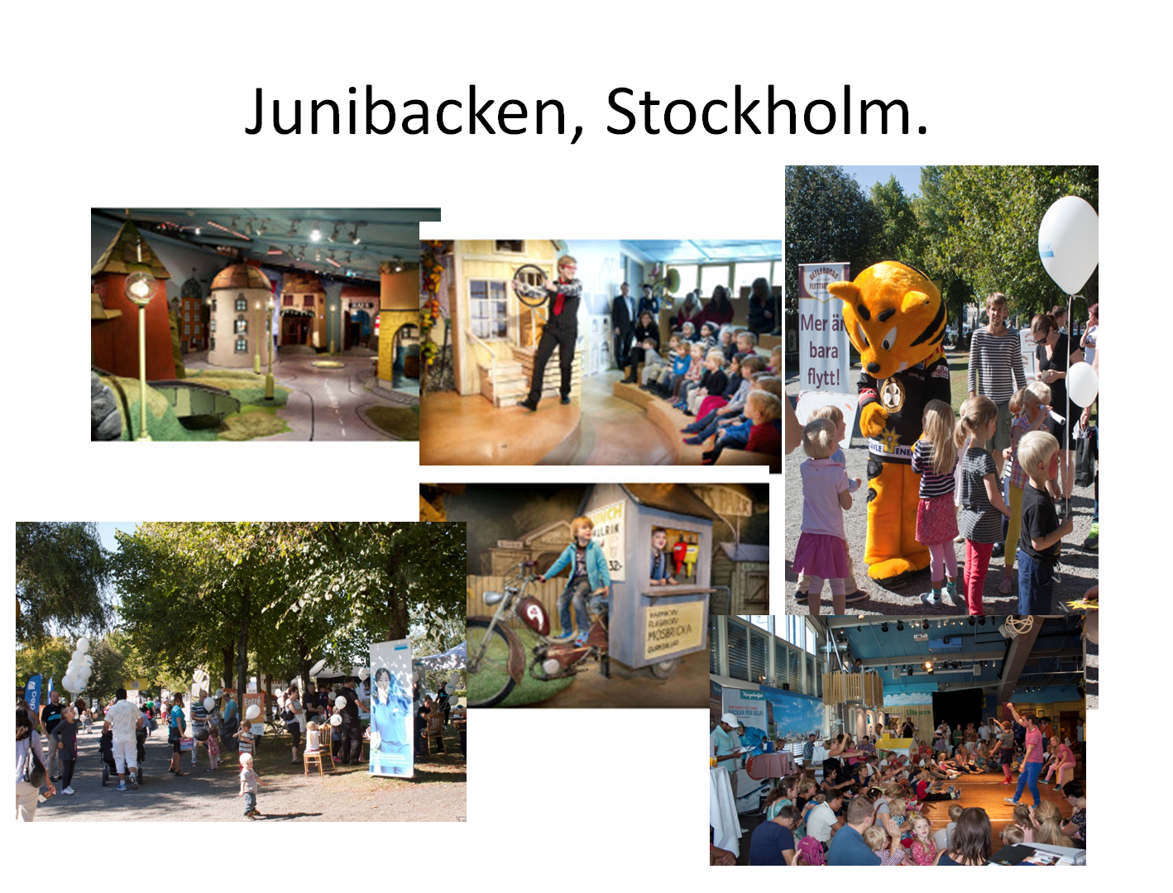

Slide 20
What does a TechTown
look like?
Finance

Slide 21

A TechTown has...3) Finance
  Programmes which offer the different sorts of finance that start ups and scale ups need
    Angel investors, seed funding, venture capital, grants, debt finance etc
  Support to access public sector funding, contracts and infrastructure

Slide 22
What does a TechTown
look like?
Data

Slide 23

A TechTown has...4) data
  Clear governance
  Access to reliable, accurate & updated data
  Long term commitment
  A community of data users: enabling demanders and suppliers to come together and explore problems and solutions: workshops, meetings, hacks, market places, showcases, community-oriented-, and other events.

Slide 24
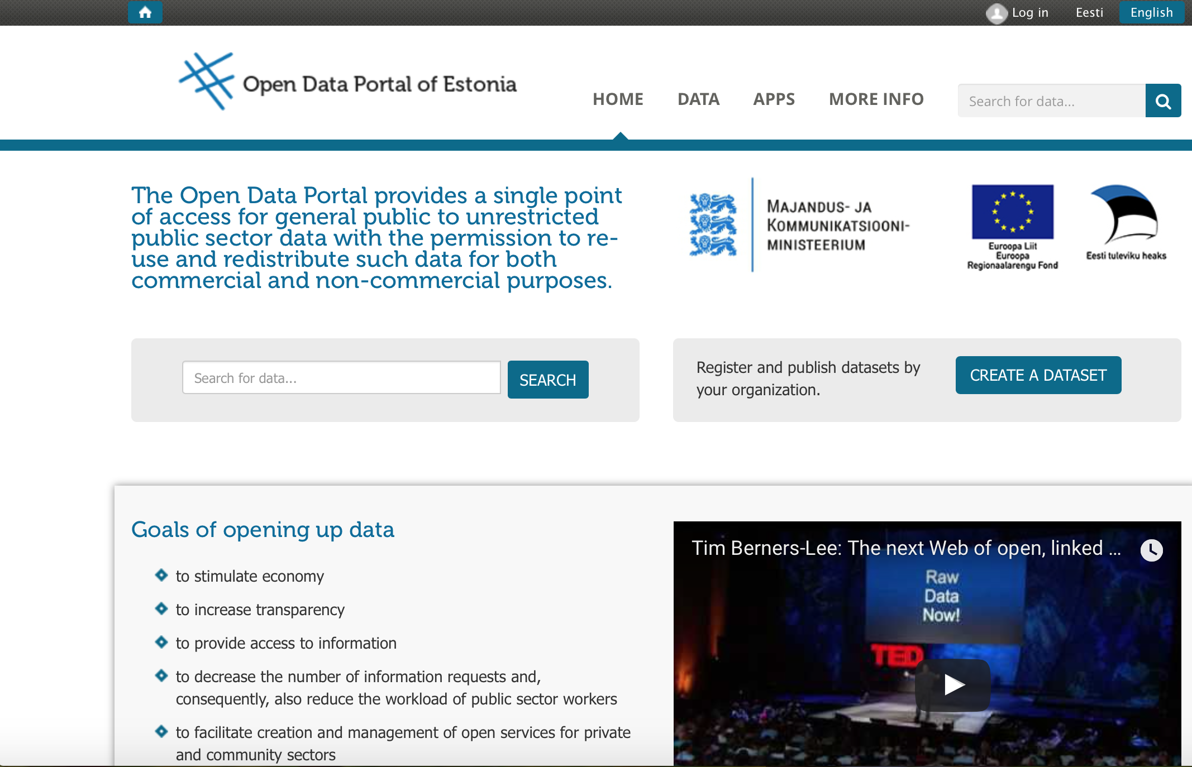

Slide 25
What does a TechTown
look like?
Connectivity

Slide 26

A TechTown is…5) connected

Slide 27
What does a TechTown
look like?
Putting it together….

Slide 28
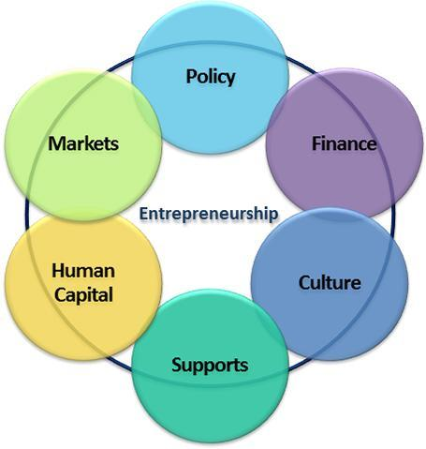
A TechTown has...
6) Entrepreneurship Ecosystem
Professor Daniel J. Isenberg
Babson College , Boston
Leading the Babson Entrepreneurship & Ecosystem Project
@danisen

Slide 29
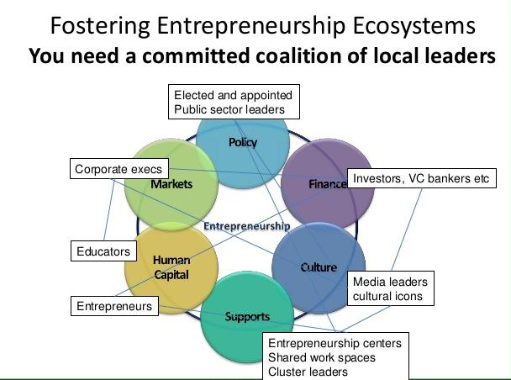
Entrepreneurship Ecosystems

Slide 30
Entrepreneurship Ecosystems
- Controlled by: Everyone (and no one)
- Owned by: Everyone (and no one)
- Self-sustaining in the right conditions
- Self-perpetuating with the right inputs

Slide 31
*Important Slide Alert*
If you only remember one thing:

Slide 32
*Important Slide Alert*
If you only remember one thing:
You can’t create an ecosystem from the top down, but you can create the conditions to encourage a vibrant ecosystem to flourish.

Slide 33
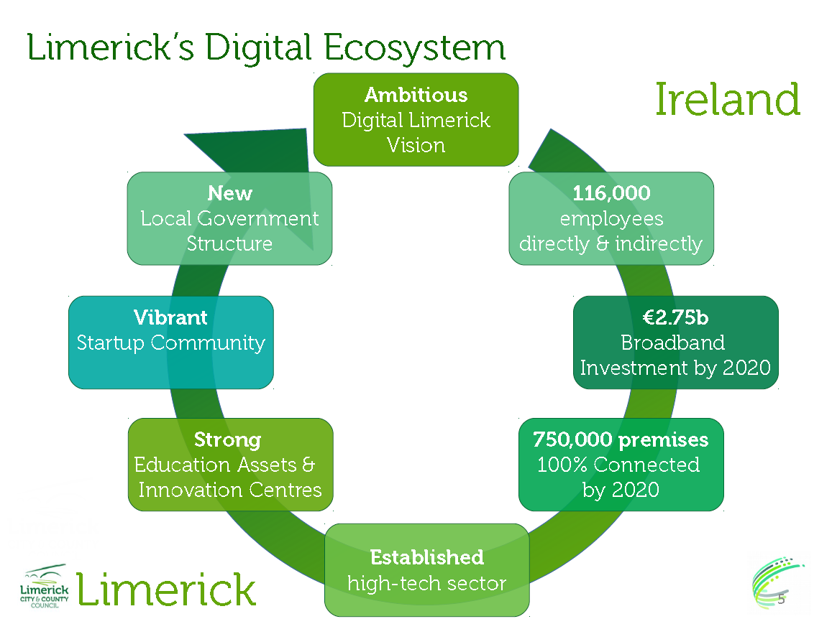

Slide 34






Question time
Czas na zapytania
Klausimų valanda
Jautājumu laiks
Kérdések órája
H ώρα των ερωτήσεων
Frågestund
Turno de preguntas
L'heure des questions
Doba vyhrazená pro otázky
Vprašanje časa
Kyselytunti
Spørgetid
vragenuurtje
Hodina otázok
Questão de tempo
Infotund
Ora interpelărilor

Slide 35
TechTown
Review of City Action and ULG / IAP progress

Slide 36

‘Hot topics’ discussion
Each City Group – write on 1 post-it:
1 topic they would like to discuss with other TechTown Partners

Slide 37

Time for a cuppa…

Slide 38
TechTown
Mid Term Review

Slide 39

Questions to be addressed:
  What is working well?
  What is working less well?
  What changes would you make?
  How would you do this?
Notes:
What is an IAP
Do we want a template / guidance for TT?

Slide 40

Different areas of activity
  Project Management
  Transnational exchange and learning
  Local impact – ULG and IAP
  Communication & Dissemination
Notes:
What is an IAP
Do we want a template / guidance for TT?

Slide 41

Survey Monkey results:
Notes:
What is an IAP
Do we want a template / guidance for TT?

Slide 42
Survey Monkey results:
Everything is perfect – thanks ☺
The transnational meetings are inspirational
Many people from the ULG took part in the transnational meetings. we asked them to prepare a detailed report after every meeting as to share inspirations, models and new findings with all members. The meetings dedicated to transfer the lessons learnt were successful
We've been really pleased with how much progress we have made - lots of smaller wins that are building up to form a significant action plan
Notes:
What is an IAP
Do we want a template / guidance for TT?

Slide 43

Survey Monkey results:
Notes:
What is an IAP
Do we want a template / guidance for TT?

Slide 44
Survey Monkey results:
To what extent do you think that internal communication within the network is well organised?
Notes:
What is an IAP
Do we want a template / guidance for TT?

Slide 45
Survey Monkey results:
It is good to use digital tools (we learn to use new tools!), but we find it a bit difficult with the mix of social dialogue and important documents in Slack. We miss an overview of documents.
Slack is a useful tool but due to the number of comments and posts it is possible to miss important information. Email is still a useful tool.
We would like more communication/collaboration with other networks, more communication towards local officials to integrate them (maybe a dedicated meeting organised by national URBACT point)
Notes:
What is an IAP
Do we want a template / guidance for TT?

Slide 46
Survey Monkey results:
To what extent do you think the network’s findings/results are widely circulated and the project website is useful?
Notes:
What is an IAP
Do we want a template / guidance for TT?

Slide 47
Survey Monkey results:
Not sure if results are widely circulated and website's usefulness is limited as there isn't a lot of content or outputs from events.
We never used this website. We don't feel comfortable in using it at local level for two reasons: the language (few people in our ULG speak English); we are using another web platform to promote the the project and its method and results.
We have had serious technical issues uploading/losing content (from the TechTown minisite) which is frustrating. Trying to address this but it is costing extra resource
Notes:
What is an IAP
Do we want a template / guidance for TT?

Slide 48
Questions to be addressed:
  What is working well?
  What is working less well?
  What changes would you make?
  How would you do this?
Notes:
What is an IAP
Do we want a template / guidance for TT?

Slide 49
Different areas of activity
  Project Management
  Transnational exchange and learning
  Local impact – ULG and IAP
  Communication & Dissemination
Notes:
What is an IAP
Do we want a template / guidance for TT?

Slide 50
Ranking…..warming up
  I am confident that I have the right stakeholders fully engaged in my ULG
  I believe my IAP will have impact locally
  The learning from the transnational events is feeding into my IAP
  The slides and podcasts produced after each event are useful in communicating key messages
Notes:
What is an IAP
Do we want a template / guidance for TT?

Slide 51
What is working well?
  Project Management
  Transnational exchange and learning
  Local impact – ULG and IAP
  Communication & Dissemination
Notes:
What is an IAP
Do we want a template / guidance for TT?

Slide 52
What is working less well?
  Project Management
  Transnational exchange and learning
  Local impact – ULG and IAP
  Communication & Dissemination
Notes:
What is an IAP
Do we want a template / guidance for TT?

Slide 53
What can be done better?
GROUP EXPO exercise
Notes:
What is an IAP
Do we want a template / guidance for TT?

Slide 54
The process - GRPXPO
roup around topics
eflection (individual)
air evaluation
groups (cross groups)
oster - group discussion
rganisation
G
R
P
X
P
O
Notes:
What is an IAP
Do we want a template / guidance for TT?

Slide 55
GROUP
  Questions to answer:
  How might we improve stakeholder engagement in ULGs so as to co-create IAP’s
  How might we ensure that the ULG is benefitting from the exchange at transnational level
  What local outputs or tools have worked well? How can we spread this good practice around the TechTown network?
Notes:
What is an IAP
Do we want a template / guidance for TT?

Slide 56
GROUP
  Maximum number of participants in one group: …..
  First comes first served principle, but everyone will work with each theme eventually!
Notes:
What is an IAP
Do we want a template / guidance for TT?

Slide 57
GROUP
  Everyone returns to her/his seat
  Pen and paper are available
  Everyone works alone, silently – no small discussions
  Time available: approx. 5 minutes. Collect your thoughts / ideas / proposals regarding your selected topic
Notes:
What is an IAP
Do we want a template / guidance for TT?

Slide 58
POSTER
  Return to your group
  Each group appoints one note-taker, one time-keeper and one facilitator
  Everyone recites briefly her / his proposals (1-2 minutes each),
  This is followed by discussion and forming group proposals (5-7/group) and recording on post its
  Record your proposals as precisely as possible
  The more specific proposals, the better!
  Time available: 20 minutes
Notes:
What is an IAP
Do we want a template / guidance for TT?

Slide 59
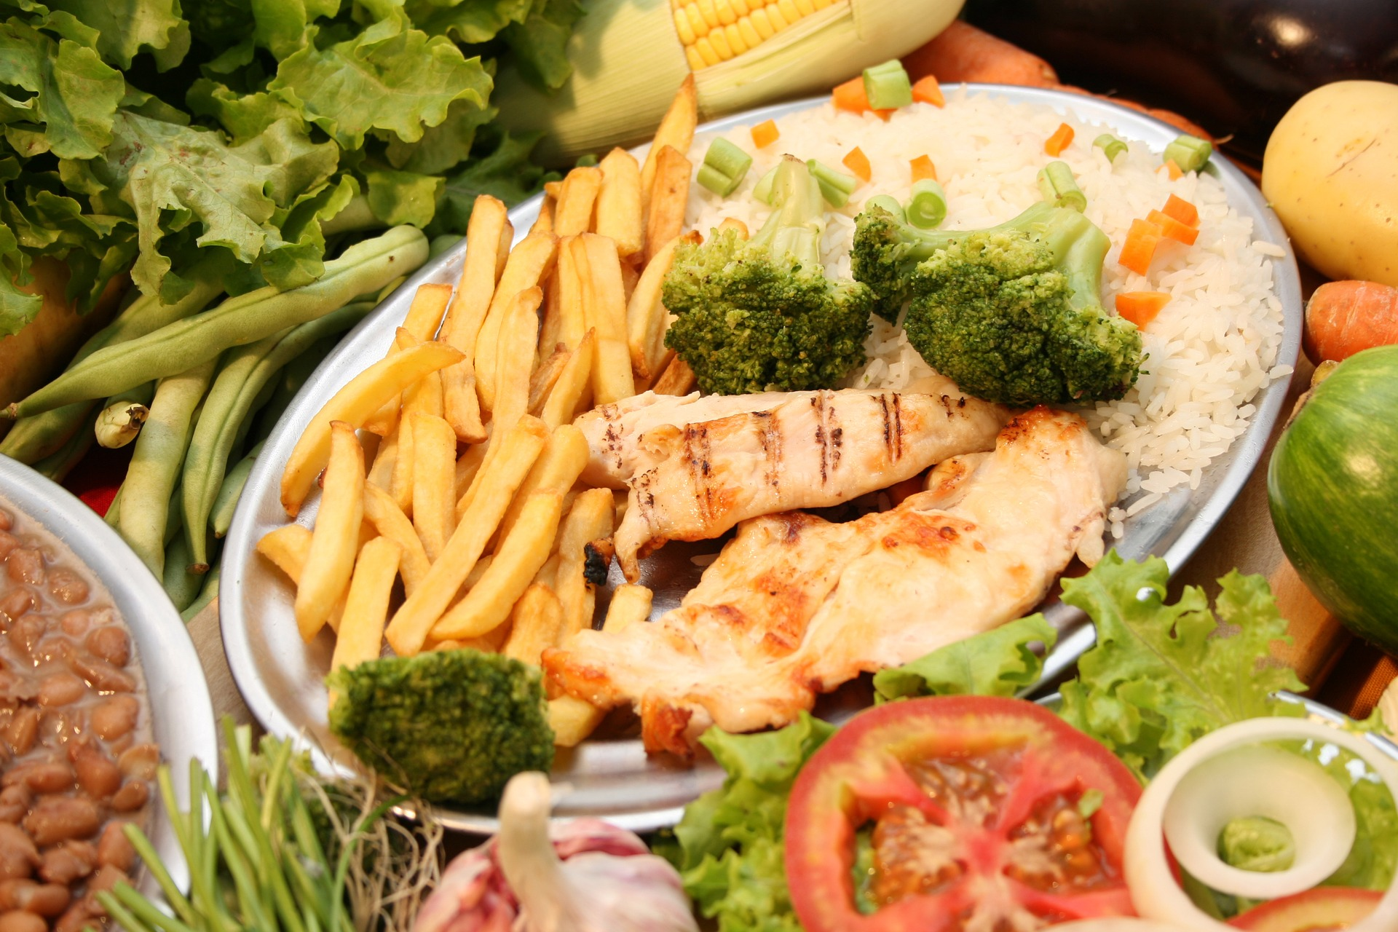
Lunchtime!
Notes:
What is an IAP
Do we want a template / guidance for TT?

Slide 60
X GROUPS
  Everyone counts from one to n, one after the other (n: either the number of participants in the smallest groups, or the number of groups, whichever is smaller)
  People saying the same number will belong to the same cross-group
  In each cross-group, the person(s) belonging to the given topic summarises the proposals (3 min), than follows discussion and additions, recorded on the flipchart. NO REMOVING EXISTING PROPOSALS
  Time available: 10 minutes / topic for each group, then the cross-groups move to another topic
Notes:
What is an IAP
Do we want a template / guidance for TT?

Slide 61
PAIR EVALUATION
  We work in pairs
  Pair with people you have not worked today yet
  Each pair walks around and evaluates the proposals
  Select 2-4 best proposals under each topic
  Each pair may award 4 dots under each topic
  Time available: 10 minutes
Notes:
What is an IAP
Do we want a template / guidance for TT?

Slide 62
Evaluation criteria
IMPACT
EFFORT
Notes:
What is an IAP
Do we want a template / guidance for TT?

Slide 63


Next Steps and Timeframe
MACRO LEVEL
5/2016 – 5/2018
PHASE 2
CB
June
19-21
MTR
9/17
CB
Feb
/18
PR
3/17
PR
9/17
Reprogram
MICRO LEVEL
First draft
MTR report
Shared with Secretariat
Refined
MTR report
Shared with Secretariat
Final
MTR report
Submitted to Secretariat
Provide data - Questionnaire for each partner
URBACT inserts reprogramming
changes in
SYNERGIE
MTR Webex
!
7 June
(15 June)
APN Training
!
End
July
!
30
Sept
7/3/17
March - June
19-21
/6/17
June - July
August - Sept
October
Mid Term Review Template and Guidance
Exchange of all partner findings in a Network transnational meeting
Sharing between Networks
> For further refinement of MTR Report
Get Partners feedback and agreement on MTR report
URBACT provides feedback request clarifications
Final re-
Programming request
Dec
Approval
by MC
Check Guidelines for Network meeting
Notes:
Date
Activity
Output
7 March 2017
WebEx on-line session with LPs and LEs (Presentation of Mid Term Review, what is expected, consulting partners, integrating MTR in a transnational meeting)
Mid Term Review Template and Guidance
April-June
Each partner city (including LP) responds to questions in the template questionnaire for collection of data at partner level.
Presentation, analysis and exchange of all partner findings in a network transnational meeting
Partner level inputs, self-assessments, feedback
19-21 June
LE and LP pull together findings.
Review, analysis and exchange (including networks peer-review) during the APN training session in Paris – reality check, assess progress towards achievement of the expected outputs and results
Draft Mid Term review report
June-July
Based on the discussions during the training, LP sends the Mid Term Review report for partners’ feedback and adjusts the report accordingly
Partners’ feedback and agreement
End July
LP submits the adjusted Mid Term Review assessment to the URBACT Secretariat
Adjusted Mid Term review report
August-Sept
URBACT feedback on reports, request for clarifications where needed
URBACT feedback on reports
30 September
LP submits Final Mid Term Reviews following URBACT Secretariat feedback
Final Mid Term review
1-31 October
LP submits the reprogramming request arising from the Mid Term review for URBACT feedback
Final reprogramming request
November
Approved proposals for reprogramming are inserted in SYNERGIE by URBACT Secretariat on behalf of LP
Reprogrammed Application Form submitted in SYNERGIE
December
Re-programming approved by Monitoring Committee
Approved Application Form

Slide 64
TechTown
Integrated Action Plans

Slide 65


The result framework
ACTION PLAN
MONITORING &
EVALUATION
Specific
objective
Intended
result
Result
indicator
SITUATION
CHANGE
Output
Output
indicator
Notes:
Starting point: in your city an existing problem, need or opportunity is identified [a ‘situation’] and properly documented – justifying the need and possibility for an intervention
This should be based on the discussion you had in ULG 1 using the Problem Tree and the problem statement you arrived at.
On this basis you can define an action plan which is includes the main ingredients of the result framework:
specific objective(s) (what do you want to change/achieve) – the result you intend to reach
Result indicator(s): to quantify this result and measure if you achieve it
Output(s): what do you need to do and make to reach your result
Output indicator(s): to determine in advance what you expect to make
The implementation of your action plan will lead to a change in the pre-existing situation – the city is better off now
Monitoring and evaluation during and after implementation will show you
- how you are doing during implementation of the action plan AND
- if you have achieved your objectives and why/why not

Slide 66
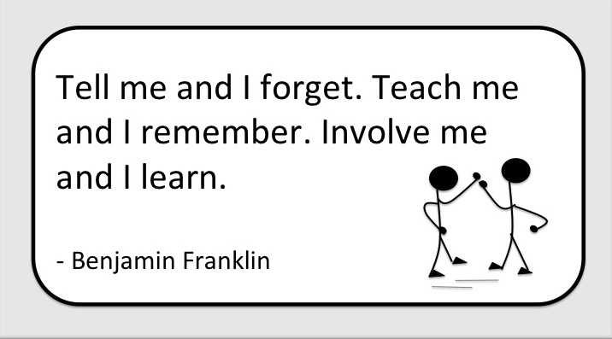
Where are we?
Baseline & context
Problem statement (s)
Specific Objectives (s)
Result indicators
Actions…..
Notes:
What is an IAP
Do we want a template / guidance for TT?

Slide 67
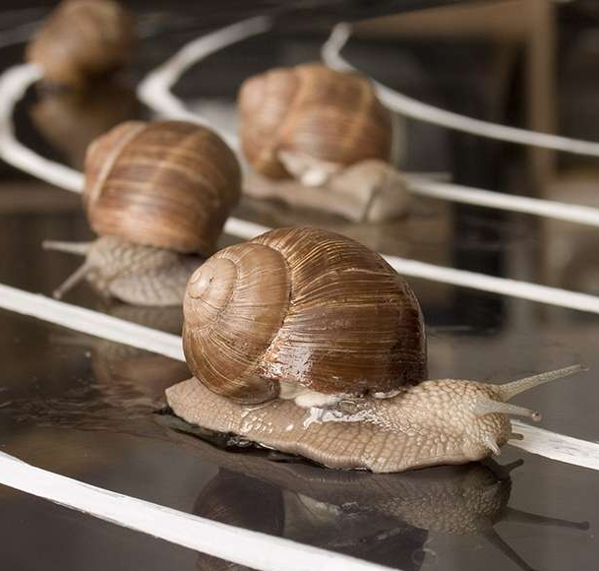
Where are we going?
City context and key challenges / problems
Focus of the IAP – problem statement, specific objectives, result indicators
The Plan e.g. strategic goal, priorities, detailed breakdown of actions planned, how they will be delivered, who will deliver them and when? Output indicators etc
Funding / resources
Governance
Calendar / workplan
Notes:
What is an IAP
Do we want a template / guidance for TT?

Slide 68
Roadmap
Coherent set of tangible actions in response to the expected results
Stakeholder involvement – roles and responsibilities
Clear timeline (1,3,5,10 year plan?)
Link to 2014-2020 results framework (results, actions, outputs, indicators)
What-How-Who-When-Where?
Notes:
Make point

Slide 69
Developing a ROADMAP
ROADMAP
Expected result |  | Reduced motorised traffic in the city centre to 50% of 1990 figures
Action Title & Short Description | Lead Actor or Agency | Key Partners | Intended Outputs | Timescale | Resources per annum
1.1 Introduction of smart traffic charging scheme Establishment of charging perimeter and installation smart control infrastructure | Municipality – Transport Dept. | - Police - Private IT company - Parking Authority Motorist organisations - Media | Lower % of daily commuter car journeys | December 2015 | ?
1.2 Programme of pedestrianisation and redesign of public open space
1.3 Increase public transport offer
1.4 Extend and improve cycle network
1.5 Reorganise parking system (offer and access routes)
…

Slide 70

Useful resources
URBACT II Local Support Group Toolkit http://urbact.eu/sites/default/files/urbact_toolkit_online_4.pdf
Community Toolbox http://ctb.ku.edu/en
Dave Gray – Sunni Brown – James Macafuno: GAMESTORMING – A Playbook for Innovators, Rulebreakers, and Changemakers
Mindtools- www.mindtools.com
Nesta toolkit http://diytoolkit.org/
Notes:
LUCIE- More from Soraya

Slide 71

Homework….
Meet your ULG, review work done to date & move to action planning
Send draft IAP to Alison by Friday 8 September to include as a minimum:
  Baseline information – data, context
  Problem statement, specific objective(s) and result indicators
  Area(s) of focus / priority (& rationale)
  Initial thoughts on actions
  Initial thoughts on governance & resources

Slide 72
Workplan through to completion….
Task | Date
Homework to Alison – draft summary in English | 8 September
1:1 skype calls | 13 or 20 September
Dubrovnik – discussions | 26/28 September
Full draft to Alison | 18 October
1:1 skype calls | 25 Oct & 1 November
Loop City – peer review | 23/24 November
1:1 skype calls | January
Final executive summary to Alison | 31 January 2018
Final event – Action Plan pitch off | March 2018

Slide 73
Time for a cuppa…

Slide 74
Partner meeting….

Slide 75
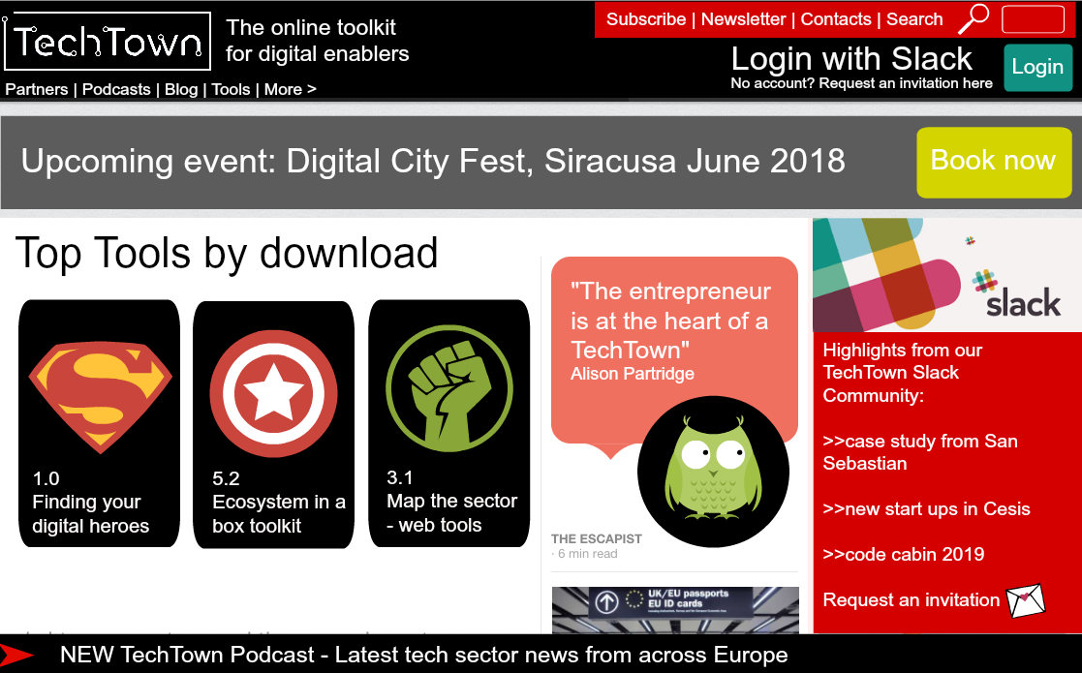
TechTown Space…

Slide 76

The purpose of TechTown Space is…..
To share the knowledge and learning generated from within the URBACT TechTown Network with other EU cities
To create a community where TechTowns from across the EU can explore what works and what doesn’t when it comes to creating the conditions for an effective digital economy which grows good quality digital jobs

Slide 77
Partner meeting….
Dubrovnik – 26 & 27 September – Growing digital jobs through the Smart City Agenda
Loop City – 23 and 24 November – The role of the City and Action Plan Peer Reviews
TechTown Dissemination events – central and local
Finance, audit, claims
Programme level updates
Any other business

