Slide 1


What can medium sized cities do to provide places and spaces for connections in the digital economy?
Notes:
Tracey to introduce

Slide 2
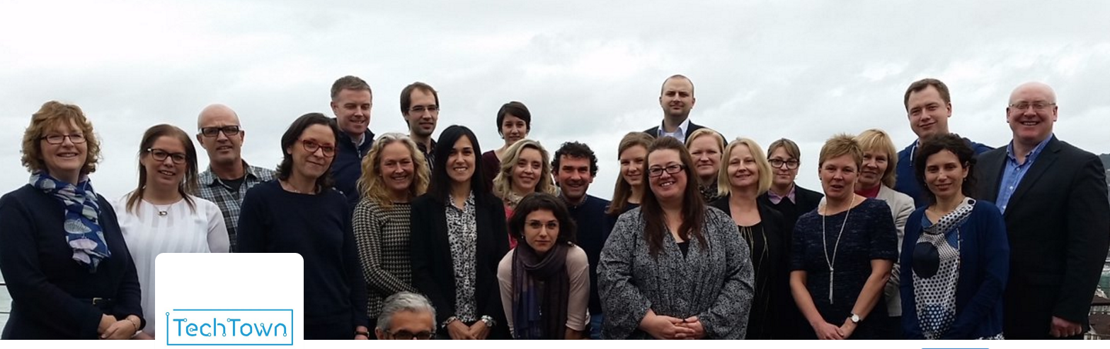
A few conclusions from…..
#TeamTechTown

Slide 3

TechTown
Thematic Focus – a reminder
Notes:
Back to the serious stuff – short reminder of where we got to

Slide 4

Thematic Focus
Understanding
Digital
Digital Jobs
Governance – the role of cities
Digital
Talent

Slide 5
Thematic Focus
Better understanding the digital economy
Growing digital jobs
Growing new digital jobs through start ups and existing businesses
Growing jobs through the digital transformation of traditional industry
Growing digital jobs through the smart city agenda
Providing spaces and places for connections
Finding, growing, retaining and returning talent
Notes:
Theme
Better understanding the digital economy
How can cities identify their digital community?
How to others define 'digital jobs' and is it helpful to pin down a precise definition?
What tools already exist which can help to measure existing and future growth potential?
What new metrics will be needed to measure city interventions?
Is there scope to develop a tool for TechTown cities to help with this?
Growing new digital jobs through start ups
What can cities do to support digital start ups?
How can cities better position themselves to optimise the conditions for competitiveness?
What sort of business support do digital start ups want and need?
How can cities help start ups to survive and to grow?
Growing jobs through the digital transformation of traditional industry
What can cities do to support digital transformation of traditional industry and existing businesses?
What is the role of cluster policy?
(How can cities help small family (retail) businesses?)
Growing digital jobs through the smart city agenda
How can cities ensure that they maximise the local jobs creation potential linked to delivering smart city agendas?
How can they avoid larger multinationals reaping all the rewards?
What role could local city challenges, hackathons play?
What role could public procurement play?
Providing spaces and places for connections
How important is it to have a physical space for the digital community? What does this space look like? What is the accompanying 'offer' in terms of business support, incubator or accelerator support? What is the unique position of medium sized cities?
Finding, growing, retaining and returning talent
How can medium sized cities attract and retain (young) skilled people?
How can they position themselves so that people want to live and work there?
What can cities do to better match education and training provision with the needs of the digital economy (now and in the future)?
How can they avoid losing out to larger regional and national 'hubs'?

Slide 6
Key questions on
spaces & places
How important is it to have a physical space for the digital community? What does this space look like?
What is the accompanying 'offer' in terms of business support, incubator or accelerator support? How can the city make it a living thing which makes digital people tick?
Are there positive examples of long lasting networks and hubs?
Who is best placed to develop and run such a space? Public? Private? Both? Other?
What is the unique position of medium sized cities?

Slide 7
First…..
Some definitions
Notes:
Back to the serious stuff – short reminder of where we got to

Slide 8
Incubators – a defintion
Provide work space designed to actively support the growth of start-ups or a business in its early stage of development. A distinguishing feature of an incubator is the provision of business support. Businesses leasing space in an incubator are chosen through a competitive application process and do so to access business support facilities which may be provided by the incubator management or their partners. This support is provided in return for a share in profit or minor equity stake in the business.

Slide 9
Accelerators – a definition
Typically provides space to start-up businesses or existing businesses (which might have been operating for several years) with the potential for fast growth and good financial returns. A key characteristic is the fiercely competitive nature of the selection process and dedicated support provided by the space management and/or investors who working closely with the business to guide their growth. In return for access to space and business support an accelerator will require an equity stake. This support lasts for a defined short period, at which time the investor will decide to expand their involvement or exit the business, either of which will result in the business moving on from the accelerator space.

Slide 10
Co working spaces – a definition
The spaces provide a combination of workplace and supporting facilities at affordable rates with easy in-out contractual conditions. The renting of space is set up to attract users who require ad hoc and short term access to workstations and supporting facilities such as meeting rooms. The format of space is primarily open plan and of an informal setting, aimed at facilitating an interactive and creative networking environment to form a sense of community among users.

Slide 11
So, what can medium sized cities do to provide places and spaces for connections in the digital economy?
Notes:
Back to the serious stuff – short reminder of where we got to

Slide 12
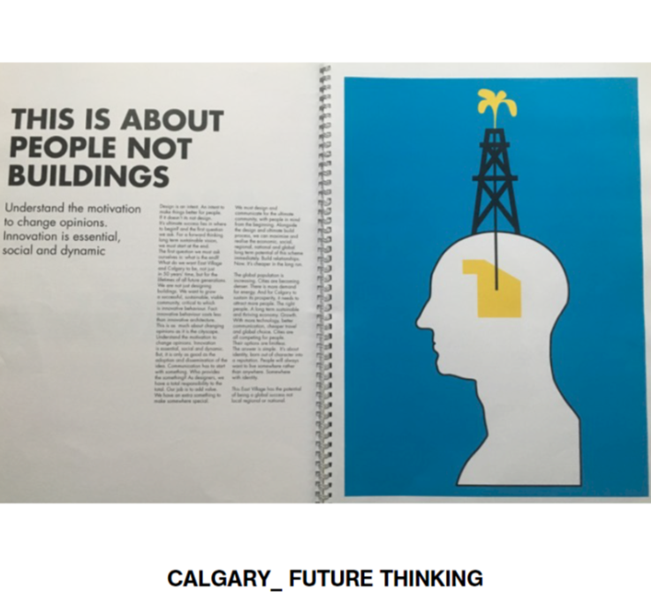
Medium sized cities can…..
Co create – with the digital community & for the digital community – spaces and places which build on the differences of the place rather than copying what others are doing
  There are lots of ‘anywhere towns’
  Places have meaning; spaces do not
  Don’t be afraid of other actors / competitors

Slide 13
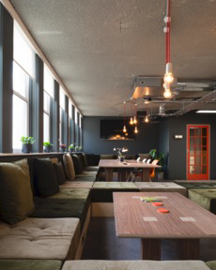
Medium sized cities can…..
Facilitate high quality collaborative leadership
Facilitate access to (public sector) funding programmes
Ensure that spaces have a high quality community offer with wrap around (business support) services and reasons to visit
Co locate business and start up support services in the building
Explore uses of existing public buildings and spaces for (meanwhile) co working

Slide 14
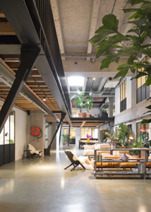
Medium sized cities can…..
Promote high quality design which accounts for local assets, culture and provenance
Look beyond the building – it’s all about relationships and people
Listen to and learn from customers and data
Create spaces where people want to be – and belong – it’s not all about the shiny things

Slide 15

Medium sized cities can…..
Mix people – artists, creatives, tech and digital – to disrupt and generate innovation and creativity

Slide 16
Some words of wisdom to finish….
Notes:
Back to the serious stuff – short reminder of where we got to

Slide 17
<Test then learn and test again….>
The goal is to discover new….
Notes:
Back to the serious stuff – short reminder of where we got to

Slide 18
<Digital is like sugar in hot milk….>
Digital is a tool, not a goal
Notes:
Back to the serious stuff – short reminder of where we got to

Slide 19
<Stay hungry; stay foolish….>
Frugality is the key to creativity
Notes:
Back to the serious stuff – short reminder of where we got to

Slide 20
www.urbact.eu/techtown
Notes:
Tracey to introduce

Slide 21
With thanks to our speakers:
Alison Partridge, Projects and Partnerships Lead, Capital Enterprise
Steve Pette, Director of Hearts and Minds and co founder of Central Working
Rich Brett , CEO of We Like Today
Tracey Johnson, Barnsley Digital Media Centre
Lucy Brailsford, Code Cabin
Jean David Olekhnovitch, Digital Tech Entrepreneur, Clermont Ferrand
Zoltán BÁLINT, CEO of Giganet Ltd, Nyíregyháza
Javi BuronGarcia, Director of FabLab, University of Limerick
Notes:
Tracey to introduce

