Slide 1


Fourth Transnational Event
Barnsley – March 2017
Notes:
Tracey to introduce

Slide 2
Our Key Question
What does your city do – or plan to do – to provide places and spaces for connections in the digital economy?

Slide 3

Linked questions….
How important is it to have a physical space for the digital community? What does this space look like?
What is the accompanying 'offer' in terms of business support, incubator or accelerator support? How can the city make it a living thing which makes digital people tick?
Are there positive examples of long lasting networks and hubs?
Who is best placed to develop and run such a space? Public? Private? Both? Other?
What is the unique position of medium sized

Slide 4
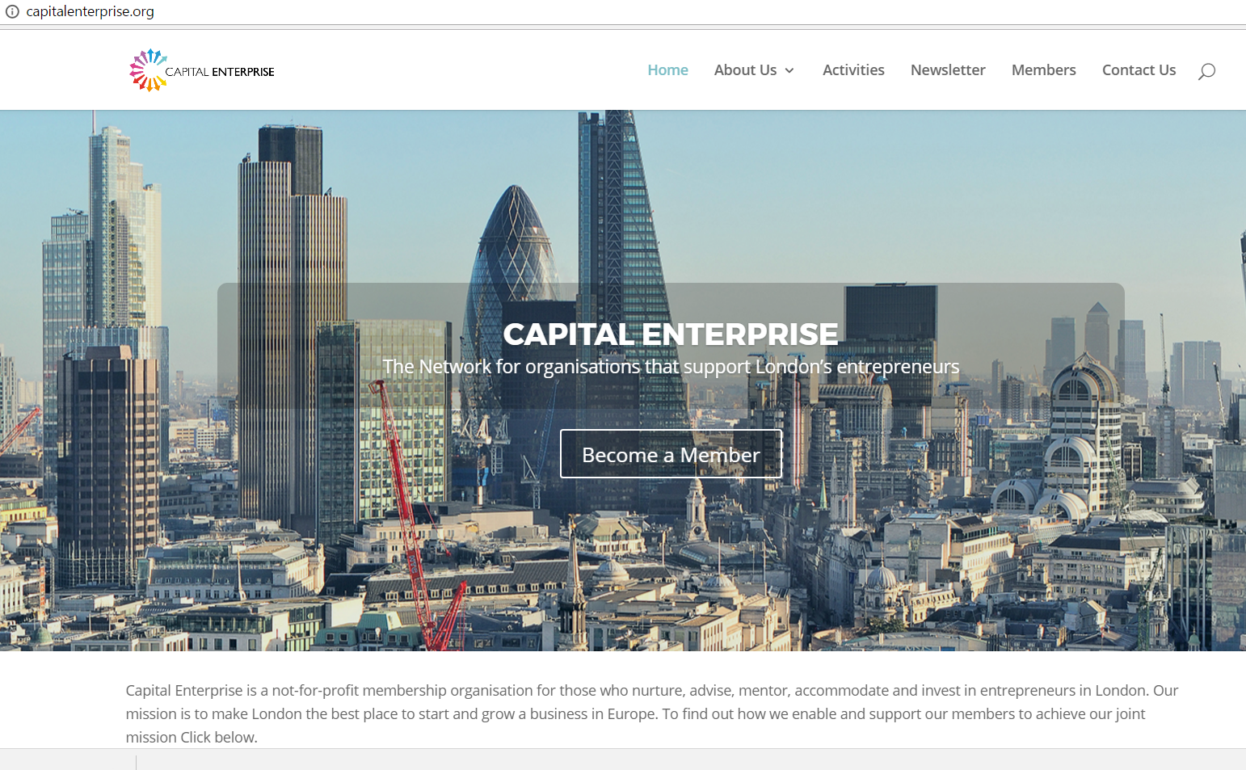
Incubators, Accelerators, Co Working Spaces – what do we mean?

Slide 5
Incubators – a defintion
Provide work space designed to actively support the growth start-ups or a business in its early stage of development. A distinguishing feature of an incubator is the provision of business support. Businesses leasing space in an incubator are chosen through a competitive application process and do so to access business support facilities which may be provided by the incubator management or their partners. This support is provided in return for a share in profit or minor equity stake in the business.

Slide 6
Accelerators – a definition
Typically provides space to start-up businesses or existing businesses (which might have been operating for several years) with the potential for fast growth and good financial returns. A key characteristic is the fiercely competitive nature of the selection process and dedicated support provided by the space management and/or investors who working closely with the business to guide their growth. In return for access to space and business support an accelerator will require an equity stake. This support lasts for a defined short period, at which time the investor will decide to expand their involvement or exit the business, either of which will result in the business moving on from the accelerator space.

Slide 7
Co working spaces – a definition
The spaces provide a combination of workplace and supporting facilities at affordable rates with easy in-out contractual conditions. The renting of space is set up to attract users who require ad hoc and short term access to workstations and supporting facilities such as meeting rooms. The format of space is primarily open plan and of an informal setting, aimed at facilitating an interactive and creative networking environment to form a sense of community among users.

Slide 8
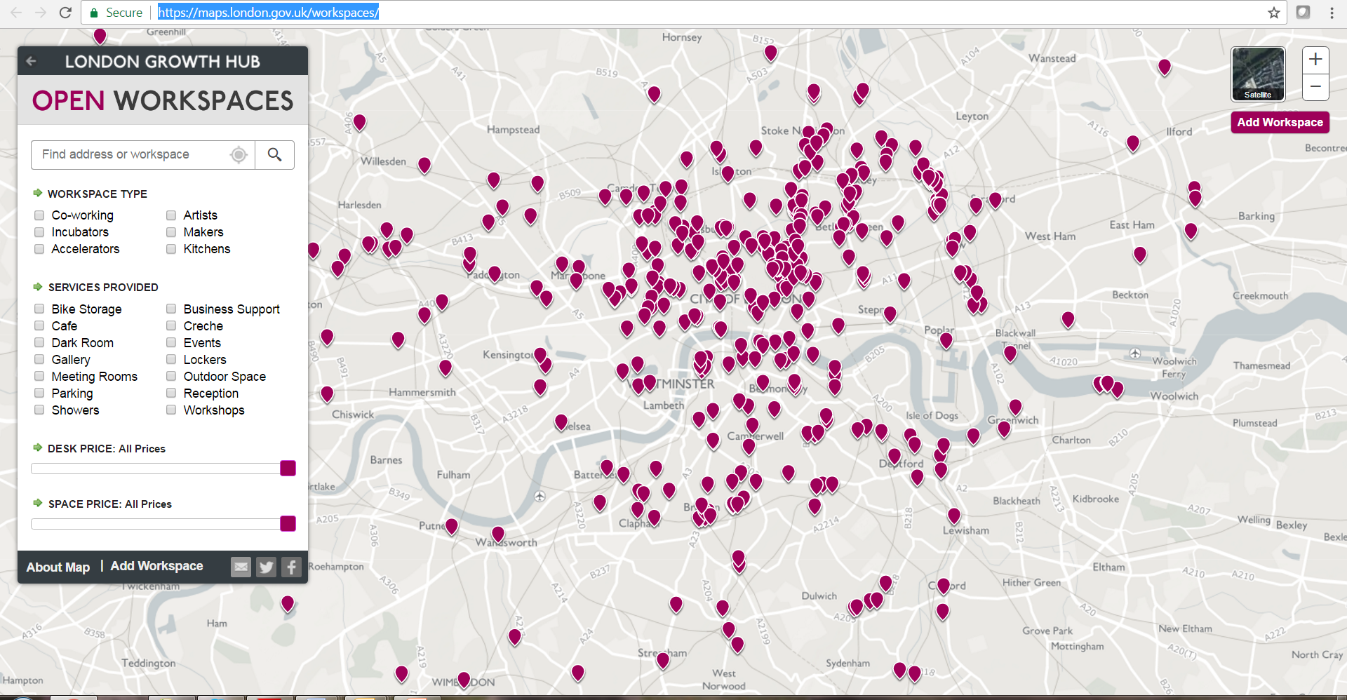
Mapping

Slide 9
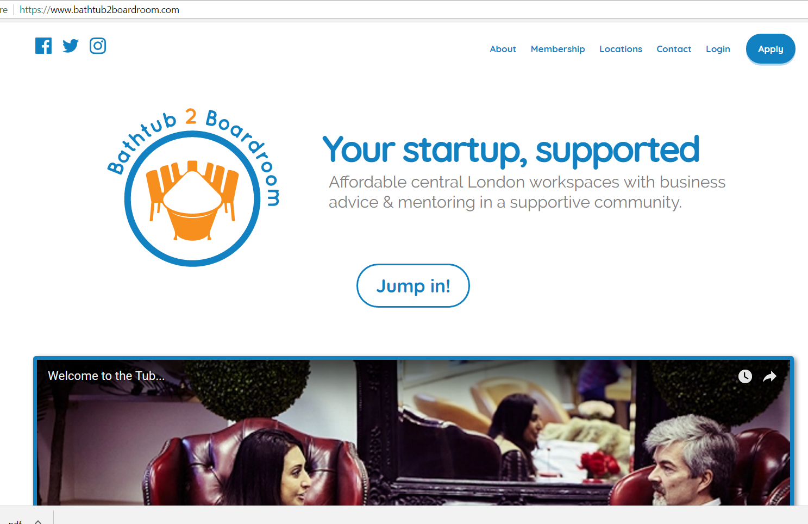

Slide 10
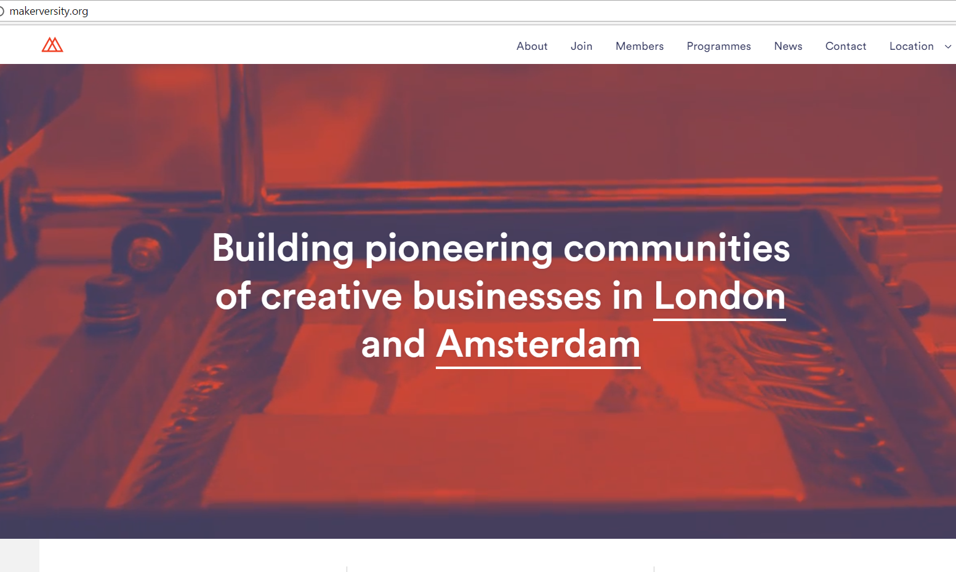

Slide 11
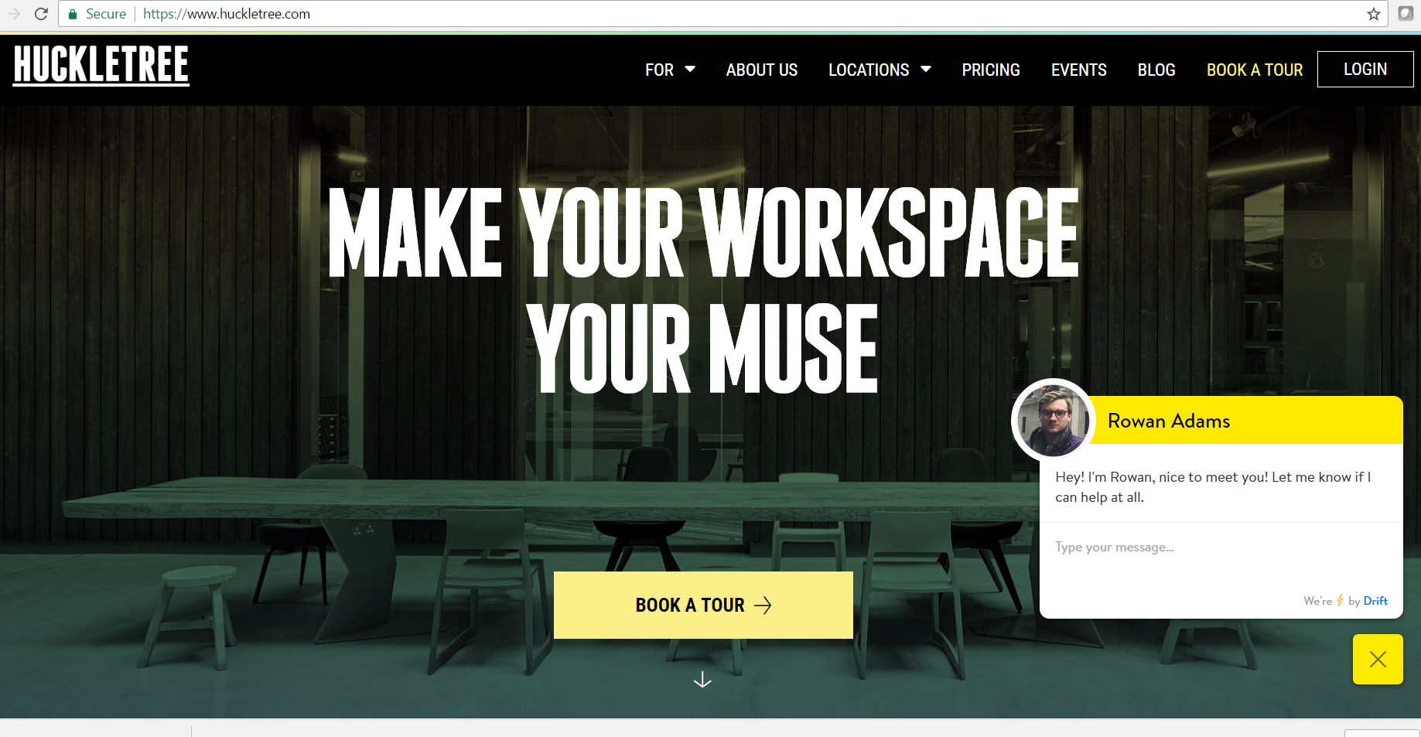

Slide 12






Question time
Czas na zapytania
Klausimų valanda
Jautājumu laiks
Kérdések órája
H ώρα των ερωτήσεων
Frågestund
Turno de preguntas
L'heure des questions
Doba vyhrazená pro otázky
Vprašanje časa
Kyselytunti
Spørgetid
vragenuurtje
Hodina otázok
Questão de tempo
Infotund
Ora interpelărilor

Slide 13
Places & Spaces
Capturing the learning
Work with people from your city
What have you learnt?
How is it relevant to your own challenges and Integrated Action Plan?
How will you use the learning? What will you do differently between now and the next meeting? & longer term?

Slide 14
Question time
Czas na zapytania
Klausimų valanda
Jautājumu laiks
Kérdések órája
H ώρα των ερωτήσεων
Frågestund
Turno de preguntas
L'heure des questions
Doba vyhrazená pro otázky
Vprašanje časa
Kyselytunti
Spørgetid
vragenuurtje
Hodina otázok
Questão de tempo
Infotund
Ora interpelărilor

