Slide 1


Slide 2

Welcome to Barnsley!
Barnsley is a former mining town in South Yorkshire, in the North of the UK. It is a medium-sized town of 237,800 positioned between the cities of Leeds and Sheffield, leading it to be in both the wider Leeds and Sheffield City Regions.
The business base is made up of over 80% micro-businesses, and jobs are dominated by public sector roles and low-skilled occupations.
Town has a relatively high employment rate and strong private sector job growth
Part of Sheffield and Leeds City Regions

Slide 3
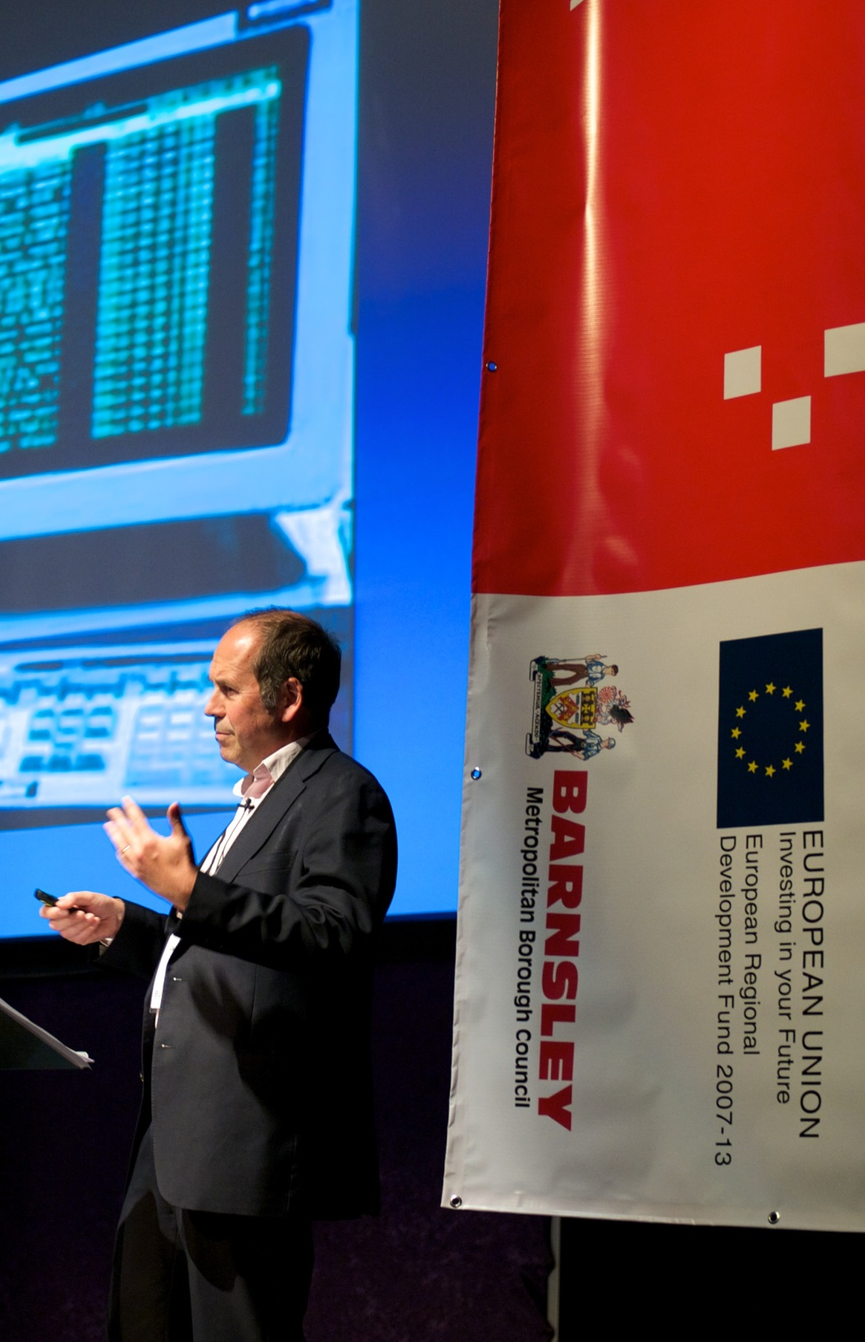

Removes barriers to BUSINESS GROWTH
as part of JOBS AND BUSINESS PLAN
Enterprising Barnsley project is
CHANGING PERCEPTIONS
Delivering measurable and tangible
ECONOMIC IMPROVEMENTS
Moving forward it will form the basis for a
NEW LEP BUSINESS SUPPORT MODEL
Rory Cellen Jones at 2015 Connected Business Event

Slide 4
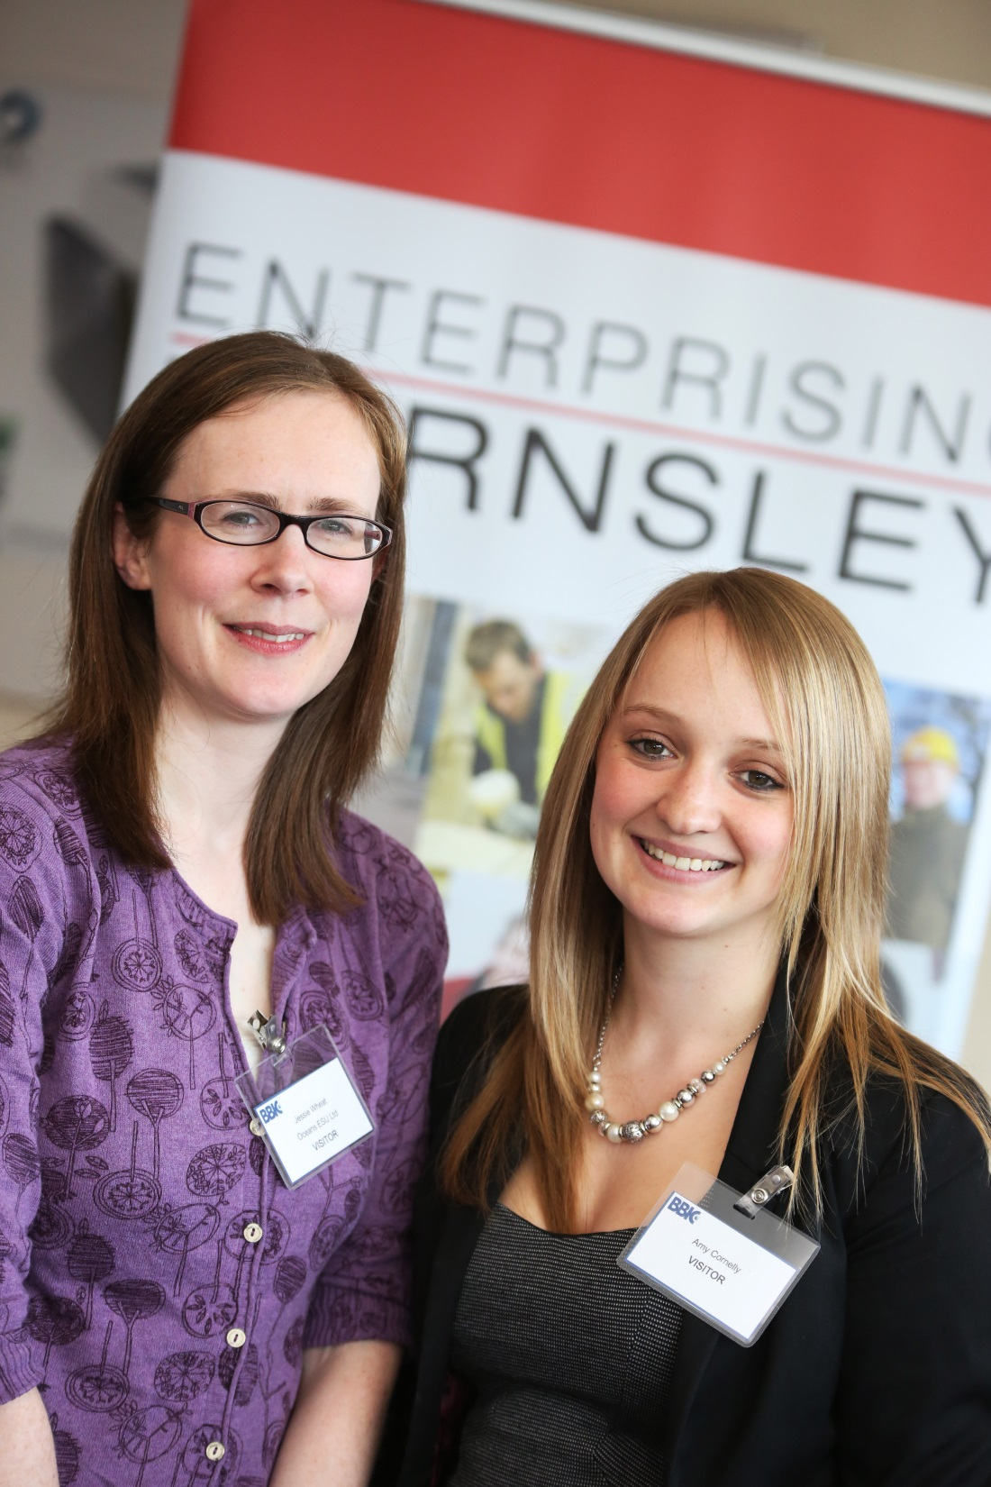
Economic
Improvement
Best performing “city” with regards to
private sector employment growth
Employee jobs have increased by 3.1%
in 5 years - greater than the 2% nationally
Employment rate increased by 13%
in 5 years - greater than the 3.8% nationally
DCLG highlighted Enterprising Barnsley as an
exemplar project for supporting and stimulating
successful enterprise within their report
“ERDF Local Growth Success Stories”
Enterprising Barnsley has delivered tangible economic change
Best performing “city” with regards to private sector employment growth
Employee jobs have increased by 3.1% - greater than the 2% nationally
Employment rate increased by 13% - greater than the 3.8% nationally
1597 jobs created
883 businesses supported
32% of supported companies now exporting
£35.3m positive impact on GVA
1597 jobs created
883 businesses supported
32% of supported companies now exporting
£35.3m positive impact on GVA

Slide 5
WHAT OUR CUSTOMERS THINK…..

Slide 6
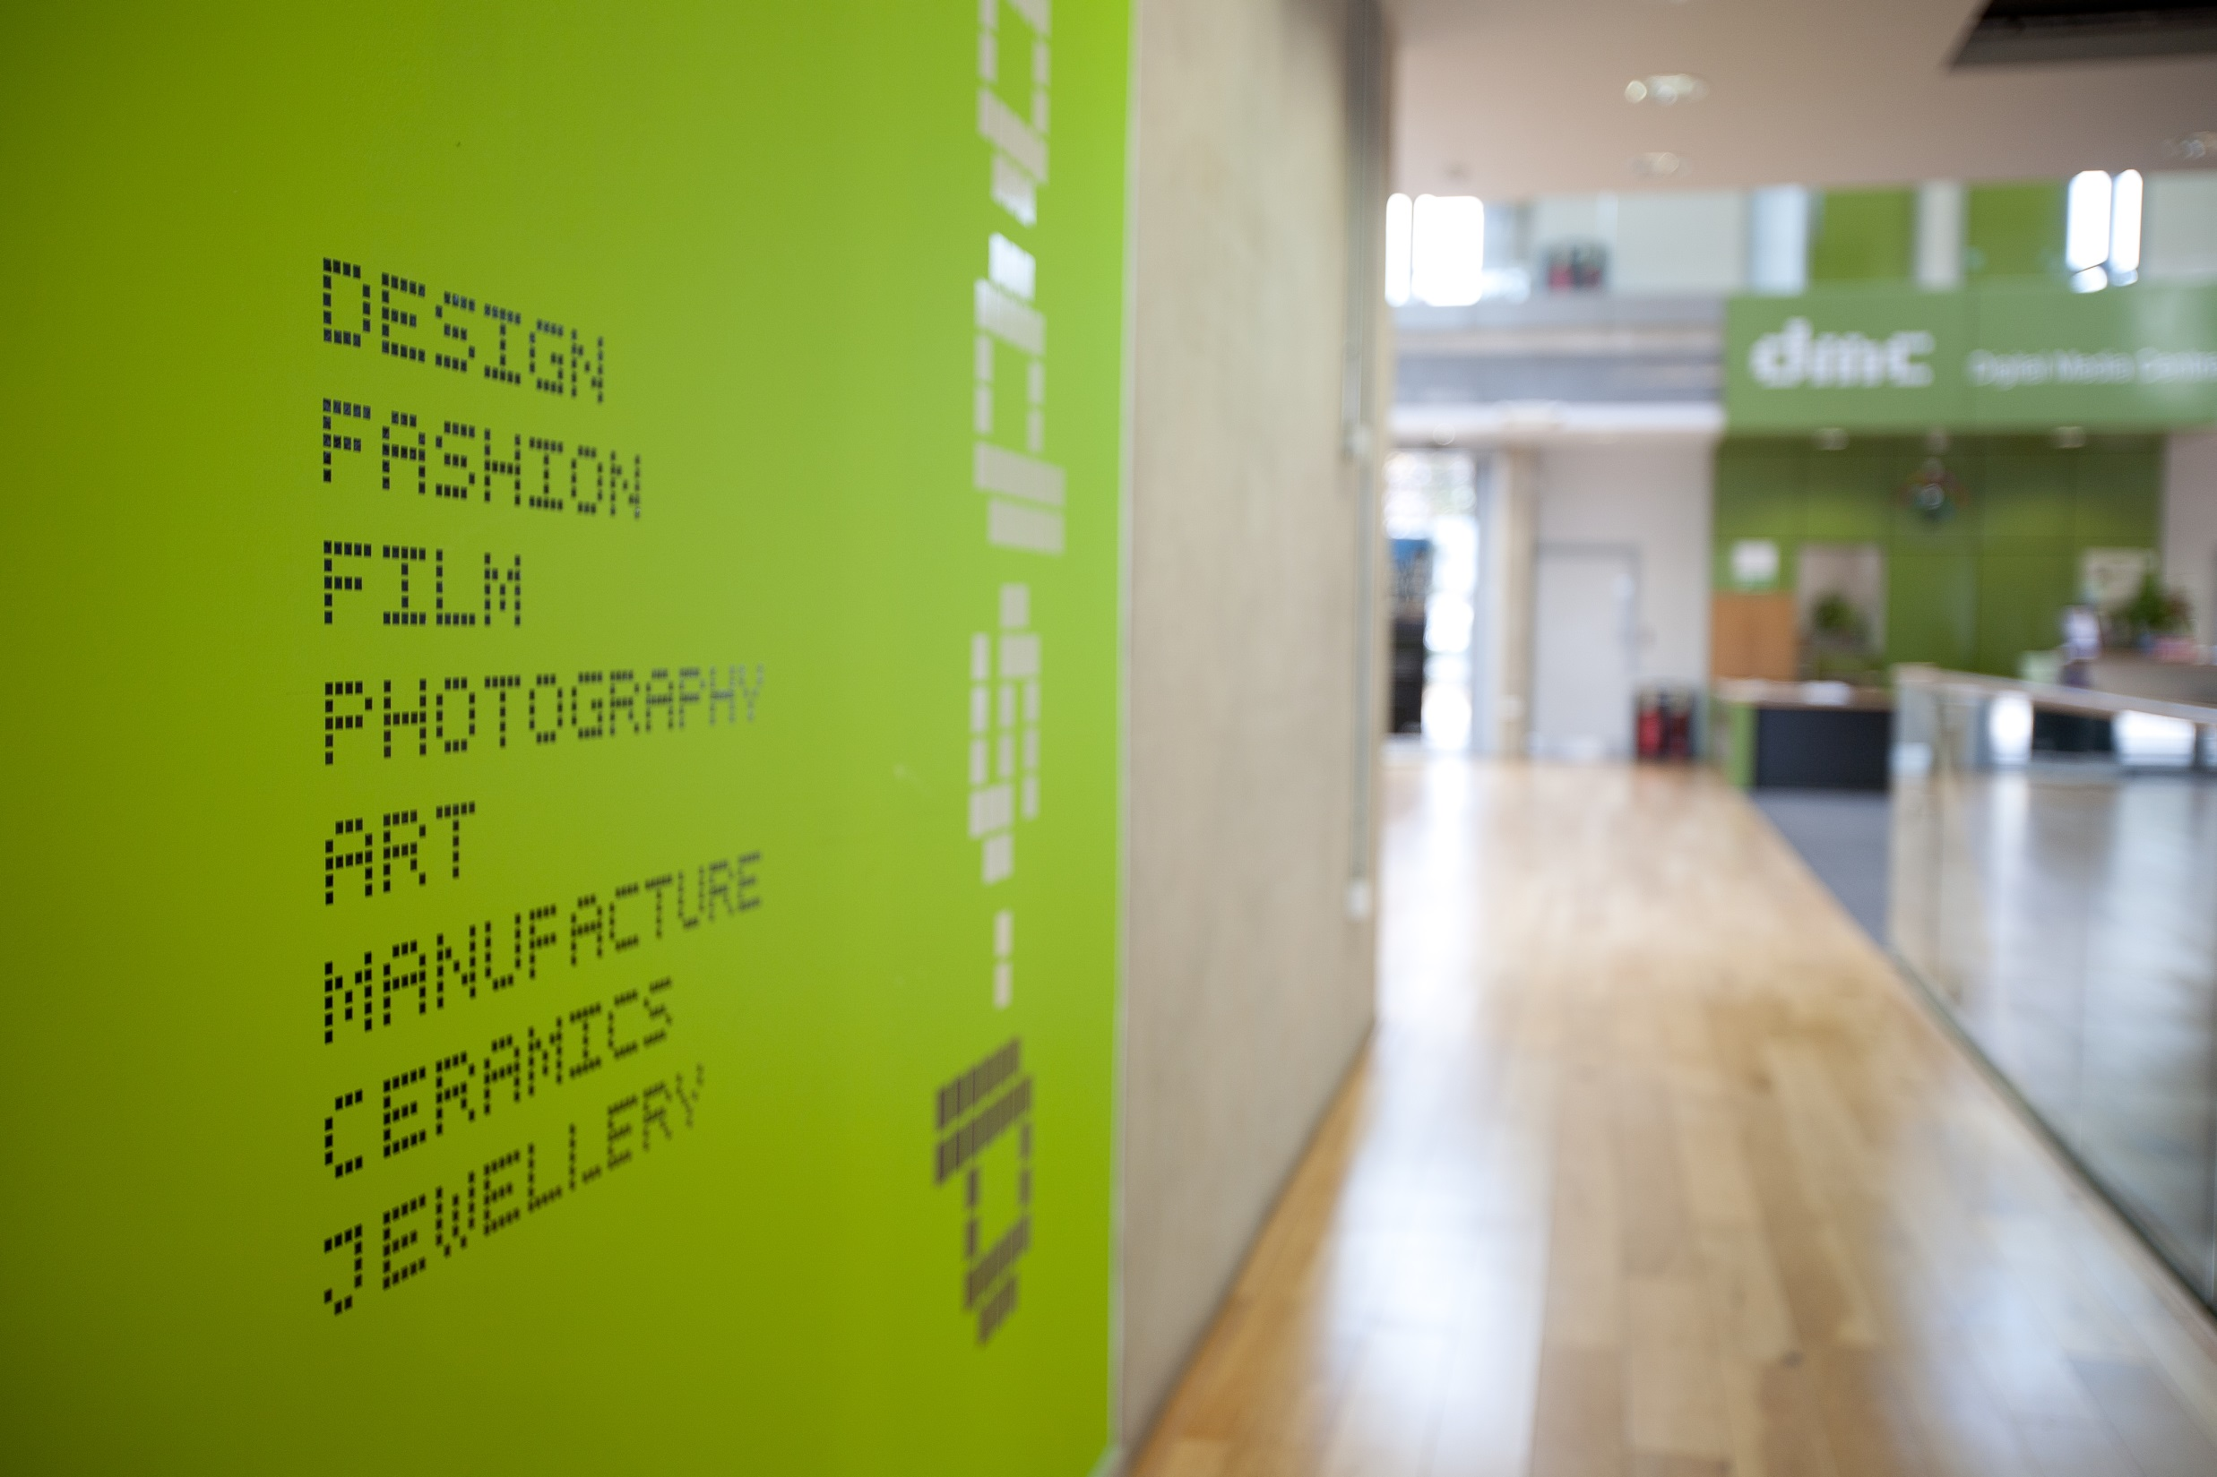
Challenges
Barnsley's economic performance continues to lag behind regional and national economic indicators.
24.7% of all jobs in Barnsley are public sector based. The private sector has been unable to absorb the number of jobs that have been lost to date.
It's taking Barnsley longer to recover from the recession than the rest of the UK
An increasing number of skilled Barnsley people are commuting for better jobs in other parts of South Yorkshire. This is due to the lack of opportunities closer to home and those that do exist are mainly low paid and part time.
There are also low numbers of business start ups and 6-% are either lifestyle or businesses simply replacing others that have ceased to exist with limited additional employment opportunities.

Slide 7
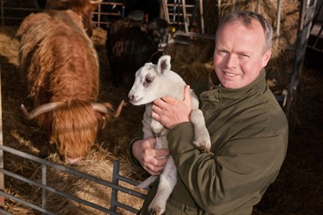
WHY DIGITAL??
Our jobs and business plan identifies digital as an enabling sector
This shows the potential impact it can have on the wider economy
Substantial existing commitment to creative and digital industries through Digital Media Centre and dedicated business support
We are definitely seeing growth - more businesses identifying as creative and digital between 2009 and 2015 and more jobs emerging
More roles available across business base that are ‘digital’
Digital ‘challenges’ not unique to sector – infrastructure and skills relevant to ALL sectors
Enterprising Barnsley has delivered tangible economic change
Best performing “city” with regards to private sector employment growth
Employee jobs have increased by 3.1% - greater than the 2% nationally
Employment rate increased by 13% - greater than the 3.8% nationally
1597 jobs created
883 businesses supported
32% of supported companies now exporting
£35.3m positive impact on GVA
Robert Nicholson – MD of Cannon Hall Farm and Enterprising Barnsley client

Slide 8
Building on the Jobs and Business Plan, Barnsley Council’s Employment and Skills Strategy for 2016-2020 has a focus on ‘More and Better Jobs’
Importantly, the strategy places an emphasis on the quality as well as the quantity of job opportunities and mentions that Logistics and ICT have experienced the biggest recent business growth.

Slide 9
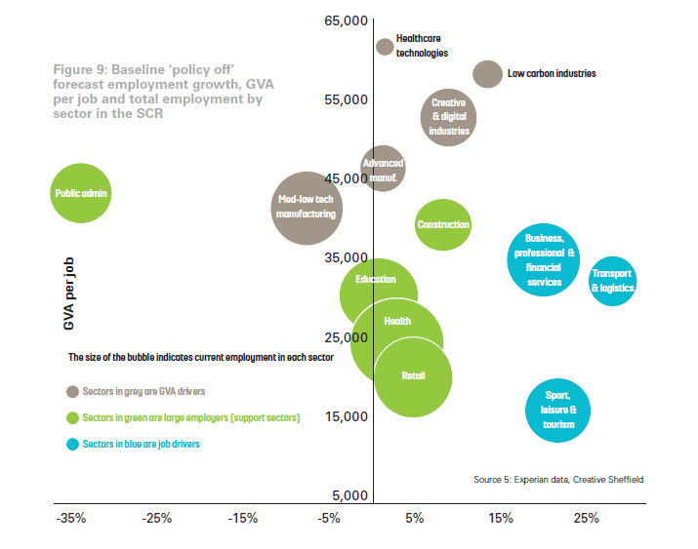

Slide 11
Why is it important for Barnsley to have more and better jobs?
Disconnect between business, and education and other parties
Lack of focus on digital skills within schooling/education of pupils, parents and business
Lack of the right infrastructure (digital, physical and support) to foster digital business start-up, growth and retention
Low awareness and take up of opportunities offered by digital tech in traditional economy
Fear of change in business, e.g. digitalisation, innovation
The Barnsley brand has negative connotations – mining, place etc
For businesses | Increased innovation and productivity Improved quality products and services Attraction and retention of talented people
For people | More and better job opportunities More money Greater quality of life Improved lifestyle leading to better health and wellbeing Higher aspirations
For the local economy | More local spend from the public and businesses More money for local government to spend on town services and development More attractive place to live

Slide 12
Problem tree
Disconnect between business, and education and other parties
Lack of focus on digital skills within schooling/education of pupils, parents and business
Lack of the right infrastructure (digital, physical and support) to foster digital business start-up, growth and retention
Low awareness and take up of opportunities offered by digital tech in traditional economy
Fear of change in business, e.g. digitalisation, innovation
The Barnsley brand has negative connotations – mining, place etc

Slide 13

Lack of job ready
graduates
Need to employ people
who haven’t got the
necessary skills and train them
Brain drain from Barnsley – people
live here, but work elsewhere
Low take-up from digital sector of
skills funding schemes
Digital talent and companies are
locating in Sheffield/elsewhere
Ambition to adopt digital within
companies, but lacking strategy, planning
and confidence/guidance to progress
People don’t access
local tech jobs
Lack of integration of digital in
personal-development planning
Lack of entrepreneurial
culture/spirit and ideas
Hard to retain talent in digital roles
Effects
Low skilled, low paid jobs
Can be seen as an embarrassment
to succeed
Lack of a clear vision or
understanding of technology
Digital skills seen as ‘nerdy’
Lack of soft skills for business
in young people
Low aspirations/ambition
of young people - disenfranchised
Unfilled vacancies
Changing the perception
of Barnsley’s brand
Disconnect between business,
and education and other parties
Lack of awareness of opportunities offered by digital tech in traditional economy
Problem
Schooling/education of pupils, parents
and business
Need the right infrastructure to foster
business s start-up, growth and retention
Fear of change in business,
e.g. digitalisation, innovation
Differences in digital skill
levels between age groups
Larger city regions and Tech Nation/Tech
North don’t recognise Barnsley
People don’t believe
in themselves / low aspiration
High expectations – want to
work for Google for £££
Educational system not
aligned to business needs. Out
of date digital curriculum.
Lack of digital talent/skills
Strong digital clusters in
Leeds and Sheffield
Lure of the city
Causes
Risk averse culture
Complex digital environment
Lack of digital
role models
Limited innovation
Difficult to ascertain
level of digital talent
Low educational
attainment
Poor careers advice
Lack of communication forum for collaboration
between business and education
City-centric universities,
lack of engagement
Low awareness of digital in
traditional sectors
Decline of traditional
industry
Difficult to quantify
benefits/risks
of digital adoption
Centres of excellence, e.g.
universities and UTCs in cities
Poor reputation of
Barnsley brand
Young people aren’t
aware of digital jobs
Public sector needs to be seen
to achieve results

Slide 14
Initial Objectives
Linking the business and education sectors to promote communication and help develop skills and a digital talent stream.
Business engagement activities to reduce the fear of change, e.g. the use of new innovation approaches and awareness of digital technologies.
Developing the infrastructure and support for entrepreneurship, start-ups and business growth with a focus on digital.
Having an impact on Barnsley’s brand through positive marketing of the group’s activities and news from the wider digital community.

Slide 15
Our problem reframed
In Barnsley, there are a low number of job opportunities and the jobs that are available tend to be low-skilled.
Our objectives reframed
We want to address this problem through a digital lens:
1) To create more high skilled digital and tech job opportunities.
2) To develop a supply of talented people to fill digital and tech job opportunities.
In other words, we want to use digital as an enabler to create More and Better Jobs.

Slide 16
Short term wins
New, stronger relationship with local College
Activity programme to highlight wide ranging nature of digital and tech
Connected Healthcare & Connected Manufacturing
Launchpad start up programme
Closer connections with city regions
Medium term goals
New courses/content at the College and beyond influenced by employers
Address infrastructure challenges
Raise awareness of DMC and digital careers
Target start up activity at digital and tech ideas
Upskill traditional industries
Long term future
Strong skills pipeline
Digitally enabled businesses
More and better jobs!

