Slide 1

INNOVATIVE TECHNOLOGY FOR SAFE AND SUSTAINABLE AGRICULTURAL SYSTEM
PhD. Ariola MORINA

Slide 2

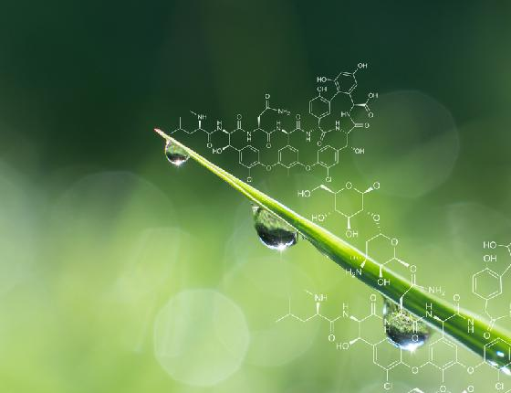
Partnership and the Future of Agricultural System
According to FAO, under current
circonstances, by 2050 the agri-food
sector will have to generate 50% more
food and feed to be able to meet the
increased demand for food.
Innovative technology and
partnership will enable safe
and sustainable systems for
the production of nutritional,
affordable and safer food.

Slide 3

Food and Agricultural System are facing an unprecedented confluence of changes
Climate changing and intensification of natural hazards
Planting zone shifting
Increase in extreme weather
Insect range expansion
Crop disease increases
Impact on water availability
Rising in population
1980 – 4.4 Billion
2020 – 7.8 Billion
2050 – 9.7 Billion
Declining arable land
1970 – 0.38 ha/person
2000 – 0.23 ha/person
2050 – 0.15 ha/person
Food loss and waste
- FAO estimated that 1/3 of all food produced globally is lost or goes to waste.

Slide 4
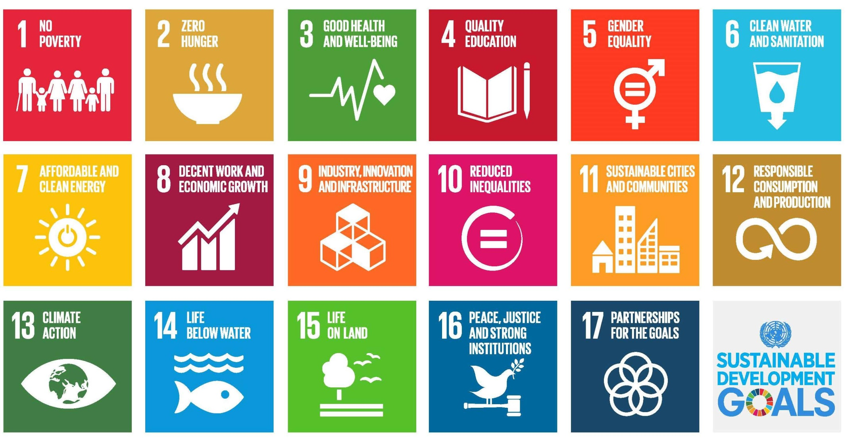
A new ambitions and innovative world vision 17 goals to transform our world

Slide 5
Resource productivity improvements that help meet the future’s needs
Achieving resource productivity
Improvements would off-set the
increase in land demand and water
demand
Increasing yields on large/small scale farms
Reducing food waste
Reducing land degradation
Improving irrigation techniques
Adoption of technology innovation leads to increase in crop yields. Key drivers:
Improved germplasm breeding
Better farm equipment
Optimized nutrient usage
Better water management
Crop protection products
Adoption of biotechnology traits
Application of biotechnology in crop production brings safe and delivers yield, economic and environmental benefits by using fewer pesticides, lower greenhouse gas emissions, increased yields, improved soil quality

Slide 6

Management of Food Lost and Waste
Environmental impact
More food reaches landfill and
incinerates than any other
waste, according to estimates
from USEPA.
Food waste is the third largest
producer of methane gas
behind China and USA,
making it an important
contributor to global warming.
“Think of the natural resources we would save – water, land, energy – if food production is more efficient.”- John Kerry, US Secretary of State.
Food loss and waste is a significant issue up and down the value chain. Emerging technology innovations are stepping up to meet the challenge.

Slide 7
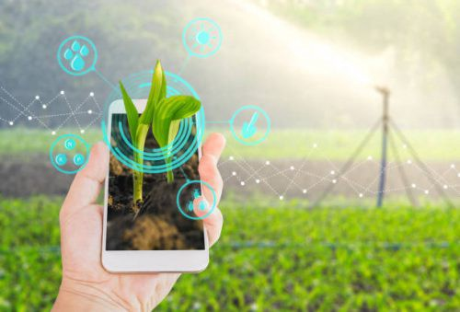
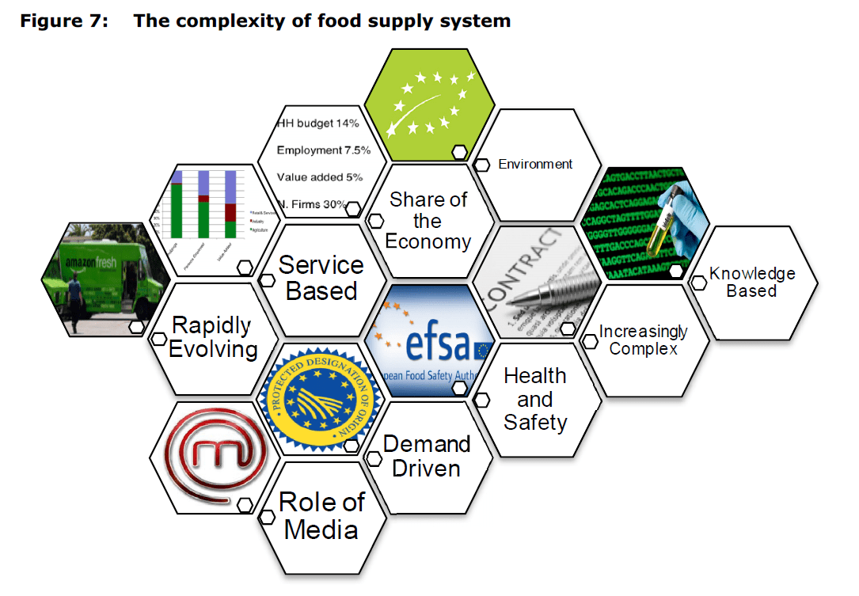
Innovation addresses weak links
There are opportunity to take a more system based approach to cut food waste throughout the entire food chain from farm level right through to the dining table.
Moving up the supply chain innovators are also focusing their efforts on how waste from the production process can be brought back into a circular economy model.
“Waste bio engineering is a model that can be applied to other food supply chains. It takes the finding of technological chemical solutions to valorize waste streams.

Slide 8
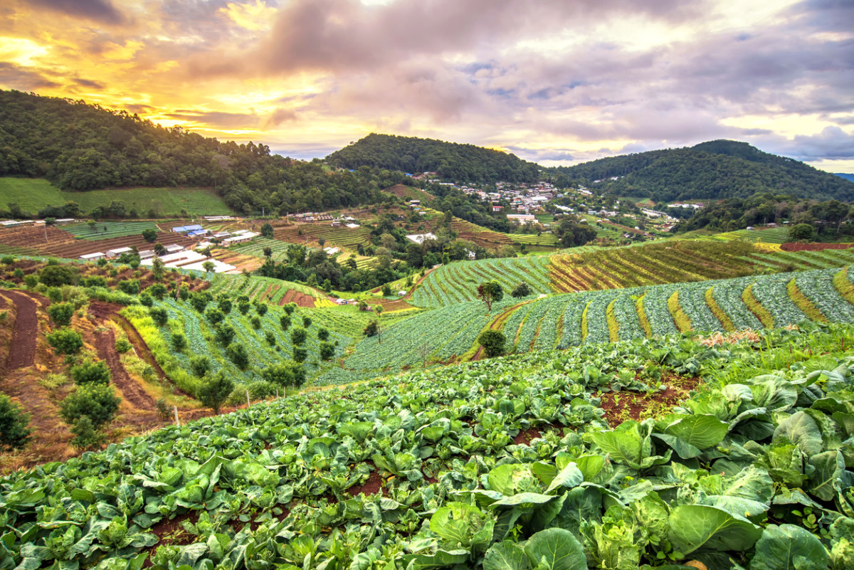
Strategies on innovation for sustainable food and agricultural system
Enabling environment at different levels:
Local, National and Global
R&D – Science, Technology and Innovation
Investment and Financing
Policies and Incentives
Governance and Institution

Slide 9
Global challenges for the future of food and agricultural systems
Agriculture productivity
Population increase, High urbanisation and economic growth of developing countries putting pressure on the demand.
Conservation of resources and environment
Increased water and land usage for agriculture
CO2 emissions
Improvement of nutrition and public health
Hunger and obesity disparities
Diet-related chronic diseases
Difficult adoption of healthy diets across developed countries
Fertilizers consumption
The production of high-calorie but low-nutrition food, reduced access of small-scale farmers to distribution channels, high levels of food loss and important ecological footprint.
Deforestation and topsoil erosion
“GREAT FOOD TRANSFORMATION”
Food security
Food safety and health
Sustainability

Slide 10
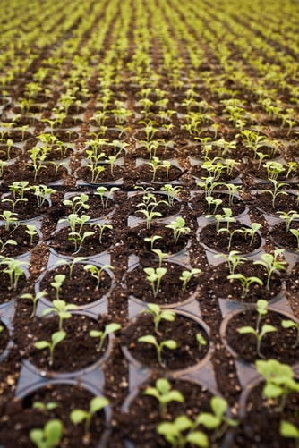
Conclusions
People
The way forward
Target “Sustainability for all” scenario and commit to:
strong environmental protection actions
major improvements in food production practices via technology
healthy dietary patterns
No need for increase in agricultural production by 50% in order to meet the SDG targets.
Population growth and ageing
Economic growth
Consumption patterns
Urbanisation
Global challenges affecting and potentially disturbing the future of food and agricultural systems
Global forces driving the future evolution of the food chain
Technology
Tech innovation
Digitalisation
Nature
Climate change and pollution
Competition on resources
Food waste

Slide 11

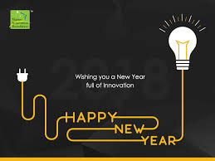
amorina@ubt.edu.al

