Slide 1





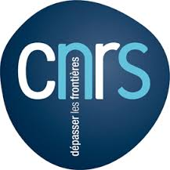
Linking Networks of Protected Areas to territorial development -
LinkPAs Project)

Slide 2
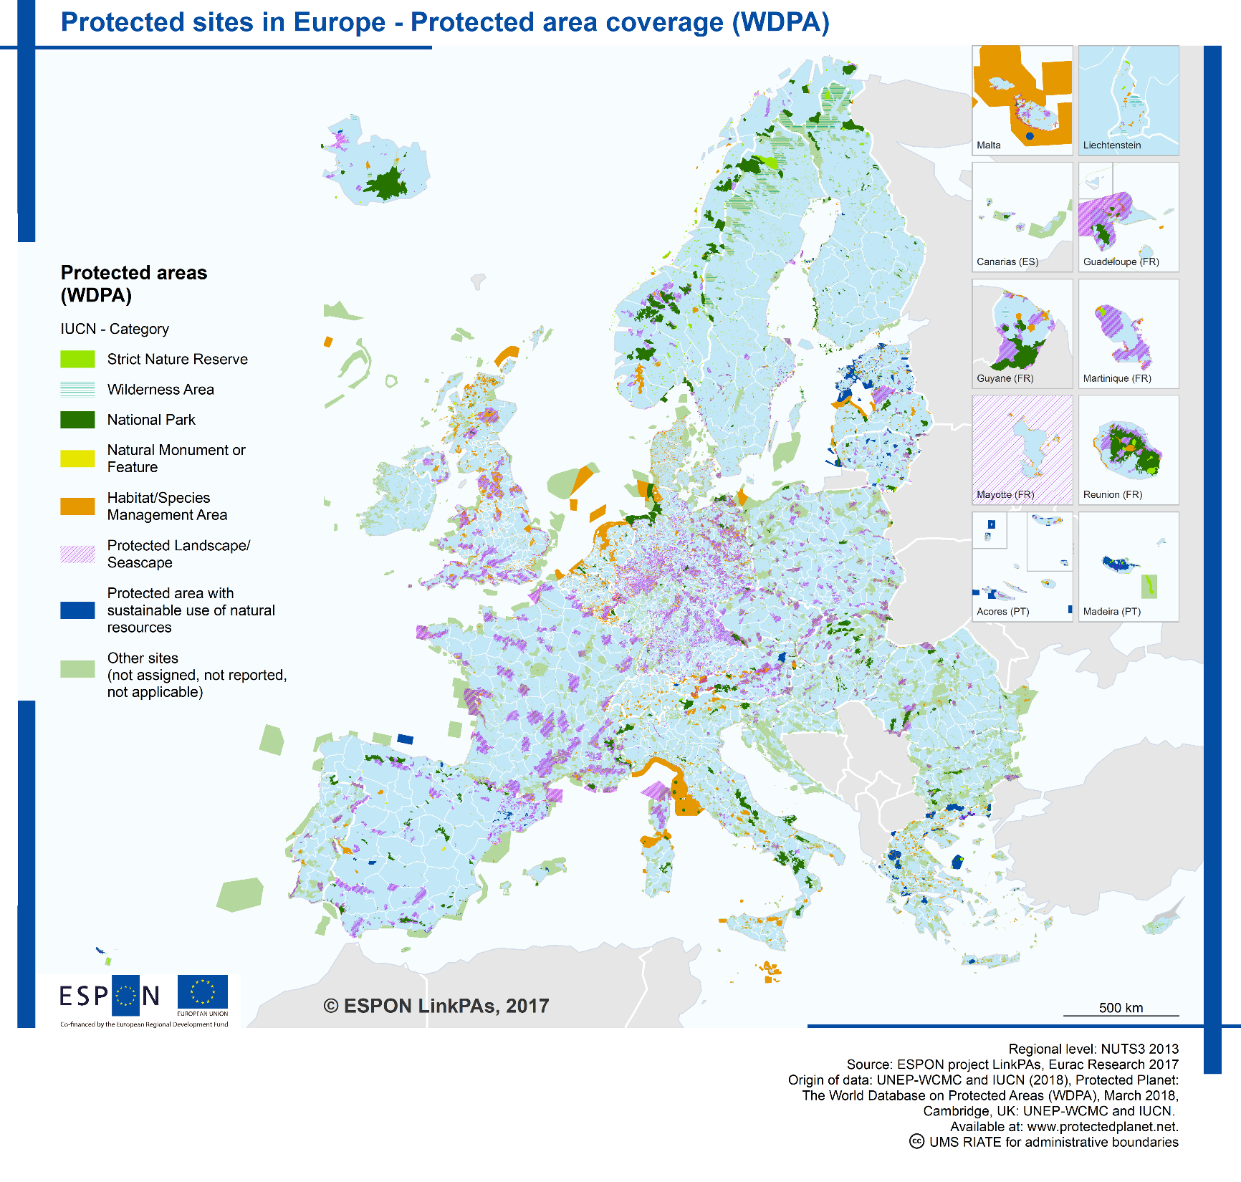
What were the main challenges for LinkPAs Target Analysis?
0

Slide 3
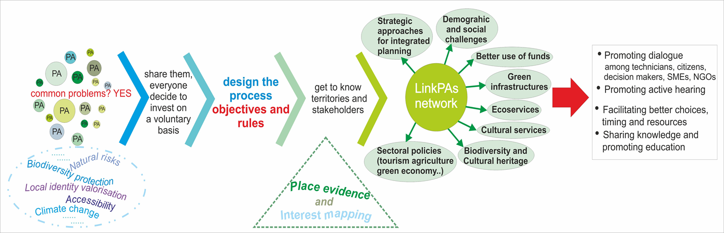
LinkPAs project
general main attended outcomes
The new evidence on the impact of Networks of Protected Areas (NPAs) on territorial development, and recommendations for successful integration of the management of natural resources into sectoral strategies;
Identification of the features and extent of the application of NPAs;
Identification of the main relevant sector policies on which NPAs impact on and the territorial specificities to be connected with;
Data collection at regional scale and per relevant sectors and identification of indicators for monitoring outcomes of actions undertaken within NPAs and their effects on policy sectors, especially “green economy” sectors.

Slide 4
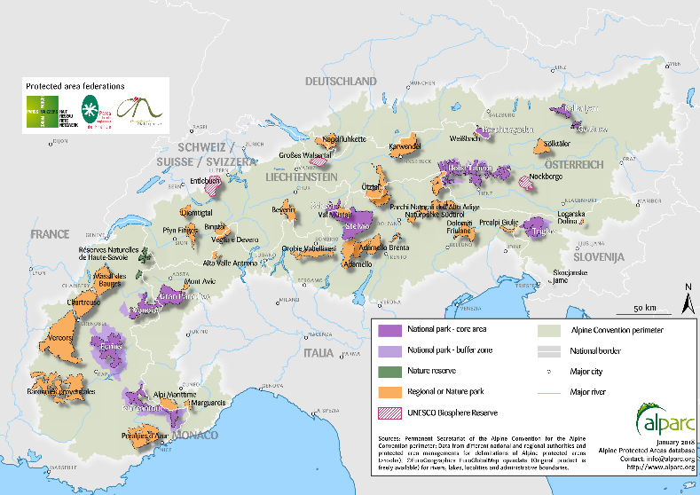
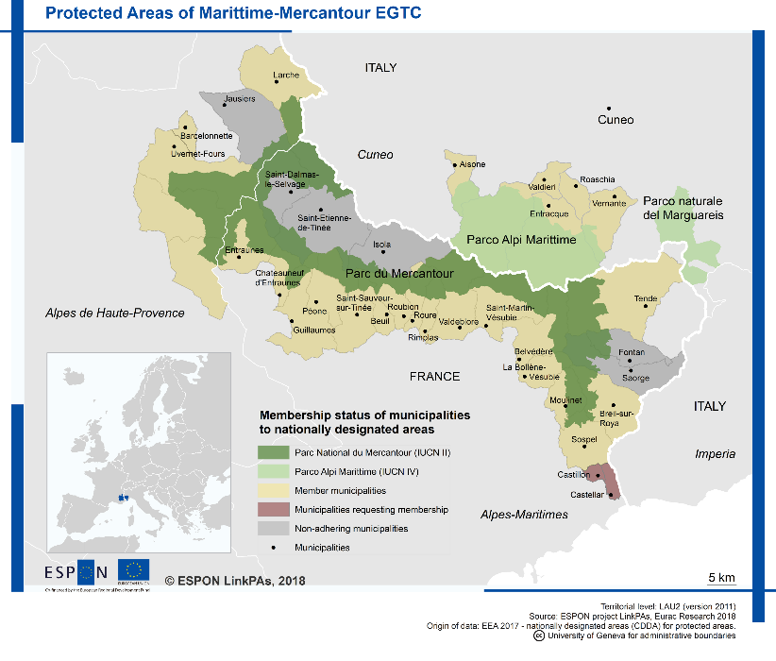
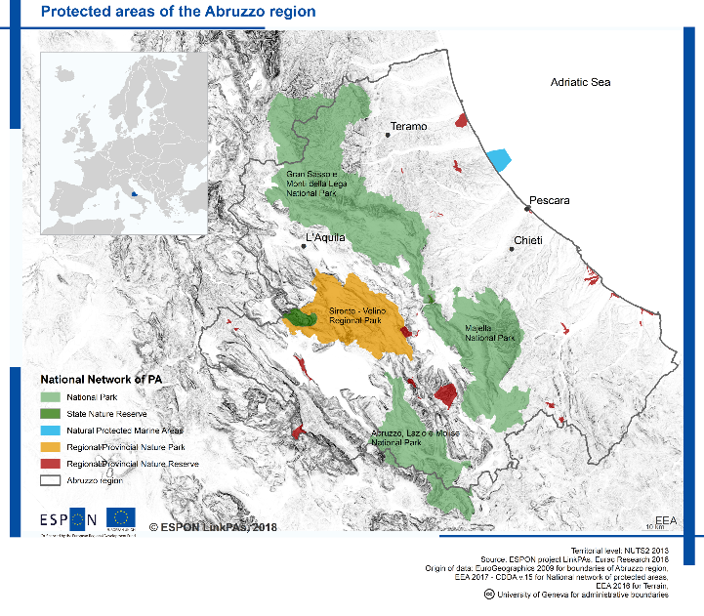
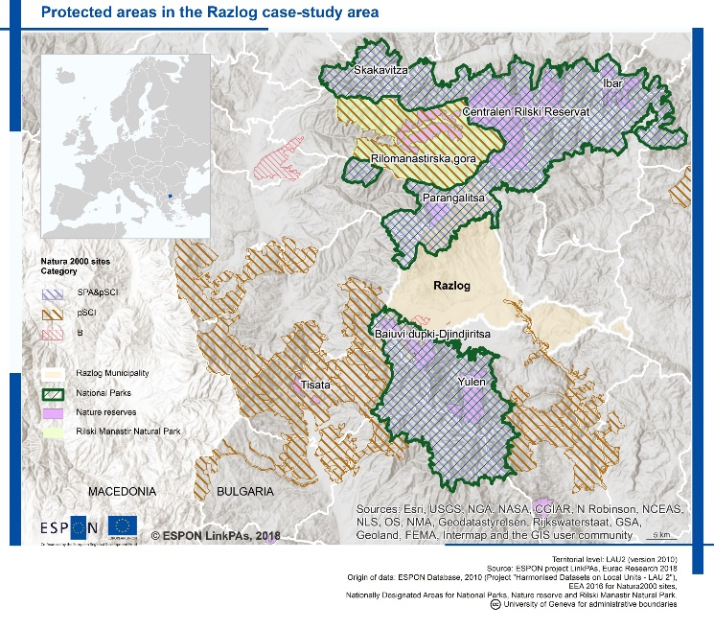
5 key questions by 4 Stakeholders at different levels
Different types of NPAs in European mountain and in the stakeholder territories
NPAs contribution to developing and implementing sustainable territorial development strategies
Policy sectors NPAs impact on
Actions and/or policies needed to ensure a sustainable and integrated management of natural resources in mountain areas
NPAs role and governance in supporting local business development (main economic sectors, schemes, financial and legal framework, policy dialogue and cross-sectoral approaches, stakeholder involvement methods, policy cycle assessment, SMEs and private sector investment mobilization in supporting green jobs and business creation)
ALPARC (international NPA)
Marittime-Mercantur (transboundary NPA)
Abruzzo (regional NPA)
Razlog (local NPA)

Slide 5
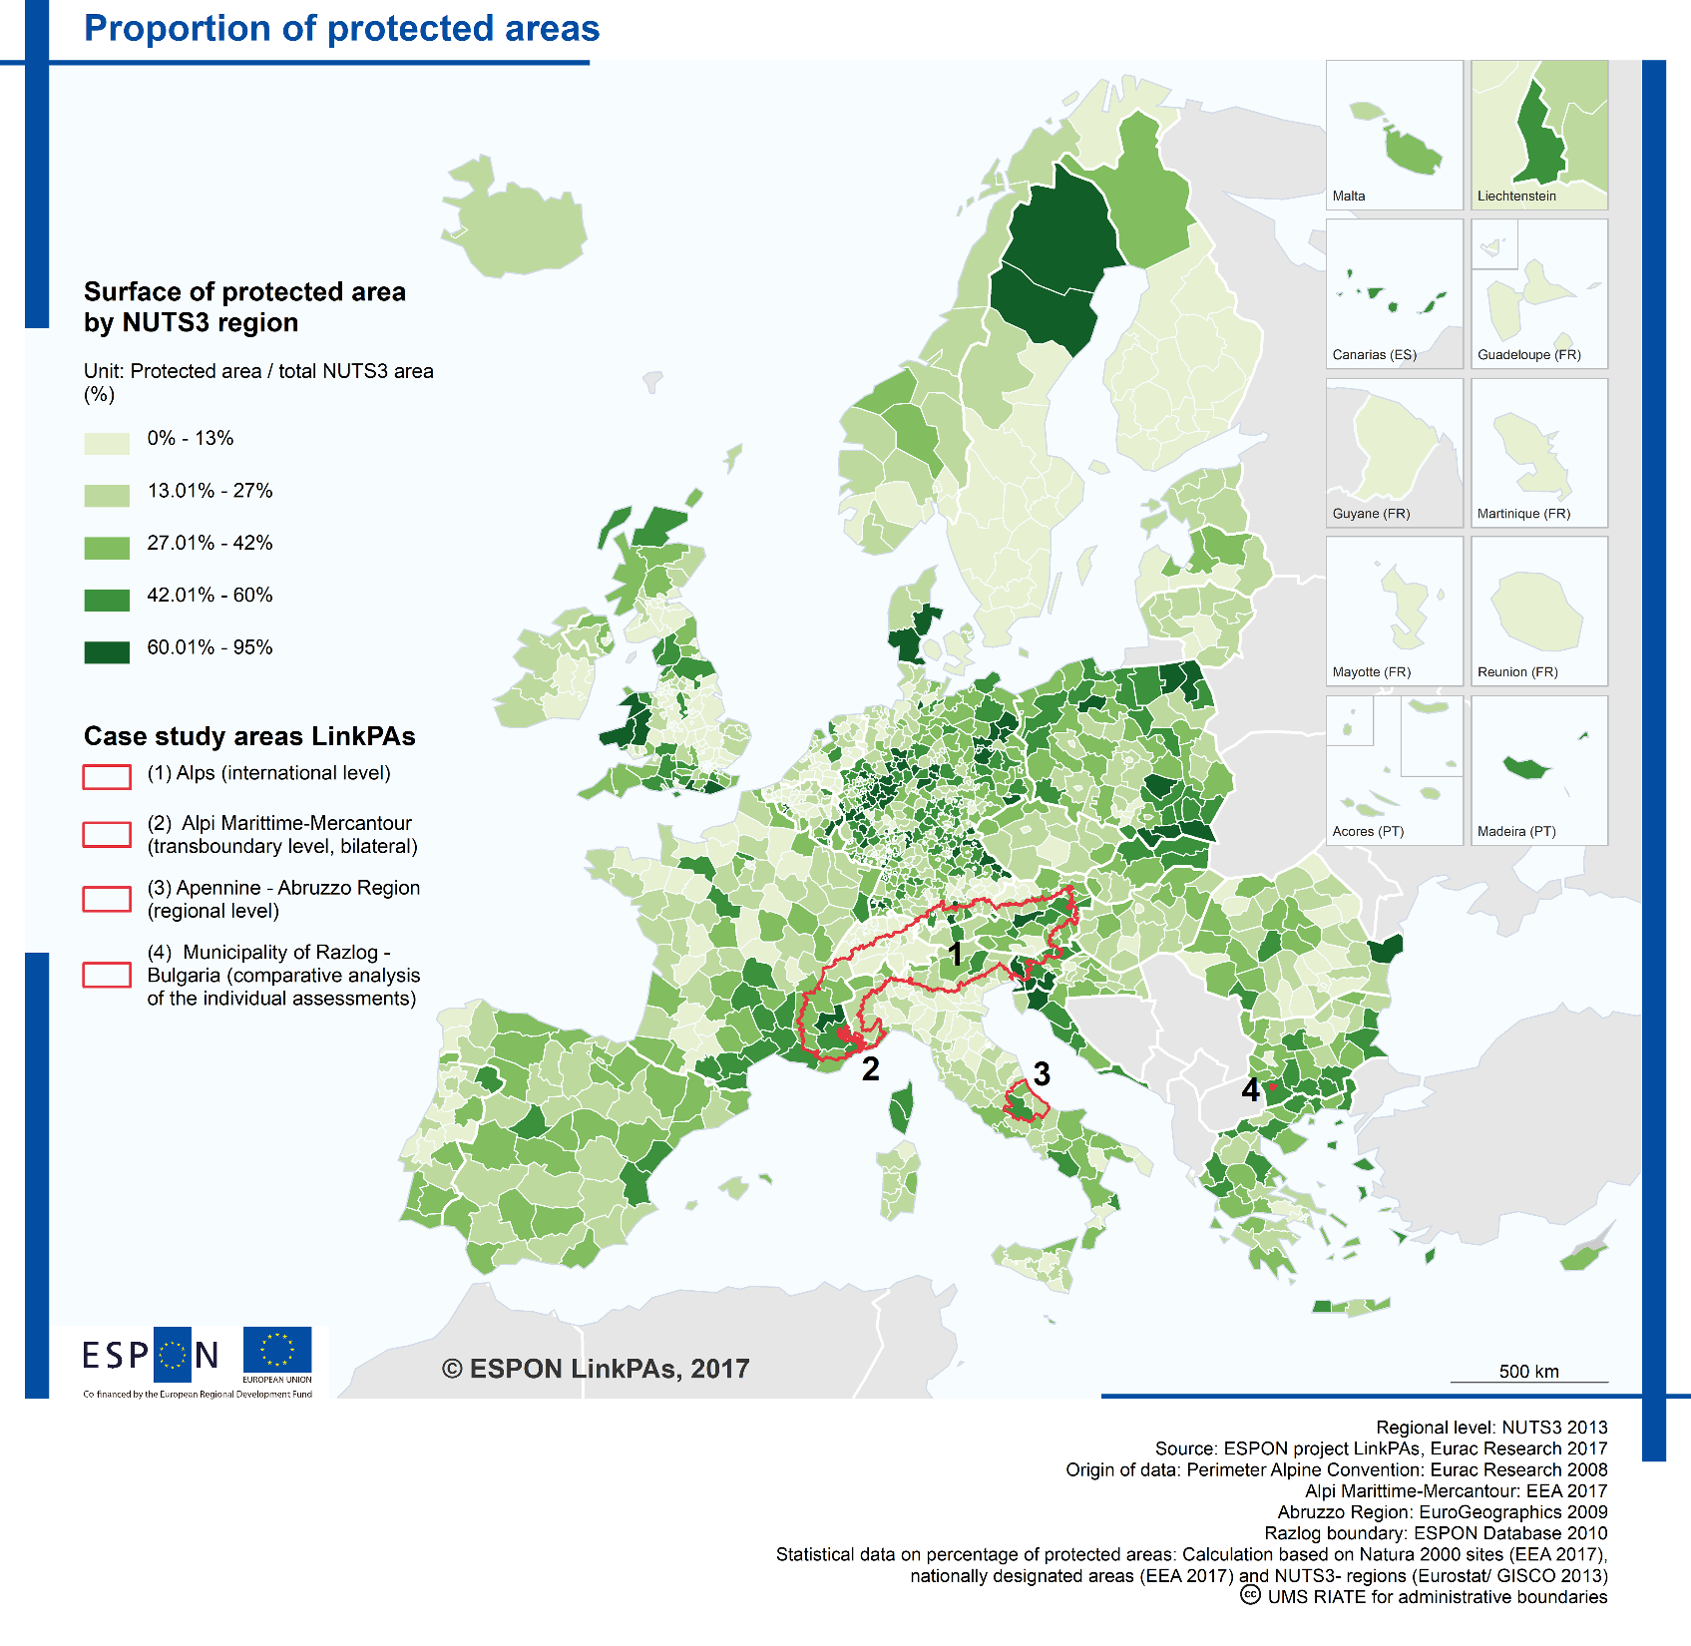
Analysis of NPAs evidence models:
16 operative NPAs analysed in deep
1

Slide 6
LinkPAs project analyses the Protected Areas (PAs) existing Europe (in 28+4 countries) related to GI, circular economy and green economy (policy sectors) where NPAs impact on
Institutional set up | Description | Countries
Presence of only one national network depending on a single agency | In the States with a more centralized governance, only one national network of PAs is established at national level by a general law; in some cases, the national authority identifies PAs in agreement with the subnational authority. In some cases (e.g. Germany) a shared process for the identification of PAs involving local authorities can be envisaged. | Czech Republic; Germany; Hungary; Ireland; Latvia; Lithuania; Luxembourg; Netherlands; Poland; Romania; Slovakia; Slovenia; Iceland; Liechtenstein; Norway; Switzerland
Presence of more national networks depending on different sectoral agencies | More national networks are established by sectoral authorities, e.g. authority for the forests or other sector policies. The PAs’ system comprises more than one networks relaying on different institutional bodies at national level. Generally one holds general objectives and the others specific objectives (e.g. forest management, hunting ..) | Bulgaria - Cyprus – Denmark- Malta
Presence of one or more national networks and subnational networks | In the States with shared competence on PAs among national and subnational authorities, a more complex situation emerges since both national and regional laws are able to establish national NPAs and regional and local NPAs. The PAs’ system comprises one or more national institutional networks together with other networks established at subnational levels. Formally the networks are independent one from each other. | Croatia; Estonia; Finland; France; Greece; Italy; Portugal; Spain; Sweden
Presence of only regional (county) networks | There is no national institutional body and a national federal law, the PAs’ system is determined at subnational level and there are only regional (county) networks. | Austria – Belgium - United Kingdom
Starting from the study of different existing models of NPAs across Europe, LinkPAs project built an overview of the different situations.
Four main types of institutional set-up for PAs have been found.

Slide 7
… and their models of governance
NPAs governance models are influenced by:
different levels of relationships between PAs;
the presence of an institutional framework for NPAs activities and the capacity of involving institutional bodies as well as other actors, public and private reflecting different interests;
the specificity in themes and scope in their activities.
In this sense, NPAs refer to a general model of polycentric governance holding the possibility to involve a large number of interdependent actors such as NGOs, the private sector, scientific networks, international institutions and citizens
In order to identify models of governance for NPAs, LinkPAs project established some criteria related to governance aspects; they can be gathered into four categories referring to:
the relationship between PAs within a network;
the relationship between NPAs and the related institutional framework;
iii) the relationship between PAs and the other involved actors;
iv) the specificity in themes and scope of NPAs’ aims and activities.

Slide 8
NPAs in EU and in stakeholders areas summarized within 4 MODELS:
MODEL 1 - NPAs established in the framework of agreements or conventions with a wider perspective (as ALPARC)
MODEL 2 - NPAs based on a shared programme to face common challenges from an ecological and/or environmental point of view (as Razlog and Abruzzo Region which could develop towards model 3)
MODEL 3 - Territorial networks: NPAs for the management of specific physiographic units (as EGTC Alpi Marittime /Mercantour)
MODEL 4 - NPAs as platforms addressing different topics and aiming at exchanging experiences (EUROPARC, MedPAN, European Geoparks Network, Protected Micro-Reserves, SAPA)

Slide 9
NPAs models: governance features, opportunities and challenges (1)
NPA models | Criteria combination (cluster) | Opportunities | Challenges
MODEL 1 - NPAs established in the framework of agreements or conventions with a wider perspective Example: ALPARC, CNPA, OSPAR, HELCOM, SPAMIs, BPAN | Existence of a strategic/ institutional agreement as political framework for the NPA. Existence of a shared action plan or programme identifying priorities and actions to be taken by/under the NPA. The NPA: applies to a geographically specific area; participates in institutional decision-making processes at the EU/Transnational/National/ Local level; involves PAs and territorial authorities. Existence of specific funds – external, public or private, EU, national or regional - supporting NPA activities. | The existence of an institutional agreement within which the network is established enhances its ability to contribute to the pinpointing of territorial strategies for the related geographical area; The NPA: is able to enforce policies for the protection of biodiversity in and outside the PA area and foster the strengthening of ecological networks; it promotes the exchange of experiences between Pas, which increases the effectiveness of PA actions; it promotes connections between PAs to strengthen partnerships – applicable to some of PAs within the network - on common themes and projects. NPA can mobilize additional resources for PAs. | Enhancing the involvement of local populations in the policy processes of the individual PAs. Depending on the extension of the area involved, this may or may not be advisable; Improving the possibility of influencing directly the activation of economic processes on a local scale while maintaining its links to broader strategies; Encouraging partnerships among PAs to implement pilot projects; developing innovative tools and agreements
MODEL 2 - NPAs based on a shared programme to face common challenges from an ecological and/or environmental point of view Example: DANUBEPARKS, MAIA, SAPA | Absence of a strategic/institutional agreement as political framework for the NPA Existence of a shared action plan or programme identifying priorities and actions to be taken by/under the NPA The NPA applies to a geographical specific area The NPA might involve PAs as well as territorial authorities. | The NPA promotes the exchange of experiences between PAs, which increases the effectiveness of PA actions; The NPA can strengthen partnerships among Pas, sharing common environmental challenges; The NPA is based on programmes and not on institutional agreements; this means that the NPA is a more flexible instrument of governance in terms of its establishment and management. | Improving the involvement of other institutional actors to activate biodiversity conservation policies outside PAs and better integrate them within territorial policies; Increasing the opportunities for PAs to develop joint activities that increase their ability to influence local decision-making processes and launch economic processes, including the possibility of attracting additional funds.

Slide 10
NPAs models: governance features, opportunities and challenges (2)
MODEL 3 - Territorial networks: NPAs for the management of specific physiographic units Example: EGTC Alpi Marittime/Mercantour, MAB Biosphere Reserve | Existence of a shared action plan or programme identifying priorities and actions to be taken by/under the NPA The NPA applies to a geographically specific area The NPA has decision-making power in substitution of or on behalf of PAs Existence of a continuous coordination of PA activities | The NPA is in a specific geographical, ecological, landscape area; this fosters the development of common strategies and projects for biodiversity management that are generally more effective than those that can be implemented by single PAs; Possibility of making use of well-known tools for the management of specific areas (e.g. ECTC, MAB..); The NPA can involve local populations, since it stresses the importance of the identity of such a specific area; Facing common issues with a shared programme allows for a more efficient utilization of available resources; The stable collaboration between PAs enhances their ability in proposing and/or taking part in projects and therefore the possibility of access to additional funds. | Strengthening the role of the NPA in developing wider territorial policies Strengthening the NPA’s role as a model for other similar territories; Improving the ability to involve the private sector and stimulate innovation as a basis to foster SMEs’ activities
MODEL 4 - NPAs as platforms addressing different topics and aiming at exchanging experiences Example: EUROPARK, MedPAN, European Geoparks Network | The NPA involves PAs and other territorial authorities and stakeholders The NPA focuses on shared topics The NPA might apply to a geographically specific area The NPA might have some internal funds (membership fees, if applicable) | The NPA facilitates the exchange of experiences and information between PAs, and knowledge on management aspects. The NPA can improve knowledge and raise awareness of a given territory or theme; It involves heterogeneous bodies such as stakeholders, experts, managing bodies of the PAs, institutional bodies, NGOs; It identifies and disseminates common guidelines and tools that can be applied by each PA to their own contexts (e.g. the European Chart of Sustainable Tourism - ECST set up by EUROPARC). | Enhancing the participation of PA management bodies and other bodies (institutional, private, stakeholders, experts) since part of the added value of this NPA is the heterogeneity of the actors involved; Increasing the ability to disseminate the experiences already developed and the results achieved by some PAs within the NPA; Tackling a greater number of issues addressed by the NPA by taking into account both the priorities emerging from the international policies and the specific needs of the individual PAs

Slide 11
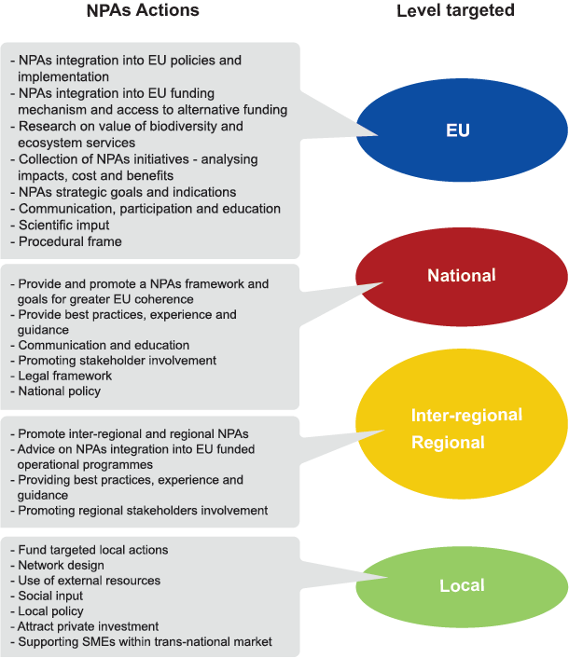
NPAs contribution to developing and implementing sustainable territorial development strategies
2

Slide 12
NPAs are the backbone of the European Green Infrastructure (GI) strategy
NPAs are able to help bio-diversity conservation across Europe as they respect the specific characteristics of each area and its local identity within the post-2010 biodiversity policy.
NPAs allow to adopt shared mitigation measures and policies to facilitate, in particular, the climate change adaptation, through management and sector development strategies, generally integrated within planning instruments (according to national/regional legislation)
In defining and implementing territorial development strategies, NPAs assigned and potential role depends on the territorial and policy context (i.e. countries with a planning system that integrates biodiversity concerns in all instruments; countries that adopt different planning tools for environmental and development plans; ….).
In relation with NPAs:
spatial planning focuses on the connectivity and accessibility of the natural and cultural components: mainly to ensure conservation, environmental protection, landscape development and facilitate the transition towards sustainability
spatial planning concentrates on the socio-economic interaction between established PAs and the territorial contexts: help to maintain the identity values of protected areas, often linked to resident communities

Slide 13
In the mountain regions, the role of the NPAs in territorial development appears particularly strategic considering that:
  in Europe, most mountain regions extend over national borders and cooperation between neighboring countries is crucial for their sustainable development;
  mountain areas (with large cover of forest in the European context) have a central role in providing most ecosystems services from a quantitative and qualitative standpoint and for this reason protected areas play a strategic role in promoting a more balanced development model.
The specific ecosystem services provided by Mountain Protected Areas (MPAs) are:
i) the provisioning services, food, fibre, fresh water;
ii) regulating services, erosion control, climate adaptation
iii) cultural services, recreation and ecotourism, aesthetic and spiritual values

Slide 14
Policy sectors
NPAs impact on
3

Slide 15
NPAs have the potential to interlink the different sectors, promote synergy and overcome sectoral limits and administrative boundaries.
Starting from GI related policy sectors: Nature/Biodiversity; Spatial planning; Urban policy; Agriculture; Forestry; Tourism and leisure; Transport infrastructure; Energy; Water/flood management and disaster risk reduction; Climate change; Marine and coastal policy, LinkPAs project defined sector policies that NPAs impact on by means of analysis of policy documents and plan related to stakeholders’ territories, the policy sectors that the NPAs have a significant impact within the stakeholder regions are:
Biodiversity; Conservation; Tourism and recreation; Education
In addition, tight links can funded in relation to Agriculture and Forestry in order to promote multifunctional resilient agriculture and forestry; Investment and employment when it comes to promoted a better image of NPAs themselves; enhancing Transport by encouraging sustainable travelling (e.g. multimodal links and integration of transport systems); NPAs are connected to the Ecoservices in order to improve the resilience of these areas.

Slide 16
Actions and/or policies needed to ensure a sustainable and integrated management of natural resources in mountain areas
4

Slide 17
By analysis of case studies (in stakeholders regions), LinkPAs project highlights the NPAs share some common characters.
They can influence and shape territorial development by:
  (1) influencing regional or national policies;
  (2) exchanging knowledge and experiences;
  (3) obtaining funding to develop projects.
  Therefore:
    Policies/strategies and available funding instruments are key requirements for NPAs to achieve territorial impacts.
    The domain of territorial impact has been selected to link policy and funding with results that can be concretely detected and assessed.
    Exchange and coordination are the only aspects that can have a direct and real impact on the territories, without being directly linked to funding instruments or concrete policies.
    PAs can thus be fully shaped and managed by NPAs, whereas concrete projects, changes in legislation, planning or administrative processes which require links to either corresponding funding programmes or appropriate strategies and policies

Slide 18
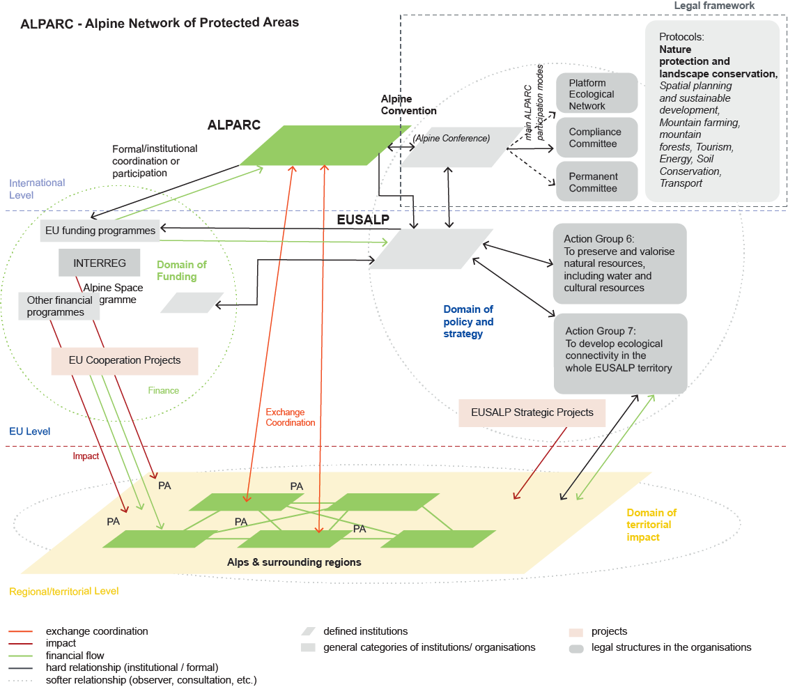
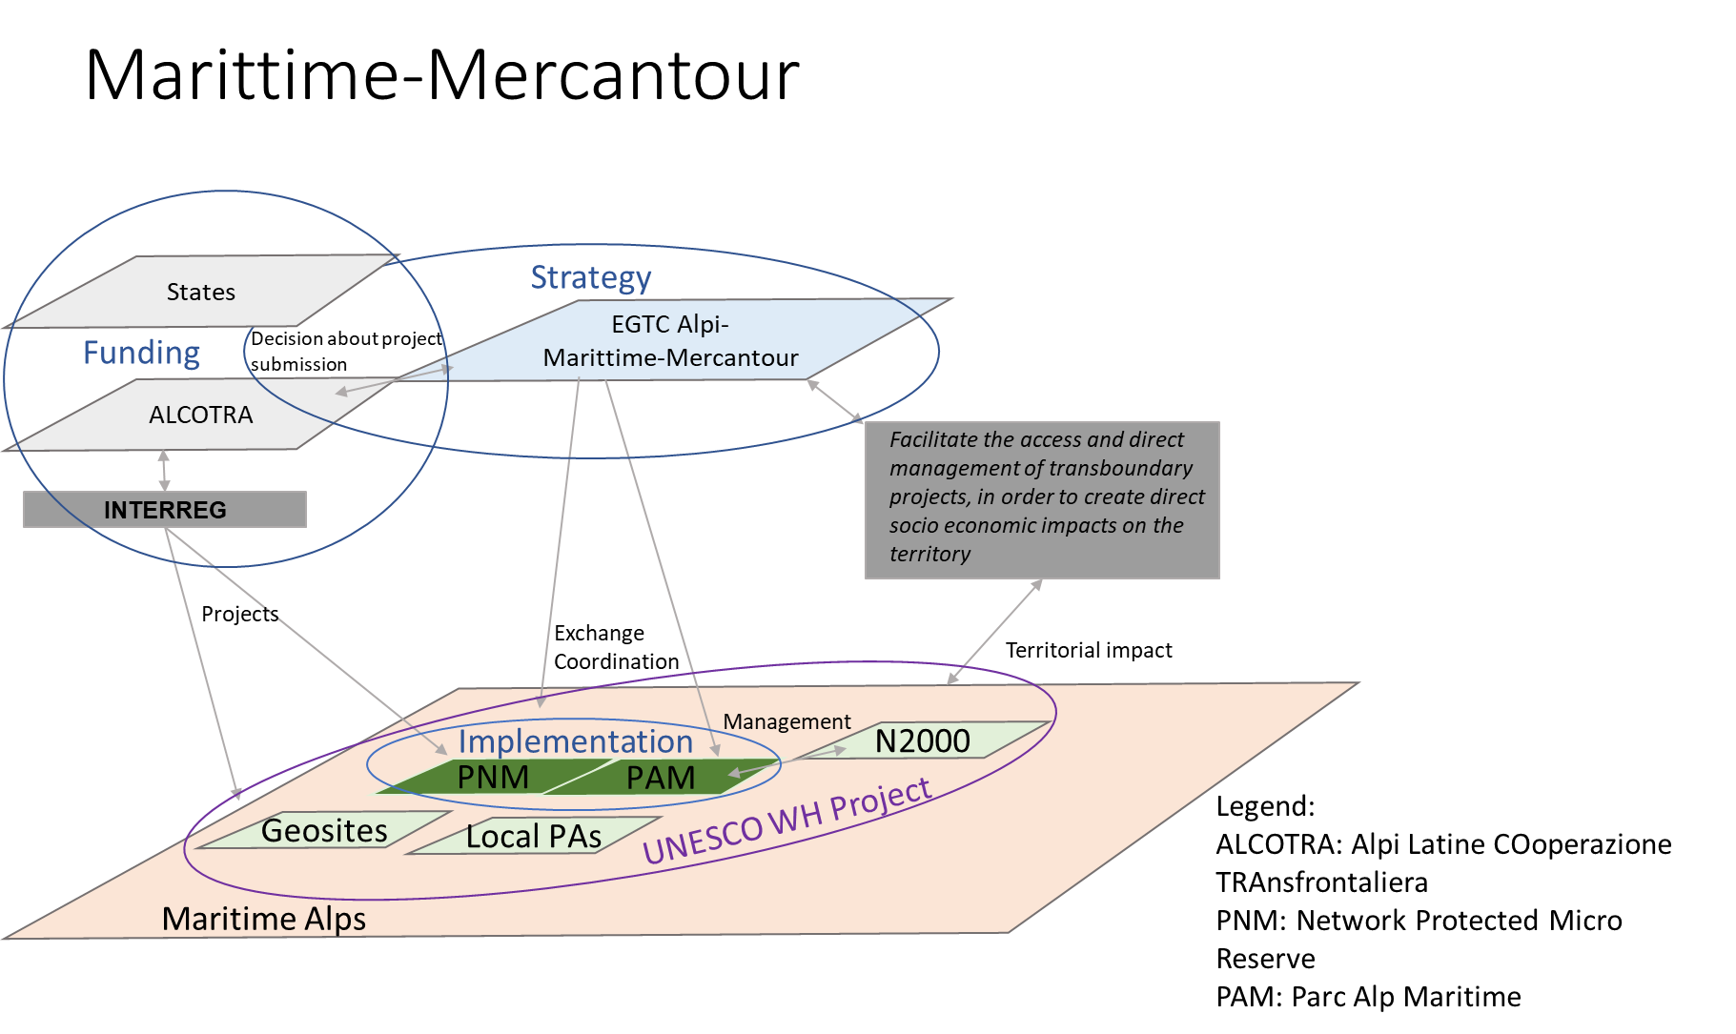
Spheres of influence of ALPARC case study: (1) Domains of Funding, (2) Policy and Strategy and (3) territorial impact
Spheres of influence of Alpi Marittime – Mercantour case study: (1) Domains of Funding, (2) Policy and Strategy and (3) territorial impact

Slide 19
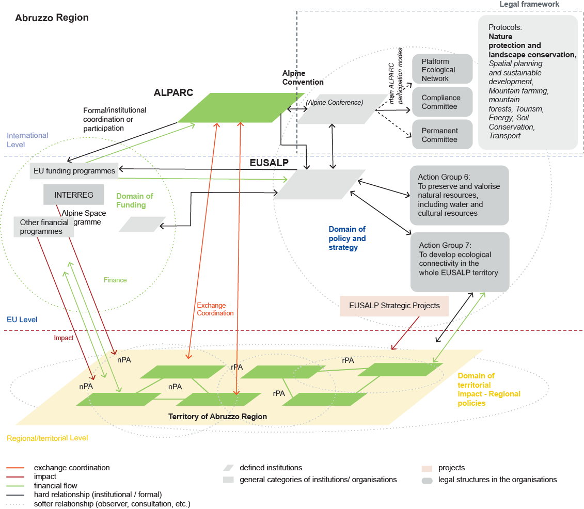
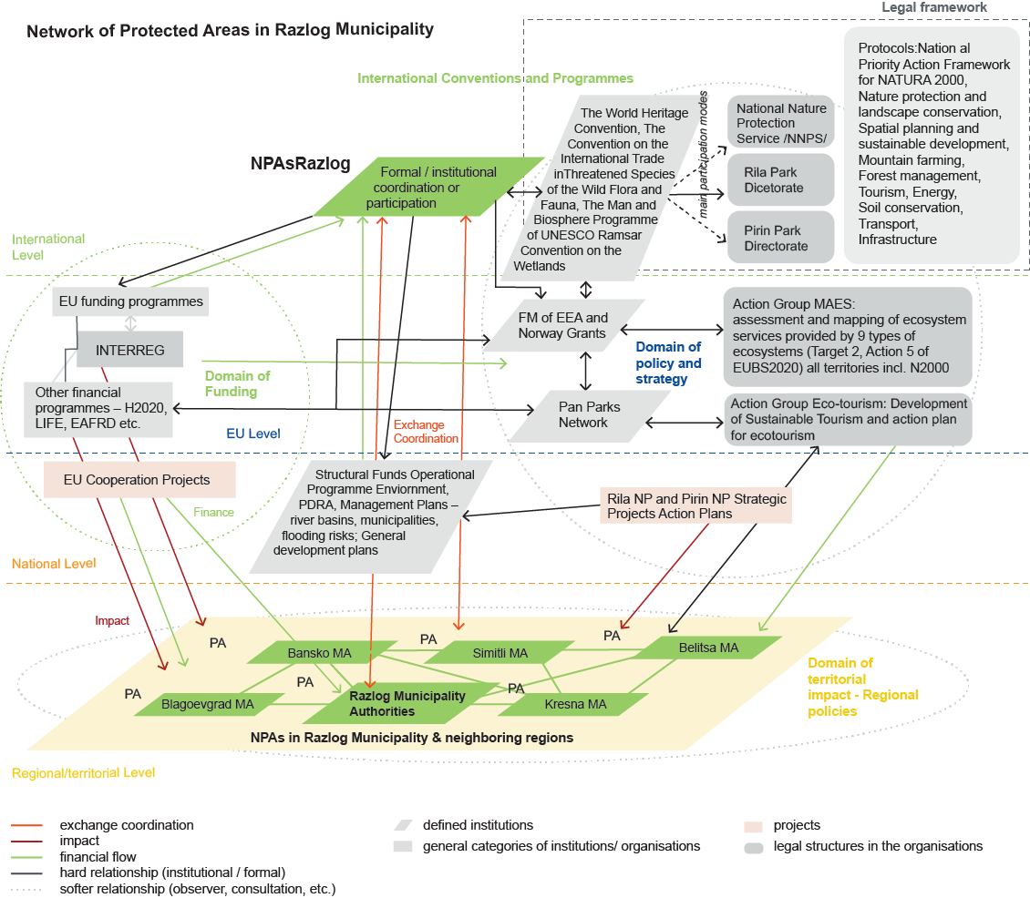
Spheres of influence of Abruzzo Region case study: (1) Domains of Funding, (2) Policy and Strategy and (3) territorial impact, (4) Domain of Funding
Spheres of influence of Razlog Municipality case study: (1) Domains of Funding, (2) Policy and Strategy and (3) territorial impact, (4) Domain of Funding

Slide 20
Common elements in governance models
LinkPAs project identified
all NPAs are directly linked to the involved PAs and consequently, in different ways, to the municipalities;
all NPAs have directly connections with central and regional administrative bodies;
all NPAs pay particular attention to international and EU conservation policies, especially to GI;
all NPAs focus on monitoring tools;
all NPAs consider financial and communication aspects as important to involve local actors such as SMEs, citizens, NGOs, etc.

Slide 21
The main features of a broad organisation and management model that can be applied to integrate the NPAs’ management into sector development strategies are:
Establishing a unified and harmonised planning strategy that sets a well-defined role for the NPAs within a given territory;
This strategic planning document should clearly define the role of the NPAs, which become:
  Bodies of territorial cooperation aiming at: orienting policy; maintaining international and European relations; linking with EU cooperation programs; interacting with international, European, transnational, national and regional strategies; suggesting innovative paths for sustainable territorial development; and assessing PA actions qualitatively and quantitatively, along with ex ante and ex post assessment tools. The NPAs can actively relate to the government, regions, and municipalities in accordance with their institutional set-up and sectoral focus. They can coordinate PA actions; they can collaborate on and promote the development of development strategies within PA territory.
  instruments that allow to receive, interpret and implement the directives linked to GIs on the basis of territorial diversity. The NPAs operate at technical level and interact with the political actors, thus also enhancing lobbying activities.

Slide 22
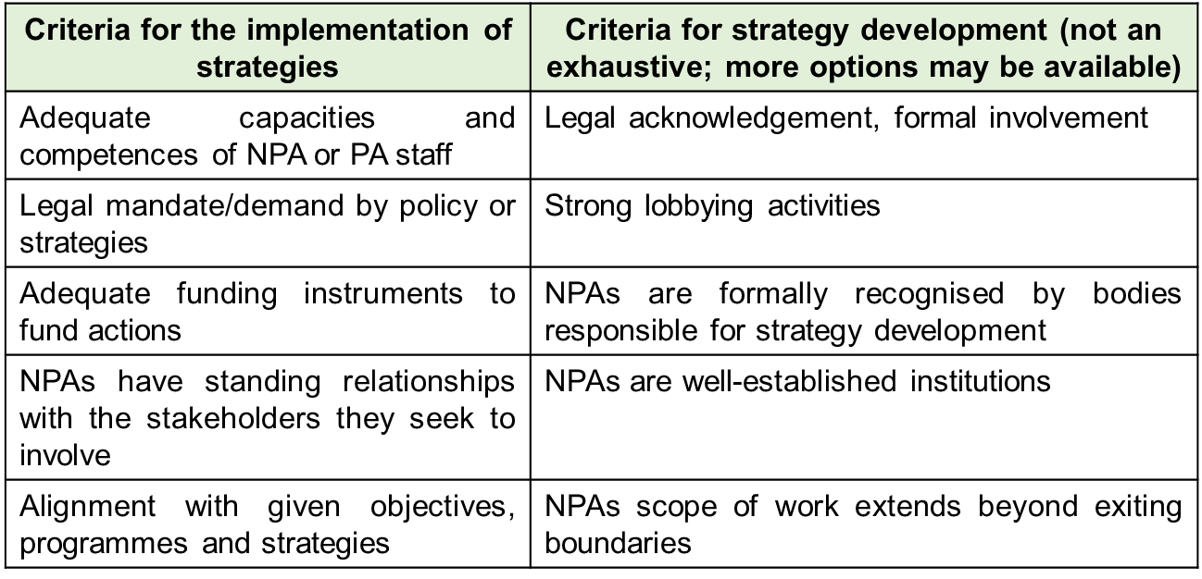
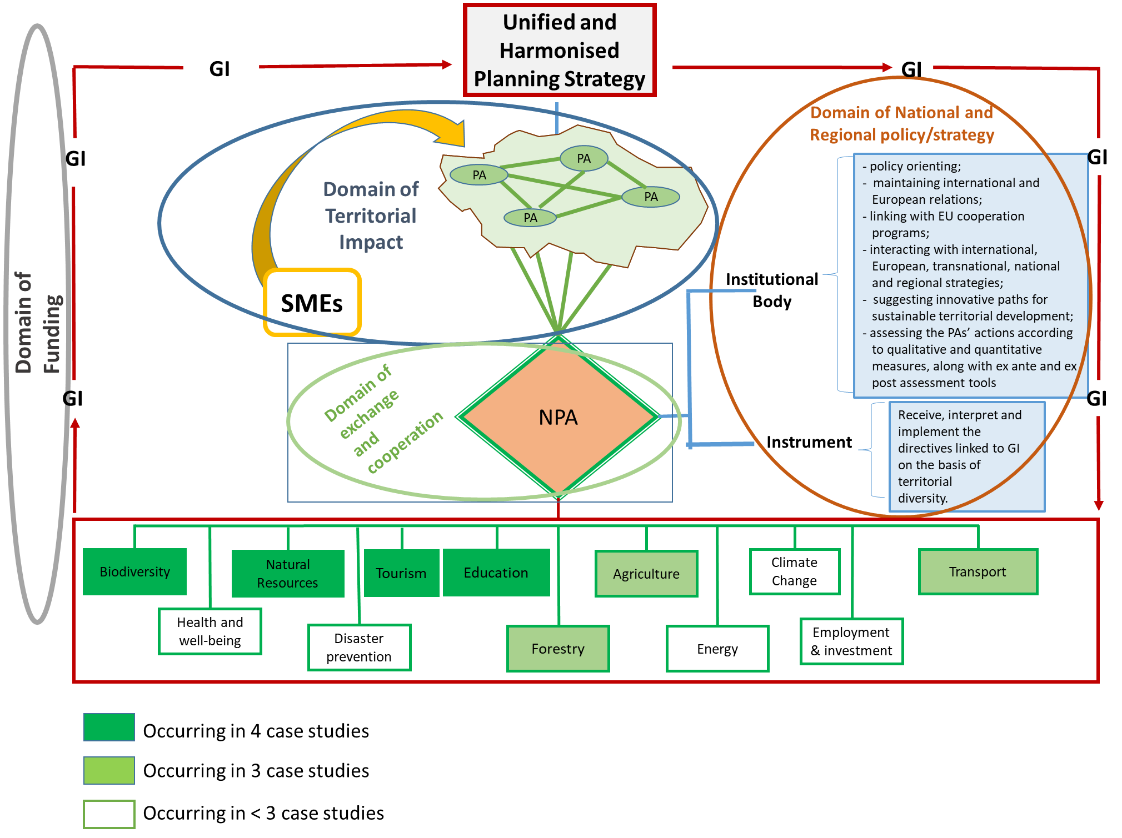
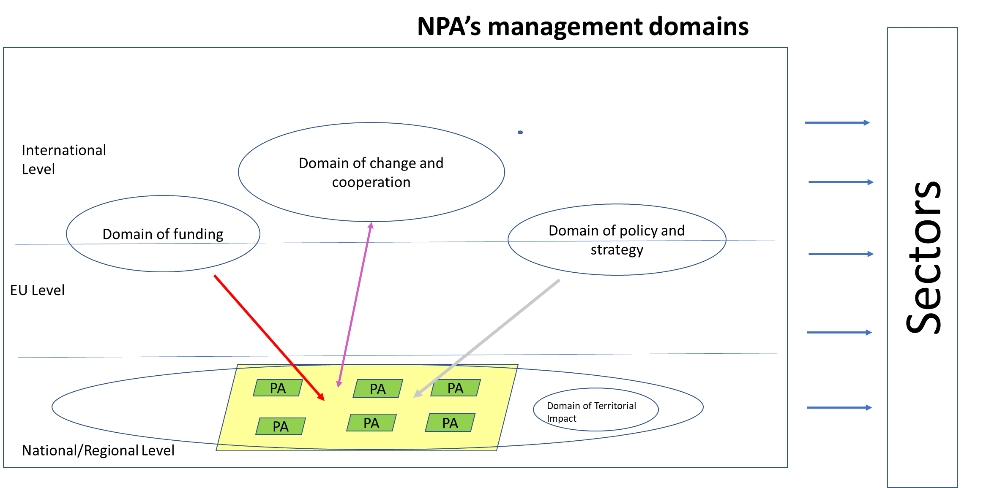
Some mechanisms may help NPAs to fulfil their role in sustainable territorial development by case studies
LinkPAs proposed an EGTC unified management model

Slide 23
NPAs role and governance in supporting local business development
5

Slide 24
Category of policy instruments | Non-Standardised governance needs to manage green policy instruments in PAs and mountain zones
Regulatory instruments (command & control) | assuring compliance and enforcement of rules, effective PA management and financing effective monitoring on enforcement, knowledge on local communities and issues, know-how on stakeholder consultations
Economic instruments | mechanisms for knowledge sharing, information on resource endowment, information on tax bases (potential), shared database for environmental, ecosystem and assets information
Information | shared database for environmental, ecosystem and assets information, available knowledge on green consumerism / green marketing, availability of good institutional relationships (vertical governance e.g. for GPP), availability of good business relationships (horizontal governance), knowledge and trade-off management

Slide 25
Policy recommendations for integrating NPAs into territorial and sectoral development strategies
6

Slide 26
…in general
…for mountain areas
Agree on a set of common measures (e.g. drafting sub-forms of operative and infrastructural projects) directly targeting PAs with very low I&R profiles.
Propose policies aimed at helping communities deal with the digital transition, especially those in mountain PAs; help local SMEs improve their international outlook;
Focus on the middle-aged population and on women and migrants, encouraging them acquire new skills that can help them re-enter the labour market.
Link I&R to local SMEs to increase their access to new ESIF with a more strictly joint collaboration between SMEs, regional institutions, and the educational/research system;
Encourage communication, disseminate projects and results across the local/regional system so as to foster public-private cooperation within PAs;
Accept and commit to major European and international agreements; agree to the experimental use of the European strategic impact assessment processes, particularly TIA and SEA, as applied to policies, programmes and plans at different subsidiary levels;
Improving the EU GI policy in order to make the EU Biodiversity Strategy more effective
Experimenting with new multi-level governance models
Extending the NPAs field of action across different territorial dimensions (identity, traditions, legislation, regulations, attitudes, economic activities, etc.) and within the framework of EU policies
Adopting ecoservices accounting within the framework of territorial diversity
Stressing the experience of NPAs in the sustainable management of natural resources
Supporting the designing and/or implementation of policy instruments to involve local business in territorial development
Promoting training and professional education for improving capacities on the NPAs to support the development and growth of SMEs within PAs and in surrounding territories.
Enhancing the NPAs’ role in implementing Integrated Territorial Investment, Structural Funds (ESIF) and EU Infrastructural Plans to help PAs management in mountain area.

Slide 27
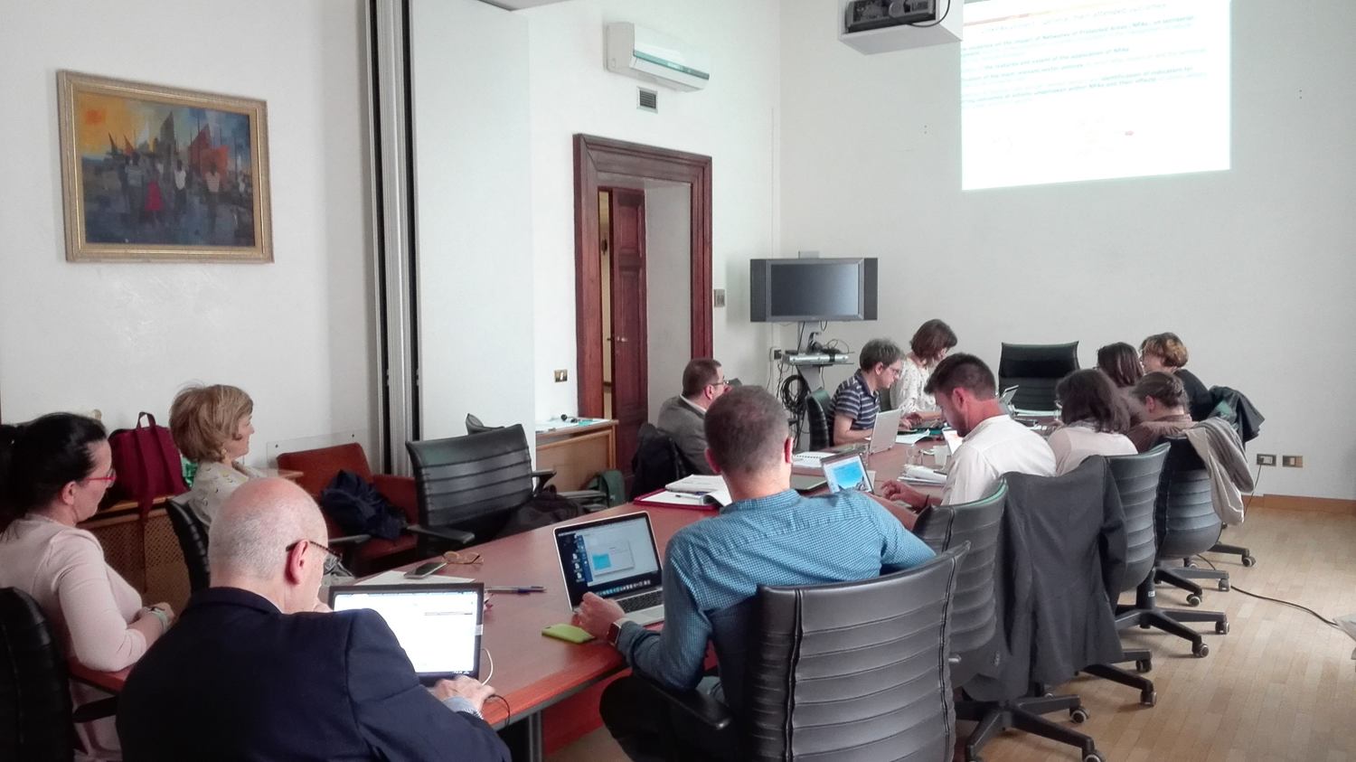
Benefit from the stakeholder support during the TA development
7
IV Steering Committee Meeting
Rome, 4th May 2018

Slide 28
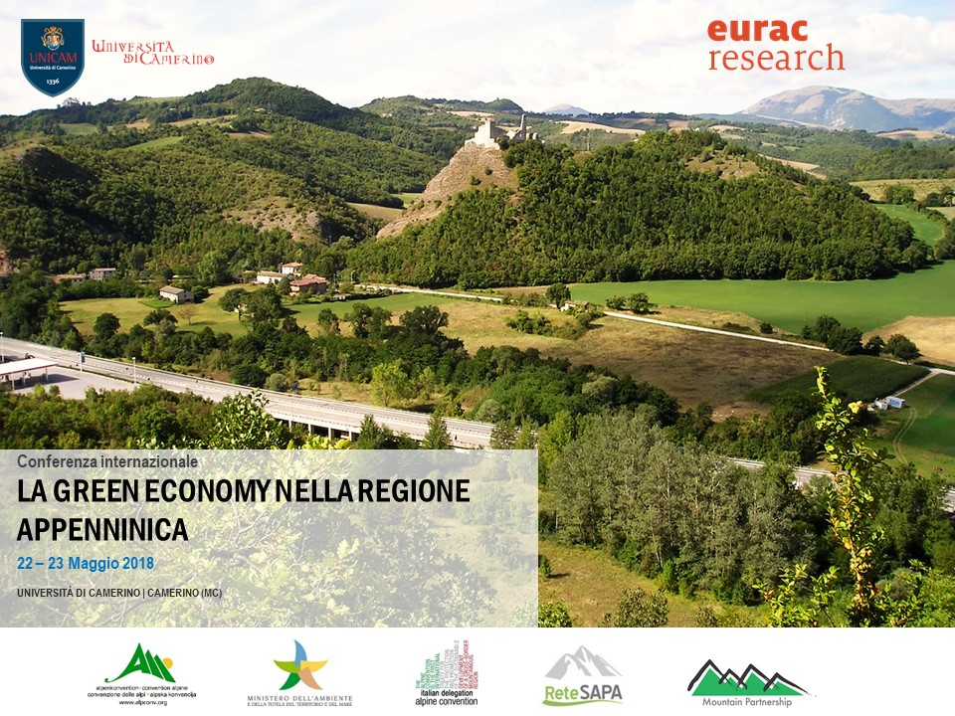
Benefit from the stakeholder support and guidance
support in submission LinkPAs semi-structured questionnaires in case study areas (integrated into the analysis of the individual stakeholder territories)
Critical and collaborative revision of project deliveries
Better detailed requirement in clarifying additional policy needs: focus on climate change guidelines at regional level; request to support in creating
new mountain NPA Apennine area devote to CC mitigation

Slide 29
Lesson learned
NPAs require a clearly defined mission and objective that must be supported by a clear mandate.
NPAs capacities and competences need to be considered
NPAs activity requires continuity and institutional formalisation
NPAs are the most effective tools for sharing knowledge
NPAs objectives, strategies and mandate need to be aligned in mountain zones
Remain focused on NPAs policy role in matter of CC mitigation
NPAs need to be equipped with adequate funding instruments, capacities and competences if they are to fulfil additional roles

Slide 30
Thank you for your attention
Maria Prezioso and LinkPAs project team
https://www.espon.eu/protected-areas

