Slide 1
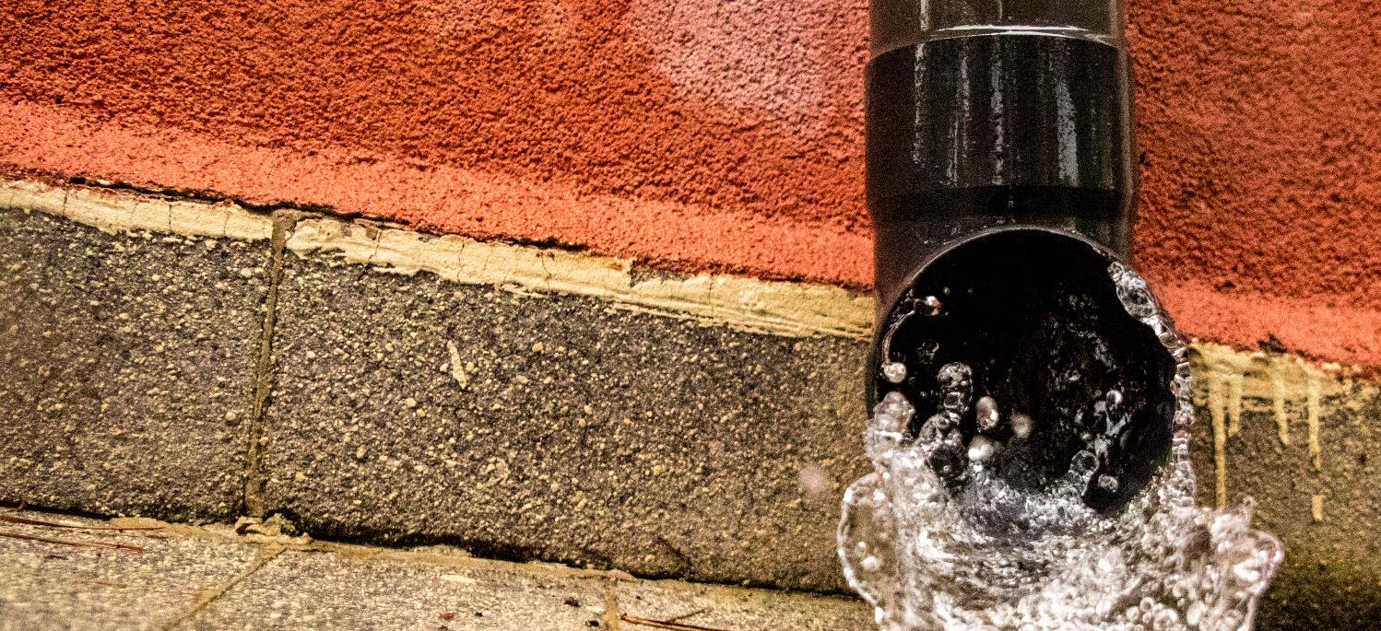


Policy recommendations
for implementing the integrated stormwater management in the Baltic Sea Region
City of Riga
City Development Department of the Riga City Council
Nika Kotoviča, Urban Planning Expert

Slide 2

The Baltic Sea Region is facing more frequent and heavier rainfalls
Notes:
Due to the climate change Baltic Sea Region is facing more frequent and heavier rainfalls, most heavily affecting densely built and inhabited urban areas.
Common urban development trend is that in cities urban areas are densifying, and land becomes more covered with sealed, impermeable surfaces. It leads to reduced infiltration, less evaporation and considerably higher runoff volumes. Cities are facing common challenges of increasing stormwater floods, and degradation of natural resources and infrastructure caused by climate change and densified urban areas.

Slide 3

… managing stormwater runoff and quality is a growing challenge for any city in the Baltic Sea Region
Notes:
Therefore, cities are in emerging need to deal with the challenge of stormwater flooding – a challenge that may lead to environmental degradation, infrastructure damage, risks to human safety and other adverse impacts to urban environment.

Slide 4

Solution – a holistic, comprehensive, and knowledge-based approach to stormwater management
Notes:
Such challenge is not easily answered as it requires a holistic, comprehensive, and knowledge-based approach to stormwater management.

Slide 5

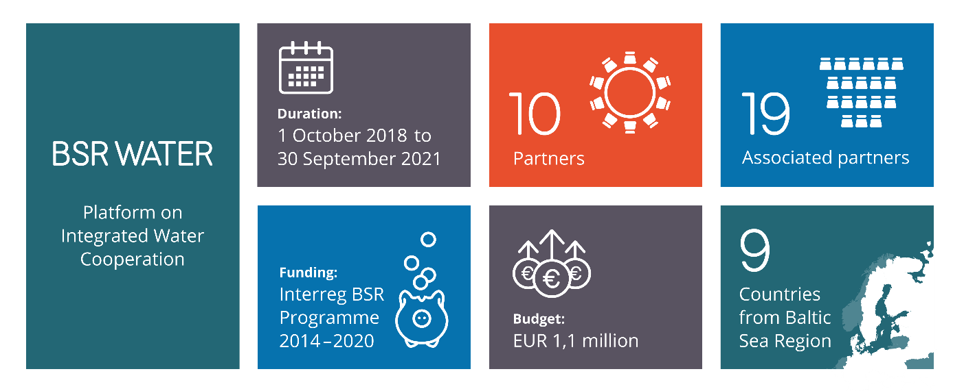
www.bsrwater.eu

Slide 6
BSR WATER Contributing Project – iWater
Read more: iWater project
Notes:
In 7 iWater partner cities solutions have been identified for improving urban planning, by integrating stormwater management into urban planning, (infrastructure) construction, operation and maintenance processes.
Concrete proposals for implementation of the integrated stormwater management system in 7 cities were elaborated – each partner city developed its own tailor-made solution – a city-specific stormwater management strategy/programme/plan, as well as each city established an institutional model for stormwater management based on a strong commitment of all involved stakeholders – coordinated cross-sectorial cooperation and balanced allocation of functions/responsibilities among municipal authorities and other local stakeholders, such as landowners, property developers, etc.

Slide 7
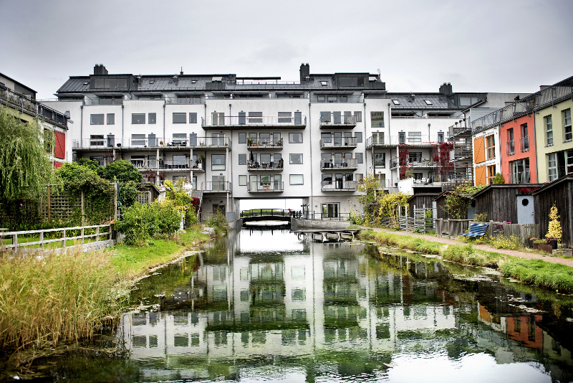
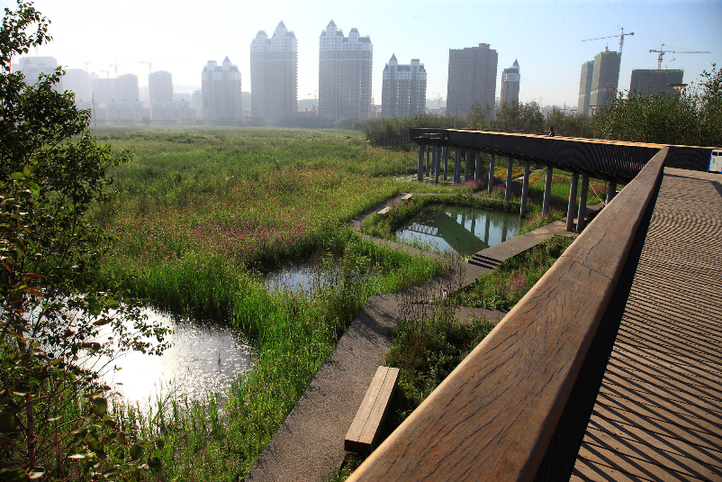
New Approach to Stormwater Management
Malmö, Sweden:
scandinaviancityguide.com
Qunli, China:
Stormwater Wetland Park
Integrated: alternative solutions combined, stakeholders working together
Tailored: “case-by-case” multidisciplinary solutions
Notes:
The solution requires going beyond a narrow focus on a single problem to undertaking a comprehensive water resource protection strategy: recognizing the characteristics of specific water resources, understanding the relevant impacts, and tailoring a comprehensive array of tools to individual situations. A combined use of multiple stormwater management solutions is not just possible, but also advisable to increase resilience to extreme weather and climate events. This is possible with an Integrated Stormwater Management (ISWM) approach.

Slide 8
Integrated Stormwater Management
The Integrated Stormwater Management (ISWM) is a comprehensive approach to stormwater management:
Instead of a narrow focus on a single problem, the ISWM undertakes a holistic stormwater management approach: studying the characteristics of specific sites and areas, understanding the relevant impacts, and tailoring a comprehensive array of tools to individual situations
Success requires the integration of the ISWM into the urban development processes of the city at all levels, from urban planning to operation and maintenance
Notes:
Contrary to conventional stormwater management practices, the ISWM is a comprehensive approach to stormwater management. Instead of a narrow focus on a single problem, the ISWM undertakes a holistic stormwater management approach: studying the characteristics of specific sites and areas, understanding the relevant impacts, and tailoring a comprehensive array of tools to individual situations. Success requires the integration of the ISWM system into the urban development processes of the city at all levels, from urban planning to operation and maintenance.

Slide 9
Integrated Stormwater Management
With an ISWM system a city can:
achieve its goals of water quality protection and flood mitigation
design for not just the worst-case scenario, but also for average and minimal events to minimize the impact of stormwater on neighbouring lands
determine what solutions and infrastructure together with their interconnections are required to manage different stormwater runoff
ensure that stormwater is treated as a resource that enhances our cities
Read more: iWater project

Slide 10
Policy recommendations
for implementing the integrated stormwater management in the Baltic Sea Region
Notes:
These policy recommendations for implementing sustainable and integrated stormwater management in the BSR on regional, national and local levels, were elaborated on the basis of accumulated knowledge and practices of those forerunner BSR cities that have already obtained experience, understanding and practical skills within the field of natural, holistic and sustainable urban stormwater management.

Slide 11
Survey on Stormwater Governance and Practices: Key Findings
Notes:
With the aim to better understand the baseline and other pre-conditions for setting up integrated stormwater management in the BSR, a comprehensive survey on stormwater-related legislation was carried out in all 10 BSR countries.
In parallel, structured interviews were carried out in 25 medium and large-sized cities of the BSR, assessing their current progress with introduction of sustainable and integrated urban stormwater management governance and practices, implemented improvements, as well as needs and future development prospects.
Whom? The respondent cities have mostly medium density of non-permeable/semi-permeable surfaces (between 25% and 50%). 92% of the respondent cities have experienced stormwater-caused floods in last 10 years.

Slide 12

Presence of climate change adaptation plan
Notes:
More than a half (60%) of the cities have indicated having a climate change mitigation/adaptation plan, 40% have not. The pioneering cities like Copenhagen, Helsinki, Växjö or Gdansk have created comprehensive multi-sector plans looking at risks, impacts and measures across the entire spectrum, incl. stormwater, green infrastructure as an integral part.

Slide 13
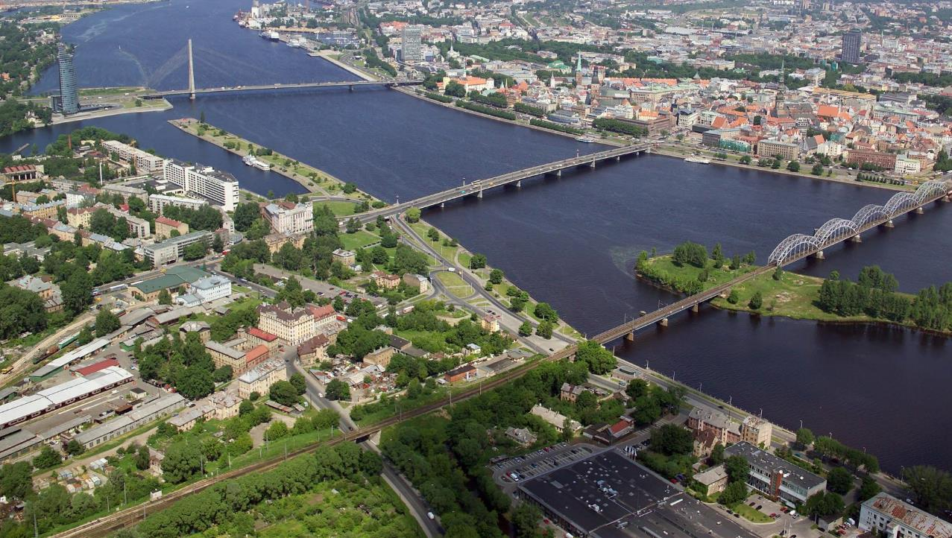
Presence of sustainable stormwater management solutions
Notes:
Most cities (70%) indicated applying on-site SUDS. 48% of the municipalities have implemented SUDS purposely for improvement of stormwater quality in the city.

Slide 14
Presence of stormwater quality monitoring
Notes:
The stormwater quality is monitored in 52% of the municipalities. Monitoring mostly is done at the discharge points, as well as often in industrial sites/parking lots and other areas of potential risk. Most popular frequency of monitoring is once a month or after each major storm. More frequent monitoring in the framework of the project was reported by one municipality.

Slide 15
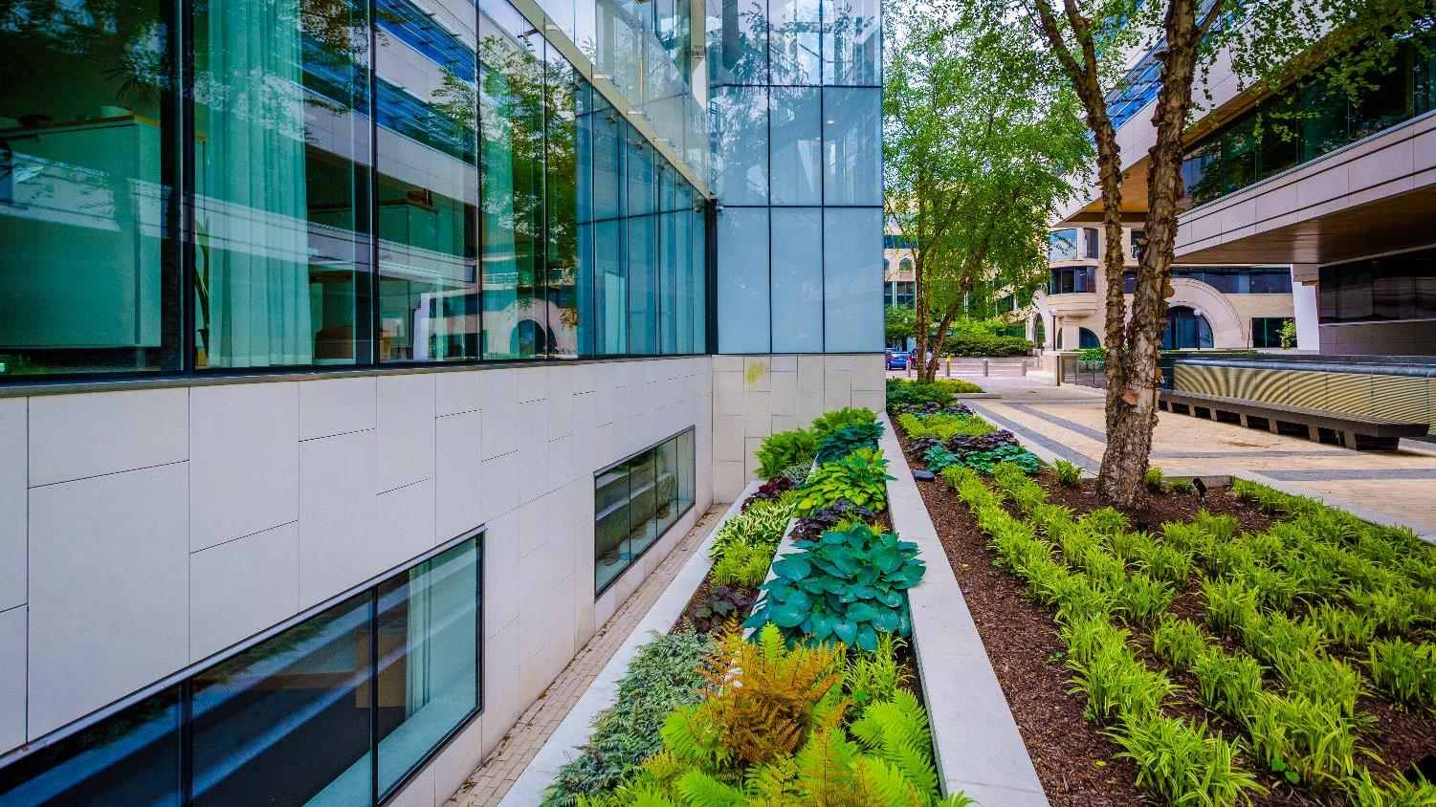
Presence of integrated stormwater management (ISWM) plan/strategy
Notes:
The integrated approach to stormwater management (or ISWM) is becoming a prevailing paradigm in a holistic, sustainable urban stormwater management.

Slide 16
Main Challenges and Barriers
Cities have indicated the following main problems with the existing stormwater system and barriers concerning improving it:
lack of capacity in existing systems and poor technical conditions
retrofitting – challenging in densely built areas
stormwater treatment – insufficient, presence of foul connections
absence of regular water quality monitoring
lack of collaboration among responsible city structures
low priority of the stormwater management on political agenda
lack of knowledge, financing, human resources…

Slide 17
Stormwater Management Recommendations

Slide 18
EU & BSR
Recommendations at the EU and BSR levels
Guidance, requirements and recommendations should be prepared to strive for a common regional approach
Guidance documents prepared on planning and creation of multi-functional and multi-benefit urban spaces
Specified criteria for transport and urban revitalisation projects under EU funds to include multi-functional and integrated green infrastructure
Outlined incentives' approach emphasising the benefits of the ISWM
Dedicated policy area for integrated solutions in the EU Strategy for the Baltic Sea Region

Slide 19
national
Recommendations at the national level
General principles and priorities of sustainable stormwater management, including the integrated approach to it, should be defined and included into the legislation
Specified integrated approach to stormwater management, ISWM principles included in the regulation on spatial planning
Stormwater treatment mandated in legislation related to environmental permitting, spatial planning and planning and design of stormwater systems
Specified treatment and water quality requirements based on local specifics
National level guidance documents developed for the local implementation

Slide 20
local
Recommendations at the local level
Local stormwater management programme, plan and guidance need to be developed for taking into use by the city, developers, landowners
Regulation (roles, responsibilities, decision making procedure etc.) for the ISWM and the local task force present
Local requirements for emission limit values and monitoring of stormwater quality, based on the water status of the receiving water
Local financial incentives and building control tools

Slide 21
Conclusions

Slide 22
Conclusions
In most cities of the BSR, there is awareness of and work on the ISWM concepts:
many cities are applying catchment basin planning principles concerning stormwater and have developed catchment plans for at least some of the catchment basins in their territory
many cities have stormwater management programmes/plans and guidelines for sustainable stormwater management
in most cities there is a fee for stormwater management
in most cities stormwater quality is monitored, however, frequency varies
Only in several cities ISWM is an overarching strategic approach!

Slide 23
Conclusions
New policies, binding targets, and generous incentives are needed for transition to sustainable stormwater management
Further promotion and prioritization of on-site stormwater treatment approaches that improve urban environment, contribute to urban ecosystem services, and thus, have crucial role in increasing cities’ resilience in the context of the climate change

Slide 24
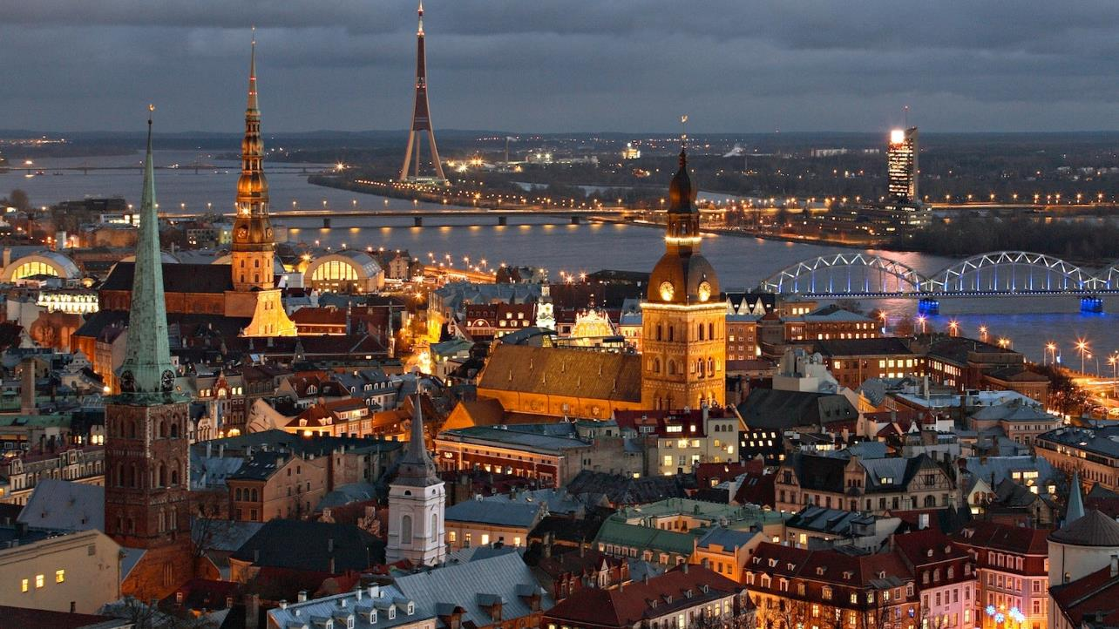
Full report is available at the project website: www.bsrwater.eu

Slide 25
Thank you!
Contact
Nika Kotoviča
City of Riga | BSR WATER project expert
Phone: (+371) 2922 6404
E-mail: nika.kotovica@riga.lv
Baltic Water Hub Expert:
www.balticwaterhub.net/expert/nika-kotovica
www.bsrwater.eu

