Slide 1
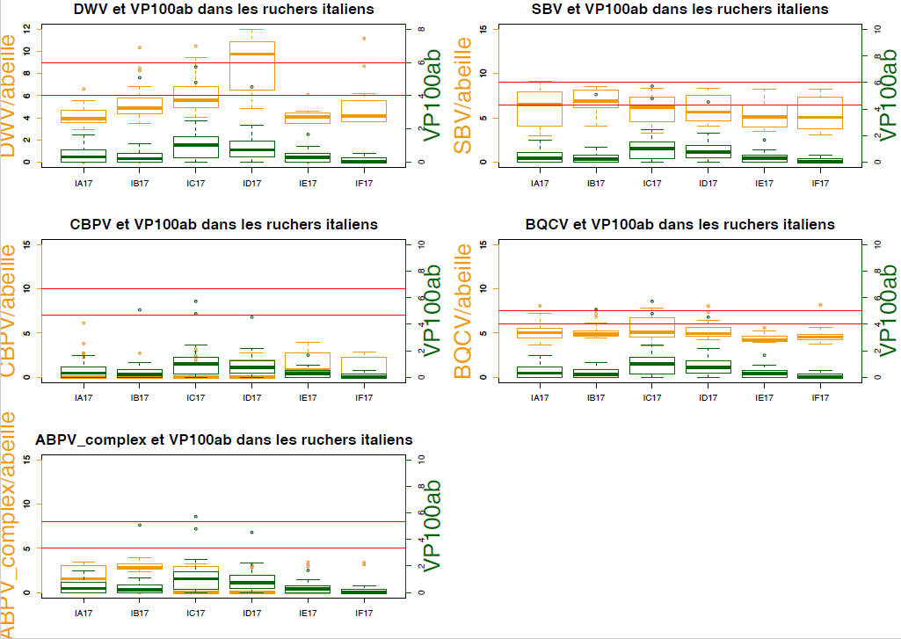
QUANTIFICATION OF THE VIRAL LOAD IN THE ITALIAN APIARIES
WP3 Activity 3 Health Parameters • Embrun, 26-27 March 2018
Virginie et Mathilde :
OK pour Ajouter les diapos FR envoyés par André
+ ajouter les commentaires (André Lucie ?)
On est plutôt pour les présenter à la fin après les
récapitulatifs des manips : qu’en pensez-vous ?
Visite 1 (July 2017)

Slide 2
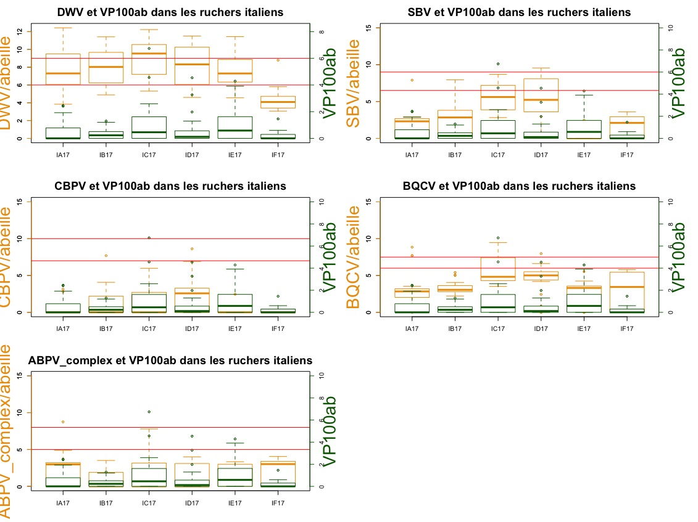
WP3 Activity 3 Health Parameters • Embrun, 26-27 March 2018
QUANTIFICATION OF THE VIRAL LOAD IN THE ITALIAN APIARIES
Visite 2 (September 2017)

Slide 3
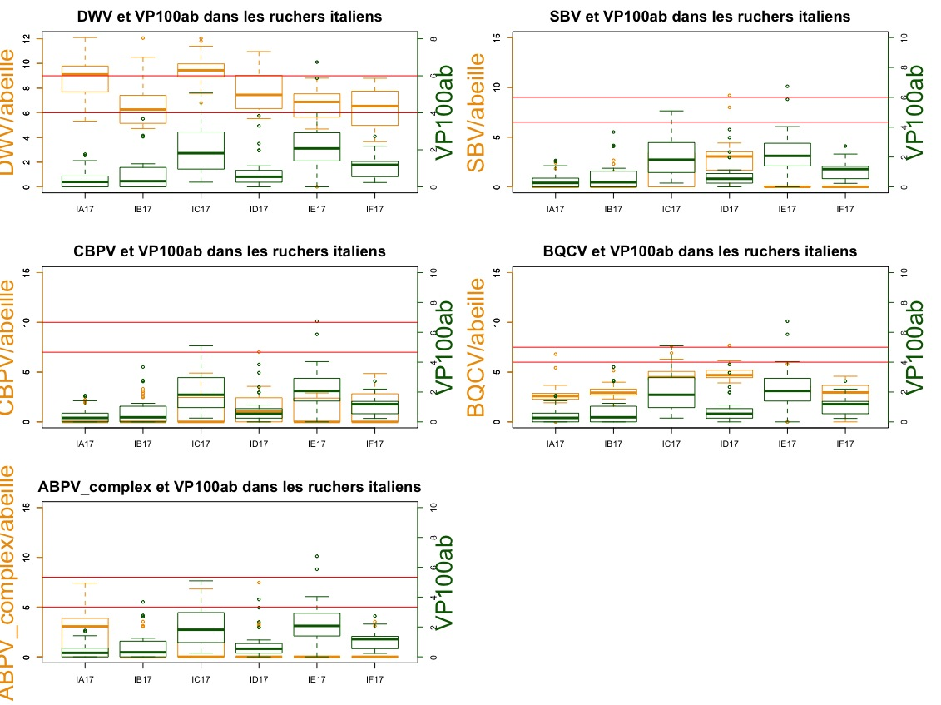
WP3 Activity 3 Health Parameters • Embrun, 26-27 March 2018
QUANTIFICATION OF THE VIRAL LOAD IN THE ITALIAN APIARIES
Visite 3 (October 2017)

Slide 4
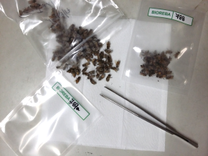
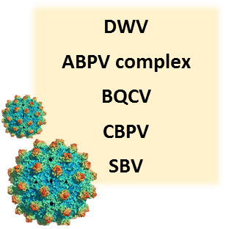
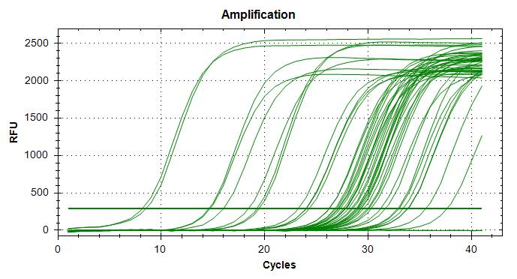
QUANTIFICATION OF THE VIRAL LOAD REMINDERS
WP3 Activity 3 Health Parameters • Embrun, 26-27 March 2018
Echantillonnage : transfert terrain/labo
Pas de fichier de data fournies avec l’arrivée d’échantillon : PB
Délai de traitement des data/lucie trop loin. Avoir un fichier au même moment
Attention reine dans un echantillon
Etc…..
RNA EXTRACTION FROM TWO SAMPLES/COLONY:
if less than 40 bees/sample are available, we proceed with the extraction from smaller samples; the n°of bees/sample will be taken into account when calculating the viral load (expressed in virus copy n°/bee)
DIFFERENT qPCR PLATES FOR DIFFERENT VIRUSES:
each plate includes two replicates of each standard DNA dilution:
10⁻², 10⁻³, 10⁻⁵, 10⁻⁷, 10⁻⁸, 10⁻⁹,
and the negative controls (1 × extraction, 1 × RT, 2 × qPCR)
THRESHOLD TO DETERMINE THE PRESENCE OF INFECTION:
in order to exclude false positive results, a threshold value of virus copy n° calculated on C_{T}=35 has been established
1- What to do if negative controls are positive? Do we lower the threshold?
2- Do we keep the same threshold for all the five targets?
Virginie et Mathilde :
OK pour les recap. Pour FR : on ne peut pas mettre les 3 blancs dans chaque run (1x extract + 1x qPCR, 1xRT + 1x qPCR, en alternance)
Question 1 idem
Question 2 : on avait dit que l’on harmoniserait/target virus après chaque saison de prélèvement et fin de fin de projet ; à confirmer + besoin de recul en FR pour les thresold de l’appareil 384.
Question 3 : que fait-on quand les 2 réplicats biologique ont des Cq éloignés (delta Cq à définir, qu’est-ce qui est acceptable ?)

Slide 5
QUANTIFICATION OF THE VIRAL LOAD
WP3 Activity 3 Health Parameters • Embrun, 26-27 March 2018
Results of qPCR on negative controls of RNA extraction from Italian samples
ID neg. contr. | extraction date | n° samples | DWV C_{T} | ABPV c. C_{T} | BQCV C_{T} | CBPV C_{T} | SBV C_{T}
IPSP.17/418 | 31/08/17 | 39 | 40 | - | - | - | -
IPSP.17/566 | 11/09/17 | 35 | - | - | - | - | 36
IPSP.17/602 | 14/09/17 | 35 | - | - | - | - | -
IPSP.17/637 | 18/09/17 | 35 | - | - | - | - | -
IPSP.17/751 | 21/09/17 | 35 | - | - | - | - | -
IPSP.17/810 | 02/10/17 | 58 | - | - | - | - | -
IPSP.17/846 | 05/10/17 | 35 | 32 | - | 36 | - | 32
IPSP.17/1049 | 26/10/17 | 43 | 36 | - | - | - | -
IPSP.17/1081 | 14/11/17 | 31 | 30 | - | - | - | -
IPSP.17/1111 | 17/11/17 | 29 | 34 | - | 32 | - | 35
IPSP.17/1143 | 23/11/17 | 31 | 32 | - | - | - | -
IPSP.17/1172 | 28/11/17 | 29 | 34 | - | - | - | -
Distinguer les différents temoins negatifs (extract rt et qPCR
What to do if negative controls are positive? Do we lower the threshold?
Do we keep the same threshold for all the five targets?

Slide 6
WP3 Activity 3 Health Parameters • Embrun, 26-27 March 2018
QUANTIFICATION OF THE GENE EXPRESSION IN THE ITALIAN APIARIES
Incomprehensible pour les auditeurs
= Resultats
Mettre reminders avant :A refaire avec definition
Faire une compile sur une feuille
1 IT 1FR
+ un resumé FR/IT
Ajouter la signification de la cible
+ Voir Cedric

Slide 7
WP3 Activity 3 Health Parameters • Embrun, 26-27 March 2018
QUANTIFICATION OF THE GENE EXPRESSION IN THE ITALIAN APIARIES

Slide 8
WP3 Activity 3 Health Parameters • Embrun, 26-27 March 2018
QUANTIFICATION OF THE GENE EXPRESSION IN THE ITALIAN APIARIES

Slide 9
QUANTIFICATION OF THE GENE EXPRESSION REMINDERS
WP3 Activity 3 Health Parameters • Embrun, 26-27 March 2018
Mettre déf
RELATIVE QUANTIFICATION OF GENE EXPRESSION:
RQ =2^{-ΔΔCт}
ΔΔCт = ΔCт(sample) - ΔCт(reference)
ΔCт = Cт(target gene) - GEOMETRIC MEAN ΔCт(housekeeping genes)
vitellogenin
AKHr
InR-1
actin
RPS5
FIVE TARGET GENES IN ONE qPCR PLATE:
each plate includes cDNA from the reference sample FR-1
and the negative controls (1 × extraction, 1 × RT, 2 × qPCR)
Some preliminary tests were carried out to assess the level of genomic DNA contamination (qPCR on non-retrotranscribed RNA), which was finally evaluated neglectable
Similarly, some negative controls of extraction (Italian samples) were positive for some target genes (the more expressed - correspondence with virus results), but the level of contamination was limited (C_{T} >32)
What do the expression levels of these genes tell us about the status of the colonies?
Notes:
Be careful! If cDNA was stocked at -20 °C after preparing qPCR plates for viral load quantification, mix it thoroughly after thawing and before loading new qPCR plates

