Slide 1

The MyCOAST PROJECT
A Coordinated Atlantic Coastal Operational Oceanographic Observatory

Slide 2

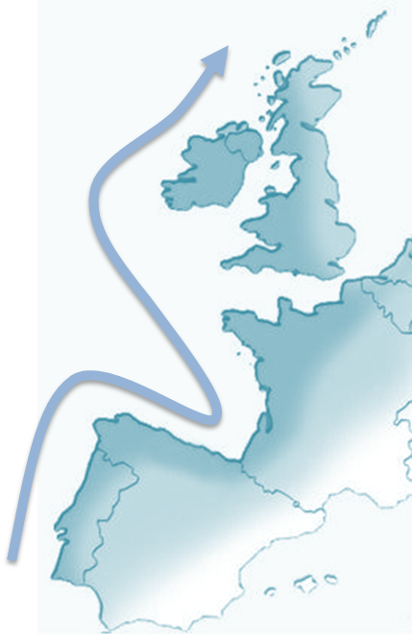
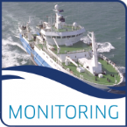


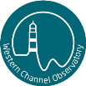

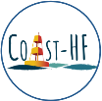



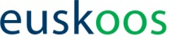
MyCOAST fills the gap between the output of large scale European programmes and the end-users through the transnational coordination of coastal observatories
SCObs
SmartBuoy
LOREA
Lisbon Metropolitan Area Coastal Observatory
OCASO

Slide 3
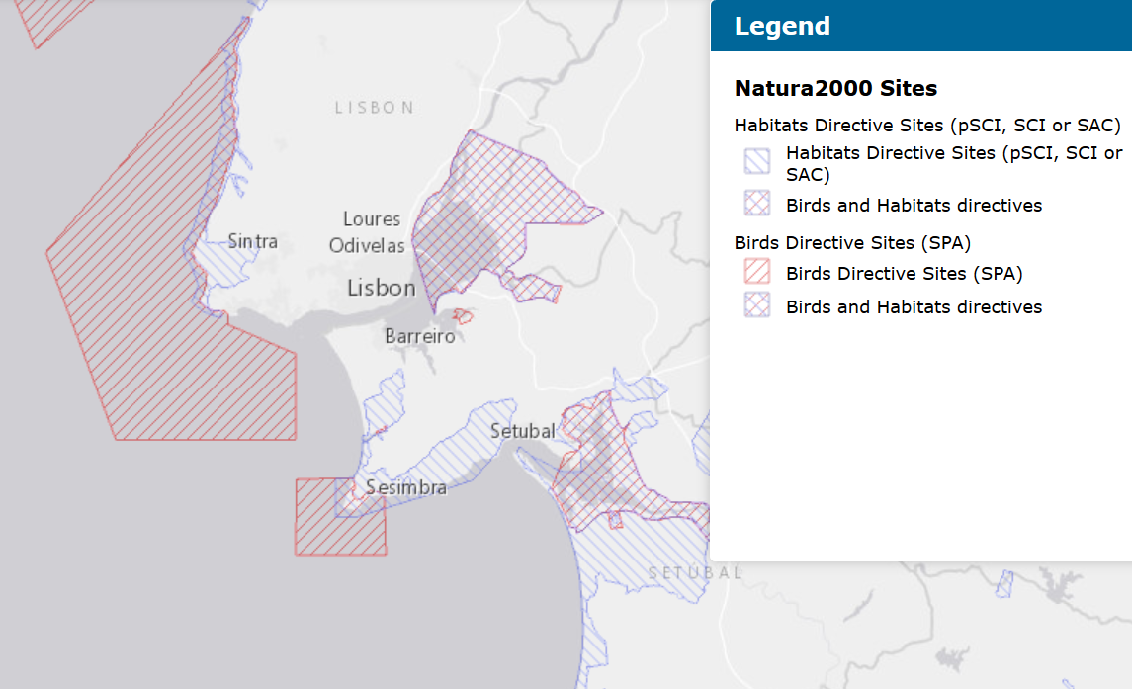


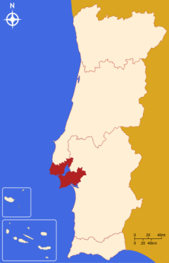
Lisbon Metropolitan Area Coastal Observatory - Motivation:
Population: 2.8 million inhabitants live in the Lisbon Metropolitan Area.
Ports and tourism: commercial (Lisbon and Setubal) and recreational (Cascais and Sesimbra);
7 Natura 2000 network protected areas under the habitats and birds directive and a marine protected area.
Source: http://natura2000.eea.europa.eu/

Slide 4
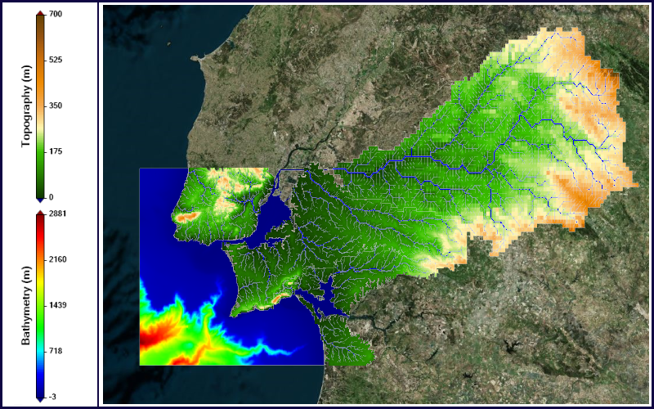
Vision
Aggregate sparse observations using an operational model and Remote Sensing to create services for:
Blue economy,
Authorities,
Research Community,
General public.
Continuum approach, from the inland, Transitional and coastal waters.

Slide 5
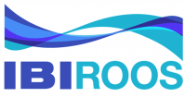
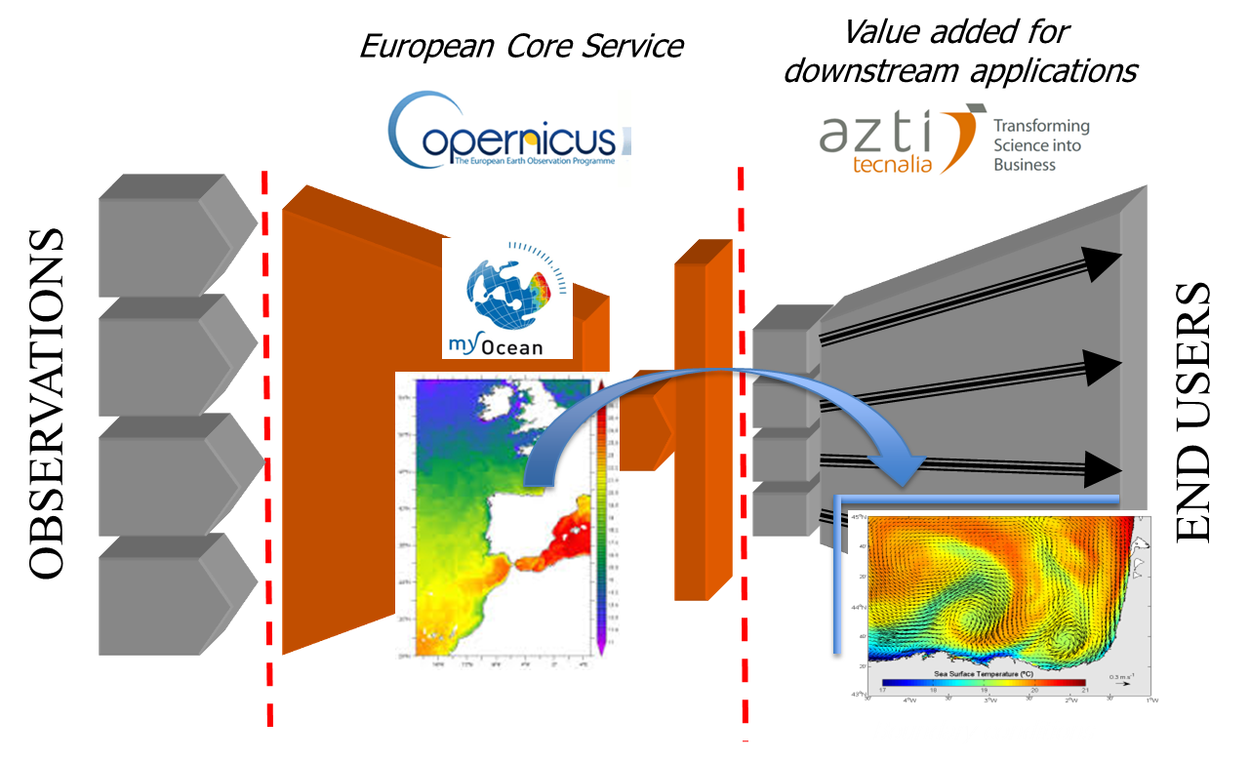


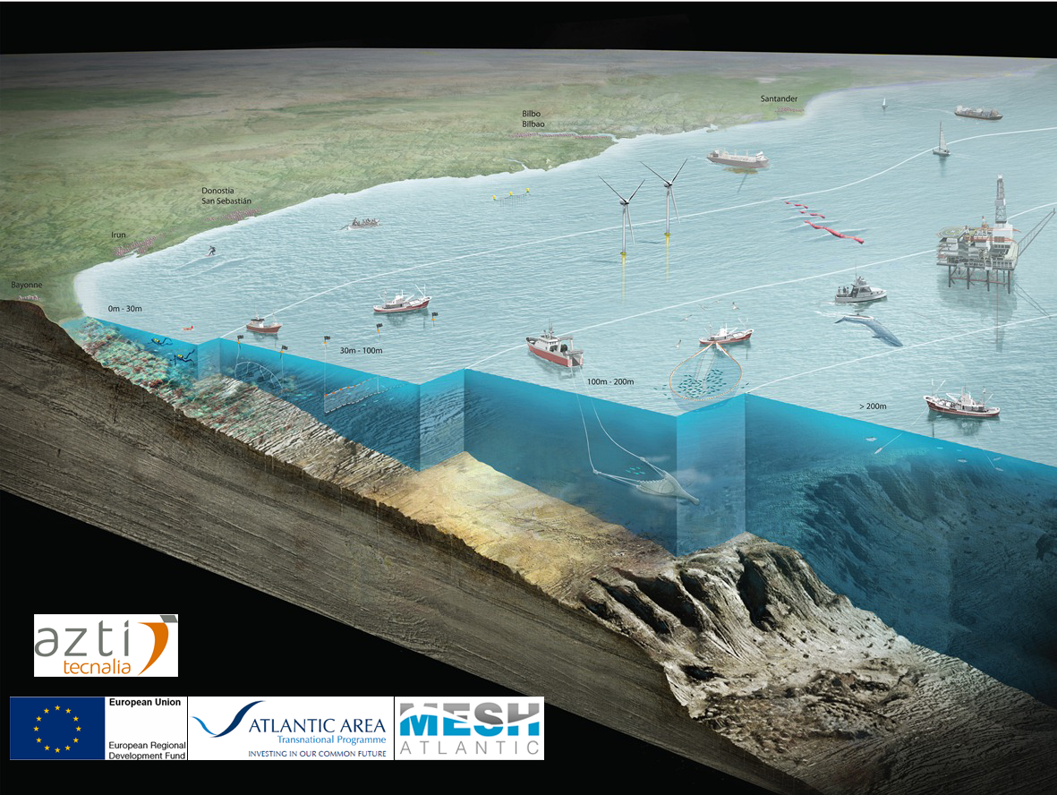
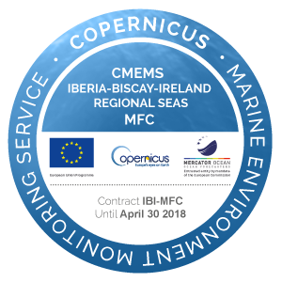
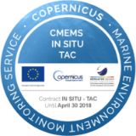
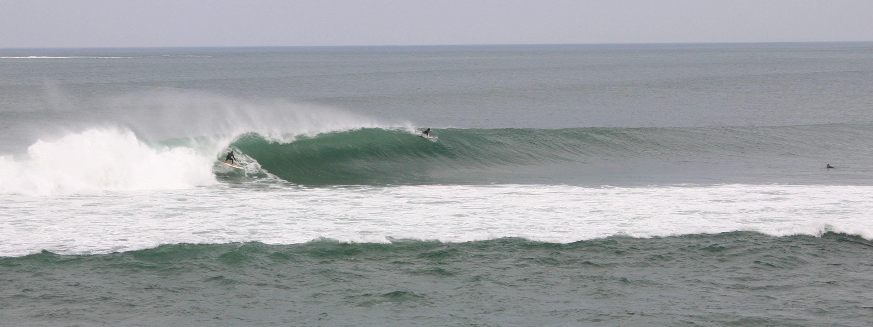
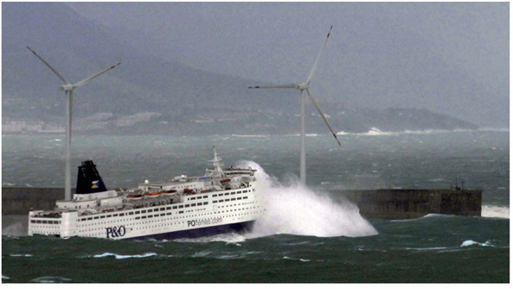
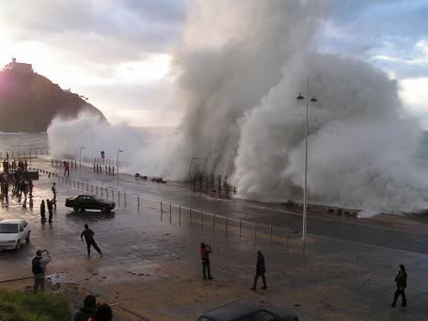
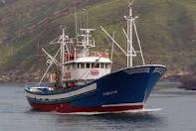
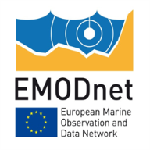
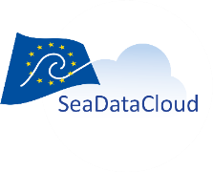

PRODUCTS & SERVICES
FOR KEY COASTAL ISSUES
The end product is innovative and standardized tools for risk management of events such as extreme weather, flooding, maritime safety and coastal pollution

Slide 6
Our Objectives are:
To improve co-operation between observational and forecasting systems, and end users
To build a coordinated Atlantic Coastal Operational Observatory across five European countries from existing cross-border collaborative activities
To use common standards, promoting information sharing and interoperability between coastal observatories
To promote the use of downstream applications of CMEMS, enhancing coastal resilience to risk

Slide 7
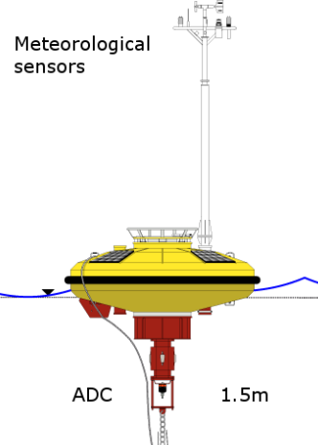

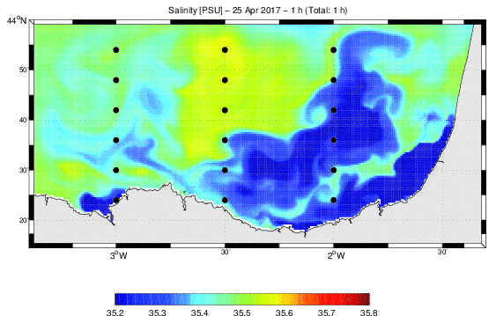
Work plan
WP 6 Complying with Data Interoperability Standards
WP 3 Project Capitalization
WP 4 Development of coastal observing systems
WP 7 Development of coastal risks tools
WP 2 Project Communication
WP 5 Downscalling from regional to coastal services
WP 8 Pilot implementations of coastal risk tools
WP 1 Project coordination

Slide 8
Check out our NEWS, PRODUCTS and ACTIVITIES on our PROJECT WEBSITE
www.mycoast-project.org

Slide 9
PARTNERS | COUNTRY
AZTI Foundation | ES
Spanish Institute for Oceanography
Technological Institute for the Monitoring of the Marine Enviroment in Galicia
University of Santiago de Compostela
Spanish Holding of Harbours
General Secretariat of Quality and Environmental Assesment
Instituto Superior Técnico | PT
Instituto Hidrográfico
Qualitas Instruments Lda
French hydrographic office | FR
French Research Institute for Exploitation of the Sea
Centre for Environment Fisheries and Aquaculture Science | UK
Plymouth Marine Laboratory
Marine Scotland
Marine Institute | IR
Thank you for your attention
ASSOCIATED PARTNERS
Directorate of Emergency and Meteorology, Security Department, Basque Government | ES
A Coruña Port Authority
Coastguard of Galicia
Câmara Municipal de Lisboa | PT
Scottish Environment Protection Agency | UK
Bordeaux Port Atlantique | FR
European Global Ocean Observing System | BE
Contact the project coordinator: Julien Mader, AZTI, jmader@azti.es

