Slide 1














Beneficial uses of dredged sediments from waterways: Towards a validation step of sediments as a resource
ENERO: June 2022
Avec le soutien du Fonds européen de développement régional
Notes:
Interreg et le partenariat transfrontalier France Wallonie Flandre
New cross-border resources: Towards a validation of scenarios for the valorisation of sediments and other materials

Slide 2
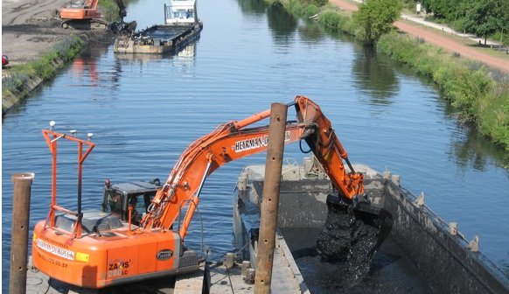
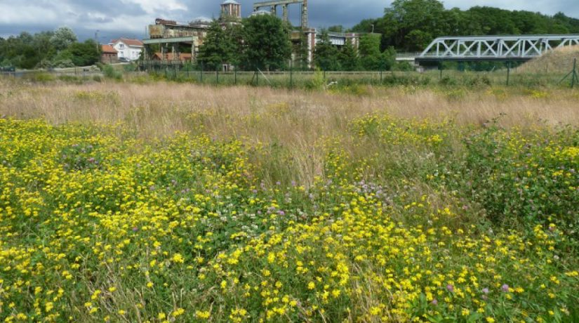
Context: Why VALSE?
3 regions with a lack of efficient, operational and sustainable solutions to manage sediments from waterways
3 regions with industrial wastelands / brownfields sites for soil rehabilitation
General objectives:
Promote the beneficial re-use of soil and dredged materials into the circular economy
Validate cross-border materials valorisation pathways

Slide 3
Main addressed topics
Legislation analysis (3 regions):
Law comparison relative to dredged sediments and soil excavation ;
Identification of restrictions for re-use and valorisation;
Proposal strength → ease implementation pathway of valorisation.
Tool development :
Analytical tools for sediments characterization in the field (pXRF, Raman, FTIR, passif samplers, electrodes,…)→ micro-pollutants
Decision support tools:
Models that allow, from the characteristics of sediments, to predict their evolution, their aging as well as potential ways of valorisation;
Interactive maps which, based on the location of sediments and their physico-chemical characteristics, offer potential ways of valorisation in compliance with the principles of the circular economy.
Exploration of valorisation pathway :
« Soft » valorisation : Landscaping pathway: sediment mound along a roadside
« Hard » valorisation : Civil engineering pathway :
Pouzzolan (sediment fine fraction < 63µm);
Concrete (raw sediment fraction).

Slide 4
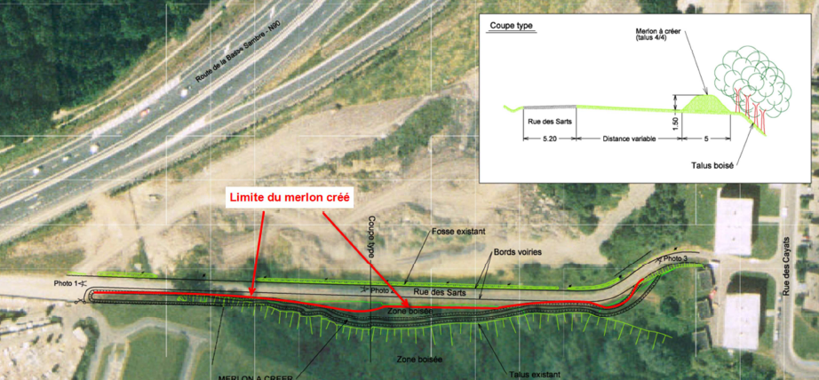
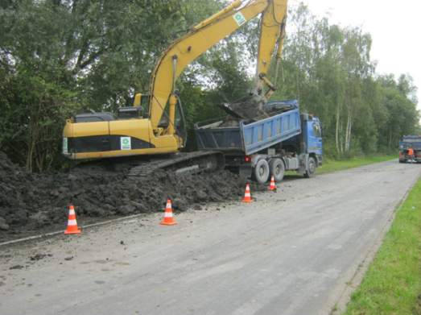
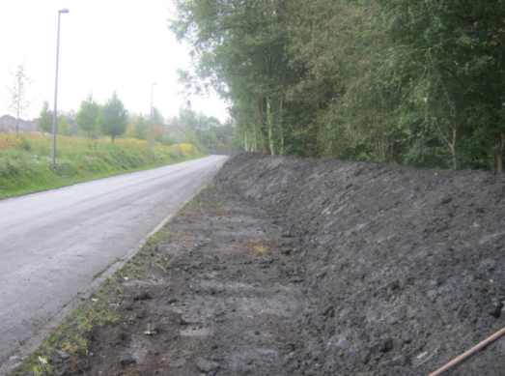
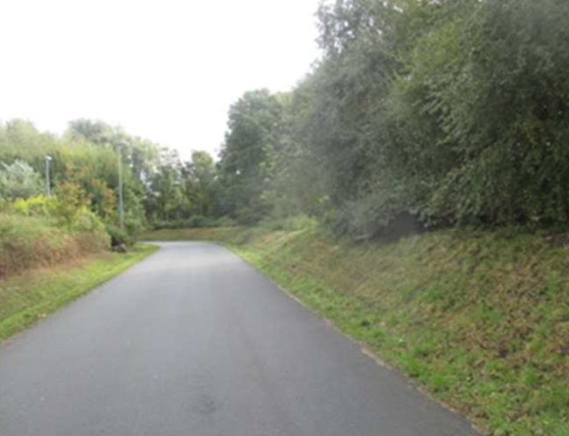
Landscaping mound (1)
Aim:
Monitoring of the ecological quality (faunistic and floristic inventories) and the ecotoxicity of materials
Volume of unpolluted dredging material: 1500 m³

Slide 5
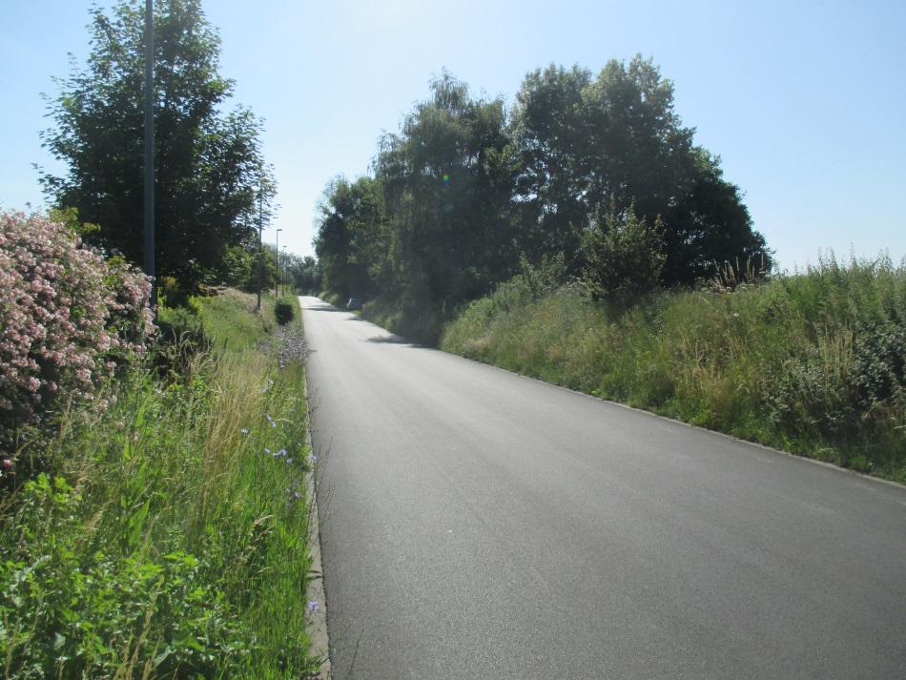
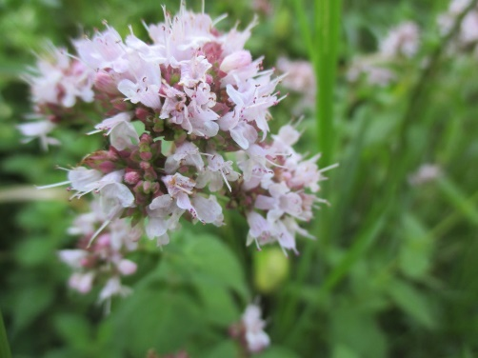
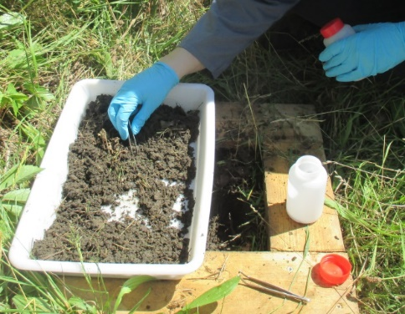
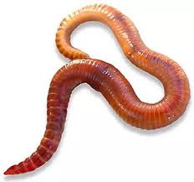
Landscaping mound (2)
Floristic inventory
Faunistic inventory
Origanum vulgare
(June 2020)
Macro-invertebrate sampling
(June 2020)
Landscaping mound and control site (Farciennes, Belgium)
Conclusions:
The use of non-contaminated sediments in a landscaping mount does not have any significant toxic effect on the flora and fauna of Eutrophic sites
Biodiversity index is similar compared to the roadside of the surrounding area with some difference in the fauna species and flora from seeds trapped in the sediments
Eisenia fetida

Slide 6
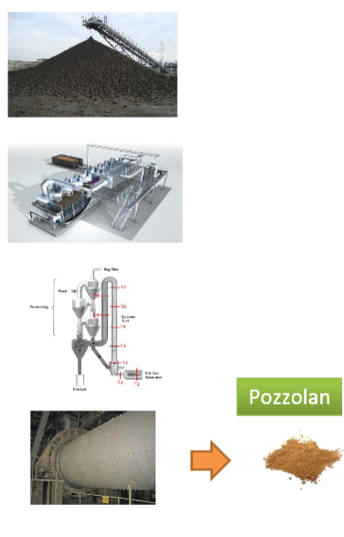
Pozzolan pathway
Process
Aim: To assess the potential for valorisation of a river sediment: contribution of the fine fraction (< 63µm) to the pozzolanic cement composition
Fraction < 63 µm
Drying (70-140°C)
Calcination (750-850°C)
Grinding
(Clinker)
Pozzolanic reactivity:
All calcinated products are considered reactive
Faster contribution than reference fly ash

Slide 7
Inventaire floristique
Inventaire faunistique
Pozzolan pathway
Cement
30% substitution of Portland clinker by calcinated sediments
Performance properties
Mechanical resistance slightly higher than CEM II/B-V (containing fly ash)
No setting delay problems, nor affected resistance (combustion of the OM)
Easily adjustable workability using commercial superplasticizers (PCE type) – Durability (on concrete) has been demonstrated to be equivalent to CEM II/B-V composite cement
Environnemental compatibility
Leaching (lixiviation) tests on hardened (28 days) and crushed mortars
No exceeding of the standards observed, heavy metals (if present) are frozen by the cement matrix
Conclusion: The equivalent performance and the environmental compatibility demonstrated in the VALSE project present a favorable balance for the pozzolan pathway

Slide 8
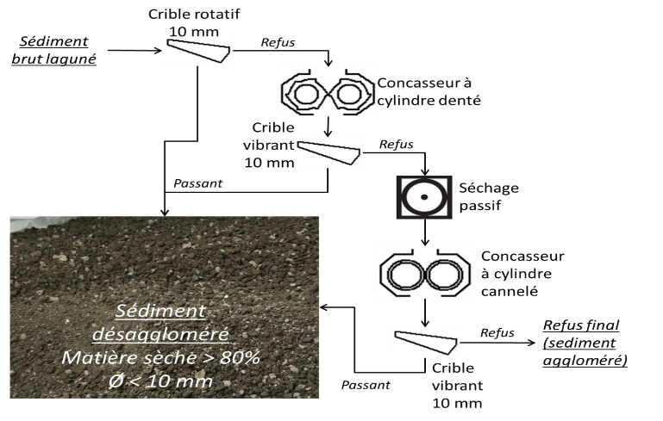
Inventaire floristique
Inventaire faunistique
Concrete pathway
Aim: To assess the potential of waterways sediments as a substitute for the sandy fraction in the cement concrete for the construction of a cycle path
Sediment typology of Hauts-de-France (France) and walloon (Belgium):
Very high fines (silt) content (70 ─ 90%) → very small grain fraction
High content of organic matter and heavy metals (mainly: Zn, Pb, Cu) due to a fairly similar industrial history → Contaminated sediments
Mechanical treatment
Final granulometry
<63μm | 75%
LOI_{550°C} (≈MO) | 13%
Fluorine >TS : Catégory B (AGW95)
Heavy metal concentrations
 | Solid (mg.kg⁻¹) | Eluate (mg.kg⁻¹)
Zn | 1115 | <1
Pb | 194 | <0,5
Cu | 81 | <1

Slide 9
Concrete pathway
Mechanical performance in test tubes (Φ11*22cm³)
Compression
Splitting
Applicable and current standards:
● NF EN 206
● NF P 98-170 (road cement concrete)
B35 - 28 days :
R_{C} = 23,67 ± 0,96 MPa → C25
R_{S} = 2,73 ± 0,04 MPa → S2,7
→ Concrete of class 5 : sufficient “resistance” for a cycle path
B35 : Sed 220 kg.m⁻³

Slide 10
Concrete pathway
From « laboratory » scale to « field» scale : mechanical monitoring of the cyle path
Compression
Splitting
 |  | E/C | R_{C-7} (MPa) | R_{C-28} (MPa) |  | R_{S-7} (MPa) | R_{S-28} (MPa)
Concrete plant | BC¹ | 0,53 | 24,83 | 40,11 |  | 2,57 | 3,87
 | BE² | 0,75 | 14,00 | 26,21 |  | 1,54 | 2,61
Core (cycle path) | BC | 0,53 | 21,54 | 35,06 |  | ─ | 2,01
 | BE | 0,75 | 13,70 | 22,50 |  | ─ | 1,83
¹BC = Control concrete; ²BE = B35 = Experimental concrete (35% sand)
B35 : Sed 220 kg.m⁻³
Conclusions:
« Drying delay » effect on BE (concrete with sediment) → sediments affect the rise in resistance due to the negative effect of organic matter on the cement setting;
Labo/Field (Core worksite) → simillar and consistent results.
Notes:
JE NE COMPRENDS PAS CE QU’EST « LE CENTRALE » ET LA CAROTTE

Slide 11
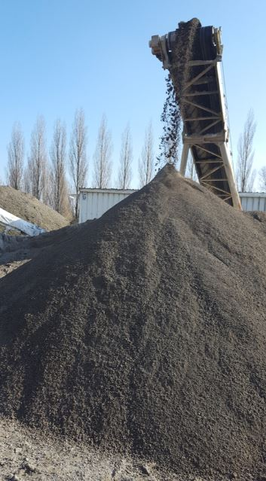
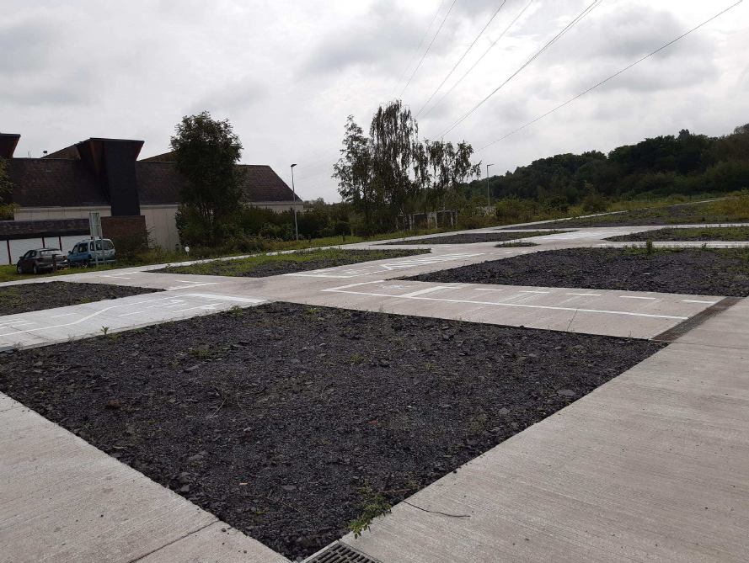
Inventaire floristique
Inventaire faunistique
Concrete pathway
Pilot test site in Chatelet (Belgium) for the cycle track
Conclusions:
1st Educational cycle path with sandy fraction substituted at 35% by mass by contaminated river sediment
Experimental formulation allows the use of 220 kg of dry sediment per m3 of fresh concrete.
“Freezing/defreezing” resistance on BE/BC results show no significant difference
The environmental analysis (lixiviation test) on the concrete leachates comply with the legislation
Notes:
Tu peux t’arreter ici et aller à la conclusion ou ajouter 2 / 3 dia de ton travail. Avec un titre qui pourrait être : « si on veut aller plus loin » et rebondir sur les outils présentés au début de l’exposé… Par contre il faut vraiment rester sur 2/3 dia pas plus ça ne doit pas prendre le dessus.
OK

Slide 12
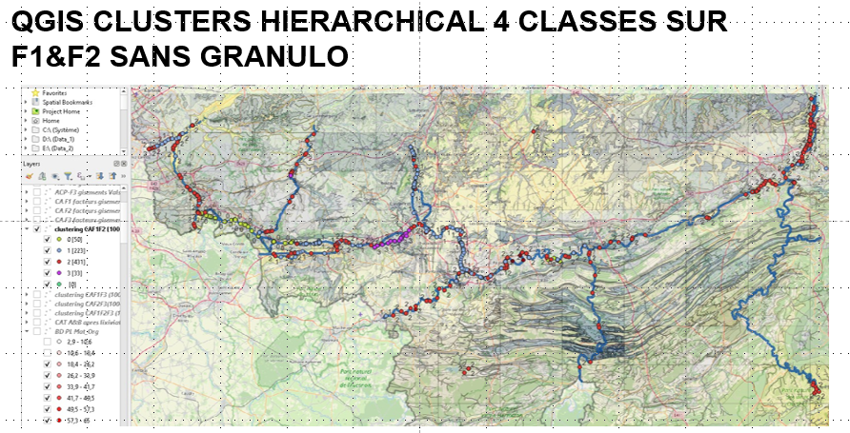
Sediments classification
Objectives: Characterize the sediments into categories towards the different valoraisation pathways
Approach: Statistical analysis (cluster analysis ) of the Walloon (SPW) and French (VNF) databases, mapping of associations
Data: inorganic/
organic contaminants, particle size, mineral composition
Notes:
A revoir sans doute ou mm à supprimer? CEST BON QUAND MEME

Slide 13

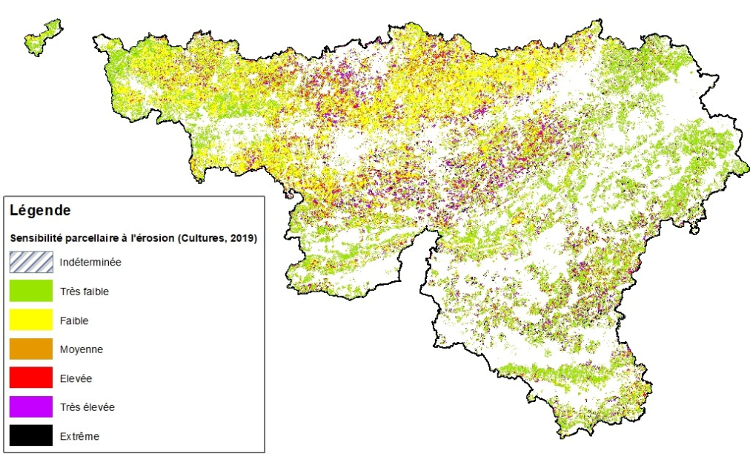
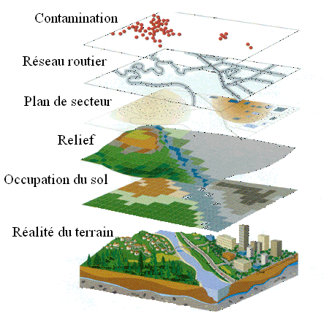
Interactive map
Strategy proposal : cartographic and GIS tool
GIS?
Sensitivity to erosion of agricultural plots on bare soil in Wallonia. Source: Giser
Tool: Geographic Information System as a management tool
Objective: Interconnection of dredged sediments disposal sites and sites for valorisation pathways

Slide 14
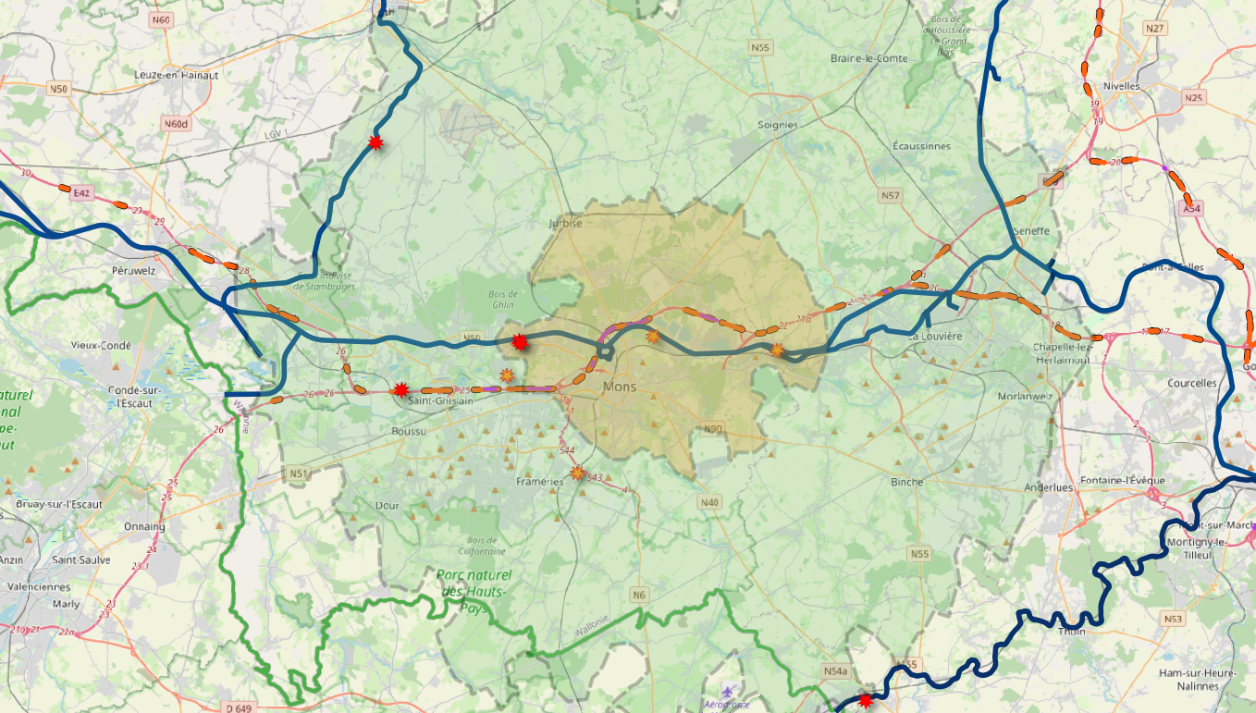
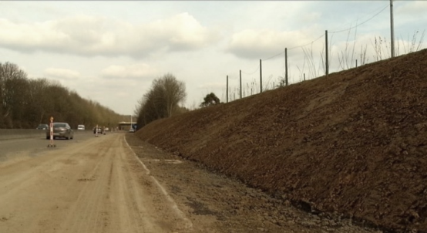
Interactive map (1)
Relationship between the demand and the offer : From the “disposal sites” towards the “valorisation pathways”
A civil engineer perspective of noise-reducing embankments on motorways
Region of Mons-Charleroi: location of noise-reducing embakments available (Orange dots) along the speeedways on a maximal distance by truck of 10 Km (yellow color area) and of 25Km from a disposal site located at Obourg (green color area). Orange /red stars: disposal sites

Slide 15
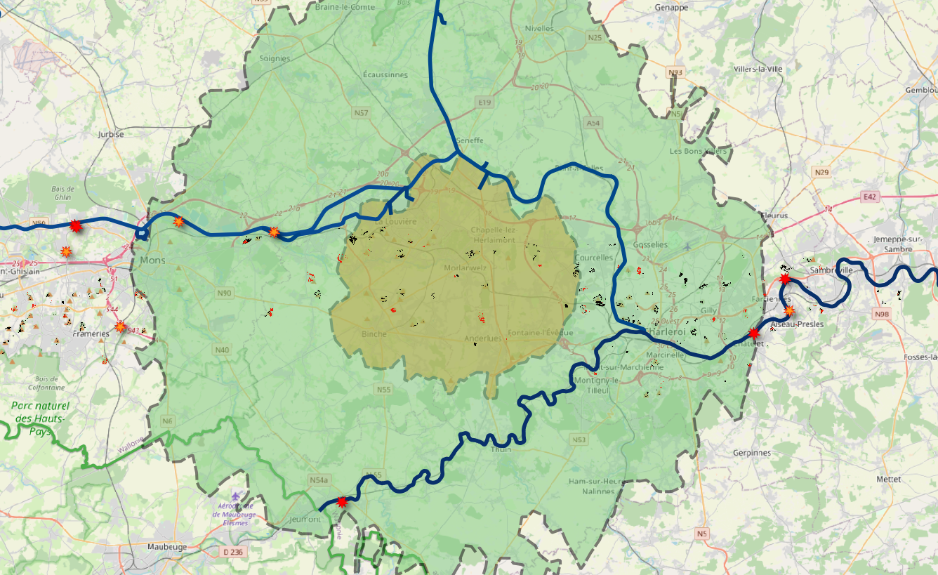
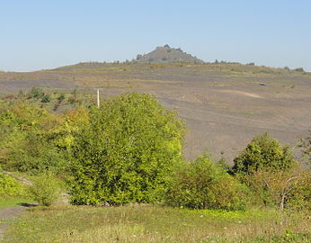
Interactive map (2)
Relationship between the demand and the offer: From the “valorisation pathways” towards the “disposal sites”
An agronomic perspective of valorisation based on flat mining heap
Région Mons-Charleroi: location 25Km from a disposal site available on a maximal distance by road (Yellow color) and of 25Km by truck from a mine heap located in Morlanwelz. Red spots : Contaminated or potentially contaminated soil; Black color: uncontaminated soil; Orange /red stars: disposal sites

Slide 16
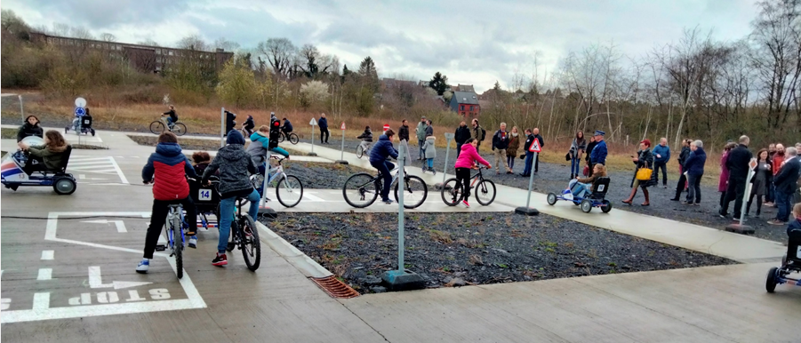
Inventaire floristique
Inventaire faunistique
General conclusions
Promising valorisation pathways of dredged sediments within the circular economy framework with industrial interest for concrete and pozzolan tracks;
1st Walloon educational cycle path based on waterway sediments;
Landscaping mound opportunities (with noise reduction effect);
GIS tool to assist sediment management.
Notes:
Tu peux t’arreter ici ou ajouter 2 / 3 dia de ton travail. Avec un titre qui pourrait être : « si on veut aller plus loin » et rebondir sur les outils présentés au début de l’exposé… Par contre il faut vraiment rester sur 2/3 dia pas plus ça ne doit pas prendre le dessus syr.
JE PENSE QUE SI J’AJOUTE DES DIAPOS, CELA DEVIENDRA TROP LONG. MERCI LAURENCE.

Slide 17

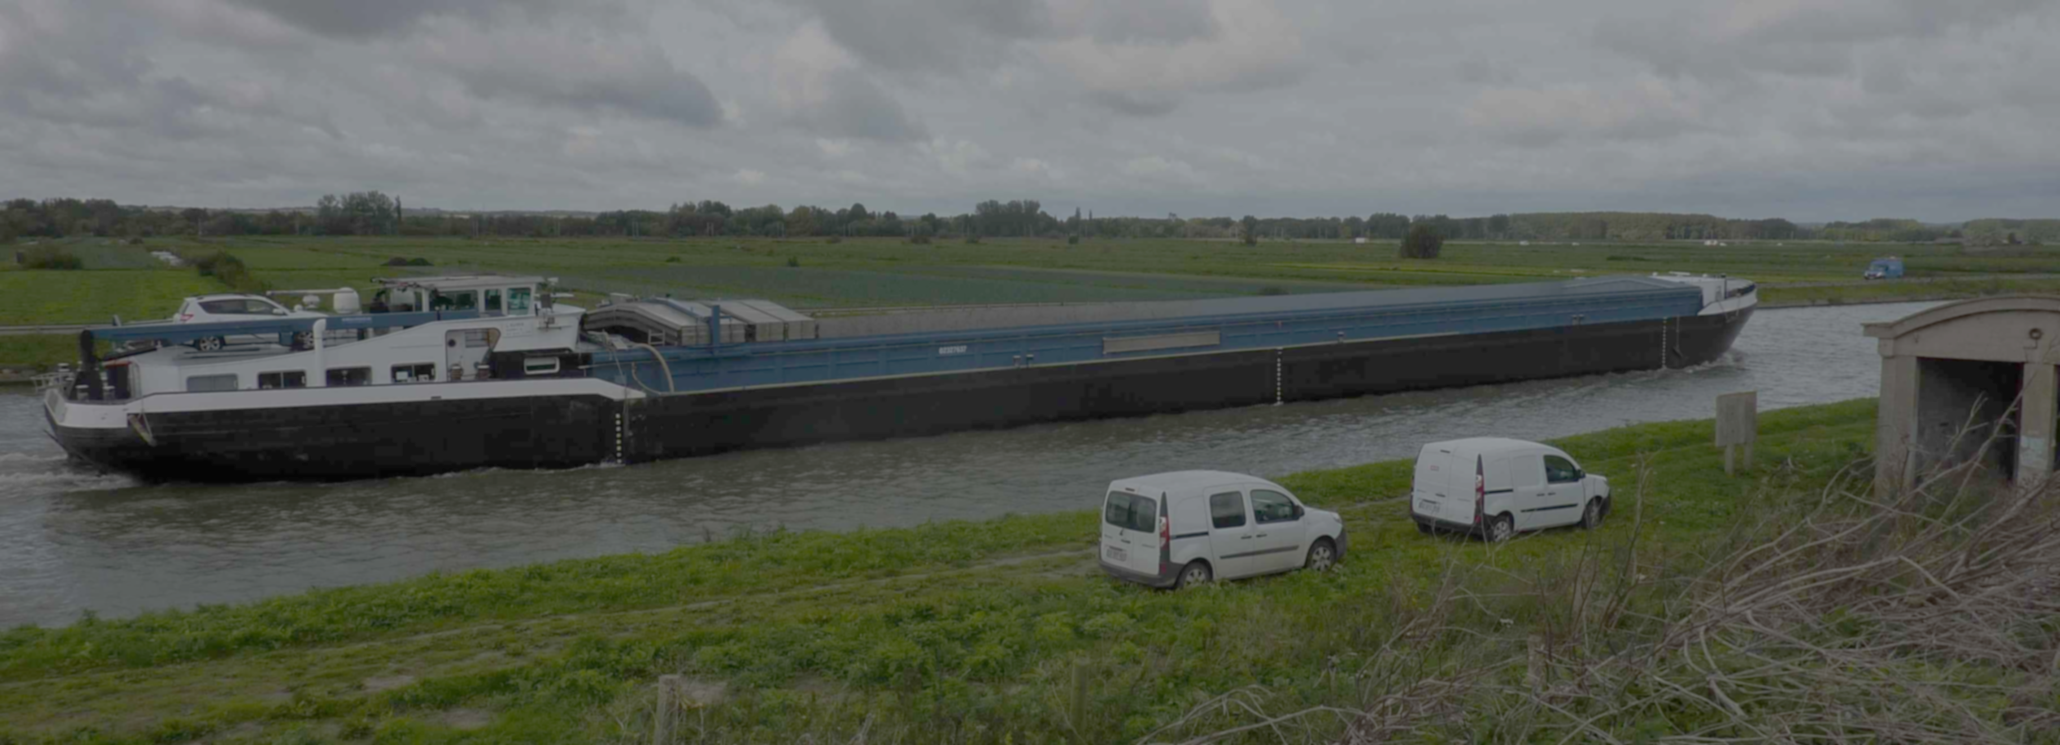
Thank you for your attention
Beneficial Uses of dredged sediments from waterways: Towards a validation step of sediments as a resource
www.valse.info
Avec le soutien du Fonds européen de développement régional

