Slide 1
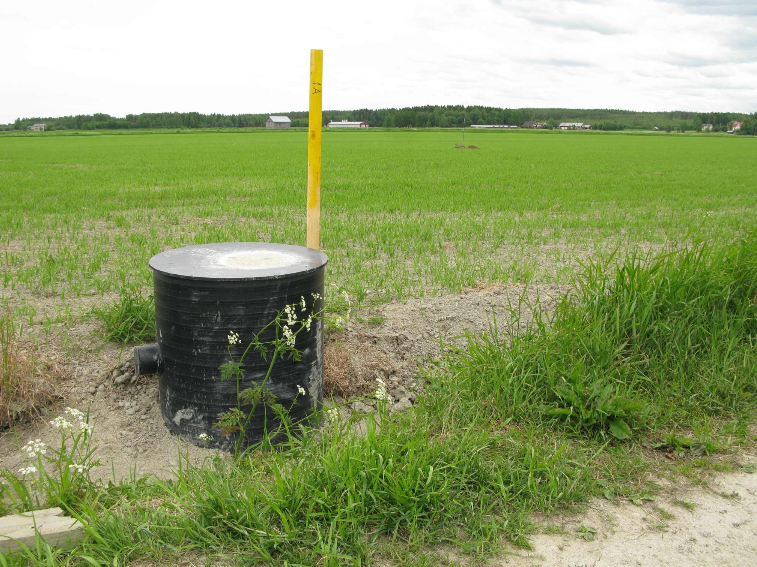
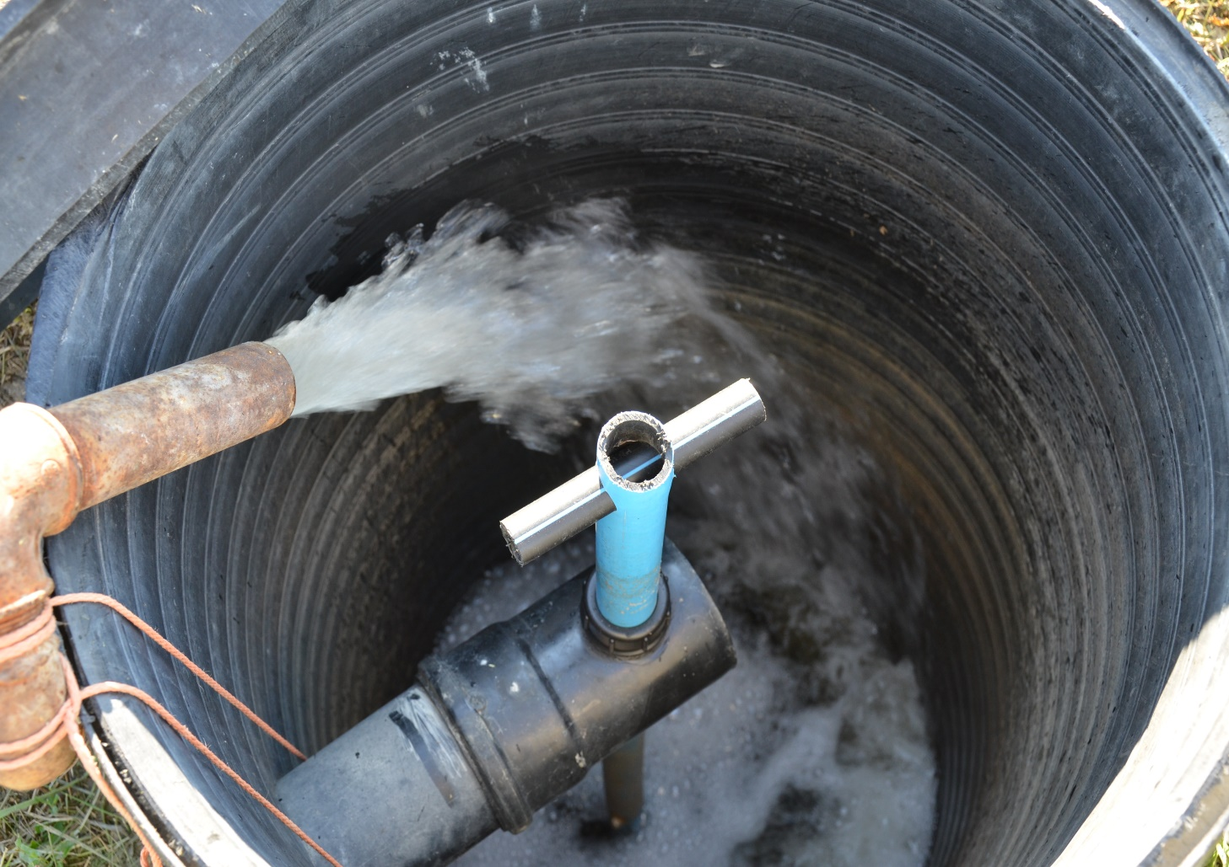
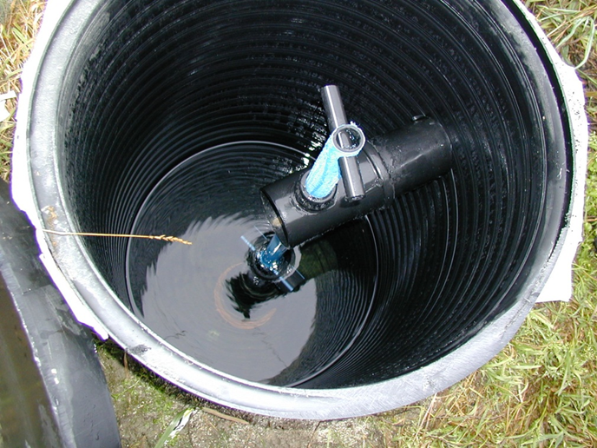
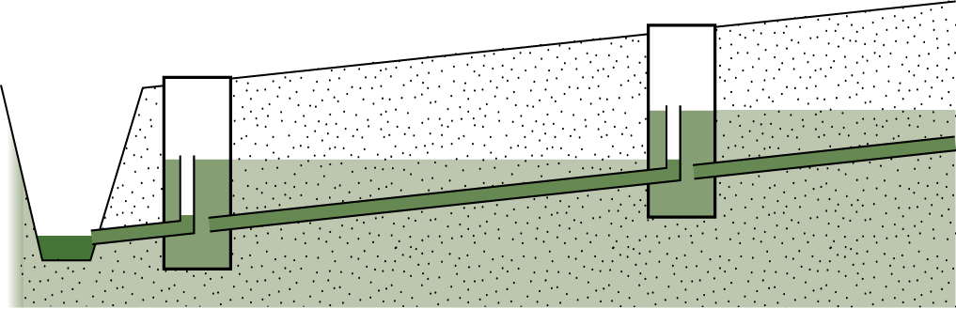
Controlled drainage and subirrigation
Controlled drainage regulates the subsurface drainage from the fields by means of damming devices installed in the control wells
When additional water is led to the soil through subsurface drains, we talk about subirrigation
Controlled drainage and subirrigation are best suited for flat and well-permeable fields
As long dry periods become more common, the importance of controlled drainage and subirrigation is emphasized

Slide 2
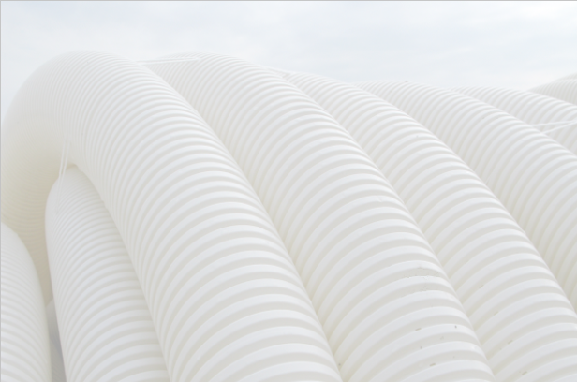
Benefits of controlled drainage in agriculture
Water storage and subirrigation can be used to regulate field water management.
Nutrient leaching decreases (nitrate nitrogen is reduced to nitrogen gas).
The formation of acidity and the leaching of metal compounds from acid sulphate soils are reduced. Potential leaching can be smoothed out over time.
Compaction of peatlands and decomposition of organic matter slow down.
Greenhouse gas emissions on peatlands are decreasing.
Less rust is generated.

Slide 3
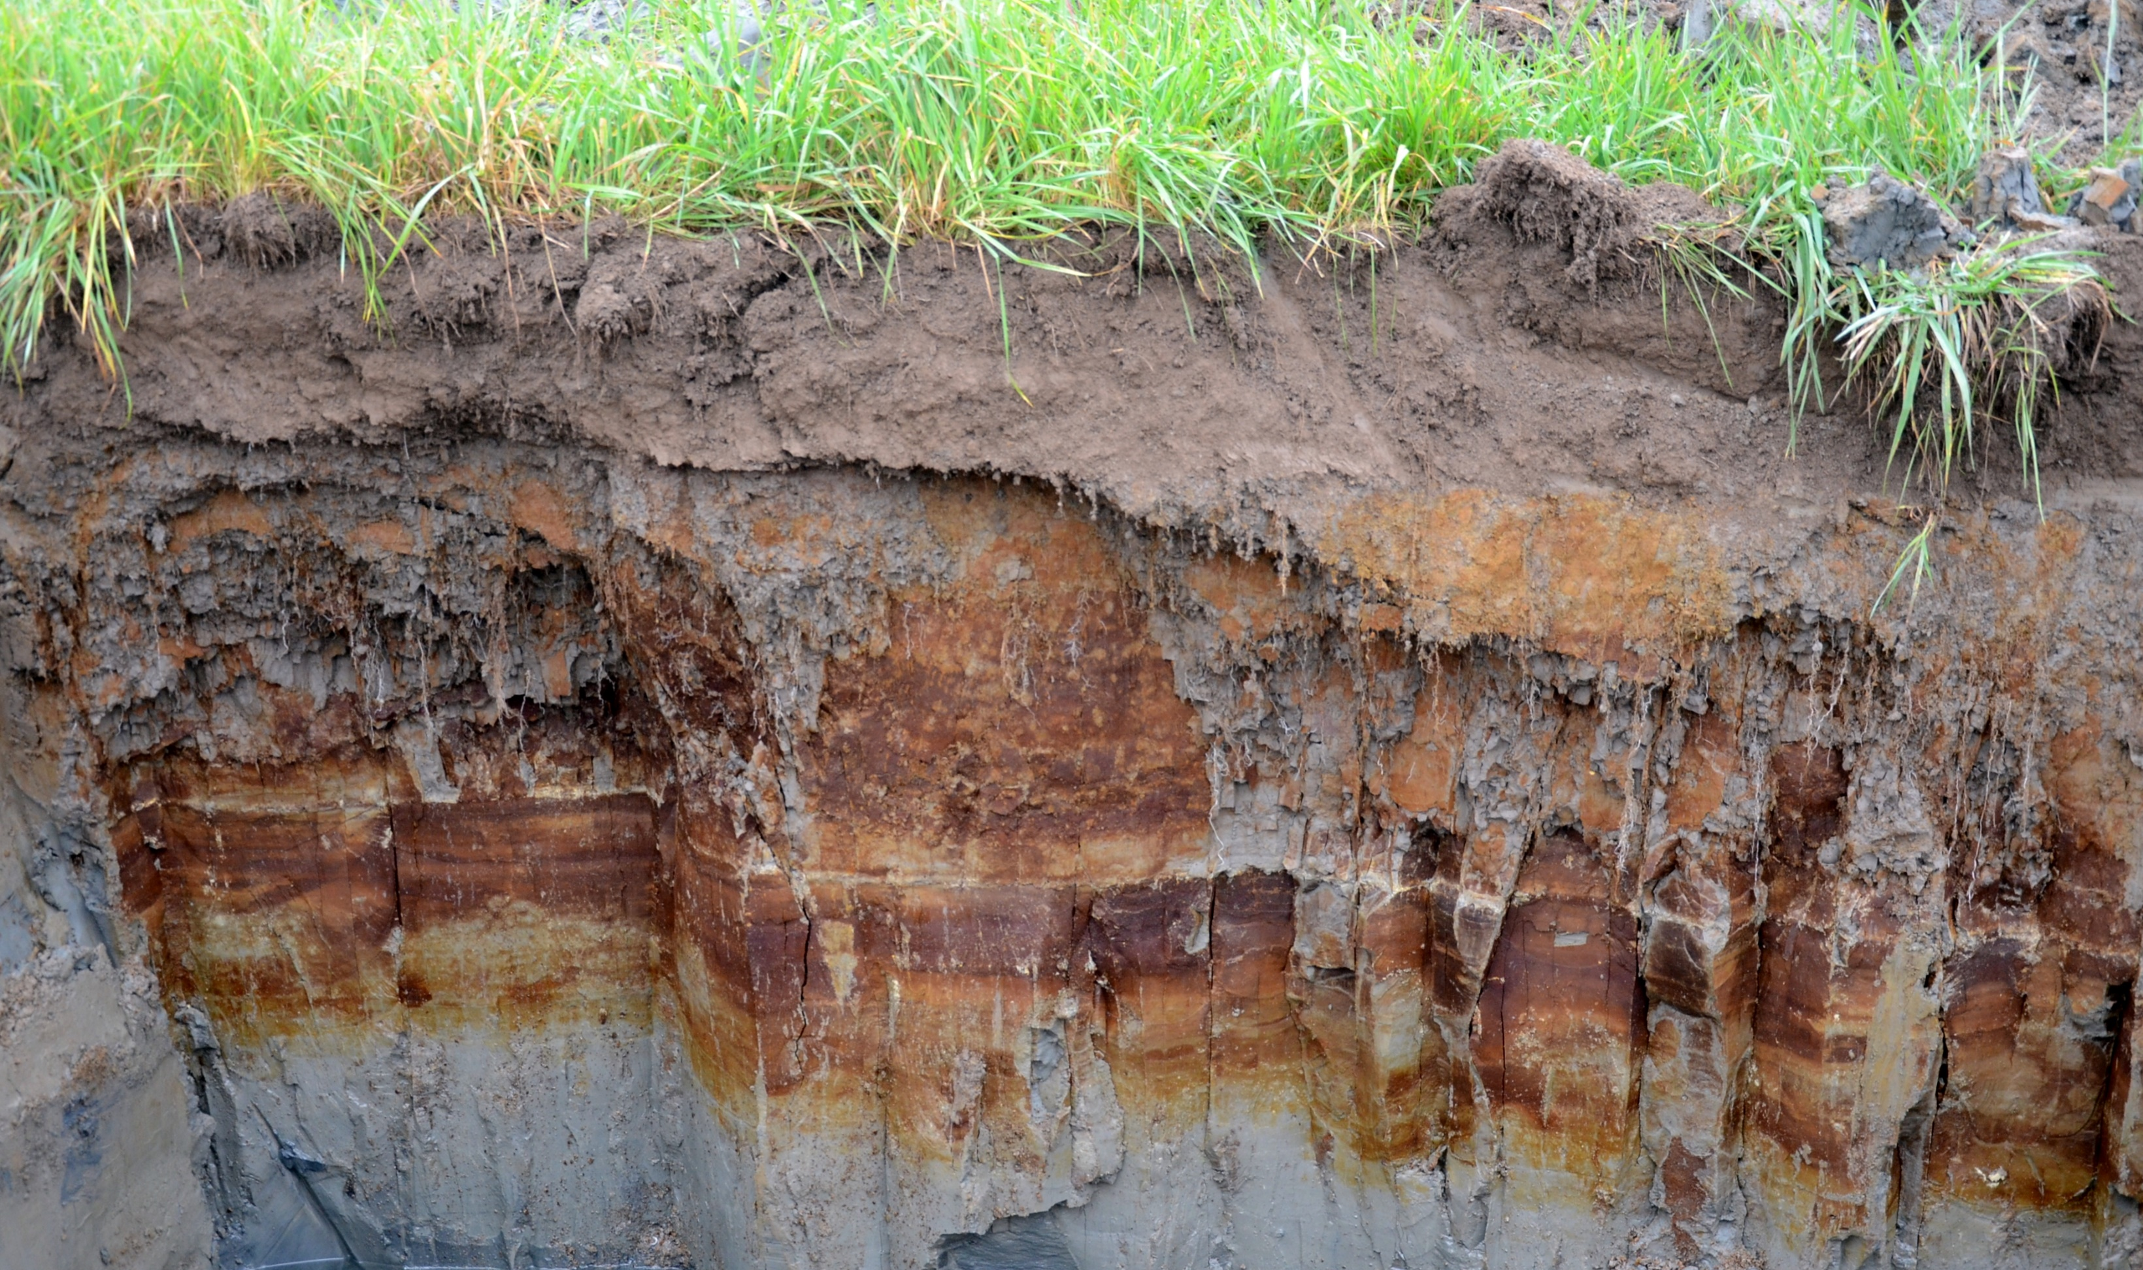




control well
valve open
topsoil
drain material
drainage pipe (unperforated)
drainage pipe (unperforated)
Subsurface drainage + control well - permeable soil

Slide 4

control well
valve closed
top soil
drain material
drainage pipe (unperforated)
drainage pipe (unperforated)
Subsurface drainage - permeable soil

Slide 5
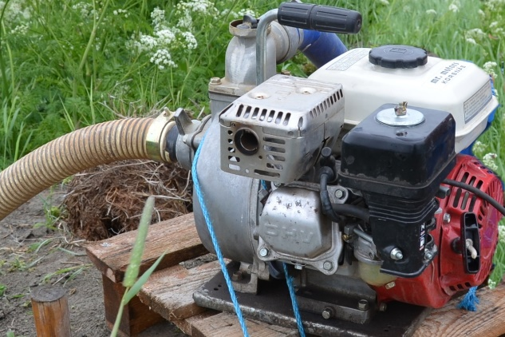
pump
control well
valve closed
topsoil
drain material
drainage pipe (unperforated)
drainage pipe (unperforated)
Subsurface drainage + subirrigation - permeable soil

Slide 6
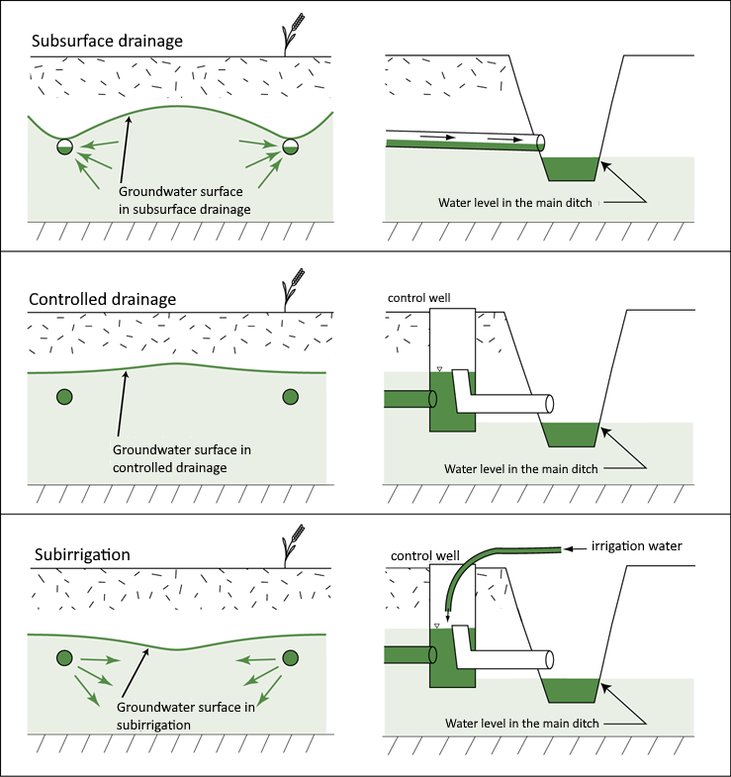
CONDITIONS FOR CONTROLLED DRAINAGE
AND SUBIRRIGATION
Well-permeable soil:
silt loam and coarser soil types
Poorly permeable soil layer under subsurface drains
Controlled drainage, slope of the field max. 2%
Subirrigation, slope of the field max. 1%
Denser ditch spacing than in conventional drainage

