Slide 1
Handiheat Seminar
Claremorris
David Silke
23rd May 2019

Slide 2
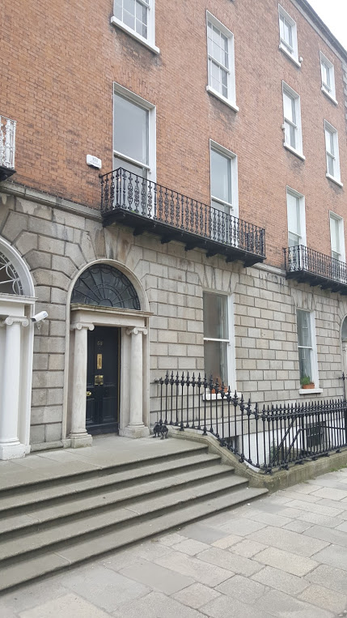
Housing Agency
State Agency - operating on a national basis
Work with others on the delivery of housing and housing services for citizens
Our vision is to promote the building of sustainable communities

Slide 3
Housing Agency
The Agency works with and supports:
Local Authorities
Approved Housing Bodies (AHBs) – Housing Associations
Department of Housing, Planning & Local Government
Private Sector
in the delivery of housing and housing services.

Slide 4
Setting the Scene…

Slide 5

Population in Ireland
Population: | 4,761,865 Up 4% since 2011
Average age: | 37.4 years
Dependency ratio: | 53%
Persons aged 14 or less: | 32%
Persons aged 65 and over: | 21%

Slide 6
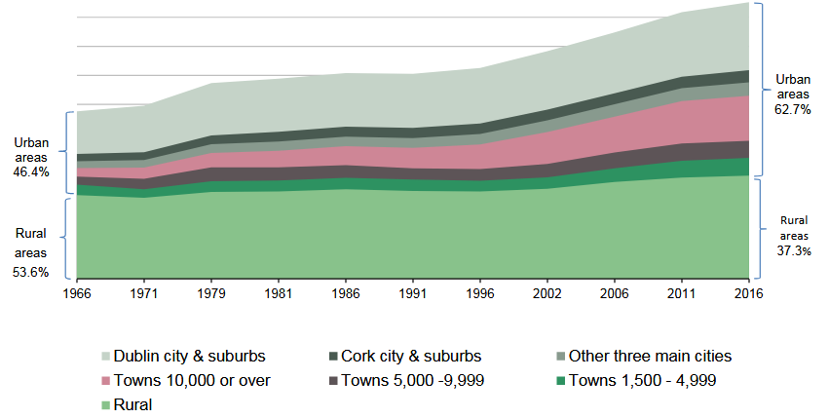
Population Growth by area 1966 – 2016 (CSO)

Slide 7
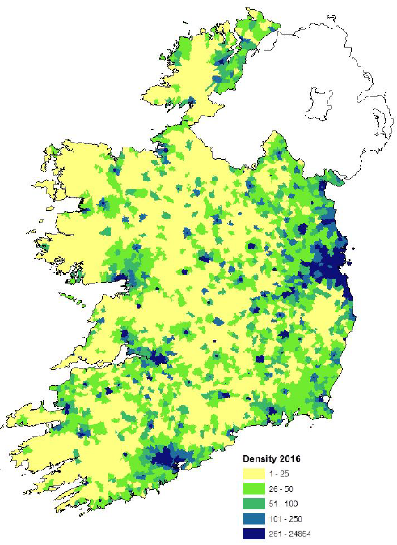
Population Density 2016
Source, ESRI 2018
Notes:
https://www.esri.ie/system/files/media/file-uploads/2018-01/RS70.pdf (page 50)

Slide 8
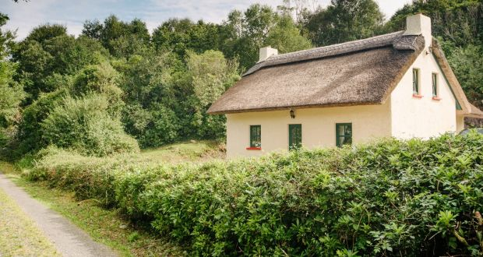
The Housing Stock
Overall Housing Stock
2 million
Social Housing Stock
c.135,000 local authority
180,000 (9%) vacant
Low density, but not like this picture!
c. 36,000 voluntary, non-profit
c. 63,000 in private rented sector with housing subsidy
[c. +30,00 rent supplement]

Slide 9
Types of buildings in the housing stock
Europe (EU 15) Ireland
45.0%
42.2%
42.0%
28.7%
28.3%
12.0%
Sources: Census 2016 (E1005) and SILC (ilc_lvho01) for EU15

Slide 10
Household Tenure and Size
Av. household size: 2.75 people
Notes:
SOURCE NEEDED

Slide 11
Household Sizes Ireland, UK and European average, 1920-2013
Sources: CSO Census Data and Data from Housing Europe
Notes:
The most significant demographic change in Ireland has been the extremely rapid reduction in household size over the last 50 years.
The reduction in household size over this period is twice the European average.
The effects on our society needs to be analysed and understood.

Slide 12
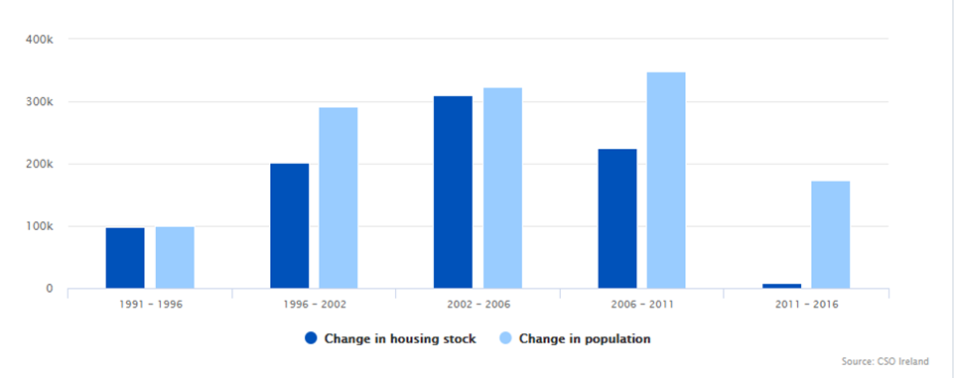
Changes Population and Housing Stock, 1991 - 2016

Slide 13
Challenges

Slide 14
Challenges for rural housing to become more energy efficient
Location – need to move from one-off to villages and towns to reduce reliance on cars
Planning – planning for smaller household sizes
– one-off houses dominate rural areas
Practice – high reliance on oil, turf, coal
Poverty – fuel poverty rate of 20% limits investment options

Slide 15

Planning for Sustainable Development

Slide 16
Thank You
info@housingagency.ie

