Slide 1
Energy Efficiency & Demand Side Management
May 2019
Handiheat Seminar, Claremorris, Mayo

Slide 2
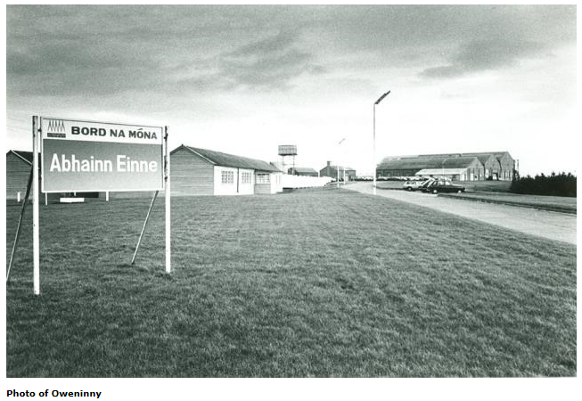
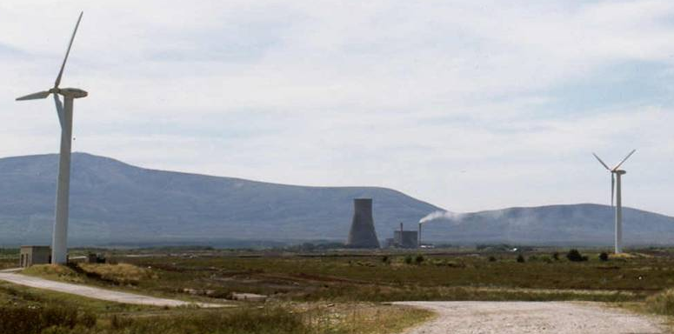
BnM in Mayo – Introduction
Bord na Móna have been in Mayo since the 1950’s. Initially we provided peat to fuel a 40MW ESB power station.
We currently own & operate the first ever wind farm installed in Ireland at Bellacorrick in 1992.
21 Turbines / 6.4MW
2015 Stakeholders
Speaker ~ Tom Quinn: Energy Services Manager with Powergen Operations

Slide 3
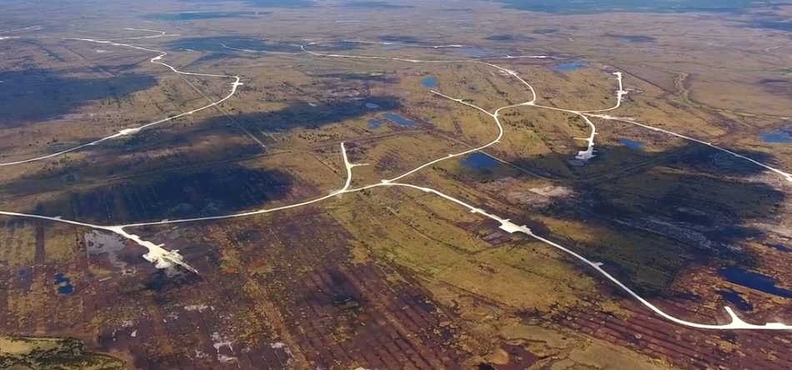

More Recent Work in Mayo
89MW Wind Farm, Oweninny under construction, turbines being erected on site, project due for completion soon

Slide 4
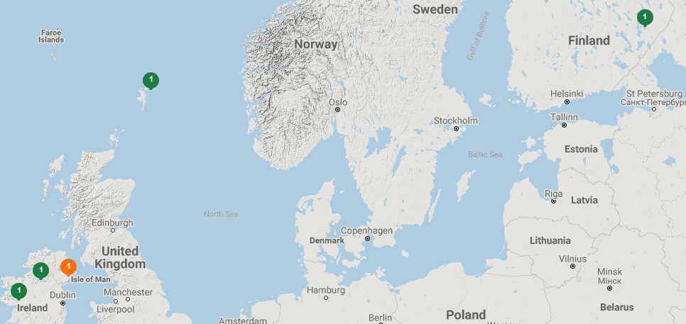
Why are BnM here today?
Description (EN): HANDIHEAT aims to create a best practice, innovative model within the energy sector with the end result promoting and increasing the uptake of sustainable community energy plans. The objective of the project is to develop and focus on energy networks such as district heating fuelled by renewables and gas networks, to tackle the issue of energy poverty and security in rural, border communities who rely on imported fossil fuel.. …

Slide 5
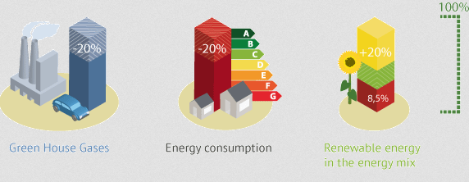
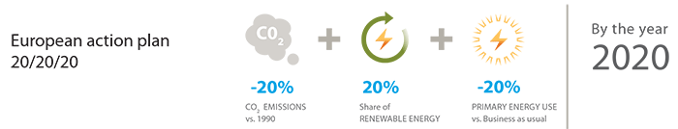
Energy Efficiency ~ EU Policy
2030 ~ EU have revised the EED to give a 32% Energy Efficiency Target, an estimated cumulative target of approx. 60,500 GWh

Slide 6
Bord na Móna ~ Energy Efficiency
c. 100GWh Energy Efficiency kWh Generated
Equivalent to approx>5,000 homes annual energy consumption
Equivalent to c. 10 years of output from existing Bellacorrick Windfarm

Slide 7

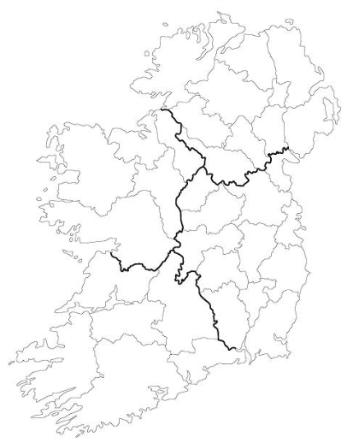







Efficiency in the Community

Slide 8
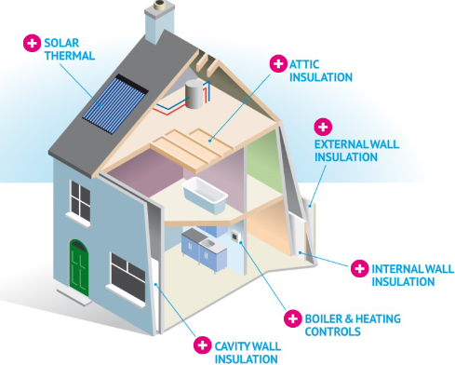
Efficiency Measures;
@ Homes in the community
@ Work in the community
Heat Pumps
Low Energy Lighting
Energy Management
Efficient Pumping
Efficient Controls
High Efficiency Boilers
Transport Project
Insulation
Solar PV

Slide 9

Clár ICH / Bord na Móna / SEAI ~ BEC 2019
Bord na Móna are delighted to be working with Alma and the team on this important community project.
This project builds on our partnership, and importantly reaches out to homes and businesses.
Clár continue to impress BnM with its great ability to reduce energy consumption, energy spend and increase efficiency in communities across Ireland.

Slide 10
The size of the Challenge in Ireland

Slide 11
Demand Side Management
Demand Side Management (DSM) ~ reference to the consumer managing their consumption.
Bord na Móna have been working with homes and businesses to assist in understanding their consumption, so that energy savings can be targeted.
Energy in the home can be in the form of solid fuel, electricity, oil, gas and water. Generating information about the energy consumption patterns, allows customers to see opportunities for savings.
If you can Measure it, you can Manage it……

Slide 12
Demand Side Response
In addition, there are global developments in demand side response.
This means that communities will in the future be able to look at their energy load, and consumption and respond to signals from the grid.
Community energy projects may become about how the community can respond to request to reduce consumption, turn off plant, or even become independent grids of their own (micro grids).
This all starts with being in charge of your energy….

Slide 13
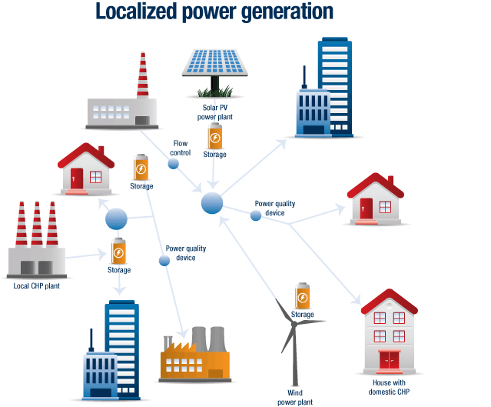
Community Projects in the Future

Slide 14
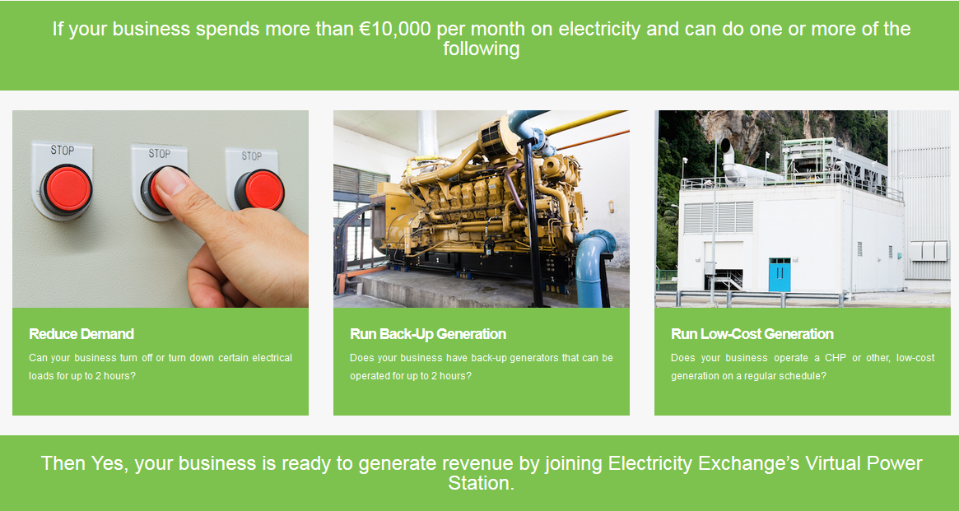
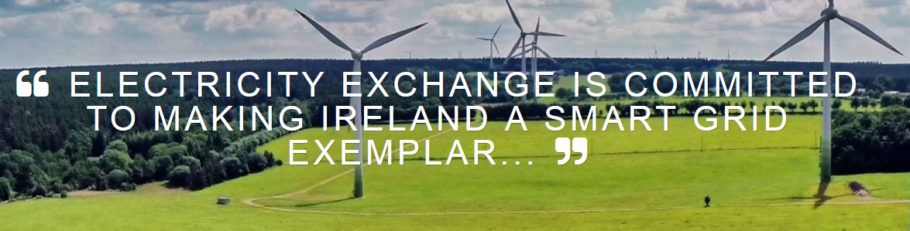
What are BnM doing in Demand Response?
In August 2016, Bord na Móna acquired a 50% share of Electricity Exchange, a leading provider of smart grid technology and services
We are delighted to be assisting Electricty Exchange in a very modest way on their innovative rooftop Solar PV project

Slide 15

Thank you

