Slide 1
HANDIHEAT
Project
2nd Full Partner Meeting
Jyvaskyla
7th Feb 2019

Slide 2
HANDIHEAT
Welcome
Robert Clements
Project Lead
Northern Ireland Housing Executive

Slide 3
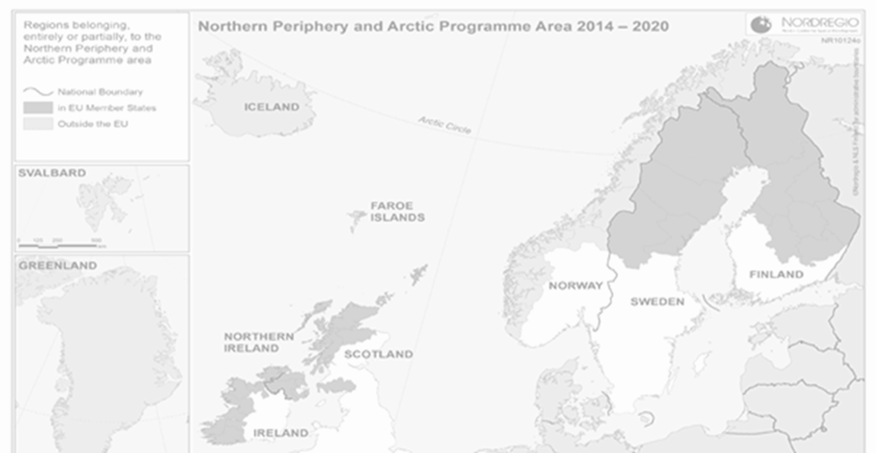
HANDIHEAT Project
Project Overview

Slide 4
HANDIHEAT Project
Why
Partnership – Start with ARC ……. Led to Transnational Co-operation
Common Challenges – Fuel Poverty, High Dependency Fossil Fuels,
Opportunities – Across Northern Europe High Wind Penetration,
Passion – Make a Difference

Slide 5
HANDIHEAT Project
Specific Objective: use of energy efficiency and renewable
energy solutions in housing and public infrastructures in remote,
sparsely populated areas

Slide 6
HANDIHEAT Project
Partners
Work Packages
Budget (Euros) 2,015K
Performance Reviews/
Control Measures
Lead Partner NIHE
Project Lead & Management
Pilot – Co Fermanagh
NIHE 449K
Monthly Partner Conference Call
Full Partners
ARC Healthy Living, NI
Clara Irish Centre
Housing, RoI
PURE Energy Centre, Shetland, Scotland
Karelia University Finland
Austurbruses Energy Iceland
Natural Resources Institute, Finland (LUKE)
Assessment policy gaps/energy, fuel poverty interventions (ARC)
Assessment of regional best practice for rural/community energy models (Austurbruses)
Pilots to reduce reliance on heating oil by Compressed Biogas and Wind Curtailment (Karelia)
Future Models for Rural Areas eg. Toolkit/roadmap and training resource for rural groups (PURE)
External communication, concluding seminars, industry events for rural areas/local communities (Clara ICH)
ARC 274K
Austurbruses 165K
Karelia 393K
PURE 252K
Clara ICH 239K
LUKE 240K
4 monthly
F2F Partner Meetings
Lead Partner Annual NPA Meeting
Compliance Checks – LP with External Expertise
Associate Partners
Ulster University
Power On Technology
Irvinestown Trustee Enterprise Company (ITEC)
Shetland Heat Energy & Power (SHEAP)
Partners checked by FLC each country
2nd Level Control by SEUPB
Support full partner WP

Slide 7
HANDIHEAT Project
Deliverables & Outputs
Policy Review, Fuel Poverty, Health/Housing and Winter Deaths
Benchmark existing Best Practice across Partner countries
Demonstration Pilots in Finland and N Ireland
Toolkit of Best Practice Policies and Sustainable Solutions for Retrofit
protect rural communities from energy price fluctuations & improve the social wellbeing and quality of living throughout the participating regions

Slide 8
Any Questions

