Slide 1

2nd Pilot Demonstration Update
3rd Full Partner Meeting
Claremorris, Co Mayo
22 & 23rd May 2019

Slide 2


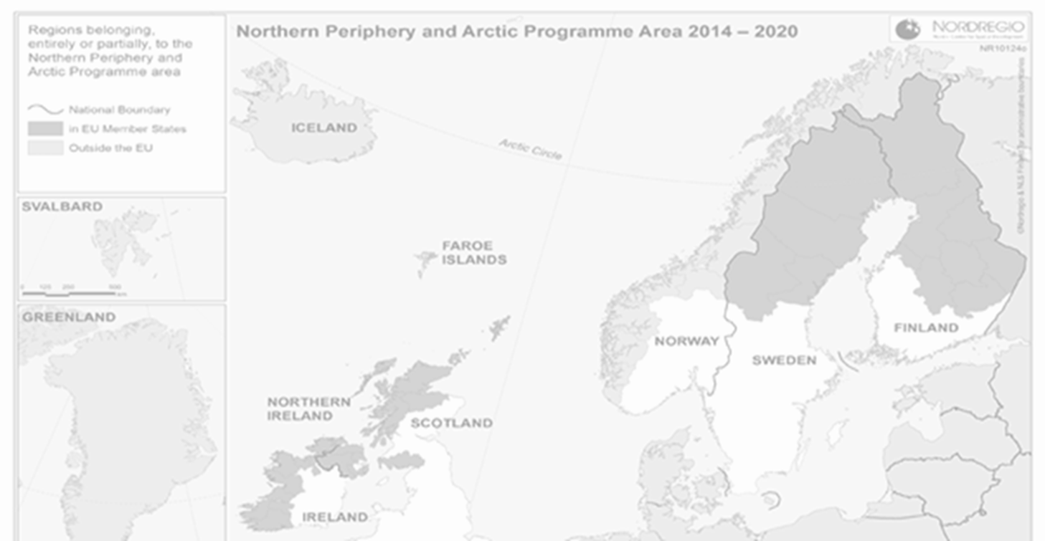
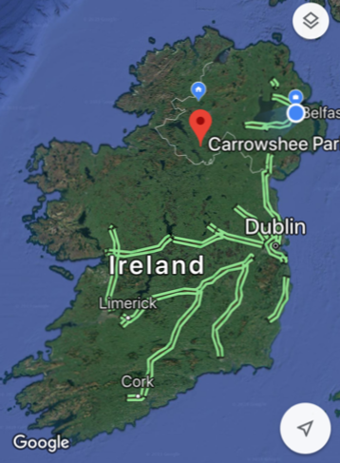
2nd Pilot Demonstration
Approx. 5 dwellings
EE Retrofit & Low Carbon Heating (within budget)
Rural Fermanagh (Lisnaskea)
Social Housing
1-2 years data monitoring

Slide 3
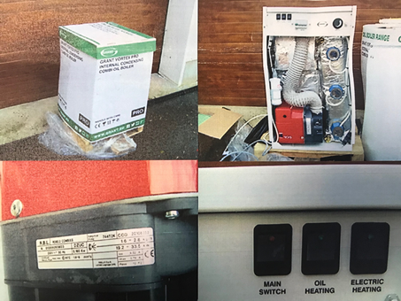
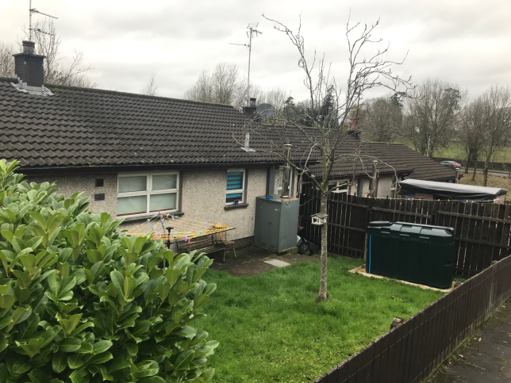
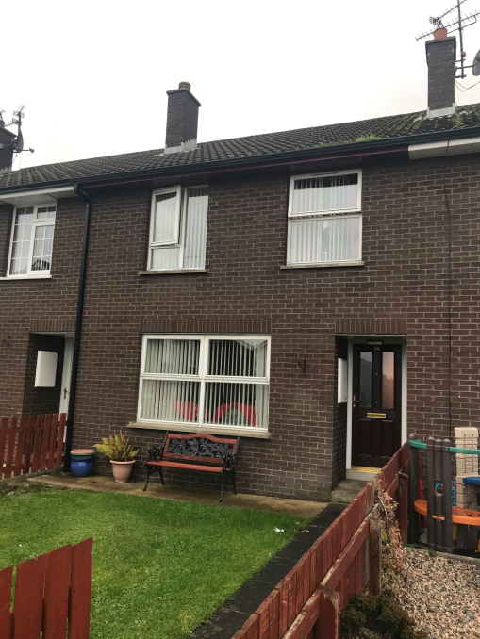
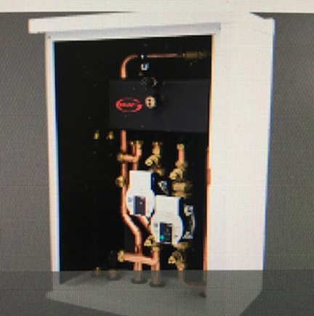
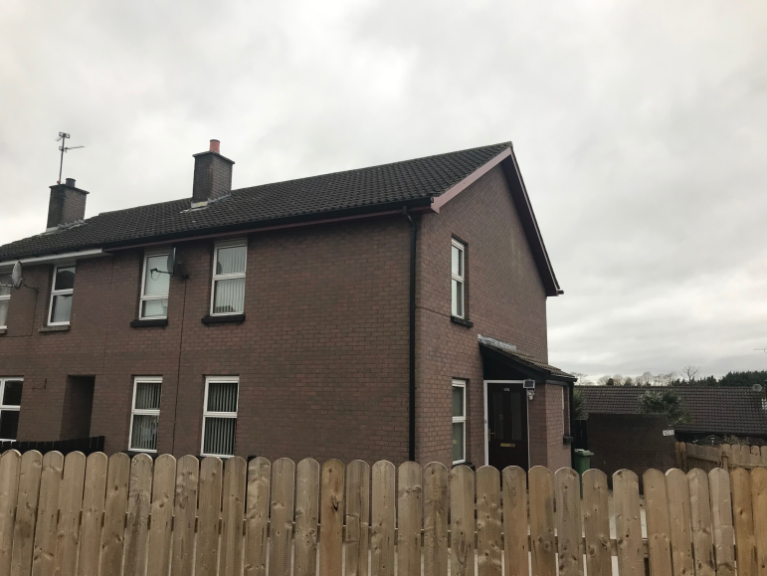

Slide 4

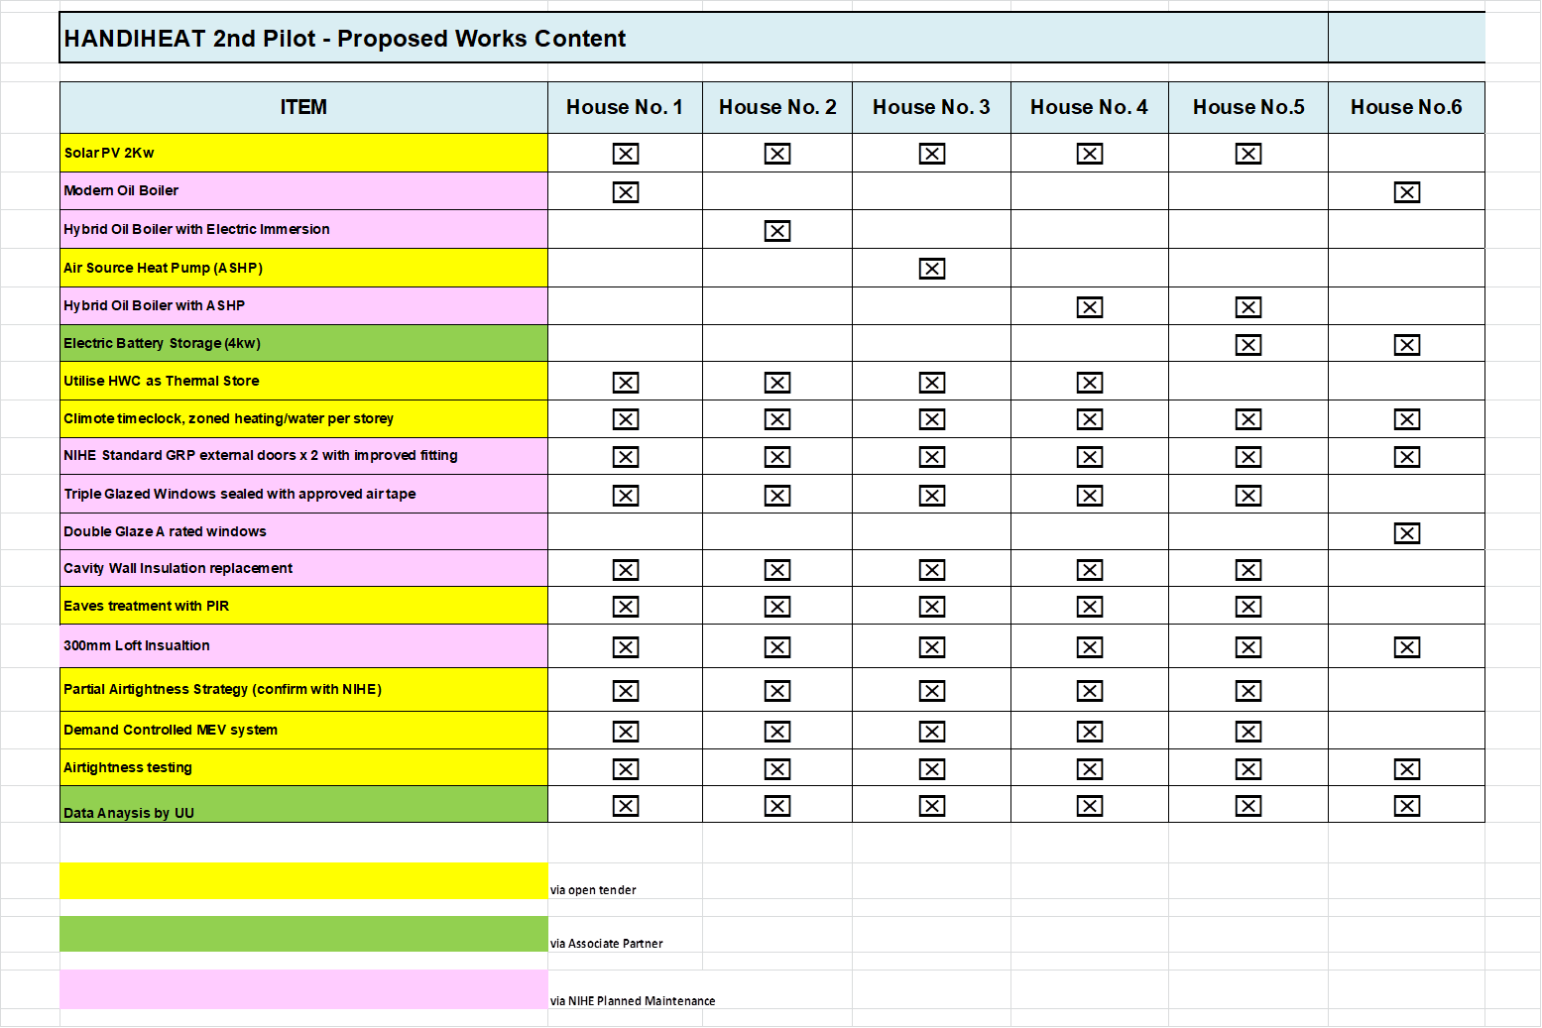

Slide 6
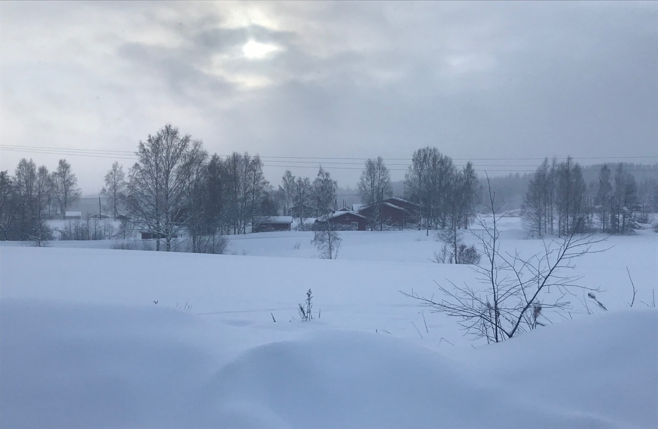
Any Questions

