Slide 1



HandiHeat
Work Package 5
Policy Gaps
May in Mayo

Slide 2
Relevance
“Fuel poverty is a long-standing health issue: the impact of cold housing on health and the stresses brought on by living in fuel poverty have been recognised by all policy makers… fuel poverty is avoidable and it contributes to social and health inequalities”. Marmot, The Health Impacts of Cold Homes and Fuel Poverty 2011

Slide 3
What are we trying to achieve?
The purpose of this work package is to capture the hearts and minds of local government and their partner agencies across the NPA area, so that when they come across a cold, damp home they know where to refer, why they are referring and be confident that the referral could make a difference to people’s lives.

Slide 4

Bringing together the agencies that can create the change…
Health and Wellbeing Boards – The 1848 Public Health Act was one of the first Acts to link population health and housing. Health and Wellbeing Boards have a critical role to focus and lead affordable warmth and fuel poverty strategies. They embed a preventative and social determinants approach within the working practices of the local authority, NHS, and social care commissioners and providers. Local Authorities can use their leadership role and bring together it's services with health, voluntary and community partners and local residents to tackle fuel poverty and cold homes.

Slide 5
Public Health
Public Health – overall aim is to improve healthy life expectancy of the population they serve. Reducing fuel poverty and improving warmth is an important element of improving life chances and closing that gap

Slide 6
Housing Executive
Housing – Strategic role to oversee all housing in local authorities’ areas, in terms of new supply, homelessness and housing advice and improving conditions in all tenures.

Slide 7

Leading change

Slide 8
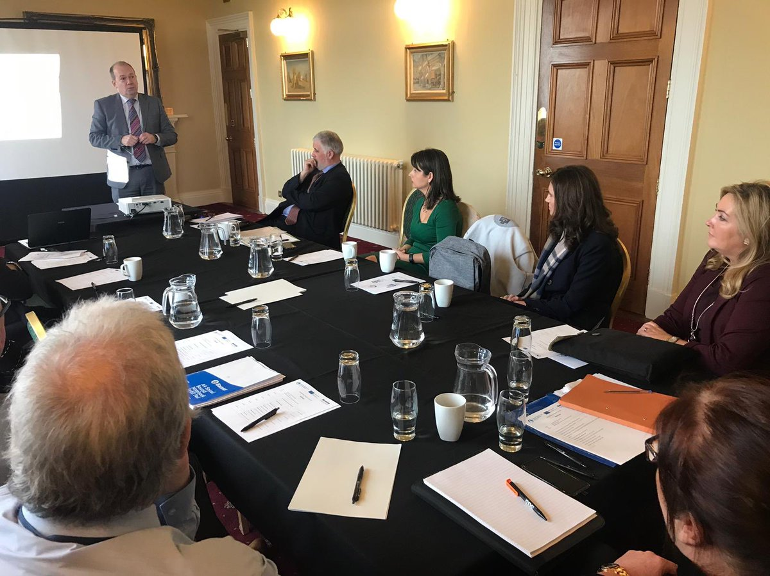
Starting the conversation

Slide 9
Desk Research
https://www.gov.uk/government/publications/final-report-of-the-fuel-poverty-review
https://www.nao.org.uk/wp-content/uploads/2016/11/Overview-Local-government.pdf
http://www.fph.org.uk/uploads/UKHF-HP_fuel%20poverty_report.pdf
https://www.nice.org.uk/guidance/ng6
https://www.gov.uk/government/publications/cutting-the-cost-of-keeping-warm
http://www.instituteofhealthequity.org/resources-reports/the-health-impacts-of-cold-homes-and-fuel-poverty

Slide 10
Learning from others
https://youtu.be/GWUGQi4RIvQ

