Slide 1
Biogas production and potential in UK, Ireland and Finland
Erika Winquist
Heat and Anaerobic Digestion for District Heating
HANDIHEAT partner meeting 22.-23.5.2019

Slide 2
Decentralized renewable energy production
Mitigating climate change
Improving national energy self-sufficiency
Improving local energy security
New small energy companies and jobs for rural areas

Slide 3
Why biogas?
Landfilling of organic waste not allowed (since 2016):
  Composting
  Anaerobic digestion
Pressure for more environmentally friendly and resource-efficient agriculture
  Reducing emissions
  Combining food and energy production
Scope in Handiheat:
  Decentralized heat production
    Agricultural / farm-scale biogas plants
  Replacing natural gas with biogas in heat production

Slide 4
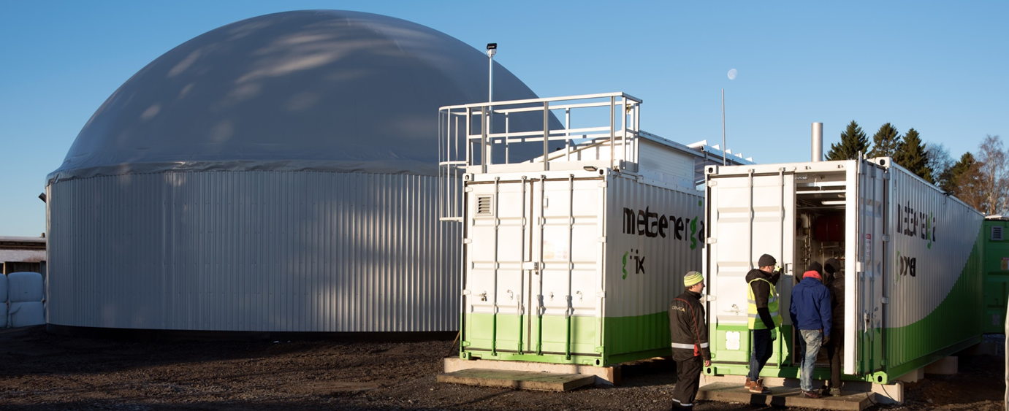
Farm-scale biogas plant
Energy
self-sufficiency
Emissions from
storage of slurry
Substrates:
- Cow slurry
- Excess grass silage
from feeding
Nutrient
Self-sufficiency
Replacing
fossil energy
Kuva: Demeca Oy
Products:
- Biogas
- Recycled nutrients
Notes:
Biokaasun tuotannon kaksi tasoa: teollinen yhdyskuntajätteen käsittely, maatilojen omat laitokset.
Esimerkiksi tältä voisi näyttää maitotilan biokaasulaitos.
Metaani voimakas kasvihuonekaasu.

Slide 5
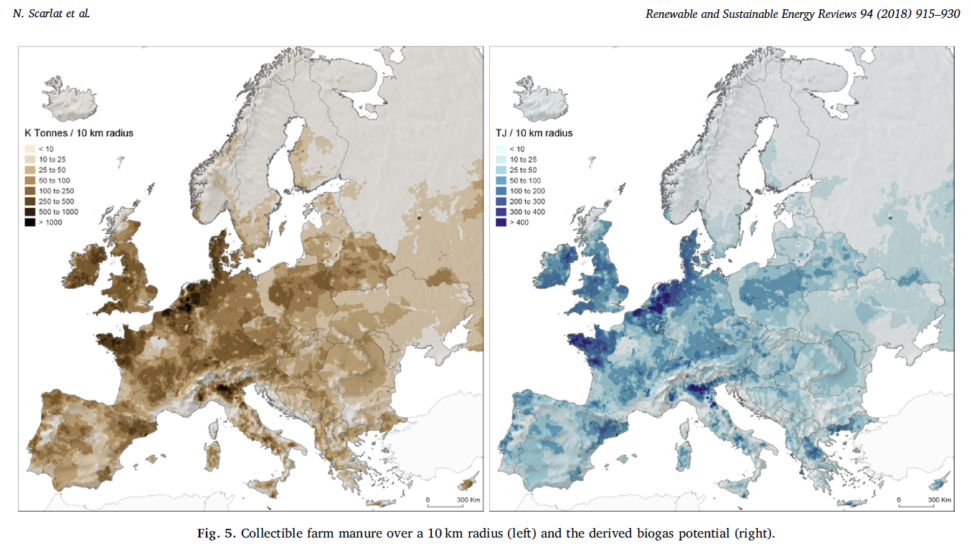
Collectible farm manure and biogas potential in Europe
(Scarlat et al. 2018)

Slide 6
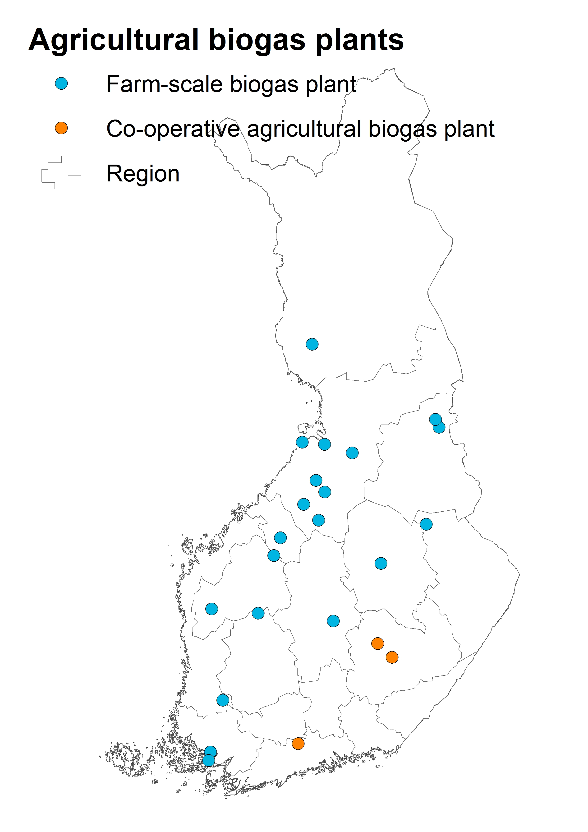
→ 23 plants in 2018

Slide 7
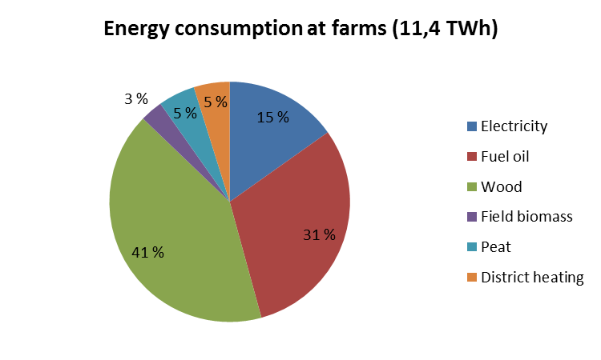
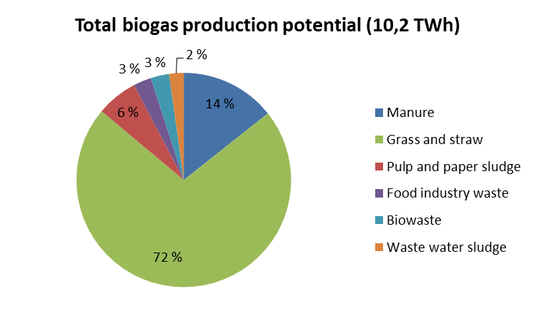
Comparison in Finland

Slide 8
Situation in Finland
The number of agricultural biogas plants is growing fast in Finland
Farm-scale biogas production is supported through investment support (40%)
The available biomasses could almost cover the total need of energy in agriculture
Currently two well established biogas plant providers for farm-scale plants (Metener Ltd, Demeca Ltd) but new companies are emerging
A freely available biogas tool might lower the treshold for farmers to get interested in biogas production

Slide 9
Biogas planning tool
Farm-scale biogas production
Languages English and Finnish
Broad selection of possible feed materials and their composition
Three technologies
  Wet
    Traditional continuously strirred tank reactor (CSTR)
  High dry matter
    Raw material pre-treatment + CSTR
  Solid
    Leach bed

Slide 10
Biogas planning tool
Based on selected raw materials and processing technology:
  Biogas energy content
  Digestate nutrient content
Four options for biogas utilization
  Heat
  Heat and electricity (CHP)
  Biogas upgrading and feeding to the grid
  Biogas upgrading and selling as traffic fuel
Economic feasibility
  Default values based on Finnish values
  Possibility to fill in own values

