Slide 2
Our Vision – Creating a Cleaner Energy Future
Moving towards a Low Carbon Energy Future - Sustainable, secure, affordable, and clean energy.
We need to use LESS energy and CLEAN energy. Develop new solutions to meet our energy needs.
Leading the transition to Smarter and more Sustainable energy activities.
So what is Energy Efficiency about?
Reducing the amount of energy needed to run the home, especially heating.​
More efficient ways of generating the energy needed.

Slide 3
SEAI Programmes
Delivery team
Warmer Homes
Homes
Communities
Deep retro fit
Others
Lighting programme
Public Sector
Exeed
Renewable heat
Solar PV
Electric Vehicles

Slide 4
Delivery programmes
Focus on domestic

Slide 5
SEAI Programmes
Delivery team
Warmer Homes €24M
Homes €17M
Communities €23M
Deep retro fit €7M

Slide 6
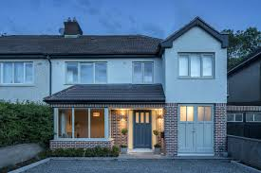
Retrofit homes
#1 Fabric first
Wall insulation
Attic/roof insulation
Ensure windows are performing
Possibly underfloor insulation
#2 Heating system
Renewable energy: heat pump
#3 Solar PV or solar thermal

Slide 7
Warmer Homes
Programme aimed at Fuel Poor.
Service is free at point of access
Subject to qualifying criteria
Qualifying criteria set by the Department and currently under review
Previously this scheme aimed at providing cost effective measures to large volumes
New focus on delivery of a full upgrade requiring no further intervention?

Slide 8
Grants Homes
Energy Efficiency Measures |  | Grant Value
Insulation | Attic | €400
 | Wall - Cavity | €400
 | Wall - Internal Dry Lining
 | Apartment (any) or Mid-terrace House | €1,600
 | Semi-detached or End of Terrace | €2,200
 | Detached House | €2,400
 | Wall - External
 | Apartment (any) or Mid-terrace House | €2,750
 | Semi-detached or End of Terrace | €4,500
 | Detached House | €6,000
Heat Pump Systems | Air-to-water / Ground-to-water | €3,500
 | Air-to-air | €600
 | *Technical Advisor (*only in conjunction with the Heat Pump System grant) | €200
Heating Controls |  | €700
Solar Thermal |  | €1,200
Bonus Grant | For 3rd measure | €300
 | For 4th measure | €100
** Building Energy Rating (BER) |  | €50

Slide 9
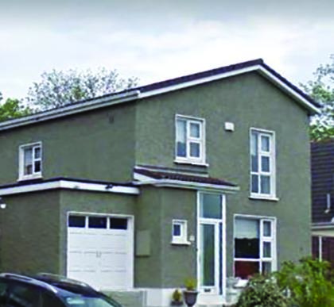
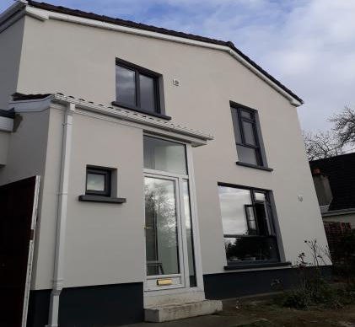
Deep retro Fit Results

Slide 10
Communities

Slide 11
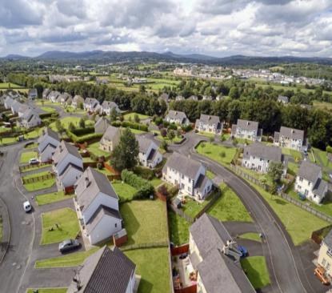
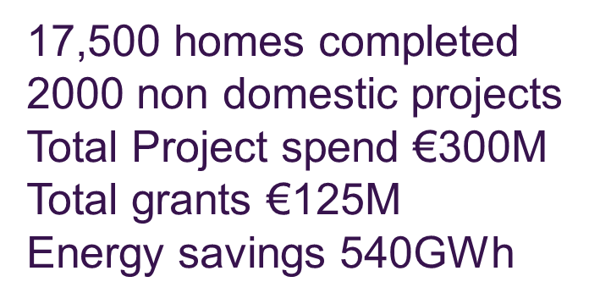
Communities 2012- 2018

Slide 12
Communities 2019 -2020
Budget Allocation for 2019 €23M
Currently 55 projects for approval
Commitments for 2019 €24M
Homes 600 (Minimum B2 BER requirement)
Non Domestic buildings
2020 No significant programme adjustments
2021 On refocus on SEC delivery of communities scheme

Slide 13
What does delivery look like!!

Slide 14
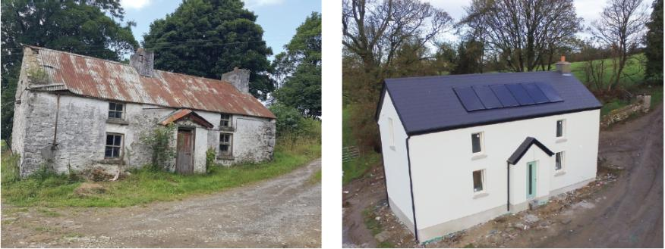
Homes what’s possible?

Slide 15
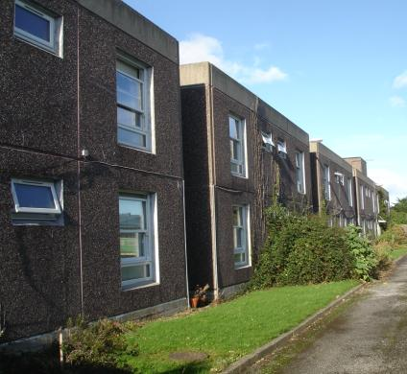
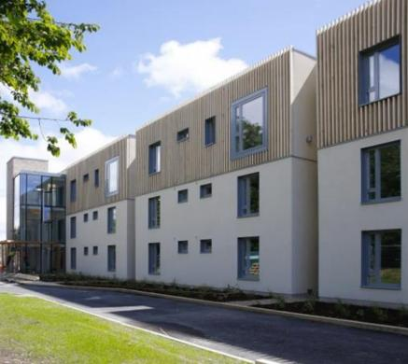
South Dublin Local authority homes

Slide 16
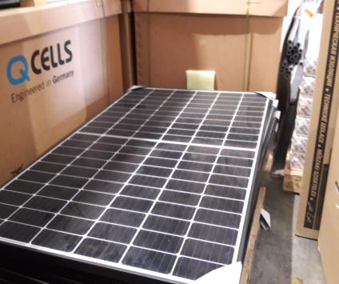
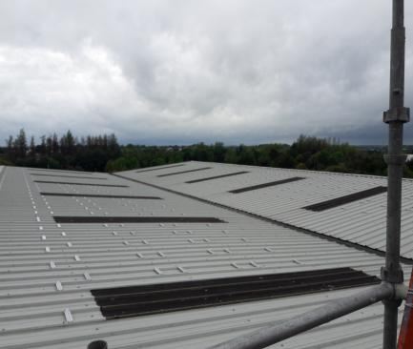
Solar Power is a significant technology for 2019

Slide 18
Communities 2019 Housing Strand
Housing strand aimed at
Local Authority's
Housing associations
Funding 35% Local Authority
50% Funding for Housing associations
Requirements
B2
Contract directly with end client

Slide 19
Questions
John Flynn Programme Manager Communities
01 8082095

