Slide 1

FINAL CONFERENCE
Marche Region
BLUE KEP
Ancona, 26th September 2019
www.italy-croatia/web/blue-kep

Slide 2

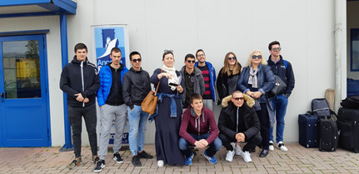
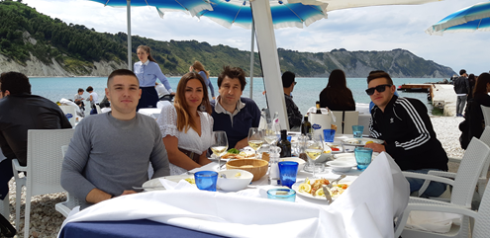

STUDENTS’ MOBILITY ACTIVITIES
Incoming groups to Italy
Marche Region

Slide 3
Preparation of incoming Mobility
Realization of a welcome meeting, aimed at the first reception of the beneficiaries and to provide all the detailed information useful for staying abroad;
Introduction to the hosting schools and tutors;
Logistic arrangement of the groups of beneficiaries (in dormitories or hostels);
Transfer from/ to the harbour for students and accompanying tutors (where necessary)
Provision of ticket for local transports
Health and safety at the workplace training
Constant monitoring and tutoring

Slide 4
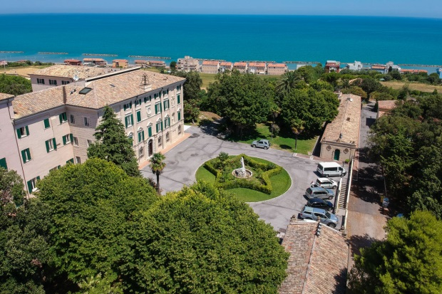
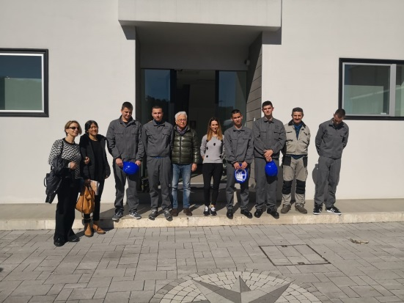
Mobility activities in Ancona
SENDING SCHOOL: Nautical School Split
PERIOD: 4 March – 12 April 2019
HOSTING SCHOOL: IIS Volterra Elia, Ancona
HOSTING COMPANIES: C.P.N. S.r.l. (Industrial ship-building and outfitting)
ACCOMMODATION: Hotel Stella Maris, Ancona

Slide 5
Mobility activities in Ancona
PARTICIPANTS:
Croatian Students: Dino Blic, Duje Zekic, Antonio Gatalica, Nikola Kapulica, Jakov Miletic
Croation accompanying teachers: Hana Rubic, Jere Poljak
COORDINATION:
Italian School tutors: Franca Pizzi, Ferdinado Leone
Marche Region: Paola Paolinelli, Cristina Galante, Sabina Riatti
Eurocentro: Claudio Carlone

Slide 6
Mobility activities in Ancona
ACTIVITIES CARRIED OUT IN THE SCHOOL:
Mechanics, Nautical sciences, English, Safety course, Navigaton Simulator, Sailing
EXAMPLES OF ACTIVITIES CARRIED OUT BY THE TRAINEES IN THE COMPANY:
Assisting in hull construction in outer shipyards
Assisting in construction of the outer ship
Assisting in connecting two parts of the building ship
Assisting in connecting two parts of the ship
Welding

Slide 7
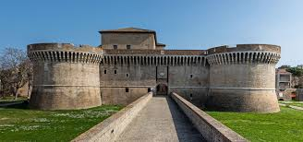
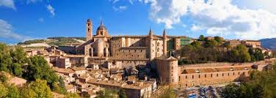
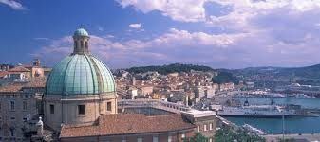
Mobility activities in Ancona
CULTURAL ACTIVITIES:
Visiting Ancona
Day trip to Senigallia: Fortress of Senigallia (Rocca Roveresca), tour around the city, Palazzetto Baviera – photography exhibition
Day trip to San Marino
Day trip to Urbino: Tour around the city, the Ducal Palace

Slide 8
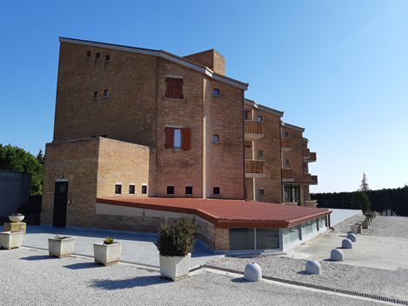
Mobility activities in Fermo
SENDING SCHOOL: Nautical School Split
PERIOD: 4 March – 12 April 2019
HOSTING SCHOOL: IIS “G. e M. Montani”, Fermo
HOSTING COMPANIES: Ascolani Francesco, Association “Liberi nel vento”
ACCOMMODATION: Centre for Vocational Training “ARTIGIANELLI” (dormitory in Fermo)

Slide 9
Mobility activities in Fermo
PARTICIPANTS:
Croatian Students: Ivan Vucovic, Ante Bresan, Stella Musa
Croation accompanying teachers: Ana Novakovic, Katica Kezic
COORDINATION:
Italian School tutors: Giovanni Petruzzi, Gianna Maura Bonifazi
Marche Region: Paola Paolinelli, Cristina Galante, Sabina Riatti
Eurocentro: Claudio Carlone

Slide 10
Mobility activities in Fermo
ACTIVITIES CARRIED OUT IN THE SCHOOL:
Mechanics, Maritime English, Nautical Sciences, English, Safety Course
EXAMPLES OF ACTIVITIES CARRIED OUT DURING THE TRAINEESHIP:
Shipyard “Ascolani Francesco”: Sailboat refitting
Visit to Mr. Cappella’s boat-building site in Marina Palmense
Training in the Navigaton simulator
Basic course for nautical licence
Sail boat practice with the Sport Association “Liberi nel Vento”

Slide 11
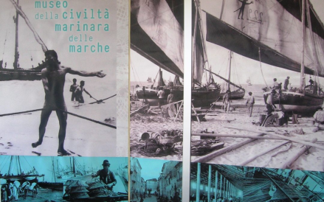
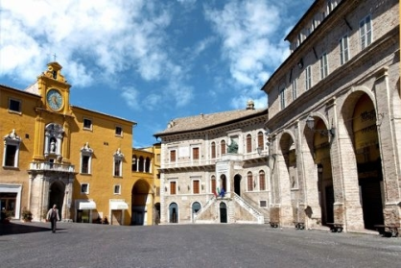
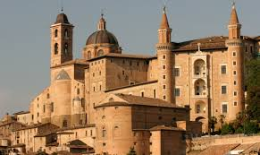
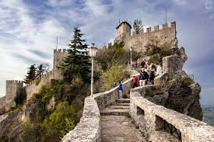
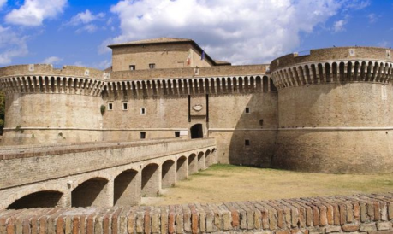
Mobility activities in Fermo
CULTURAL ACTIVITIES:
Tour of Fermo, the Roman architecture
Visit to the Sea Museum in San Benedetto del Tronto
Day trip to Senigallia: Fortress of Senigallia (Rocca Roveresca), tour around the city, Palazzetto Baviera and photography exhibition)
Day trip to San Marino
Day trip to Urbino: Tour around the city, the Ducal Palace

Slide 12
Mobility activities in Grottammare
SENDING SCHOOL: Technical School Sibenik
PERIOD: 29 April – 7 June 2019
HOSTING SCHOOL: IIS “Fazzini Mercantini”, Grottamare
HOSTING COMPANIES: CRM s.r.l. and NAVALTECNICA COSTRUZIONI NAVALI s.r.l.
ACCOMMODATION: Dormitory of the school IPSIA “A. Guastaferro”, San Benedetto del Tronto

Slide 13
Mobility activities in Grottammare
PARTICIPANTS:
Croatian Students: Kristijan Vodan, Marko Žaija
Croation accompanying teachers: Dunja Odak, Romeo Vlahov, Tomislav Perak, Ivan Pamuković
COORDINATION:
Italian School tutors: Cecilia Mariani, Mauro Alessandrini
Marche Region: Paola Paolinelli, Cristina Galante, Sabina Riatti
Eurocentro: Claudio Carlone

Slide 14
Mobility activities in Grottammare
ACTIVITIES CARRIED OUT IN THE SCHOOL:
English, Italian, Mechanics, Laboratory (CAD), Plan design and Construction, Safety, Logistics, Navigation science, Surveying, Electrotechnics, Maths, PE, General Culture (film in English), Different sports/leisure activities
EXAMPLES OF ACTIVITIES CARRIED OUT BY THE TRAINEES IN THE COMPANY:
Repair and installation of electronic communication devices
Assembly and acceptance test
Carpenter assistance
Activity planning

Slide 15
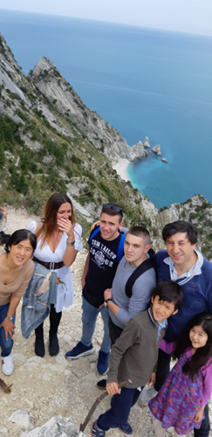
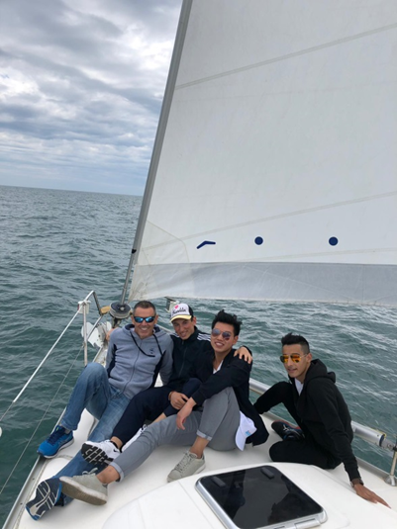
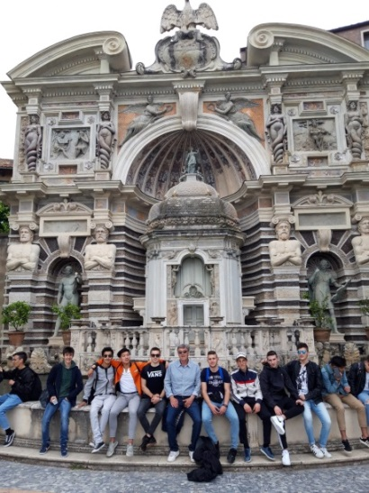
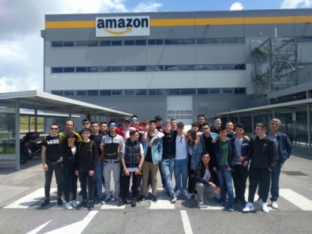
Mobility activities in Grottammare
CULTURAL ACTIVITIES AND STUDY TRIPS:
School trip to Fossato di Vico, Perugia
School trip to Rome with papal audience and visit to Apostolic Palace
Cultural visit to Ascoli Piceno
Cultural and natural visit of Monte Conero
Visit to Amazon warehouse (Rome) and Villa d’Este (Tivoli)
Sailing day in Alba Adriatica

