Slide 1

International Cultural Turistic Route
HADRIATICA ROMANA
Routes Shaping a Unique Civilization

Slide 2









WHY HERA TRADEMARK?
HERA TM was developed with idea to develop joint cross-border platform within the Adriatic area for management and promotion of sustainable tourism based on common cultural heritage
In that way a holistic approach were used to define unified guidelines for the assessment and categorization of the localities / destinations and routes in the Adriatic region
Rules for recognition of HERA cultural tourism routes
Rules for recognition of HERA visitor centres

Slide 3

Project HERA
Project HERCULTOUR
(INTERREG)
Defined rules for Rules for recognition of HERA cultural tourism routes
HERCOULTOUR build on results of HERA
Created International Cultural tourism route in order to test practical feasibility of previously developed Rules for recognition of HERA cultural tourism routes
Practical feasibility of the rules tested on newly created local Cultural tourism routes and visitor centres
Practical feasibility of the rules for international CTR was not implemented

Slide 4
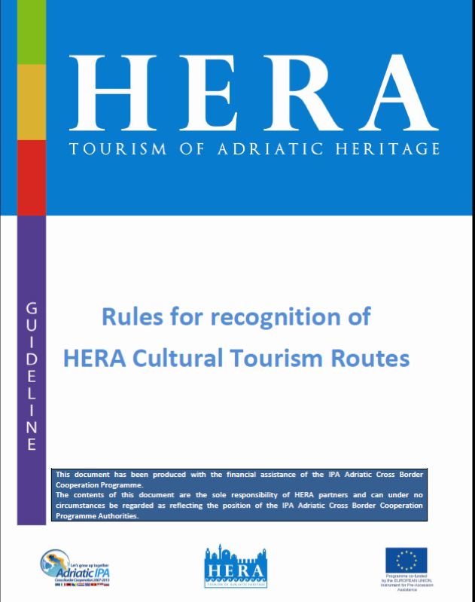
How to obtain HERA TM Cultural Tourism Route certification?
How to obtain HERA TM INTERNATIONAL Cultural Tourism Route certification
HADRIATICA ROMANA Routes shaping a unique civilization

Slide 5
CULTURAL HERITAGE INTEPRETATION
1.1. Type of interpretation - at least one type of interpretation
Interpretation for children Interpretation for older students Interpretation for disabled persons Interpretation for smaller population groups, ethnic minorities social groups Interpretation for tourists of special interests
1.2. Assessment of the experience by the relevant route stakeholders /quality of the interpretation - at least two criteria need to be addressed
There is a multisensory experience – a holistic approach Level of story interpretation Authenticity Unique interpretation Language
HADRIATICA ROMANA Routes shaping a unique civilization
Notes:
THE FIRST GROUP IS DEDICATED TO THE CULTURAL HERITAGE INTEPRETATION – TO WHOM AND HOW ?
AT LEAST ONE TYPE OF INTERPATION SHOULD BE IN OFFER
IN ORDER TO ENSURE THE QUALITY OF INTERPREATION AT LEAST 2 CRITERIA SHOULD ME MATCHED:
DA ME TU NETKO PITA A ŠTO JE TO LEVEL OF STORY INTERPREATION ILI UNIQUE INTERPREATION – NE ZNAM ŠTO BIH ODGOVORILA!!!

Slide 6
2. CONTENT CULTURAL HERITAGE INTEPRETATION
2.1. Cultural content - at least two key kultural sites
Public and religious buildings Rural heritage Monuments Geographical sites | Historical sites Archaeological sites Industrial heritage
2.2. Structural content - at least two structural contents
Intangible heritage Interpretive activities Museums Attractions Private collections | Exhibition spaces Workshops Library Centers
2.3. Additional contents/Events – at least two events during the tourist season (one in the off season)
Festivals Gastro events Multimedia centre | Music and dance events Theater Other
HADRIATICA ROMANA Routes shaping a unique civilization
Notes:
THE IDEA OF AWARDED HERA TM PRODUCT IS TO PRESENT A HARMONY ALONG THE ROUTE NECESSASRY TO DEVELOP A VARIETY OF CONTENT, HAVE INTEGRATED THEME (WITH CULTURAL AND STRUCTURAL OCNTENT) IN A HOLISTIC SENSE.
AS FOR A CONTENT OF CULTURAL HERITAGE INTEPRETATION THERE ARE 3 ELEMENTS TO BE TAKEN IN CONSIDERATION:
CULTURAL CONTENT RELATED TO TANGIBLE CULTURAL HERITAGE (AND THEIR LEVEL OF ATTRACTIVITIES)
STRUCTURAL CONTENT RELATED TO INTANGIBLE HERITAGE PRESENTED IN MUSEUMS, LIBRIERS, ATTRACTIONS AND SO
ADDITIONAL CONTENST OR EVENTS ORGANIZED TO SUPPORT THE PROMOTION AND VISIBILITY OD ROUTE/VR ILI ?
ARE ALL THESE ELEMENTS OF CATEGORY 2 RELATED TO THE HERA ROUTE/VC????

Slide 7
3. HOSPITALITY SERVICES
Food related services
At least two quality providers of food-related services (restaurant, traditional and other types of restaurant, bar, cafe etc.)
Lodging services
At least two different types of lodging services in the driving range of 30 min maximum (camp, private B&B, rural tourism, a minimum 3 star hotel, hostel etc.)
HADRIATICA ROMANA Routes shaping a unique civilization
Notes:
THE ISSUE OF HOSPITALITY SERVICES IS VERY IMPORTANT - THE SERVICES ARE DIVEDED INTO FOOD REALTED SERVICES AND LODGING SERVICES.

Slide 8
4. SIGNALIZATION AND ACCESSIBILITY
- at least three criteria needs to be addressed
Accessibility by public and other types of transport Tourist-info centre or some other type of an info point Rest stops along the route (parking, vista, toilet, garbage depository etc.) The route has a clear signalization There is a way to monitor the circulation of visitors There is a parking lot in the near distance The route is accessible for people with disabilities It is important to emphasise that HERA routes must have visually unified signalisation that will help them make more recognisable.
HADRIATICA ROMANA Routes shaping a unique civilization
Notes:
ALL HERA ROUTES MUST HAVE VISUALLY INIFIED SIGNALIZZATION THAT WILL MAKE THEM NOT ONLY MORE RECONGNIZABLE BUT ALSO AS A DISTINCTIVE MARK
AT LEAST 3 CRITERIA MUST ME MATCHED:

Slide 9
5. MANAGEMENT AND SUSTAINABILITY
- at least one of the below plans need to be developed
There is a clear strategic and action plan There is a clear sustainability plan There is a management plan There is a Cost-benefit analysis (and Feasibility study if needed) There is a marketing plan with visibility and branding aspects
HADRIATICA ROMANA Routes shaping a unique civilization
Notes:
THE CATEGORY OF MANAGEMENT AND SUSTAINABILITY OF THE HERA PRODUCTS IS VERY IMPORTANT ISSUE – ONLY WITH A CLEAR BUSINESS AND PROMOTIONAL PLAN IT IS POSSIBLE TO MANAGE THE DEVELOPMENT OF THE ROUTE. IT IS NECESSARY NOT ONLY TO PROVIDE YOUR ORGANIZATION WITH WRITTEN PLANS AND DOCUMENTS THAT VERY OFTEN ARE THEIR PURPSUE ONLY ON OFFICES SHELVES – BUT TO IMPLEMENT THOSE DOCUMENTS AND ACTION PLANS AND TO MONITOR ACHIEVEMNET OF THEIR RESULTS AND TO CONTRIBUITE IN TIME FOR SOME NECESSARY CHANGES.

Slide 10
6. PARTICIPATORY APPROACH IN RESEARCHING AND DEVELOPING A THEME
- at least two criteria needs to be addressed
The topic is researched and related to the region The topic was developed including local community and experts A number of tour operators, touristic agencies and DMCs involved There is an interdisciplinary approach Co-funding of the project from different sources
HADRIATICA ROMANA Routes shaping a unique civilization
Notes:
CATEGORY NUMBER 6 DEFINES THE PROCEDURE OF CREATING OF HERA AWARDED ROUTES – A PARTICIPATORY APPROACH IN THE PREPARATION AND IDEA DEVELOPMENT BY DIFFERENT STAKEHOLDERS – AT LEAST 2 FROM THIS LIST – IS MANDATORY.

Slide 11
7. HORIZONTAL THEMES
- at least one horizontal theme needs to be addressed
Ensure the inclusion of ethnic and social minorities Level of IT and multimedia inclusion in the interpretation of cultural heritage (e.g. 3 D interpretation, holograms etc.) Innovation and social innovation in the interpretation, education and/or promotion of HERA cultural routes Horizontal themes give an added value to the cultural route and are relevant to all cultural routes disregarding its theme, location and other criteria.
HADRIATICA ROMANA Routes shaping a unique civilization

Slide 12
8. CAPACITY BUILDING REQUIREMENTS
at least one officially trained/certified heritage interpreter on staff/available in partner organizations
HADRIATICA ROMANA Routes shaping a unique civilization

Slide 13
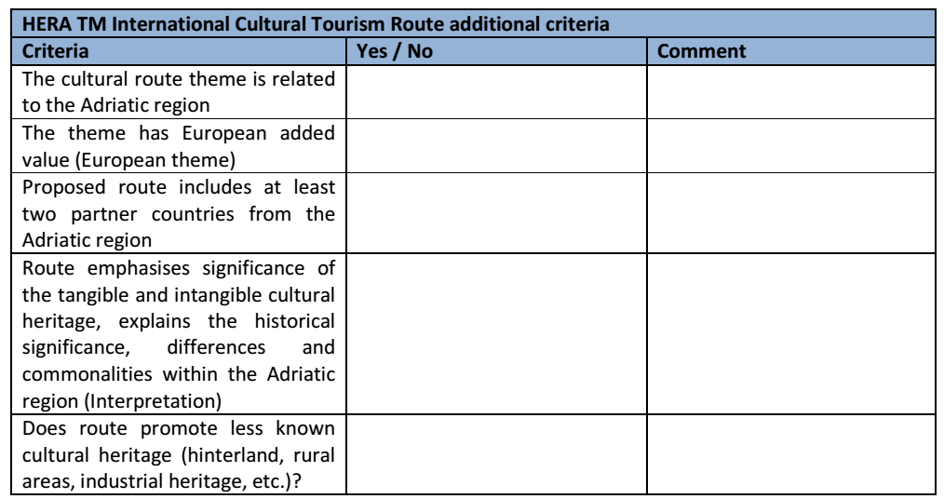
Checklist for HERA International route1
HADRIATICA ROMANA Routes shaping a unique civilization
Notes:
THERE OF COURSE ADDITIONAL CRITERIAS FOR HERA INTERNATIONAL ROUTES THAT ARE BASICLY AT LEAST TWO COUNTRIES LOCAL HERA ROUTES JOINT TOGETHER BUT ONLY IF THEY CAN SATISFY THESE ADDITIONAL CRITERIA:

Slide 14
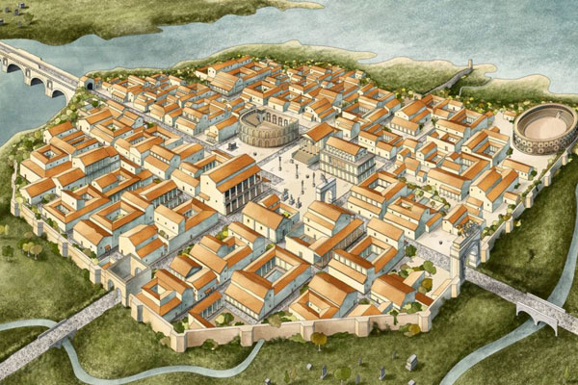
International Cultural Turistic Route
HADRIATICA ROMANA
Routes Shaping a Unique Civilization
HADRIATICA ROMANA Routes shaping a unique civilization
Notes:
THERE OF COURSE ADDITIONAL CRITERIAS FOR HERA INTERNATIONAL ROUTES THAT ARE BASICLY AT LEAST TWO COUNTRIES LOCAL HERA ROUTES JOINT TOGETHER BUT ONLY IF THEY CAN SATISFY THESE ADDITIONAL CRITERIA:

Slide 15
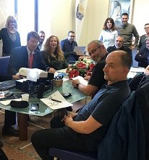
Route Partners
Applicant institution: ADSU TERAMO
Partners:
Zadar County
Primorje-Gorski Kotar County
Šibenik-Knin County
Tourist destination of “ROMAGNA”
COPE Teramo
HADRIATICA ROMANA Routes shaping a unique civilization
Notes:
THERE OF COURSE ADDITIONAL CRITERIAS FOR HERA INTERNATIONAL ROUTES THAT ARE BASICLY AT LEAST TWO COUNTRIES LOCAL HERA ROUTES JOINT TOGETHER BUT ONLY IF THEY CAN SATISFY THESE ADDITIONAL CRITERIA:

Slide 16
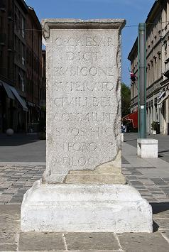
Theme
The main theme of the International Cultural route "Hadriatica Romana" is to present the Adriatic Roman Routes; monuments and political, economic and cultural processes that took place between both sides of the Adriatic coast during Roman domination.
HADRIATICA ROMANA Routes shaping a unique civilization
Notes:
THERE OF COURSE ADDITIONAL CRITERIAS FOR HERA INTERNATIONAL ROUTES THAT ARE BASICLY AT LEAST TWO COUNTRIES LOCAL HERA ROUTES JOINT TOGETHER BUT ONLY IF THEY CAN SATISFY THESE ADDITIONAL CRITERIA:

Slide 17
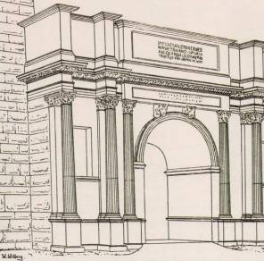
Theme
Roman Empire - both sides of Adriatic were united in one state
Foundation of common civilization
Central part of Italy and east coast / Roman Province of Dalmatia
The Roman presence is solid in each partner area under the form of monuments, theaters, villas/houses, mosaics, ports, bridges, military places, archaeological parks, museums, information points, etc.
HADRIATICA ROMANA Routes shaping a unique civilization
Notes:
THERE OF COURSE ADDITIONAL CRITERIAS FOR HERA INTERNATIONAL ROUTES THAT ARE BASICLY AT LEAST TWO COUNTRIES LOCAL HERA ROUTES JOINT TOGETHER BUT ONLY IF THEY CAN SATISFY THESE ADDITIONAL CRITERIA:

Slide 18
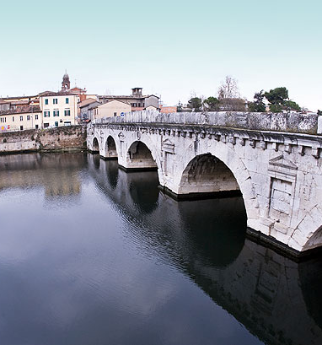
Adriatic Roman Routes
Physical Roman roads (Vias Romanas) – sea routes & roads (ports, roads, military routes, naval routes, trade routes…)
Social, economic and cultural movements („routes”) - processes that took place between both sides of the Adriatic coast during Roman domination.
HADRIATICA ROMANA Routes shaping a unique civilization

Slide 19

Route, created by HERA rules
Transnational (and European) values (common heritage and culture; education; tolerance, etc.)
Open for inclusion of other regions, localities and sites, as long as they comply with HERA regulations
The route complies with standards and regulations of Cultural Routes of the Council of Europe
HADRIATICA ROMANA Routes shaping a unique civilization

Slide 20
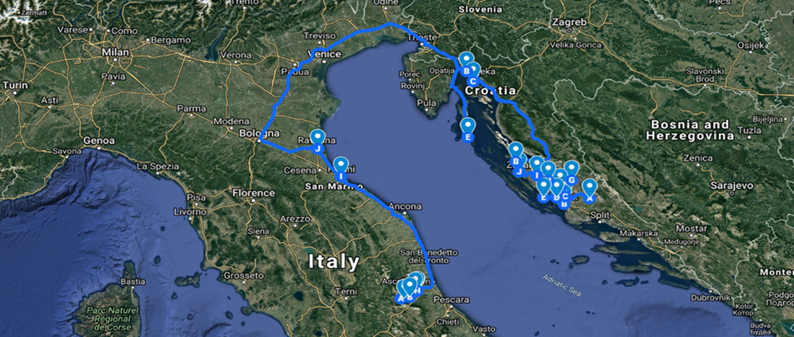
Adriatic Roman Routes

Slide 21
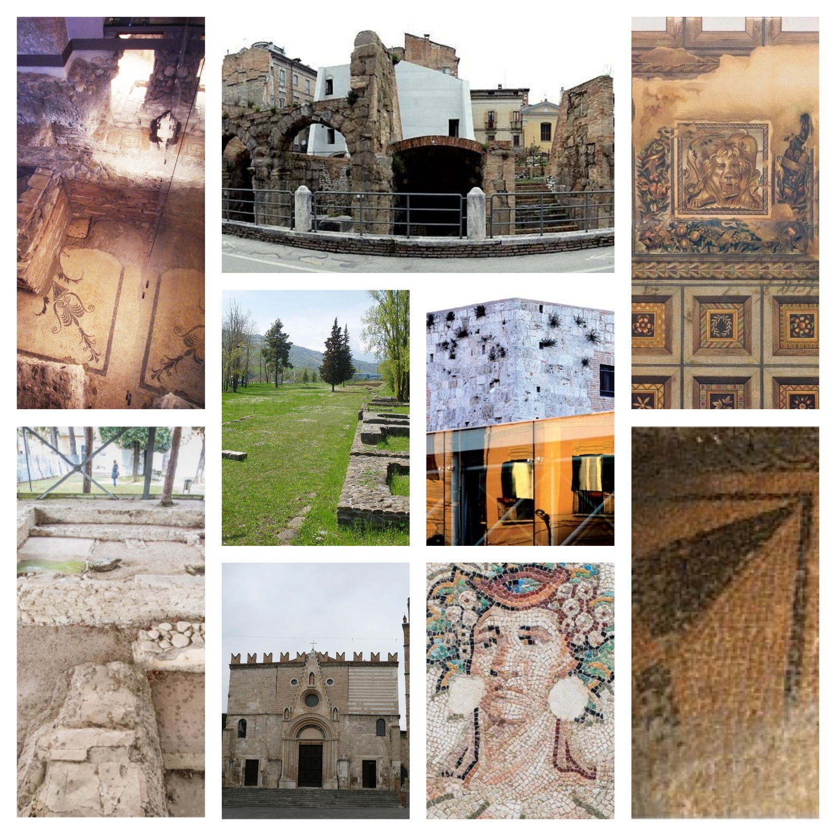
Teramo, Abruzzo
Key cultural site 1: Roman theatre (Teramo) –
Key cultural site 2: Roman amphitheater
Key cultural site 3: Necropolis of Ponte Messato
Key cultural site 4: Domus and Mosaic of the Lion
Key cultural site 5: Archeological site of Torre Bruciata
Key cultural site 6: Archaeological site of largo Madonna delle Grazie
Key cultural site 7: Domus of Vico delle Ninfe
Key cultural site 8: Melatino Palace (Teramo)

Slide 22
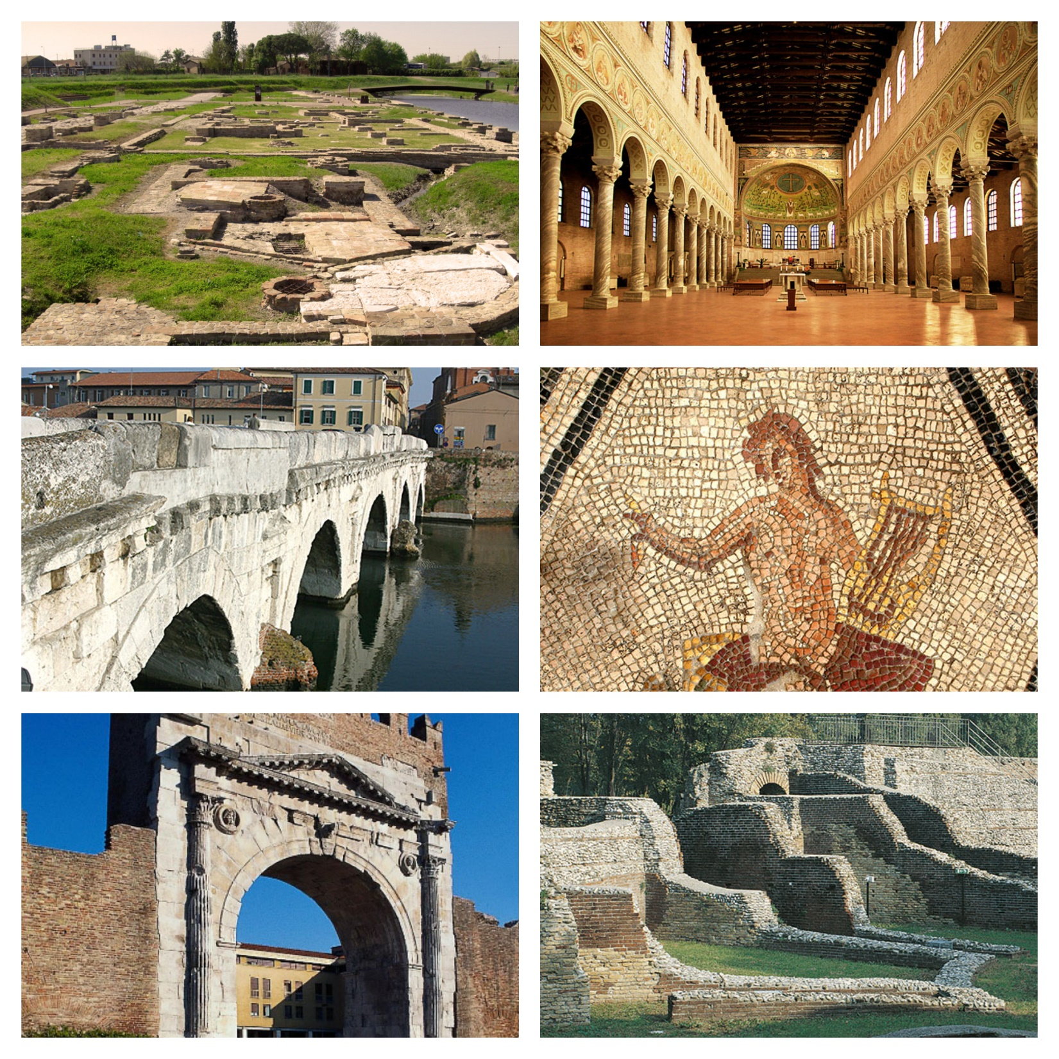
Romagna (Rimini – Ravenna)
Key cultural site 1: Ancient Port of Ravenna – Classe
Key cultural site 2: Basilica of Sant’Apollinare in Classe (Ravenna)
Key cultural site 3: Surgeon’s home, Rimini
Key cultural site 4: Tiberio’s bridge, Rimini
Key cultural site 5: Augusto’s arch, Rimini
Key cultural site 6: Amphitheatre in Rimini

Slide 23
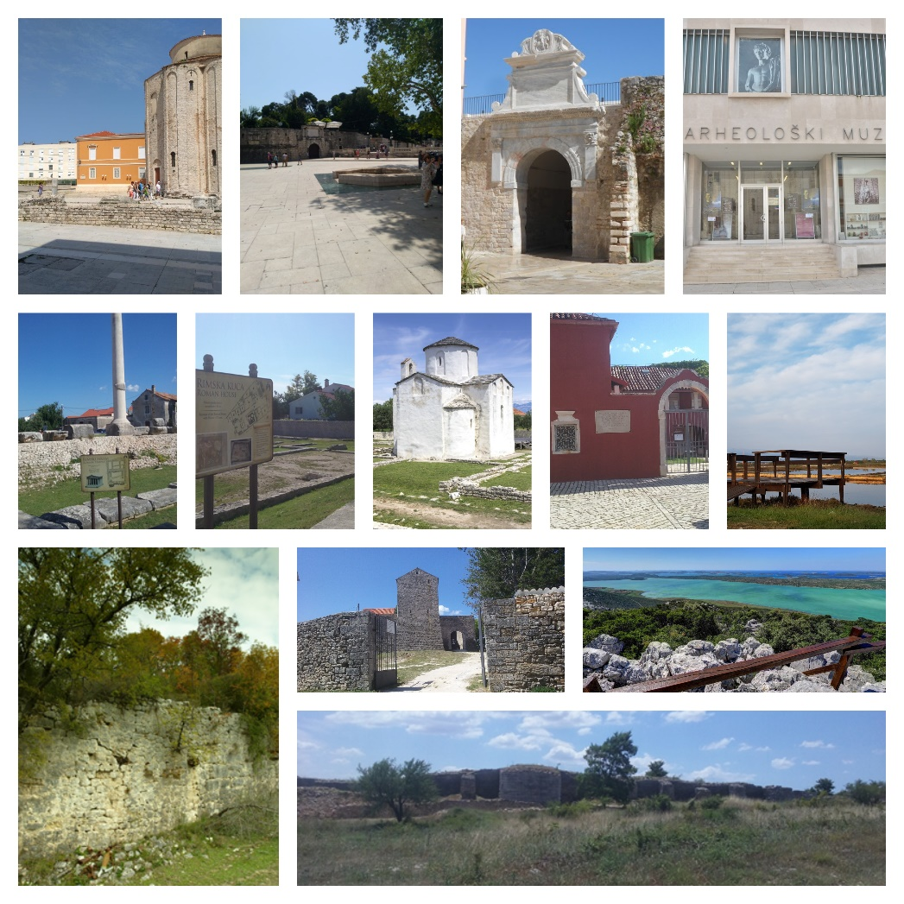
Zadar County
Key cultural site 1: Iadera (Zadar) with roman monuments: Roman Forum with the temple in Zadar; Porta Triumphalis with roman fortifications and urban street system.
Key cultural site 2: Aenona (Nin) with roman monuments: Roman Forum with Temple in Nin; Roman Villa Urbana with mosaics in Nin; Different minor remains from the Roman period – roman houses, fortifications, saltworks, etc.
Key cultural site 3: Nedinum (Nadin)
Key cultural site 4: Asseria

Slide 24
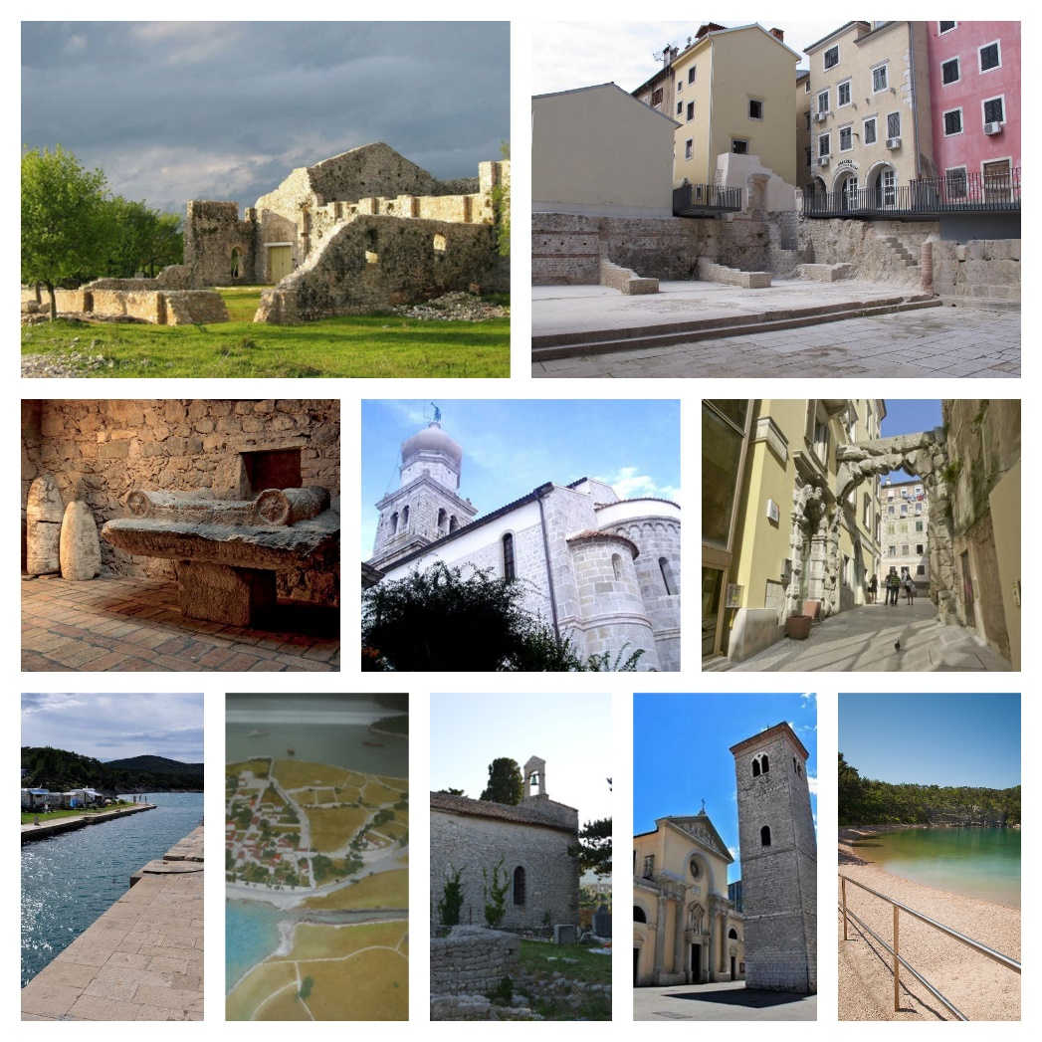
Primorje – Gorski Kotar County
Key cultural site 1: The Tarsatica Principia (city center of Rijeka) - today there is an Archaeological park.
Key cultural site 2: Fulfinum – Mirine (island Krk near Omišalj) - an ancient Roman city. Mirine is the early Christian complex, a basilica
Key cultural site 3: The Museum of Apoxyomenos (Mali Lošinj) - dedicated to the bronze statue of a young athlete, the Apoxyomenos
Key cultural site 4: old town Krk (Krk island) - the urban centre of the island 3000 years ago
Key cultural site 5: old town Osor (on Cres island) – Roman town Apsoros / archaeological site

Slide 25
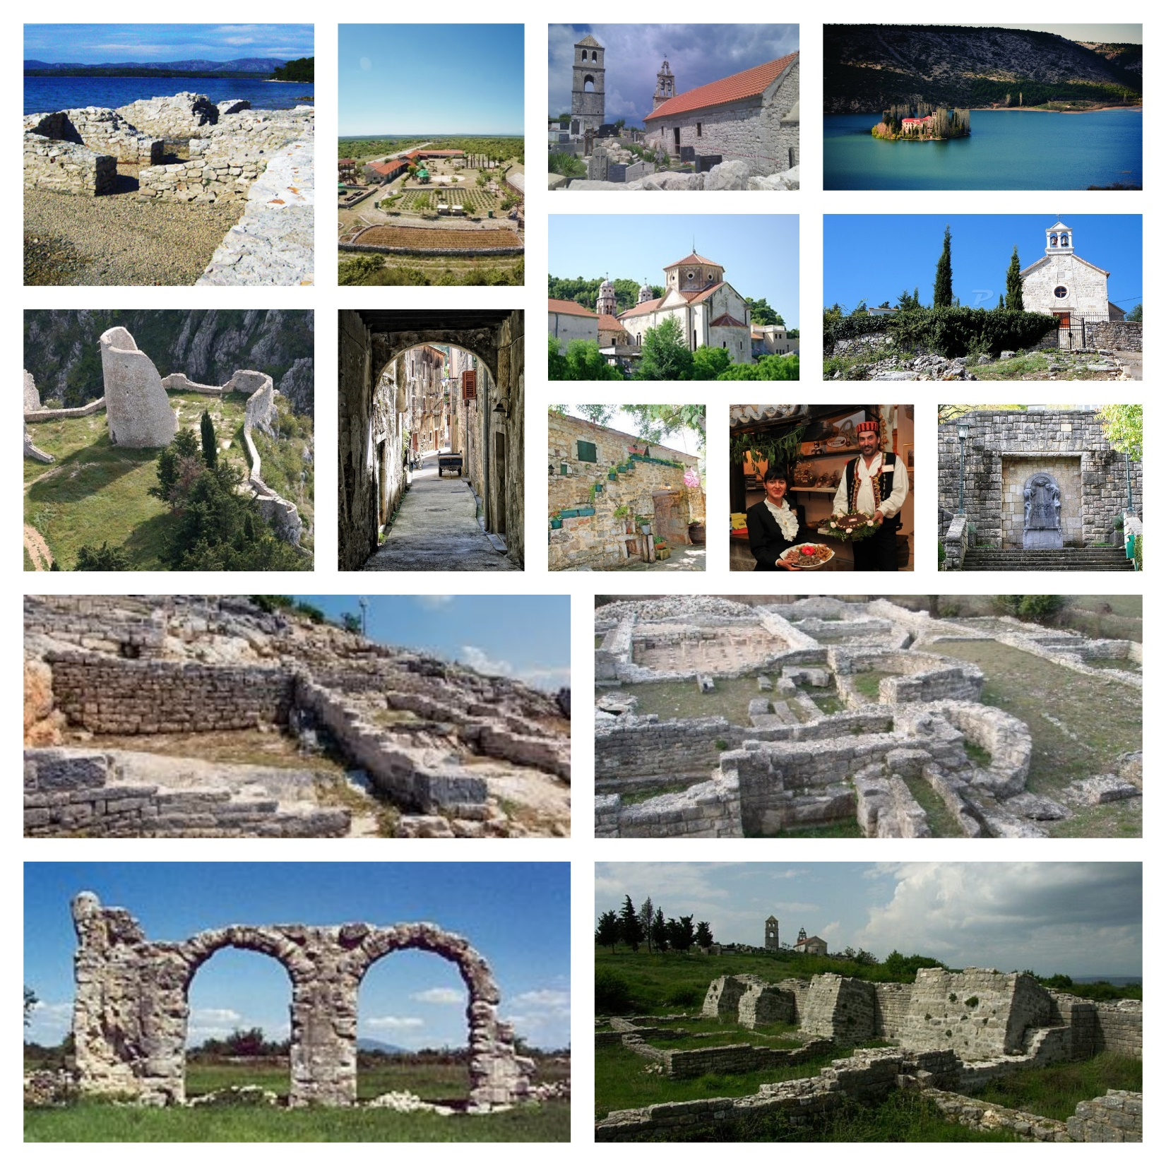
Šibenik – Knin County
Key cultural site 1: Burnum (inside area of National park Krka) – roman settlement, museum, and amphitheater
Key cultural site 2: Scardona (Skradin)– roman settlement and important military port
Key cultural site 3: Varvaria (Bribir - Bribirska glavica) / archaeological site
Key cultural site 4: Rider (Danilo Biranj) – connected services: Basic interpretation; Restaurant; Bike Route
Key cultural site 5: Magnum – roman settlement on the road Aquileia-Dyrrachium
Key cultural site 6: Velika Mrdakovica – roman archaeologic site with functional cistern (hinterland of city of Vodice)
Key cultural site 7: Colentum (Murter Kornati municipality – Island Murter) – settlement of indigenous community of people of Liburnia in the Roman period.

Slide 26
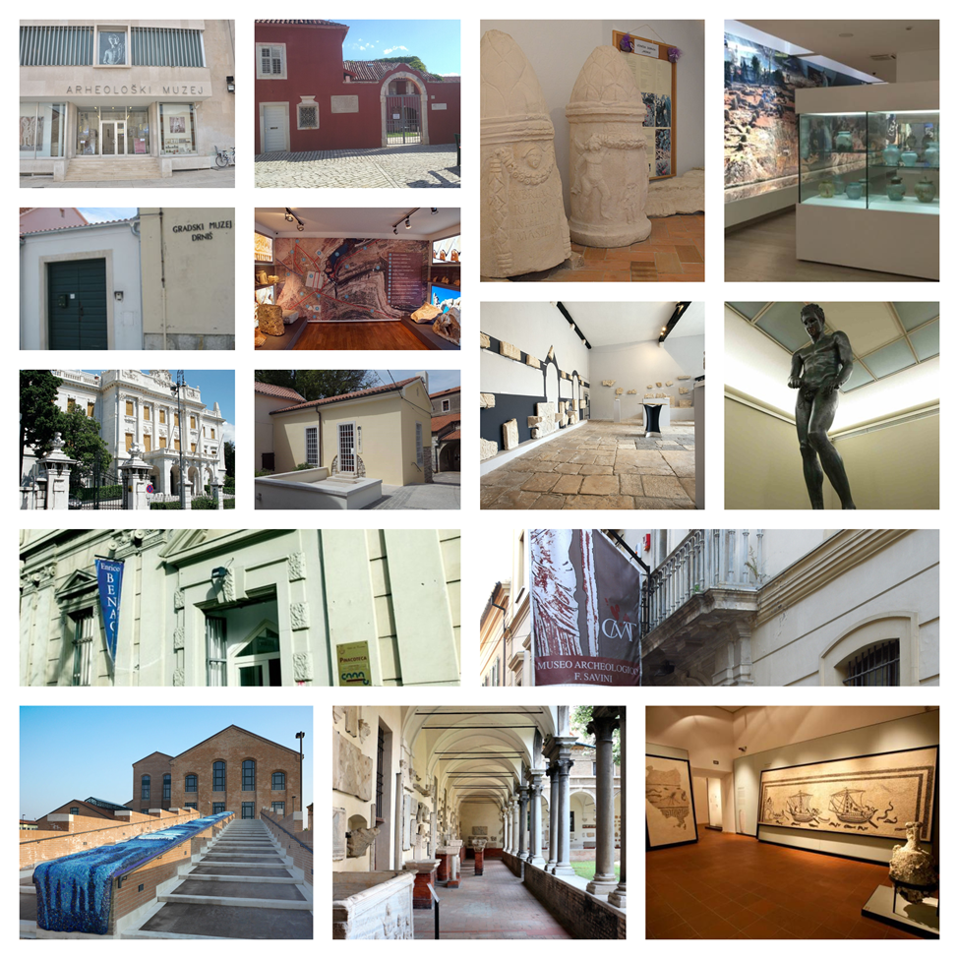
Structural content part of the evaluated international CTR
Intangible heritage
Interpretive activities
Museums
Attractions
Private collections
Exhibition spaces
Workshops
Library
Centres
HADRIATICA ROMANA Routes shaping a unique civilization

Slide 27
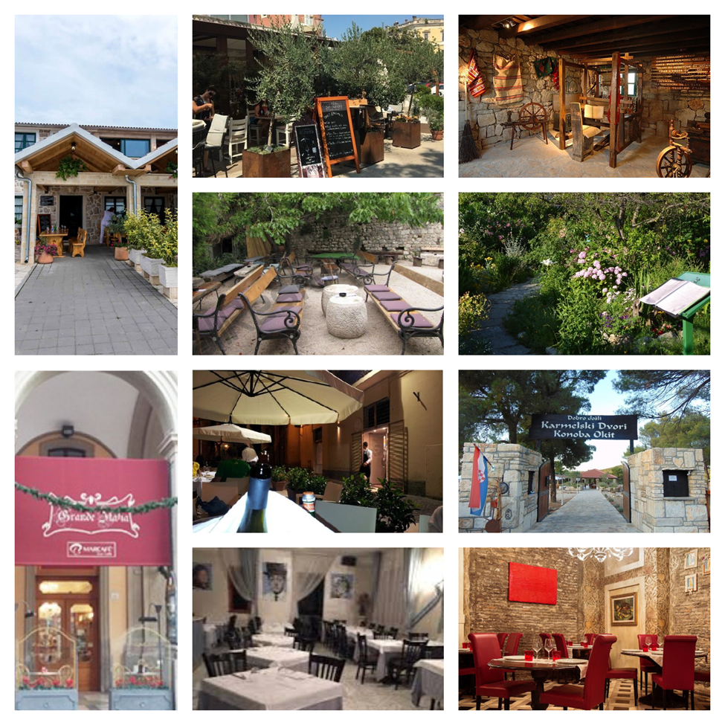
Food related services on the route
There are different food and beverage services on the international cultural tourism route Hadriatica Romana in all sub-destinations. Some food and beverage service in the vicinity of each key cultural sites in sub destinations are listed hereinafter. However, it will depend on travel agencies or other bodies that will offer visiting program of the ICTR which one will be included in the program.
HADRIATICA ROMANA Routes shaping a unique civilization

Slide 28
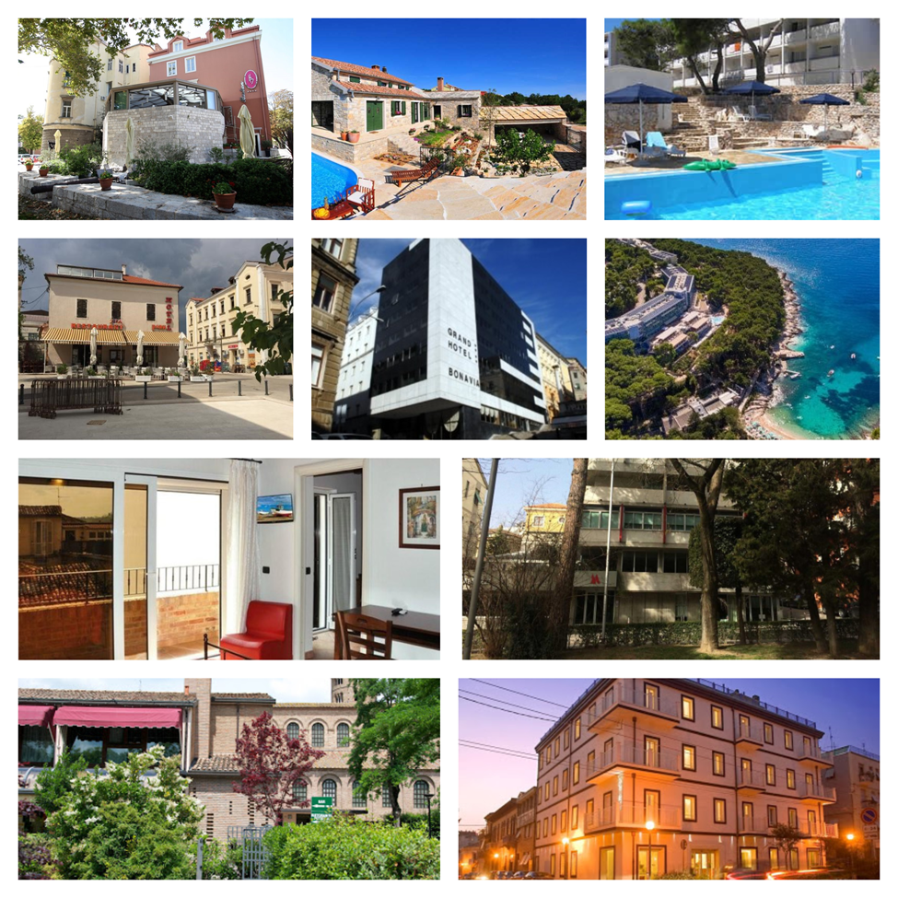
Accomodation
There are different Accommodation services on the international cultural tourism route Hadriatica Romana in all sub-destinations. Some of them are listed here in after, but it will depend on travel agencies or other bodies that will offer visiting program of the route which one will be included in the program.
HADRIATICA ROMANA Routes shaping a unique civilization

Slide 29

…other conected services, facilities, events, and elements that make the experience complete….
HADRIATICA ROMANA Routes shaping a unique civilization

Slide 30
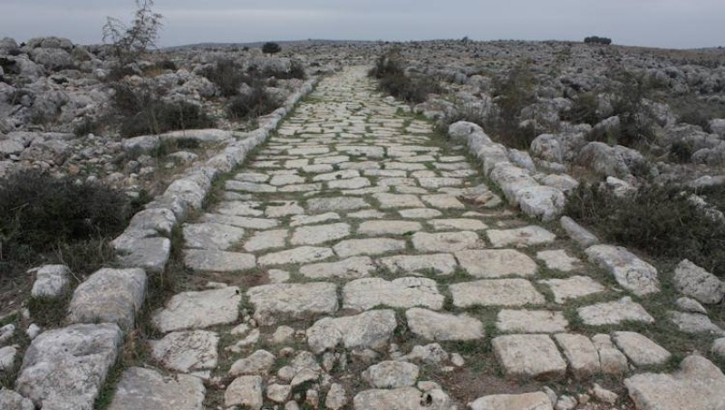
Where do we go from here?
HADRIATICA ROMANA Routes shaping a unique civilization

Slide 31




HADRIATICA ROMANA – Route Shaping a Unique Civilization
Kreator ATK | Šibenik
Krešimir Grubić
Bana Jelačića 28, HR 22000 Šibenik
kresimir.grubic@kreator-atk.hr
+385 (0)99 215 512 8
www.kreator-atk.hr

