Slide 1


Social Media Strategies for Success: Make your Business Bang
David Rennie
Marking & Business Development Manager
Digital Peninsula Network

Slide 2
Social Media Marketing
Social Media Marketing is:
“Putting your brand / business where the conversation already is.”

Slide 3
Research, Research, Research
Fail to prepare, prepare to fail.
Identify your target audience and research which SMM platforms they are using.
Where are you users going – what are they using? Research / Listen / Analyse

Slide 4
Why is you business on Social Media?
Beginning with a big-picture objective makes the goal-setting process less intimidating.
Here are some examples for reference:
Small business: engage local followers and grow a greater community presence
Startup: build awareness for a new product and generate leads for it
Enterprise company: provide a timely customer service channel to boost customer loyalty
With a broad objective in mind, you can then start thinking about specific, granular goals that’ll directly inspire your day-to-day social activities.

Slide 5
SMM overview tips
Humans are a sociable bunch – they want to be part of a community and they love a story. Use this to support your social media and engage with potential clients.
When writing your content – you want to think about both your audience and your business aims.
Identify your target audience and research which SMM platforms they are using.
Ensure your online identity matches – icons and imagery. Logos / branding elements from your website should be visible on your social media.

Slide 6
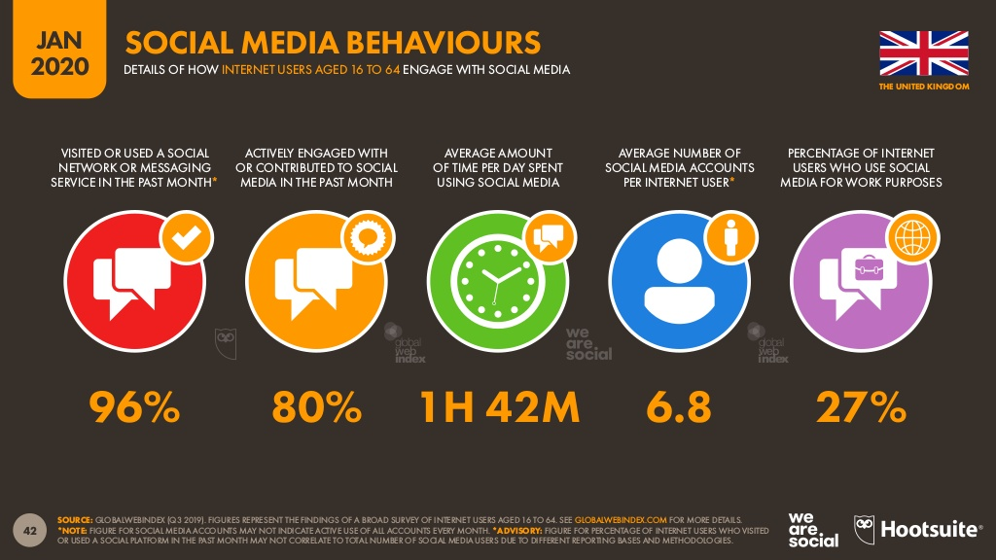
UK Social Media Behaviours
Notes:
Source: Global Data Statshot – July 2020 | WeAreSocial and Hootsuite

Slide 7
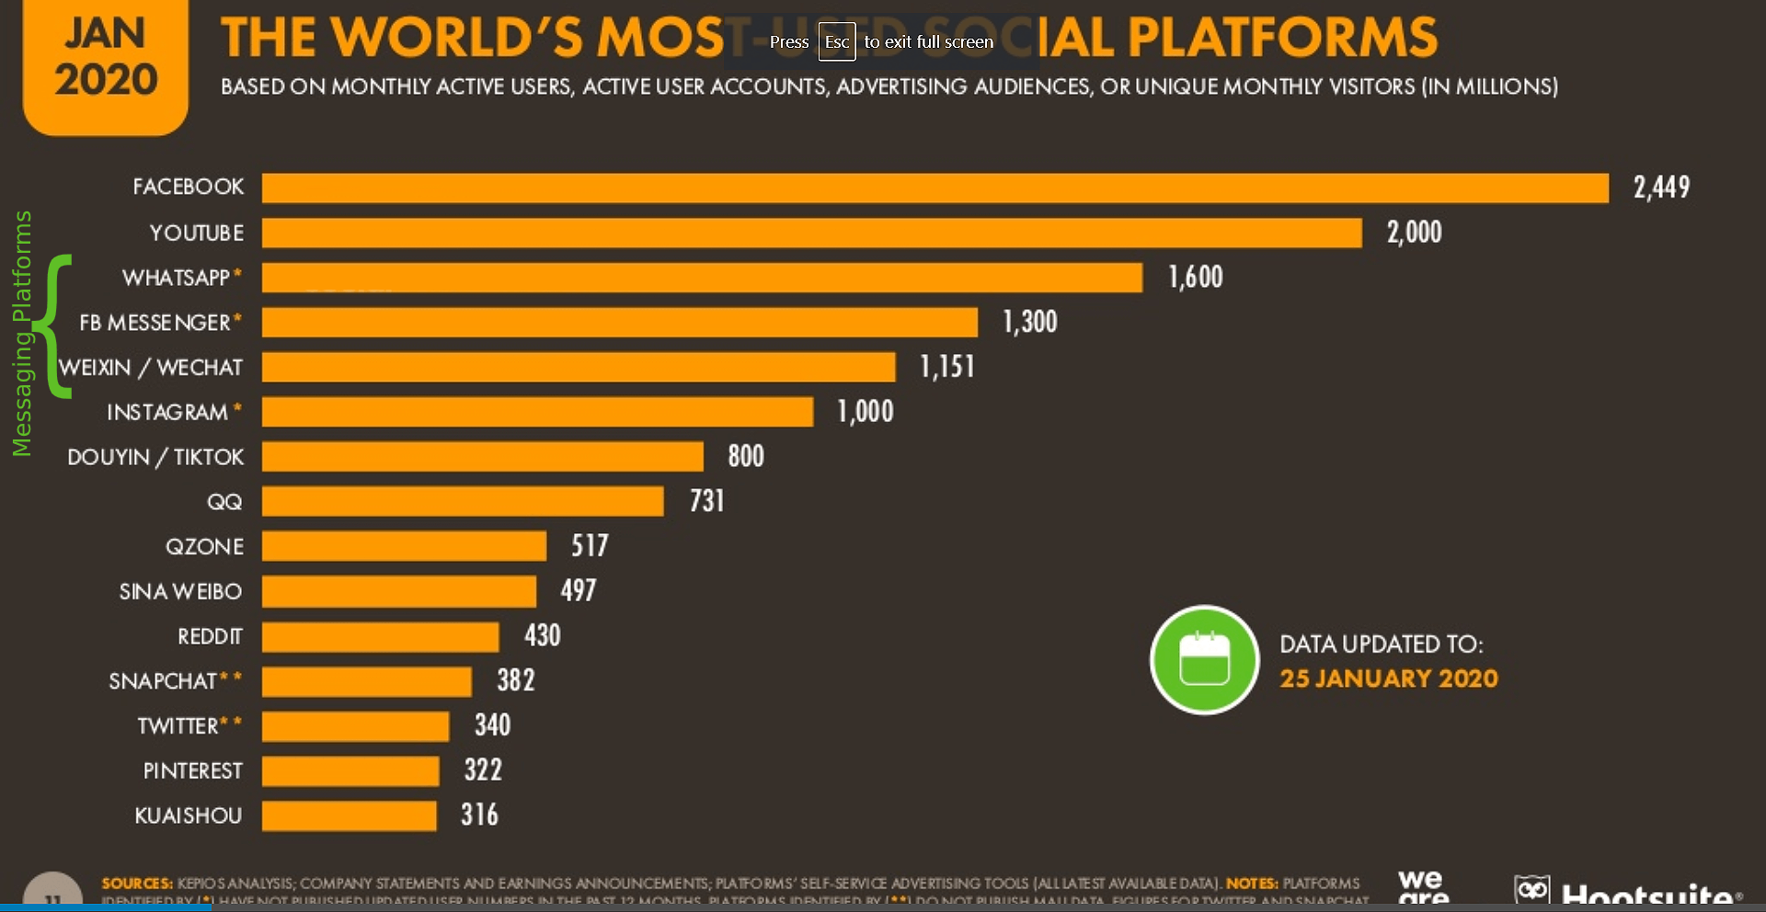
Most Used Social Platforms

Slide 8
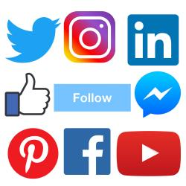
Social Media Platforms
What’s the difference?
Notes:
MAU – Monthly Active Users
1.79 billion people on average who log onto Facebook daily active users (Facebook DAU) for August 2020
Just to put that into context – as of April 2019 the world population is 7.7 billion (almost 1/3 of humans are Facebook MAU)

Slide 9
Facebook
Facebook represents a huge potential market for your social media efforts, but it is becoming increasingly difficult to stand out from the crowd.
Worldwide, there are over 2.7 billion monthly active Facebook users (Facebook MAUs) which is a 13 percent increase year over year.
(Source: Statista.com as of 10/08/20)
Notes:
MAU – Monthly Active Users
1.79 billion people on average who log onto Facebook daily active users (Facebook DAU) for August 2020
Just to put that into context – as of April 2019 the world population is 7.7 billion (almost 1/3 of humans are Facebook MAU)

Slide 10
Facebook
98.3% of users access Facebook via a mobile device - - - - - - - - - - - - - -
As of July 2020 Facebook stats show the gender ratio has changed with more males using the platform than females:
Facebook users are 43.6% female and 56.4% male.
Age demographics show 18 – 44 as the most engaged age groupings
Notes:
https://www.statista.com/statistics/376128/facebook-global-user-age-distribution/ (July 2020) Critically, marketers can now use Facebook to reach one-third of all the world’s adults aged 18 and above, and more than half of all the world’s adults aged 18 to 34.

Slide 11
Facebook & business
Facebook is quickly becoming a “pay to play” environment - what do we mean by that and how can we combat that.
Notes:
Your posts do not necessarily go to all your followers.
Facebook VP Brian Boland has stated that there’s too much content being published, making visibility in the News Feed increasingly competitive & Facebook is trying to show people content that is the most relevant to them.
In other words – if a follower has interacted with your posts recently – maybe the content is not relevant to them any more and maybe you would like to invest in a Boost – to spread your information further.
https://www.facebook.com/business/news/Organic-Reach-on-Facebook

Slide 12
Facebook & business
Dealing with Declining Organic Reach
Be very selective about what you post
Encourage fans to engage with your posts – as simple as “like and share”
Use a calendar to ensure that you have a variety of content to post and build in planning time to ensure quality of posts.
Notes:
Your posts do not necessarily go to all your followers.
Use a calendar to plan and prepare quality content that varies – use this alongside your analytics to identify the reach of your posts.

Slide 13
Facebook & strategy
Know your story
What is your unique voice? Are you a local volunteer organization or a global foundation? How can you bring your story to life in a compelling, authentic, and personal way?
Know your audience
Who are your customers? How will they want to connect with you? What content will be important to them?
Know your goals
What kind of relationship do you want to have with the people who connect to your Page? How much time are you willing to spend updating your Page? Defining and prioritizing your goals will help you create your Page posting strategy.

Slide 14
Facebook & posting
Find your own voice
Speak in the first person / build an online personality / share candid stories and updates
Create a conversation
Ask a question in your status update / respond to people who comment on your posts / re-post your supporters updates if appropriate
Offer a rich experience / share exclusive content
Use a range of content - visuals are more compelling than text / Share links to news / celebrate milestones / post backstage pictures (behind the scenes) / give your followers an exclusive feel – they know more because they’re friends with you.

Slide 15

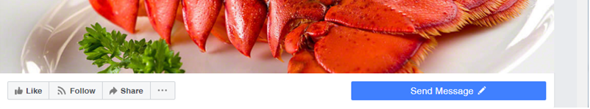
Messenger for Communication
All business Pages have access to messaging. By default, when you create a Page, you’ll have messaging enabled.
Choose Send Message as your Page’s call to action. When people visit your Page, they’ll see the CTA prominently displayed beneath your cover photo.

Slide 16
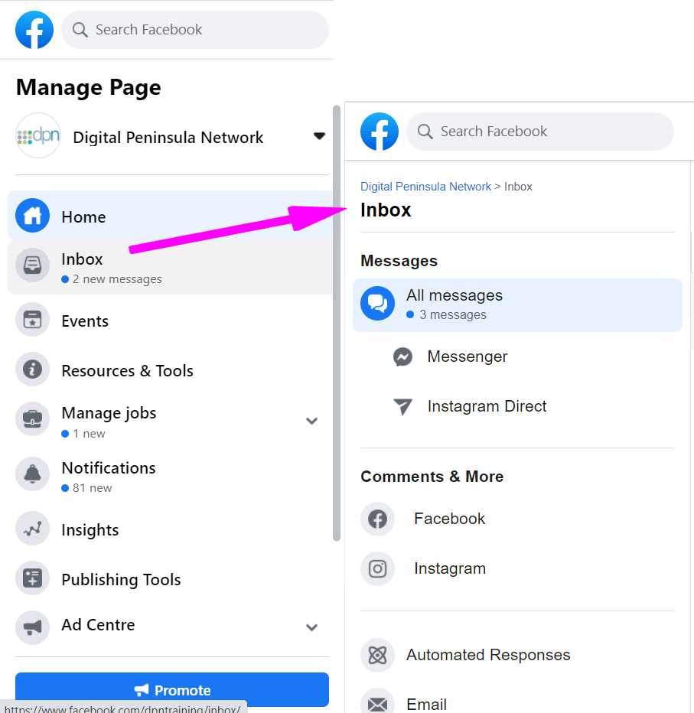
Automatic Messages
Messenger Greeting (In Manage Page > Inbox)
This customizable note appears when someone starts a new message thread with you, but before they actually send their first message. It can be a great way to greet people and set a friendly tone, while also letting them know what types of messages are expected.
Automated responses (located in your Inbox)
There are a range of potential responses that
you can activate. These can be tailored for
individual businesses and include personalised options.

Slide 17
Instagram
Share your life/ business through pictures / series of pictures / video – connect through imagery. Tell a story visually.
Who uses ?
Main age group: 18-24 (30%) 32-34 year olds (35%)
Platform users: 56.3% female and 43.7% are male.
70% of shopping enthusiasts use Instagram for product discovery.
Posts with at least one hashtag average 12.6% more engagement.
Users Engage More on Weekdays with Tuesday and Thursday showing most engagement.
Notes:
Photos With Faces Get 38% More Likes.
Source Omnicore Agency: https://www.omnicoreagency.com/instagram-statistics/

Slide 18
Instagram & business
Why do companies use it?
Show the brand / visual exposure / editing tool for photos /
One of fastest expanding platforms – doubled active monthly users in last year. 1 billion+ monthly active users. (25/01/2020)
Excellent engagement opportunities
Integration – cross platform possibilities (bought by Facebook)
Advertising
2.4 more times likely to have users click an Advert on Instagram than any other platform – emotional responses to effective images.
Notes:
Total Number of Daily Active Instagram Users: 400 million (02/05/2019)
The most popular hashtags on Instagram are #Love, #Instagood, #Photooftheday, #Fashion, and #Beautiful.

Slide 19
Instagram - development
Where it’s going
Since being bought by Facebook there has been a lot of changes :
business accounts & analytics (business accounts only)
view products (requires Facebook account)
Product tagging allowed in posts
Instagram Stories now allow for product tagging

Slide 20
Instagram - what's good
Visual content of brand – credible source, behind the scenes, create a relationship between the business & the customer (they feel they know you)
Integration – cross platform application, mix it up – variety is the spice of life! You can use the filters and then share the pictures across platforms.
Clear demographics - Young to middle age users, slightly female dominated

Slide 21
Instagram - Top Tips
If you get stuck - Instagram have a useful “help” site at: https://help.instagram.com/
If you're a business check this option - so you can connect to your business website & potential customers too.
The more followers you have, the further your images and name will spread - share the love! (go follow others)
Following interesting people is a great way to get inspired, and it helps Instagram’s algorithms learn what you like and suggest photos and videos in the Discovery tab.
Notes:
To switch to business Account: Click your person (bottom right of screen) > 3 vertical dots (top right) to open options. Under Account > Switch to Business Profile.
You can now get Insights (analytics) for your Instagram business account – demographic information only kicks in once you have over 100 followers.

Slide 22
Instagram - #HashTags
You can use up to 30 hashtags
There are ways to check out which are most popular through sites such as: ritetag.com or hashtagify.me/hashtag
Hashtags numbers do appear in Instagram as you type in your #, however if you choose to click on then it defaults (currently) to lowercase, and CamelCase is more accessible for screen readers.
Notes:
A good method to get connections that have potential for real engagement:
Create a list of targeted Instagram accounts that have similar followers that you’d like to attract – such as competitors, complementary brands, influencers in your niche, etc.
Then like 1-2 photos from each account regularly (daily). These users will get a notification that you liked their pics and come check out your Instagram. Since it’s a similar account, the likelihood is that they’ll like your brand and want to follow you.
There are apps to help you to do this such as Kicksta or FollowersChief.

Slide 23
Twitter
Twitter is 13 years old, making it one of the grand-daddies of the social networking family.
The platform’s 326 million monthly active users* send more than 500 million Tweets every day.
On average, around 6,000 tweets are tweeted every second
More importantly for marketers, Twitter users are actively discovering and interacting with businesses through the social network.
Notes:
*26/10/2018
The total number of Twitter users in the UK is 13 million. (26/10/2018)
Number of Twitter Daily Active Users: 100 million (26/10/2018)

Slide 24
Twitter
The biggest secret behind getting your tweet noticed is to post it several times, ensuring it's exposed to different audiences and users throughout the day. The logic of this is that tweets have the shortest life spans of any social media update - different studies claim varying numbers, but none suggests that an average tweet is likely to get any attention after 30 minutes of its publication:
Wiselytics found that the average life of a tweet is 24 minutes.
Moz found that the number is around 18 minutes.
This means that your followers will only see the tweet if they're online and viewing their feeds exactly at the time of you posting, or within 30 minutes after. This is a very small segment of your following.
Notes:
To give more people a chance to see the tweet, you need to post it a few times.
Remember it's a good idea to reword your tweet and use different visual elements to make your Twitter feed more diverse and appeal even to those followers who saw it first time you tweeted the same URL. To streamline that process, you need a good Twitter management tool such as DrumUp.

Slide 25
Twitter & business
Sixty-six percent of Twitter users have discovered a new small or medium-sized business (SMB) through the network, 79 percent have retweeted an SMB, and a whopping 94 percent plan to make a purchase from the SMBs they follow.
And that’s not just talk.
Sixty-nine percent have already purchased from an SMB because of something they saw on Twitter.*
Notes:
Figures from Twitter+ Research Now – Small Business Customer Insights Study. 2018

Slide 26
Twitter & business
The most important thing to know about Twitter location demographics is that 79 percent of accounts are based outside the United States—perhaps not surprising given that Twitter supports more than 40 languages.
This is the Social Media Platform for International reach!
37 percent of internet users aged 18 to 29 use Twitter. That rate basically holds steady until users hit age 50. Then, things again take a deep dive: only 13 percent of those aged 50 to 64 use Twitter.
Notes:
Figures from Twitter+ Research Now – Small Business Customer Insights Study. 2018
https://www.omnicoreagency.com/twitter-statistics/ 2018

Slide 27
Twitter updates
Photos, GIFs, polls, videos and quoted tweets will no longer count toward your 140-character limit.
The company has also added similar functionality to replies — so that user handles will no longer count toward character limits either.

Slide 28
YouTube
Allows billions of people to watch and share originally created videos.
Provides a forum for people to connect, inform and inspire others across the globe and acts as a distribution platform for original content creators and advertisers (large & small)
Easy to use – you could look up specific videos or topics.
79% of Internet Users have a YouTube account 62% of YouTube users are Males.
35+ & 55+ age groups are fastest growing YouTube demographics.
Millennials prefer YouTube two-to-one over traditional television.
YouTube is responsible for 37% of ALL mobile internet traffic.
Notes:
Note: Google owns YouTube.
For the first time, teens are watching YouTube more often than cable TV, according to a new survey by investment bank Piper Jaffray. 14th Oct. 2016
For Millennials in both the US and UK markets, the most used social network is YouTube.
https://www.statista.com/chart/17321/global-downstream-mobile-traffic-by-app/

Slide 29
YouTube demographics
Demographics
Who looks at your videos – difficult to be certain (don’t need an account to use YouTube so hard to ascertain) Account wise – this is the home of the male user.
Terminology
Subscribe – liking their page / video
Playlist – a list of videos that you like
Channel – your profile (house content, display branding, etc)

Slide 30
YouTube – R&R
RISKS
Cost of content creation – could be quite costly – quality does count.
Trolls in comments – needs active management – or remove commenting option (disable)
REWARDS
Ease of consumption
Entertainment
SEO – google owns YouTube so having videos really helps your Search Engine Optimisation

Slide 31
YouTube - sharing
Sharing YOUTUBE videos
Ensure people can find you
Leverage your other platforms
Email list
Blog
Website
Social media platforms
YouTube provides you with the ability to share / embed your video. This is great for websites. You can put your video on YouTube and then embed it into your website increasing your spread.
Notes:
When creating a video, keep the title and description short and sweet. You should include keywords wherever possible. This’ll help your video be found by your target audience.

Slide 32
YouTube & SEO
Due to Google Universal Search; videos, images, news, books and local searches are blended together in Google’s search results.
Videos are appearing more often in Google’s search results. This shows Google considers video to be as important as text-only pages.
You can take advantage of this by writing high-quality articles on your site & creating complementary videos in YouTube. This builds backlinks to your site, so you’ll be found on Google more often.
By utilising YouTube as part of your marketing strategy for your business, you’re also increasing the authority of your website. The more authoritative your website is in Google’s eyes, the higher all your pages will rank in the search results.

Slide 33
PINTEREST
A digital community where a user or business can post / manage / upload / save images & videos as “pins” through collections known as “boards”.
Courtesy of wikipedia
Curating Content
71% of the user base are female 40% of new signups are male
85% of Pinners say Pinterest is where they start new projects
89% of Pinners use Pinterest for purchase inspriation
Notes:
Currently this platform works better with product businesses.
https://www.omnicoreagency.com/pinterest-statistics/
https://business.pinterest.com/audience/

Slide 34
PINTEREST & Business
Why do companies use it?
Active monthly users: 335 million + in 2019 (4th quarter)
Conversion to spend
Pinterest isn’t a platform that only rewards great photos. 89% of US Pinners use Pinterest for inspiration in their path to purchase. And it’s not just inspiration that consumers are looking for. 47% of Pinners log onto the site specifically to shop, making it nearly four times more effective at generating sales than other social platforms.
2018 introduced Product Pins: letting brands upload full catalogs of shoppable items and include pricing info, availability, product title, description and links that lead directly to the checkout page on the retailer’s site.
Notes:
The figures are American for spending - but that should translate to UK too. Its worth noting.
87% of Pinners have purchased a product because of Pinterest. (07/09/20)

Slide 35
PINTEREST & Promotion
Promoted Pins
“Promoted pins” are Pinterest Adverts – to promote a “pin” it must be already on your boards, public, it can be your own or a “re-pin”.
Video Pins
Pinterest recently announced promoted video pins, these pins show an animated GIF which lead you to the full video when you click on them.
Pinners do use the platform as a search and discovery engine. Its 200 million monthly active users perform 2 BILLION searches a month and 97% of searches on Pinterest are unbranded – meaning the searcher isn’t looking for a particular brand and may be open to discovering YOURS.
Notes:
https://business.pinterest.com/en/blog/express-your-brand-story-new-promoted-video-option.

Slide 36
PINTEREST Trends
If you’re looking for inspiration, check out Pinterest Trends (in beta), a new tool helping businesses tap into emerging trends to make better strategic decisions.
https://trends.pinterest.com/
https://www.pinterest100.com/
Lots of helpful visuals – why are we not surprised!
https://business.pinterest.com/en-gb/

Slide 37
PINTEREST & Boards
When creating a ‘Board’ you want to keep in mind:
Naming for relevancy & discovery (SEO style)
Descriptions – unique / relevant / interesting / accurate
Category's- specific topics
Keep a ‘Board’ secret until close to product launch – close enough to create a buzz not too early in case of copies.
Consider who can pin if multiple staff have access
Things to consider: source, location (if bricks & mortar store) & price (if directly about a product)
Notes:
Audiences are just as interested in discovery through Pins as well – 51% of women Pinterest users have found new brands just by browsing Pinterest.
Note: If putting a price on an item – then ensure you have a year or season on it so that increases in price over time are anticipated rather than a surprise: £29.00 A/W16

Slide 38
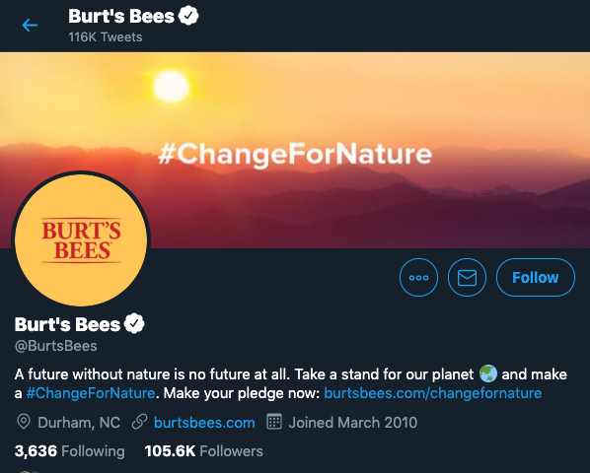
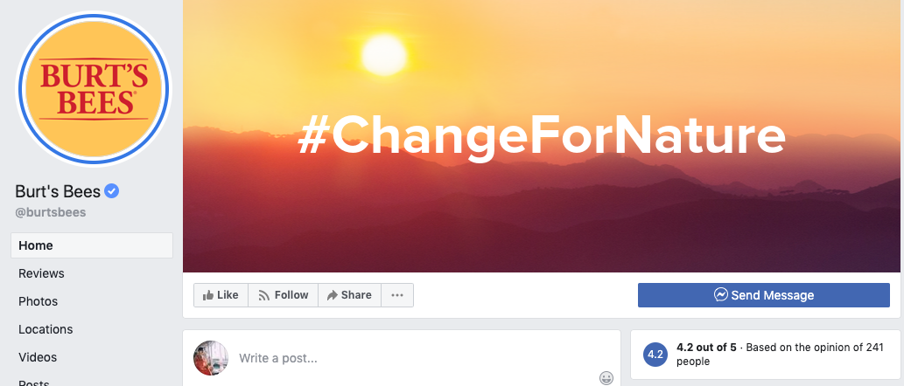
Brand continuity across platforms
Ensure that you have a consistent logo, colour palette, bio, boilerplate and handle.
Whichever you choose, the most important thing is to ensure your profiles have a common thread that people will recognise as your brand.
Notes:
In the above example, Burt’s Bees uses the same logo for both Facebook and Twitter. Their banners are also the same. It isn’t always necessary for the two banners to be the same on every network, but this approach succeeds because even the colors in the banners reflect those in the logo. You could implement this with different banner designs by retaining a recognizable brand color palette, even if the text or the imagery in the design changes from one network to another. Since Facebook allows you to create Video Cover Photos, you could also explore animating your standard brand banner—think video views!

Slide 39
Social Media & Time
Talking of Time – there are tools to help you.
HootSuite
SproutSocial
CoSchedule
Tailwind
Buffer
ContentCal
Create links between your platforms!
Notes:
HootSuite allows you to have 3 social platforms for free. Publish messages to Twitter, Facebook, Google+, Pinterest, Instagram.
SproutSocial – 30 day free trial prior to payment (range of plans available) Publish messages to Twitter, Facebook, Google+ and LinkedIn.

Slide 40

What to post?
Notes:
MAU – Monthly Active Users
1.79 billion people on average who log onto Facebook daily active users (Facebook DAU) for August 2020
Just to put that into context – as of April 2019 the world population is 7.7 billion (almost 1/3 of humans are Facebook MAU)

Slide 41
Match your business objectives
Making sure marketing activities align with business goals seems obvious enough. But, overarching strategy and departmental plans for many companies end up getting made independently.
Social Media can get the work out there quickly, but it takes time to develop an engaged and motivated audience.

Slide 42
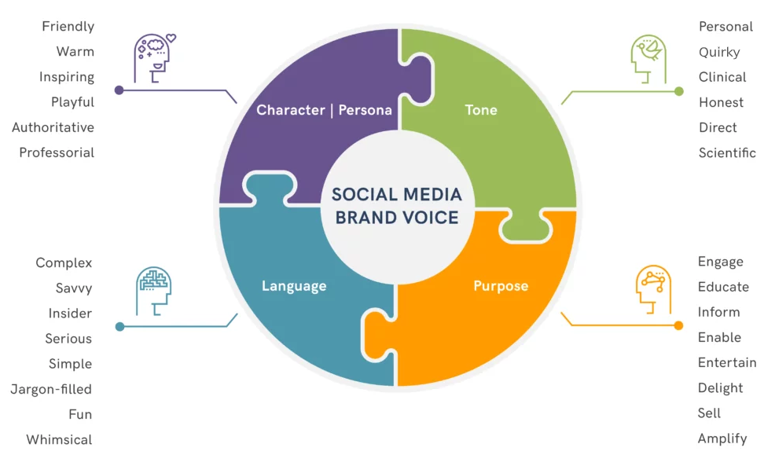
Brand Voice Matrix

Slide 43
Posting Content: How often?
“If you post too infrequently, your audience will forget that you exist and you will quickly fade into the deep dark recesses of their minds. However, if you are posting too often, you will become a complete nuisance and they will dread seeing your posts overcrowding their feed.”
Neil Patel
Finding the right balance for your business is linked to your audience and their needs / uses of social media accounts.
So, how often to post on social media?
As often as you can consistently post quality content.

Slide 44
Recommended posting frequency
Facebook:
Optimal > 1 per day
SME > 3 times per week
Minimum > 1 a week
Maximum > 2 per day
Hubspot found that pages under 10,000 fans experienced a 50% drop in engagement per post if they posted more than once per day. When your audience is online will determine when you should post. Be sure to check your Facebook Insights.
Instagram:
Optimal > 1-2 times a day
SME > 3 times per week
Minimum > 1 a week
Maximum > 3 times a day
Avoid sharing a bunch of posts in quick succession or disappearing for weeks at a time.
Notes:
Hubspot found that pages under 10,000 fans experienced a 50% drop in engagement per post if they posted more than once per day.

Slide 45
Recommended posting frequency
Pinterest:
Optimal > 5 fresh pins per day
SME > 1-2 times per day
Minimum > 3 per week
Maximum > 25-30 per day
In 2019 Pinterest decided to give preference to NEW Pins so ‘fresh’ pins are the way to go rather than re-pinning.
Twitter:
Optimal > 15 - 25 per day
SME > 3-6 times per day
Minimum > 1 a day
Maximum > 30 per day (I kind of feel this is extreme)
Disappearing from Twitter for weeks or months – you’ll lose followers. Find the right pattern / frequency / cadence for your business and capacity: some thoughts from Twitter.

Slide 46
Recommended posting frequency
LinkedIn:
Optimal > 1 per day
SME > 2 times per week
Minimum > 1 per week
Maximum > 1 per day
Post in the mornings is recommended and using a third-party platform (such as MissingLettr) recirculates blog posts and keeps them in front of connections – in case they were missed or time to read was short.
YouTube:
There isn’t a set answer for this one – roughly once a week is good. This video from Amy Landino will set us straight – apologies for her attitude – but it’s real.
Notes:
Amy Landino – How often should you post? https://youtu.be/BYfXq5mvNSU
Wondershare Filmora Editor: Your first 1K subscribers. https://youtu.be/IA7e2tk8Jbo ?sub_confirmation=1 – to get subscription pop-up on your links to YouTube video.

Slide 47
Recommended posting frequency
What we’ve learnt is that there are a variety of factors that will affect your business Posting Frequency / Pattern / Cadence
Your audience
Quality of content
Capacity of business / organisation (time and resources)
start from a safe place > get acquainted with the process > find your flow > build your audience > grow & evolve from there

Slide 48

More tips to stand out
Notes:
MAU – Monthly Active Users
1.79 billion people on average who log onto Facebook daily active users (Facebook DAU) for August 2020
Just to put that into context – as of April 2019 the world population is 7.7 billion (almost 1/3 of humans are Facebook MAU)

Slide 49
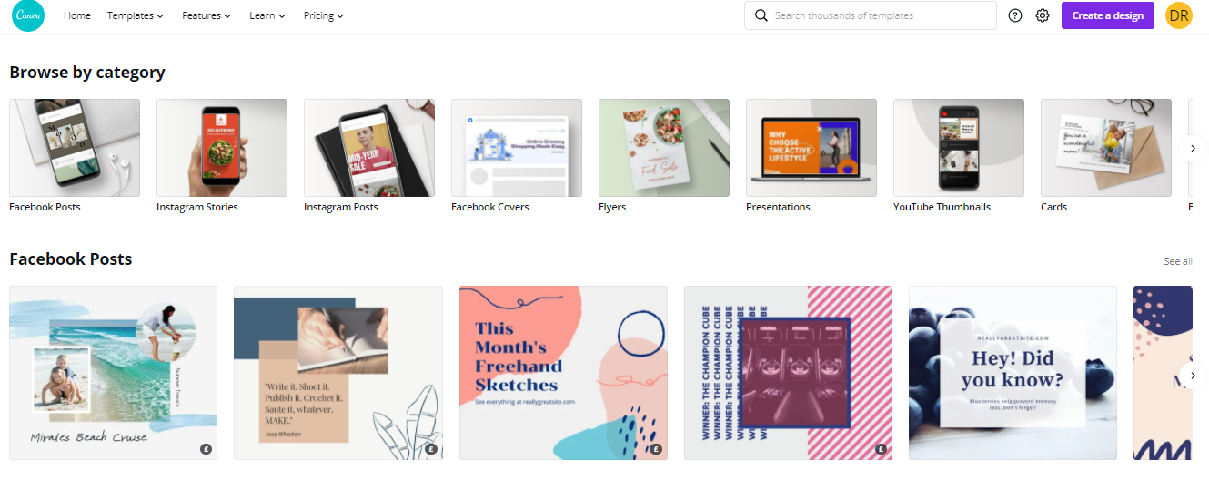
Look and feel
Not a graphic designer? Use tools like Canva for correct sizing and easy design of posts.
Notes:
In the above example, Burt’s Bees uses the same logo for both Facebook and Twitter. Their banners are also the same. It isn’t always necessary for the two banners to be the same on every network, but this approach succeeds because even the colors in the banners reflect those in the logo. You could implement this with different banner designs by retaining a recognizable brand color palette, even if the text or the imagery in the design changes from one network to another. Since Facebook allows you to create Video Cover Photos, you could also explore animating your standard brand banner—think video views!

Slide 50

Be personable
We already mentioned about humans being sociable.
Your prospective customers want to get to know you.
Use social media to show your personality – or the personality of your business.
Use pictures / videos of you or your staff
This is Karl wearing a Christmas jumper. Social media loved Karl’s outfit.
Notes:
In the above example, Burt’s Bees uses the same logo for both Facebook and Twitter. Their banners are also the same. It isn’t always necessary for the two banners to be the same on every network, but this approach succeeds because even the colors in the banners reflect those in the logo. You could implement this with different banner designs by retaining a recognizable brand color palette, even if the text or the imagery in the design changes from one network to another. Since Facebook allows you to create Video Cover Photos, you could also explore animating your standard brand banner—think video views!

Slide 51

Trade secret…
Notes:
MAU – Monthly Active Users
1.79 billion people on average who log onto Facebook daily active users (Facebook DAU) for August 2020
Just to put that into context – as of April 2019 the world population is 7.7 billion (almost 1/3 of humans are Facebook MAU)

Slide 52
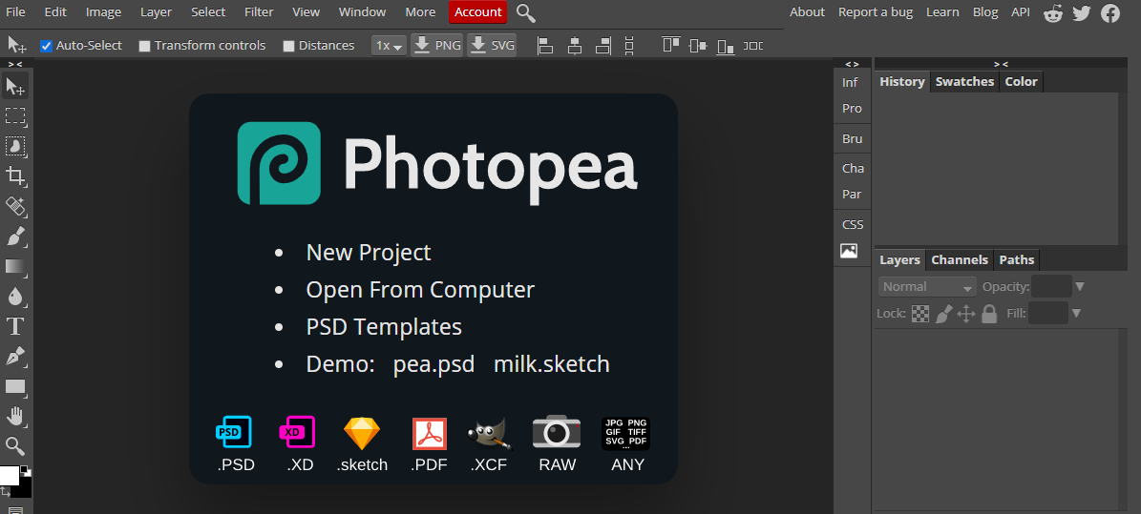
Photoshop – for free
Photopea (photopea.com) is a FREE editing software similar to Photoshop CC with just as much power.
Notes:
In the above example, Burt’s Bees uses the same logo for both Facebook and Twitter. Their banners are also the same. It isn’t always necessary for the two banners to be the same on every network, but this approach succeeds because even the colors in the banners reflect those in the logo. You could implement this with different banner designs by retaining a recognizable brand color palette, even if the text or the imagery in the design changes from one network to another. Since Facebook allows you to create Video Cover Photos, you could also explore animating your standard brand banner—think video views!

