Slide 1
Touristic Development of Franciscan Cultural Heritage Sites of the Border Area by the Cooperation of the Two Provinces
SKHU/1601/1.1/060
MONUMENTIS
Closing Conference
skhu.eu

Slide 2
Agenda
Project summary | 3
Project results | 6
Implementation experience of the project | 12
Future cooperation possibilities | 15

Slide 3
1
Project summary
12/2017-01/2021

Slide 4
Lead Beneficiary
Beneficiary
FONS SACER belső egyházi jogi személy
Hungary: Mátraverebély-Szentkút, Szécsény
Budget: 1 959 340,63 EUR
Franciscan
Slovakia: Bratislava, Fil’akovo
Budget: 980 544,49 EUR

Slide 5
Activities
Project management
Communication
Restoration of cultural heritage sites
- Project meetings (2 in Slovakia, 1 in Hungary and 1 via TEAMS),
- Monitoring the implemantation process of the project,
- Risk management,
- Joint preparation of the project reports and modification requests.
Preparation of the joint marketing plan,
Printing materials (5 brochures, 1 bulletin),
Opening press conference with press release,
Closing conference,
4 temporary billboards and 4 permanent
plaques,
Promotion matierials (pens, notepads),
Media campaigns and logos.
- Internal and external (church, sacristy, altars, tower) restoration in the 4 locations (Bratislava, Fil’akovo, Szentkút, Szécsény).
Tourist destination development
Cultural events and products
Purchasing equipment,
Landscaping the surroundings of the Shrine in Szentkút, digital guide system,
Establishing an open-air reception and bulilding an open-air artist room in Szentkút,
Digitalisation of 17th century book in Fil’akovo,
Virtual tours in Bratislava and Fil’akovo,
Adaptation of corridor and rooms for installation of exhibitions, historic friars’ room.
Historia Domus research and Conference,
Publishing a billingual pilgrims’s book and the revised history of the Shrine in Szentkút,
Traveling exhibiton in 4 themes,
2 permanent exhibitons in Fil’akovo and Bratislava wirh opening ceremonies.

Slide 6
2
Project results

Slide 7
2.2.1.
Szentkút
Historia Domus research and Conference,
The revised history of the shrine in Szentkút,
Developement the website: https://skhu.szentkut.hu,
Printing brouchures in 3 languages,
Advertising in newspapers,
Restoration of works of arts,
Pilgrims’ book,
Printing banners for the traveling exhibition „History of the two Provinces” and „Franciscan martyrs and monastic life in the communism era”,
Multilingual digital guide system,
Garden tools
Medical room’s equipments,
Furniture,
Exterior renovation of church and Landscaping the surroundings of the shrine,
Establishing a common room, and an open-air reception,
Building the "House of Silence",
Building an open-air artist room.

Slide 8
2.2.2.
Szécsény
Development the website https://szecseny.ferencesek.hu/en/kezdolap/
Printing brochures in 3 languages,
Logo design for Szécsény,
Internal wall, stone and wooden restoration of the church (sacristy and altars) with scaffoldings.

Slide 9
2.2.3.
Bratislava
Opening press conference,
Vernissage at the opening of the permanent exhibition in Bratislava,
Booklet,
Social network campaign,
Press advertising,
Logo creation,
Audiovisual version of the virtual tours,
Restoration of the stone and wooden parts of the tower,
Adaptation of the exhibition room at the tower,
Cleaning and preparation of exhibition items for the permanent exhibitions in Bratislava,
Interactive projection,
3D virtual tour,
Electric radiator,
Banners for 2 traveling exhibitions.

Slide 10
2.2.4.
Fil’akovo
- Vernissage at the opening of the permanent exhibition in Fiľ akovo,
Booklet,
Social network campaign,
Digitalisation of 17th century book,
Press advertising,
Logo creation,
Restoration of altar,
Adaptation of the historic friars’ room,
Adaptation of corridor for installattion of exhibition,
Equipment of the exhibition room with chairs and of the historic friar’s room,
Cleaning and preparation of exhibition items for the permanent exhibitions,
Interactive projection.

Slide 11
The MONUMENTIS project in pictures and in words
http://skhu.szentkut.hu/a-monumentis-projekt-eredmenyei/

Slide 12
3
Implementation experiences of the project

Slide 13
Best practises, good experiences
Lead Beneficiary
Slovak Beneficiary
Solution oriented participants.
Patience and politically correct approaches in preparation bilingual historical texts.
Good experiences in cooperation with the Slovak Province.
Humor. ☺
Working relationship in implementing the project.
First project participation opportunity for the Slovak Province.

Slide 14
Difficulties
Lead Beneficiary
Slovak Beneficiary
Changes in lead roles during the project (Szentkút, Szécsény).
International project, lots of participants.
Missing competent person in Szécsény who can supervise the restoration works (no official supervision in Hungary).
Difficulties in seeing the framework provided by the JS (legal, technical, administration) at the beginning of the project.
IMIS problems.
Legal framework provides the supervision support continously during implementation and after finishing the restoration work, the responsible authority will on-site monitor the results.
Slovak FLC should be more customer and solution oriented: the different way to prepare the beneficiary report than the porject report caused many difficulties in reporting.
IMIS had not been transfering all the information from beneficiary reports to the project reports.

Slide 15
4
Future cooperation possibilities

Slide 16
Joint Marketing Plan
Possible next steps
Recommend each other’s cultural events, programmes and attractions.
Organising joint cultural events and pilgrimages.
Visiting each other’s locations for ecclesiastical purposes.
Cooperation between Szentkút and Fil’akovo.
Further circulation of the travellling exhibition materials.
September 2021 Szentkút gathering Slovak pilgrimages is possible from Slovak part (from Fil’akovo).
- Cooperation with Bratislava – Fr. Lóránt will travel to Bratislava for the travelling exhibition material and discuss the further possibilities.

Slide 17
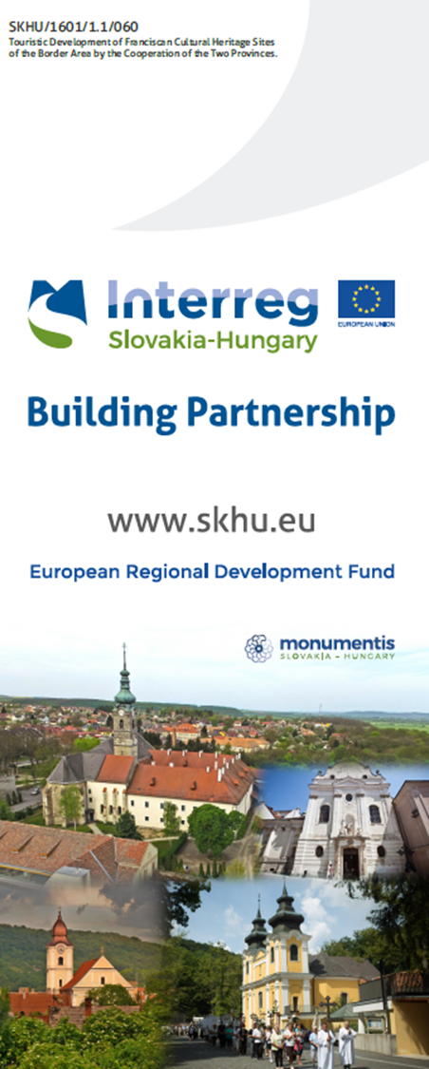
Thank you for your attention!

